Slide 1
My name is cloud... ownCloud
Efstathios Iosifidis
iosifidis@opensuse.org
Notes:
Welcome everybody

Slide 2
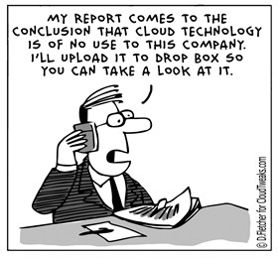
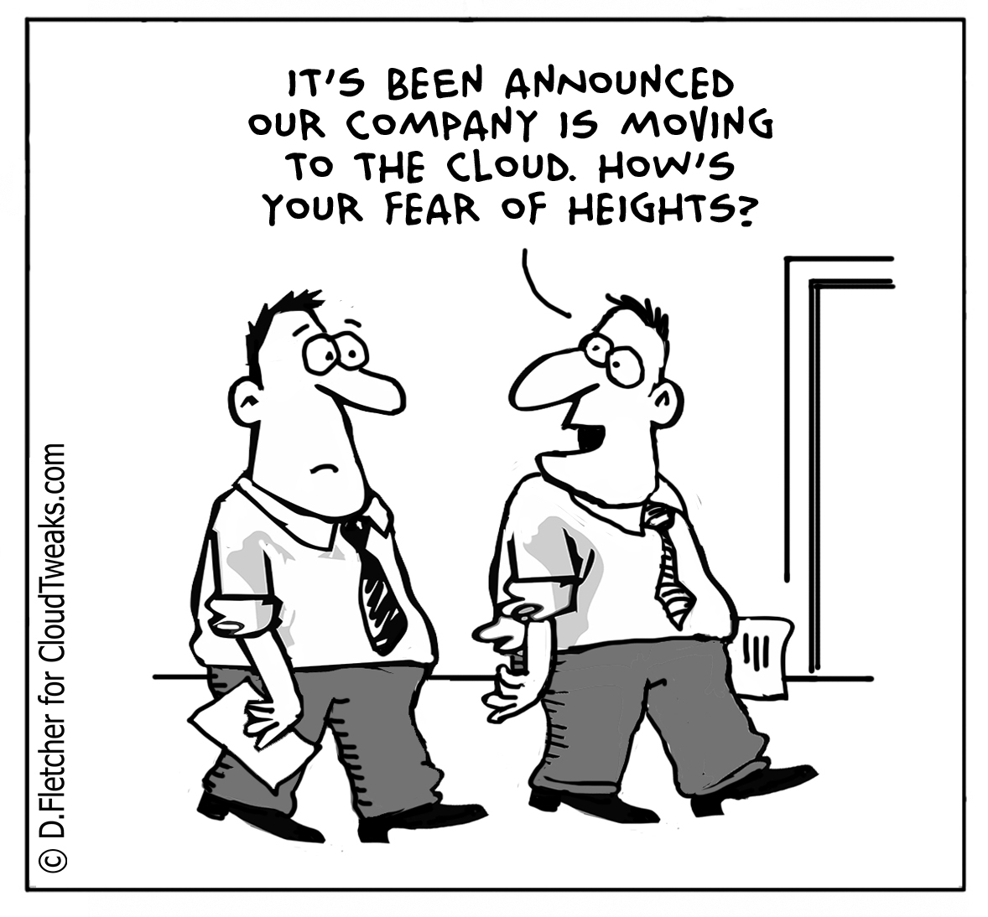
Why cloud?

Slide 3
Need for cloud service
Access files
Access calendar
Access mail
Access contacts
Easy sharing and collaboration
All free!!!

Slide 4
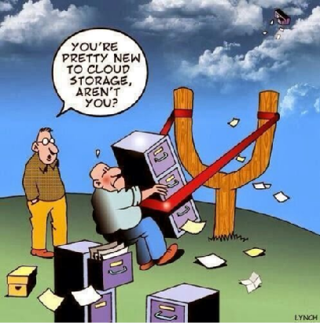
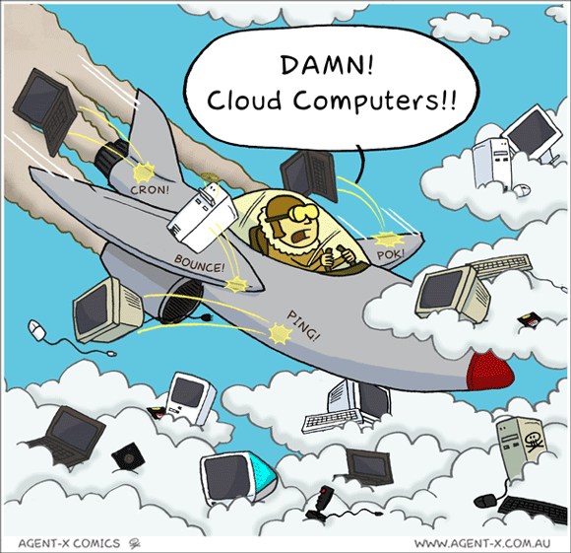
Cloud technology is still new!!!

Slide 5
The awesome cloud
Notes:
Start with the awesomeness of the cloud. Do I need to tell you?

Slide 6
Awesomeness of the cloud
Accessible everywhere
Back up online
Easy sharing and collaboration
All free!!!
  (or super cheap)
Notes:
Android phone breaks – log in on new
Games online
Chatting, sharing pics or documents with others
Free or cheap!

Slide 7
The awful cloud
Notes:
Last point – price. How do we pay?
Bad side of the cloud.

Slide 8
Awfulness of the cloud
Where is my data?
Who can access my data?
How is my data used?
Notes:
Ask yourself these questions.

Slide 9
Comparison
 | Google Drive | One Drive (MS) | Dropbox | iCloud | ownCloud
Size | 15GB | 15GB | 2GB | 5GB | Unlimited
Calendar | Yes | Yes | No | Yes | Yes
Contacts | Yes | Yes | No | Yes | Yes
Extra | Google docs, Photos | Office online |  | Pages, Numbers, Keynote, Photos | Documents, Apps
Mail | Gmail | Outlook | No | Yes | Personal-APP
Clients | Mobile-PC | Mobile-PC | Mobile-PC | Mobile-PC | Mobile-PC
Safety | Google | Microsoft | Dropbox | Apple | YOU
Notes:
Here is a small comparison of the most popular services and ownCloud.

Slide 10
Take back your data
Notes:
You should be convinced now:
Cloud is awesome
But endangers privacy
And privacy matters
You know what you need: something you OWN.

Slide 11
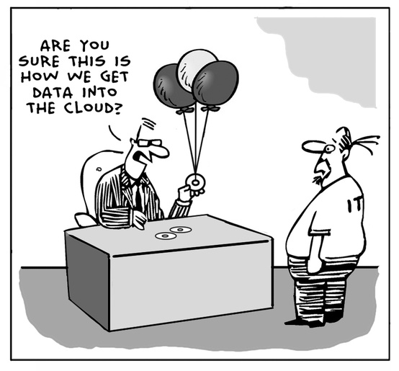
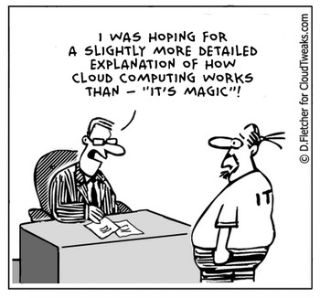

Slide 12

Introducing ownCloud
Sync and share
Open Source
Easy to use
Easy to install
Easy to extend
Multi-platform
Notes:
So, here's one such solution: ownCloud
Core: sync and share data
Ticks more boxes
Including what we discussed earlier

Slide 13
Sync and Share
External Storage
  FTP, NFS, WebDAV, dropbox, S3, …
  Encryption
  Versioning
Sharing
  Public links, passwords, expiring, upload rights
Federated cloud
Favorites/Metadata support
Notes:
External Storage
* FTP, NFS, WebDAV, dropbox, S3, …
* Encryption
* Versioning
Sharing
Friends took pictures at your wedding?
Send them a public link, expiring in 2 monhts, protected with a password for uploading files!
Server to server sharing
3 German universities: 500K students, one cloud.
Federation and decentralization!

Slide 14


Easy to use
Easy to deploy
Easy to hack on or inspect: PHP, JS, CSS
All-platform access

Slide 15
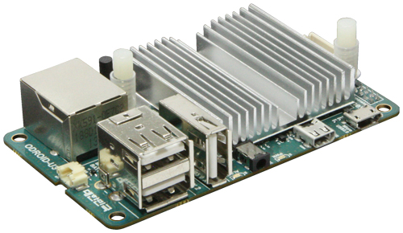
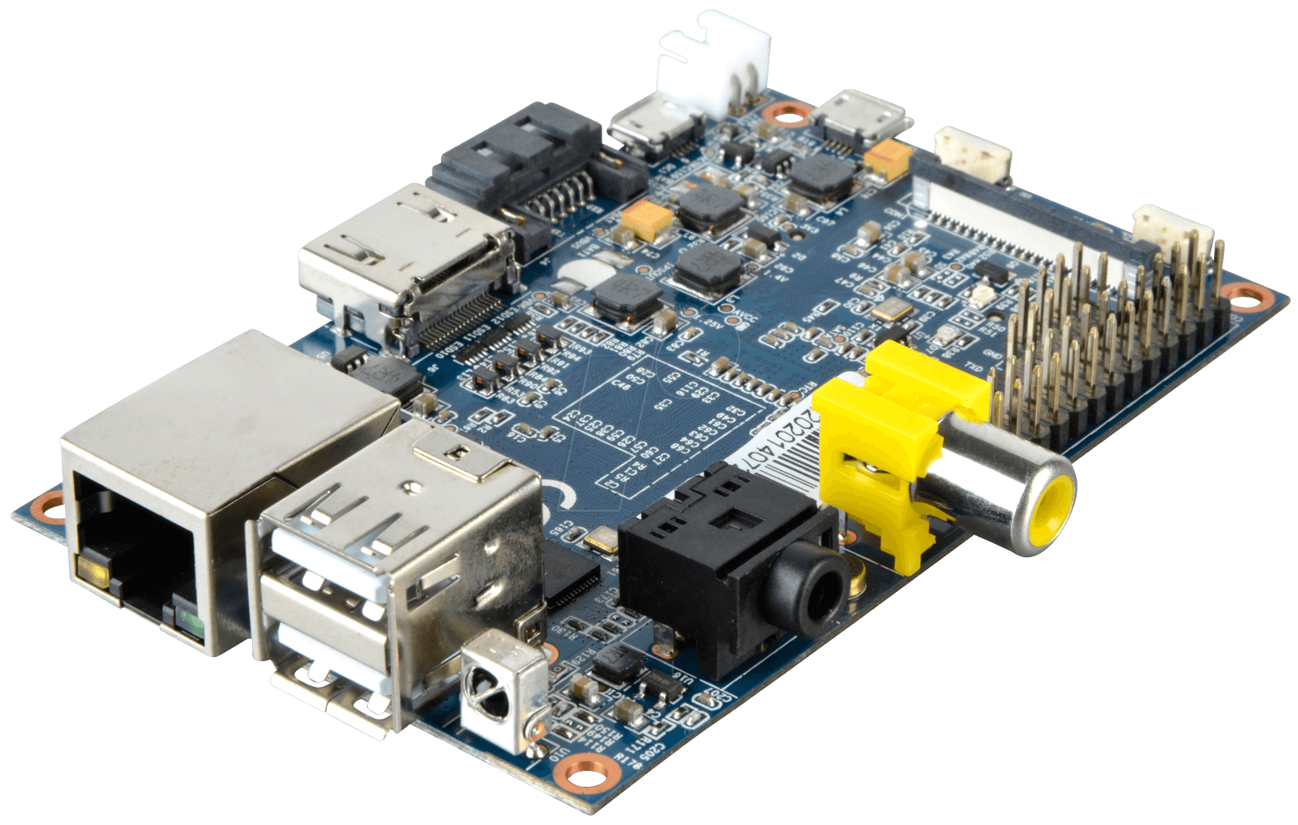

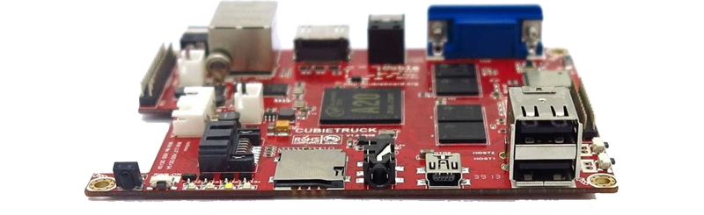
What you need...
System - Storage
Bandwith - 24/7/365 online
LAMP (read documentation)
ownCloud

Slide 16
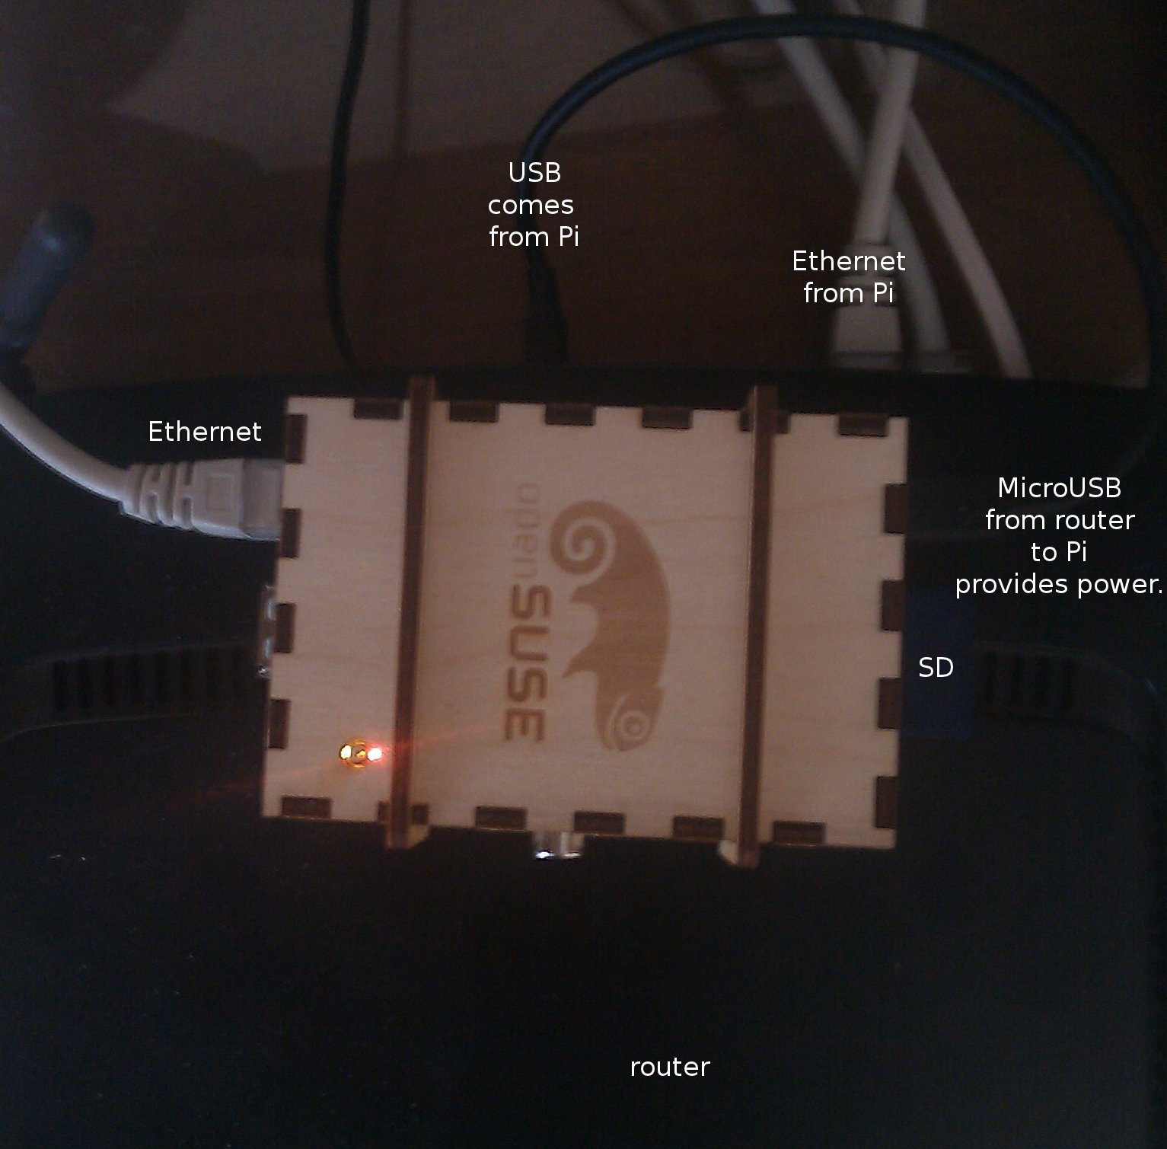
Home ownCloud

Slide 17
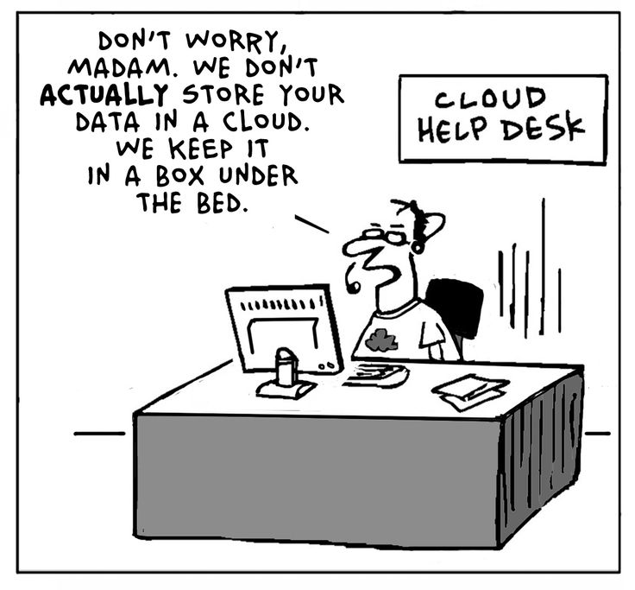
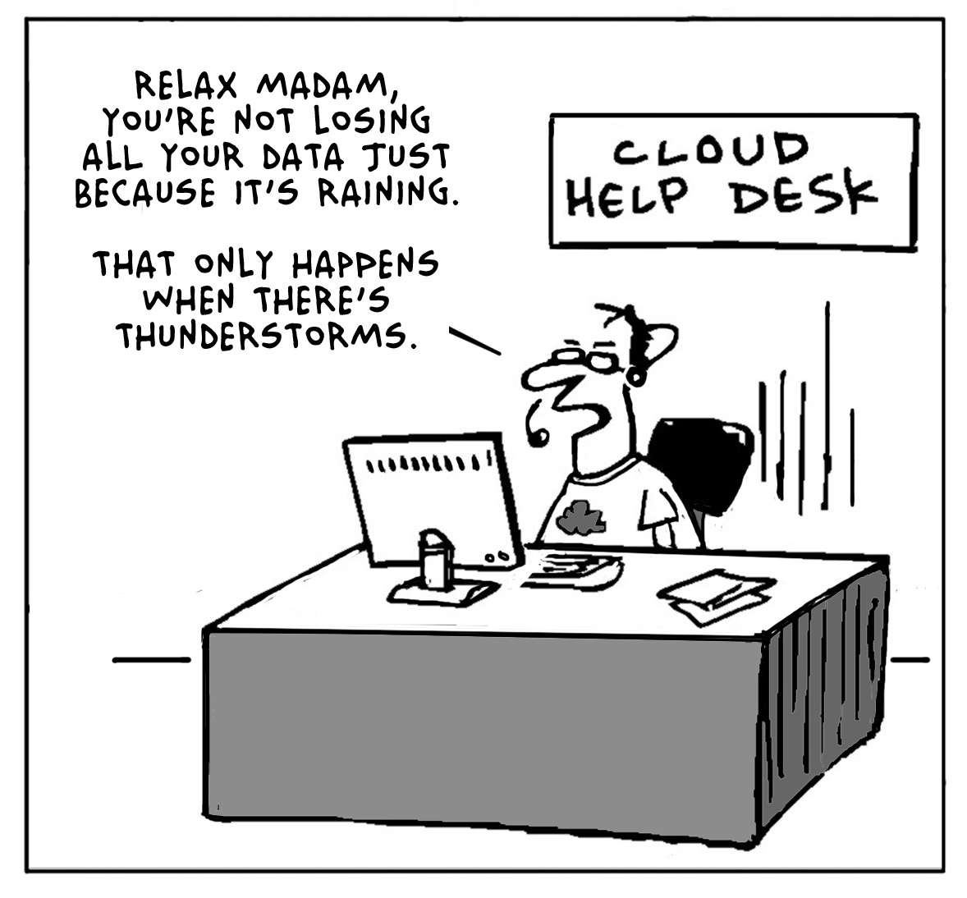
End users need HELP!!!

Slide 18
Screenshot time

Slide 19
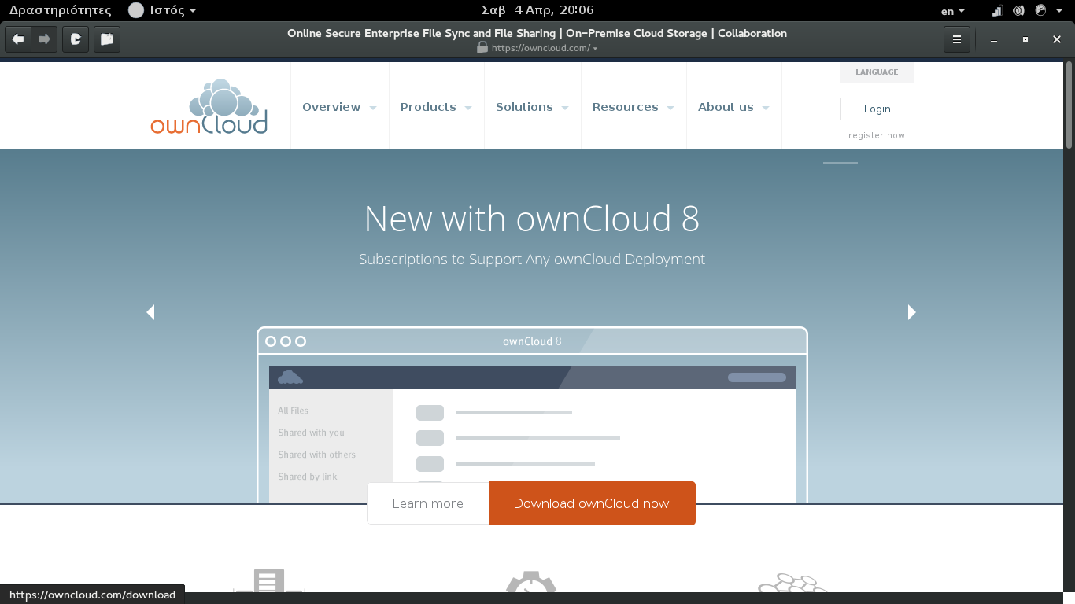
Notes:
There's enterprise edition of ownCloud.

Slide 20
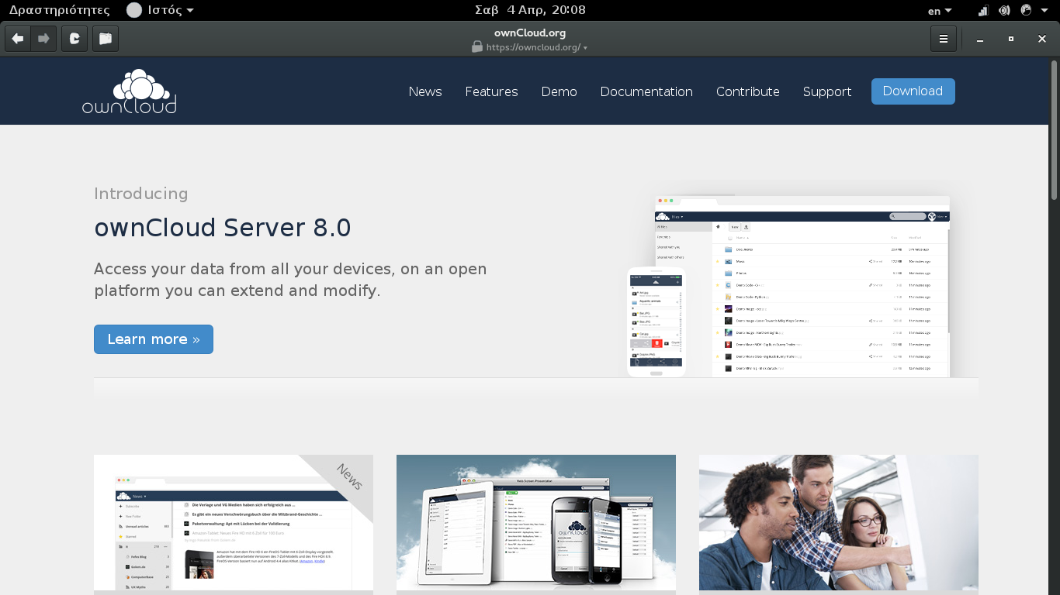
Notes:
But we will present the community edition.

Slide 21
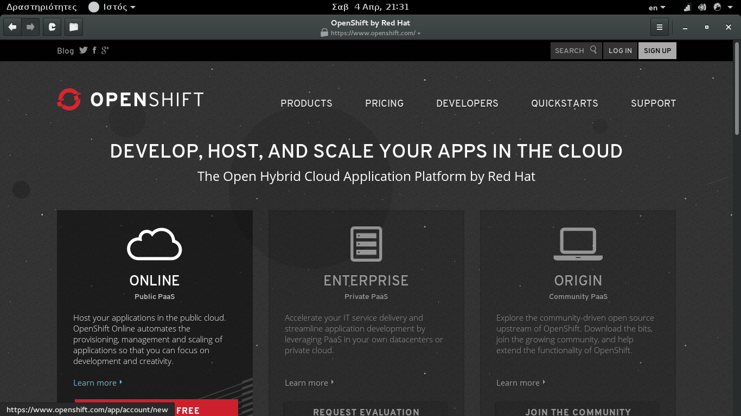
DO IT YOURSELF NOW!!!
ONLY FOR TESTING

Slide 22
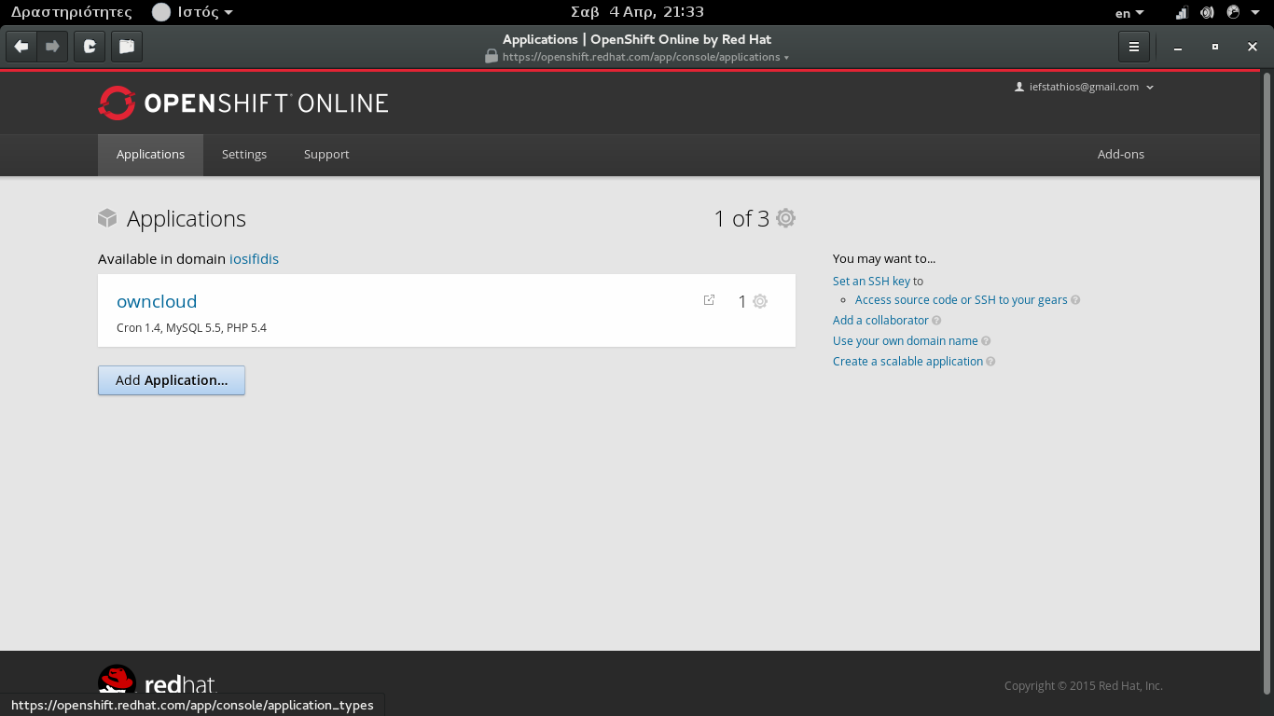
Click Add Application

Slide 23
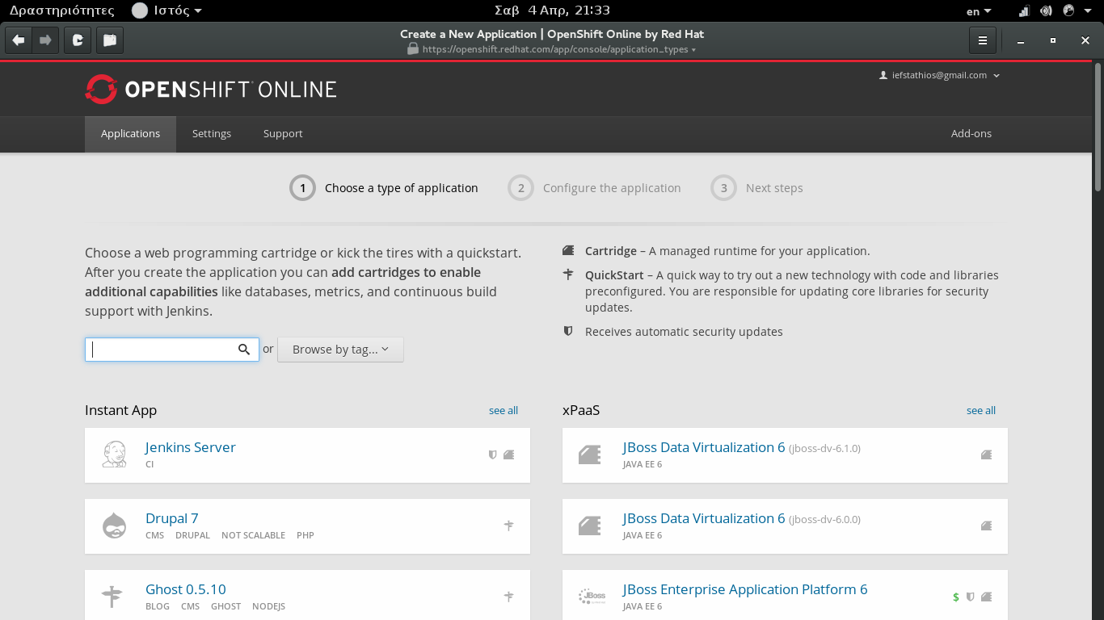
Search owncloud

Slide 24
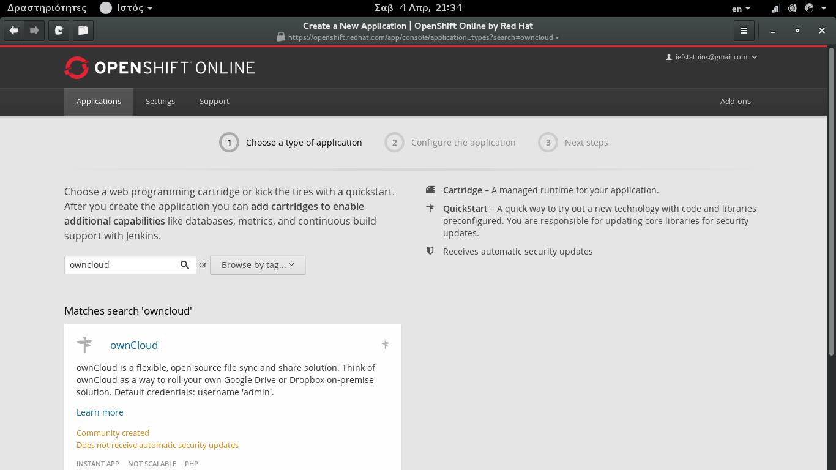
Click on the blue ownCloud...

Slide 25
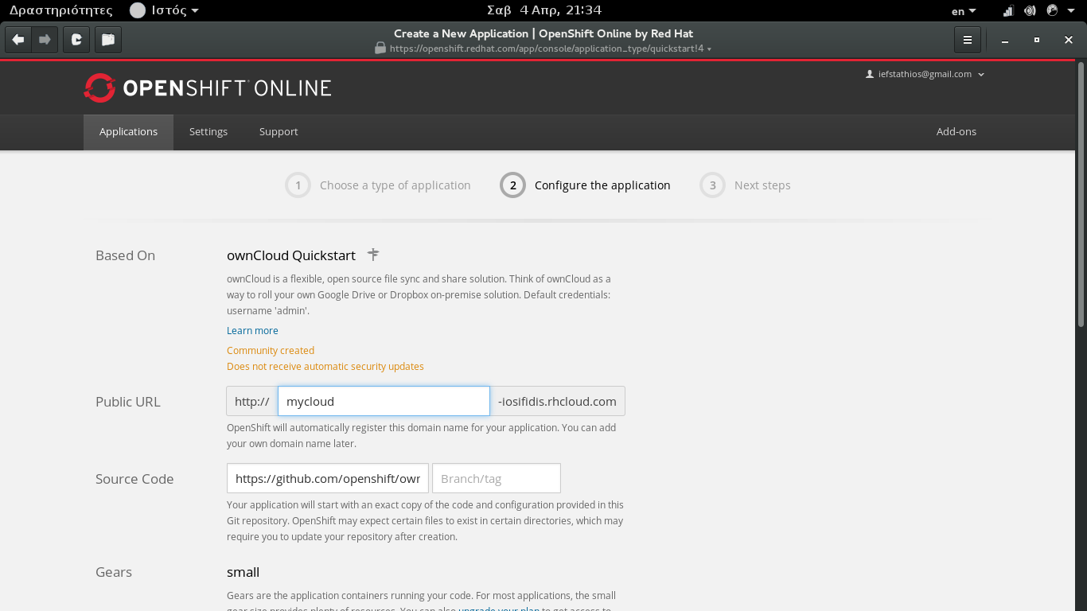
What link do you prefer?

Slide 26
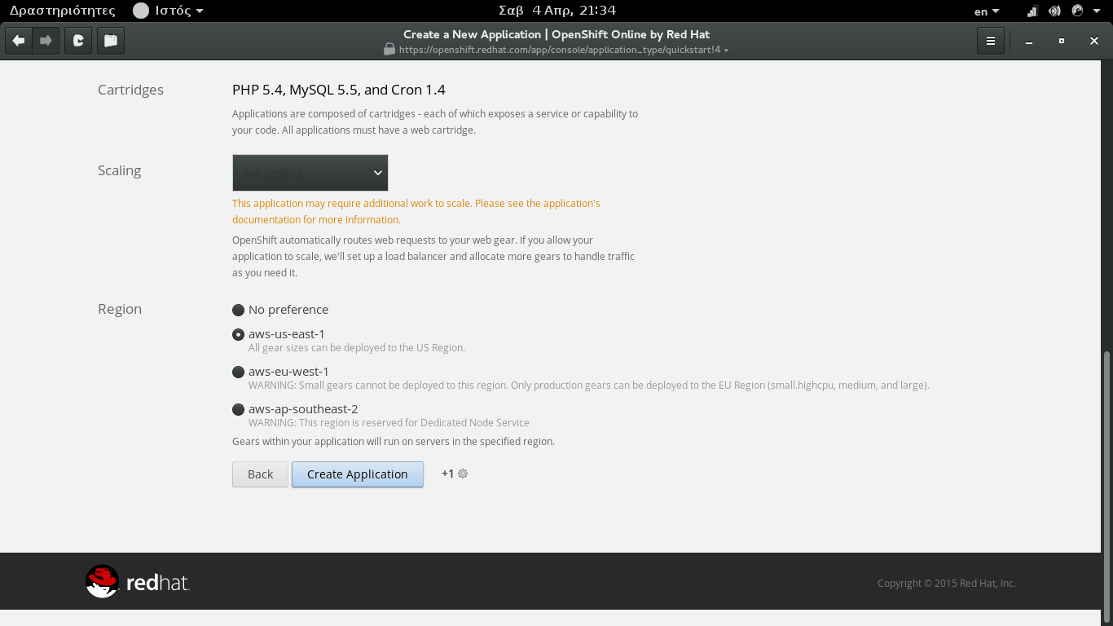
Click Create Application and wait!!!

Slide 27
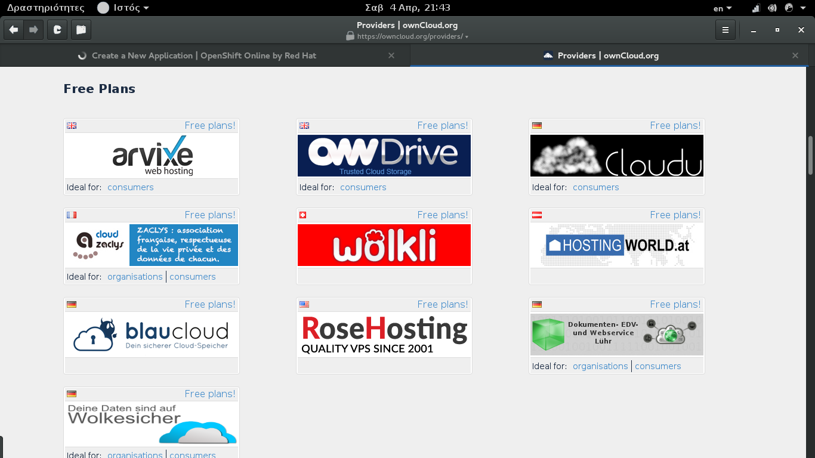
Visit providers (YES FREE PLANS!!!)

Slide 28
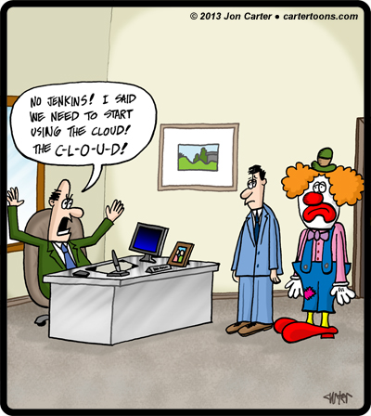
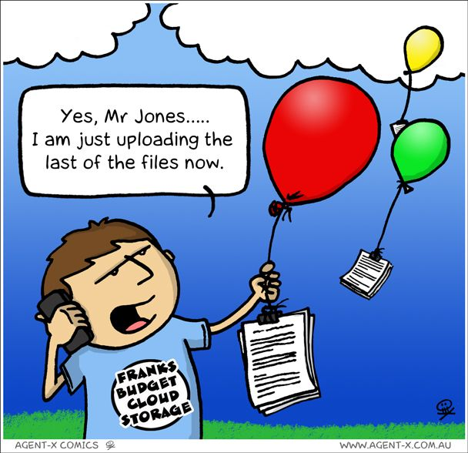

Slide 29
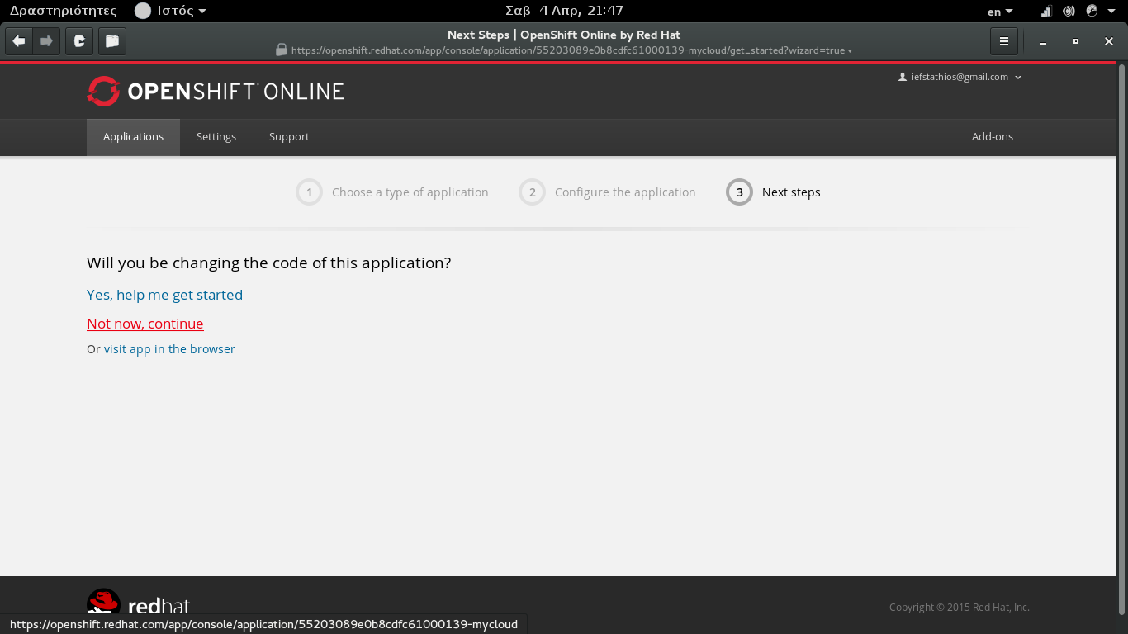
Change the code? Nope...

Slide 30
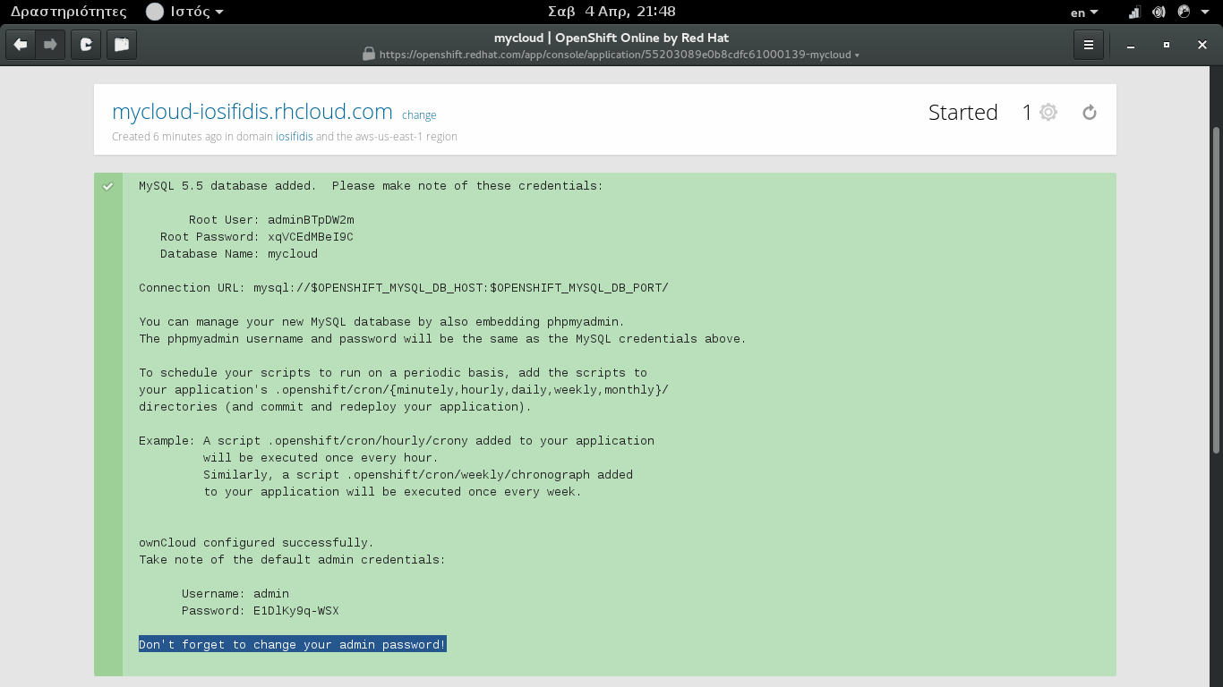
Final info...
NEVER CALL YOUR ADMIN, ADMIN.
CHANGE PASSWORD. HERE IT'S ONLY TESTING

Slide 31
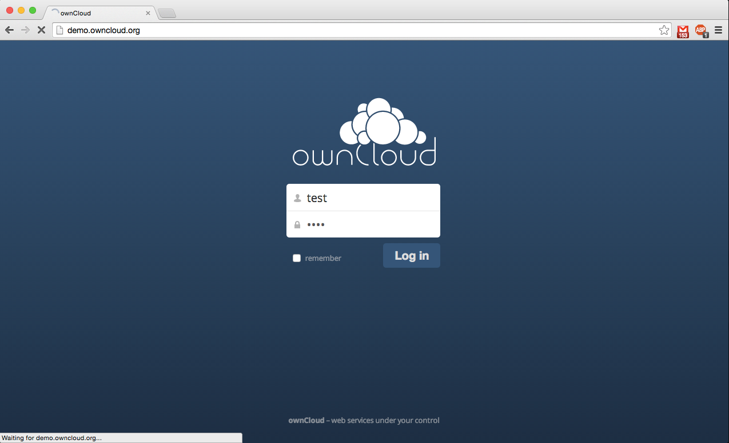
Notes:
Enter your username/password to enter.

Slide 32
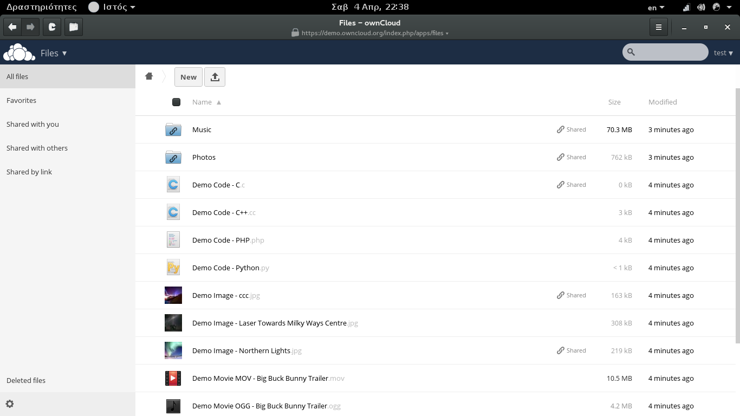
Notes:
The first screen is the place where you have your files stored.

Slide 33
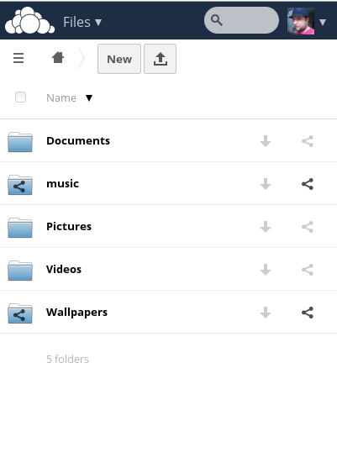
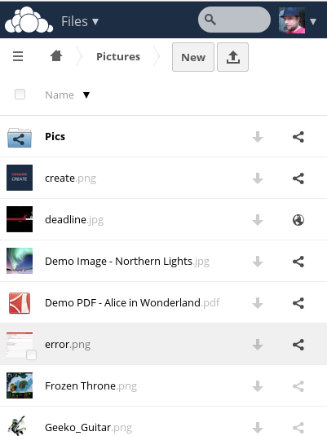
Mobile UI

Slide 34
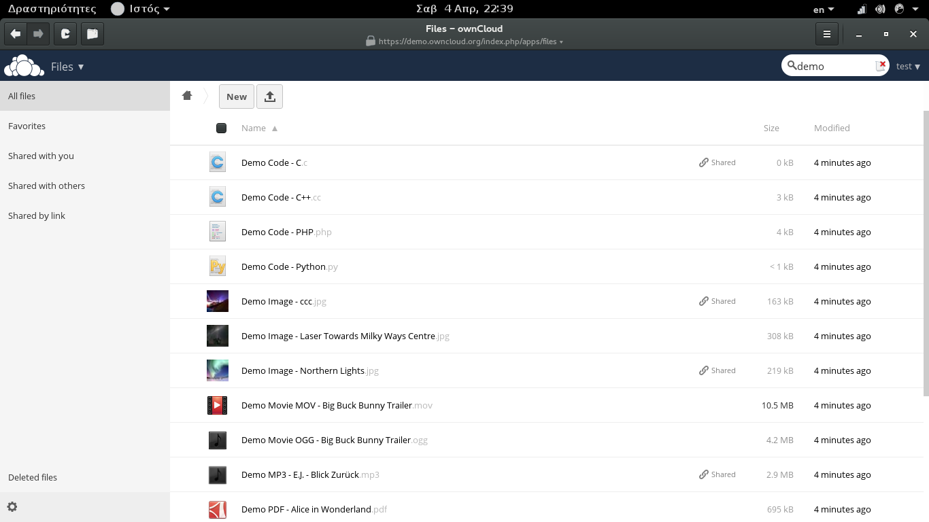
Notes:
If you don't remember the file you want, there's a search box at the top right side.

Slide 35
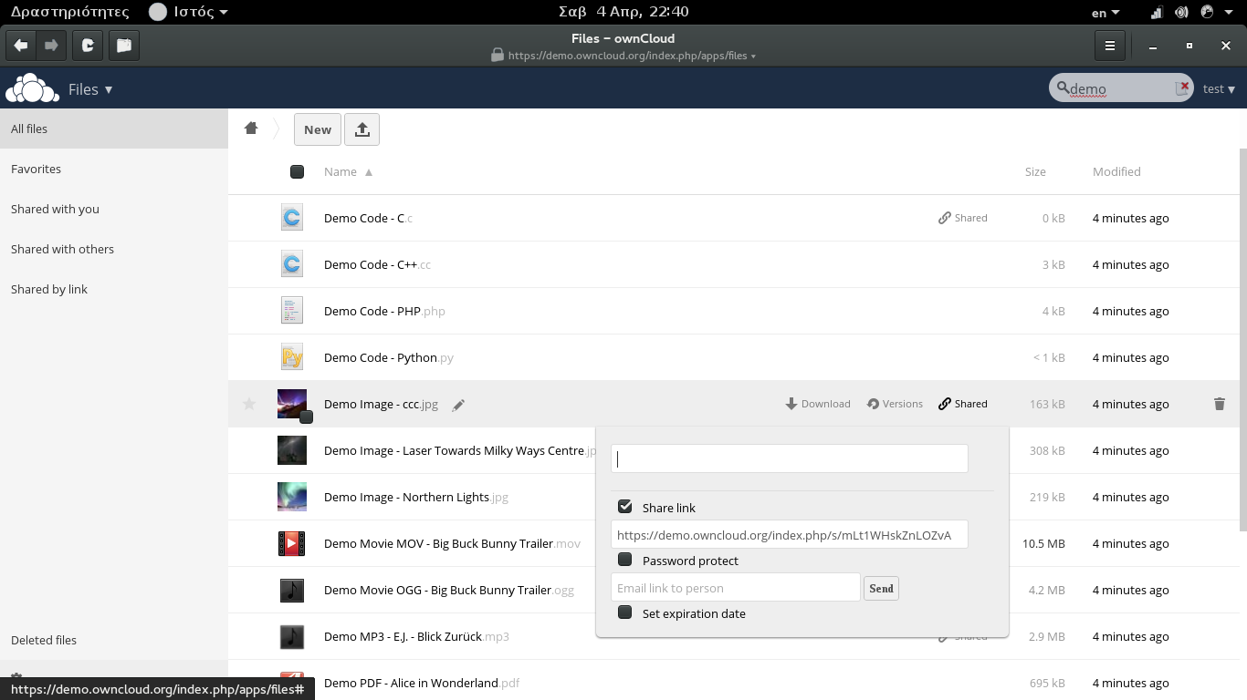
Notes:
Share options of a file.

Slide 36
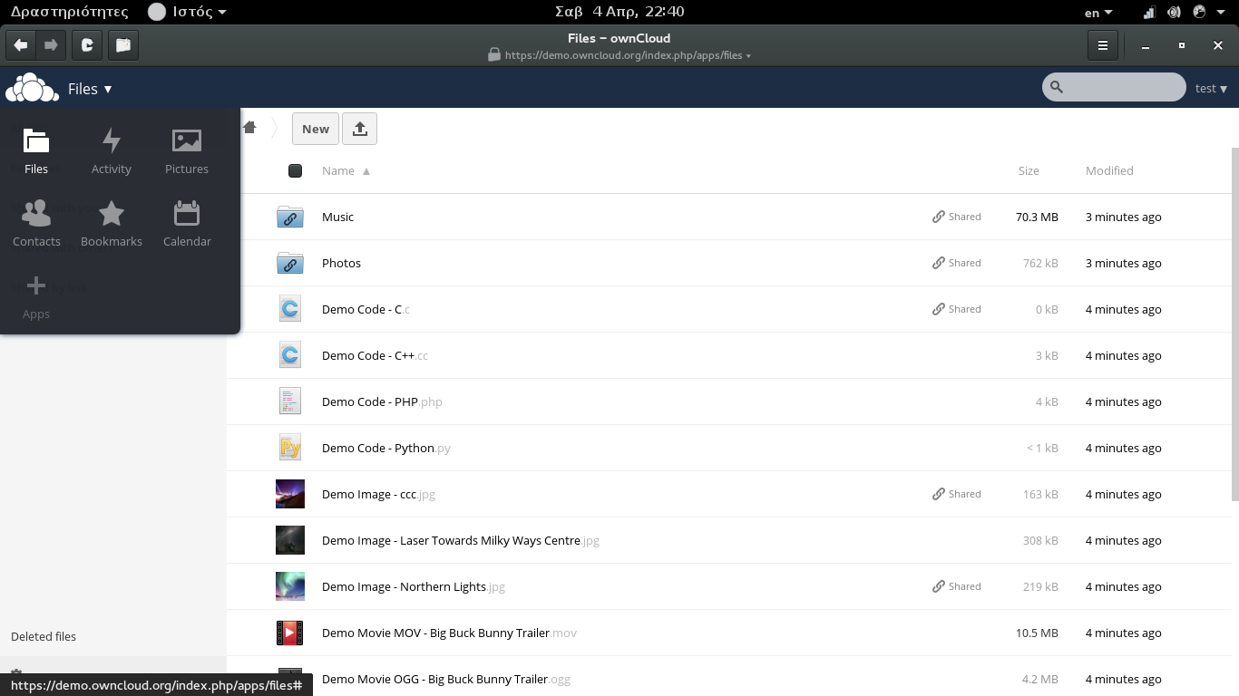
Notes:
Left menu
Files, Activity, Documents, Photos, Calendar, Contacts, Apps, Deleted!!!

Slide 37
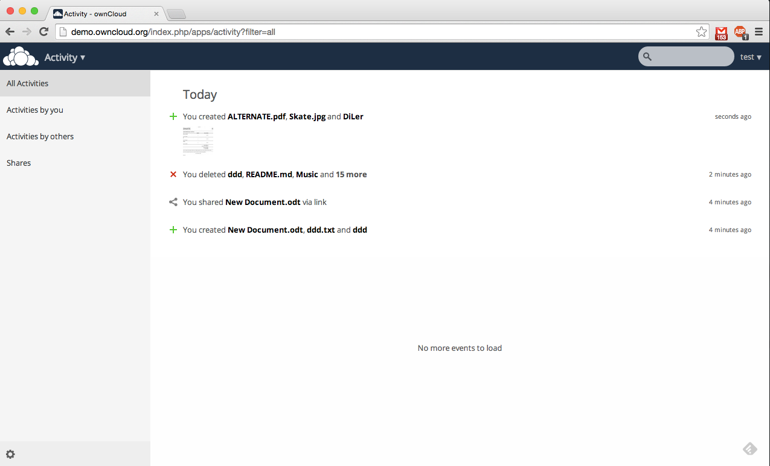
Notes:
Activity overview. What happened with your files?

Slide 38
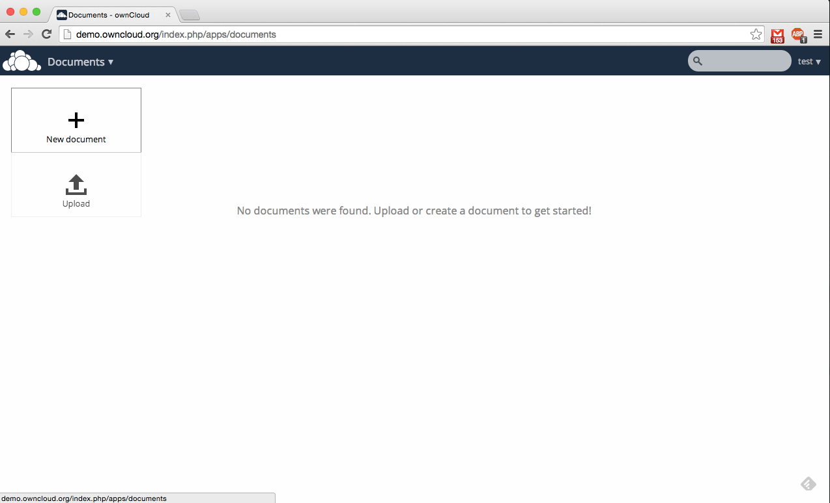
Notes:
Documents

Slide 39
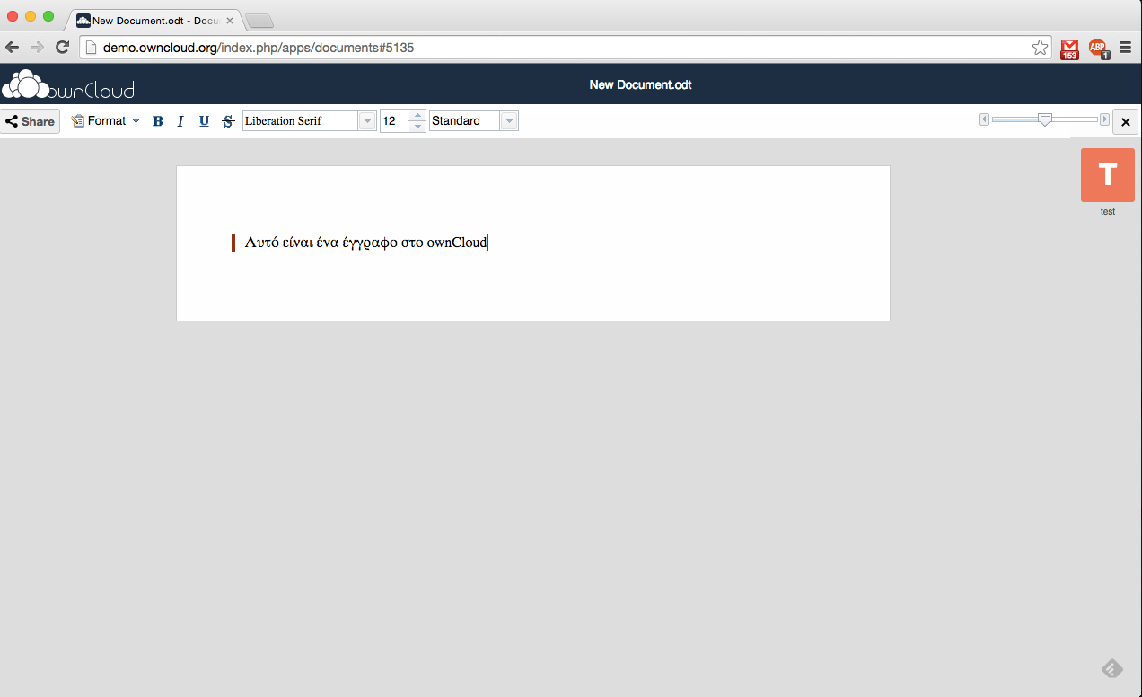
Notes:
Create a document

Slide 40
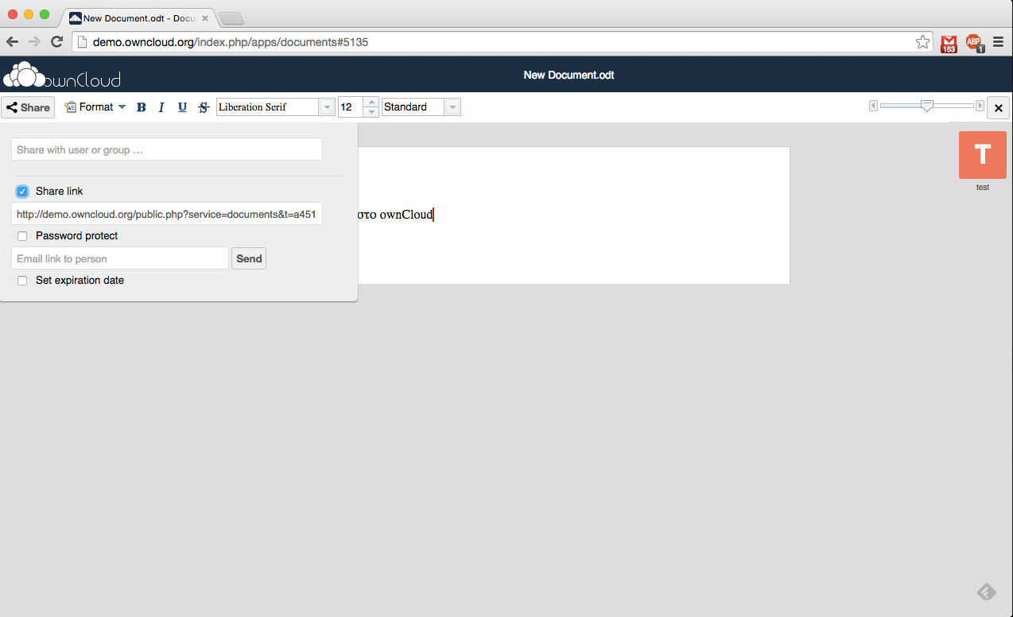
Notes:
Share the document

Slide 41
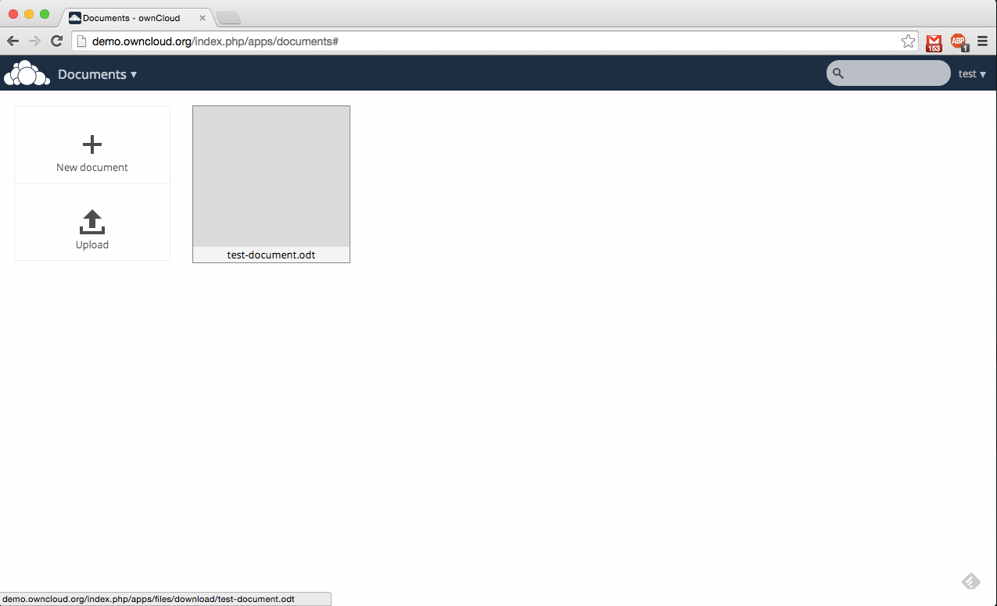
Notes:
The document is saved

Slide 42
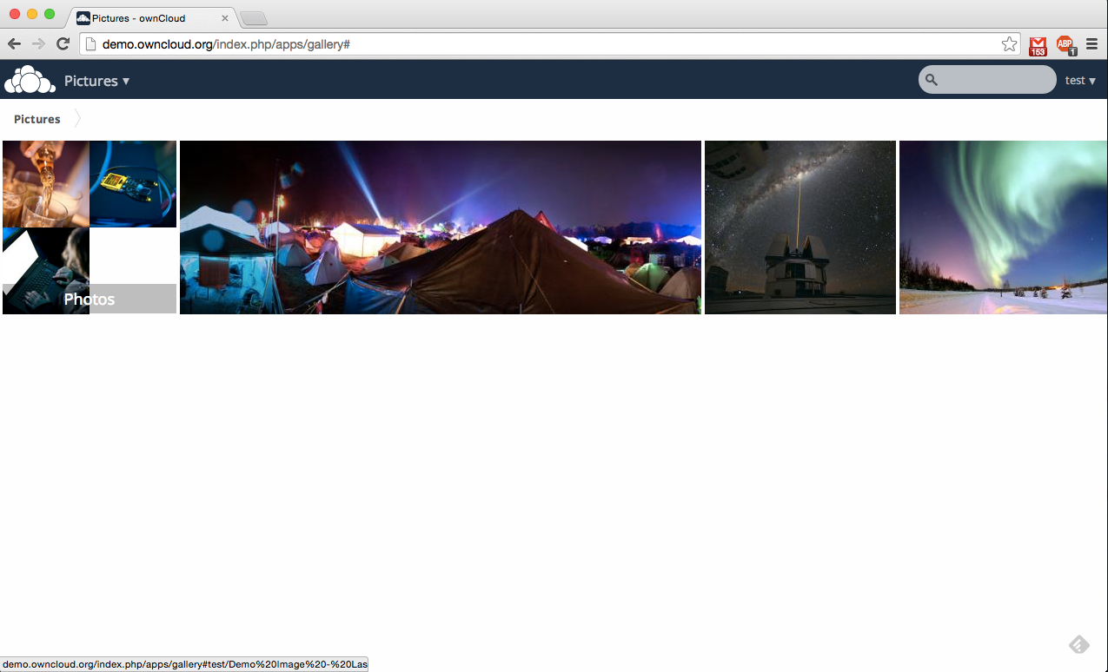
Notes:
Photos overview.

Slide 43
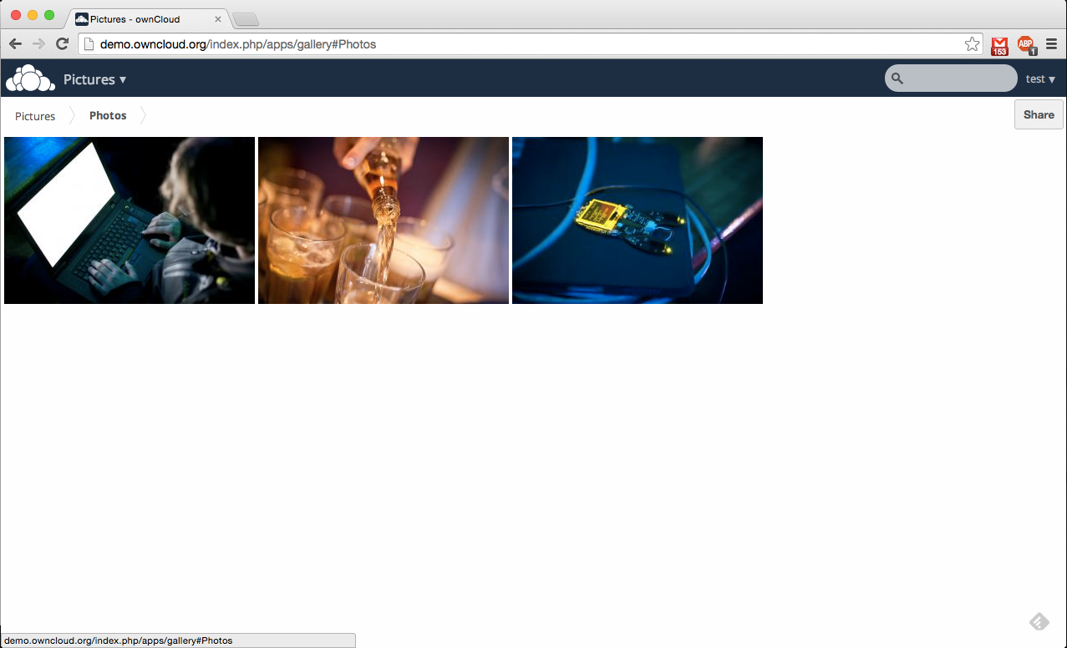
Notes:
Photos can be grouped in a folder.

Slide 44
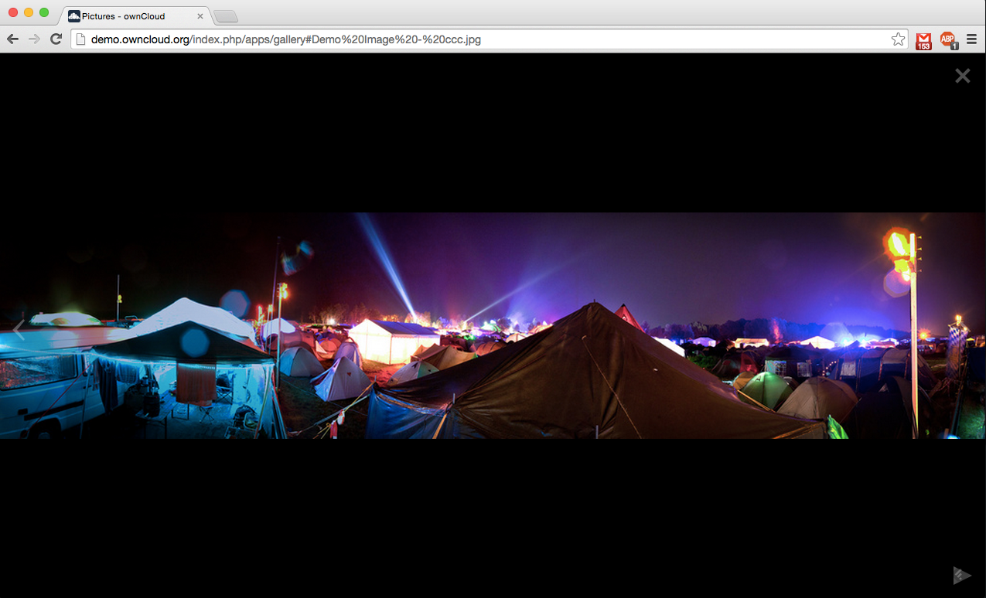
Notes:
Photo preview.

Slide 45
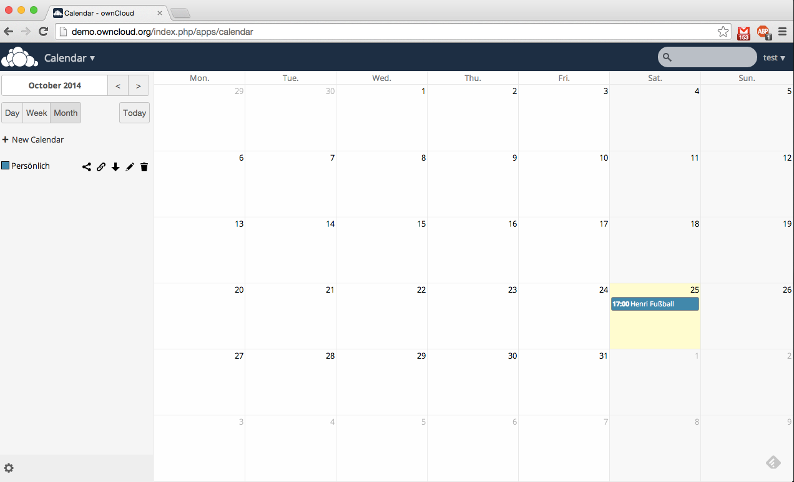
Notes:
Calendar

Slide 46
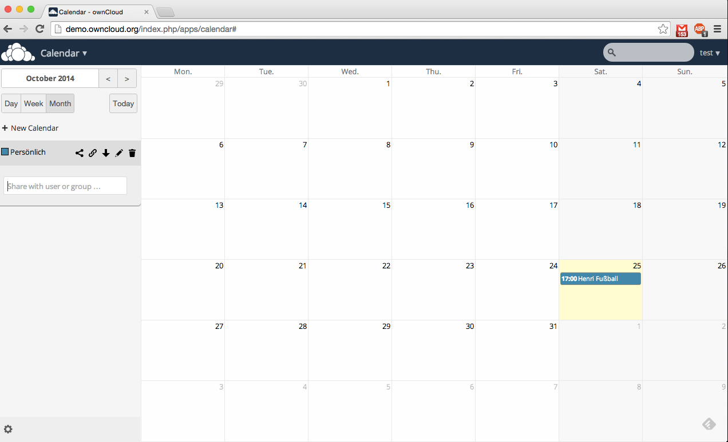
Notes:
Share the calendar with the group.

Slide 47
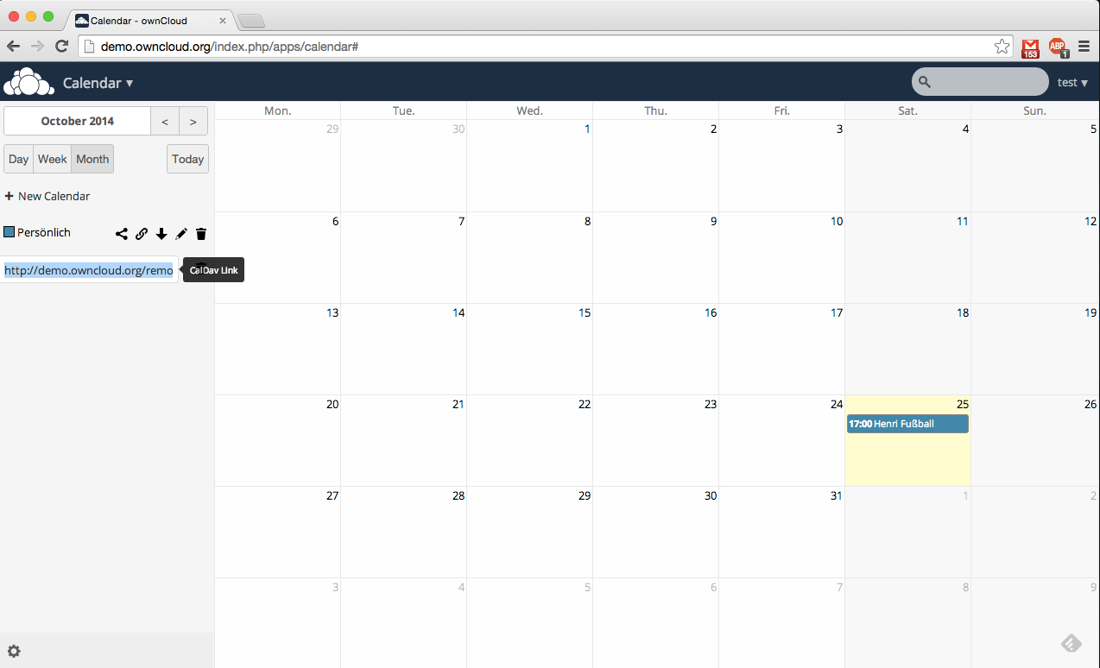

Notes:
Use the calendar with CalDAV or save an ics file.

Slide 48
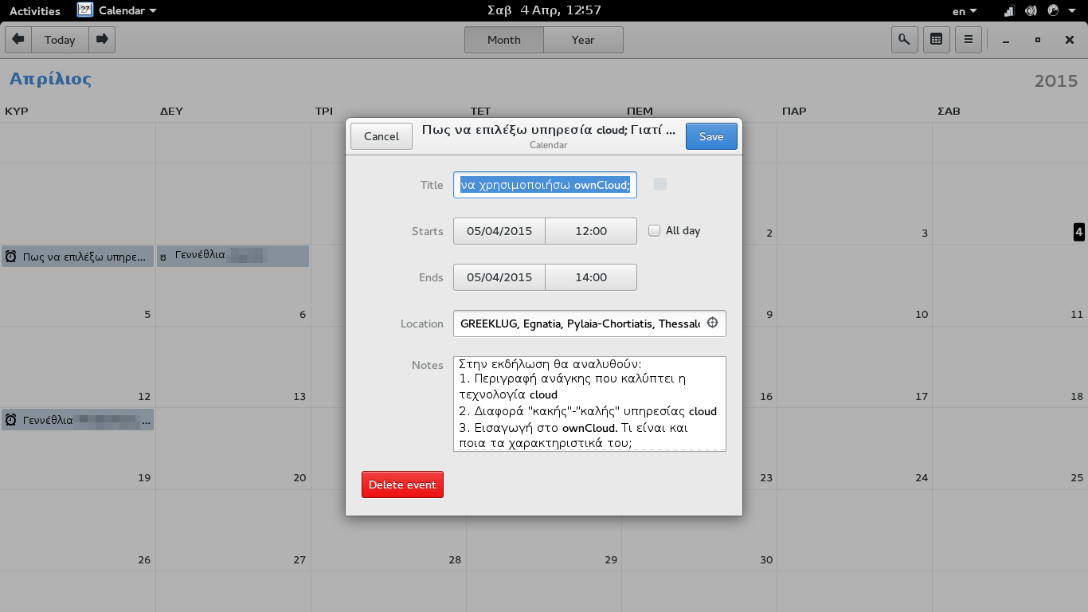
Calendar GNOME 3.16

Slide 49
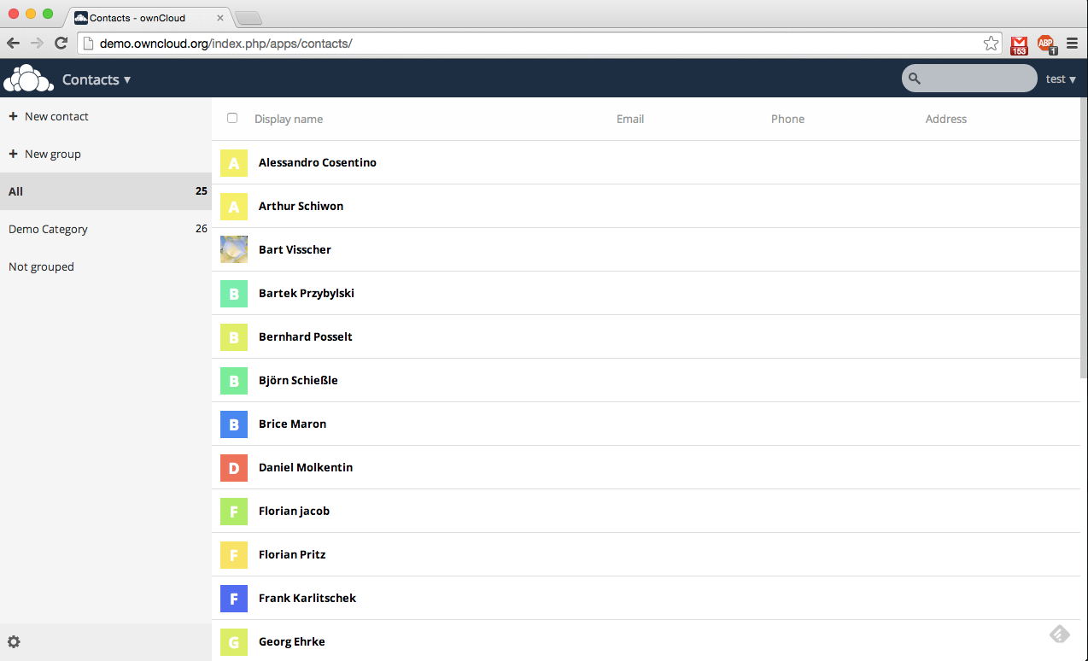
Notes:
Contacts

Slide 50
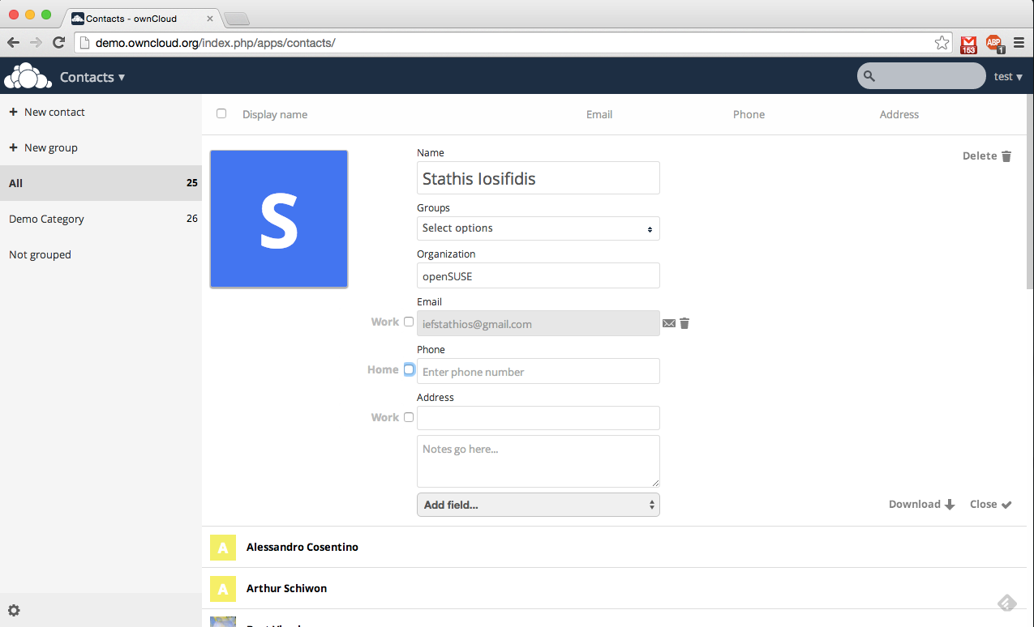
Notes:
Create a new contact

Slide 51
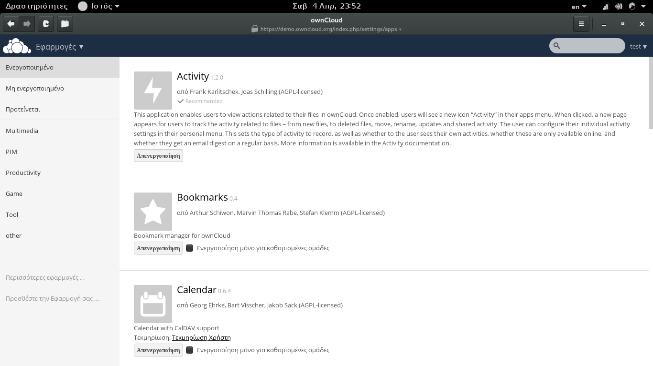
Notes:
Enable new applications

Slide 52
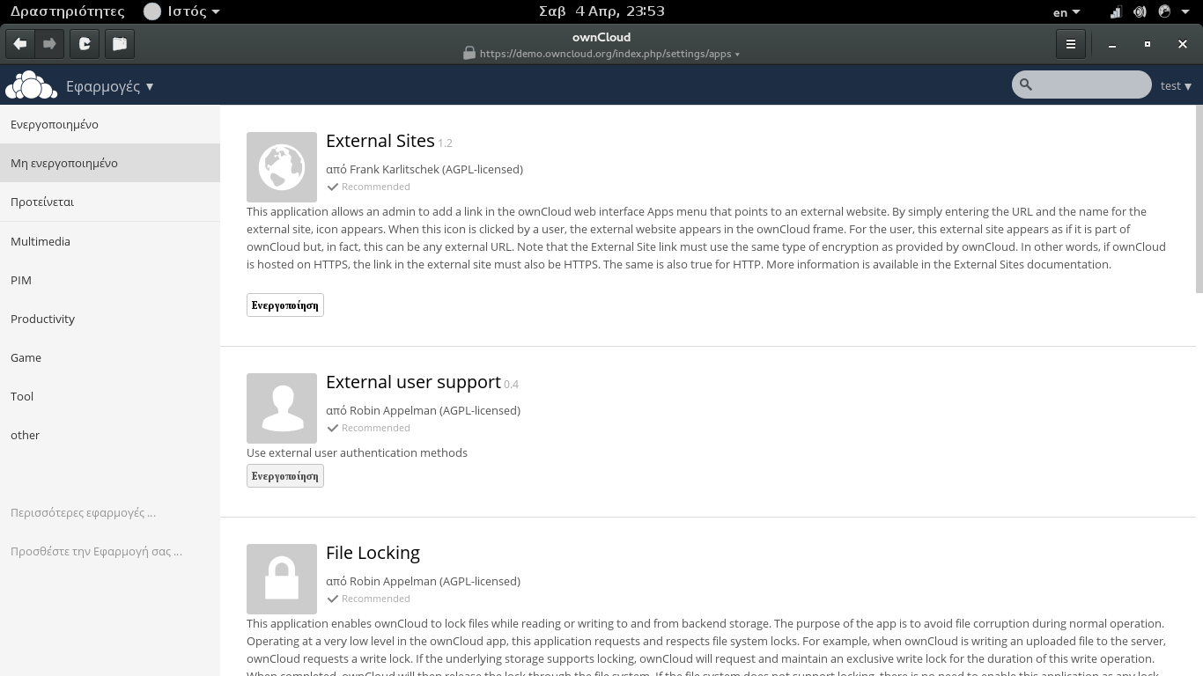

Slide 53
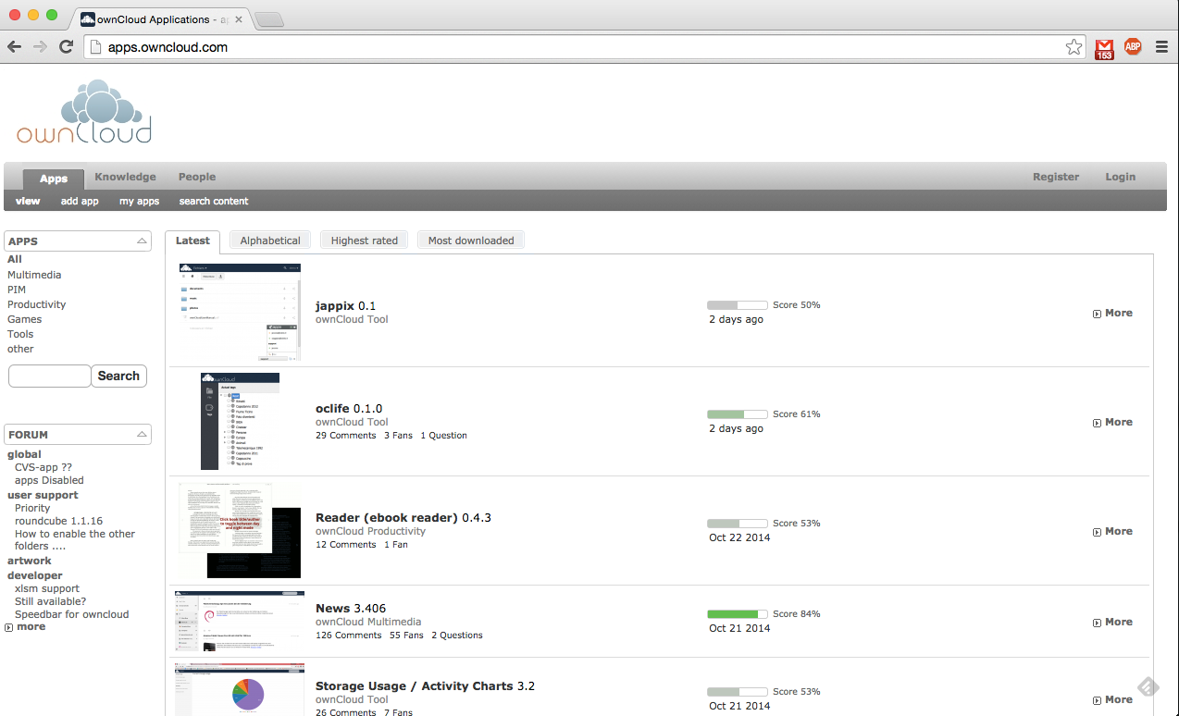
Notes:
Application site

Slide 54
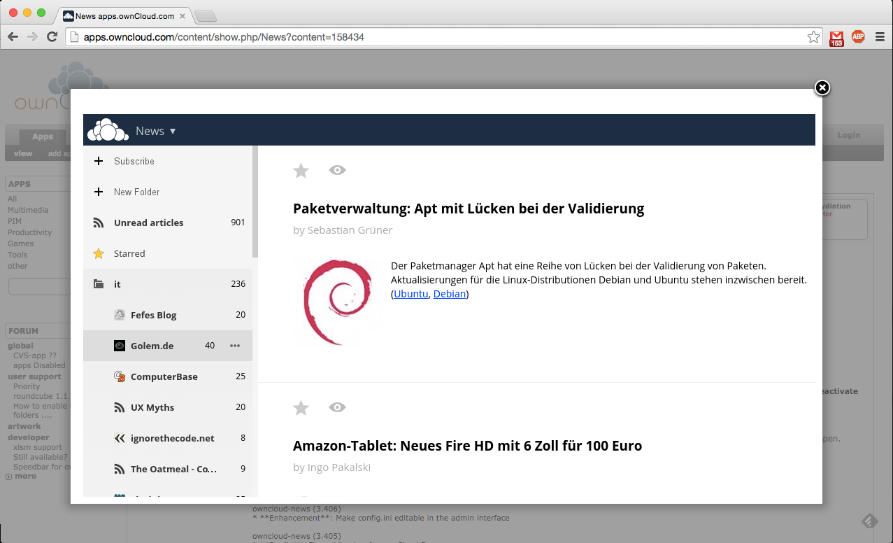
Notes:
Application example: NEWS

Slide 55

Notes:
Right menu
Personal, Users, Admin, Help

Slide 56

Notes:
Change your personal info

Slide 57

Notes:
Add more users.
Group them together.

Slide 58

Notes:
Check-change settings. Administrator panel.

Slide 59

Upgrade

Slide 60

Notes:
Documentation. How to use ownCloud

Slide 61

Notes:
Desktop-mobile clients

Slide 62

Notes:
Add your account to GNOME online accounts

Slide 63

Notes:
You can have access through nautilus (files).

Slide 64


Slide 65
Android
Files (0.79E): https://play.google.com/store/apps/details?id=com.owncloud.android
Folder Sync Lite (Files):
https://play.google.com/store/apps/details?id=dk.tacit.android.foldersync.lite
CardDAV (contacts +):
https://play.google.com/store/apps/details?id=com.contapps.android
CalDAV (2.59E)
https://play.google.com/store/apps/details?id=org.dmfs.caldav.lib
DevDroid (CalDav+CardDav):
https://f-droid.org/repository/browse/?fdid=at.bitfire.davdroid

Slide 66
Installation
Notes:
Last point – price. How do we pay?
Bad side of the cloud.

Slide 67
Installation steps
Install distribution (SD card or server)
Boot→ssh→update→ set server static IP
Install LAMP (SQLite/MariaDB)
Mount storage
Download and install ownCloud

Slide 68
DEBIAN

Slide 69
Install LAMP (SQLite/MariaDB)
One line:
apt-get install apache2 php5 php5-json php5-gd php5-sqlite curl libcurl3 libcurl4-openssl-dev php5-curl php5-gd php5-cgi php-pear php5-dev build-essential libpcre3-dev php5 libapache2-mod-php5 php-apc php-xml-parser php5-intl php5-mysql smbclient
Now make the changes to php.ini file
nano /etc/php5/apache2/php.ini
Find the values and change them to what you want.
upload_max_filesize = 2M
post_max_size= 2M
Restart the server
service apache2 restart

Slide 70
Mount storage (USB/Hard Disk)
Find the dev name (cat /proc/partitions or lsblk)
Make directory/mount point
mkdir /media/usb
Mount it (/etc/fstab). Add the line and reboot.
/dev/sda1 /media/usb ext4 defaults 1 0
Create the data directory and give permissions
mkdir /media/usb/owncloud-data
chown -R www-data:www-data /media/usb/owncloud-data
chown -R 775 /media/usb/owncloud-data

Slide 71

Notes:
But we will present the community edition.

Slide 72


Slide 73
Install ownCloud
Go to the server directory.
cd /var/www
Donload the file (get the link from the site)
wget https://download.owncloud.org/community/owncloud-8.0.2.tar.bz2
Extract it
tar -xjf owncloud-8.0.2.tar.bz2
Change the persmissions
chown -R www-data:www-data /var/www/owncloud
After installation, you have to add your DDNS address
nano /var/www/owncloud/config/config.php

Slide 74

http://serverIP/owncloud

Slide 75
openSUSE

Slide 76
Install LAMP (SQLite/MariaDB) II
openSUSE (go to http://goo.gl/cDd6Xh and find your version's repository)
zypper addrepo http://download.opensuse.org/repositories/isv:ownCloud:community/openSUSE_Tumbleweed/isv:ownCloud:community.repo
zypper refresh
zypper install owncloud apache2 mariadb
Start the services
systemctl enable apache2.service mysql.service
systemctl start apache2.service mysql.service

Slide 77

Firewall and apache (YaST) I

Slide 78

Firewall and apache (YaST) II

Slide 79

Firewall and apache (YaST) III

Slide 80

Firewall and apache (YaST) IV

Slide 81
Setup mariaDB I
Setup
mysql_secure_installation
Press (prompts):
Enter current password for root (enter for none): ←ENTER
Set root password? [Y/n] ←ENTER
New password: ←mariadbpassword
Re-enter new password: ←mariadbpassword
Remove anonymous users? [Y/n] ←ENTER
Disallow root login remotely? [Y/n] ←ENTER
Remove test database and access to it? [Y/n] ←ENTER
Reload privilege tables now? [Y/n] ←ENTER

Slide 82
Setup mariaDB II
Commands @Mysql prompt:
mysql -u root -p
Put the Mysql password which you selected before, & create a database for ownCloud in Mysql prompt:
CREATE DATABASE owncloud;
Assign privileges to a new MySQL user to handle database operations for ownCloud:
GRANT ALL ON owncloud.* to 'owncloud'@'localhost' IDENTIFIED BY 'database_password';
exit

Slide 83
Enable php5 for apache2
a2enmod php5
nano /srv/www/htdocs/owncloud/.htaccess
Options +FollowSymLinks
[...]

Slide 84

http://serverIP/owncloud

Slide 85
LibreOffice
Install LibreOffice to be able to read .doc and .docx files:
: ~ $ sudo apt-get install libreoffice
: ~ $ sudo add-apt-repository ppa: libreoffice / libreoffice-4-2
Add this in config.php
: ~ $ sudo nano /var/www/owncloud/config/config.php
'preview_libreoffice_path' => '/ usr / bin / libreoffice'

Slide 86

Notes:
If you like it and you're bored to setup, there's a ready ISO. ownCloud in a box.

Slide 87


Slide 88
Community ownClouders
Facebook: https://www.facebook.com/ownClouders
Google Plus: (http://goo.gl/rqn38m) https://plus.google.com/107072838776436530705
Twitter: @ownclouders
Mail: https://mailman.owncloud.org/mailman/listinfo
IRC: #owncloud @freenode http://webchat.freenode.net/?channels=owncloud
Events: https://owncloud.org/events/
Translation: https://www.transifex.com/projects/p/owncloud/
Notes:
Where you can find us.

Slide 89
Thank you

