Slide 1
ownCloud for Users
Efstathios Iosifidis
iosifidis@opensuse.org
Notes:
Welcome everybody

Slide 2
Initial Problem
Access files from anywhere
Access calendar from anywhere
Access contacts from anywhere
Easy sharing and collaboration
All free!!!

Slide 3
The awesome cloud
Notes:
Start with the awesomeness of the cloud. Do I need to tell you?

Slide 4
Awesomeness of the cloud
Accessible everywhere
Back up online
Easy sharing and collaboration
All free!!!
  (or super cheap)
Notes:
Android phone breaks – log in on new
Games online
Chatting, sharing pics or documents with others
Free or cheap!

Slide 5
The awful cloud
Notes:
Last point – price. How do we pay?
Bad side of the cloud.

Slide 6
Awfulness of the cloud
Where is my data?
Who can access my data?
How is my data used?
Notes:
Ask yourself these questions.

Slide 7
This thing called privacy
Notes:
Why it matters? Privacy, just that.

Slide 8
What do you have to hide?
You don't know!
You SHOULD have something!
Everybody needs privacy
Notes:
I have nothing to hide.
Well, you do. And you should. Besides, this isn't even the right argument to have.
Let's go over these three points

Slide 9
Take back your data
Notes:
You should be convinced now:
Cloud is awesome
But endangers privacy
And privacy matters
You know what you need: something you OWN.

Slide 10

Introducing ownCloud
Sync and share
Open Source
Easy to use
Easy to install
Easy to extend
>1.8 mln users
Notes:
So, here's one such solution: ownCloud
Core: sync and share data
Ticks more boxes
Including what we discussed earlier

Slide 11


Sync and Share
Sync and Share
Notes:
Cross-platform
Win/Lin/Mac desktop
Android, iOS, firefox and Jolla
third party applications

Slide 12
Sync and Share
Multi-platform
External Storage
  FTP, NFS, WebDAV, dropbox, S3, …
  Encryption
  Versioning
Sharing
  Public links, passwords, expiring, upload rights
Server to server sharing
Notes:
External Storage
* FTP, NFS, WebDAV, dropbox, S3, …
* Encryption
* Versioning
Sharing
Friends took pictures at your wedding?
Send them a public link, expiring in 2 monhts, protected with a password for uploading files!
Server to server sharing
3 German universities: 500K students, one cloud.
Federation and decentralization!

Slide 13
Easy to use
Easy to deploy: LAMP
Easy to hack on or inspect: PHP, JS, CSS
All-platform access

Slide 14
Extensible
              OwnCloud Apps
Notes:
ownCloud is a platform you can build apps on
Over 200 available
Get some examples later

Slide 15
Comparison
 | Google Drive | One Drive (MS) | Dropbox | ownCloud
Size | 15GB | 15GB | 2GB | Unlimited
Calendar | Yes | Yes | No | Yes
Contacts | Yes | Yes | No | Yes
Extra | Google docs | Office online |  | Apps
Mail | Gmail | Outlook | No | Personal-APP
Clients | Mobile-PC | Mobile-PC | Mobile-PC | Mobile-PC
Safety | Google | Microsoft | Dropbox | YOU
Notes:
Here is a small comparison of the most popular services and ownCloud.

Slide 16
Screenshot time

Slide 17
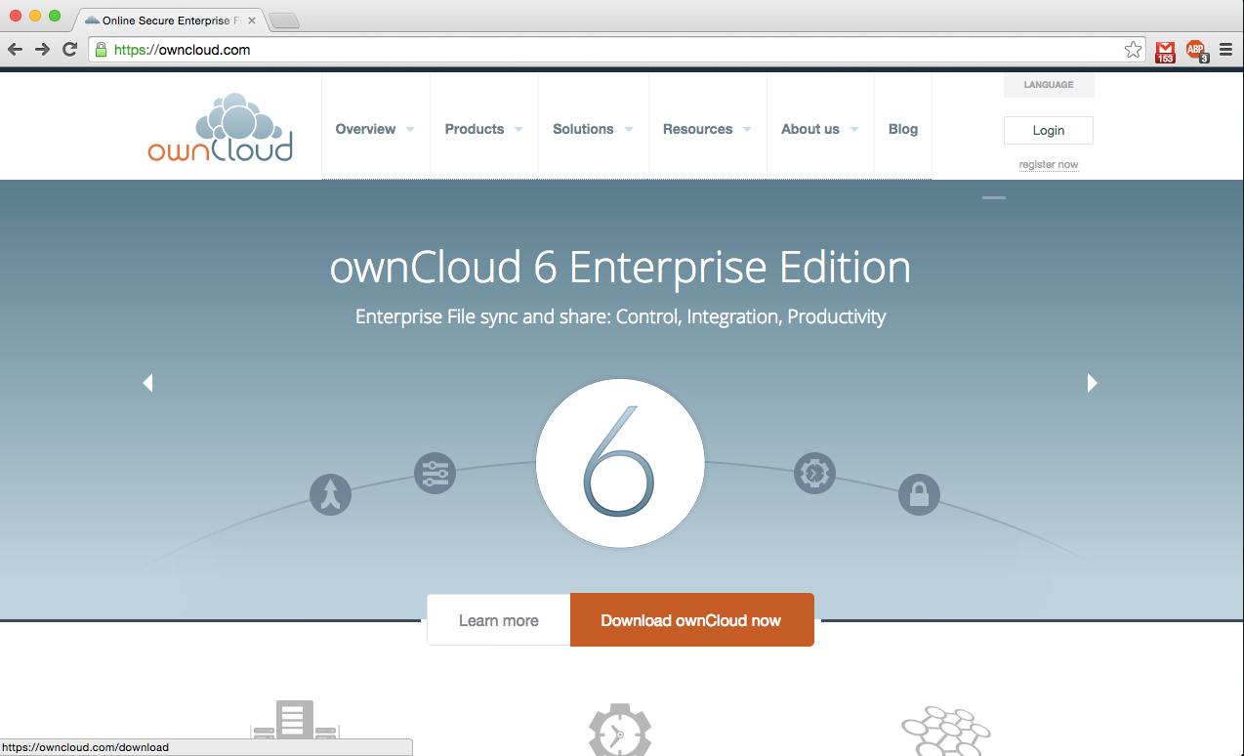
Notes:
There's enterprise edition of ownCloud.

Slide 18
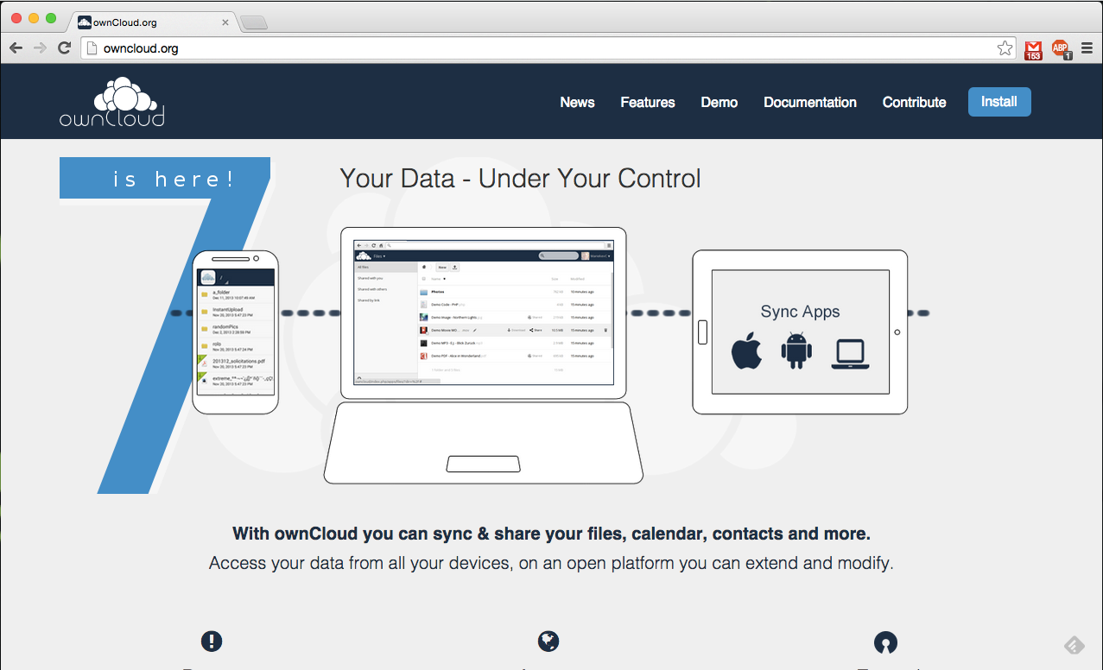
Notes:
But we will present the community edition.

Slide 19
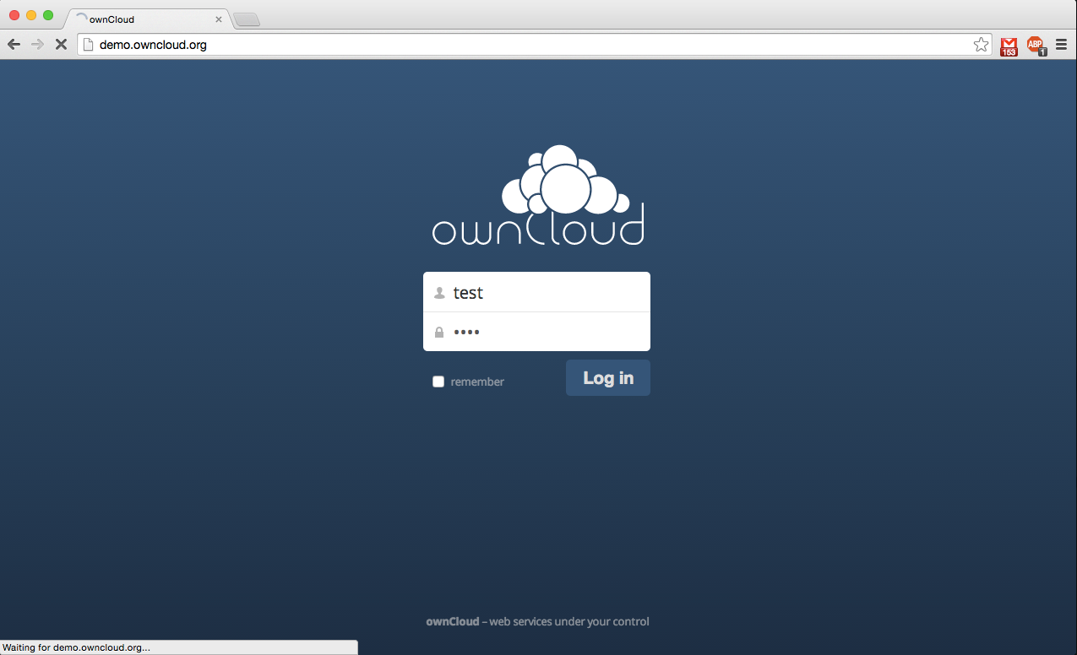
Notes:
Enter your username/password to enter.

Slide 20
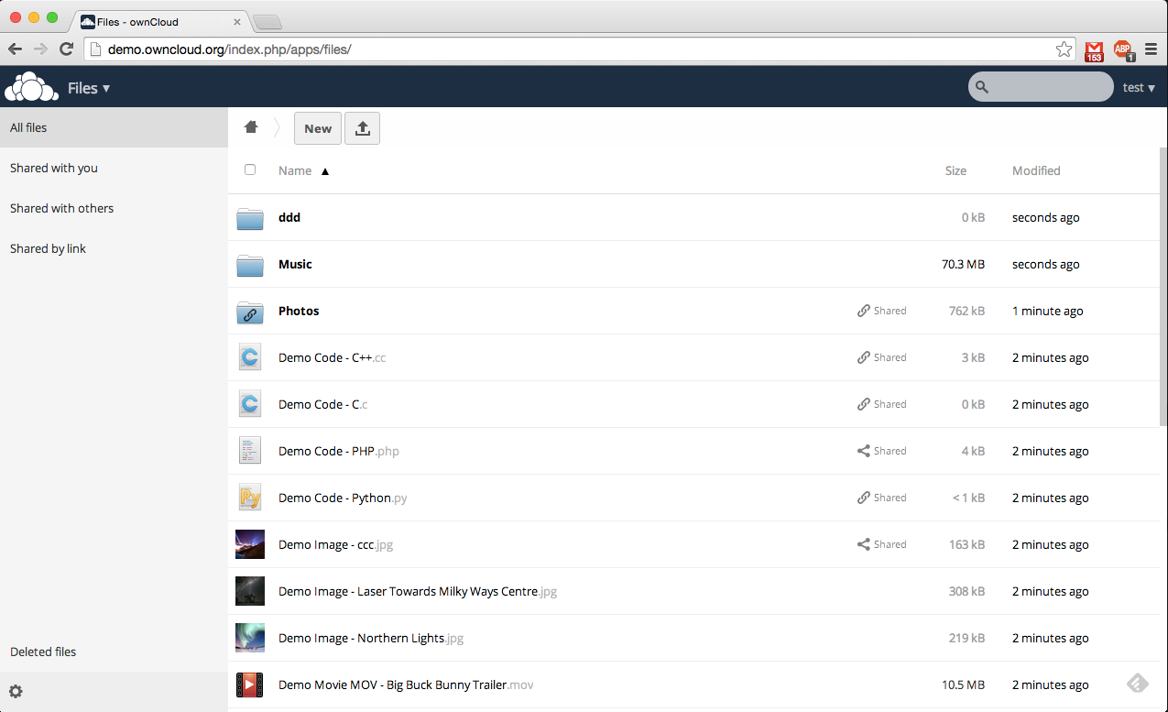
Notes:
The first screen is the place where you have your files stored.

Slide 21
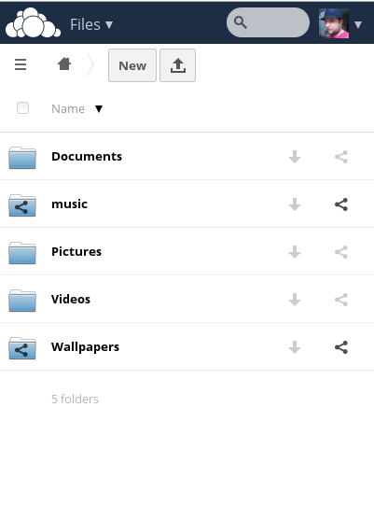
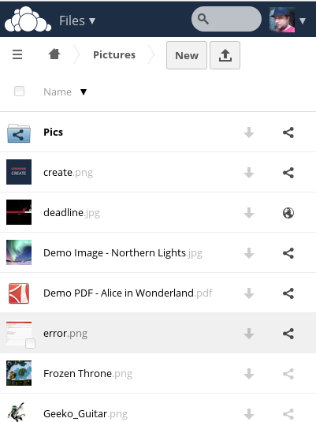
Mobile UI

Slide 22
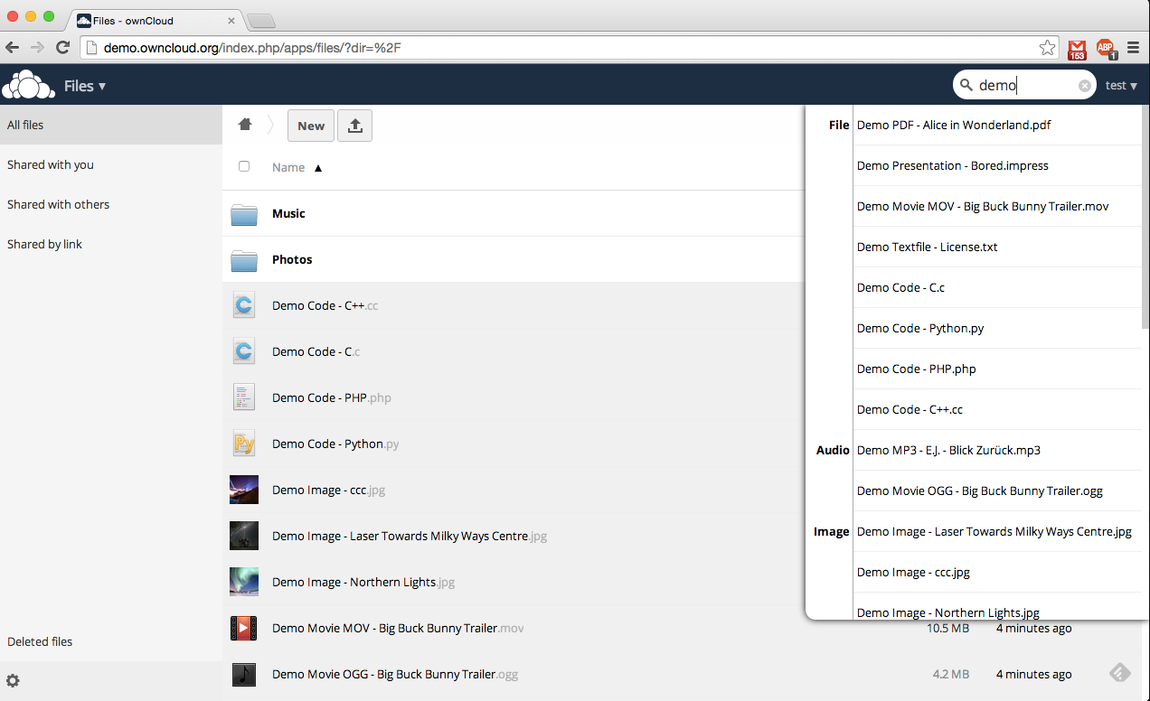
Notes:
If you don't remember the file you want, there's a search box at the top right side.

Slide 23
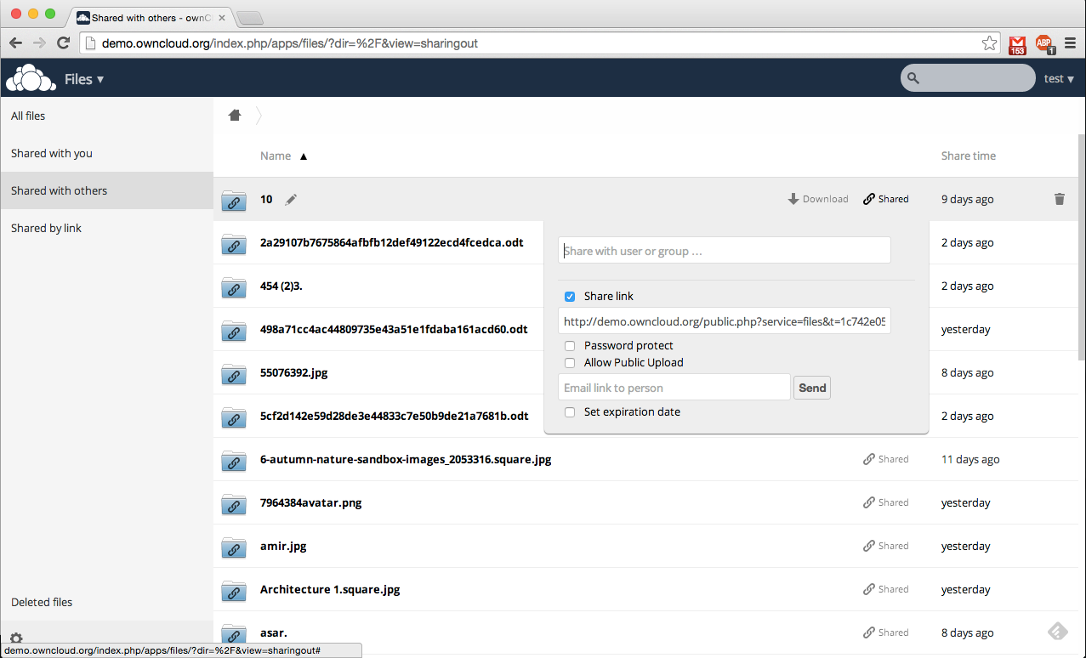
Notes:
Share options of a file.

Slide 24
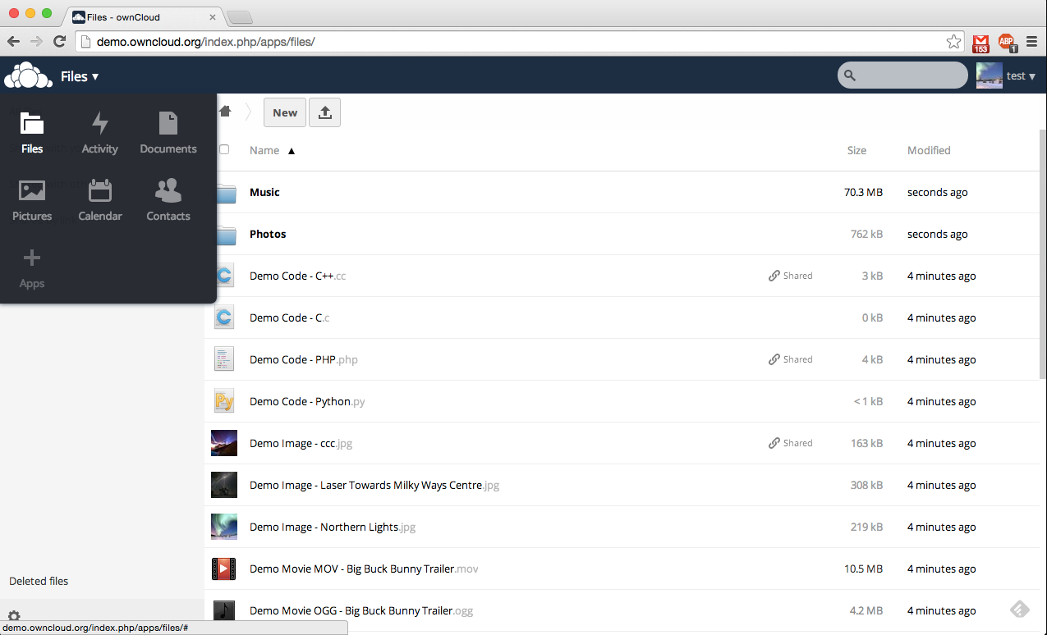
Notes:
Left menu
Files, Activity, Documents, Photos, Calendar, Contacts, Apps, Deleted!!!

Slide 25
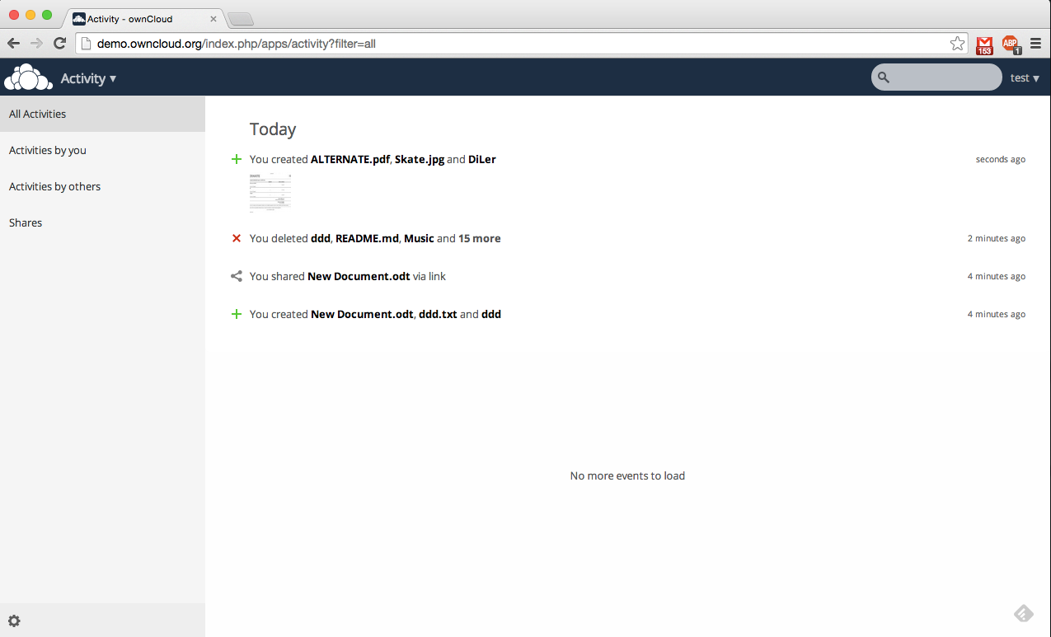
Notes:
Activity overview. What happened with your files?

Slide 26
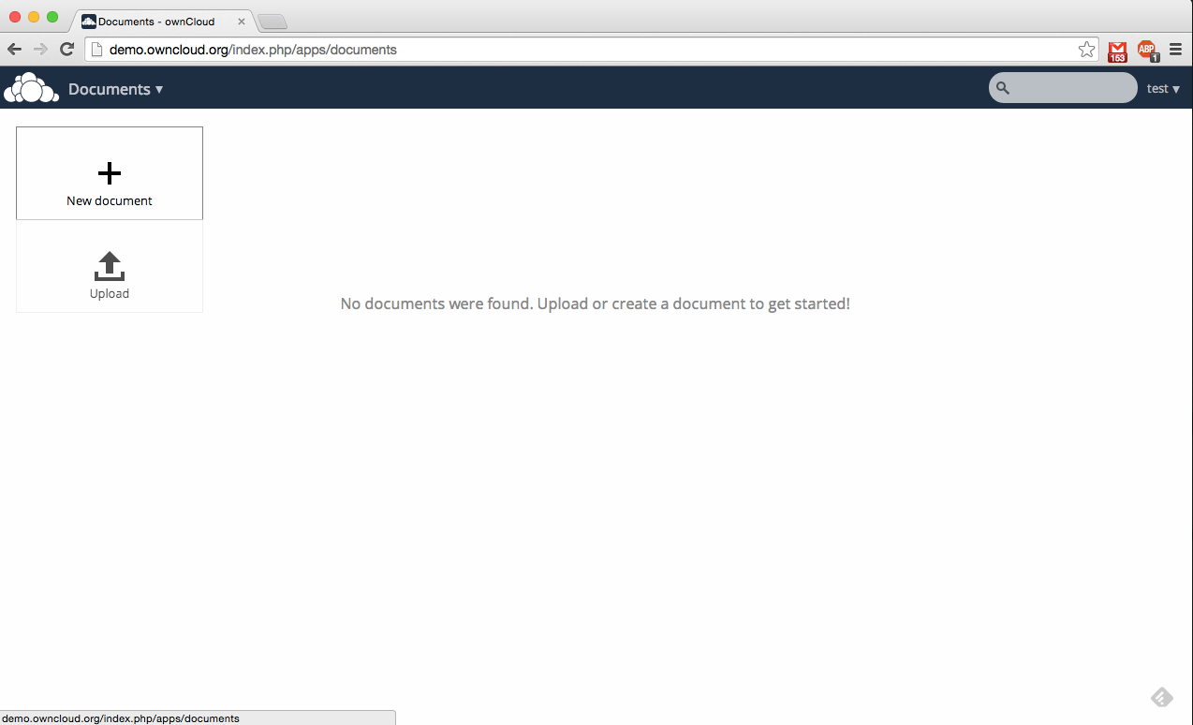
Notes:
Documents

Slide 27
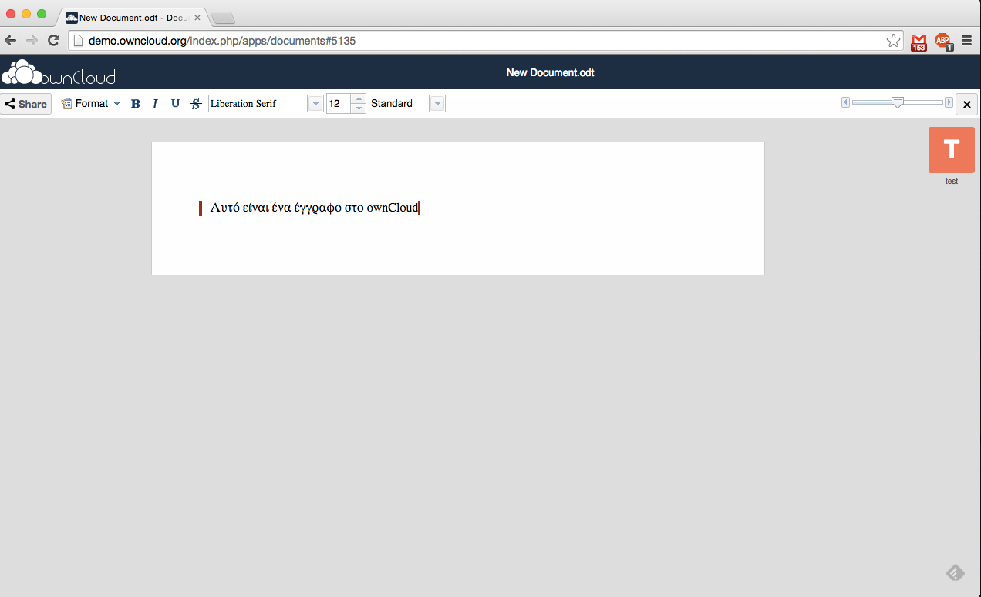
Notes:
Create a document

Slide 28
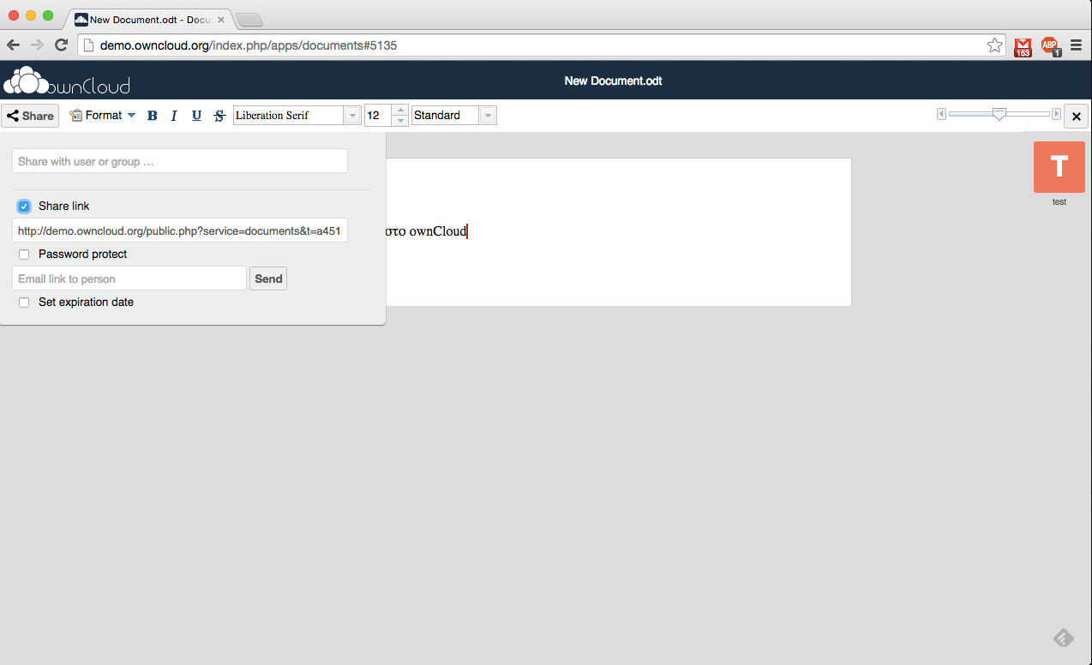
Notes:
Share the document

Slide 29
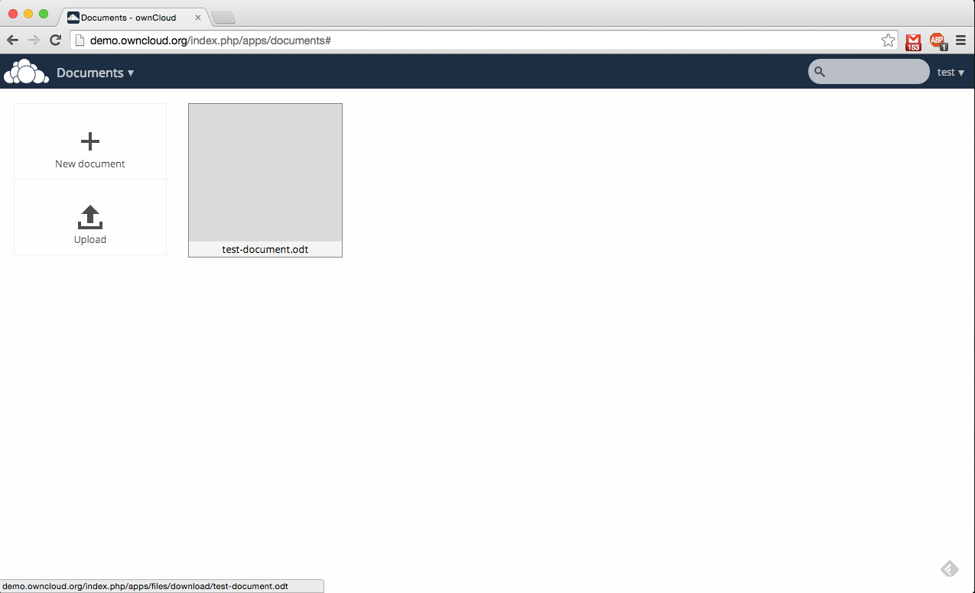
Notes:
The document is saved

Slide 30
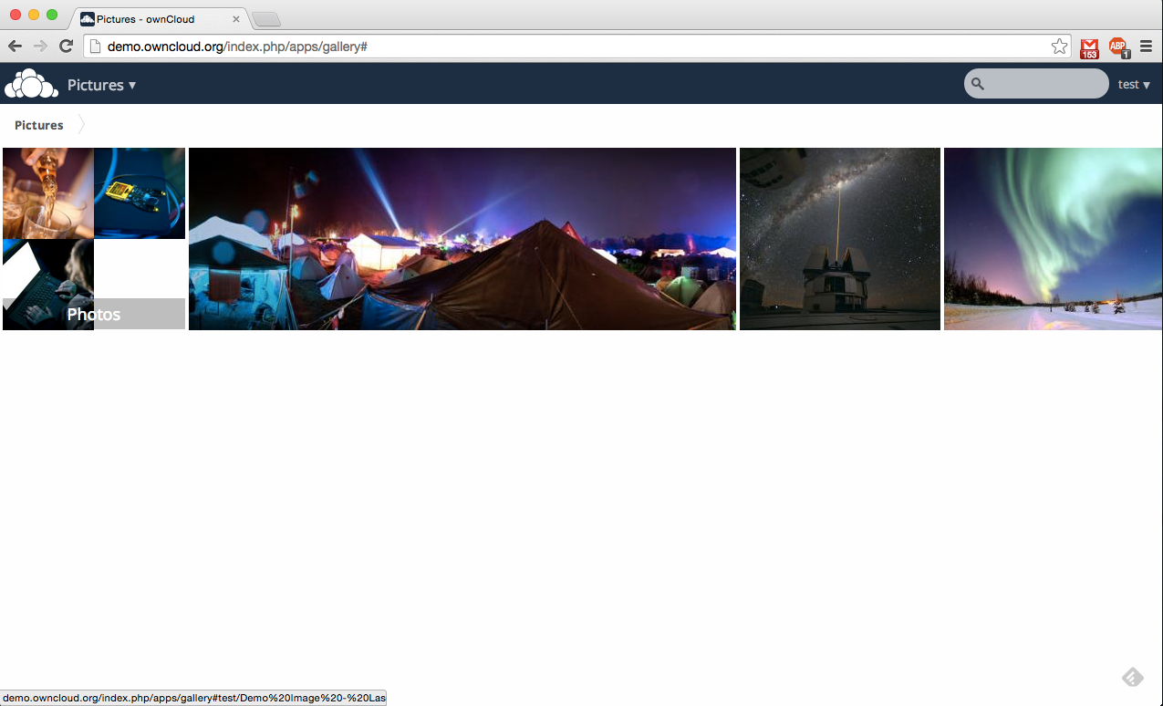
Notes:
Photos overview.

Slide 31
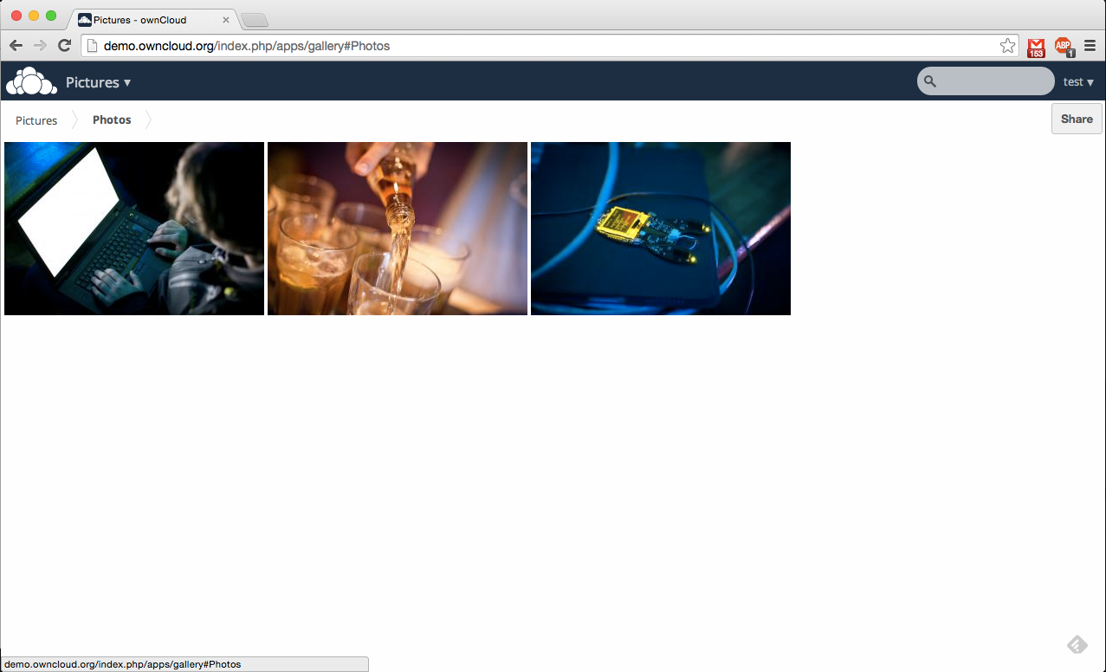
Notes:
Photos can be grouped in a folder.

Slide 32
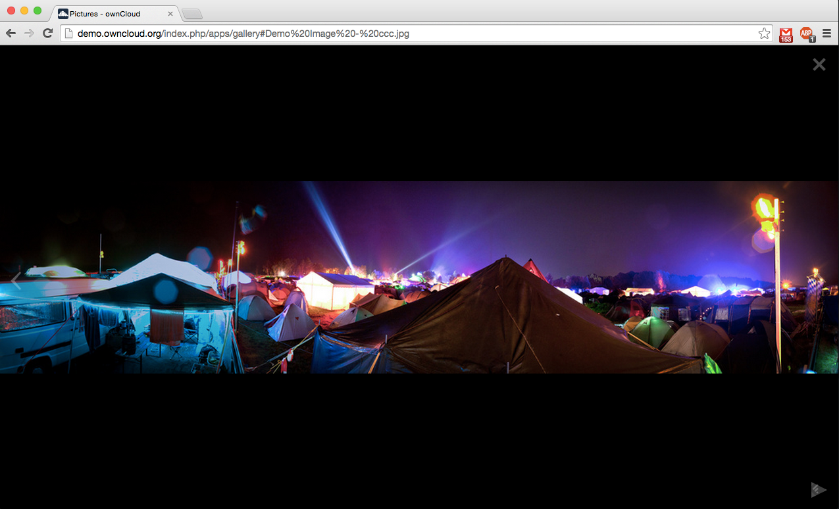
Notes:
Photo preview.

Slide 33
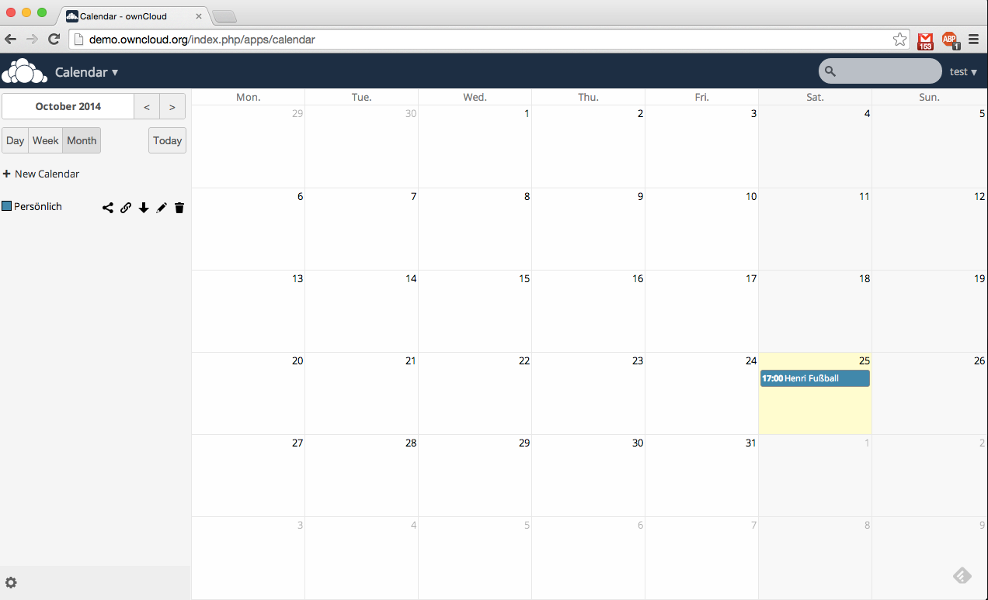
Notes:
Calendar

Slide 34
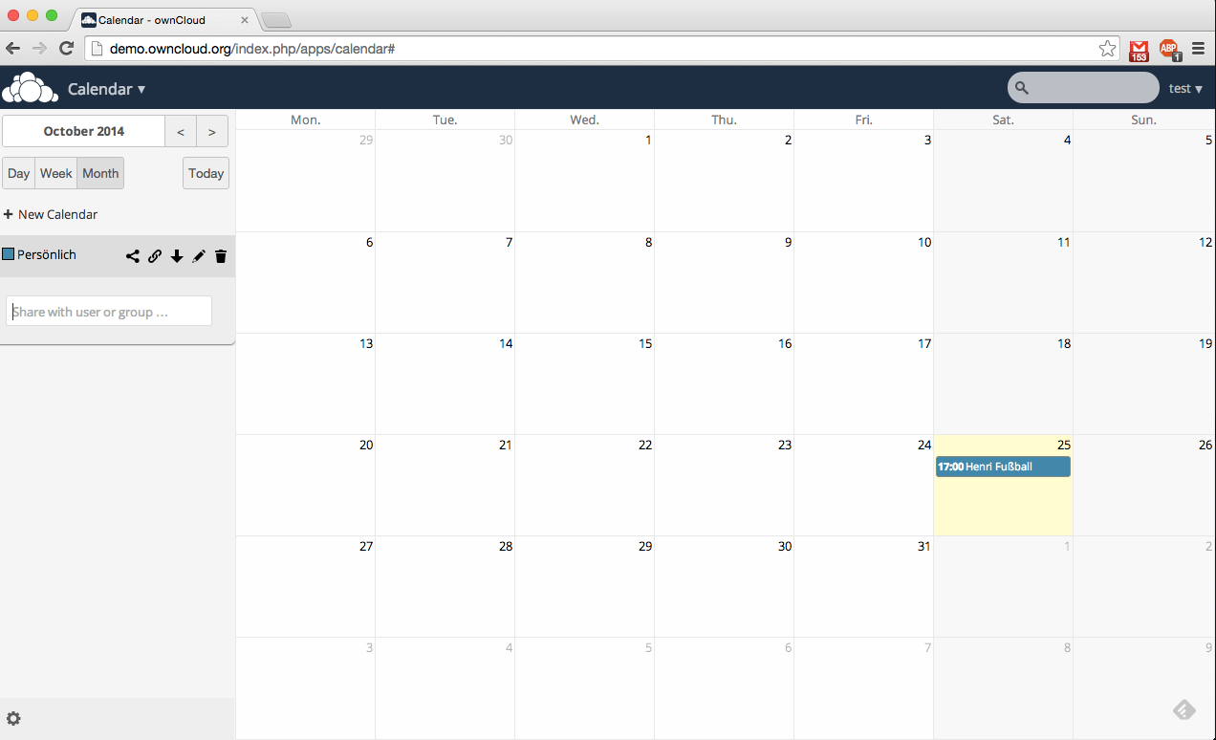
Notes:
Share the calendar with the group.

Slide 35
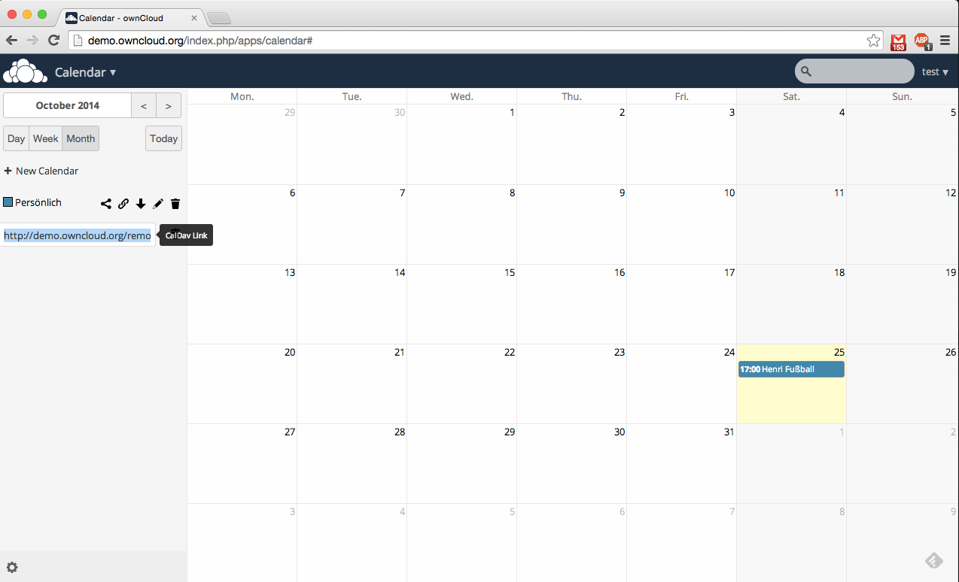

Notes:
Use the calendar with CalDAV or save an ics file.

Slide 36
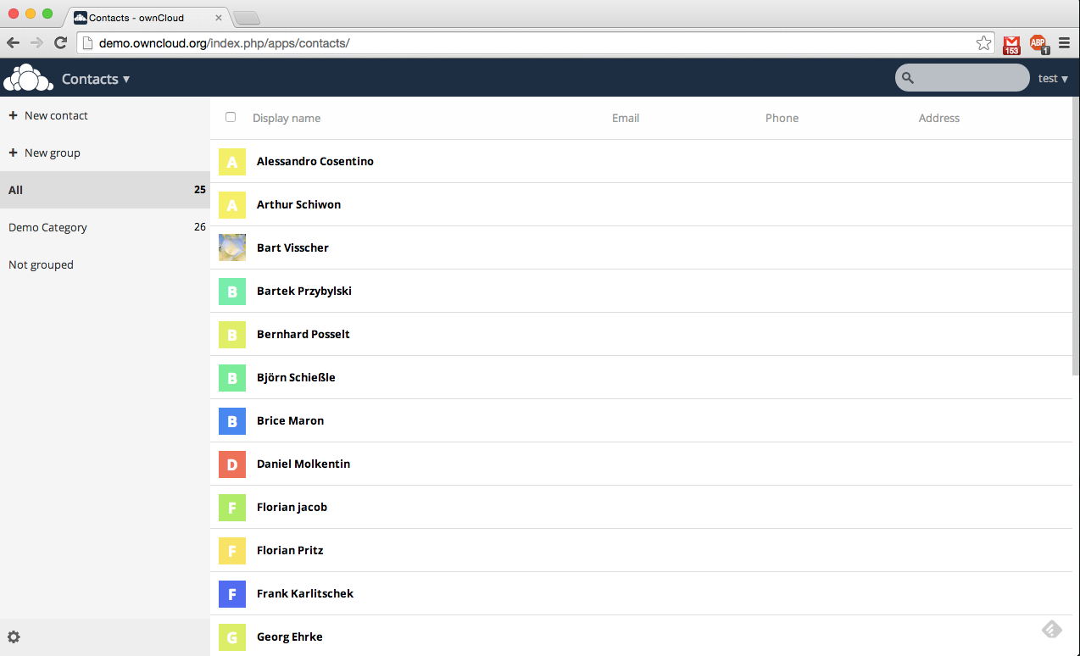
Notes:
Contacts

Slide 37
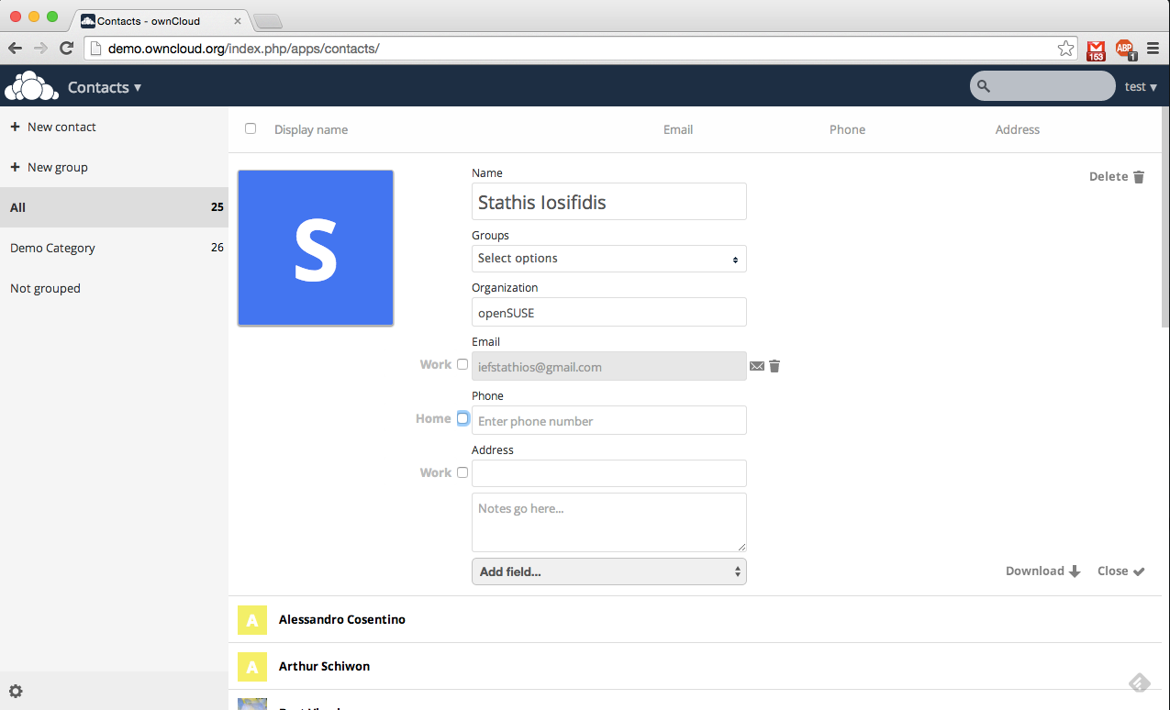
Notes:
Create a new contact

Slide 38
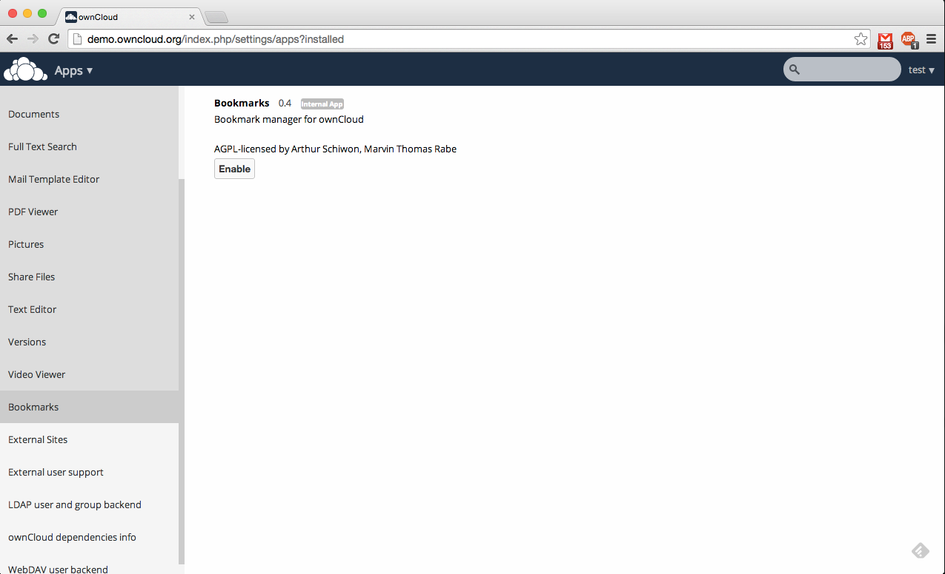
Notes:
Enable new applications

Slide 39
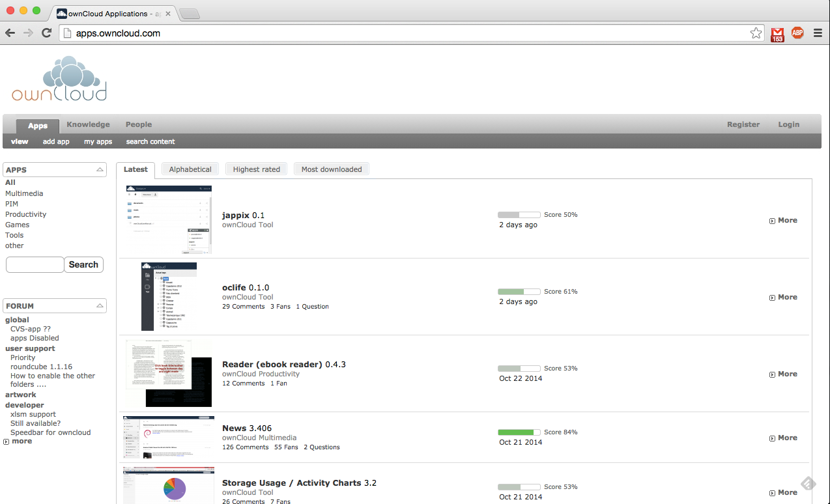
Notes:
Application site

Slide 40
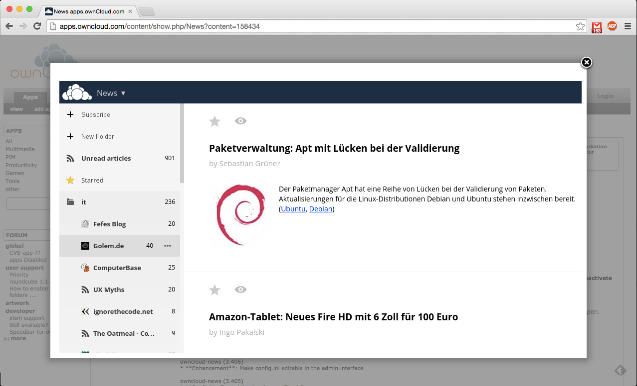
Notes:
Application example: NEWS

Slide 41
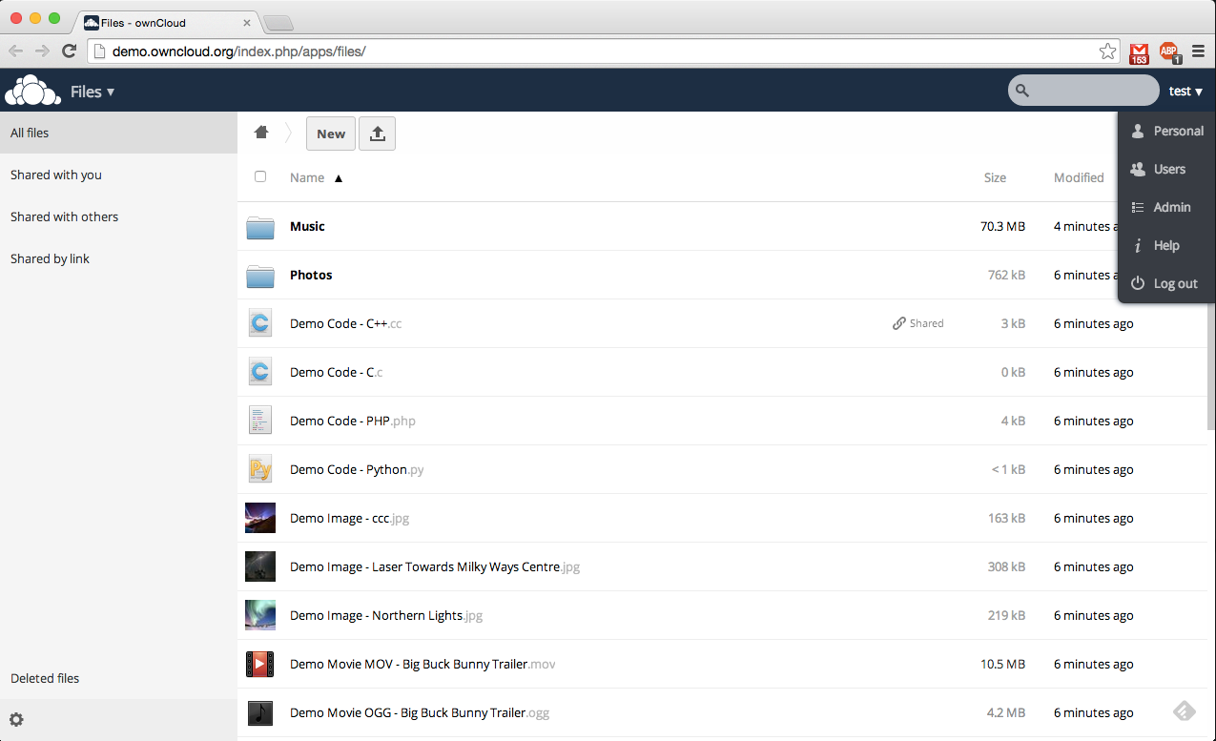
Notes:
Right menu
Personal, Users, Admin, Help

Slide 42
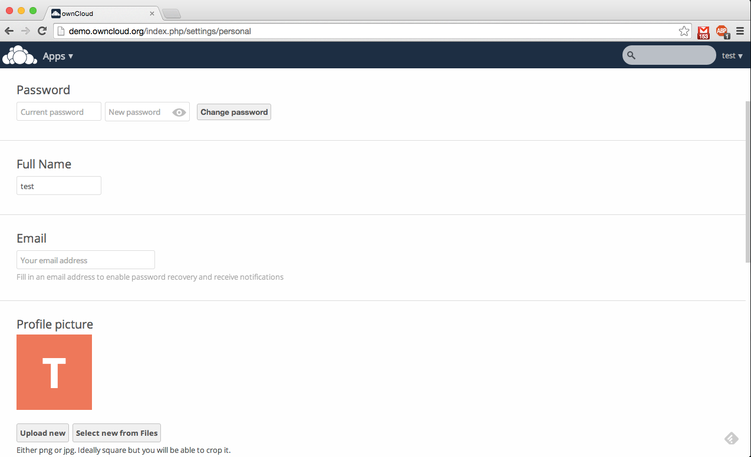
Notes:
Change your personal info

Slide 43
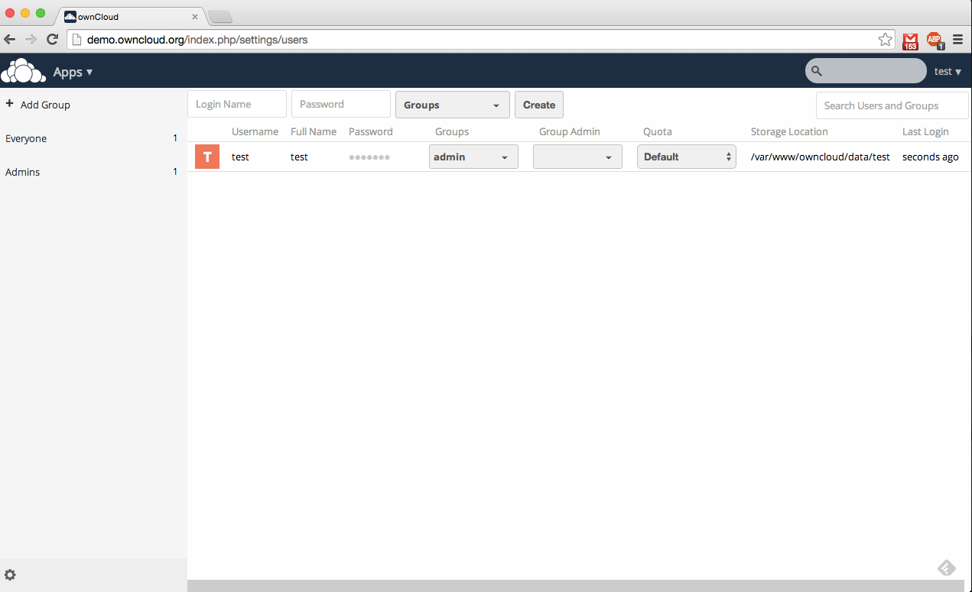
Notes:
Add more users.
Group them together.

Slide 44
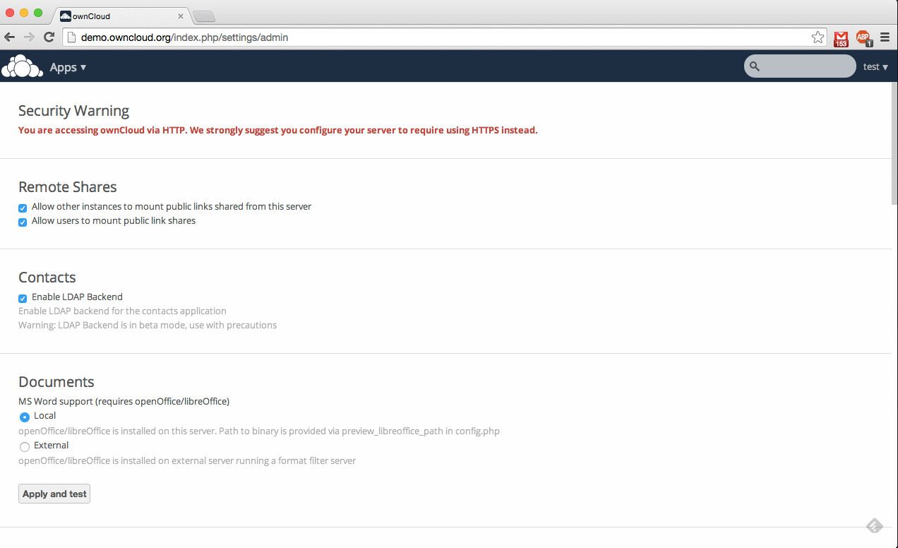
Notes:
Check-change settings. Administrator panel.

Slide 45
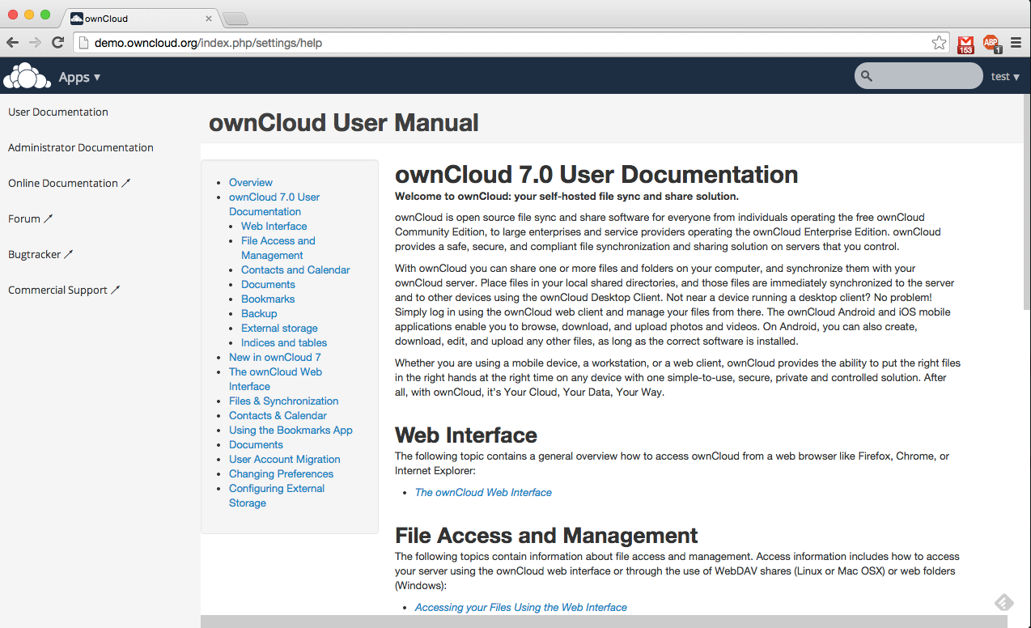
Notes:
Documentation. How to use ownCloud

Slide 46
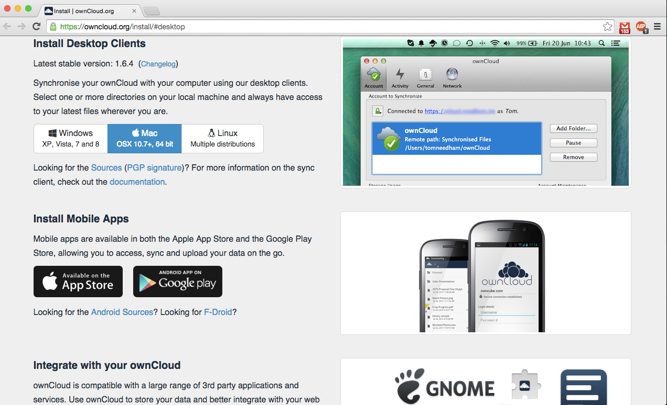
Notes:
Desktop-mobile clients

Slide 47
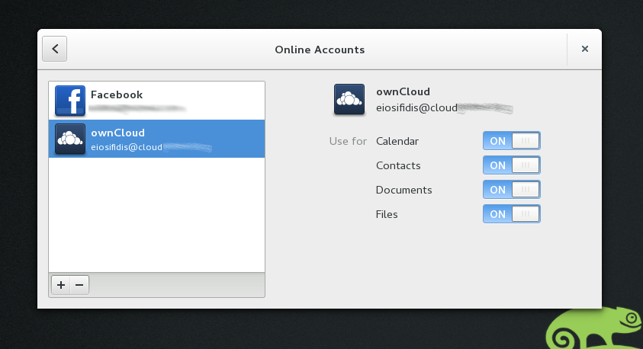
Notes:
Add your account to GNOME online accounts

Slide 48
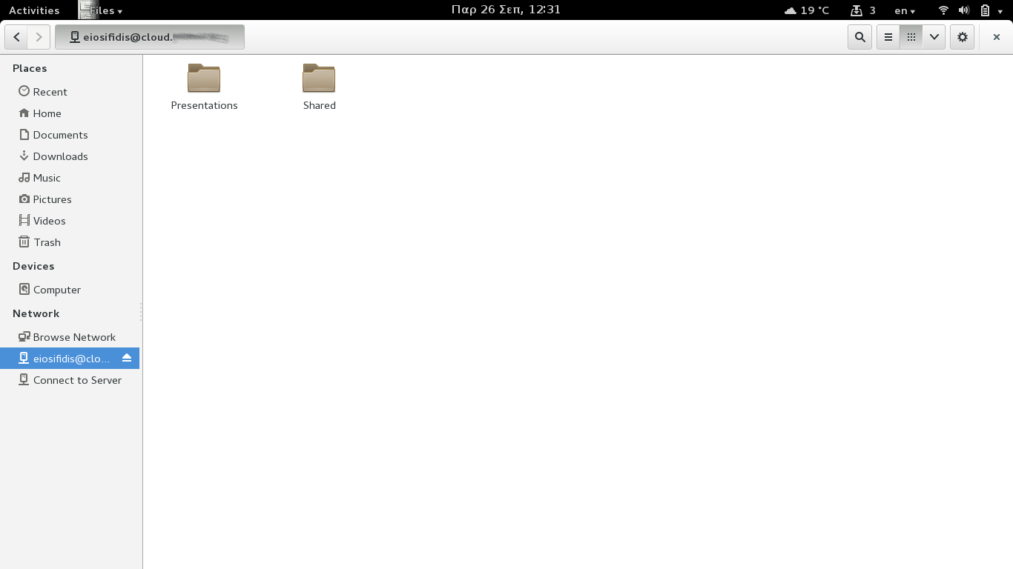
Notes:
You can have access through nautilus (files).

Slide 49
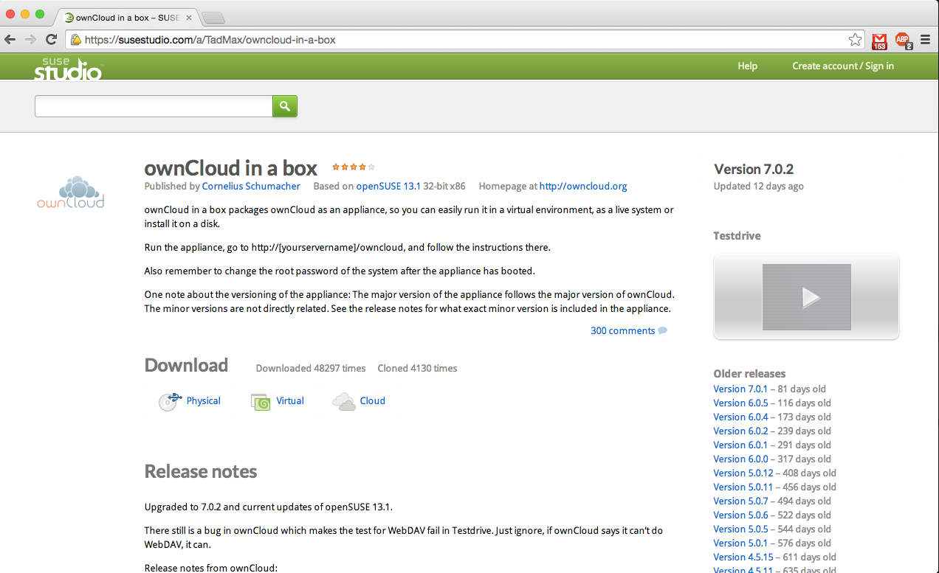
Notes:
If you like it and you're bored to setup, there's a ready ISO. ownCloud in a box.

Slide 50
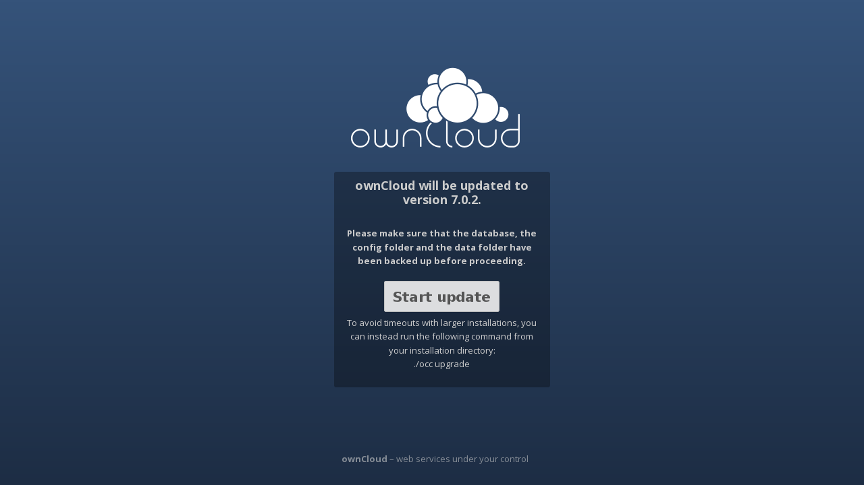
Upgrade

Slide 51
Community ownClouders
Facebook: https://www.facebook.com/ownClouders
Google Plus: (http://goo.gl/rqn38m) https://plus.google.com/107072838776436530705
Twitter: @ownclouders
Mail: https://mailman.owncloud.org/mailman/listinfo
IRC: #owncloud @freenode http://webchat.freenode.net/?channels=owncloud
Events: https://owncloud.org/events/
Translation: https://www.transifex.com/projects/p/owncloud/
Notes:
Where you can find us.

Slide 52
Thank you

