Slide 1
ownCloud for Users
Efstathios Iosifidis
iosifidis@opensuse.org
Notes:
Welcome everybody

Slide 2
Need for cloud service
Access files
Access calendar
Access mail
Access contacts
Easy sharing and collaboration
All free!!!

Slide 3
The awesome cloud
Notes:
Start with the awesomeness of the cloud. Do I need to tell you?

Slide 4
Awesomeness of the cloud
Accessible everywhere
Back up online
Easy sharing and collaboration
All free!!!
  (or super cheap)
Notes:
Android phone breaks – log in on new
Games online
Chatting, sharing pics or documents with others
Free or cheap!

Slide 5
The awful cloud
Notes:
Last point – price. How do we pay?
Bad side of the cloud.

Slide 6
Awfulness of the cloud
Where is my data?
Who can access my data?
How is my data used?
Notes:
Ask yourself these questions.

Slide 7
Take back your data
Notes:
You should be convinced now:
Cloud is awesome
But endangers privacy
And privacy matters
You know what you need: something you OWN.

Slide 8

Introducing ownCloud
Sync and share
Open Source
Easy to use
Easy to install
Easy to extend
>1.8 mln users
Notes:
So, here's one such solution: ownCloud
Core: sync and share data
Ticks more boxes
Including what we discussed earlier

Slide 9
Sync and Share
Multi-platform
External Storage
  FTP, NFS, WebDAV, dropbox, S3, …
  Encryption
  Versioning
Sharing
  Public links, passwords, expiring, upload rights
Server to server sharing
Notes:
External Storage
* FTP, NFS, WebDAV, dropbox, S3, …
* Encryption
* Versioning
Sharing
Friends took pictures at your wedding?
Send them a public link, expiring in 2 monhts, protected with a password for uploading files!
Server to server sharing
3 German universities: 500K students, one cloud.
Federation and decentralization!

Slide 10
Comparison
 | Google Drive | One Drive (MS) | Dropbox | iCloud | ownCloud
Size | 15GB | 15GB | 2GB | 5GB | Unlimited
Calendar | Yes | Yes | No | Yes | Yes
Contacts | Yes | Yes | No | Yes | Yes
Extra | Google docs, Photos | Office online |  | Pages, Numbers, Keynote, Photos | Documents, Apps
Mail | Gmail | Outlook | No | Yes | Personal-APP
Clients | Mobile-PC | Mobile-PC | Mobile-PC | Mobile-PC | Mobile-PC
Safety | Google | Microsoft | Dropbox | Apple | YOU
Notes:
Here is a small comparison of the most popular services and ownCloud.

Slide 11
Screenshot time

Slide 12
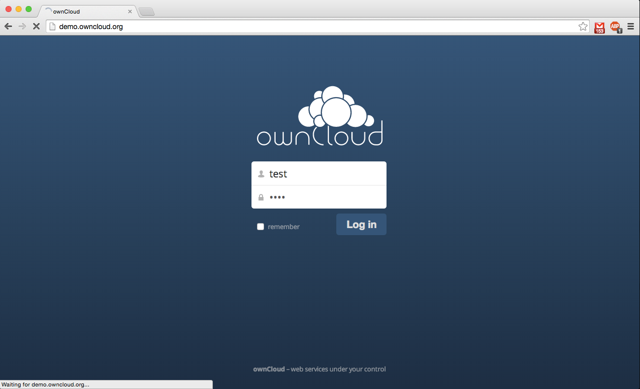
Notes:
Enter your username/password to enter.

Slide 13
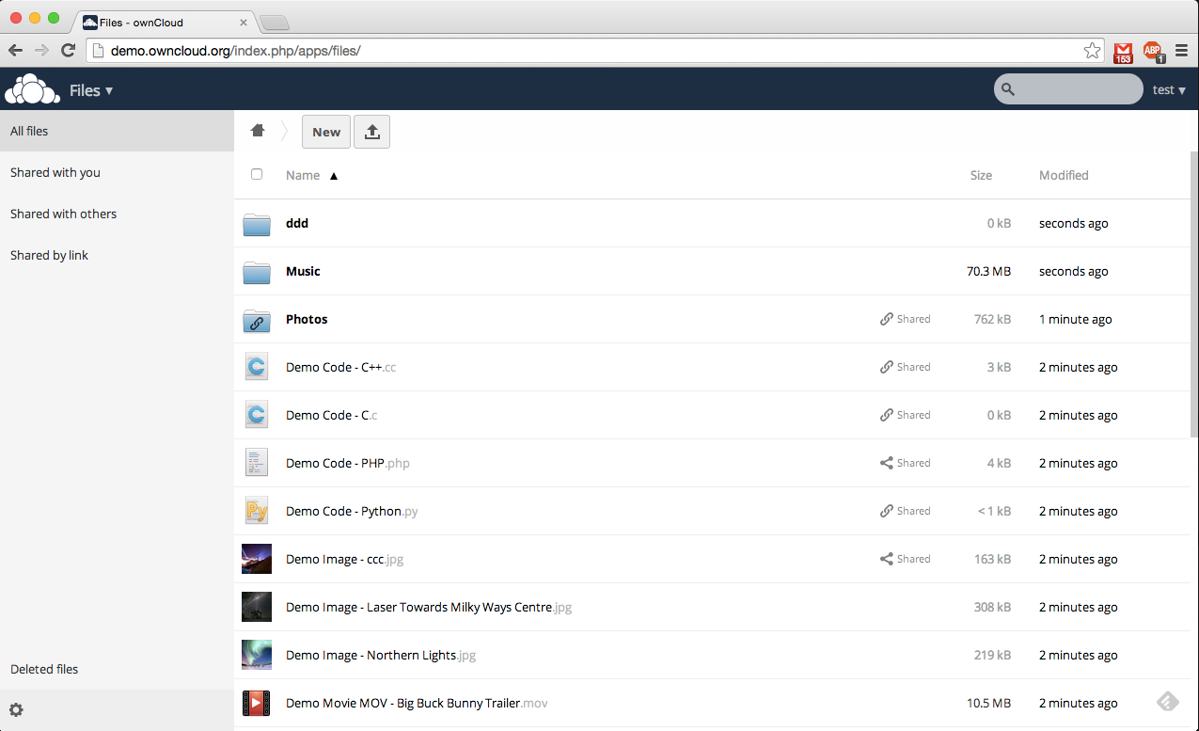
Notes:
The first screen is the place where you have your files stored.

Slide 14
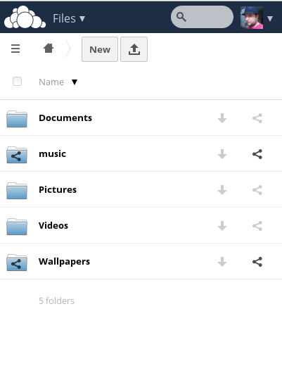
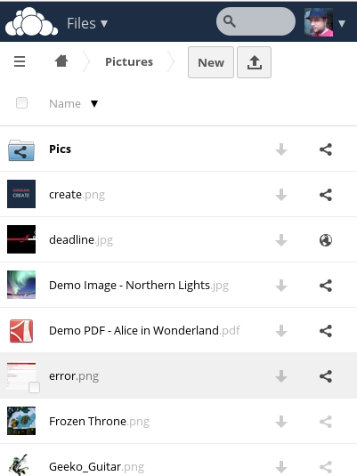
Mobile UI

Slide 15
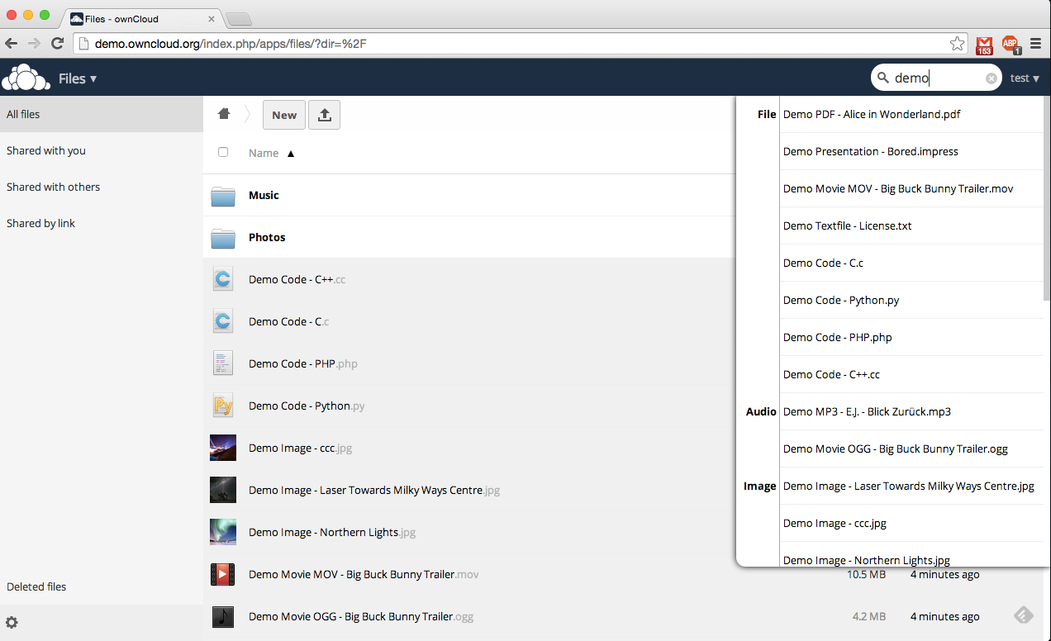
Notes:
If you don't remember the file you want, there's a search box at the top right side.

Slide 16
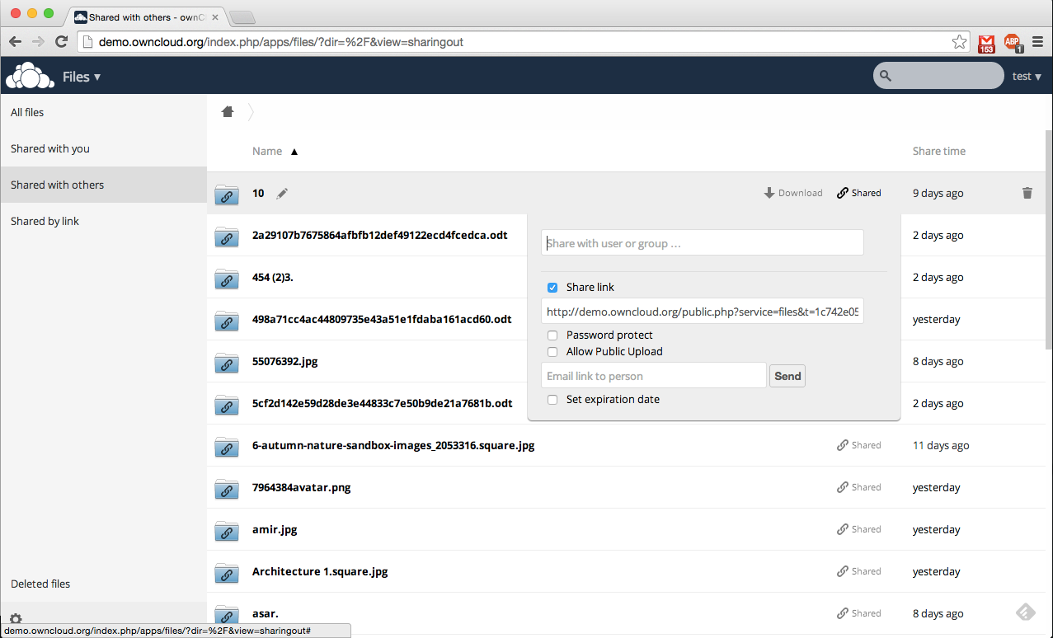
Notes:
Share options of a file.

Slide 17
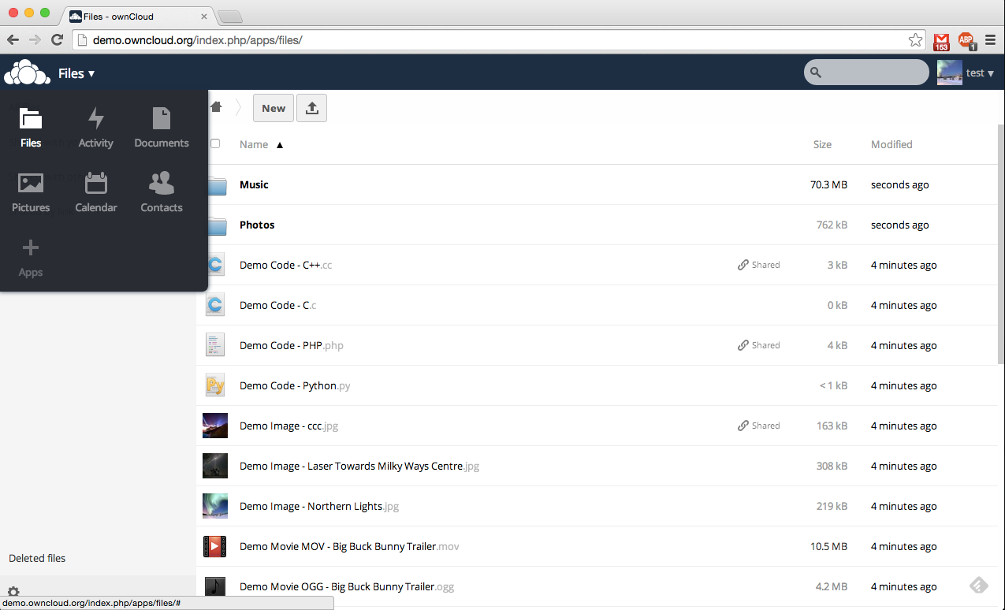
Notes:
Left menu
Files, Activity, Documents, Photos, Calendar, Contacts, Apps, Deleted!!!

Slide 18
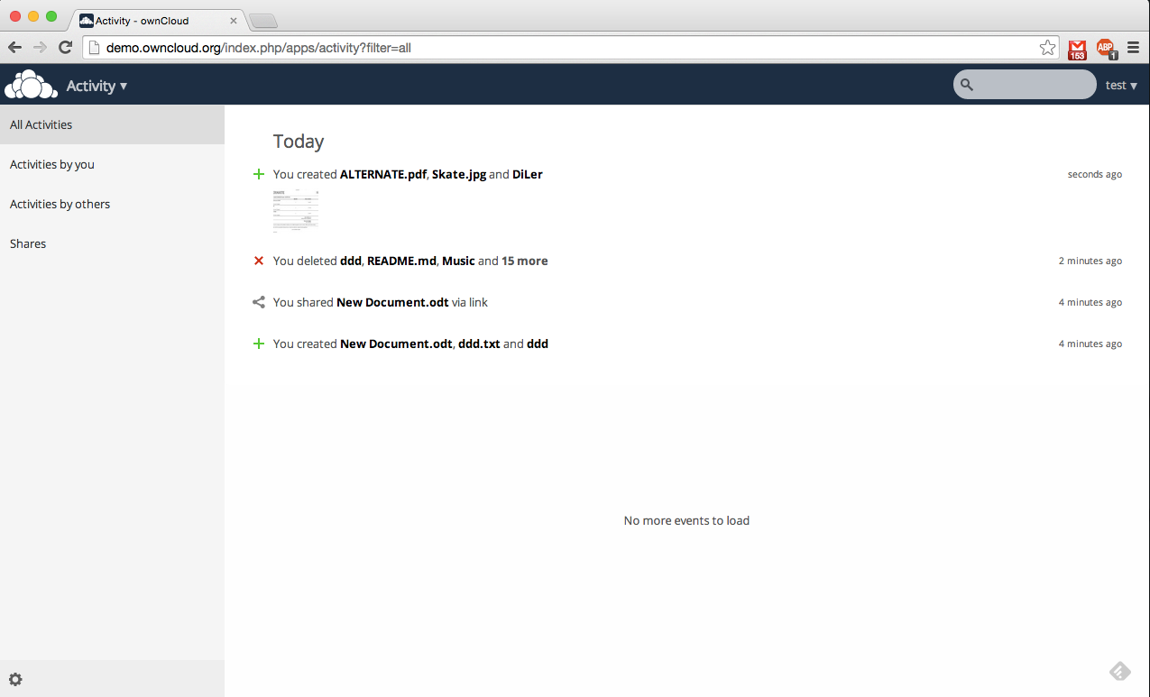
Notes:
Activity overview. What happened with your files?

Slide 19
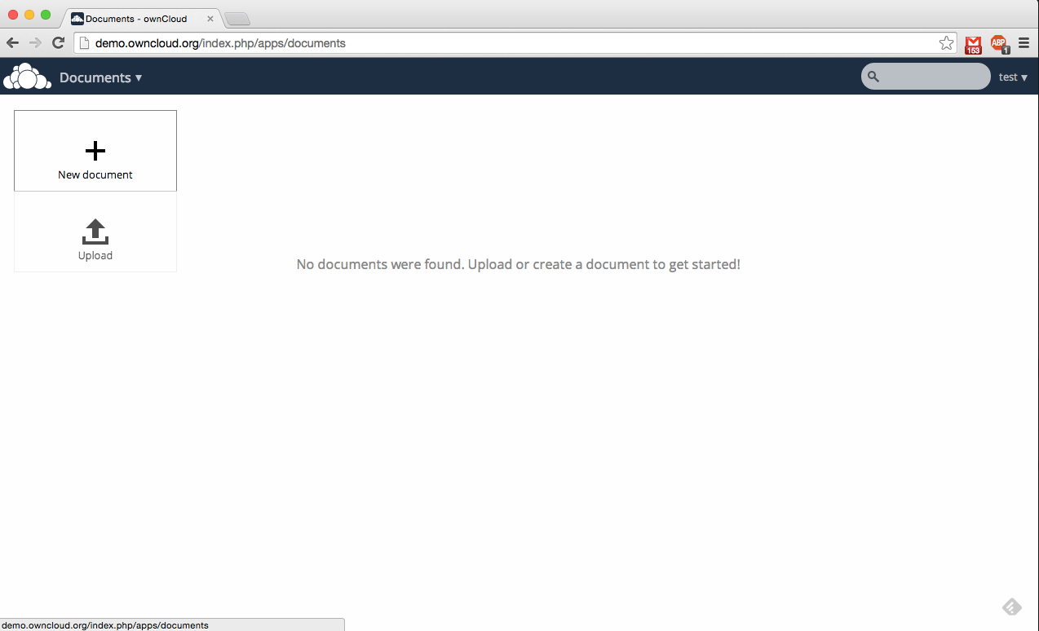
Notes:
Documents

Slide 20
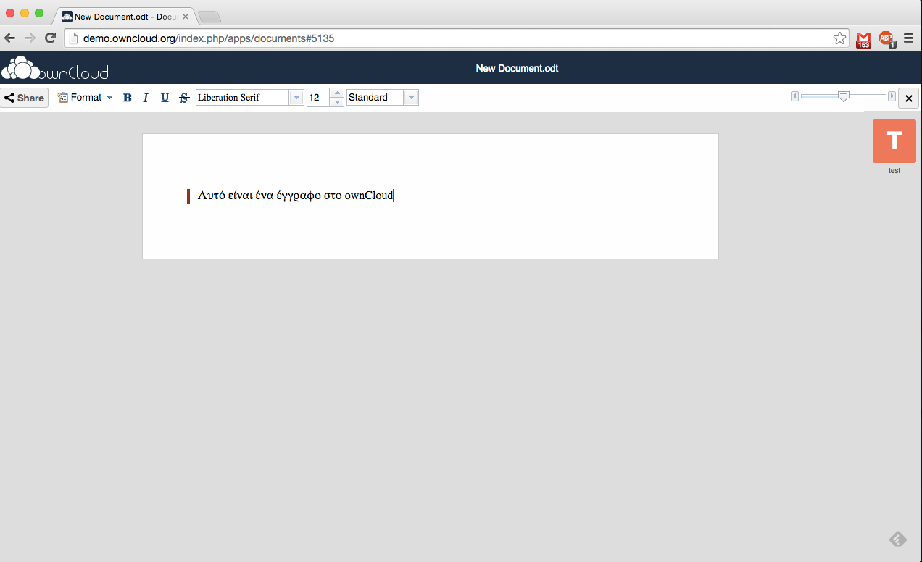
Notes:
Create a document

Slide 21
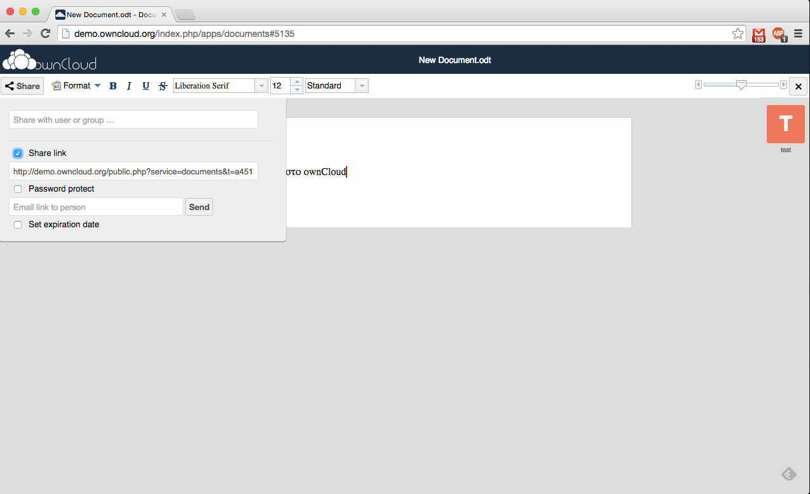
Notes:
Share the document

Slide 22
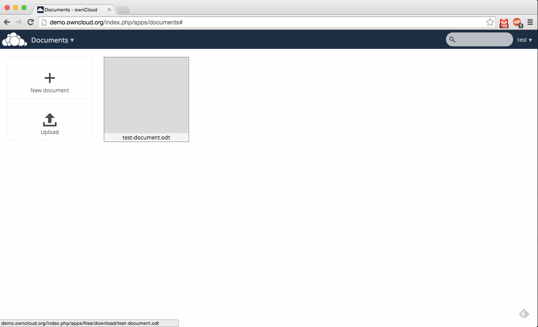
Notes:
The document is saved

Slide 23
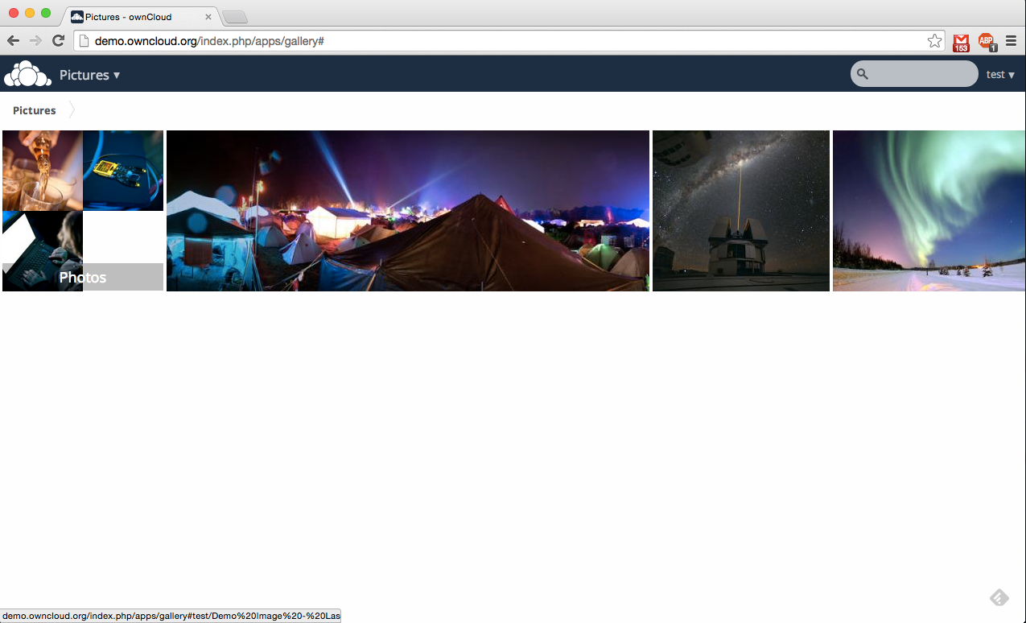
Notes:
Photos overview.

Slide 24
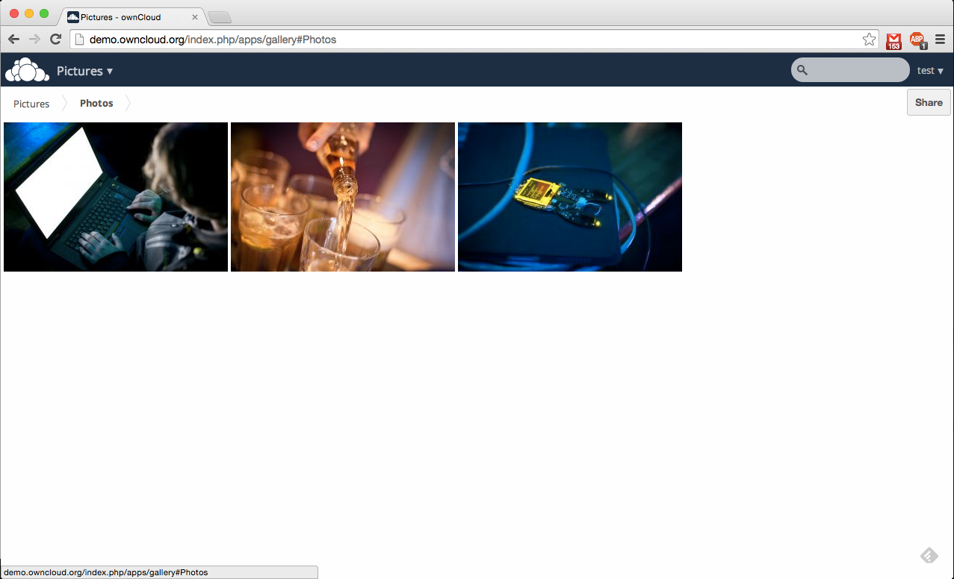
Notes:
Photos can be grouped in a folder.

Slide 25
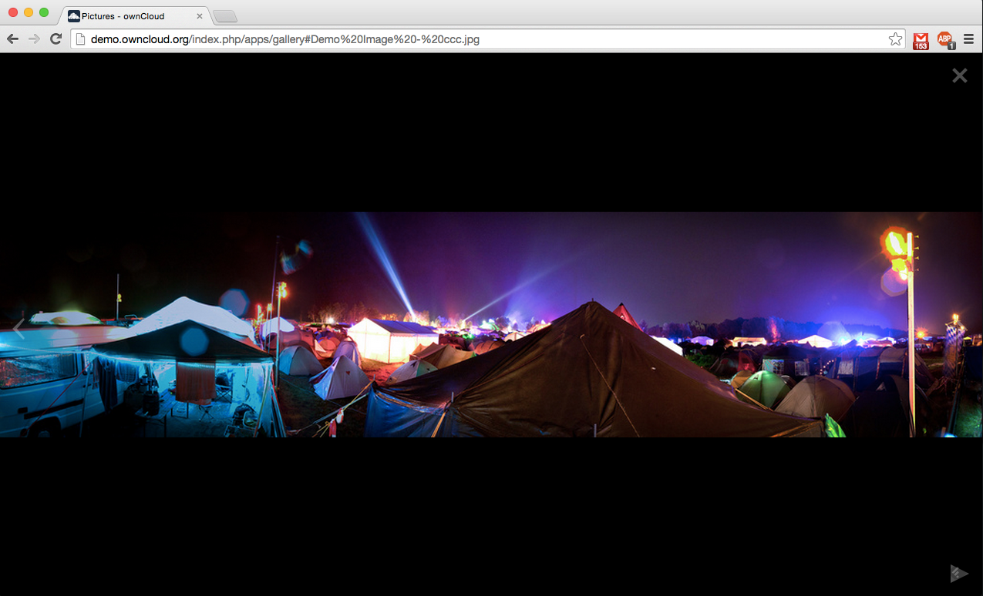
Notes:
Photo preview.

Slide 26
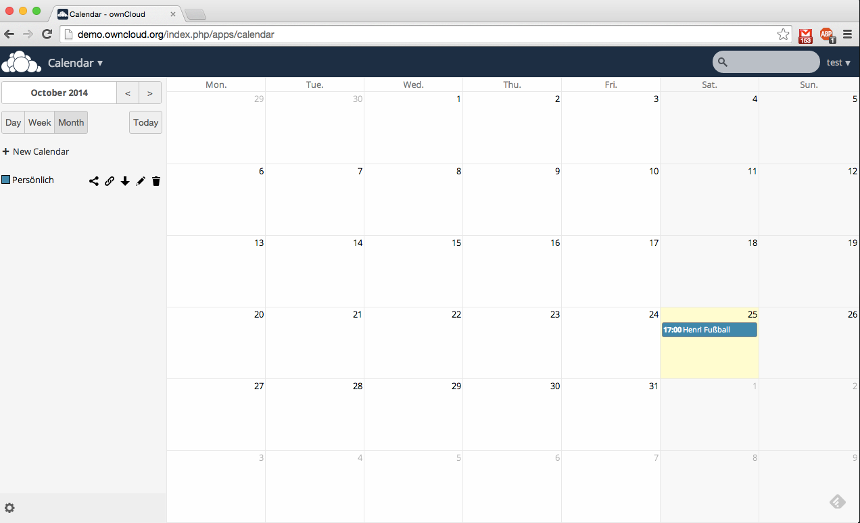
Notes:
Calendar

Slide 27
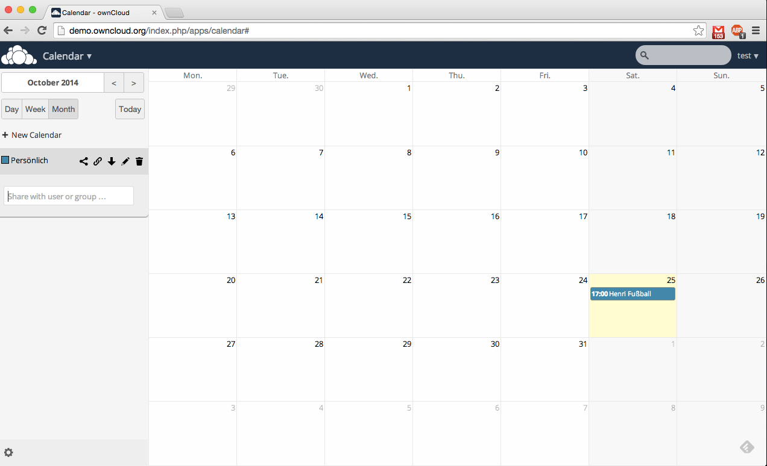
Notes:
Share the calendar with the group.

Slide 28
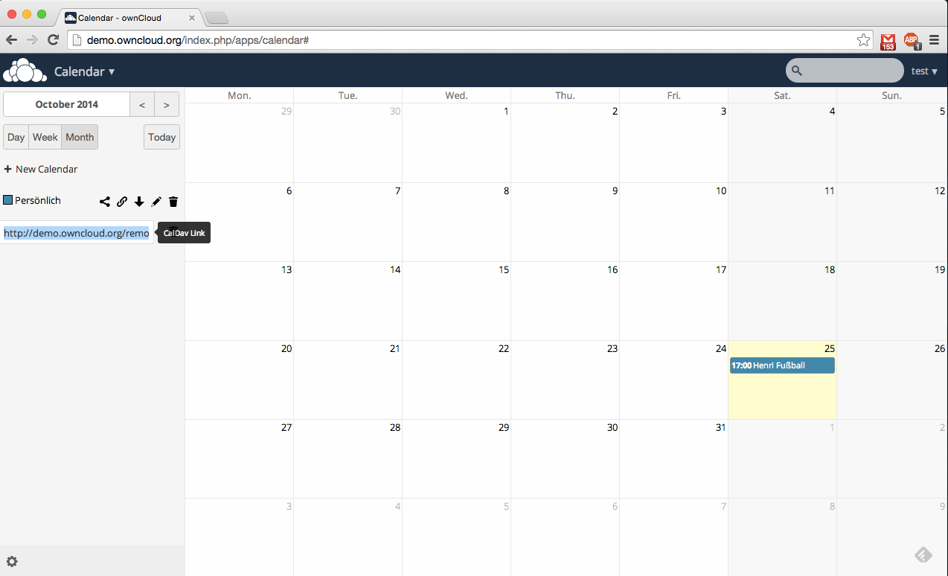

Notes:
Use the calendar with CalDAV or save an ics file.

Slide 29
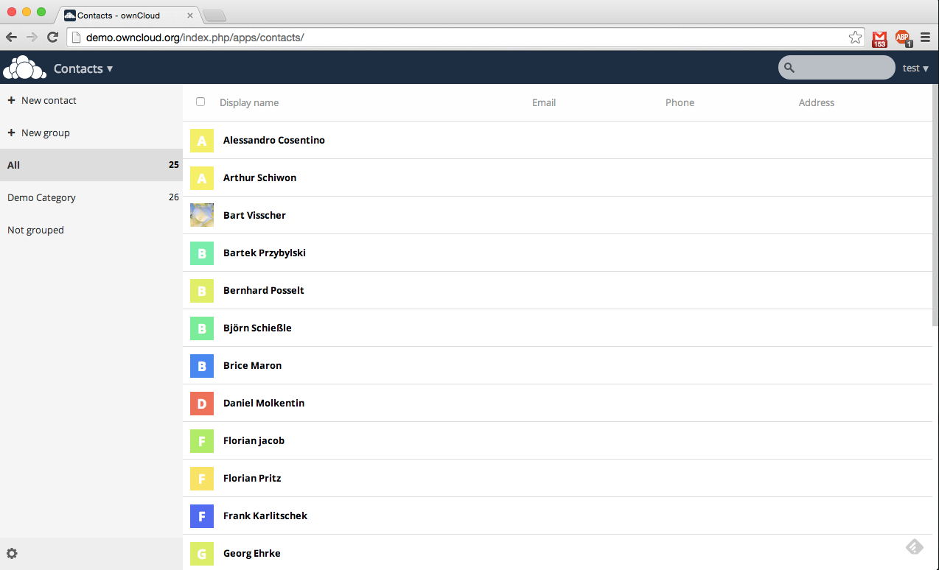
Notes:
Contacts

Slide 30
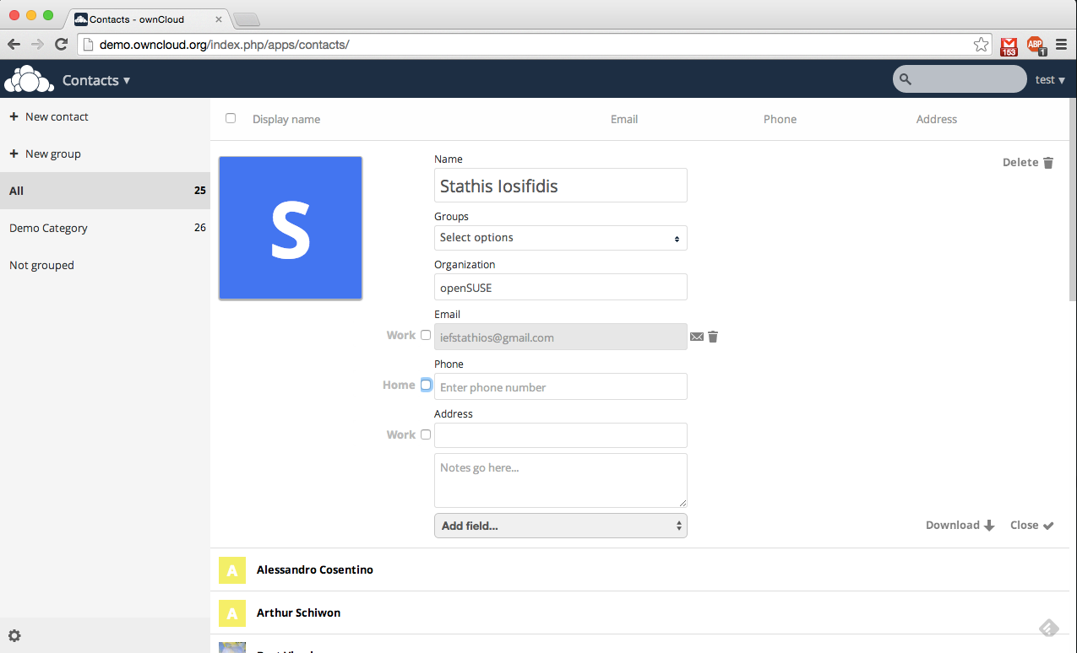
Notes:
Create a new contact

Slide 31
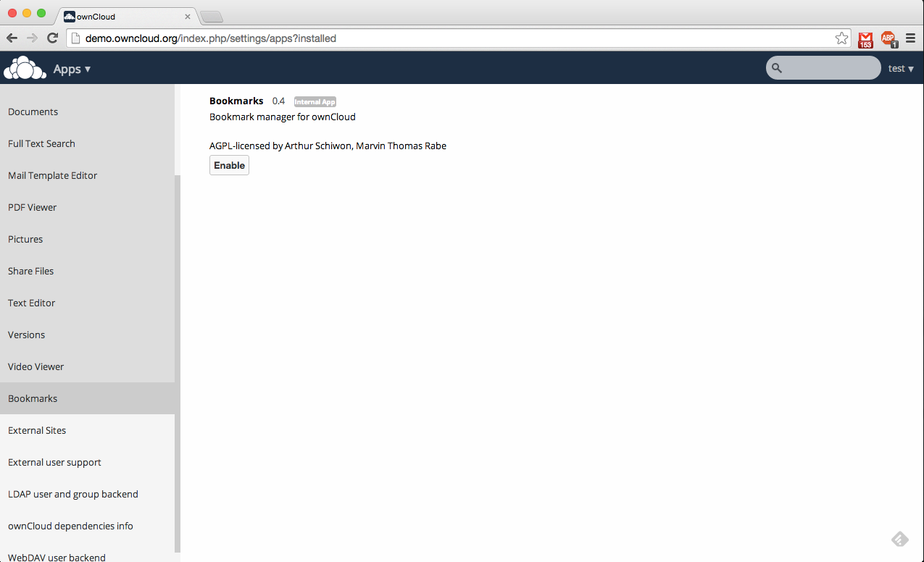
Notes:
Enable new applications

Slide 32
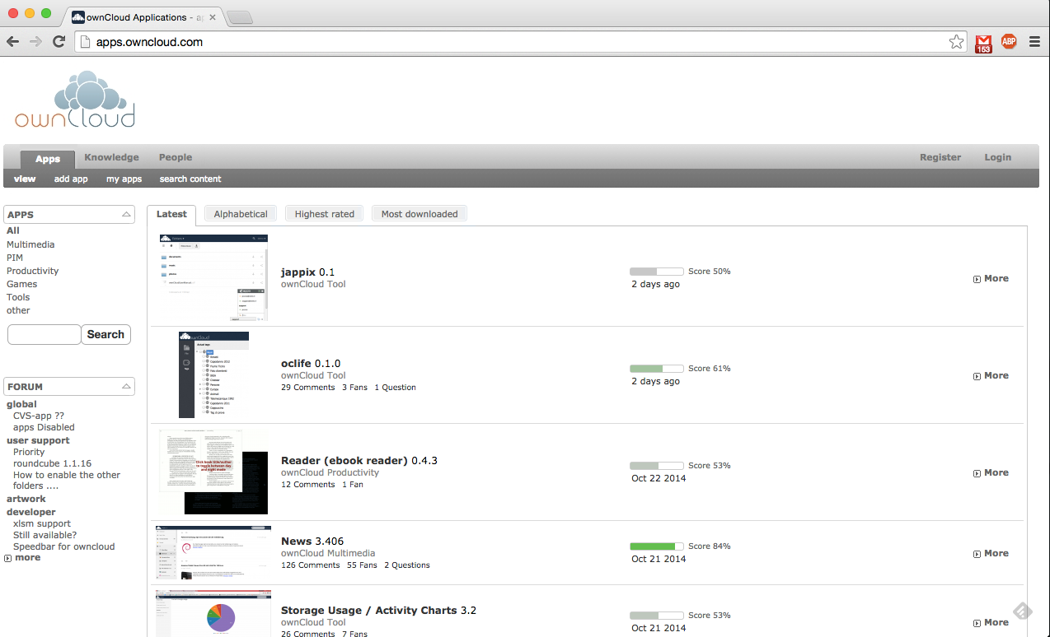
Notes:
Application site

Slide 33
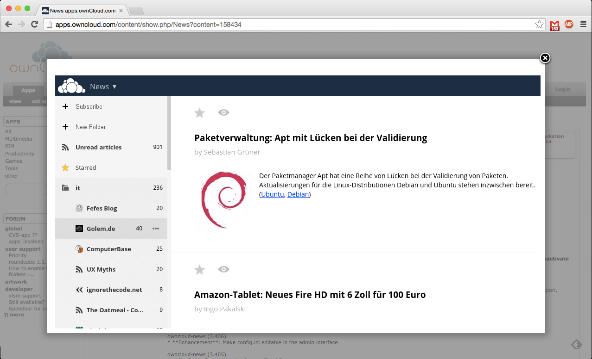
Notes:
Application example: NEWS

Slide 34
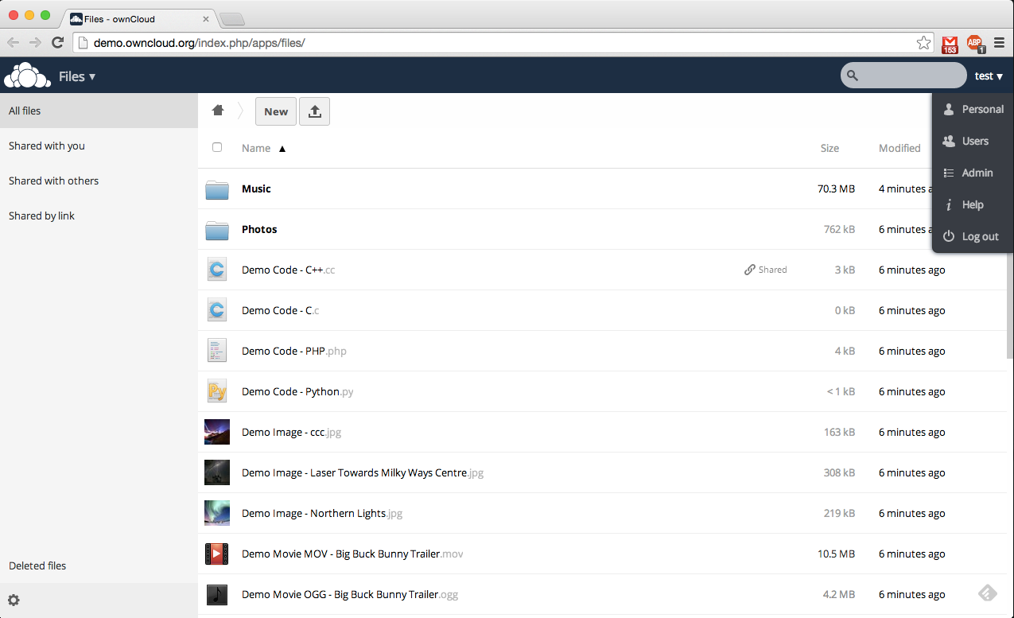
Notes:
Right menu
Personal, Users, Admin, Help

Slide 35
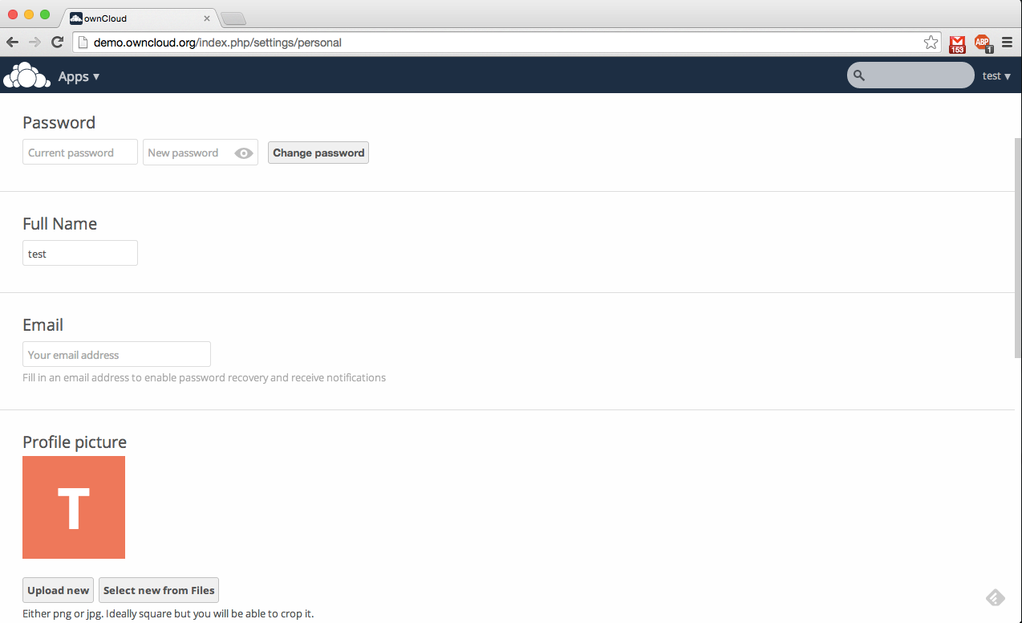
Notes:
Change your personal info

Slide 36
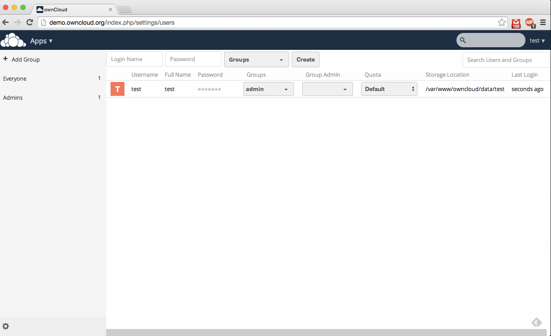
Notes:
Add more users.
Group them together.

Slide 37
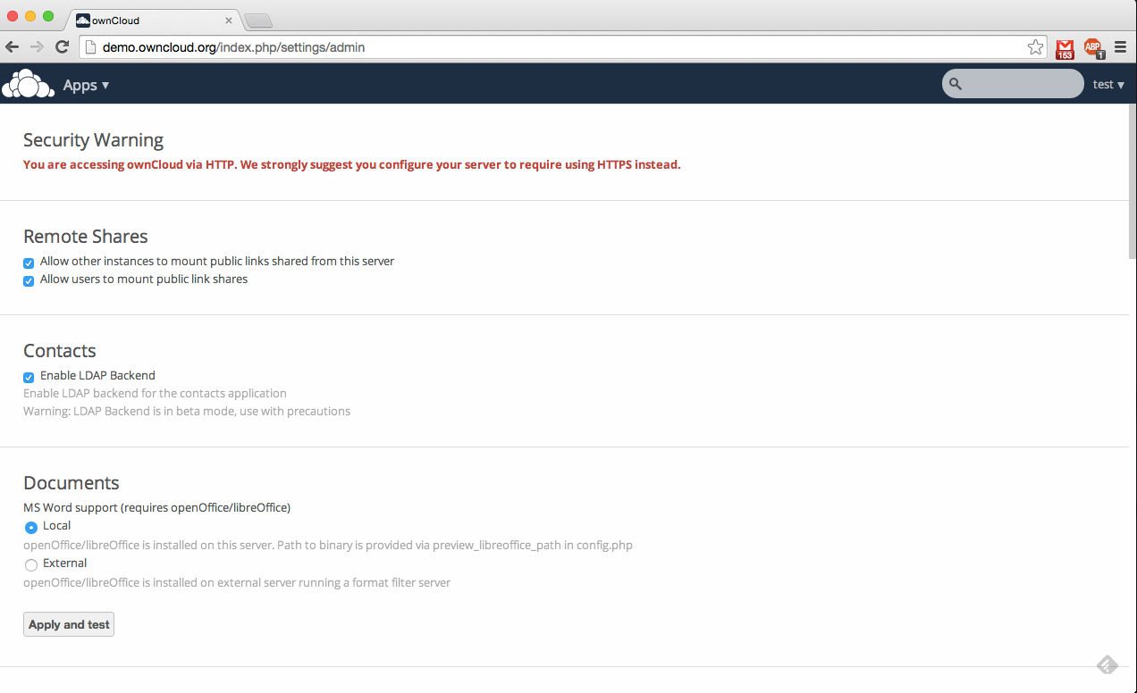
Notes:
Check-change settings. Administrator panel.

Slide 38
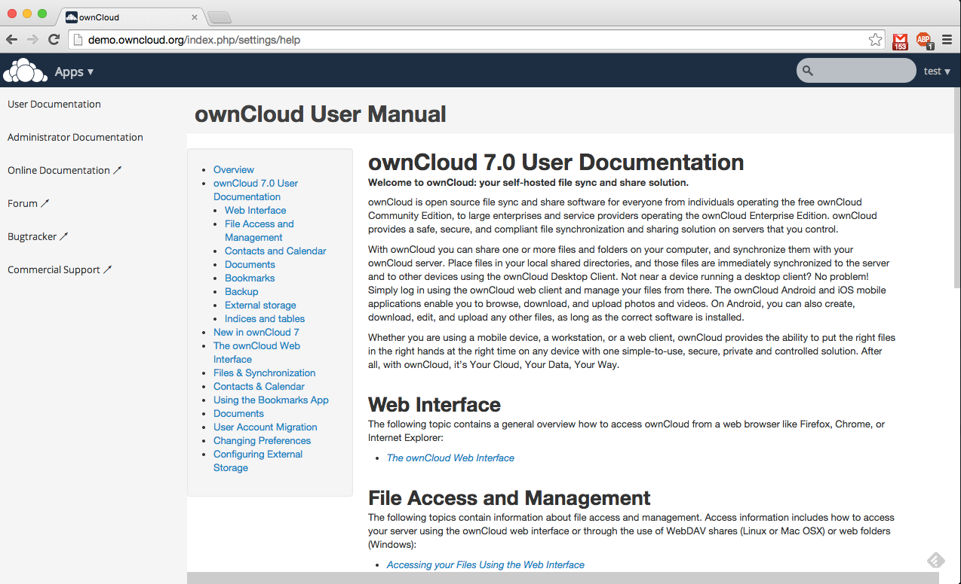
Notes:
Documentation. How to use ownCloud

Slide 39
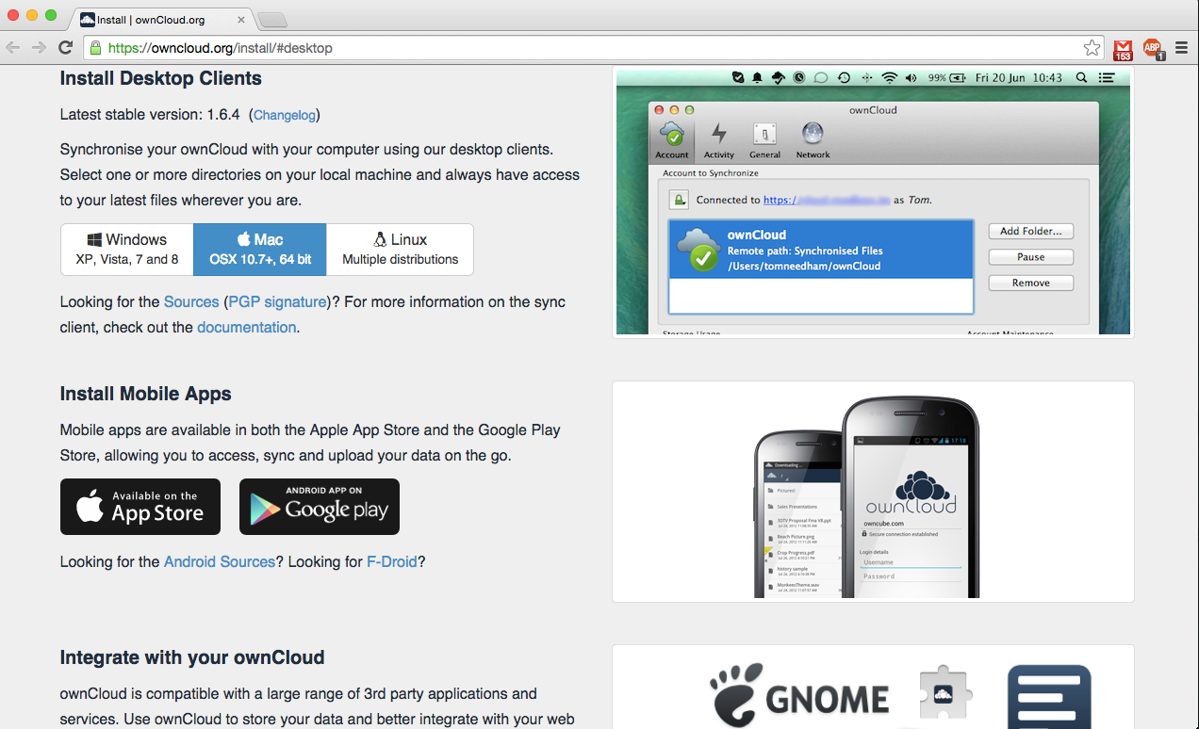
Notes:
Desktop-mobile clients

Slide 40
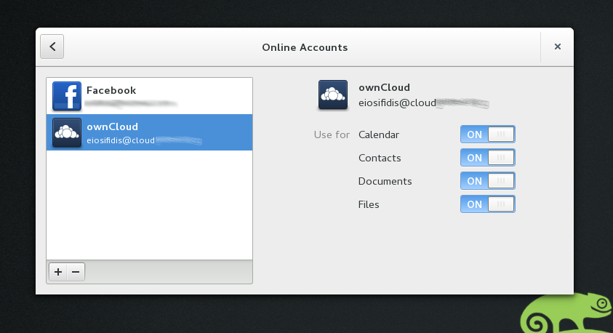
Notes:
Add your account to GNOME online accounts

Slide 41
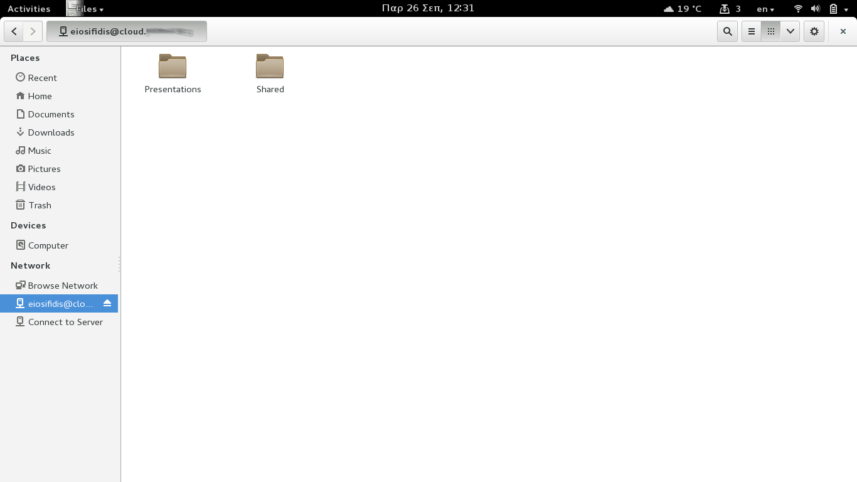
Notes:
You can have access through nautilus (files).

Slide 42
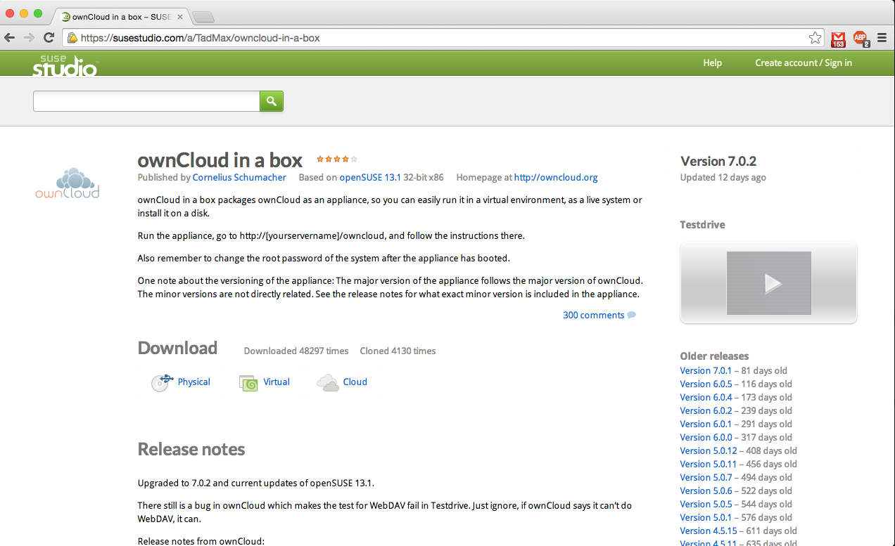
Notes:
If you like it and you're bored to setup, there's a ready ISO. ownCloud in a box.

Slide 43
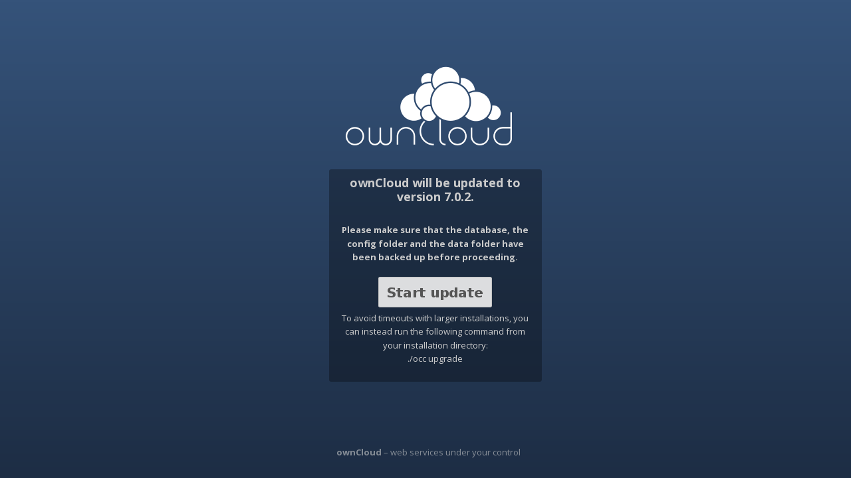
Upgrade

Slide 44
Community ownClouders
Facebook: https://www.facebook.com/ownClouders
Google Plus: (http://goo.gl/rqn38m) https://plus.google.com/107072838776436530705
Twitter: @ownclouders
Mail: https://mailman.owncloud.org/mailman/listinfo
IRC: #owncloud @freenode http://webchat.freenode.net/?channels=owncloud
Events: https://owncloud.org/events/
Translation: https://www.transifex.com/projects/p/owncloud/
Notes:
Where you can find us.

Slide 45
Thank you

