Slide 1
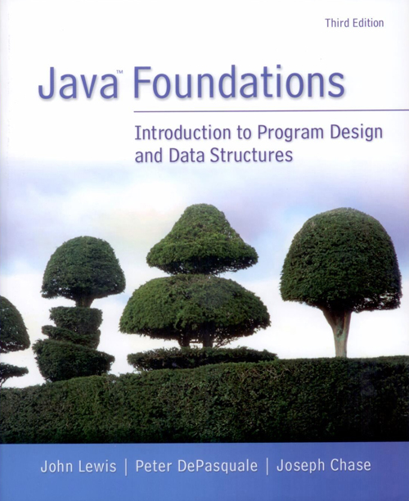
Chapter 5
Writing Classes

Slide 2
Chapter Scope
Identifying classes and objects
Structure and content of classes
Instance data
Visibility modifiers
Method structure
Constructors
Relationships among classes
Static methods and data

Slide 3
Classes and Objects Revisited
The programs we’ve written in previous examples have used classes defined in the Java API
Now we will begin to design programs that rely on classes that we write ourselves
The class that contains the main method is just the starting point of a program
True object-oriented programming is based on defining classes that represent objects with well-defined characteristics and functionality

Slide 4
Classes and Objects
Recall that an object has state, defined by the values of its attributes
The attributes are defined by the data associated with the object's class
An object also has behaviors, defined by the operations associated with it
Operations are defined by the methods of the class

Slide 5
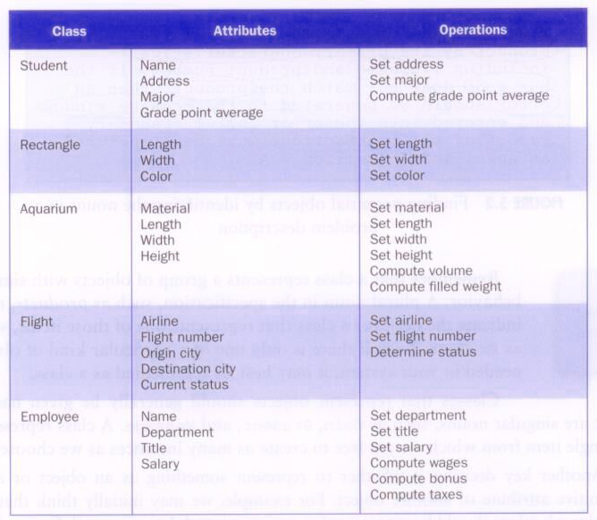
Classes and Objects

Slide 6
Identifying Classes and Objects
A class represents a group (classification) of objects with the same behaviors
Generally, classes that represent objects should be given names that are singular nouns
Examples: Coin, Student, Message
A class represents the concept of one such object
We are free to instantiate as many of each object as needed

Slide 7
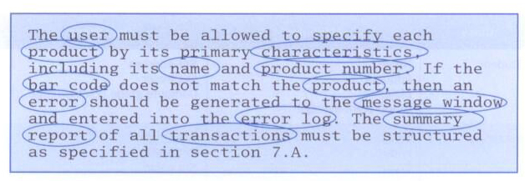
Identifying Classes and Objects
One way to find potential objects is by identifying the nouns in a problem description:

Slide 8
Identifying Classes and Objects
Sometimes it is challenging to decide whether something should be represented as a class
For example, should an employee's address be represented as a set of variables or as an Address object
The more you examine the problem and its details the more clear these issues become
When a class becomes too complex, it often should be decomposed into multiple smaller classes to distribute the responsibilities

Slide 9
Identifying Classes and Objects
We want to define classes with the proper amount of detail
For example, it may be unnecessary to create separate classes for each type of appliance in a house
It may be sufficient to define a more general Appliance class with appropriate instance data
It all depends on the details of the problem being solved

Slide 10
Identifying Classes and Objects
Part of identifying the classes we need is the process of assigning responsibilities to each class
Every activity that a program must accomplish must be represented by one or more methods in one or more classes
We generally use verbs for the names of methods
In early stages it is not necessary to determine every method of every class – begin with primary responsibilities and evolve the design

Slide 11
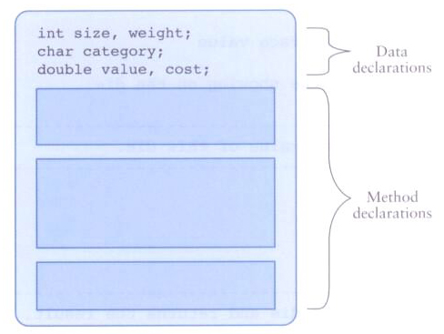
Anatomy of a Class
A class contains data declarations and method declarations

Slide 12
Anatomy of a Class
Consider a six-sided die (singular of dice)
It’s state can be defined as which face is showing
It’s primary behavior is that it can be rolled
We can represent a die in software by designing a class called Die that models this state and behavior
We’ll want to design it so that it's a versatile and reusable resource
Any given program will not necessarily use all aspects of a given class

Slide 13
//********************************************************************
// SnakeEyes.java Java Foundations
//
// Demonstrates the use of a programmer-defined class.
//********************************************************************
public class SnakeEyes
{
//-----------------------------------------------------------------
// Creates two Die objects and rolls them several times, counting
// the number of snake eyes that occur.
//-----------------------------------------------------------------
public static void main(String[] args)
{
final int ROLLS = 500;
int num1, num2, count = 0;
Die die1 = new Die();
Die die2 = new Die();
for (int roll=1; roll <= ROLLS; roll++)
{
num1 = die1.roll();
num2 = die2.roll();
if (num1 == 1 && num2 == 1) // check for snake eyes
count++;
}

Slide 14
System.out.println("Number of rolls: " + ROLLS);
System.out.println("Number of snake eyes: " + count);
System.out.println("Ratio: " + (float)count / ROLLS);
}
}

Slide 15
//********************************************************************
// Die.java Java Foundations
//
// Represents one die (singular of dice) with faces showing values
// between 1 and 6.
//********************************************************************
public class Die
{
private final int MAX = 6; // maximum face value
private int faceValue; // current value showing on the die
//-----------------------------------------------------------------
// Constructor: Sets the initial face value of this die.
//-----------------------------------------------------------------
public Die()
{
faceValue = 1;
}
//-----------------------------------------------------------------
// Computes a new face value for this die and returns the result.
//-----------------------------------------------------------------
public int roll()
{
faceValue = (int)(Math.random() * MAX) + 1;
return faceValue;
}

Slide 16
//-----------------------------------------------------------------
// Face value mutator. The face value is not modified if the
// specified value is not valid.
//-----------------------------------------------------------------
public void setFaceValue(int value)
{
if (value > 0 && value <= MAX)
faceValue = value;
}
//-----------------------------------------------------------------
// Face value accessor.
//-----------------------------------------------------------------
public int getFaceValue()
{
return faceValue;
}
//-----------------------------------------------------------------
// Returns a string representation of this die.
//-----------------------------------------------------------------
public String toString()
{
String result = Integer.toString(faceValue);
return result;
}
}

Slide 17
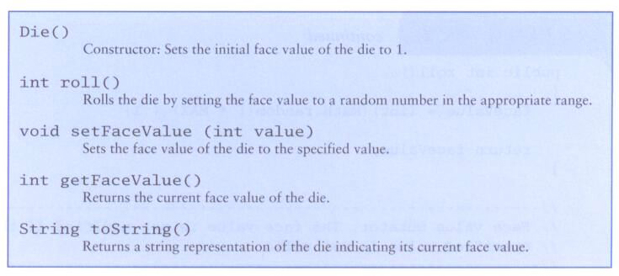
Anatomy of a Class
The primary difference between the Die class and other classes you've used is that the Die class is not part of the Java API

Slide 18
The toString Method
Most classes should define a toString method
The toString method returns a character string that represents the object in some way
It is called automatically when an object is concatenated to a string or when it is printed using the println method

Slide 19
Constructors
As mentioned previously, a constructor is a special method that is used to set up an object when it is initially created
A constructor has the same name as the class
The Die constructor is used to set the initial face value of each new die object to one
We examine constructors in more detail later in this chapter

Slide 20
Data Scope
The scope of data is the area in a program in which that data can be referenced (used)
Data declared at the class level can be referenced by all methods in that class
Data declared within a method can be used only in that method
Data declared within a method is called local data
In the Die class, the variable result is declared inside the toString method -- it is local to that method and cannot be referenced anywhere else

Slide 21
Instance Data
The faceValue variable in the Die class is called instance data because each instance (object) that is created has its own version of it
A class declares the type of the data, but it does not reserve any memory space for it
Every time a Die object is created, a new faceValue variable is created as well
The objects of a class share the method definitions, but each object has its own data space
That's the only way two objects can have different states

Slide 22
Instance Data
We can depict the two Die objects from the SnakeEyes program as follows:
Each object maintains its own faceValue variable, and thus its own state
die1
faceValue
5
die2
faceValue
2

Slide 23
UML Diagrams
UML stands for the Unified Modeling Language
UML diagrams show relationships among classes and objects
A UML class diagram consists of one or more classes, each with sections for the class name, attributes (data), and operations (methods)
Lines between classes represent associations
A solid arrow shows that one class uses the other (calls its methods)

Slide 24
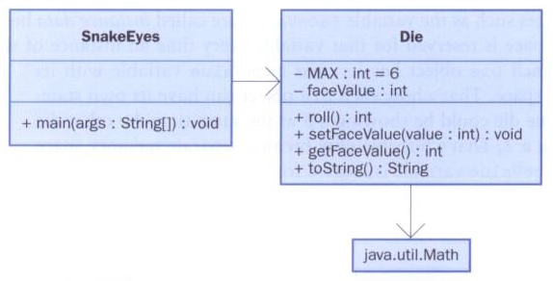
UML Diagrams
A UML class diagram showing the classes involved in the SnakeEyes program:

Slide 25
Encapsulation
We can take one of two views of an object
internal - the details of the variables and methods of the class that defines it
external - the services that an object provides and how the object interacts with the rest of the system
From the external view, an object is an encapsulated entity, providing a set of specific services
These services define the interface to the object

Slide 26
Encapsulation
One object (called the client) may use another object for the services it provides
The client of an object may request its services (call its methods), but it should not have to be aware of how those services are accomplished
Any changes to an object's state (its variables) should be made by that object's methods
We should make it difficult, if not impossible, for a client to access an object’s variables directly
That is, an object should be self-governing

Slide 27
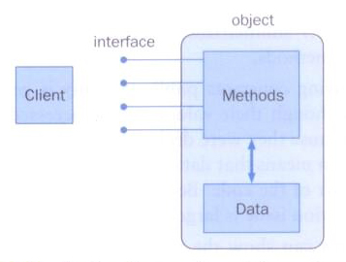
Encapsulation
An encapsulated object can be thought of as a black box – its inner workings are hidden from the client
The client invokes the interface methods of the object, which manages the instance data

Slide 28
Visibility Modifiers
In Java, we accomplish encapsulation through the appropriate use of visibility modifiers
A modifier is a Java reserved word that specifies particular characteristics of a method or data
We've used the final modifier to define constants
Java has three visibility modifiers: public, protected, and private
The protected modifier involves inheritance, which we will discuss later

Slide 29
Visibility Modifiers
Members of a class that are declared with public visibility can be referenced anywhere
Members of a class that are declared with private visibility can be referenced only within that class
Members declared without a visibility modifier have default visibility and can be referenced by any class in the same package
An overview of all Java modifiers is presented in Appendix E

Slide 30
Visibility Modifiers
Public variables violate encapsulation because they allow the client to “reach in” and modify the values directly
Therefore instance variables should not be declared with public visibility
It is acceptable to give a constant public visibility, which allows it to be used outside of the class
Public constants do not violate encapsulation because, although the client can access it, its value cannot be changed
Notes:
Encapsulation does not include being able to access the information, but being able to mutate it.

Slide 31
Visibility Modifiers
Methods that provide the object's services are declared with public visibility so that they can be invoked by clients
Public methods are also called service methods
A method created simply to assist a service method is called a support method
Since a support method is not intended to be called by a client, it should not be declared with public visibility
Notes:
Methods in an Object class should be set to private so that they can be invoked through main.

Slide 32
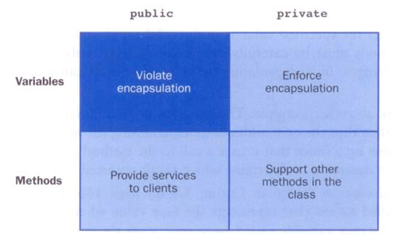
Visibility Modifiers

Slide 33
Accessors and Mutators
Because instance data is private, a class usually provides services to access and modify data values
An accessor method returns the current value of a variable
A mutator method changes the value of a variable
The names of accessor and mutator methods take the form getX and setX, respectively, where X is the name of the value

Slide 34
Accessors and Mutators
They are sometimes called “getters” and “setters”
In the Coin class
The isHeads method is an accessor
The flip method is a mutator
The Coin class is used in two different examples: CountFlips and FlipRace

Slide 35
//********************************************************************
// CountFlips.java Java Foundations
//
// Demonstrates the use of programmer-defined class.
//********************************************************************
public class CountFlips
{
//-----------------------------------------------------------------
// Flips a coin multiple times and counts the number of heads
// and tails that result.
//-----------------------------------------------------------------
public static void main(String[] args)
{
final int FLIPS = 1000;
int heads = 0, tails = 0;
Coin myCoin = new Coin();
for (int count=1; count <= FLIPS; count++)
{
myCoin.flip();
if (myCoin.isHeads())
heads++;
else
tails++;
}

Slide 36
System.out.println("Number of flips: " + FLIPS);
System.out.println("Number of heads: " + heads);
System.out.println("Number of tails: " + tails);
}
}

Slide 37
//********************************************************************
// Coin.java Java Foundations
//
// Represents a coin with two sides that can be flipped.
//********************************************************************
public class Coin
{
private final int HEADS = 0; // tails is 1
private int face; // current side showing
//-----------------------------------------------------------------
// Sets up this coin by flipping it initially.
//-----------------------------------------------------------------
public Coin()
{
flip();
}
//-----------------------------------------------------------------
// Flips this coin by randomly choosing a face value.
//-----------------------------------------------------------------
public void flip()
{
face = (int) (Math.random() * 2);
}

Slide 38
//-----------------------------------------------------------------
// Returns true if the current face of this coin is heads.
//-----------------------------------------------------------------
public boolean isHeads()
{
return (face == HEADS);
}
//-----------------------------------------------------------------
// Returns the current face of this coin as a string.
//-----------------------------------------------------------------
public String toString()
{
return (face == HEADS) ? "Heads" : "Tails";
}
}

Slide 39
//********************************************************************
// FlipRace.java Java Foundations
//
// Demonstrates the reuse of programmer-defined class.
//********************************************************************
public class FlipRace
{
//-----------------------------------------------------------------
// Flips two coins until one of them comes up heads three times
// in a row.
//-----------------------------------------------------------------
public static void main(String[] args)
{
final int GOAL = 3;
int count1 = 0, count2 = 0;
Coin coin1 = new Coin(), coin2 = new Coin();
while (count1 < GOAL && count2 < GOAL)
{
coin1.flip();
coin2.flip();
System.out.println ("Coin 1: " + coin1 + "\tCoin 2: " + coin2);
// Increment or reset the counters
count1 = (coin1.isHeads()) ? count1+1 : 0;
count2 = (coin2.isHeads()) ? count2+1 : 0;
}

Slide 40
if (count1 < GOAL)
System.out.println("Coin 2 Wins!");
else
if (count2 < GOAL)
System.out.println("Coin 1 Wins!");
else
System.out.println("It's a TIE!");
}
}

Slide 41
Method Declarations
Let’s now examine method declarations in more detail
A method declaration specifies the code that will be executed when the method is invoked (called)
When a method is invoked, the flow of control jumps to the method and executes its code
When complete, the flow returns to the place where the method was called and continues
The invocation may or may not return a value, depending on how the method is defined

Slide 42
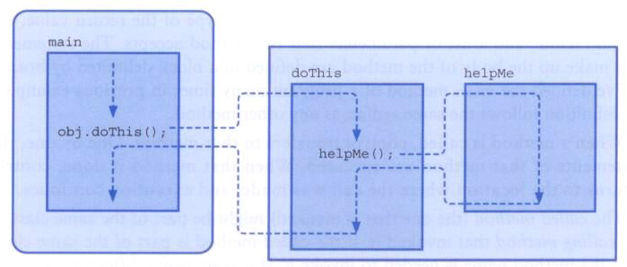
Methods
The flow of control through methods:

Slide 43
Method Header
A method declaration begins with a method header
char calc (int num1, int num2, String message)
method
name
parameter list
return
type
The parameter list specifies the type
and name of each parameter
The name of a parameter in the method
declaration is called a formal parameter

Slide 44
Method Body
The method header is followed by the method body
char calc (int num1, int num2, String message)
{
int sum = num1 + num2;
char result = message.charAt (sum);
return result;
}
sum and result
are local data
They are created each time the method is called, and are destroyed when it finishes executing
The return expression
must be consistent with
the return type

Slide 45
The return Statement
The return type of a method indicates the type of value that the method sends back to the caller
A method that does not return a value has a void return type
A return statement specifies the value that will be returned
return expression;
Its expression must conform to the return type

Slide 46
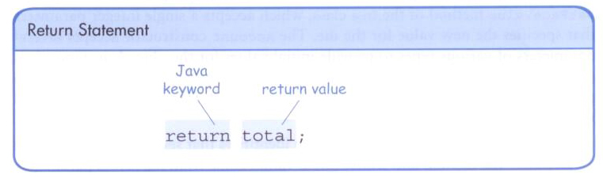
The return Statement

Slide 47
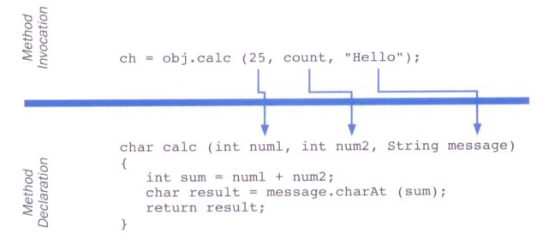
Parameters
When a method is called, the actual parameters in the invocation are copied into the formal parameters in the method header

Slide 48
Local Data
As we’ve seen, local variables can be declared inside a method
The formal parameters of a method become automatic local variables in the method
When the method finishes, all local variables are destroyed (including the formal parameters)
Keep in mind that instance variables, declared at the class level, exists as long as the object exists

Slide 49
Bank Account Example
Let’s look at another example that demonstrates the implementation details of classes and methods
We’ll represent a bank account by a class named Account
It’s state can include the account number, the current balance, and the name of the owner
An account’s behaviors (or services) include deposits and withdrawals, and adding interest

Slide 50
Driver Programs
A driver program drives the use of other, more interesting parts of a program
Driver programs are often used to test other parts of the software
The Transactions class contains a main method that drives the use of the Account class, exercising its services

Slide 51
//********************************************************************
// Transactions.java Java Foundations
//
// Demonstrates the creation and use of multiple Account objects.
//********************************************************************
public class Transactions
{
//-----------------------------------------------------------------
// Creates some bank accounts and requests various services.
//-----------------------------------------------------------------
public static void main(String[] args)
{
Account acct1 = new Account("Ted Murphy", 72354, 25.59);
Account acct2 = new Account("Angelica Adams", 69713, 500.00);
Account acct3 = new Account("Edward Demsey", 93757, 769.32);
acct1.deposit(44.10); // return value ignored
double adamsBalance = acct2.deposit(75.25);
System.out.println("Adams balance after deposit: " +
adamsBalance);
System.out.println("Adams balance after withdrawal: " +
acct2.withdraw (480, 1.50));

Slide 52
acct3.withdraw(-100.00, 1.50); // invalid transaction
acct1.addInterest();
acct2.addInterest();
acct3.addInterest();
System.out.println();
System.out.println(acct1);
System.out.println(acct2);
System.out.println(acct3);
}
}

Slide 53
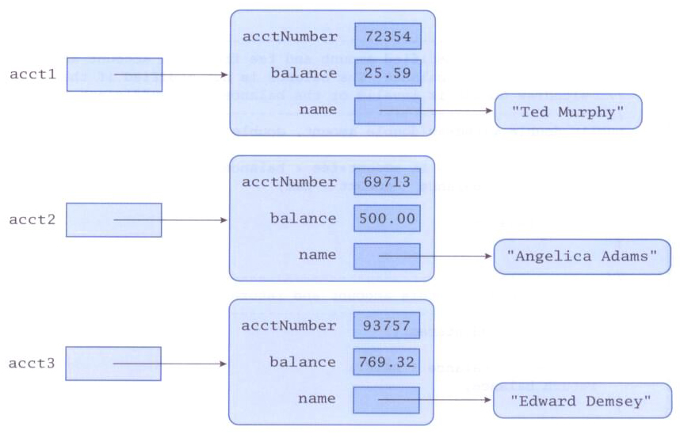
Bank Account Example
The objects just after creation could be depicted as follows:

Slide 54
//********************************************************************
// Account.java Java Foundations
//
// Represents a bank account with basic services such as deposit
// and withdraw.
//********************************************************************
import java.text.NumberFormat;
public class Account
{
private final double RATE = 0.035; // interest rate of 3.5%
private String name;
private long acctNumber;
private double balance;
//-----------------------------------------------------------------
// Sets up this account with the specified owner, account number,
// and initial balance.
//-----------------------------------------------------------------
public Account(String owner, long account, double initial)
{
name = owner;
acctNumber = account;
balance = initial;
}

Slide 55
//-----------------------------------------------------------------
// Deposits the specified amount into this account and returns
// the new balance. The balance is not modified if the deposit
// amount is invalid.
//-----------------------------------------------------------------
public double deposit(double amount)
{
if (amount > 0)
balance = balance + amount;
return balance;
}
//-----------------------------------------------------------------
// Withdraws the specified amount and fee from this account and
// returns the new balance. The balance is not modified if the
// withdraw amount is invalid or the balance is insufficient.
//-----------------------------------------------------------------
public double withdraw(double amount, double fee)
{
if (amount+fee > 0 && amount+fee < balance)
balance = balance - amount - fee;
return balance;
}

Slide 56
//-----------------------------------------------------------------
// Adds interest to this account and returns the new balance.
//-----------------------------------------------------------------
public double addInterest()
{
balance += (balance * RATE);
return balance;
}
//-----------------------------------------------------------------
// Returns the current balance of this account.
//-----------------------------------------------------------------
public double getBalance()
{
return balance;
}
//-----------------------------------------------------------------
// Returns a one-line description of this account as a string.
//-----------------------------------------------------------------
public String toString()
{
NumberFormat fmt = NumberFormat.getCurrencyInstance();
return (acctNumber + "\t" + name + "\t" + fmt.format(balance));
}
}

Slide 57
Constructors Revisited
Note that a constructor has no return type specified in the method header, not even void
A common error is to put a return type on a constructor, which makes it a “regular” method that happens to have the same name as the class
The programmer does not have to define a constructor for a class
Each class has a default constructor that accepts no parameters

Slide 58
Static Class Members
Recall that a static method is one that can be invoked through its class name
For example, the methods of the Math class are static:
result = Math.sqrt(25)
Variables can be static as well
Determining if a method or variable should be static is an important design decision

Slide 59
The static Modifier
We declare static methods and variables using the static modifier
It associates the method or variable with the class rather than with an object of that class
Static methods are sometimes called class methods and static variables are sometimes called class variables
Let's carefully consider the implications of each

Slide 60
Static Variables
Normally, each object has its own data space, but if a variable is declared as static, only one copy of the variable exists
private static float price;
Memory space for a static variable is created when the class is first referenced
All objects instantiated from the class share its static variables
Changing the value of a static variable in one object changes it for all others

Slide 61
Static Methods
class Helper
{
public static int cube (int num)
{
return num * num * num;
}
}
Because it is declared as static, the method can be invoked as
value = Helper.cube(5);

Slide 62
Static Class Members
The order of the modifiers can be interchanged, but by convention visibility modifiers come first
Recall that the main method is static – it is invoked by the Java interpreter without creating an object
Static methods cannot reference instance variables because instance variables don't exist until an object exists
However, a static method can reference static variables or local variables

Slide 63
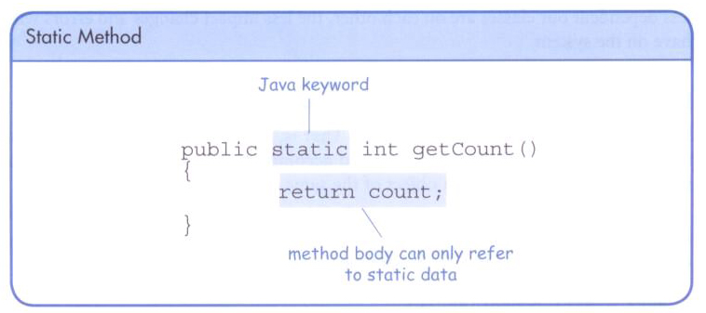
Static Class Members

Slide 64
Static Class Members
Static methods and static variables often work together
The following example keeps track of how many Slogan objects have been created using a static variable, and makes that information available using a static method

Slide 65
//********************************************************************
// SloganCounter.java Java Foundations
//
// Demonstrates the use of the static modifier.
//********************************************************************
public class SloganCounter
{
//-----------------------------------------------------------------
// Creates several Slogan objects and prints the number of
// objects that were created.
//-----------------------------------------------------------------
public static void main(String[] args)
{
Slogan obj;
obj = new Slogan("Remember the Alamo.");
System.out.println(obj);
obj = new Slogan("Don't Worry. Be Happy.");
System.out.println(obj);
obj = new Slogan("Live Free or Die.");
System.out.println(obj);
obj = new Slogan("Talk is Cheap.");
System.out.println(obj);

Slide 66
obj = new Slogan("Write Once, Run Anywhere.");
System.out.println(obj);
System.out.println();
System.out.println("Slogans created: " + Slogan.getCount());
}
}

Slide 67
//********************************************************************
// Slogan.java Java Foundations
//
// Represents a single slogan or motto.
//********************************************************************
public class Slogan
{
private String phrase;
private static int count = 0;
//-----------------------------------------------------------------
// Constructor: Sets up the slogan and increments the number of
// instances created.
//-----------------------------------------------------------------
public Slogan(String str)
{
phrase = str;
count++;
}
//-----------------------------------------------------------------
// Returns this slogan as a string.
//-----------------------------------------------------------------
public String toString()
{
return phrase;
}

Slide 68
//-----------------------------------------------------------------
// Returns the number of instances of this class that have been
// created.
//-----------------------------------------------------------------
public static int getCount()
{
return count;
}
}

Slide 69
Class Relationships
Classes in a software system can have various types of relationships to each other
Three of the most common relationships:
Dependency: A uses B
Aggregation: A has-a B
Inheritance: A is-a B
Let's discuss dependency and aggregation further
Inheritance is discussed in detail in Chapter 8

Slide 70
Dependency
A dependency exists when one class relies on another in some way, usually by invoking the methods of the other
We've seen dependencies in many previous examples
We don't want numerous or complex dependencies among classes
Nor do we want complex classes that don't depend on others
A good design strikes the right balance

Slide 71
Dependency
Some dependencies occur between objects of the same class
A method of the class may accept an object of the same class as a parameter
For example, the concat method of the String class takes as a parameter another String object
str3 = str1.concat(str2);
This drives home the idea that the service is being requested from a particular object

Slide 72
Dependency
The following example defines a class called RationalNumber to represent a rational number
A rational number is a value that can be represented as the ratio of two integers
Some methods of the RationalNumber class accept another RationalNumber object as a parameter

Slide 73
//********************************************************************
// RationalTester.java Java Foundations
//
// Driver to exercise the use of multiple Rational objects.
//********************************************************************
public class RationalTester
{
//-----------------------------------------------------------------
// Creates some rational number objects and performs various
// operations on them.
//-----------------------------------------------------------------
public static void main(String[] args)
{
RationalNumber r1 = new RationalNumber(6, 8);
RationalNumber r2 = new RationalNumber(1, 3);
RationalNumber r3, r4, r5, r6, r7;
System.out.println("First rational number: " + r1);
System.out.println("Second rational number: " + r2);
if (r1.isLike(r2))
System.out.println("r1 and r2 are equal.");
else
System.out.println("r1 and r2 are NOT equal.");

Slide 74
r3 = r1.reciprocal();
System.out.println("The reciprocal of r1 is: " + r3);
r4 = r1.add(r2);
r5 = r1.subtract(r2);
r6 = r1.multiply(r2);
r7 = r1.divide(r2);
System.out.println("r1 + r2: " + r4);
System.out.println("r1 - r2: " + r5);
System.out.println("r1 * r2: " + r6);
System.out.println("r1 / r2: " + r7);
}
}

Slide 75
//********************************************************************
// RationalNumber.java Java Foundations
//
// Represents one rational number with a numerator and denominator.
//********************************************************************
public class RationalNumber
{
private int numerator, denominator;
//-----------------------------------------------------------------
// Constructor: Sets up the rational number by ensuring a nonzero
// denominator and making only the numerator signed.
//-----------------------------------------------------------------
public RationalNumber(int numer, int denom)
{
if (denom == 0)
denom = 1;
// Make the numerator "store" the sign
if (denom < 0)
{
numer = numer * -1;
denom = denom * -1;
}
numerator = numer;
denominator = denom;
reduce();
}

Slide 76
//-----------------------------------------------------------------
// Returns the numerator of this rational number.
//-----------------------------------------------------------------
public int getNumerator()
{
return numerator;
}
//-----------------------------------------------------------------
// Returns the denominator of this rational number.
//-----------------------------------------------------------------
public int getDenominator()
{
return denominator;
}
//-----------------------------------------------------------------
// Returns the reciprocal of this rational number.
//-----------------------------------------------------------------
public RationalNumber reciprocal()
{
return new RationalNumber(denominator, numerator);
}

Slide 77
//-----------------------------------------------------------------
// Adds this rational number to the one passed as a parameter.
// A common denominator is found by multiplying the individual
// denominators.
//-----------------------------------------------------------------
public RationalNumber add(RationalNumber op2)
{
int commonDenominator = denominator * op2.getDenominator();
int numerator1 = numerator * op2.getDenominator();
int numerator2 = op2.getNumerator() * denominator;
int sum = numerator1 + numerator2;
return new RationalNumber(sum, commonDenominator);
}
//-----------------------------------------------------------------
// Subtracts the rational number passed as a parameter from this
// rational number.
//-----------------------------------------------------------------
public RationalNumber subtract(RationalNumber op2)
{
int commonDenominator = denominator * op2.getDenominator();
int numerator1 = numerator * op2.getDenominator();
int numerator2 = op2.getNumerator() * denominator;
int difference = numerator1 - numerator2;
return new RationalNumber(difference, commonDenominator);
}

Slide 78
//-----------------------------------------------------------------
// Multiplies this rational number by the one passed as a
// parameter.
//-----------------------------------------------------------------
public RationalNumber multiply(RationalNumber op2)
{
int numer = numerator * op2.getNumerator();
int denom = denominator * op2.getDenominator();
return new RationalNumber(numer, denom);
}
//-----------------------------------------------------------------
// Divides this rational number by the one passed as a parameter
// by multiplying by the reciprocal of the second rational.
//-----------------------------------------------------------------
public RationalNumber divide (RationalNumber op2)
{
return multiply(op2.reciprocal());
}
//-----------------------------------------------------------------
// Determines if this rational number is equal to the one passed
// as a parameter. Assumes they are both reduced.
//-----------------------------------------------------------------
public boolean isLike(RationalNumber op2)
{
return ( numerator == op2.getNumerator() &&
denominator == op2.getDenominator() );
}

Slide 79
//-----------------------------------------------------------------
// Returns this rational number as a string.
//-----------------------------------------------------------------
public String toString()
{
String result;
if (numerator == 0)
result = "0";
else
if (denominator == 1)
result = numerator + "";
else
result = numerator + "/" + denominator;
return result;
}

Slide 80
//-----------------------------------------------------------------
// Reduces this rational number by dividing both the numerator
// and the denominator by their greatest common divisor.
//-----------------------------------------------------------------
private void reduce()
{
if (numerator != 0)
{
int common = gcd(Math.abs(numerator), denominator);
numerator = numerator / common;
denominator = denominator / common;
}
}
//-----------------------------------------------------------------
// Computes and returns the greatest common divisor of the two
// positive parameters. Uses Euclid's algorithm.
//-----------------------------------------------------------------
private int gcd(int num1, int num2)
{
while (num1 != num2)
if (num1 > num2)
num1 = num1 - num2;
else
num2 = num2 - num1;
return num1;
}
}

Slide 81
Aggregation
An aggregate is an object that is made up of other objects
Therefore aggregation is a has-a relationship
A car has a chassis
In software, an aggregate object contains references to other objects as instance data
The aggregate object is defined in part by the objects that make it up
This is a special kind of dependency – the aggregate usually relies on the objects that compose it

Slide 82
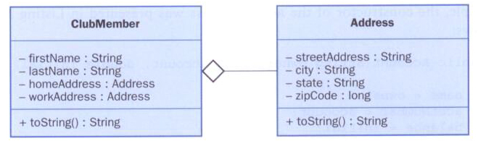
Aggregation in UML

Slide 83
The this Reference
The this reference allows an object to refer to itself
That is, the this reference, used inside a method, refers to the object through which the method is being executed
Suppose the this reference is used in a method called tryMe, which is invoked as follows:
obj1.tryMe();
obj2.tryMe();
In the first invocation, the this reference refers to obj1; in the second it refers to obj2

Slide 84
The this reference
The this reference can be used to distinguish the instance variables of a class from corresponding method parameters with the same names
The constructor of the Account class could have been written as follows:
public Account (String name, long acctNumber,
double balance)
{
this.name = name;
this.acctNumber = acctNumber;
this.balance = balance;
}

Slide 85
Method Design
As we've discussed, high-level design issues include:
identifying primary classes and objects
assigning primary responsibilities
After establishing high-level design issues, its important to address low-level issues such as the design of key methods
For some methods, careful planning is needed to make sure they contribute to an efficient and elegant system design

Slide 86
Method Design
An algorithm is a step-by-step process for solving a problem
Examples: a recipe, travel directions
Every method implements an algorithm that determines how the method accomplishes its goals
An algorithm may be expressed in pseudocode, a mixture of code statements and English that communicate the steps to take

Slide 87
Method Decomposition
A method should be relatively small, so that it can be understood as a single entity
A potentially large method should be decomposed into several smaller methods as needed for clarity
A public service method of an object may call one or more private support methods to help it accomplish its goal
Support methods might call other support methods if appropriate

Slide 88
Method Decomposition
Let's look at an example that requires method decomposition – translating English into Pig Latin
Pig Latin is a language in which each word is modified by moving the initial sound of the word to the end and adding "ay"
Words that begin with vowels have the "yay" sound added on the end
book
ookbay
table
abletay
item
itemyay
chair
airchay

Slide 89
Method Decomposition
The primary objective (translating a sentence) is too complicated for one method to accomplish
Therefore we look for natural ways to decompose the solution into pieces
Translating a sentence can be decomposed into the process of translating each word
The process of translating a word can be separated into translating words that
begin with vowels
begin with consonant blends (sh, cr, th, etc.)
begin with single consonants

Slide 90
//********************************************************************
// PigLatin.java Java Foundations
//
// Demonstrates the concept of method decomposition.
//********************************************************************
import java.util.Scanner;
public class PigLatin
{
//-----------------------------------------------------------------
// Reads sentences and translates them into Pig Latin.
//-----------------------------------------------------------------
public static void main(String[] args)
{
String sentence, result, another;
Scanner scan = new Scanner(System.in);
do
{
System.out.println();
System.out.println("Enter a sentence (no punctuation):");
sentence = scan.nextLine();

Slide 91
System.out.println();
result = PigLatinTranslator.translate(sentence);
System.out.println("That sentence in Pig Latin is:");
System.out.println(result);
System.out.println();
System.out.print("Translate another sentence (y/n)? ");
another = scan.nextLine();
}
while (another.equalsIgnoreCase("y"));
}
}

Slide 92
//********************************************************************
// PigLatinTranslator.java Java Foundations
//
// Represents a translator from English to Pig Latin. Demonstrates
// method decomposition.
//********************************************************************
import java.util.Scanner;
public class PigLatinTranslator
{
//-----------------------------------------------------------------
// Translates a sentence of words into Pig Latin.
//-----------------------------------------------------------------
public static String translate(String sentence)
{
String result = "";
sentence = sentence.toLowerCase();
Scanner scan = new Scanner(sentence);
while (scan.hasNext())
{
result += translateWord(scan.next());
result += " ";
}
return result;
}

Slide 93
//-----------------------------------------------------------------
// Translates one word into Pig Latin. If the word begins with a
// vowel, the suffix "yay" is appended to the word. Otherwise,
// the first letter or two are moved to the end of the word,
// and "ay" is appended.
//-----------------------------------------------------------------
private static String translateWord(String word)
{
String result = "";
if (beginsWithVowel(word))
result = word + "yay";
else
if (beginsWithBlend(word))
result = word.substring(2) + word.substring(0,2) + "ay";
else
result = word.substring(1) + word.charAt(0) + "ay";
return result;
}

Slide 94
//-----------------------------------------------------------------
// Determines if the specified word begins with a vowel.
//-----------------------------------------------------------------
private static boolean beginsWithVowel(String word)
{
String vowels = "aeiou";
char letter = word.charAt(0);
return (vowels.indexOf(letter) != -1);
}

Slide 95
//-----------------------------------------------------------------
// Determines if the specified word begins with a particular
// two-character consonant blend.
//-----------------------------------------------------------------
private static boolean beginsWithBlend(String word)
{
return ( word.startsWith ("bl") || word.startsWith ("sc") ||
word.startsWith ("br") || word.startsWith ("sh") ||
word.startsWith ("ch") || word.startsWith ("sk") ||
word.startsWith ("cl") || word.startsWith ("sl") ||
word.startsWith ("cr") || word.startsWith ("sn") ||
word.startsWith ("dr") || word.startsWith ("sm") ||
word.startsWith ("dw") || word.startsWith ("sp") ||
word.startsWith ("fl") || word.startsWith ("sq") ||
word.startsWith ("fr") || word.startsWith ("st") ||
word.startsWith ("gl") || word.startsWith ("sw") ||
word.startsWith ("gr") || word.startsWith ("th") ||
word.startsWith ("kl") || word.startsWith ("tr") ||
word.startsWith ("ph") || word.startsWith ("tw") ||
word.startsWith ("pl") || word.startsWith ("wh") ||
word.startsWith ("pr") || word.startsWith ("wr") );
}
}

Slide 96
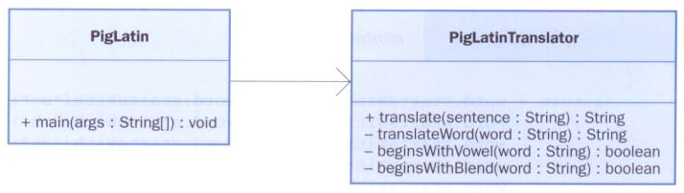
Method Decomposition
This example depicted in a UML diagram:
Notations can be used to indicate if a method is public (+) or private (-)

Slide 97
Objects as Parameters
Another important issue related to method design involves parameter passing
Parameters in a Java method are passed by value
A copy of the actual parameter (the value passed in) is stored into the formal parameter (in the method header)
Therefore passing parameters is similar to an assignment statement

Slide 98
Passing Objects to Methods
When an object is passed to a method, the actual parameter and the formal parameter become aliases of each other
What a method does with a parameter may or may not have a permanent effect (outside the method)
Note the difference between changing the internal state of an object versus changing which object a reference points to

Slide 99
//********************************************************************
// ParameterTester.java Java Foundations
//
// Demonstrates the effects of passing various types of parameters.
//********************************************************************
public class ParameterTester
{
//-----------------------------------------------------------------
// Sets up three variables (one primitive and two objects) to
// serve as actual parameters to the changeValues method. Prints
// their values before and after calling the method.
//-----------------------------------------------------------------
public static void main(String[] args)
{
ParameterModifier modifier = new ParameterModifier();
int a1 = 111;
Num a2 = new Num(222);
Num a3 = new Num(333);
System.out.println("Before calling changeValues:");
System.out.println("a1\ta2\ta3");
System.out.println(a1 + "\t" + a2 + "\t" + a3 + "\n");

Slide 100
modifier.changeValues(a1, a2, a3);
System.out.println("After calling changeValues:");
System.out.println("a1\ta2\ta3");
System.out.println(a1 + "\t" + a2 + "\t" + a3 + "\n");
}
}

Slide 101
//********************************************************************
// ParameterModifier.java Java Foundations
//
// Demonstrates the effects of changing parameter values.
//********************************************************************
public class ParameterModifier
{
//-----------------------------------------------------------------
// Modifies the parameters, printing their values before and
// after making the changes.
//-----------------------------------------------------------------
public void changeValues(int f1, Num f2, Num f3)
{
System.out.println("Before changing the values:");
System.out.println("f1\tf2\tf3");
System.out.println(f1 + "\t" + f2 + "\t" + f3 + "\n");
f1 = 999;
f2.setValue(888);
f3 = new Num(777);
System.out.println("After changing the values:");
System.out.println("f1\tf2\tf3");
System.out.println(f1 + "\t" + f2 + "\t" + f3 + "\n");
}
}

Slide 102
//********************************************************************
// Num.java Java Foundations
//
// Represents a single integer as an object.
//********************************************************************
public class Num
{
private int value;
//-----------------------------------------------------------------
// Sets up the new Num object, storing an initial value.
//-----------------------------------------------------------------
public Num(int update)
{
value = update;
}
//-----------------------------------------------------------------
// Sets the stored value to the newly specified value.
//-----------------------------------------------------------------
public void setValue(int update)
{
value = update;
}

Slide 103
//-----------------------------------------------------------------
// Returns the stored integer value as a string.
//-----------------------------------------------------------------
public String toString()
{
return value + "";
}
}

Slide 104
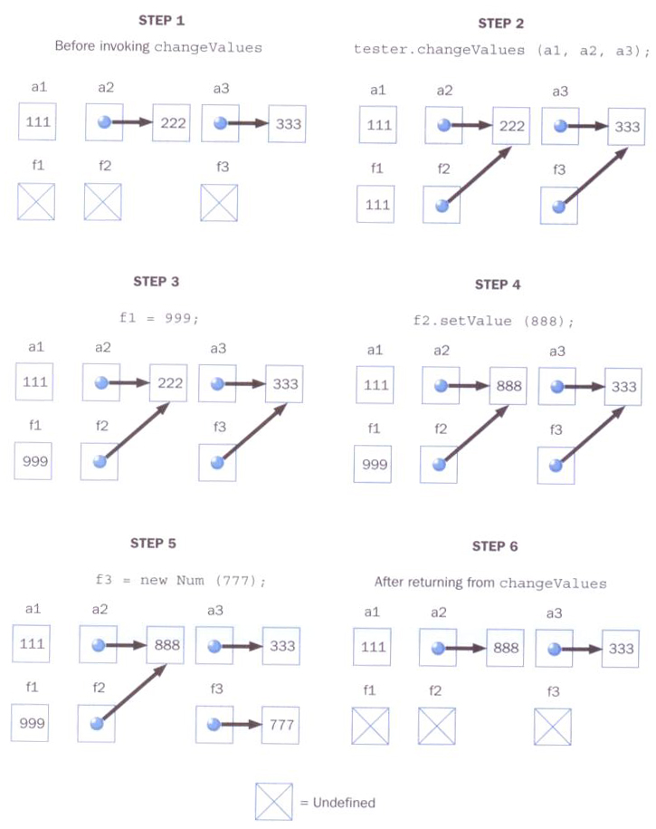
xxx
Tracing the parameter values:

Slide 105
Method Overloading
Method overloading is the process of giving a single method name multiple definitions
If a method is overloaded, the method name is not sufficient to determine which method is being called
The signature of each overloaded method must be unique
The signature includes the number, type, and order of the parameters

Slide 106
Method Overloading
The compiler determines which method is being invoked by analyzing the parameters
float tryMe(int x)
{
return x + .375;
}
Invocation
result = tryMe(25, 4.32)
float tryMe(int x, float y)
{
return x * y;
}

Slide 107
Method Overloading
The println method is overloaded
println(String s)
println(int i)
println(double d)
and so on...
The following lines invoke different versions of the println method:
System.out.println ("The total is:");
System.out.println (total);

Slide 108
Method Overloading
The return type of the method is not part of the signature
That is, overloaded methods cannot differ only by their return type
Constructors can be overloaded
Overloaded constructors provide multiple ways to initialize a new object

Slide 109
Testing
Testing
The act of running a completed program with various inputs to discover problems
Any evaluation that is performed by human or machine to asses the quality of the evolving system
Goal of testing: find errors
Testing a program can never guarantee the absence of errors

Slide 110
Testing
Running a program with specific input and producing correct results establishes only that the program works for that particular input
As more and more test cases execute without revealing errors, confidence in the program rises
Well-designed test cases are the key to thorough testing
If an error exists, we determine the cause and fix it
We should then re-run the previous test cases to ensure we didn’t introduce new errors – regression testing

Slide 111
Reviews
Review – meeting of several people designed to examine a design document or section of code
Presenting a design or code causes us to think carefully about our work and allows others to provide suggestions
Goal of a review is to identify problems
Design review should determine if the system requirements are addressed

Slide 112
Defect Testing
Testing is also referred to as defect testing
Though we don’t want to have errors, they most certainly exist
A test case is a set of inputs, user actions, or initial conditions, and the expected output
It is not normally feasible to create test cases for all possible inputs
It is also not normally necessary to test every single situation

Slide 113
Defect Testing
Two approaches to defect testing
black-box: treats the thing being tested as a black box
Test cases are developed without regard to the internal workings
Input data often selected by defining equivalence categories – collection of inputs that are expected to produce similar outputs
Example: input to a method that computes the square root can be divided into two categories: negative and non-negative

Slide 114
Defect Testing
Two approaches to defect testing
white-box: exercises the internal structure and implementation of a method.
Test cases are based on the logic of the code under test.
Goal is to ensure that every path through a program is executed at least once
Statement coverage testing – test that maps the possible paths through the code and ensures that the test case causes every path to be executed

Slide 115
Other Testing Types
Unit Testing – creates a test case for each module of code that been authored. The goal is to ensure correctness of individual methods
Integration Testing – modules that were individually tested are now tested as a collection. This form of testing looks at the larger picture and determines if bugs are present when modules are brought together
System Testing – seeks to test the entire software system and how it adheres to the requirements (also known as alpha or beta tests)

Slide 116
Test Driven Development
Developers should write test cases as they develop their source code
Some developers have adopted a style known as test driven development
test cases are written first
only enough source code is implemented such that the test case will pass

Slide 117
Test Driven Development
Test Driven Development Sequence
Create a test case that tests a specific method that has yet to be completed
Execute all of the tests cases present and verify that all test cases will pass except for the most recently implemented test case
Develop the method that the test case targets so that the test case will pass without errors
Re-execute all of the test cases and verify that every test case passes, including the most recently created test case
Clean up the code to eliminate redundant portions (refactoring)
Repeat the process starting with Step #1

Slide 118
Debugging
Debugging is the act of locating and correcting run-time and logic errors in programs
Errors can be located in programs in a number of ways
you may notice a run-time error (program termination)
you may notice a logic error during execution
Through rigorous testing, we hope to discover all possible errors. However, typically a few errors slip through into the final program
A debugger is a software application that aids us in our debugging efforts

Slide 119
Simple Debugging using println
Simple debugging during execution can involve the use of strategic println statements indicating
the value of variables and the state of objects at various locations in the code
the path of execution, usually performed through a series of “it got here” statements
Consider the case of calling a method
it may be useful to print the value of each parameter after the method starts
this is particularly helpful with recursive methods

Slide 120
Debugging Concepts
Formal debuggers generally allow us to
set one or more breakpoints in the program. This allows to pause the program at a given point
print the value of a variable or object
step into or over a method
execute the next single statement
resume execution of the program

