Slide 1
iBeacon Technology
Mai Le Khanh Hoa - iOS Developer - ZALORA Group

Slide 2

What is iBeacon?
Apple’s technology standard
First introduced in WWDC 2013 along with iOS 7
Allow Mobile Apps to understand their location on a micro-local scale, and react accordingly.
Based on Bluetooth Low Energy (BLE)

Slide 3
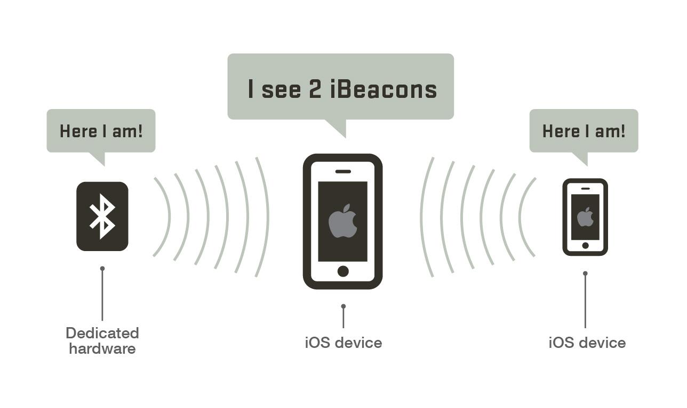
Bluetooth Low Energy
Context
Problem statement

Slide 4
Bluetooth Low Energy
What
Why
BLE is a wireless personal area network used for transmitting data over short distances.
Less power consumption
Lower cost
Simpler applications

Slide 5
How BLE works
BLE Communication consists primarily of small packet of data (Advertisement)
One-way communication
Apple’s iBeacon standard calls for an optimal broadcast interval of 100ms.
Broadcast range up to 100 meters

Slide 6
Implementation

Slide 7
UUID (Universally Unique Identifier) : 16 byte string used to differentiate a large group of related beacon
Major : 2 byte string used to distinguish a smaller subset of beacons within a larger group
Minor : 2 byte string used to identify individual beacons
Tx power : determine the proximity from the beacon

