Slide 1
Beginning Assumptions!
version 20190913

Slide 2


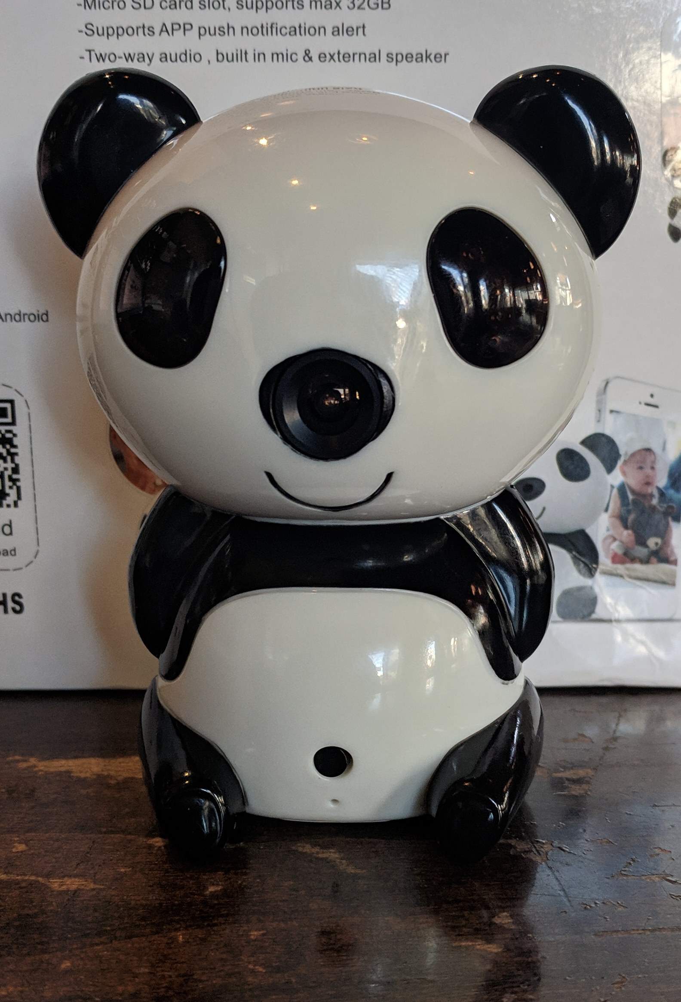
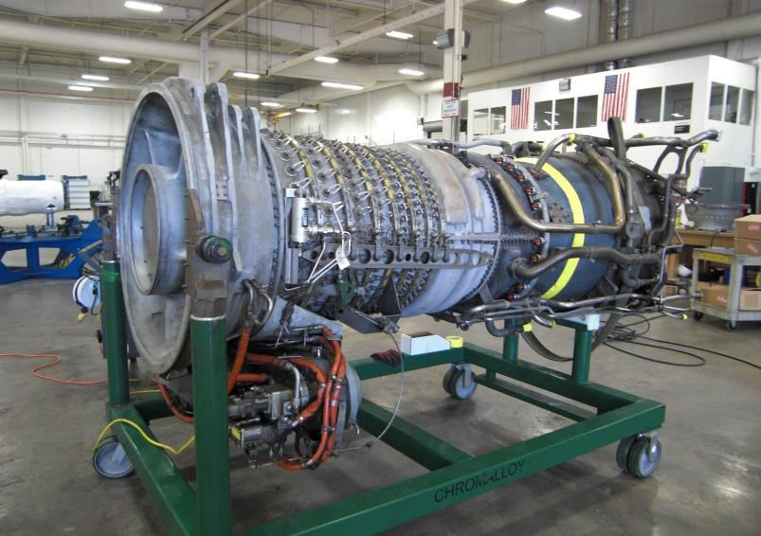


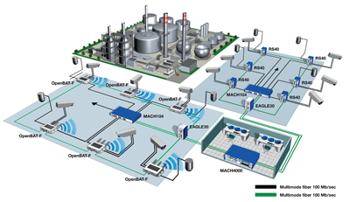
What is the problem?
Network
Operator
(owner/
resident)
Relationship
Registrar
(or JRC)
Pledge
New
Device

Slide 3

BRSKI in animation: Trusting new devices
manufacturer
IDevID
Manufacturer
Validates
Device
Network
Operator
(owner/
resident)
IDevID
Registrar
(or JRC)
Pledge

Slide 4
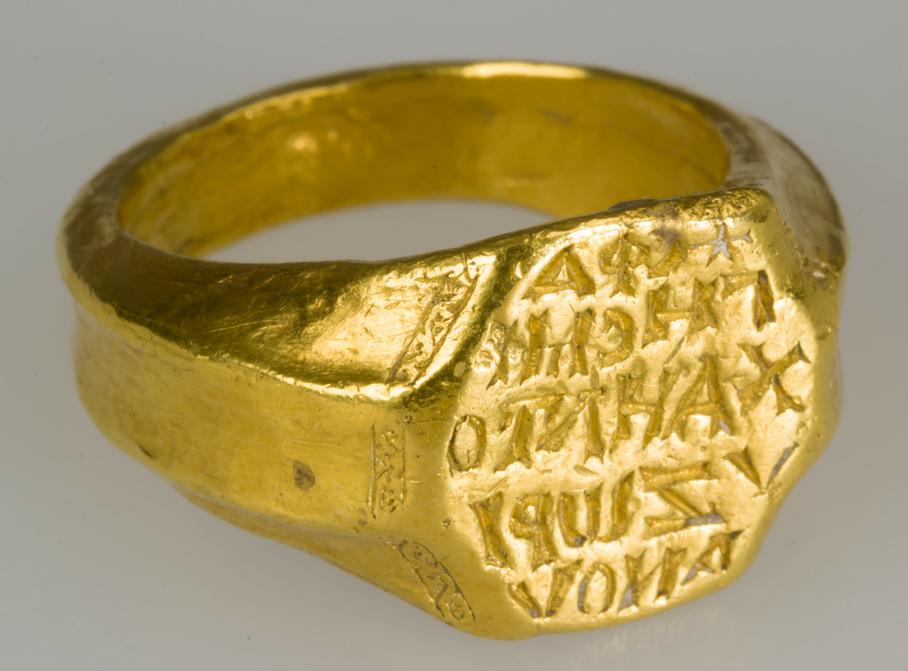
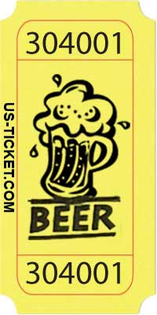
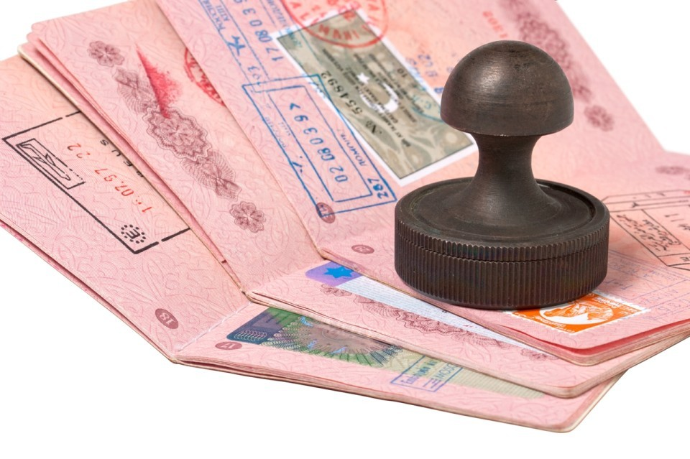
BRSKI in animation: trusting new networks
MASA
(manufacturer
Authorized
Signing
authority)
Voucher
Trust
anchor
Network
Operator
(owner/
resident)
Relationship (EST-RFC7030)
Registrar
(or JRC)
Pledge
signed
voucher
request

