Slide 1
IoT-Directorate: update on IoTSF
Quarterly Plenary, 2020-07-08
Working Groups and Projects Introduction Richard Marshall
Project: ManySecured Duncan Purves & Nick Allott, Nquiring Minds
Project: STEP and Vulnerable Things Emily Taylor, OXIL
Project: Supply Chain Integrity Amyas Phillips
Update on EN 303 645; A Common Baseline for 'Smart' Consumer Product Security Tereza Rusova, UK DCMS
IoTSF Operations and Annual Conference Jenny Devoy
WG: Smart Buildings Sarb Sembhi & James Willison
WG: Marketing Rosa Lenders
WG: Assurance & Roadmap Richard Marshall
WG: Compliance Framework Trevor Hall

Slide 2
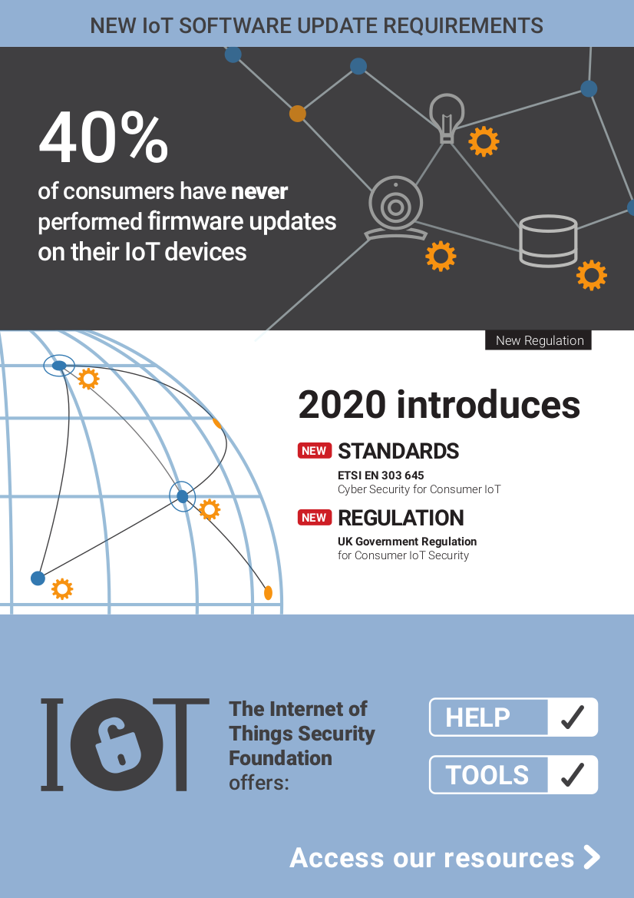
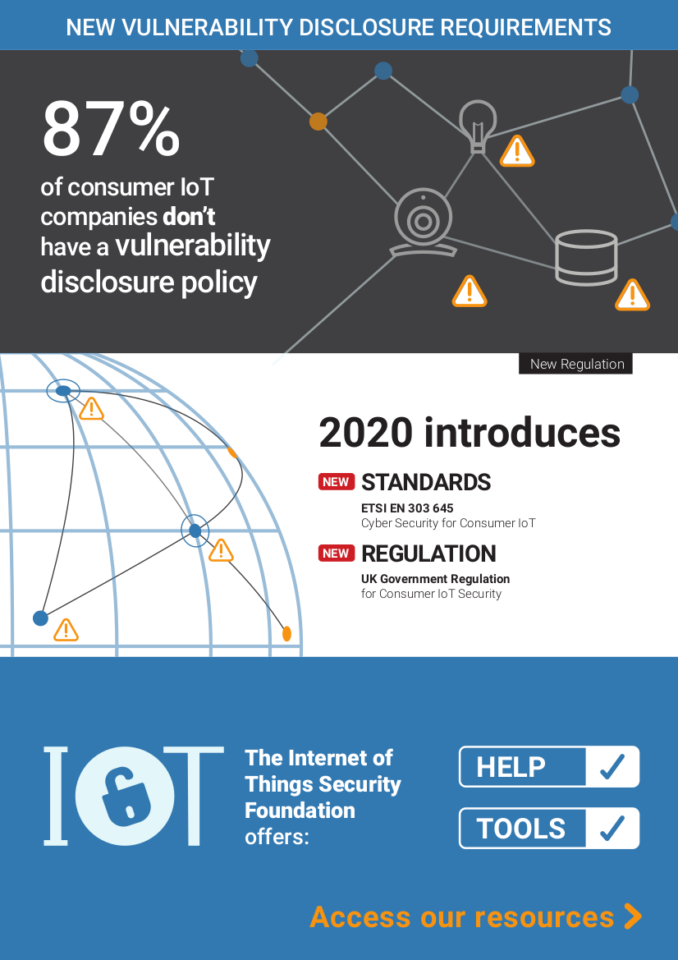
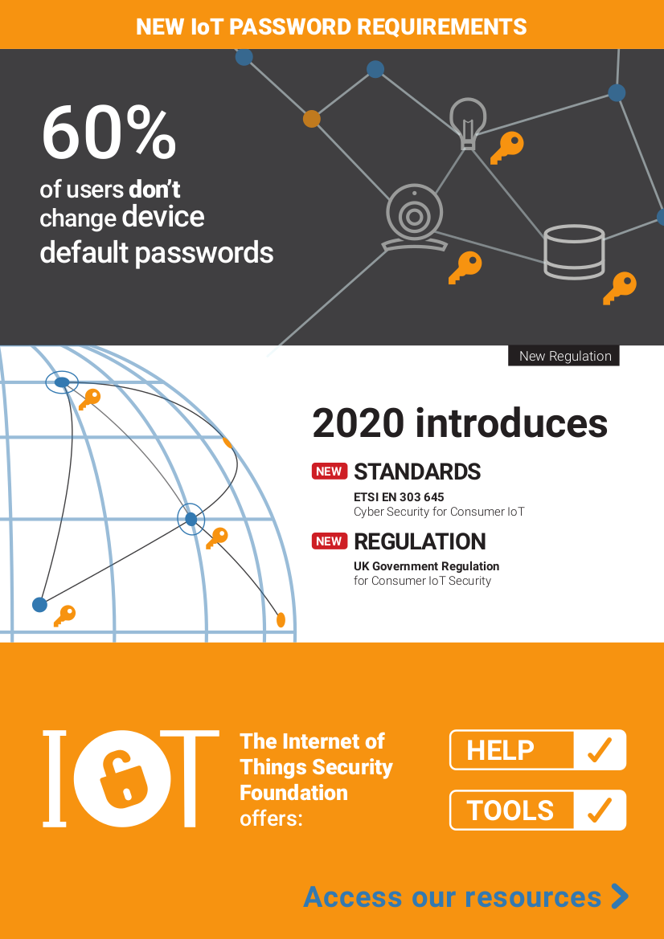
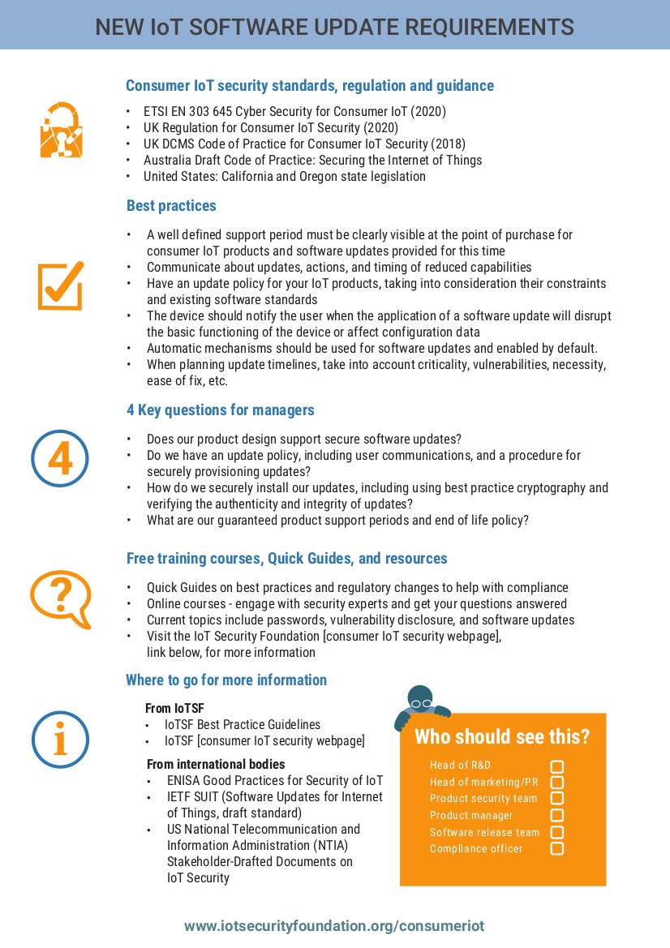
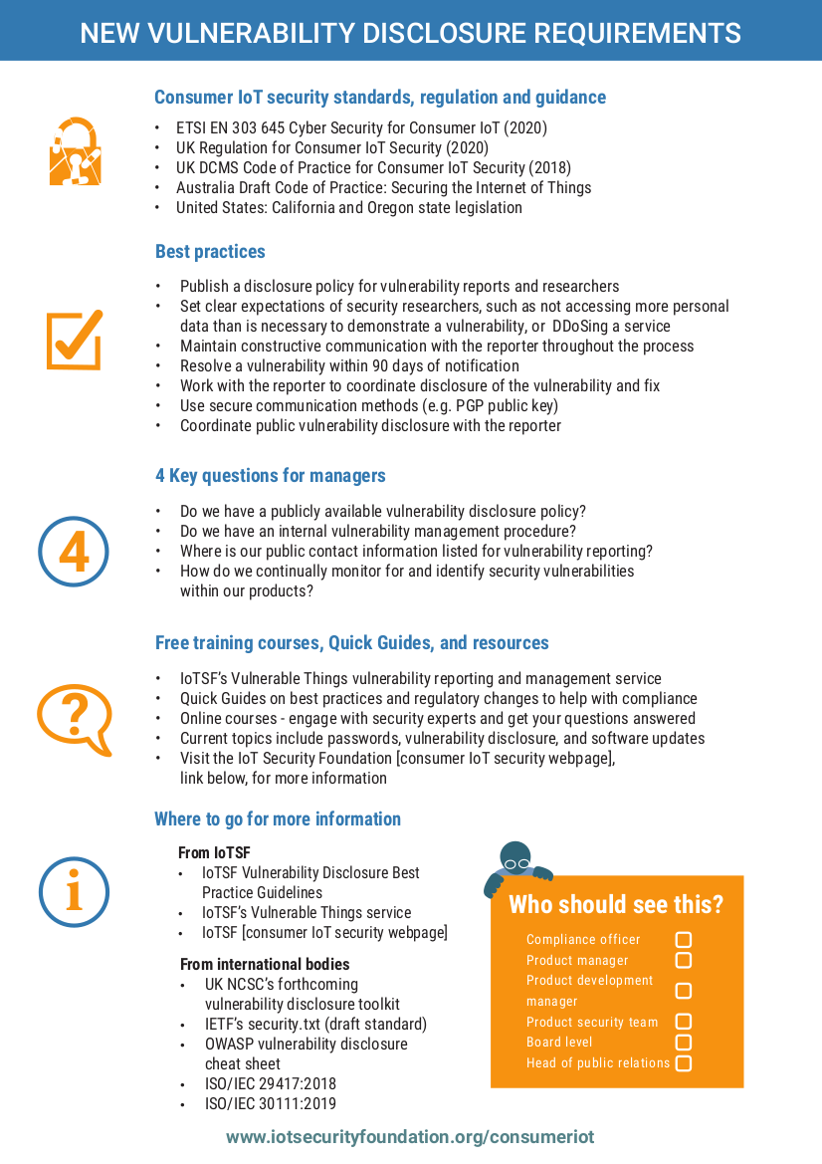
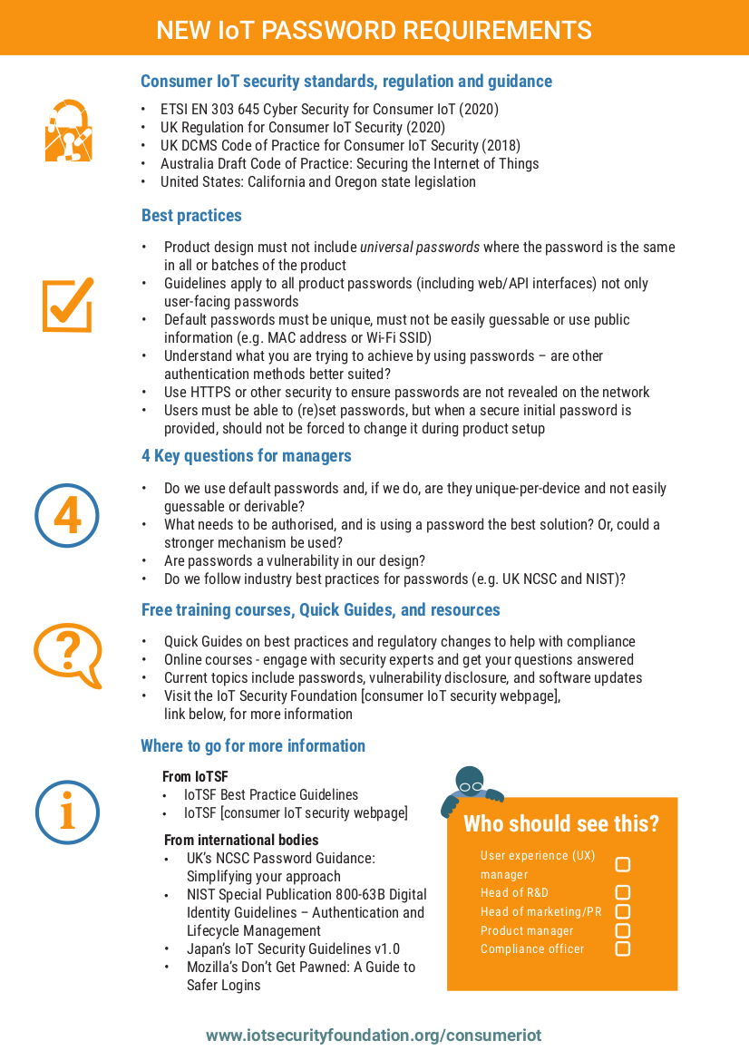
IoTSF: STEP
Security and Training Education Project
Centered around EN 303 645 release
courses (now-virtual) Aug/Sep/Oct/Nov 2020
Software Updates
expert: Michael Richardson
Vulnerability Disclosure
expert: David Rogers
Default Passwords
expert: Michael Richardson

Slide 3
IoTSF:
Building Automation security
lead by Sarb Sembhi & James Willison
four stakeholder groups:
  facilities
  manufacturers
  owners
  integrators (empty set so far :-( )

Slide 4
IoTSF:
Supply Chain Security
lead by Amyas Phillips
exact direction and nature of guidelines to be determined.
    MCR favours having a protocol/automated system, because... so many layers/parts
    . o O ( isn’t NIST doing something? Can we just use that )

Slide 5
NIST/CISQ/OMG group
https://www.it-cisq.org/software-bill-of-materials/index.htm
Integrity, core group, and ...
core group is creating model w/ontology.
  many people from Linux Foundation, Github, Microsoft, from SPDX effort, but this is not necessarily SPDX.
Integrity group is strugling, and seemed to be on verge of re-inventing JOSE.
  MCR has recruiting a few more IETFers to this effort
Unclear how SWID, CoSWID interact with this effort

