Slide 1
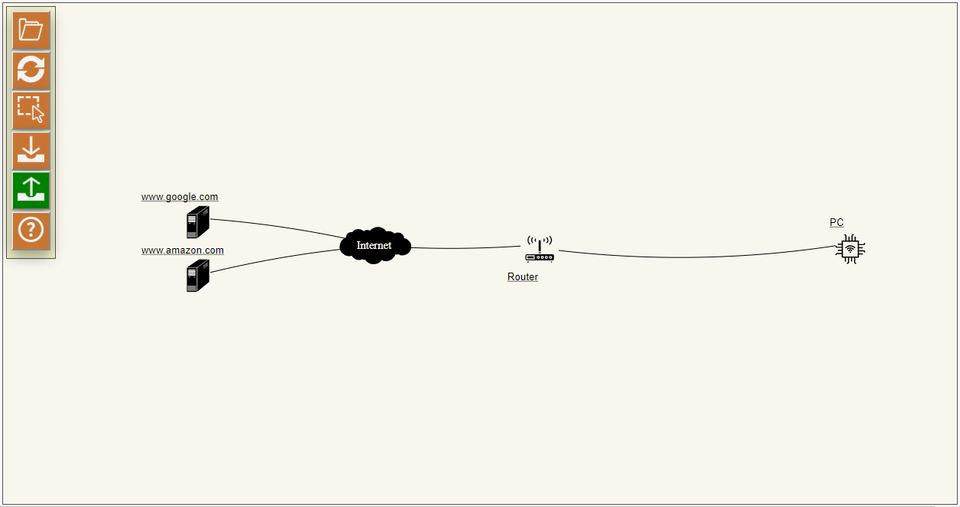
MUD-Visualizer loads a default device, i.e. a PC, which can communicate to google.com and amazon.com on the internet, and can also communicate with all the local network devices

Slide 2
Opens MUD-file(s)
Resets the drawing to initial position
Opens the menu for deselecting/selecting the visualized MUD-files
Click on this icon to change the traffic direction to “incoming”
With this icon selected, the outgoing traffic will be visualized
Opens the help page

Slide 3
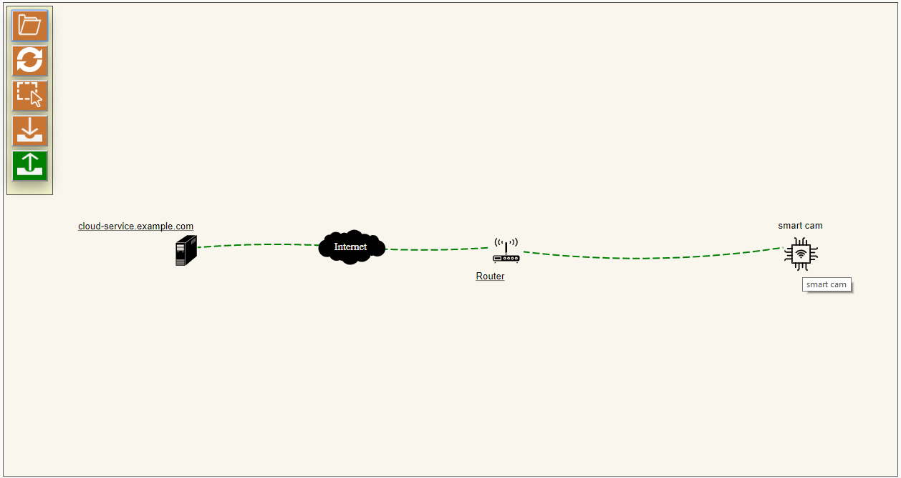
Drag any of the nodes to
change their positions
Hover on an IoT device to see the traffic flow
Servers are shown on this side
Devices are shown on this side

Slide 4
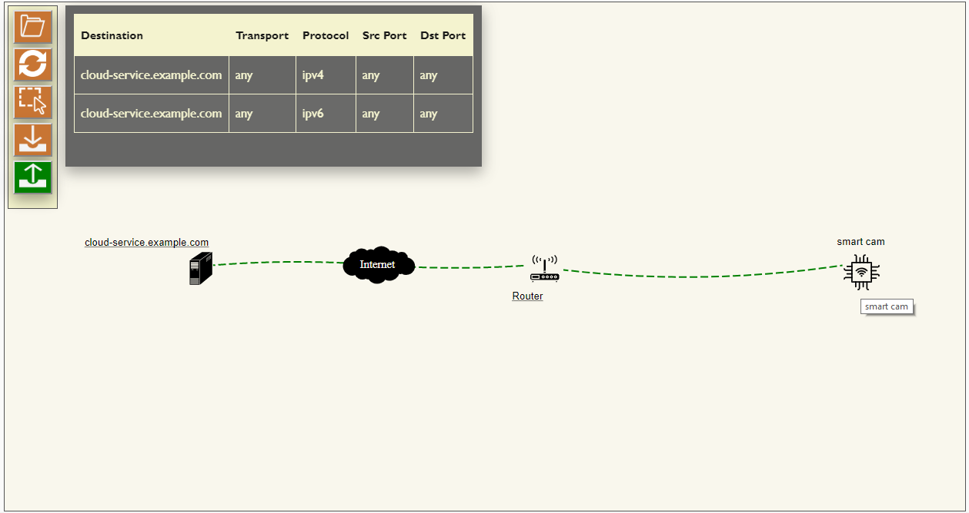
Depending on the traffic direction,
source/destination and corresponding
traffic information are displayed here
Click on a node to see its
access control rules

Slide 5
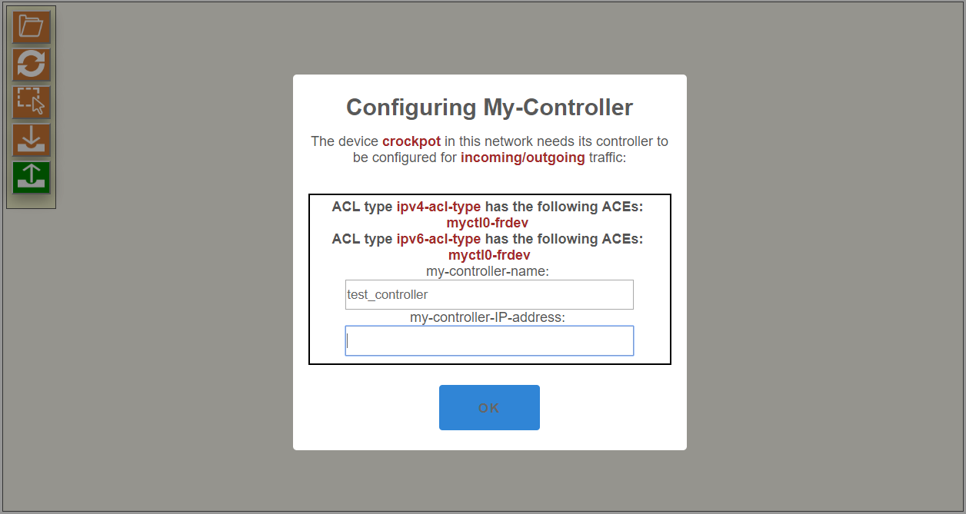
If a node has a my-controller, then you should input
the required information for the my-controller device:

Slide 6
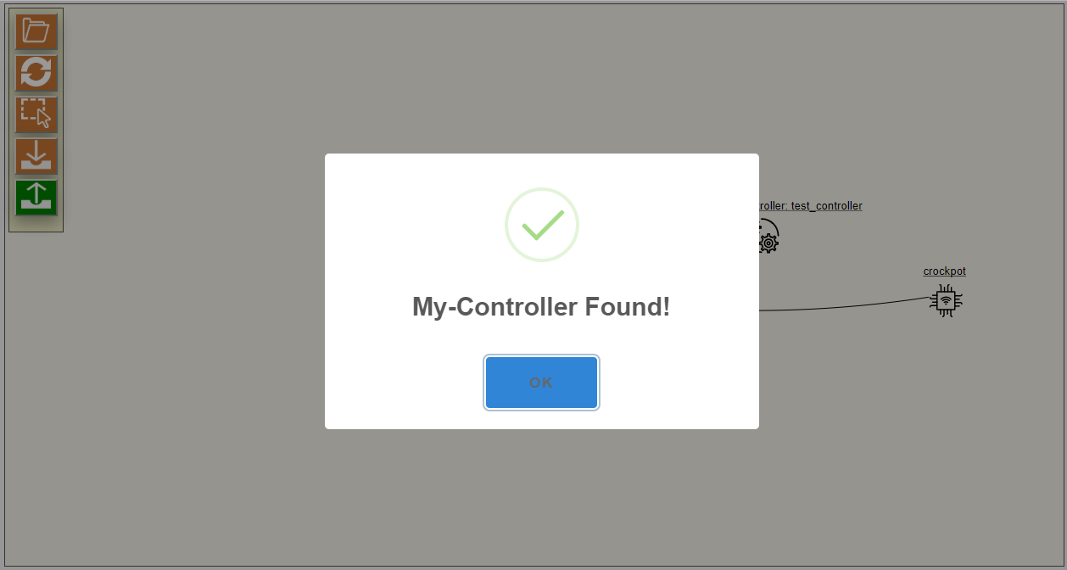
The visualizer detects if a new device uses a controller or my-controller that already exists in the network.

