Slide 1
IoT Extensions for schema.org
Community Teleconference
April 16, 2020

Slide 2
Agenda
Agenda review
Updates
Discussion - proposal for adding a thing class
Roadmap planning
AOB

Slide 3
Updates
WoT is now an official W3C Recommendation
Thing Description and Architecture documents
WISHI Online Hackathon was March 9
Semantic Proxy using W3C WoT and annotation from OneDM definitions
OneDM F2F coming up in May, 2 hour blocks
W3C WoT F2F, June in Helsinki, feat. T2TRG
Now online with online plugfest

Slide 4
Project CHIP
CHIP Project is scaled up and driving toward smart home certification around the end of the year 2020
Data models drawn from Zigbee ZCL
Focus mostly on communication protocols and device networking

Slide 5
One Data Model
SDF Version 0.9
Playground with CI tools
Automatic conversion to/from OCF and OMA LWM2M
Organizations adopting as the developer language
Starting standardization in IETF
Schema-driven editors and schema validation

Slide 6
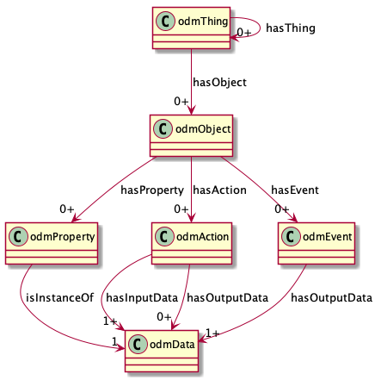
One Data Model

Slide 7
Thing Class
Encapsulate reusable Capabilities
On/Off with state Property, Commands, and Events
Compose Air Conditioner Thing from OnOff, Mode, Speed, etc. as reusable Capabilities
Reusable compositions of Capabilities
An Outlet unit for a multi-outlet strip
Each Outlet has OnOff, Energy Monitor, Overcurrent and Overtemperature protection Capabilities
Multiple Outlets are composed into an outlet strip
Outlet unit can be a Thing
Outlet Strip can also be a Thing

Slide 8
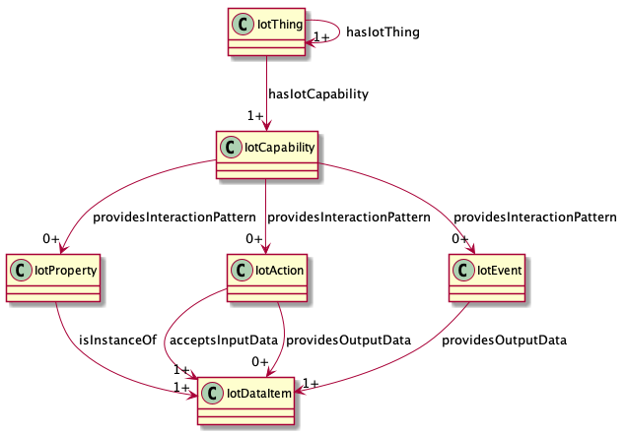
UML

Slide 9
schema.org IoT Extension Meta Model with Thing Class
IotThing
schema:thing
hasIotThing
hasIotCapability
providesOutputData
providesInteractionPattern
acceptsInputData
IotCapability
InteractionPattern
IotDataItem
schema:PropertyValue
IotAction
IotEvent
IotProperty
schema:PropertyValueSpec.
rdfs:subclassOf
schema:Property
iotschema Class
Reused Class

Slide 10
Roadmap and Planning
Ontology
Schema.org integration
Hosting
Governance

Slide 11
Ontology
Thing class
Context integration, connectors to external ontologies
Behavioral specification – state machines, rules, etc

Slide 12
Schema.org integration
IoT affordance ontology classes
Connector properties to iotschema classes
Separate namespace for iotschema types
Connector properties for IoT adjacent ontologies
BRICKschema
VSSschema

Slide 13
Governance
W3C Community Group and community process
Open source license BSD or other permissive
W3C Evergreen process

Slide 14
Hosting
Schema.org on a separate namespace
Other options, W3C?

Slide 15
High Level Example Workflow
OMA LWM2M
Convert
WoT TD
SDF
Convert
BRICKschema
VSSschema
OCF
iotschema
Annotate
RDF Shapes
ZA/CHIP DMWG
HTML
Annotate

Slide 16
Conclusion
Summary
AOB

