Slide 1
IoT Extensions for schema.org Community Teleconference
November 21, 2019
Unrestricted

Slide 2
Agenda
Agenda review
New Capability proposals:
Electric Power System
Electric Battery
Integration with schema.org
Admin and community items
AOB

Slide 3
New Capability Proposals

Slide 4
Integration with schema.org
Slides to summarize what we set out to do and where we are
Technical summary
Integration proposal

Slide 5
iotschema Review: Status and Planning
September 2019
Unrestricted

Slide 6
Contents
Charter and Objectives – What we started out to do
Status – What we have accomplished
W3C WoT integration – Test case and results
Schema.org integration – Proposal and issues
W3C Community Group – IPR policy and continuity
OneDM Liaison Group – Report out
Going forward – a proposal

Slide 7
Charter and Objectives
Create an extension to Schema.org that will enable IoT semantics
Work with relevant vendors and SDOs to architect a common information model for IoT
Develop a process to enable free contribution from diverse organizations, driving toward normalization to a common model
Enable domain and subject experts to create and maintain definitions and models
Work on practical integration with Schema.org

Slide 8
Status
Developed a common meta-model which is well adopted in industry (graphic)
Functional/semantic capabilities with common Property, Action, and Event classes of affordances
Feature of Interest integration from other namespaces – GENIVI/VSS, BrickSchema, Project Haystack
Integration with W3C SOSA/SSN
Published strawman definitions for some common IoT capabilities
Conducted test case evaluation with W3C Web of Things and IRTF T2TRG WISHI including hands-on

Slide 9
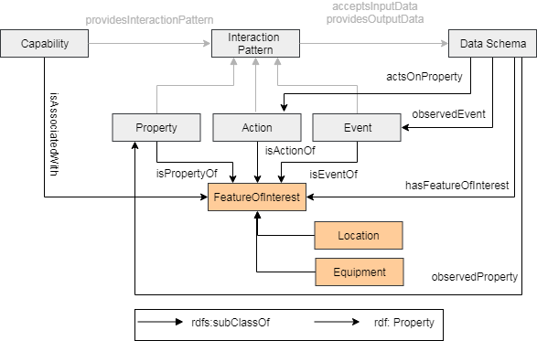
Information Meta-Model

Slide 10
W3C WoT Test Case
Integrated iotschema definitions with WoT Thing Description as semantic annotation (example)
Created strawman definitions for common use
Investigated use in discovery and configuration
Several organizations used semantic annotation
Node-RED application for semantic interoperability
Uses WoT Thing Description with iotschema annotation
WoT discovery will be further developed

Slide 11
iotschema for Node-RED Recipe-based applications
iotschema embedded in Node-RED tool
Enables an easy configuration of things using iotschema definitions
Easies the use of semantics for IoT developers
No need for a developer to know RDF(S), JSON-LD, RDF Shapes ...
Simplify creation of applications with W3C WoT
Avoids translations of serializations formats, data types, units ...
Demonstrates semantic discovery and processing
Integrates WoT Thing Directory
GitHub project location:
https://github.com/iot-schema-collab/iotschema-node-red

Slide 12
Schema.org Integration
Class names Event, Action, Property conflict
iotschema has diverse semantic types for objects, schema.org has diverse property types
Property types could be synthesized from objects but…
iotschema will potentially define hundreds of types for physical quantities (temperature, humidity, voltage, acceleration…), control affordances (open/close, brightness, color control, camera controls, operating modes…), and features of interest (rooms, machines…)

Slide 13
Schema.org Integration
The WoT use case is based on annotation consisting of RDF @type statements that point to URIs of defined terms for specialized types that conform to the classes in the meta-model
These meta-model classes would only add about 6 new property types to schema.org
iotCapability, iotEvent, iotAction, iotProperty, iotData, iotFeatureofInterest
new types like iotInterface, iotThing, etc. as needed

Slide 14
Schema.org Integration
There is a potential example pattern in schema.org
MedicalEntity, with about 7 property types
Likewise, an instance of IoT Schema would contain some set of iotCapability, iotAction, iotProperty, iotEvent, iotFeatureOfInterest properties
Specialization of iot types would happen at the next level in the graph
URIs that point to accepted specialized definitions in a different namespace (?)
lighting controls, thermostats, etc. that conform to the base types but have their own properties

Slide 15
Schema.org Integration
The base properties line up with semantic classes that have software handlers,e.g. to discover, display, control
The specialization information enables selection of application elements that can understand and interoperate with the specialized affordances, for example lighting controls
More general applications might reason about semantic constructions based on their ability to parse the semantic graph
Adaptation software may need special properties to describe data types, units, and ranges

Slide 16
W3C Community Group
Started early 2019
A few members have joined but not active yet
IPR policy for contributions based on CG membership
CG membership will become part of the community and be required for contributors and participants
Can we adopt the BSD 3-Clause license for our contributed and published content?

Slide 17
OneDM Liaison Group
Semi-private group of SDOs and associated vendors
Goal is to create a common IoT data model and normalized device definitions
Creating open source JSON language and developer tools for definitions, using BSD 3-Clause license
High level alignment with the Property-Action-Event meta-model
OneDM definitions can feed iotschema
We can share OneDM language and tools

Slide 18
Going Forward
Create an experimental area on schema.org for normalized, accepted iotschema content
Create a namespaced area per contributing org in the public github, allow open contribution of raw content
CI tools validate the contributed definitions
The definition can immediately be dereferenced in the contributor's namespace (on schema.org?)
Move definitions into the official github repository and schema.org experimental area when they are accepted

Slide 19
To Do
Integrate the iotschema W3C Community Group into the process, define licensing and publication
Design a namespace scheme for contributing orgs and for linked ontologies
Refactor the vocabulary as necessary to remediate the name conflicts
Build and deploy CI tools to check contributions

Slide 20
iotschema: Resources
W3C Community Group:
The Schema Extensions For IoT
https://www.w3.org/community/iotschema/
GitHub repository:
https://github.com/iot-schema-collab/iotschema
Teleconferences:
https://github.com/iot-schema-collab/teleconferences
Contributions:
https://github.com/iot-schema-collab/iotschema
Charter:
https://github.com/iot-schema-collab/ws-charter
Web site:
Current location
http://iotschema.org/docs/full.html
Tools:
iotschema for Node-RED
https://github.com/iot-schema-collab/iotschema-node-red

