Slide 1
iotschema.org
Community Teleconference
February 18, 2020

Slide 2
Agenda
Discuss iotschema re-charter
AOB

Slide 3
iotschema re-charter
iotschema provides an RDF integration pattern for common application semantics, using categories that are well-aligned with WoT TD
schema.org will not benefit from integration of IoT affordances – rather, vertical domain vocabularies
iotschema set out to attract product vendors to adopt a common format and entry point for iot information models
One Data Model liaison group has achieved this with respect to IoT device information models

Slide 4
iotschema benefits
Common information models provide more benefit to system integrators that need to work across vendors and verticals
WoT use cases are more aligned with system integration
Where OneDM and SDF provide a common translation format for device data models, iotschema provides common RDF integration patterns for multiple ecosystems that can be used in WoT deployments
iotschema can represent and integrate quantities and features of interest from diverse information model sources

Slide 5
iotschema + WoT benefits
WoT is an integration language
iotschema is the semantic database
data models from different ecosystems can be mapped to common iotschema concepts and exposed using WoT TD
System integrations e.g. digital twin, can adapt to diverse field devices using common semantic affordances defined in iotschema

Slide 6
Any model with any system
infomodel A
System A
Semantic "narrow waist"
infomodels => systems
iotschema
WoT
infomodel B
System B
infomodel C
System C

Slide 7
Next steps
Is there interest in going forward, will people adopt it?
All system integrators using WoT would benefit from common tools and formats
Developer tools can layer on top of WoT to provide semantic APIs to help with discovery, and for mapping affordances and data
Continue to deploy in WoT plugfests
Develop use cases to illustrate the benefits of semantic integration

Slide 9
Re-charter
We have come to a check point in this work
schema.org extension is unlikely in the current form
The iotschema focus on affordances is not aligned with schema.org use cases
Data types may be an integration point but will not drive schema.org integration
Roll up some conclusions and publish a report
Drive the work forward with new alignment

Slide 10
Re-charter – re-alignment
There is still a need for a common web entry point for IoT semantic models in RDF
Align with W3C WoT, OneDM, and semantic graphs
Build out ontology to include quantities and features of interest
Become a common public set of RDF models for IoT system integration – one stop shop and entry point
Develop the browser around the new integration patterns
Conversion and shape validation tools
Contribute directly or from e.g. SDF conversions

Slide 11
More adoption
Large players are behind successful activities
Information models + communication
Vorto is not RDF but code oriented, tool chain
Microsoft, Amazon also offer complete solutions
We are compatible with W3C WoT approach
Get support of major WoT players
we should be useful for other ecosystems

Slide 12
Build support for information model
How do people use WoT TD?
What semantics are needed for gateways
What are benefits, use case value

Slide 13
Re-charter - logistics
Develop a consortium of interested parties from W3C WoT, OneDM, OneM2M, and other prospective organizations
Discuss at WoT VF2F
Agree on a venue – W3C CG?
Define priorities, deliverables, and work streams
Discuss contributions and license

Slide 14
Venue
Existing mailing list/interest list for outreach
W3C Community group chartered for schema.org extensions – currently no activity
Google group and 2017 discussions (archive)
Discussion on use of the W3C WoT CG
Move toward a W3C activity

Slide 15
Conclusion
Next steps/meeting
AOB

Slide 16
Backup
Interaction model survey
Thing Class
OneDM Integration
schema.org integration

Slide 17
Meta-model survey – Common Affordance Semantics
Information | OneDM SDF | WoT TD | iotschema | ZCL/dotdot | OCF | SmartThings | LWM2M | Weave | Vorto | UPnP | BLE Mesh | Azure DTDL | oneM2M | OPC UA
Governing body | OneDM Liaison | W3C | W3C/schema.org | Zigbee Alliance | OCF | SmartThings | OMA SpecWorks | Google/Nest | Eclipse | OCF | BT Sig | Microsoft | oneM2M | OPC
Tools License | BSD | Many |  | Proprietary | BSD | Proprietary |  | Apache2 | Eclipse |  |  | MIT | Apache2.0
Models License | BSD | No Models |  | BSD | BSD | Proprietary | OMA | Apache2 |  |  |  | CC Attr. 4.0
representation language | JSON | LSON-LD | JSON-LD | XML | JSON | JSON | XML | WDL | vortolang | XML | XML | JSON-LD | XML | XML
Content Format | sdf+json | td+jsonld | jsonld | zcl+xml | swagger+ json | json | mod+xml | text | text | upnp+xml | xml | jsonld | sdt+xml
Reference | https://github.com/one-data-model/language | https://www.w3.org/TR/wot-thing-description/ | https://github.com/iot-schema-collab/iotschema | https://zigbeealliance.org/wp-content/uploads/zip/dotdot-ip-package.zip | https://openconnectivity.org/developer/specifications/ | https://docs.smartthings.com/en/latest/capabilities-reference.html | http://www.openmobilealliance.org/wp/omna/lwm2m/lwm2mregistry.html | https://openweave.io/guides/weave-primer/schema | https://github.com/eclipse/vorto/tree/development/docs | https://openconnectivity.org/developer/specifications/upnp-resources/upnp/ | https://www.bluetooth.com/specifications/mesh-specifications/ | https://github.com/Azure/IoTPlugandPlay/tree/master/DTDL | http://www.onem2m.org/tr-0039/ipe-and-sdt | https://opcfoundation.org/developer-tools/specifications-unified-architecture
Terminology | OneDM SDF | WoT TD | iotschema | ZCL/dotdot | OCF | SmartThings | LWM2M | Weave | Vorto | UPnP | BLE Mesh | Azure DTDL | oneM2M | OPC UA
Composed Instance | Thing/Thing | Thing | Thing/Thing | Device/EP | Platform/Device | Fingerprint | Registration | Device | Info Model | Device | Device | Capability Model | Device | Device, Server
Atomic Functionality Unit | Object | (Thing) | Capability | Cluster | Resource | Capability | Object | Trait | Function Block | Service | Model | Interface | ModuleClass | Object
Externalized state item | Property | Property | Property | Attribute | Property | Attribute | Resource | Property | Config, Status | State Variable | Attribute | Property | Data Point | Attribute, Variable
External method accepted | Action | Action | Action | Command | POST | Command | Executable Res. | Command | Operation | Action | Write | Command | Action | Method, Program
External signal emitted | Event | Event | Event | Report | Observe data | Device Event | Observe data | Event | Event | Event | Report | Telemetry | Event | Event, Alarm
Reusable data type | Datatype | Datatype | Datatype | Datatype | OAS definition | Datatype | Reusable Res. | Datatype | Datatype | Datatype | Datatype | schema | xsd types | register types
Network Binding | OneDM SDF | WoT TD | iotschema | ZCL/dotdot | OCF | SmartThings | LWM2M | Weave | Vorto | UPnP | BLE Mesh | Azure DTDL | oneM2M | OPC UA
Data Schema | JsonSchema | JsonSchema | External | XML | OAS 2.0 | Mapping Files | SenML | WDL | External | XML | XML | DTDL | XSD
Protocol Binding | External | TD Forms | External | ZCL Commands | OAS 2.0 | Device Handlers | CoAP | WDM | External | UPnP defined | BLE GATT | External | External
Protocols |  | MQTT,HTTP,CoAP |  | Zigbee Pro, CoAP | CoAP | Many | CoAP | WDM |  | HTTP | BLE

Slide 18
Thing Class
Encapsulate reusable Capabilities
On/Off with state Property, Commands, and Events
Compose Air Conditioner Thing from OnOff, Mode, Speed, etc. as reusable Capabilities
Reusable compositions of Capabilities
An Outlet unit for a multi-outlet strip
Each Outlet has OnOff, Energy Monitor, Overcurrent and Overtemperature protection Capabilities
Multiple Outlets are composed into an outlet strip
Outlet unit can be a Thing
Outlet Strip can also be a Thing

Slide 19
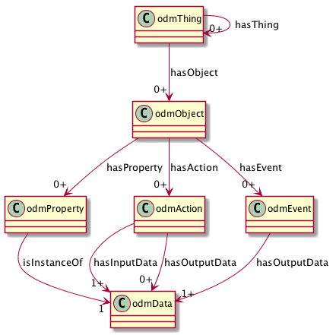
ODM Meta-Model
Thing Class to compose Objects
View (Interface) Class to virtualize affordances
Reusable Objects
Property, Action, and Event Affordances
Reusable Data Types

Slide 20
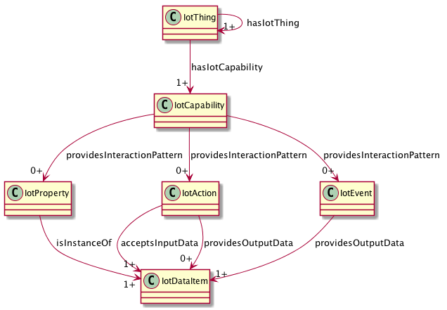
iotschema UML with iotThing class

Slide 21
schema.org IoT Extension Meta Model with Thing Class
IotThing
schema:thing
hasIotThing
hasIotCapability
providesOutputData
providesInteractionPattern
acceptsInputData
IotCapability
InteractionPattern
IotDataItem
schema:PropertyValue
IotAction
IotEvent
IotProperty
schema:PropertyValueSpec.
rdfs:subclassOf
schema:Property
iotschema Class
Reused Class

Slide 22
One Data Model integration
Re-shape One Data Model definitions as iotschema definitions
One Data Model uses JSON object hierarchy vs. RDF links
JSON pointer fragment identifiers
odm:/#/sdfObject/onoff/sdfAction/turnon
iot:onoffCapability => iot:providesTurnonAction => iot:turnonAction
iot:providesTurnonAction is a sub-class property from iot:providesInteractionPattern

Slide 23
iotschema from OneDM
odm:/#/sdfObject/onoff/sdfAction/turnon
sdfObject is "sameAs" iotCapability
Create type names
odm:/#/sdfObject/switch => iot:switchCapability
odm:/#/sdfObject/switch/sdfAction/turnon => iot:turnOnAction (iot:switchTurnOnAction?)
Synthesize the schema.org style property types
providesInteractionPattern subtypes
providesSwitchTurnOnAction

Slide 24
Path Construct in RDF
source: odm:/#/sdfObject/onoff/sdfAction/turnon
iot:iotCapability/onoff/iotAction/turnon
Contains the statement:
"@id": "odm:/#/sdfObject/onoff/sdfAction/turnon"
What does the mapped property type look like?
iot:providesInteractionPattern
iot:providesTurnonAction
iot:providesiotCapability/onoff/iotAction/turnon

Slide 25
Schema.org Integration
Class names Event, Action, Property conflict
iotschema has diverse semantic types for objects, schema.org has diverse property types
Property types could be synthesized from objects but…
iotschema will potentially define hundreds of types for physical quantities (temperature, humidity, voltage, acceleration…), control affordances (open/close, brightness, color control, camera controls, operating modes…), and features of interest (rooms, machines…)

Slide 26
Schema.org Integration
The WoT use case is based on annotation consisting of RDF @type statements that point to URIs of defined terms for specialized types that conform to the classes in the meta-model
These meta-model classes would add 7 new iot types to schema.org
iotThing, iotCapability, iotEvent, iotAction, iotProperty, iotData, iotFeatureofInterest
new types like iotInterface as needed

Slide 27
iotschema UML

Slide 28
Schema.org Integration
There is a potential example pattern in schema.org
MedicalEntity, with 7 property types
Likewise, an IoT Schema instance would contain some set of iotThing, iotCapability, iotAction, iotProperty, iotEvent, iotFeatureOfInterest classes and associated Property Types
Specialization of iot types would happen at the next level in the graph – hosted in a separate namespace
URIs that point to accepted specialized definitions in one or more specialized namespaces
lighting controls, thermostats, etc. that conform to the base types but have their own Property Types

Slide 29
Application Type Example
schema:hasIotThing
iot:hasSwitch
Switch
hasSwitch
schema:IotThing
iot:Switch
hasOnOffControl
OnOffControl
providesOnOffProperty
providesTurnOnAction
providesTurnOffAction
providesToggleAction
providesPowerInterruptedEvent
providesPowerRestoredEvent
OnOffProperty
TurnOnAction
PowerInterruptedEvent
providesOnOffStateData
OnOffStateData

