Slide 1
IoT Extensions for schema.org
Community Teleconference
February 20, 2020

Slide 2
Agenda
Agenda review
Announcements – T2TRG Workshop on Data Models and One Data Model + WISHI Hackathon
Recent developments – Project CHIP
Proposal for adding a thing class
Availability of iotschema4Node-RED over npm
Hosting and schema.org extension
AOB

Slide 3
Announcements
W3C WoT Online Virtual F2F March 16-18
T2TRG Workshop March 20 at IETF 107 Vancouver
Technical review of SDF language (OneDM)
WISHI Hackathon March 21 and 22 at IETF 107
Semantic Proxy using W3C WoT and iotschema annotation from OneDM definitions
OneDM F2F late April, Qualcomm in San Diego
W3C WoT Helsinki June 6-11 with T2TRG

Slide 4
Project CHIP
Google and Apple joined Zigbee Alliance to create a new interoperable network standard for connected homes – Project Connected Home over IP
Deliver a standard, open source reference stack, and certification program for interoperable devices
What it means to iotschema - standardized data models for connected home devices + Event, Action, Property model + open source license
Still need to address system level modeling with location, context , behavior + application domains

Slide 5
Capability Proposal
New Capability Review

Slide 6
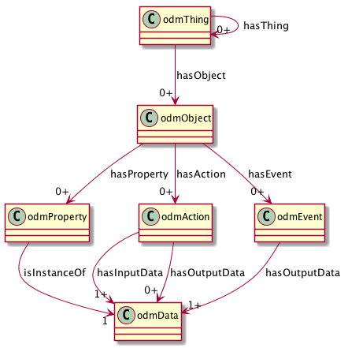
ODM Meta-Model
Thing Class to compose Objects
View (Interface) Class to virtualize affordances
Reusable Objects
Property, Action, and Event Affordances
Reusable Data Types

Slide 7
Thing Class
Encapsulate reusable Capabilities
On/Off with state Property, Commands, and Events
Compose Air Conditioner Thing from OnOff, Mode, Speed, etc. as reusable Capabilities
Reusable compositions of Capabilities
An Outlet unit for a multi-outlet strip
Each Outlet has OnOff, Energy Monitor, Overcurrent and Overtemperature protection Capabilities
Multiple Outlets are composed into an outlet strip
Outlet unit can be a Thing
Outlet Strip can also be a Thing

Slide 8
schema.org IoT Extension Meta Model with Thing Class
IotThing
schema:thing
hasIotThing
hasIotCapability
providesOutputData
providesInteractionPattern
acceptsInputData
IotCapability
InteractionPattern
IotDataItem
schema:PropertyValue
IotAction
IotEvent
IotProperty
schema:PropertyValueSpec.
rdfs:subclassOf
schema:Property
iotschema Class
Reused Class

Slide 9
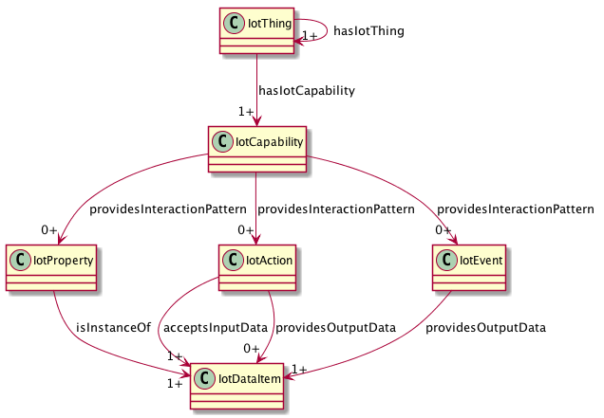
iotschema UML with iotThing class

Slide 10
High Level Integration Patterns
OMA LWM2M
WoT TD
SDF
BRICKschema
VSSschema
OCF
iotschema
Annotate
Convert
Templates
HTML
ZA/CHIP DMWG
Convert
Annotate

Slide 11
One Data Model integration
Re-shape One Data Model definitions as iotschema definitions
One Data Model uses JSON object hierarchy vs. RDF links
JSON pointer fragment identifiers
st:#/odmObject/onoff/odmAction/turnon
iot:onoffCapability => iot:providesTurnonAction => iot:turnonAction
iot:providesTurnonAction is a sub-class property from iot:providesInteractionPattern

Slide 12
iotschema from OneDM
st:#/odmObject/onoff/odmAction/turnon
odmObject => iotCapability
Create type names
st:#/odmObject/switch => iot:switchCapability
st:#/odmObject/switch/odmAction/turnon => iot:turnOnAction (iot:switchTurnOnAction?)
Synthesize the schema.org style property types
providesInteractionPattern subtypes
providesSwitchTurnOnAction

Slide 13
Path Construct in RDF
st:#/odmObject/onoff/odmAction/turnon
"@id": "iot:iotCapability/onoff"
"@id": "iot:iotCapability/onoff/iotAction/turnon"
What does the property type look like?
iot:providesInteractionPattern
iot:providesTurnonAction
iot:providesiotCapability/onoff/iotAction/turnon

Slide 14
Schema.org Integration
Class names Event, Action, Property conflict
iotschema has diverse semantic types for objects, schema.org has diverse property types
Property types could be synthesized from objects but…
iotschema will potentially define hundreds of types for physical quantities (temperature, humidity, voltage, acceleration…), control affordances (open/close, brightness, color control, camera controls, operating modes…), and features of interest (rooms, machines…)

Slide 15
Schema.org Integration
The WoT use case is based on annotation consisting of RDF @type statements that point to URIs of defined terms for specialized types that conform to the classes in the meta-model
These meta-model classes would only add about 6 new property types to schema.org
iotCapability, iotEvent, iotAction, iotProperty, iotData, iotFeatureofInterest
new types like iotInterface, iotThing, etc. as needed

Slide 16
Schema.org Integration
There is a potential example pattern in schema.org
MedicalEntity, with about 7 property types
Likewise, an instance of IoT Schema would contain some set of iotCapability, iotAction, iotProperty, iotEvent, iotFeatureOfInterest properties
Specialization of iot types would happen at the next level in the graph – hosted in a separate namespace
URIs that point to accepted specialized definitions in one or more specialized namespaces
lighting controls, thermostats, etc. that conform to the base types but have their own properties

Slide 17
Conclusion
Summary
AOB

