Slide 1
IoT Extensions for schema.org Community Teleconference
January 16, 2020
Unrestricted

Slide 2
Agenda
Agenda review
Recent developments – Project CHIP
System level modeling - Feature of Interest relation types
OneDM mapping to iotschema – Semantic Proxy
Admin and community items - Planning
AOB

Slide 3
Project CHIP
Google and Apple joined Zigbee Alliance to create a new interoperable network standard for connected homes – Project Connected Home over IP
Deliver a standard, open source reference stack, and certification program for interoperable devices
What it means to iotschema - standardized data models for connected home devices + open source license
Still need to address system level modeling with location, context , behavior + application domains

Slide 4
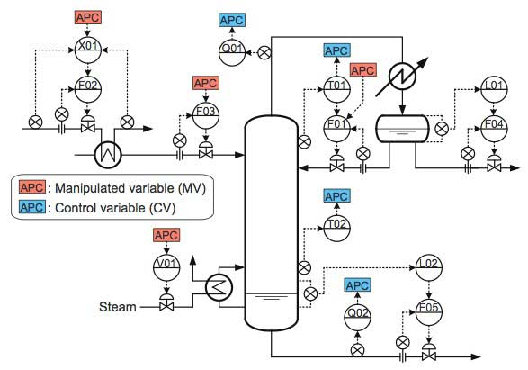
System Level Modeling
https://www.yokogawa.com/us/library/resources/yokogawa-technical-reports/energy-saving-solutions-by-advanced-process-control-apc-technology/

Slide 5
System Level Modeling
Inversion of the prevailing architecture focus
Inappropriate network centric device interaction models
Serves device and network technology vendors
System level modeling
Focus of modeling on the physical plant with attached devices
Abstraction of devices => Affordances on FoI
Descriptive effort to focus on FoI integration
IoT discovery will focus on FoI and affordances to satisfy "business logic" objectives – content for directories
Natural exposure of models for Digital Twin style modeling

Slide 6
System Level Model Extension Candidates for iotschema
Feature of Interest
Interaction models
Interaction data – modes and states
Enumerations
State Machines
Behaviors
Processes
Provenance
Usage (ala MUD)
?

Slide 7
FoI Relation Types
Victor Charpenay

Slide 8
Semantic Proxy
A Proxy for Semantic Interoperability
Proxy to enable translation from device protocol to application protocol
Provides for many-to-many mapping of application protocols to device protocols
many-to-one and one-to-many through a common semantic model
Could implement a "universal" IoT gateway

Slide 9
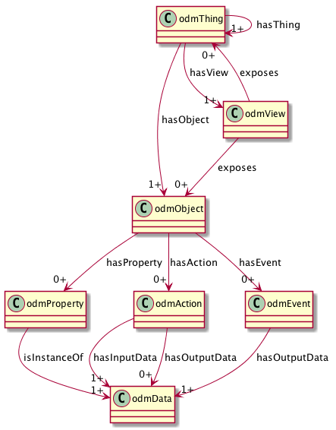
ODM Meta-Model
Thing Class to compose Objects
View (Interface) Class to virtualize affordances
Reusable Objects
Property, Action, and Event Affordances
Reusable Data Types

Slide 10
Meta Operations of Abstract Affordances
Property
value = Read(), Write(value)
Action
status response(s) = Invoke(parameters)
Event
event occurrence responses = Subscribe()

Slide 11
Semantic Proxy – Protocol Binding
Uses a common semantic model to connect applications to things over diverse network protocols and communication patterns
Proxy maps the meta-model operations to network messages in the target protocol using protocol bindings
Flavors of REST, Pub/Sub, RPC messages
Example using W3C Web of Things Architecture

Slide 12
Semantic Proxy – W3C Web of Things Integration
"Thing Description" associates semantic identifiers for Properties, Actions, and Events with affordance descriptions consisting of data schemas and protocol bindings
Protocol bindings associate network operations with meta-operations in the semantic model
"Incoming" Consumed TD and "Outgoing" Exposed TD have the same affordances in the semantic model, and customized data schemas and protocol bindings

Slide 13
Semantic Proxy - Schematic
OCF Application
Exposed Thing TD has OCF protocol binding
Consumed Thing TD has IPSO protocol binding
Ex. TD
Meta
Expose
PB
OCF Protocol
Semantic Proxy
WoT Servient
Co. TD
Consume
IPSO Protocol
Meta
PB
IPSO Device

Slide 14
Semantic Proxy - Schematic
Both TDs have the same meta interactions and operations defined by OneDM models
OCF Application
OCF Application
TD
Ex. TD
Meta
Meta
Expose
Expose
PB
OCF Protocol
Semantic Proxy
WoT Servient
Semantic Proxy
WoT Servient
SDF
RDF
Annotate
TD
Co. TD
Consume
IPSO Protocol
Meta
Consume
Meta
Convert
PB
IPSO Device
IPSO Device

Slide 15
Semantic Proxy – RDF Converter
WoT Thing Description can use iotschema definitions for annotation
WoT TD only has Thing and affordance (P/A/E) classes
iotschema style RDF definitions are aligned with the OneDM SDF meta-model
Create RDF statements from OneDM definitions for use in semantic tooling
odmObject maps to iotschema Capability
odmThing and odmView don't directly map but can extend iotschema Capability

Slide 16
Convert SDF Documents to an iotschema style Definitions
JSON-LD Frame Document
RDF Shape Document
SDF Document
JSON-LD Document
iotschema Definition
JSON-LD
Frame
Shape

Slide 17
OneDM SDF Example Mapping
{
"namespace": {
"iot": "http://iotschema.org/#"
},
"defaultnamespace": "iot",
"odmObject": {
"Switch": {
"odmProperty": {
"State": {
"type": "string",
"enum": ["on", "off"]
}
},
"odmAction": {
"On": {},
"Off": {}
}
}
}
JSON-LD Context
iotschema Capability
iotschema Property
iotschema Action

Slide 18
Expected Result – Object maps to Capability
{
"@id": "iot:SwitchCapability",
"@type": "rdfs:Class",
"rdfs:label": "SwitchCapability",
"rdfs:subClassOf": {
"@id": "iot:Capability"
},
"iot:providesInteractionPattern": [
{
"@id": "iot:SwitchStateProperty",
"@id": "iot:SwitchOnAction",
"@id": "iot:SwitchOffAction"
}
]
}

Slide 19
Expected Result - Actions
{
"@id": "iot:SwitchOnAction",
"@type": "rdfs:Class",
"rdfs:label": "SwitchOnAction",
"rdfs:subClassOf": {
"@id": "iot:Action"
}
},
{
"@id": "iot:SwitchOffAction",
"@type": "rdfs:Class",
"rdfs:label": "SwitchOffAction",
"rdfs:subClassOf": {
"@id": "iot:Action"
}
}

Slide 20
Properties and Data Types
{
"@id": "iot:SwitchStateProperty",
"@type": "rdfs:Class",
"rdfs:label": "SwitchStateProperty",
"rdfs:subClassOf": {
"@id": "iot:Property"
},
"iot:providesOutputData": {
"@id": "iot:SwitchStateData"
}
},
{
"@id": "iot:SwitchStateData",
"@type": "rdfs:Class",
"rdfs:label": "SwitchStateData",
"rdfs:subClassOf": {
"@id": "schema:PropertyValue"
},
"schema:propertyType": {
"@id": "schema:String"
}
}

Slide 21
Expected Result - Enums
How do we describe enums in iotschema style RDF?
How do we map enum values in RDF (which are URIs) to concrete representation values in schemas?
[true, false], [1, 0], ["on", "off"]
Could use schema annotation, like @type but for enum values
"enum": [
{"iot:Switch.State.On": "on"},
{"iot:Switch.State.Off": "off"}
]

Slide 22
Enum Data Item and Type in RDF
{
"@id": "iot:SwitchStateData",
"@type": "rdfs:Class",
"rdfs:label": "SwitchStateData",
"rdfs:subClassOf": {
"@id": "schema:PropertyValue"
},
"schema:propertyType": {
"@id": "iot:SwitchStateValue"
}
}
{
"@id": "iot:SwitchStateValue",
"@type": "rdfs:Class",
"rdfs:comment": "Enumeration of Switch states",
"rdfs:label": "SwitchStateType",
"rdfs:subClassOf": {
"@id": "schema:Enumeration"
}
},

Slide 23
Enum Data Values in RDF
{
"@id": "iot:SwitchOnState",
"@type": "iot:SwitchStateValue",
"rdfs:comment": "Switch On State",
"rdfs:label": "SwitchOnState"
},
{
"@id": "iot:SwitchOffState",
"@type": "iot:SwitchStateValue",
"rdfs:comment": "Switch Off State",
"rdfs:label": "SwitchOffState"
}

Slide 24
Enum Data Values in RDF
{
"@id": "iot:SwitchOnState",
"@type": "iot:SwitchStateValue",
"rdfs:comment": "Switch On State",
"rdfs:label": "SwitchOnState",
"schema:propertyType": {"@id": "schema:String"}
"schema:defaultValue": {"rdfs:Literal": "on"}
},
{
"@id": "iot:SwitchOffState",
"@type": "iot:SwitchStateValue",
"rdfs:comment": "Switch Off State",
"rdfs:label": "SwitchOffState"",
"schema:propertyType": {"@id": "schema:String"}
"schema:defaultValue": {"rdfs:Literal": "off"}
}

Slide 25
TD Semantic Annotation
iotschema Definition | TD @type annotation
Capability | iot:SwitchCapability
Property | iot:SwitchStateProperty
Data Type | iot:SwitchStateData
Property Value | iot:SwitchOnState, iot:SwitchOffState
Action | iot:SwitchOnAction, iot:SwitchOffAction
OneDM Definition | TD @type annotation
Object | odm:odmObject/Switch
Property | odm:odmObject/Switch/odmProperty/State
Data Type | odm:odmData/SwitchData
Property Value | odm:odmData/SwitchData/enum/0, odm:odmData/SwitchData/enum/1
Action | odm:odmObject/Switch/odmAction/On, odm:odmObject/Switch/odmAction/Off

Slide 26
Semantic Proxy – WoT TD
{
"@context": [
"https://www.w3.org/2019/wot/td/v1",
{"iot": "http://iotschema.org/"}
],
"@type": [ "Thing", "iot:SwitchCapability" ],
"properties": {
"SwitchStateProperty": {
"@type": ["iot:SwitchStateProperty", "iot:SwitchStateData"],
"type": "string",
"enum": ["on", "off"],
"writeOnly": false,
"readOnly": false,
"observable": true,
"forms": [
{
"href": "/SwitchCapability/properties/SwitchStateProperty",
"op": ["readproperty", "writeproperty", "observeproperty"],
"contentType": "application/json"
}
]
}
},

Slide 27
Semantic Proxy – WoT TD
"actions": {
"SwitchOnAction": {
"@type": ["iot:SwitchOnAction"],
"input": {},
"forms": [
{
"href": "/SwitchCapability/actions/SwitchOnAction",
"op": ["invokeaction"],
"contentType": "application/json"
}
]
},
"SwitchOffAction": {
"@type": ["iot:SwitchOffAction"],
"input": {},
"forms": [
{
"href": "/SwitchCapability/actions/SwitchOffAction",
"op": ["invokeaction"],
"contentType": "application/json"
}
]

Slide 28
Semantic Proxy – Semantic API
Names of affordances are resolved through Semantic Discovery
PropertyName=discover(FilterParameters)
Applications use meta-model affordances and operations
data=readProperty(PropertyName)
writeProperty(PropertyName, data)
result=invokeAction(ActionName, parameters)
data=subscribeEvent(EventName)
Supports modular, declarative programming models – Node-RED

Slide 29
References
One Data Model SDF and Model work in progress
https://github.com/one-data-model/language
https://github.com/one-data-model/playground
Semantic Proxy and W3C WoT
https://github.com/tum-ei-esi/virtual-thing
https://www.w3.org/TR/2019/CR-wot-thing-description-20191106/
https://www.w3.org/TR/2019/CR-wot-architecture-20191106/

Slide 30
Expected Result – Object maps to Capability (.)
{
"@id": "iot:Capability.Switch",
"@type": "rdfs:Class",
"rdfs:label": "SwitchCapability",
"rdfs:subClassOf": {
"@id": "iot:Capability"
},
"iot:providesInteractionPattern": [
{
"@id": "iot:Capability.Switch.Property.State",
"@id": "iot:Capability.Switch.Action.On",
"@id": "iot:Capability.Switch.Action.Off"
}
]
}

Slide 31
Expected Result – Actions (.)
{
"@id": "iot:Capability.Switch.Action.On",
"@type": "rdfs:Class",
"rdfs:label": "SwitchOnAction",
"rdfs:subClassOf": {
"@id": "iot:Action"
}
},
{
"@id": "iot:Capability.Switch.Action.Off",
"@type": "rdfs:Class",
"rdfs:label": "SwitchOffAction",
"rdfs:subClassOf": {
"@id": "iot:Action"
}
}

Slide 32
Properties and Data Types (.)
{
"@id": "iot:Capability.Switch.Property.State",
"@type": "rdfs:Class",
"rdfs:label": "SwitchStateProperty",
"rdfs:subClassOf": {
"@id": "iot:Property"
},
"iot:providesOutputData": {
"@id": "iot:Capability.Switch.Property.State.Data"
}
},
{
"@id": "iot:Capability.Switch.Property.State.Data",
"@type": "rdfs:Class",
"rdfs:label": "SwitchStateData",
"rdfs:subClassOf": {
"@id": "schema:PropertyValue"
},
"schema:propertyType": {
"@id": "schema:String"
}
}

Slide 33
Enum Data Item and Type in RDF (.)
{
"@id": "iot:Capability.Switch.Property.State.Data",
"@type": "rdfs:Class",
"rdfs:label": "SwitchStateData",
"rdfs:subClassOf": {
"@id": "schema:PropertyValue"
},
"schema:propertyType": {
"@id": "iot:Capability.Switch.Property.State.Data.Value"
}
}
{
"@id": "iot:Capability.Switch.Property.State.Data.Value",
"@type": "rdfs:Class",
"rdfs:comment": "Enumeration of Switch states",
"rdfs:label": "SwitchStateValue",
"rdfs:subClassOf": {
"@id": "schema:Enumeration"
}
},

Slide 34
Enum Data Values in RDF (.)
{
"@id": "iot:Capability.Switch.Property.State.Data.Value.On",
"@type": "iot:Capability.Switch.Property.State.Data.Value",
"rdfs:comment": "Switch On State",
"rdfs:label": "SwitchOnState"
},
{
"@id": "iot:Capability.Switch.Property.State.Data.Value.Off",
"@type": "iot:Capability.Switch.Property.State.Data.Value",
"rdfs:comment": "Switch Off State",
"rdfs:label": "SwitchOffState"
}

Slide 35
iotschema Review: Status and Planning
September 2019
Unrestricted

Slide 36
Contents
Charter and Objectives – What we started out to do
Status – What we have accomplished
W3C WoT integration – Test case and results
Schema.org integration – Proposal and issues
W3C Community Group – IPR policy and continuity
OneDM Liaison Group – Report out
Going forward – a proposal

Slide 37
Charter and Objectives
Create an extension to Schema.org that will enable IoT semantics
Work with relevant vendors and SDOs to architect a common information model for IoT
Develop a process to enable free contribution from diverse organizations, driving toward normalization to a common model
Enable domain and subject experts to create and maintain definitions and models
Work on practical integration with Schema.org

Slide 38
Status
Developed a common meta-model which is well adopted in industry (graphic)
Functional/semantic capabilities with common Property, Action, and Event classes of affordances
Feature of Interest integration from other namespaces – GENIVI/VSS, BrickSchema, Project Haystack
Integration with W3C SOSA/SSN
Published strawman definitions for some common IoT capabilities
Conducted test case evaluation with W3C Web of Things and IRTF T2TRG WISHI including hands-on

Slide 39
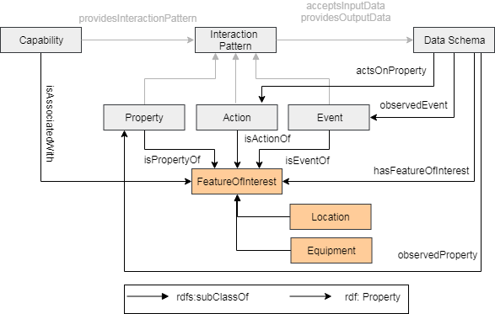
Information Meta-Model

Slide 40
W3C WoT Test Case
Integrated iotschema definitions with WoT Thing Description as semantic annotation (example)
Created strawman definitions for common use
Investigated use in discovery and configuration
Several organizations used semantic annotation
Node-RED application for semantic interoperability
Uses WoT Thing Description with iotschema annotation
WoT discovery will be further developed

Slide 41
iotschema for Node-RED Recipe-based applications
iotschema embedded in Node-RED tool
Enables an easy configuration of things using iotschema definitions
Easies the use of semantics for IoT developers
No need for a developer to know RDF(S), JSON-LD, RDF Shapes ...
Simplify creation of applications with W3C WoT
Avoids translations of serializations formats, data types, units ...
Demonstrates semantic discovery and processing
Integrates WoT Thing Directory
GitHub project location:
https://github.com/iot-schema-collab/iotschema-node-red

Slide 42
Schema.org Integration
Class names Event, Action, Property conflict
iotschema has diverse semantic types for objects, schema.org has diverse property types
Property types could be synthesized from objects but…
iotschema will potentially define hundreds of types for physical quantities (temperature, humidity, voltage, acceleration…), control affordances (open/close, brightness, color control, camera controls, operating modes…), and features of interest (rooms, machines…)

Slide 43
Schema.org Integration
The WoT use case is based on annotation consisting of RDF @type statements that point to URIs of defined terms for specialized types that conform to the classes in the meta-model
These meta-model classes would only add about 6 new property types to schema.org
iotCapability, iotEvent, iotAction, iotProperty, iotData, iotFeatureofInterest
new types like iotInterface, iotThing, etc. as needed

Slide 44
Schema.org Integration
There is a potential example pattern in schema.org
MedicalEntity, with about 7 property types
Likewise, an instance of IoT Schema would contain some set of iotCapability, iotAction, iotProperty, iotEvent, iotFeatureOfInterest properties
Specialization of iot types would happen at the next level in the graph
URIs that point to accepted specialized definitions in a different namespace (?)
lighting controls, thermostats, etc. that conform to the base types but have their own properties

Slide 45
Schema.org Integration
The base properties line up with semantic classes that have software handlers,e.g. to discover, display, control
The specialization information enables selection of application elements that can understand and interoperate with the specialized affordances, for example lighting controls
More general applications might reason about semantic constructions based on their ability to parse the semantic graph
Adaptation software may need special properties to describe data types, units, and ranges

Slide 46
W3C Community Group
Started early 2019
A few members have joined but not active yet
IPR policy for contributions based on CG membership
CG membership will become part of the community and be required for contributors and participants
Can we adopt the BSD 3-Clause license for our contributed and published content?

Slide 47
OneDM Liaison Group
Semi-private group of SDOs and associated vendors
Goal is to create a common IoT data model and normalized device definitions
Creating open source JSON language and developer tools for definitions, using BSD 3-Clause license
High level alignment with the Property-Action-Event meta-model
OneDM definitions can feed iotschema
We can share OneDM language and tools

Slide 48
Going Forward
Create an experimental area on schema.org for normalized, accepted iotschema content
Create a namespaced area per contributing org in the public github, allow open contribution of raw content
CI tools validate the contributed definitions
The definition can immediately be dereferenced in the contributor's namespace (on schema.org?)
Move definitions into the official github repository and schema.org experimental area when they are accepted

Slide 49
To Do
Integrate the iotschema W3C Community Group into the process, define licensing and publication
Design a namespace scheme for contributing orgs and for linked ontologies
Refactor the vocabulary as necessary to remediate the name conflicts
Build and deploy CI tools to check contributions

Slide 50
iotschema: Resources
W3C Community Group:
The Schema Extensions For IoT
https://www.w3.org/community/iotschema/
GitHub repository:
https://github.com/iot-schema-collab/iotschema
Teleconferences:
https://github.com/iot-schema-collab/teleconferences
Contributions:
https://github.com/iot-schema-collab/iotschema
Charter:
https://github.com/iot-schema-collab/ws-charter
Web site:
Current location
http://iotschema.org/docs/full.html
Tools:
iotschema for Node-RED
https://github.com/iot-schema-collab/iotschema-node-red

