Slide 1
iot.schema.org Community Update
May 17, 2017

Slide 2
Agenda
Review the agenda, items to add
Jason Koh – Brick Ontology (added below)
Updated meta model/ontology with FoI
Mapping Haystack tags in iot.schema.org
Brick Ontology
Documentation Workstream
Organizational updates
AOB

Slide 3
iot.schema.org
Feature of Interest
Haystack Vocabulary Alignment
May 17, 2018

Slide 4
Feature of Interest
Update on the meta-model

Slide 5
Motivation for Feature Of Interest Pattern
Binds Capability and Interaction Patterns to real-world objects
This provides information about the environment in which sensing/actuating is applied
PlugFest use cases prove that the Feature of Interest (FoI) pattern is needed in iot.schema.org

Slide 6
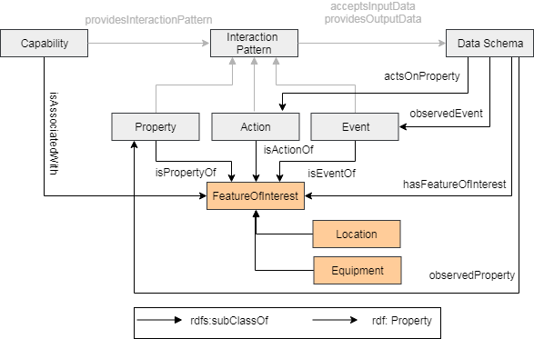
Feature Of Interest Pattern

Slide 7
Feature of Interest Example
{
"@id": "iot:TemperatureSensing",
"rdfs:subClassOf": { "@id": "iot:Capability" },
"iot:providesInteractionPattern": [ { "@id": "iot:Temperature“ }]
}, {
"@id": "iot:Temperature",
"rdfs:subClassOf": { "@id": "iot:Property" },
"iot:isPropertyOf": {"@type": "iot:Room"},
"iot:providesOutputData": { "@id": "iot:TemperatureData“ }
}, {
"@id": "iot:TemperatureData",
"rdfs:subClassOf": { "@id": "iot:DataSchema" },
"iot:hasFeatureOfInterest": {"@type": "iot:Room"},
"iot:observedProperty": "iot:Temperature",
"schema:propertyType": { "@id": "schema:Float" },
"schema:unitCode": { "@id": "iot:TemperatureUnit" },
"schema:minValue": "schema:Float",
"schema:maxValue": "schema:Float"
}

Slide 8
Haystack vocabulary in iot.schema.org
Extension of iot.schema.org

Slide 9
Project Haystack
Aims to standardize semantic data models to unlock the value of data generated by building equipment.
It is an open source initiative to enable Internet of Things applications.
Applications include automation, control, energy, HVAC, lighting, and other environmental systems.

Slide 10
Haystack Model
entity: is an abstraction for some physical object in the real world, e.g.
sites, equipment, sensor points, etc.
tag: is a name/value pair applied to an entity.
equip: is a physical asset, e.g. AHU, boiler, or chiller. Can also be used
to model a logical grouping, e.g. chiller plant.
point: is typically a digital or analog sensor or actuator
sensor: input, AI/BI, sensor
cmd: output, AO/BO, actuator, command
sp: setpoint, internal control variable, schedule
kind: Defines a tag value type, e.g., number, bool, str
Multiple tags are used to model the role of a point:
where: discharge, return, exhaust, outside
what: air, water, steam
measurement: temp, humidity, flow, pressure

Slide 11
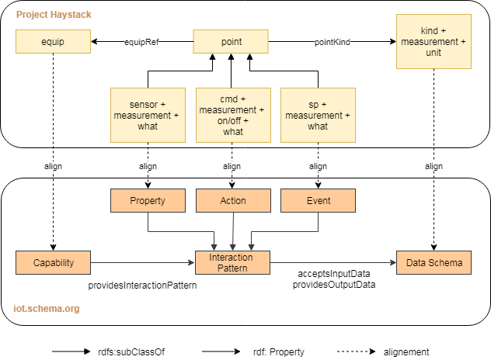
Integration of Haystack vocabulary in iot.schema.org

Slide 12
Example: Boiler in Haystack
equip: boiler
It is used to generate hot water or steam for heating.
Equip level tags:
where: equipRef must reference parent plant if associated with a plant
what: hot water or steam or oil or gas
Points associated with the boiler equip:
run cmd
run sensor
circ pump cmd
circ pump sensor
condensate pump cmd
condensate pump sensor

Slide 13
Example: Boiler mapped to iot.schema.org
iot:Capability: iot:Boiler
subclasses: iot:HotWaterBoiler, iot:SteamBoiler, iot:OilBoiler etc
iot:InteractionPattern:
iot:Action: iot:TurnOn, iot:TurnOff (run cmd)
iot:Property: iot:RunStatus (run sensor)
iot:Action: iot:CirculatePumpOn, iot:CirculatePumpOff (circ pump cmd)
iot:Property: iot:CirculatePumpStatus (circ pump sensor)
iot:Action: iot:CondensatePumpOn, iot:CondensatePumpOff (condensate pump cmd)
iot:Property: iot:CondensatePumpStatus (condensate pump sensor)
What should be the result of mapping the Haystack vocabulary into iot.schema.org?

Slide 14
Thank You!
Questions please…

Slide 15
Documentation Workstream
Landing page
One page summary
White paper
Slide deck
User guide
Developer guide

Slide 16
Landing Page (s)
iot.schema.org entry point
Browse the schemas
github entry point
Focus on developers and users
Technical guidance and examples
Tools
W3C Community Group entry point
Summary, informational, getting started
Focus on incubating new definitions

Slide 17
One Pager
What, why, how, and getting involved on a single page
Some technical detail to explain what part of the solution this is and what technology is being used
Same information on the W3C Community page

Slide 18
White Paper
Describes iot.schema.org in a conference style and format
Broad analysis of other approaches and formats
References for research

Slide 19
Slide Deck
Explains iot.schema.org
Comprehensive
Available as source material for anyone to include
10 minute version for outreach

Slide 20
User Guide
How to use iot.schema.org definitions in systems
Semantic annotation and categories
Annotation examples in TD, other formats
Discovery and filtering
Feature of Interest annotation

Slide 21
Developer Guide
How to create and contribute iot.schema.org definitions
Best practices for definitions

Slide 22
Organizational update
Resources
Shared Google Document – historical, rolling agenda
Google Discussion Group – broad issues
Github organization – issues and discussion
W3C Community Group
A venue for incubation and contribution of new definitions
New application domains – eventually may split off
Framework to apply a contributor IPR policy to CG members
Also can accept contributions from schema.org members under the schema.org IPR policy

Slide 23
Upcoming Semantic Interop Events
W3C Web of Things Plugfest
South Korea, June 30th and July 1st
WISHI Plugfest/Hackathon at IETF 102
Montreal, July 14th and 15th

Slide 24
Any Other Business

