Slide 1
IoT Extensions for schema.org
Community Teleconference
February 18, 2020

Slide 2
Agenda
Agenda review
schema.org integration patterns
AOB

Slide 3
Schema.org Integration
Class names Event, Action, Property conflict
iotschema has diverse semantic types for objects, schema.org has diverse property types
Property types could be synthesized from objects but…
iotschema will potentially define hundreds of types for physical quantities (temperature, humidity, voltage, acceleration…), control affordances (open/close, brightness, color control, camera controls, operating modes…), and features of interest (rooms, machines…)

Slide 4
Schema.org Integration
The WoT use case is based on annotation consisting of RDF @type statements that point to URIs of defined terms for specialized types that conform to the classes in the meta-model
These meta-model classes would add 7 new iot types to schema.org
iotThing, iotCapability, iotEvent, iotAction, iotProperty, iotData, iotFeatureofInterest
new types like iotInterface as needed

Slide 5
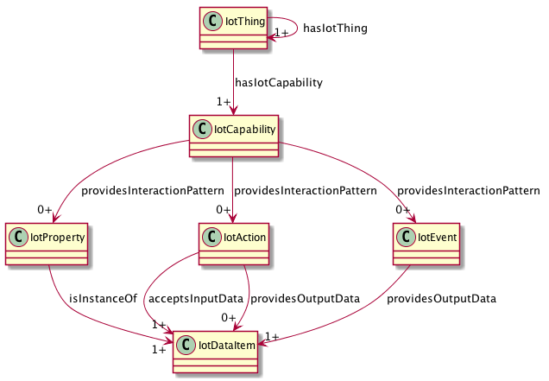
iotschema UML

Slide 6
Schema.org Integration
There is a potential example pattern in schema.org
MedicalEntity, with 7 property types
Likewise, an IoT Schema instance would contain some set of iotThing, iotCapability, iotAction, iotProperty, iotEvent, iotFeatureOfInterest classes and associated Property Types
Specialization of iot types would happen at the next level in the graph – hosted in a separate namespace
URIs that point to accepted specialized definitions in one or more specialized namespaces
lighting controls, thermostats, etc. that conform to the base types but have their own Property Types

Slide 7
Application Type Example
schema:hasIotThing
iot:hasSwitch
Switch
hasSwitch
schema:IotThing
iot:Switch
hasOnOffControl
OnOffControl
providesOnOffProperty
providesTurnOnAction
providesTurnOffAction
providesToggleAction
providesPowerInterruptedEvent
providesPowerRestoredEvent
OnOffProperty
TurnOnAction
PowerInterruptedEvent
providesOnOffStateData
OnOffStateData

Slide 8
Conclusion
Next steps/meeting
AOB

Slide 9
Backup
Interaction model survey
Thing Class
OneDM Integration

Slide 10
Meta-model survey – Common Affordance Semantics
Information | OneDM SDF | WoT TD | iotschema | ZCL/dotdot | OCF | SmartThings | LWM2M | Weave | Vorto | UPnP | BLE Mesh | Azure DTDL | oneM2M | OPC UA
Governing body | OneDM Liaison | W3C | W3C/schema.org | Zigbee Alliance | OCF | SmartThings | OMA SpecWorks | Google/Nest | Eclipse | OCF | BT Sig | Microsoft | oneM2M | OPC
Tools License | BSD | Many |  | Proprietary | BSD | Proprietary |  | Apache2 | Eclipse |  |  | MIT | Apache2.0
Models License | BSD | No Models |  | BSD | BSD | Proprietary | OMA | Apache2 |  |  |  | CC Attr. 4.0
representation language | JSON | LSON-LD | JSON-LD | XML | JSON | JSON | XML | WDL | vortolang | XML | XML | JSON-LD | XML | XML
Content Format | sdf+json | td+jsonld | jsonld | zcl+xml | swagger+ json | json | mod+xml | text | text | upnp+xml | xml | jsonld | sdt+xml
Reference | https://github.com/one-data-model/language | https://www.w3.org/TR/wot-thing-description/ | https://github.com/iot-schema-collab/iotschema | https://zigbeealliance.org/wp-content/uploads/zip/dotdot-ip-package.zip | https://openconnectivity.org/developer/specifications/ | https://docs.smartthings.com/en/latest/capabilities-reference.html | http://www.openmobilealliance.org/wp/omna/lwm2m/lwm2mregistry.html | https://openweave.io/guides/weave-primer/schema | https://github.com/eclipse/vorto/tree/development/docs | https://openconnectivity.org/developer/specifications/upnp-resources/upnp/ | https://www.bluetooth.com/specifications/mesh-specifications/ | https://github.com/Azure/IoTPlugandPlay/tree/master/DTDL | http://www.onem2m.org/tr-0039/ipe-and-sdt | https://opcfoundation.org/developer-tools/specifications-unified-architecture
Terminology | OneDM SDF | WoT TD | iotschema | ZCL/dotdot | OCF | SmartThings | LWM2M | Weave | Vorto | UPnP | BLE Mesh | Azure DTDL | oneM2M | OPC UA
Composed Instance | Thing/Thing | Thing | Thing/Thing | Device/EP | Platform/Device | Fingerprint | Registration | Device | Info Model | Device | Device | Capability Model | Device | Device, Server
Atomic Functionality Unit | Object | (Thing) | Capability | Cluster | Resource | Capability | Object | Trait | Function Block | Service | Model | Interface | ModuleClass | Object
Externalized state item | Property | Property | Property | Attribute | Property | Attribute | Resource | Property | Config, Status | State Variable | Attribute | Property | Data Point | Attribute, Variable
External method accepted | Action | Action | Action | Command | POST | Command | Executable Res. | Command | Operation | Action | Write | Command | Action | Method, Program
External signal emitted | Event | Event | Event | Report | Observe data | Device Event | Observe data | Event | Event | Event | Report | Telemetry | Event | Event, Alarm
Reusable data type | Datatype | Datatype | Datatype | Datatype | OAS definition | Datatype | Reusable Res. | Datatype | Datatype | Datatype | Datatype | schema | xsd types | register types
Network Binding | OneDM SDF | WoT TD | iotschema | ZCL/dotdot | OCF | SmartThings | LWM2M | Weave | Vorto | UPnP | BLE Mesh | Azure DTDL | oneM2M | OPC UA
Data Schema | JsonSchema | JsonSchema | External | XML | OAS 2.0 | Mapping Files | SenML | WDL | External | XML | XML | DTDL | XSD
Protocol Binding | External | TD Forms | External | ZCL Commands | OAS 2.0 | Device Handlers | CoAP | WDM | External | UPnP defined | BLE GATT | External | External
Protocols |  | MQTT,HTTP,CoAP |  | Zigbee Pro, CoAP | CoAP | Many | CoAP | WDM |  | HTTP | BLE

Slide 11
Thing Class
Encapsulate reusable Capabilities
On/Off with state Property, Commands, and Events
Compose Air Conditioner Thing from OnOff, Mode, Speed, etc. as reusable Capabilities
Reusable compositions of Capabilities
An Outlet unit for a multi-outlet strip
Each Outlet has OnOff, Energy Monitor, Overcurrent and Overtemperature protection Capabilities
Multiple Outlets are composed into an outlet strip
Outlet unit can be a Thing
Outlet Strip can also be a Thing

Slide 12
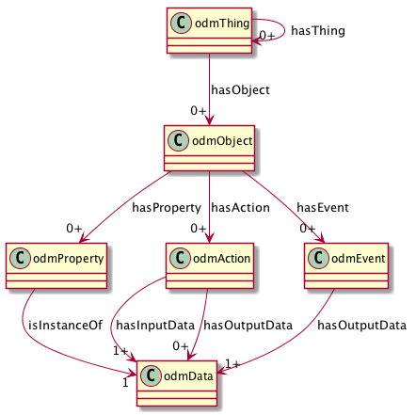
ODM Meta-Model
Thing Class to compose Objects
View (Interface) Class to virtualize affordances
Reusable Objects
Property, Action, and Event Affordances
Reusable Data Types

Slide 13
iotschema UML with iotThing class

Slide 14
schema.org IoT Extension Meta Model with Thing Class
IotThing
schema:thing
hasIotThing
hasIotCapability
providesOutputData
providesInteractionPattern
acceptsInputData
IotCapability
InteractionPattern
IotDataItem
schema:PropertyValue
IotAction
IotEvent
IotProperty
schema:PropertyValueSpec.
rdfs:subclassOf
schema:Property
iotschema Class
Reused Class

Slide 15
One Data Model integration
Re-shape One Data Model definitions as iotschema definitions
One Data Model uses JSON object hierarchy vs. RDF links
JSON pointer fragment identifiers
st:#/sdfObject/onoff/sdfAction/turnon
iot:onoffCapability => iot:providesTurnonAction => iot:turnonAction
iot:providesTurnonAction is a sub-class property from iot:providesInteractionPattern

Slide 16
iotschema from OneDM
st:#/sdfObject/onoff/sdfAction/turnon
sdfObject is "sameAs" iotCapability
Create type names
st:#/sdfObject/switch => iot:switchCapability
st:#/sdfObject/switch/sdfAction/turnon => iot:turnOnAction (iot:switchTurnOnAction?)
Synthesize the schema.org style property types
providesInteractionPattern subtypes
providesSwitchTurnOnAction

Slide 17
Path Construct in RDF
st:#/sdfObject/onoff/sdfAction/turnon
"@id": "iot:iotCapability/onoff"
"@id": "iot:iotCapability/onoff/iotAction/turnon"
What does the property type look like?
iot:providesInteractionPattern
iot:providesTurnonAction
iot:providesiotCapability/onoff/iotAction/turnon

