Slide 1
iotschema.org
"Semantic Integration Made Simple"
June 17, 2021

Slide 2
Agenda
Calendar, announcements
Semantic alignment proposal – V. Charpenay
Ongoing discussion - charter and plan
AOB

Slide 3
Calendar
W3C WoT testfest wrap-up Friday June 18
W3C WoT F2F the week of June 21 and June 28
IETF Hackathon July 19-23
IETF 111 July 26-30 12:00-18:00 PDT

Slide 4
Semantic Alignment

Slide 5
Discussion on Charter and Plan
Focus on application layer interoperability
Application semantics for W3C Thing Description
Digital Twin use cases
Integration patterns with physical system semantics - Brickschema, VSSschema, other vertical applications

Slide 6
Review of April 2021 Re-Charter

Slide 7
iotschema re-charter
iotschema provides an RDF integration pattern for common application semantics, using categories that are well-aligned with WoT TD
schema.org will not benefit from integration of IoT affordances – rather, vertical domain vocabularies
iotschema set out to attract product vendors to adopt a common format and entry point for iot information models
One Data Model liaison group has achieved this with respect to IoT device information models

Slide 8
iotschema benefits
Common information models provide more benefit to system integrators that need to work across vendors and verticals
WoT use cases are more aligned with system integration
Where OneDM and SDF provide a common translation format for device data models, iotschema provides common RDF integration patterns for multiple ecosystems that can be used in WoT deployments
iotschema can represent and integrate quantities and features of interest from diverse information model sources

Slide 9
Integration of IoT with Physical Systems
We have defined a general ontology for device affordances
There are existing ontologies for physical systems, e.g. BrickSchema for buildings
Where are other IoT related ontologies? SAREF, SOSA, SDT, SSN
Can we be an aggregation with well-defined semantic connectors?
What new ontologies will be needed?

Slide 10
One-stop Shop for IoT semantics
Extend beyond the Device Affordance Ontology to cover prominent industry gaps in IoT Semantics
Link to other sources and make them connectable, browse-able through new relation types (Object Properties)
Consume OneDM for device affordance definitions, provide an RDF front-end
Sort out Quantities and Units

Slide 11
iotschema + WoT benefits
WoT is an integration language
iotschema is the semantic database
data models from different ecosystems can be mapped to common iotschema concepts and exposed using WoT TD
System integrations e.g. digital twin, can adapt to diverse field devices using common semantic affordances defined in iotschema

Slide 12
Any model with any system
infomodel A
System A
Semantic "narrow waist"
infomodels => systems
iotschema
WoT
infomodel B
System B
infomodel C
System C

Slide 13
Going Forward
System integrators using WoT, etc. would benefit from common tools and formats for semantic integration
Developer tools can layer on top of WoT to provide semantic APIs to help with discovery, and for mapping affordances and data
Continue to deploy in WoT plugfests
Develop use cases to illustrate the benefits of semantic integration
Is there interest going forward; will people adopt it?
Can we build a new consortium?

Slide 14
Open questions
What are requirements across WoT use cases?
What are priorities, models, tools, formats?
Verticals are in different points in standardization
Move toward a W3C activity, work with VSS Ontology, BRICKSchema etc.
What is the venue? Engage the WoT CG and IG?

Slide 15
New Charter for iotschema.org
Develop semantic integration patterns for IoT information models
Connect IoT affordance models (OneDM, etc.) to physical world models (BRICKschema, VSSschema) using consistent patterns and shapes
Become a go-to place for semantic integration
Re-use existing ontologies and ontological patterns
Focus on W3C WoT and hypermedia integrations
Develop tools and repositories for models
Operate as a consortium with sub-teams

Slide 16
Work Streams
Revise the meta-model and shape constraints
iotThing class, refactor category names
Make some choices about quantities and units
Develop the browser and some simple demonstration tools like a metadata chooser plugin
Develop integration patterns for physical ontologies and digital twin
Feature of Interest and related property types
Define a release schedule and priorities for released datasets
Define an administrative structure and ground rules

Slide 17
Technical backup
Meta-information model survey across IoT
iotschema ontology

Slide 18
Meta-model survey – Common Affordance Semantics
Information | OneDM SDF | WoT TD | iotschema | ZCL/dotdot | OCF | SmartThings | LWM2M | Weave | Vorto | UPnP | BLE Mesh | Azure DTDL | oneM2M | OPC UA
Governing body | OneDM Liaison | W3C | W3C/schema.org | Zigbee Alliance | OCF | SmartThings | OMA SpecWorks | Google/Nest | Eclipse | OCF | BT Sig | Microsoft | oneM2M | OPC
Tools License | BSD | Many |  | Proprietary | BSD | Proprietary |  | Apache2 | Eclipse |  |  | MIT | Apache2.0
Models License | BSD | No Models |  | BSD | BSD | Proprietary | OMA | Apache2 |  |  |  | CC Attr. 4.0
representation language | JSON | LSON-LD | JSON-LD | XML | JSON | JSON | XML | WDL | vortolang | XML | XML | JSON-LD | XML | XML
Content Format | sdf+json | td+jsonld | jsonld | zcl+xml | swagger+ json | json | mod+xml | text | text | upnp+xml | xml | jsonld | sdt+xml
Reference | https://github.com/one-data-model/language | https://www.w3.org/TR/wot-thing-description/ | https://github.com/iot-schema-collab/iotschema | https://zigbeealliance.org/wp-content/uploads/zip/dotdot-ip-package.zip | https://openconnectivity.org/developer/specifications/ | https://docs.smartthings.com/en/latest/capabilities-reference.html | http://www.openmobilealliance.org/wp/omna/lwm2m/lwm2mregistry.html | https://openweave.io/guides/weave-primer/schema | https://github.com/eclipse/vorto/tree/development/docs | https://openconnectivity.org/developer/specifications/upnp-resources/upnp/ | https://www.bluetooth.com/specifications/mesh-specifications/ | https://github.com/Azure/IoTPlugandPlay/tree/master/DTDL | http://www.onem2m.org/tr-0039/ipe-and-sdt | https://opcfoundation.org/developer-tools/specifications-unified-architecture
Terminology | OneDM SDF | WoT TD | iotschema | ZCL/dotdot | OCF | SmartThings | LWM2M | Weave | Vorto | UPnP | BLE Mesh | Azure DTDL | oneM2M | OPC UA
Composed Instance | Thing/Thing | Thing | Thing/Thing | Device/EP | Platform/Device | Fingerprint | Registration | Device | Info Model | Device | Device | Capability Model | Device | Device, Server
Atomic Functionality Unit | Object | (Thing) | Capability | Cluster | Resource | Capability | Object | Trait | Function Block | Service | Model | Interface | ModuleClass | Object
Externalized state item | Property | Property | Property | Attribute | Property | Attribute | Resource | Property | Config, Status | State Variable | Attribute | Property | Data Point | Attribute, Variable
External method accepted | Action | Action | Action | Command | POST | Command | Executable Res. | Command | Operation | Action | Write | Command | Action | Method, Program
External signal emitted | Event | Event | Event | Report | Observe data | Device Event | Observe data | Event | Event | Event | Report | Telemetry | Event | Event, Alarm
Reusable data type | Datatype | Datatype | Datatype | Datatype | OAS definition | Datatype | Reusable Res. | Datatype | Datatype | Datatype | Datatype | schema | xsd types | register types
Network Binding | OneDM SDF | WoT TD | iotschema | ZCL/dotdot | OCF | SmartThings | LWM2M | Weave | Vorto | UPnP | BLE Mesh | Azure DTDL | oneM2M | OPC UA
Data Schema | JsonSchema | JsonSchema | External | XML | OAS 2.0 | Mapping Files | SenML | WDL | External | XML | XML | DTDL | XSD
Protocol Binding | External | TD Forms | External | ZCL Commands | OAS 2.0 | Device Handlers | CoAP | WDM | External | UPnP defined | BLE GATT | External | External
Protocols |  | MQTT,HTTP,CoAP |  | Zigbee Pro, CoAP | CoAP | Many | CoAP | WDM |  | HTTP | BLE

Slide 19
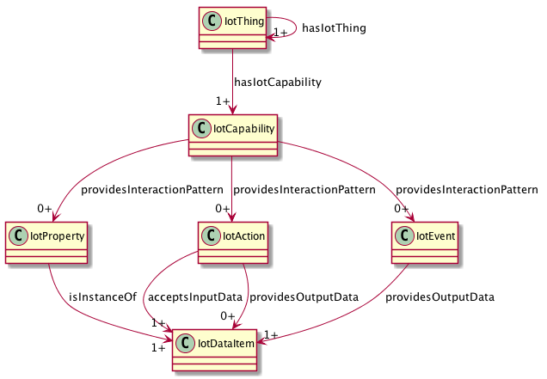
iotschema UML with iotThing class

