Slide 1
IoT Extensions for schema.org
Community Teleconference
June 18, 2020

Slide 2
Agenda
Agenda review
Announcements and industry developments
Status review
Ongoing topics – new progress ?
Thing class
One Data Model integration/format conversion
schema.org integration patterns
AOB

Slide 3
Announcements
W3C WoT Online Plugfest June 15-19
Focus on directory integration, discovery, semantics
Virtual Conference
OneDM preparing to emerge and "go public"
SDF language is stable and moving toward IETF standardization
~200 models in the playground; OCF, LWM2Mp, Zigbee, BLE Mesh examples, Energy models are another focus
Working on public-facing content for web pages and FAQ
New group in Building and Lighting industry to harmonize across several standards – commercial focus but may spawn a data model harmonization activity

Slide 4
Status update
Implementation status

Slide 5
Conclusion
Update ongoing topics
Summary
AOB

Slide 6
Backup

Slide 7
Schema.org
Number of RDF properties (capability types == 100s)
Will it be used?

Slide 8
i18n
IoT translation reference
Database
Power control and lighting domains
Domain vocabularies
~100-250 languages

Slide 9
Perceptual scales
E.g. light brightness

Slide 10
Gaps in modeling of data types
Data type constraints
Quantities, units, ranges, application semantics
Reusable sdfProperty, sdfData
Enumerations, quantized categories
Compound and complex data types
Semantic and named types
Semantic tagging and description of elements
sdfProperty, sdfData

Slide 11
Project CHIP
Google and Apple joined Zigbee Alliance to create a new interoperable network standard for connected homes – Project Connected Home over IP
Deliver a standard, open source reference stack, and certification program for interoperable devices
What it means to iotschema – unified data models for connected home devices + Event, Action, Property model + open source license
Still need to address system level modeling with location, context , behavior + application domains

Slide 12
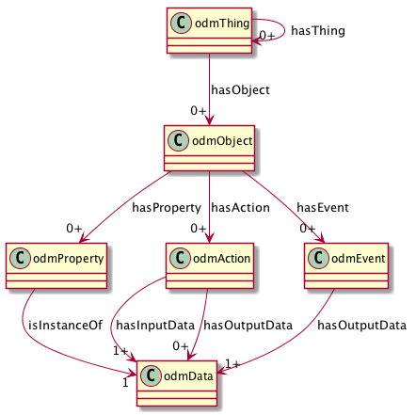
ODM Meta-Model
Thing Class to compose Objects
View (Interface) Class to virtualize affordances
Reusable Objects
Property, Action, and Event Affordances
Reusable Data Types

Slide 13
Thing Class
Encapsulate reusable Capabilities
On/Off with state Property, Commands, and Events
Compose Air Conditioner Thing from OnOff, Mode, Speed, etc. as reusable Capabilities
Reusable compositions of Capabilities
An Outlet unit for a multi-outlet strip
Each Outlet has OnOff, Energy Monitor, Overcurrent and Overtemperature protection Capabilities
Multiple Outlets are composed into an outlet strip
Outlet unit can be a Thing
Outlet Strip can also be a Thing

Slide 14
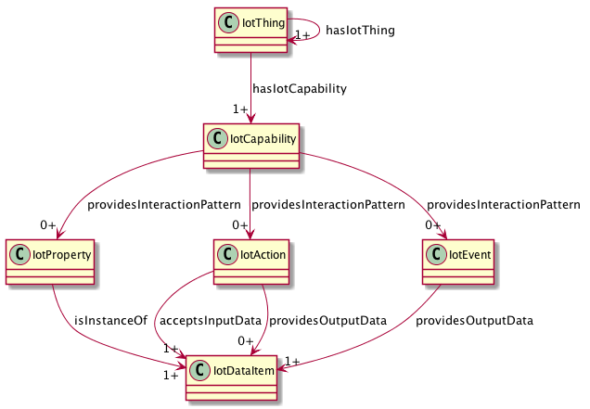
iotschema UML with iotThing class

Slide 15
schema.org IoT Extension Meta Model with Thing Class
IotThing
schema:thing
hasIotThing
hasIotCapability
providesOutputData
providesInteractionPattern
acceptsInputData
IotCapability
InteractionPattern
IotDataItem
schema:PropertyValue
IotAction
IotEvent
IotProperty
schema:PropertyValueSpec.
rdfs:subclassOf
schema:Property
iotschema Class
Reused Class

Slide 16
High Level Integration Patterns
OMA LWM2M
WoT TD
SDF
BRICKschema
VSSschema
OCF
iotschema
Annotate
Convert
Templates
HTML
ZA/CHIP DMWG
Convert
Annotate

Slide 17
One Data Model integration
Re-shape One Data Model definitions as iotschema definitions
One Data Model uses JSON object hierarchy vs. RDF links
JSON pointer fragment identifiers
st:#/sdfObject/onoff/sdfAction/turnon
iot:onoffCapability => iot:providesTurnonAction => iot:turnonAction
iot:providesTurnonAction is a sub-class property from iot:providesInteractionPattern

Slide 18
iotschema from OneDM
st:#/sdfObject/onoff/sdfAction/turnon
sdfObject is "sameAs" iotCapability
Create type names
st:#/sdfObject/switch => iot:switchCapability
st:#/sdfObject/switch/sdfAction/turnon => iot:turnOnAction (iot:switchTurnOnAction?)
Synthesize the schema.org style property types
providesInteractionPattern subtypes
providesSwitchTurnOnAction

Slide 19
Path Construct in RDF
st:#/sdfObject/onoff/sdfAction/turnon
"@id": "iot:iotCapability/onoff"
"@id": "iot:iotCapability/onoff/iotAction/turnon"
What does the property type look like?
iot:providesInteractionPattern
iot:providesTurnonAction
iot:providesiotCapability/onoff/iotAction/turnon

Slide 20
Schema.org Integration
Class names Event, Action, Property conflict
iotschema has diverse semantic types for objects, schema.org has diverse property types
Property types could be synthesized from objects but…
iotschema will potentially define hundreds of types for physical quantities (temperature, humidity, voltage, acceleration…), control affordances (open/close, brightness, color control, camera controls, operating modes…), and features of interest (rooms, machines…)

Slide 21
Schema.org Integration
The WoT use case is based on annotation consisting of RDF @type statements that point to URIs of defined terms for specialized types that conform to the classes in the meta-model
These meta-model classes would only add about 6 new property types to schema.org
iotCapability, iotEvent, iotAction, iotProperty, iotData, iotFeatureofInterest
new types like iotInterface, iotThing, etc. as needed

Slide 22
Schema.org Integration
There is a potential example pattern in schema.org
MedicalEntity, with about 7 property types
Likewise, an IoT Schema instance would contain some set of iotCapability, iotAction, iotProperty, iotEvent, iotFeatureOfInterest properties
Specialization of iot types would happen at the next level in the graph – hosted in a separate namespace
URIs that point to accepted specialized definitions in one or more specialized namespaces
lighting controls, thermostats, etc. that conform to the base types but have their own properties

