Slide 1
IoT Extensions for schema.org
Community Teleconference
February 20, 2020

Slide 2
Agenda
Agenda review
Announcements – T2TRG Workshop on Data Models and One Data Model + WISHI Hackathon
Recent developments – Project CHIP
Proposal for adding a thing class
Availability of iotschema4Node-RED over npm
Hosting and schema.org extension
AOB

Slide 3
Announcements
W3C WoT Online Virtual F2F March 16-18
T2TRG Workshop March 20 at IETF 107 Vancouver
Technical review of SDF language (OneDM)
WISHI Hackathon March 21 and 22 at IETF 107
Semantic Proxy using W3C WoT and iotschema annotation from OneDM definitions
OneDM F2F late April, Qualcomm in San Diego
W3C WoT Helsinki June 6-11 with T2TRG

Slide 4
Project CHIP
Google and Apple joined Zigbee Alliance to create a new interoperable network standard for connected homes – Project Connected Home over IP
Deliver a standard, open source reference stack, and certification program for interoperable devices
What it means to iotschema - standardized data models for connected home devices + Event, Action, Property model + open source license
Still need to address system level modeling with location, context , behavior + application domains

Slide 5
Thing Class
Encapsulate reusable Capabilities
On/Off with state Property, Commands, and Events
Compose Air Conditioner Thing from OnOff, Mode, Speed, etc. as reusable Capabilities
Reusable compositions of Capabilities
An Outlet unit for a multi-outlet strip
Each Outlet has OnOff, Energy Monitor, Overcurrent and Overtemperature protection Capabilities
Multiple Outlets are composed into an outlet strip
Outlet unit can be a Thing
Outlet Strip can also be a Thing

Slide 6
schema.org IoT Extension Meta Model with Thing Class
IotThing
schema:thing
hasIotThing
hasIotCapability
providesOutputData
providesInteractionPattern
acceptsInputData
IotCapability
InteractionPattern
IotDataItem
schema:PropertyValue
IotAction
IotEvent
IotProperty
schema:PropertyValueSpec.
rdfs:subclassOf
schema:Property
iotschema Class
Reused Class

Slide 7
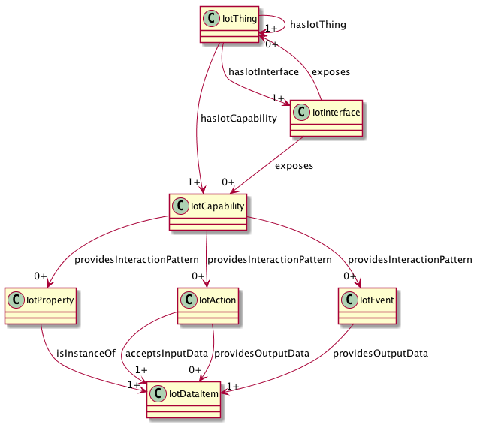
UML

Slide 8
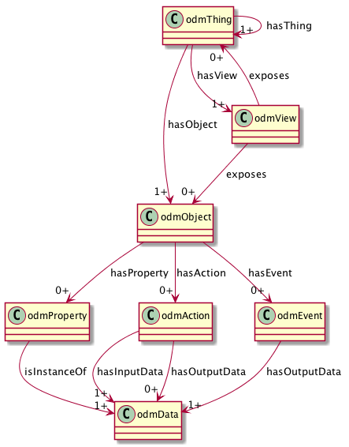
ODM Meta-Model
Thing Class to compose Objects
View (Interface) Class to virtualize affordances
Reusable Objects
Property, Action, and Event Affordances
Reusable Data Types

Slide 9
High Level
OMA LWM2M
WoT TD
SDF
BRICKschema
VSSschema
OCF
iotschema
Annotate
Convert
Templates
HTML
ZA/CHIP DMWG
Convert
Annotate

Slide 10
iotschema4Node-RED

Slide 11
iot.schema.org for Node-RED Semantic Interoperability
iot.schema.org embedded in Node-RED tool
Easies use of semantics for WoT developers
Simplify creation of applications with W3C WoT
Demonstrates semantic discovery and processing
Handsome tool for WoT PlugFests

Slide 12
Publishing iotschema Nodes to npm
iotschema nodes are currently being adapted for publication on the npm repository
This will allow iotschema Node-RED developers to easily find and access nodes without having to go via the GitHub route.
Currently available:
17 packages
Migration for packages A-C completed
D-W in progress

Slide 13
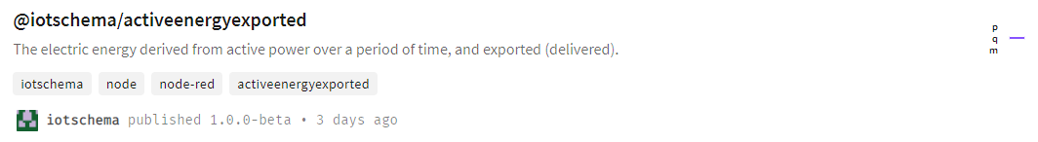
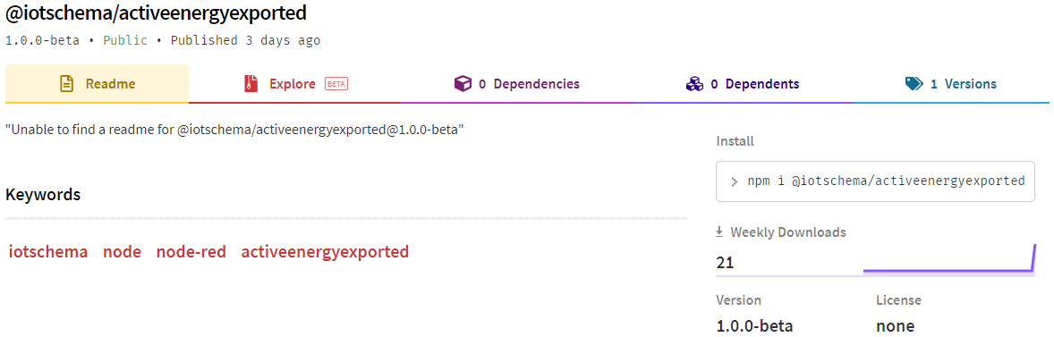
How to use npm with iotschema nodes
Users can simply issue the `npm install` command from their Node-RED environment
Example: npm install @iotschema/binaryswitch
Nodes are hosted on the npm reporitory and are browsable on npmjs.com

Slide 14
Publishing iotschema Nodes to npm – Grouping
One umbrella module (iotschema-capability) to install all nodes
More granular groups to install only specific types
Example:
@iotschema/ambientair-capability |
⌞ @iotschema/nitrogenconcentration ⌞ @iotschema/oxygenconcentration ⌞ @iotschema/carbondioxideconcentration ⌞ @iotschema/argonconcentration

Slide 15
iot.schema.org for Node-RED Semantic Interoperability
iot.schema.org embedded in Node-RED tool
Easies use of semantics for WoT developers
Simplify creation of applications with W3C WoT
Demonstrates semantic discovery and processing
Handsome tool for WoT PlugFests

Slide 16
Publishing iotschema Nodes to npm
iotschema nodes are currently being adapted for publication on the npm repository
This will allow iotschema Node-RED developers to easily find and access nodes without having to go via the GitHub route.
Currently available:
17 packages
Migration for packages A-C completed
D-W in progress

Slide 17
How to use npm with iotschema nodes
Users can simply issue the `npm install` command from their Node-RED environment
Example: npm install @iotschema/binaryswitch
Nodes are hosted on the npm reporitory and are browsable on npmjs.com

Slide 18
Publishing iotschema Nodes to npm – Grouping
One umbrella module (iotschema-capability) to install all nodes
More granular groups to install only specific types
Example:
@iotschema/ambientair-capability |
⌞ @iotschema/nitrogenconcentration ⌞ @iotschema/oxygenconcentration ⌞ @iotschema/carbondioxideconcentration ⌞ @iotschema/argonconcentration

Slide 19
Schema.org Integration
Class names Event, Action, Property conflict
iotschema has diverse semantic types for objects, schema.org has diverse property types
Property types could be synthesized from objects but…
iotschema will potentially define hundreds of types for physical quantities (temperature, humidity, voltage, acceleration…), control affordances (open/close, brightness, color control, camera controls, operating modes…), and features of interest (rooms, machines…)

Slide 20
Schema.org Integration
The WoT use case is based on annotation consisting of RDF @type statements that point to URIs of defined terms for specialized types that conform to the classes in the meta-model
These meta-model classes would only add about 6 new property types to schema.org
iotCapability, iotEvent, iotAction, iotProperty, iotData, iotFeatureofInterest
new types like iotInterface, iotThing, etc. as needed

Slide 21
Schema.org Integration
There is a potential example pattern in schema.org
MedicalEntity, with about 7 property types
Likewise, an instance of IoT Schema would contain some set of iotCapability, iotAction, iotProperty, iotEvent, iotFeatureOfInterest properties
Specialization of iot types would happen at the next level in the graph – hosted in a separate namespace
URIs that point to accepted specialized definitions in one or more specialized namespaces
lighting controls, thermostats, etc. that conform to the base types but have their own properties

Slide 22
Conclusion
Summary
AOB

