Slide 1

Chapter 1
Introduction
TCP/IP Protocol Suite

Slide 2
1-1 A BRIEF HISTORY
A network is a group of connected, communicating devices such as computers and printers. An internet is two or more networks that can communicate with each other. The most notable internet is called the internet, composed of hundreds of thousands of interconnected networks. Private individuals as well as various organizations such as government agencies, schools, research facilities, corporations, and libraries in more than 100 countries use the Internet.
TCP/IP Protocol Suite

Slide 3
Topics Discussed in the Section
ARPANET
Birth of the Internet
TCP/IP
MILNET
CSNET
NSFNET
ANSNET
The Internet Today
World Wide Web
Growth of the Internet
TCP/IP Protocol Suite

Slide 4
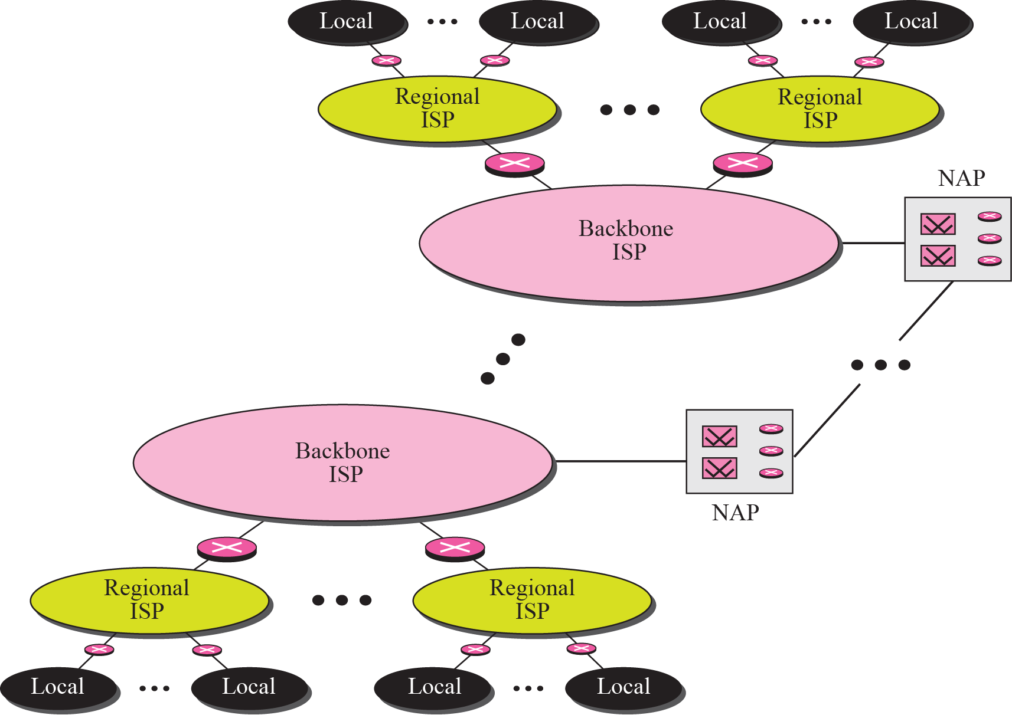
Figure 1.1 Internet today
TCP/IP Protocol Suite

Slide 5
1-2 PROTOCOLS AND STANDARDS
In this section, we define two widely used terms: protocols and standards. First, we define protocol, which is synonymous with “rule.” Then we discuss standards, which are agreed-upon rules.
TCP/IP Protocol Suite

Slide 6
1-3 STANDARDS ORGANIZATION
Standards are developed through the cooperation of standards creation committees, forums, and government regulatory agencies.
TCP/IP Protocol Suite

Slide 7
1-4 INTERNET STANDARDS
An Internet standard is a thoroughly tested specification that is useful to and adhered to by those who work with the Internet. It is a formalized regulation that must be followed. There is a strict procedure by which a specification attains Internet standard status. A specification begins as an Internet draft. An Internet draft is a working document with no official status and a six-month lifetime.
TCP/IP Protocol Suite

Slide 8
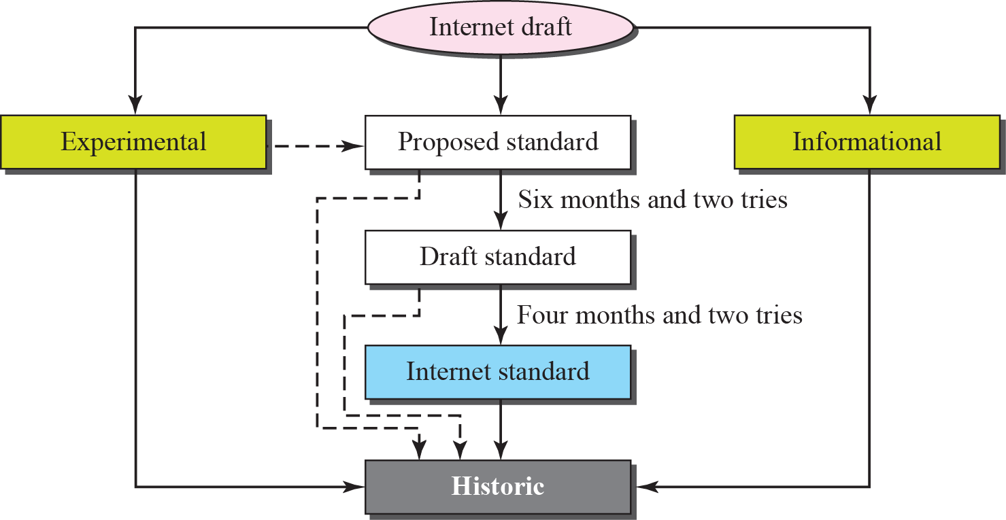
Figure 1.2 Maturity levels of an RFC
TCP/IP Protocol Suite

Slide 9

Note
RFCs can be found at
http://www.rfc-editor.org.
TCP/IP Protocol Suite

Slide 10
1-5 INTERNET ADMINISTRATION
The Internet, with its roots primarily in the research domain, has evolved and gained a broader user base with significant commercial activity. Various groups that coordinate Internet issues have guided this growth and development. Appendix G gives the addresses, e-mail addresses, and telephone numbers for some of these groups. Figure 1.4 shows the general organization of Internet administration.
TCP/IP Protocol Suite

Slide 11
Topics Discussed in the Section
Internet Society (ISOC)
Internet Architecture Board (IAB)
Internet Research Task Force (IRTF)
Internet Assigned Number Authority (IANA)
Internet Corporation for Names and Numbers
(ICANN)
Network Information Center (NIC)
TCP/IP Protocol Suite

Slide 12


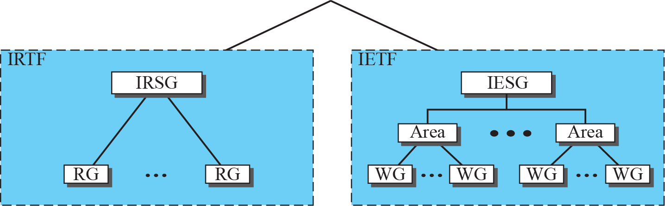
Figure 1.4 Internet administration
TCP/IP Protocol Suite

