Slide 1

Chapter 2
The OSI Model and the TCP/IP Protocol Suite
TCP/IP Protocol Suite

Slide 2
2-1 PROTOCOL LAYERS
In Chapter 1, we discussed that a protocol is required when two entities need to communicate. When communication is not simple, we may divide the complex task of communication into several layers. In this case, we may need several protocols, one for each layer.
Let us use a scenario in communication in which the role of protocol layering may be better understood. We use two examples. In the first example, communication is so simple that it can occur in only one layer.
TCP/IP Protocol Suite

Slide 3
Figure 2.1 Example 2.1
TCP/IP Protocol Suite

Slide 4
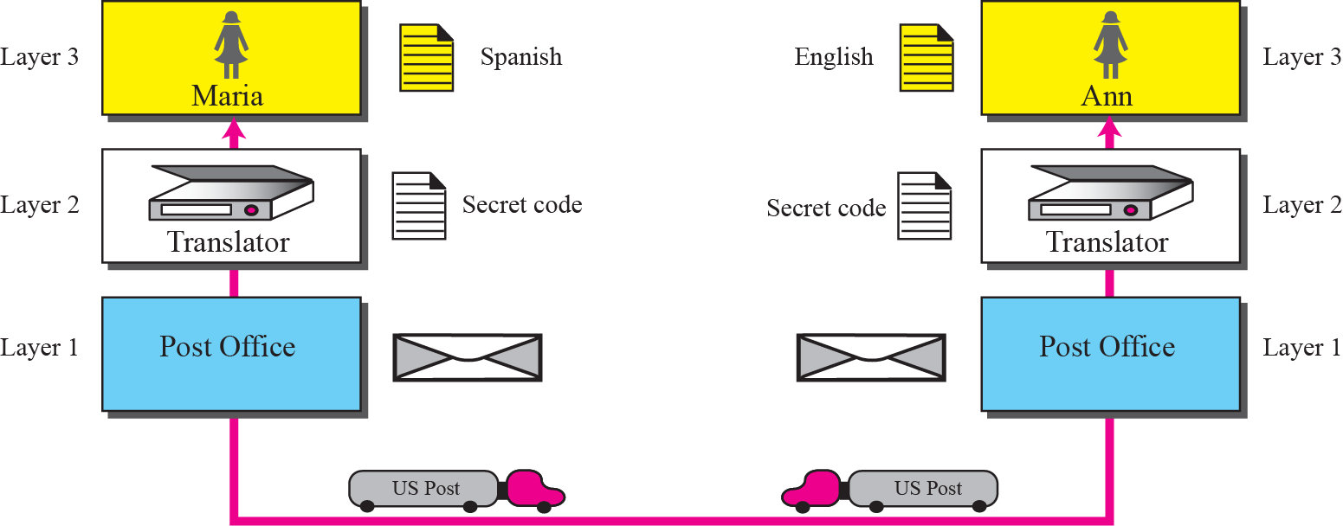
Figure 2.2 Example 2.2
TCP/IP Protocol Suite

Slide 5
2-2 THE OSI MODEL
Established in 1947, the International Standards Organization (ISO) is a multinational body dedicated to worldwide agreement on international standards. Almost three-fourths of countries in the world are represented in the ISO. An ISO standard that covers all aspects of network communications is the Open Systems Interconnection (OSI) model. It was first introduced in the late 1970s.
TCP/IP Protocol Suite

Slide 6

Note
ISO is the organization;
OSI is the model.
TCP/IP Protocol Suite

Slide 7
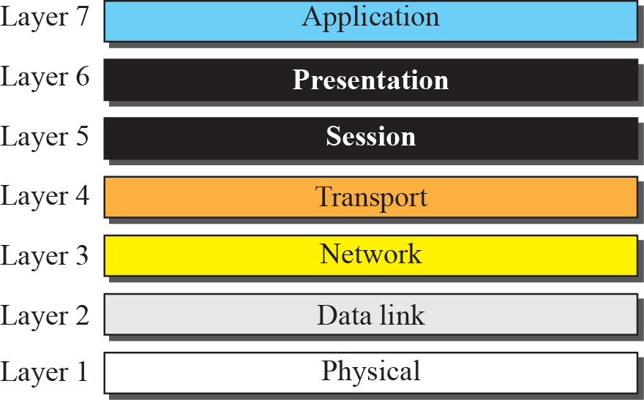
Figure 2.3 The OSI model
TCP/IP Protocol Suite

Slide 8

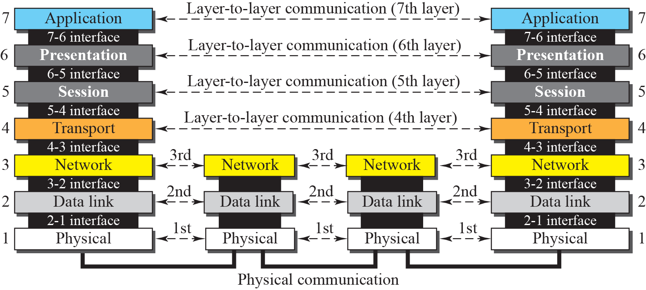
Figure 2.4 OSI layers
TCP/IP Protocol Suite

Slide 9
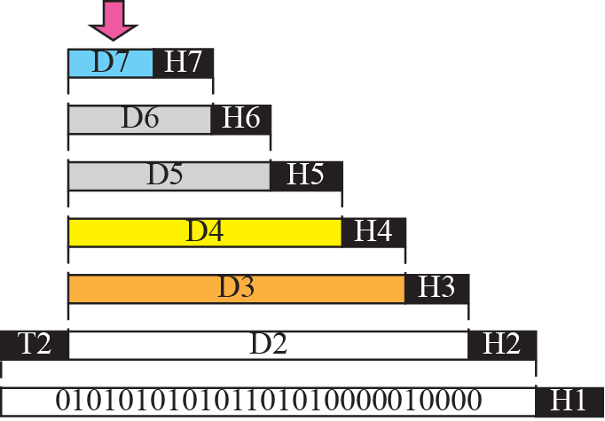


Figure 2.5 An exchange using the OSI model
TCP/IP Protocol Suite

Slide 10
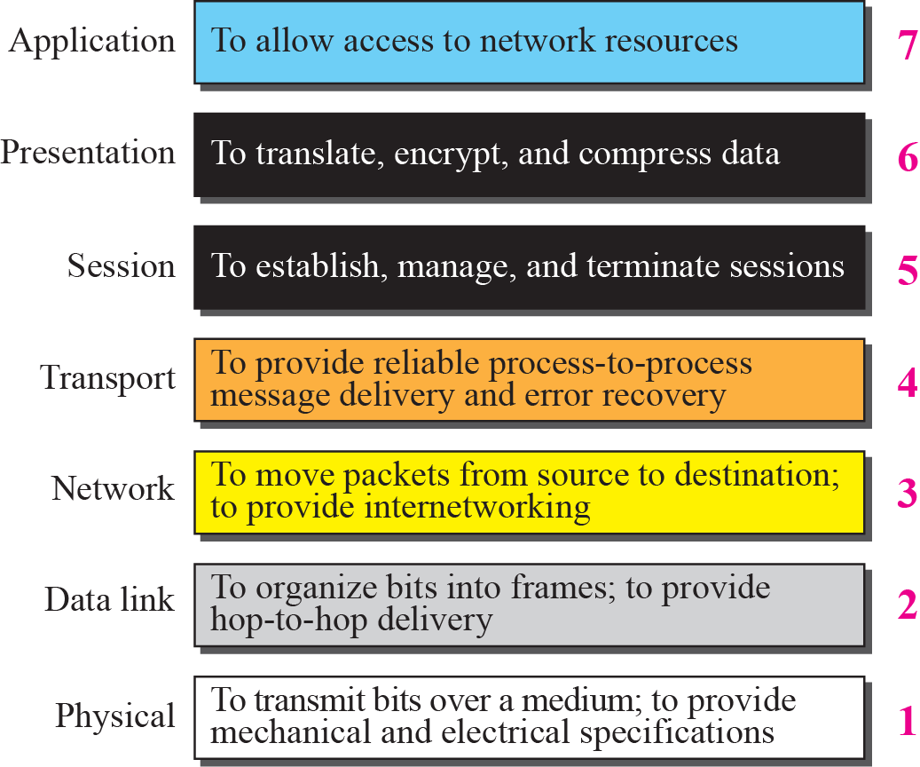
Figure 2.6 Summary of OSI Layers
TCP/IP Protocol Suite

Slide 11
2-3 TCP/IP PROTOCOL SUITE
The TCP/IP protocol suite was developed prior to the OSI model. Therefore, the layers in the TCP/IP protocol suite do not match exactly with those in the OSI model. The original TCP/IP protocol suite was defined as four software layers built upon the hardware. Today, however, TCP/IP is thought of as a five-layer model with the layers named similarly to the ones in the OSI model. Figure 2.7 shows both configurations.
TCP/IP Protocol Suite

Slide 12
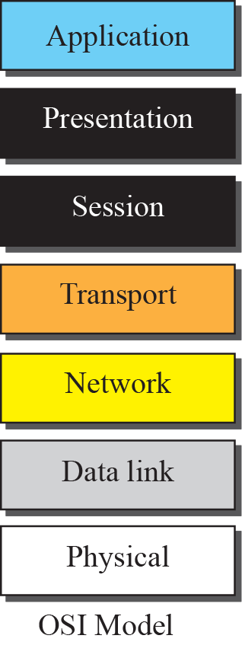
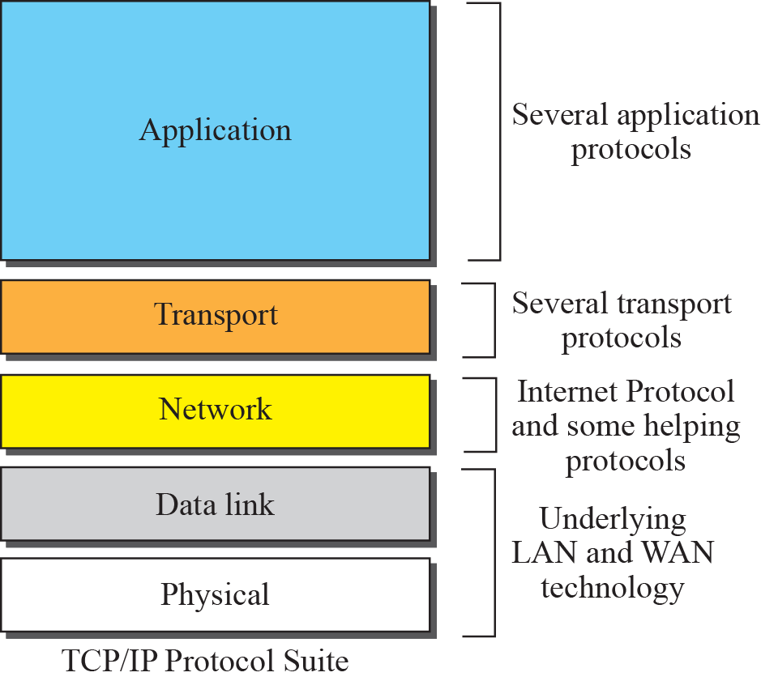
Figure 2.8 TCP/IP and OSI model
TCP/IP Protocol Suite

Slide 13
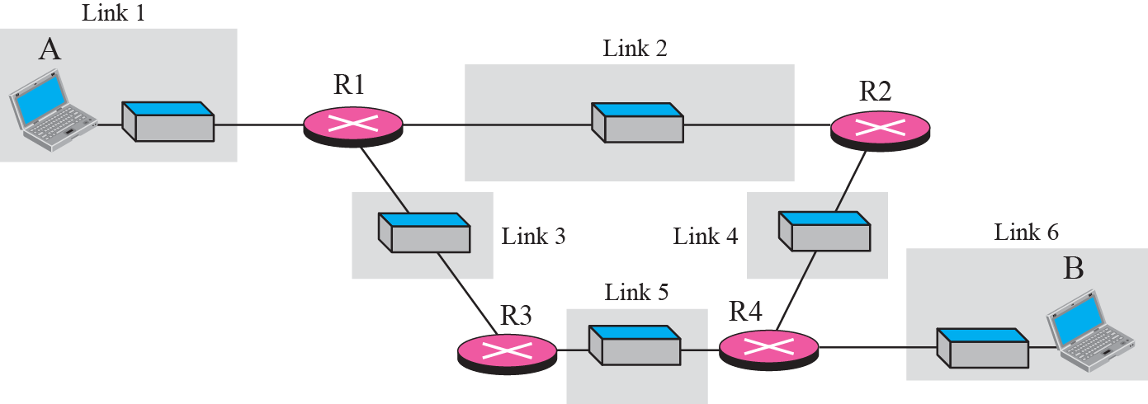
Figure 2.9 A private internet
TCP/IP Protocol Suite

Slide 14
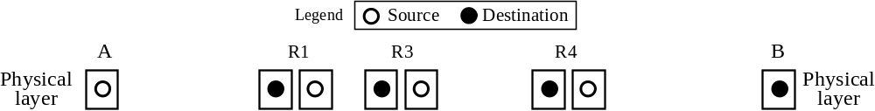





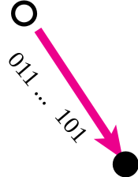


Figure 2.10 Communication at the physical layer
TCP/IP Protocol Suite

Slide 15
Note
The unit of communication at the physical layer is a bit.
TCP/IP Protocol Suite

Slide 16
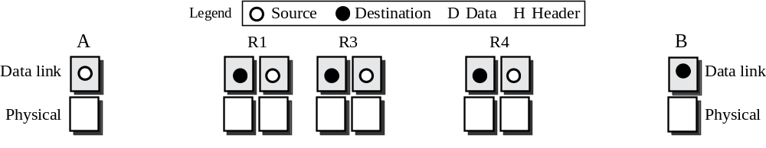
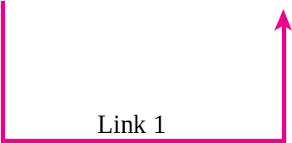
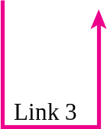


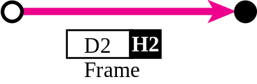
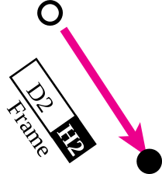
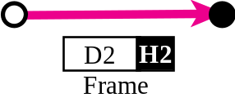

Figure 2.11 Communication at the data link layer
TCP/IP Protocol Suite

Slide 17
Note
The unit of communication at the data link layer is a frame.
TCP/IP Protocol Suite

Slide 18
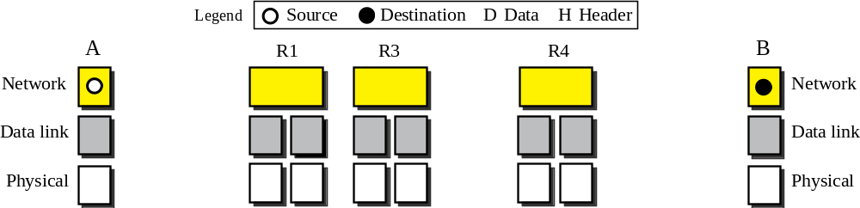

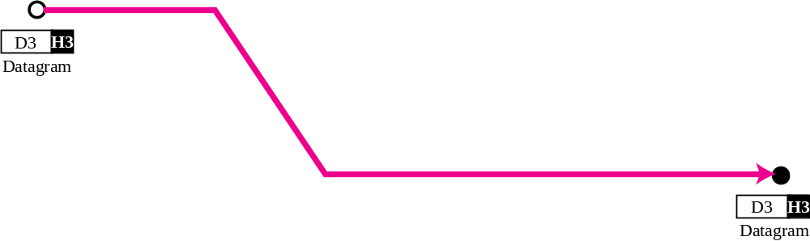
Figure 2.12 Communication at the network layer
TCP/IP Protocol Suite

Slide 19
Note
The unit of communication at the network layer is a datagram.
TCP/IP Protocol Suite

Slide 20
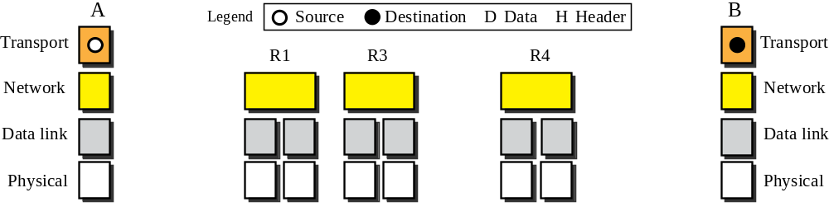

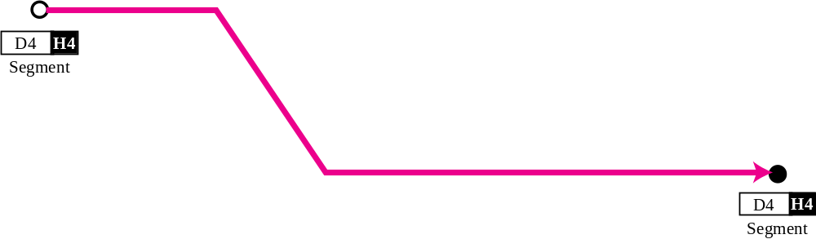
Figure 2.13 Communication at transport layer
TCP/IP Protocol Suite

Slide 21
Note
The unit of communication at the transport layer is a segment, user datagram, or a packet, depending on the specific protocol used in this layer.
TCP/IP Protocol Suite

Slide 22
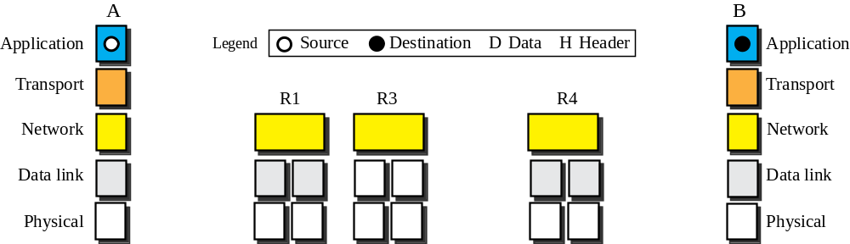

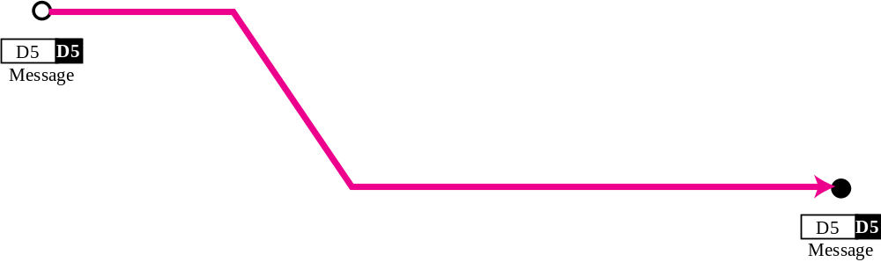
Figure 2.14 Communication at application layer
TCP/IP Protocol Suite

Slide 23
Note
The unit of communication at the application layer is a message.
TCP/IP Protocol Suite

Slide 24
2-4 ADDRESSING
Four levels of addresses are used in an internet employing the TCP/IP protocols: physical address, logical address, port address, and application-specific address. Each address is related to a one layer in the TCP/IP architecture, as shown in Figure 2.15.
TCP/IP Protocol Suite

Slide 25
Topics Discussed in the Section
Physical Addresses
Logical Addresses
Port Addresses
Application-Specific Addresses
TCP/IP Protocol Suite

Slide 26
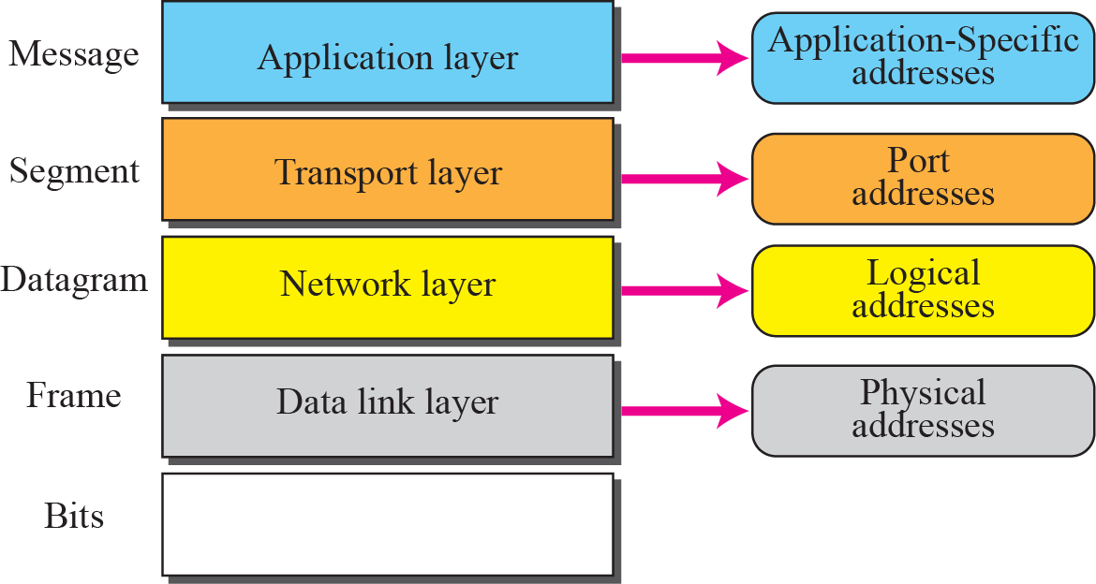
Figure 2.15 Addresses in the TCP/IP protocol suite
TCP/IP Protocol Suite

Slide 27
Example 2.4
As we will see in Chapter 3, most local area networks use a 48-bit (6-byte) physical address written as 12 hexadecimal digits; every byte (2 hexadecimal digits) is separated by a colon, as shown below:
07:01:02:01:2C:4B
A 6-byte (12 hexadecimal digits) physical address
TCP/IP Protocol Suite

Slide 28
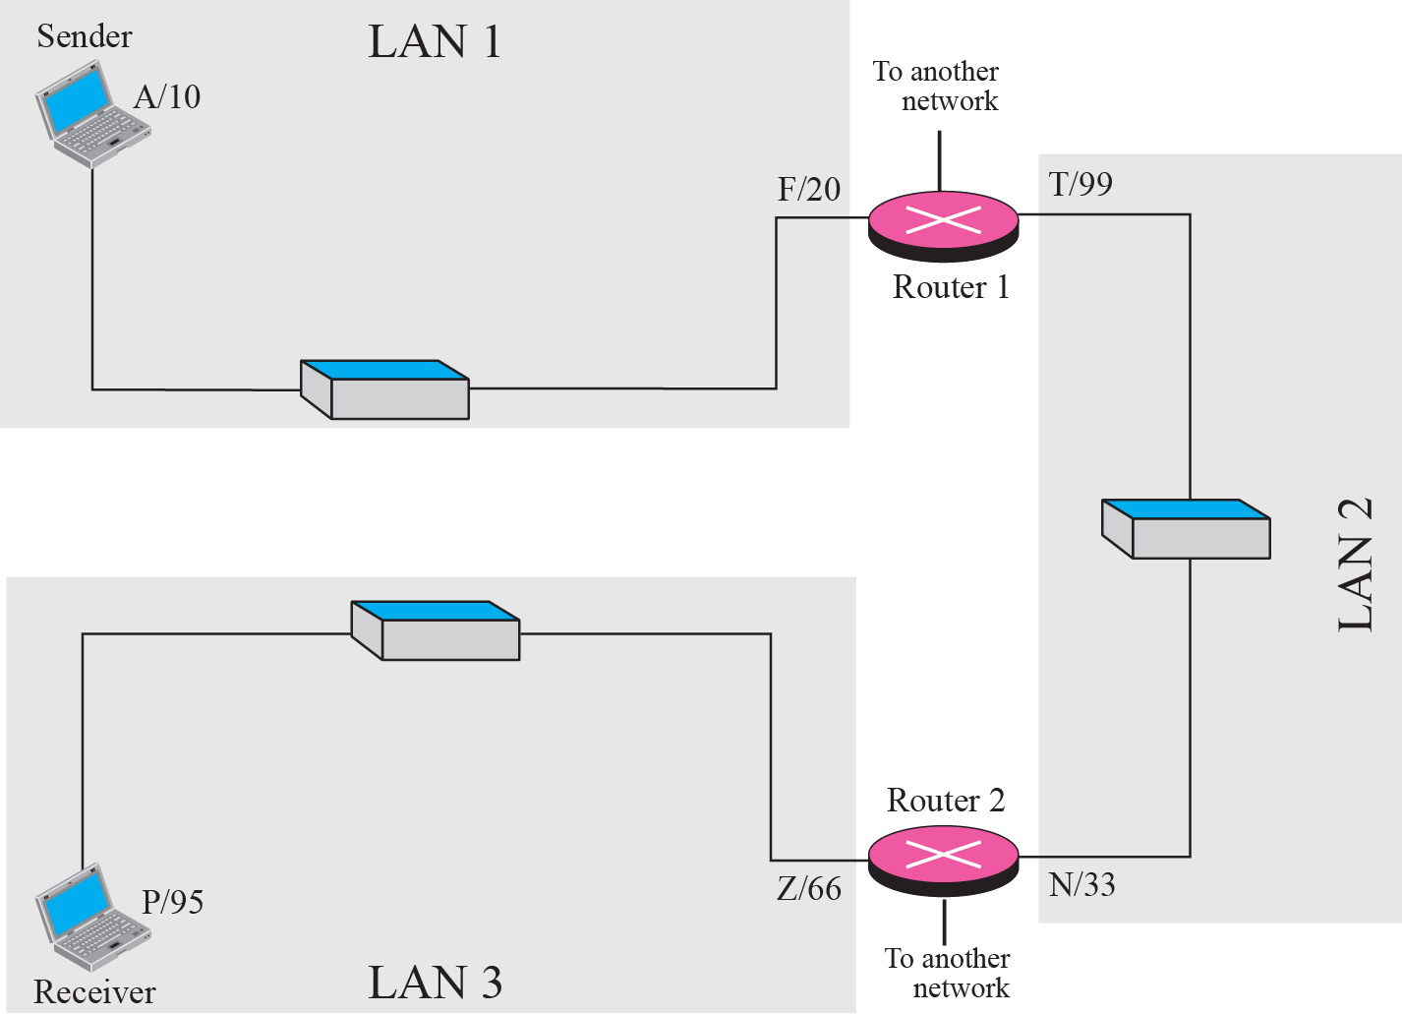
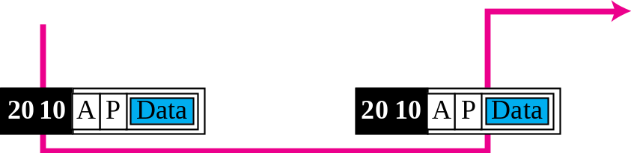
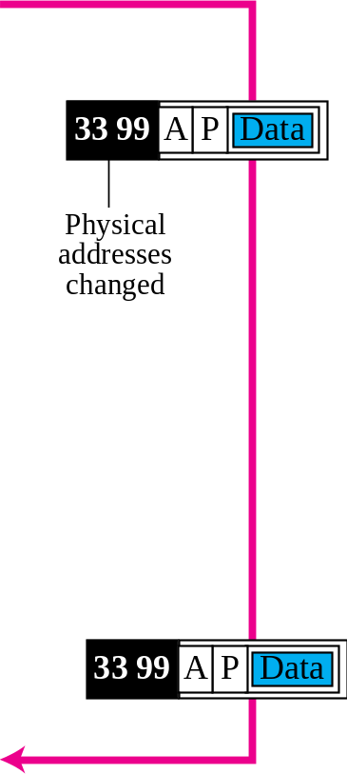
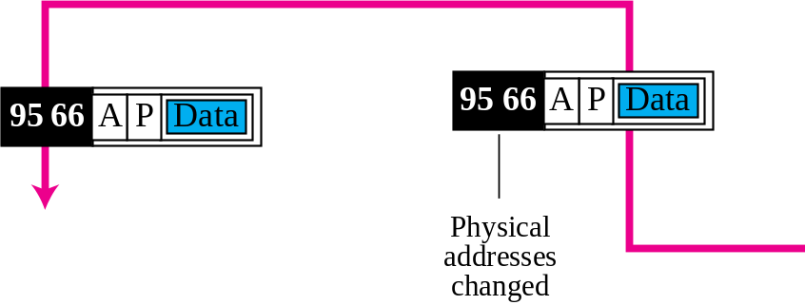
Figure 2.17 Example 2.5: logical addresses
TCP/IP Protocol Suite

Slide 29
Note
The physical addresses will change from hop to hop, but the logical addresses remain the same.
TCP/IP Protocol Suite

Slide 30
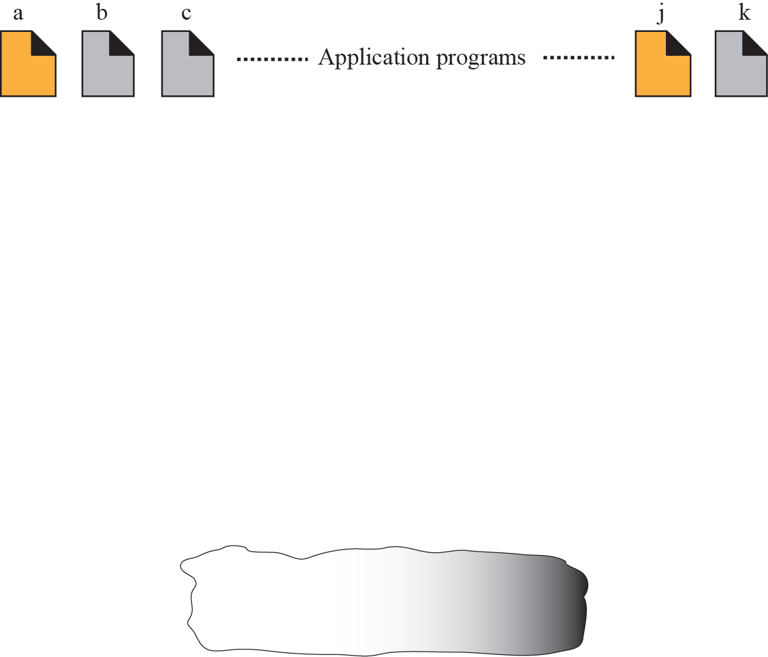
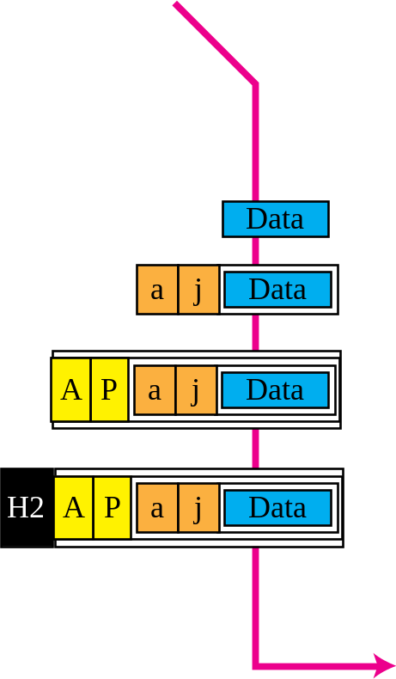
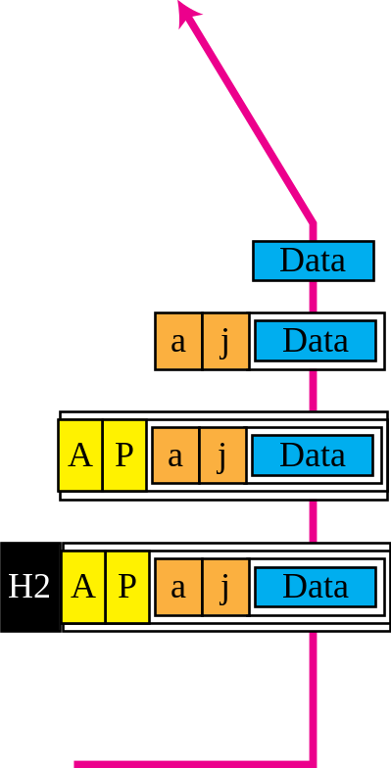


Figure 2.18 Example 2.6: port numbers
TCP/IP Protocol Suite

Slide 31
Note
The physical addresses change from hop to hop, but the logical and port addresses usually remain the same.
TCP/IP Protocol Suite

Slide 32
Example 2.7
As we will see in future chapters, a port address is a 16-bit address represented by one decimal number as shown.
753
A 16-bit port address represented as one single number
TCP/IP Protocol Suite

