Slide 1

Chapter 3
Underlying
Technology
TCP/IP Protocol Suite

Slide 2
3-1 WIRED LOCAL AREA NETWORKS
A local area network (LAN) is a computer network that is designed for a limited geographic area such as a building or a campus. Although a LAN can be used as an isolated network to connect computers in an organization for the sole purpose of sharing resources, most LANs today are also linked to a wide area network (WAN) or the Internet.
The LAN market has seen several technologies such as Ethernet, token ring, token bus, FDDI, and ATM LAN, but Ethernet is by far the dominant technology.
TCP/IP Protocol Suite

Slide 3
Topics Discussed in the Section
IEEE Standards
Frame Format
Addressing
Ethernet Evolution
Standard Ethernet
Fast Ethernet
Gigabit Ethernet
Ten-Gigabit Ethernet
TCP/IP Protocol Suite

Slide 4
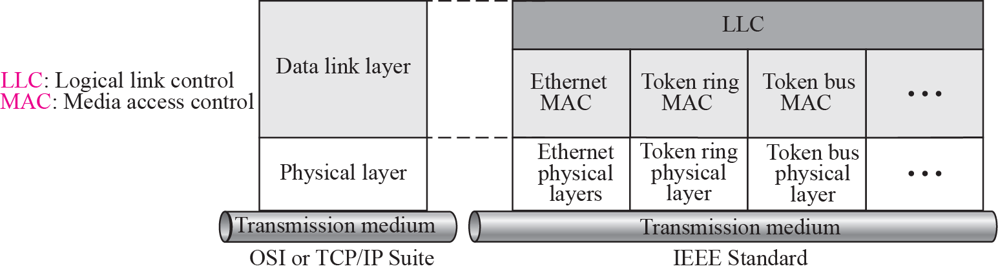
Figure 3.1 IEEE standard for LANs
TCP/IP Protocol Suite

Slide 5
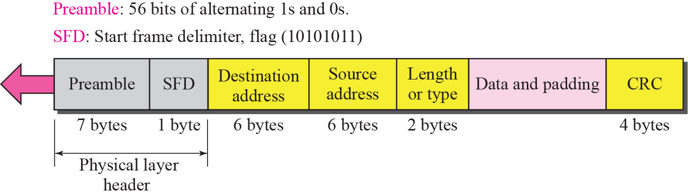
Figure 3.2 Ethernet Frame
TCP/IP Protocol Suite

Slide 6
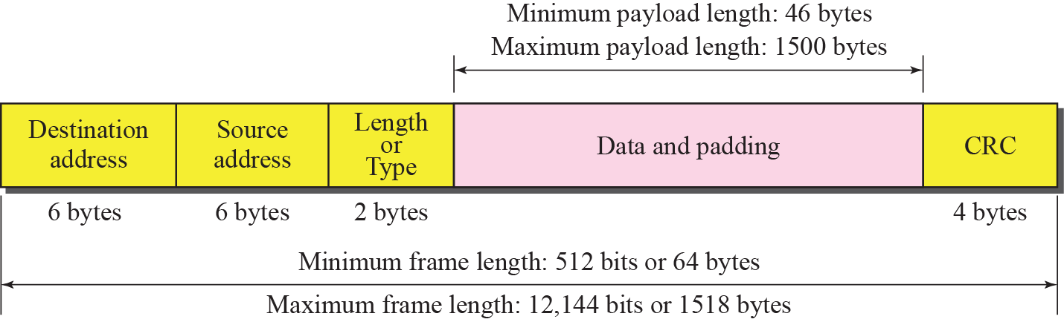
Figure 3.3 Maximum and minimum lengths
TCP/IP Protocol Suite

Slide 7

Note
Minimum length: 64 bytes (512 bits)
Maximum length: 1518 bytes (12,144 bits)
TCP/IP Protocol Suite

Slide 8
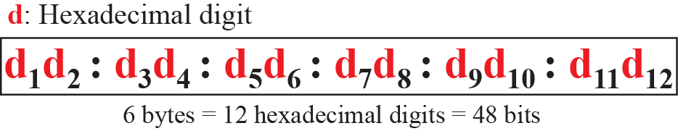
Figure 3.4 Ethernet address in hexadecimal notation
TCP/IP Protocol Suite

Slide 9
Note
The broadcast destination address is a special case of the multicast address
in which all bits are 1s.
TCP/IP Protocol Suite

Slide 10
Example 3.1
Define the type of the following destination addresses:
a. 4A:30:10:21:10:1A
b. 47:20:1B:2E:08:EE
c. FF:FF:FF:FF:FF:FF
Solution
To find the type of the address, we need to look at the second
hexadecimal digit from the left. If it is even, the address is unicast. If it is odd, the address is multicast. If all digits are F’s, the address is broadcast. Therefore, we have the following:
a. This is a unicast address because A in binary is 1010 (even).
b. This is a multicast address because 7 in binary is 0111 (odd).
c. This is a broadcast address because all digits are F’s.
TCP/IP Protocol Suite

Slide 11
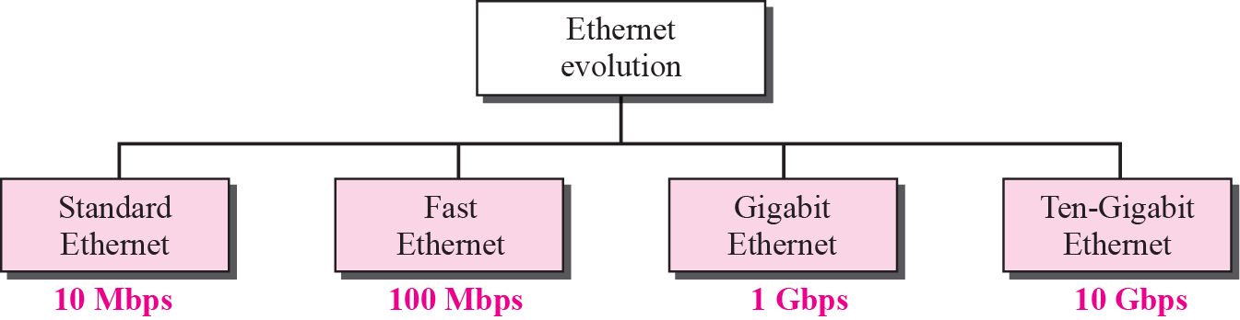
Figure 3.6 Ethernet evolution through four generations
TCP/IP Protocol Suite

Slide 12



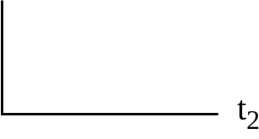
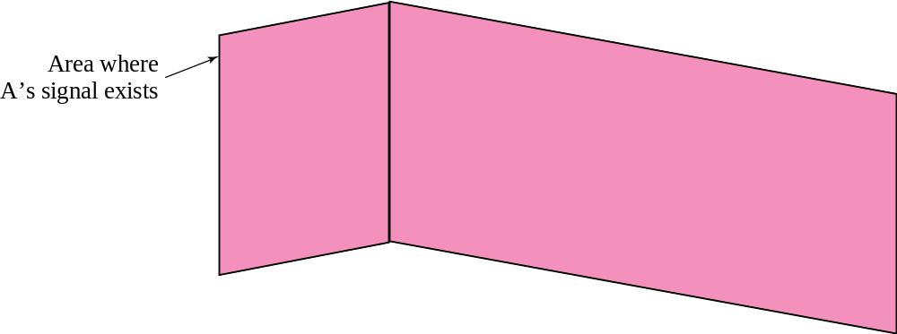
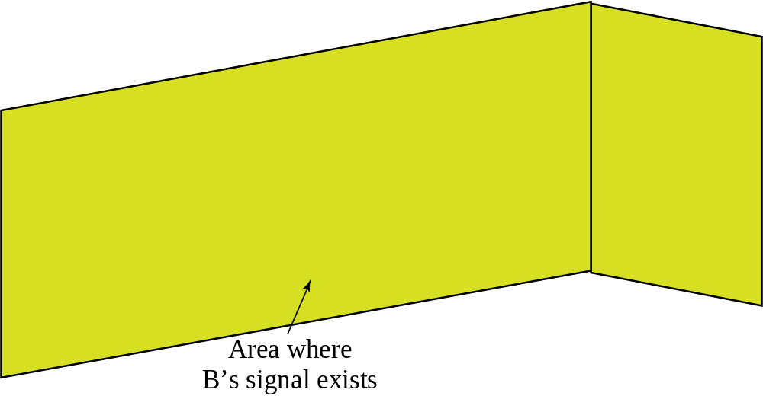
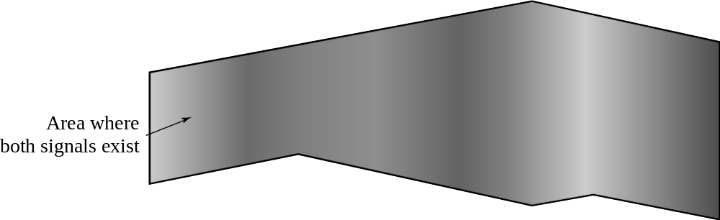
Figure 3.7 Space/time model of a collision in CSMA
A
B
C
D
T
i
m
e
T
i
m
e
TCP/IP Protocol Suite

Slide 13
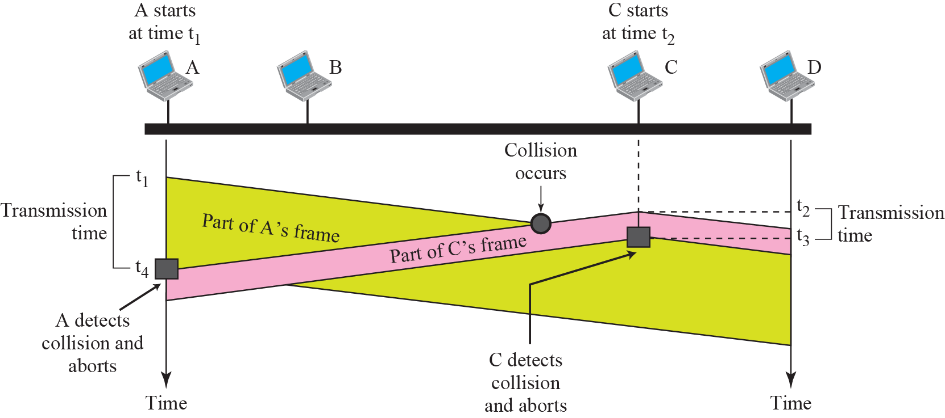
Figure 3.8 Collision of the first bit in CSMA/CD
TCP/IP Protocol Suite

Slide 14
3-2 WIRELESS LANS
Wireless communication is one of the fastest growing technologies. The demand for connecting devices without the use of cables is increasing everywhere. Wireless LANs can be found on college campuses, in office buildings, and in many public areas. In this section, we concentrate on two wireless technologies for LANs: IEEE 802.11 wireless LANs, sometimes called wireless Ethernet, and Bluetooth, a technology for small wireless LANs.
TCP/IP Protocol Suite

Slide 15
Topics Discussed in the Section
IEEE 802.1
MAC Sublayer
Addressing Mechanism
Bluetooth
TCP/IP Protocol Suite

Slide 16
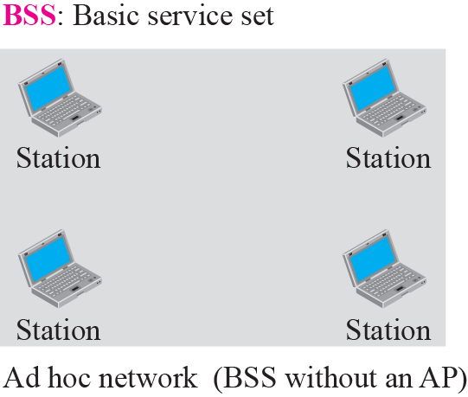
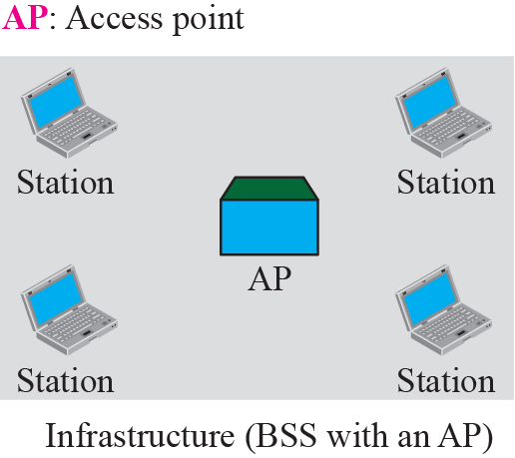
Figure 3.13 Basic service sets (BSSs)
TCP/IP Protocol Suite

Slide 17
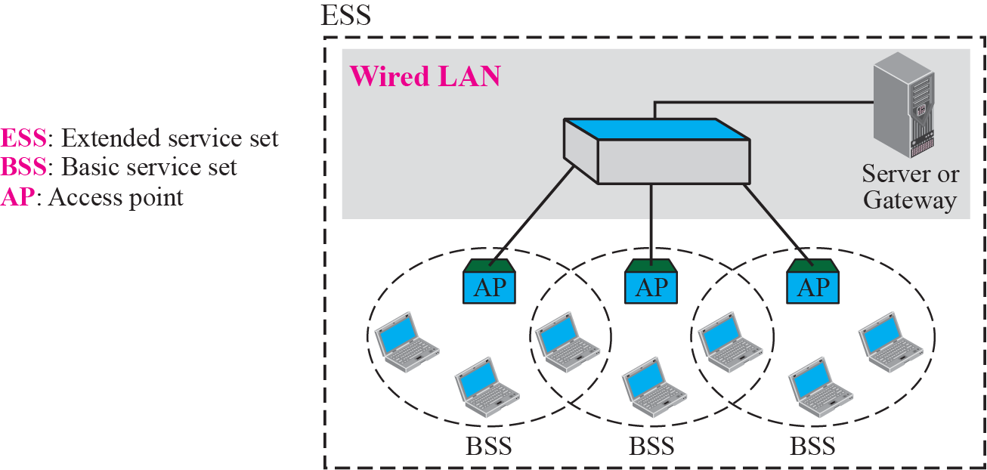
Figure 3.14 Extended service sets (ESSs)
TCP/IP Protocol Suite

Slide 18
3-3 POINT-TO-POINT WANS
A second type of network we encounter in the Internet is the point-to-point wide area network. A point-to-point WAN connects two remote devices using a line available from a public network such as a telephone network. We discuss traditional modem technology, DSL line, cable modem, T-lines, and SONET.
TCP/IP Protocol Suite

Slide 19
Topics Discussed in the Section
65K Modems
DSL Technology
Cable Modem
T Lines
SONET
PPP
TCP/IP Protocol Suite

Slide 20
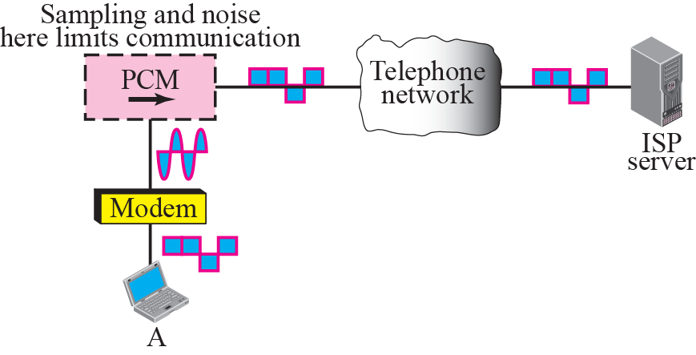
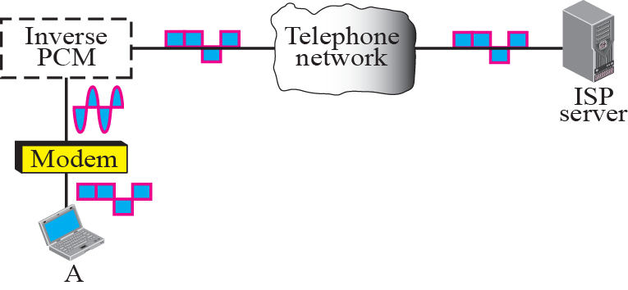


Figure 3.26 56K modem
TCP/IP Protocol Suite

Slide 21
Note
ADSL is an asymmetric communication technology designed for residential users; it is not suitable for businesses.
TCP/IP Protocol Suite

Slide 22
3-4 SWITCHED WANS
The backbone networks in the Internet can be switched WANs. A switched WAN is a wide area network that covers a large area (a state or a country) and provides access at several points to the users. Inside the network, there is a mesh of point-to-point networks that connects switches. The switches, multiple port connectors, allow the connection of several inputs and outputs.
Switched WAN technology differs from LAN technology in many ways.
TCP/IP Protocol Suite

Slide 23
Topics Discussed in the Section
X.25
Frame Relay
ATM
TCP/IP Protocol Suite

Slide 24
3-5 CONNECTING DEVICES
LANs or WANs do not normally operate in isolation. They are connected to one another or to the Internet. To connect LANs and WANs together we use connecting devices. Connecting devices can operate in different layers of the Internet model. We discuss three kinds of connecting devices: repeaters (or hubs), bridges (or two-layer switches), and routers (or three-layer switches).
TCP/IP Protocol Suite

Slide 25
Topics Discussed in the Section
Repeaters
Bridges
Routers
TCP/IP Protocol Suite

Slide 26
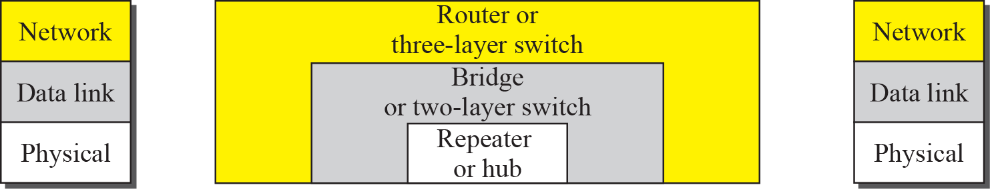
Figure 3.40 Connecting devices
TCP/IP Protocol Suite

Slide 27
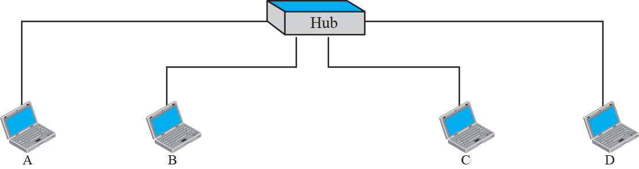
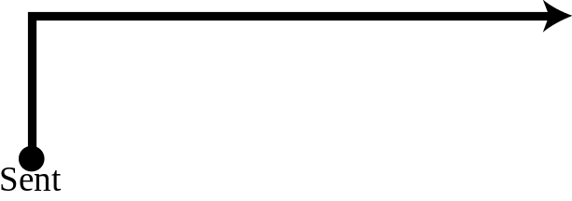


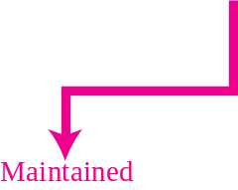
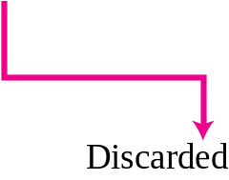
Figure 3.41 Repeater or hub
TCP/IP Protocol Suite

Slide 28
Note
A repeater forwards every bit; it has no filtering capability.
TCP/IP Protocol Suite

Slide 29
Note
A bridge has a table used in filtering decisions.
TCP/IP Protocol Suite

Slide 30
Note
A bridge does not change the physical (MAC) addresses in a frame.
TCP/IP Protocol Suite

Slide 31
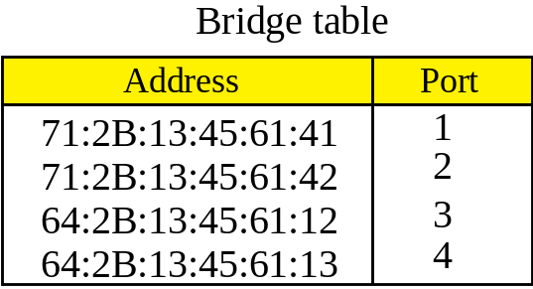
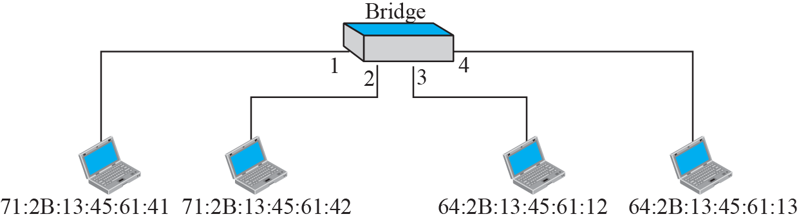


Figure 3.42 Bridge
TCP/IP Protocol Suite

Slide 32
Note
A router is a three-layer (physical, data link, and network) device.
TCP/IP Protocol Suite

