Slide 1

Chapter 4
Introduction to
Network Layer
TCP/IP Protocol Suite

Slide 2
4-1 INTRODUCTION
At the conceptual level, we can think of the global Internet as a black box network that connects millions (if not billions) of computers in the world together. At this level, we are only concerned that a message from the application layer in one computer reaches the application layer in another computer.
TCP/IP Protocol Suite

Slide 3
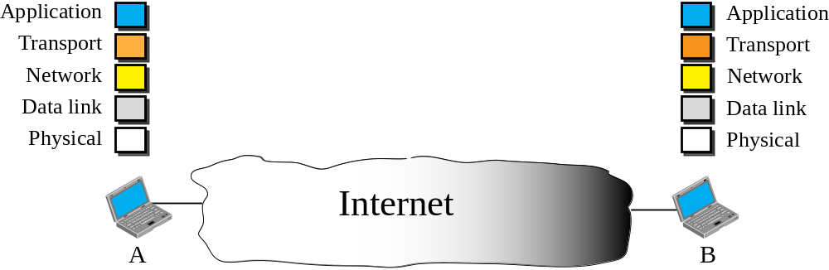
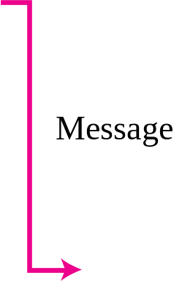
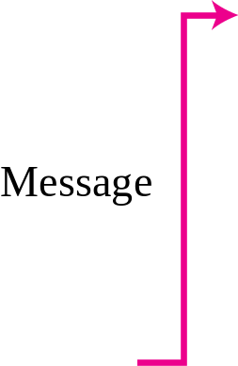
Figure 4.1 Internet as a block box
TCP/IP Protocol Suite

Slide 4
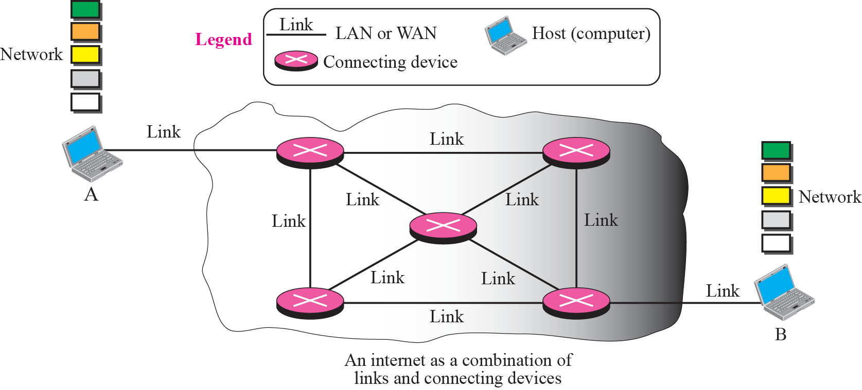
Figure 4.2 Internet as a combination of LANs and WANs connected together
TCP/IP Protocol Suite

Slide 5
4-2 SWITCHING
From the previous discussion, it is clear that the passage of a message from a source to a destination involves many decisions. When a message reaches a connecting device, a decision needs to be made to select one of the output ports through which the packet needs to be send out. In other words, the connecting device acts as a switch that connects one port to another port.
TCP/IP Protocol Suite

Slide 6
Topics Discussed in the Section
Circuit Switching
Packet Switching
TCP/IP Protocol Suite

Slide 7

Note
In circuit switching, the whole message is sent from the source to the destination without being
divided into packets.
TCP/IP Protocol Suite

Slide 8
Note
In packet switching, the message is first divided into manageable packets at the source before being transmitted.
The packets are assembled at the destination.
TCP/IP Protocol Suite

Slide 9
4-3 PACKET SWITHING
The network layer is designed as a packet-switched network. This means that the packet at the source is divided into manageable packets, normally called datagrams. Individual datagrams are then transferred from the source to the destination. The received datagrams are assembled at the destination before recreating the original message. The packet-switched network layer of the Internet was originally designed as a connectionless service, but recently there is a tendency to change this to a connection-oriented service.
TCP/IP Protocol Suite

Slide 10
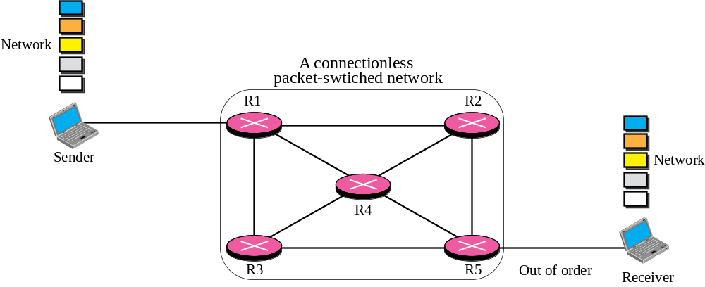







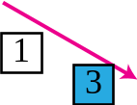



Figure 4.3 A packet-switched network
TCP/IP Protocol Suite

Slide 11
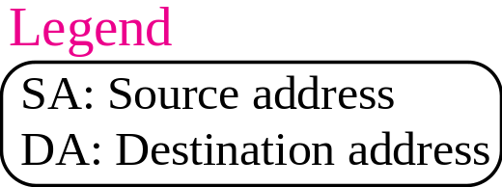
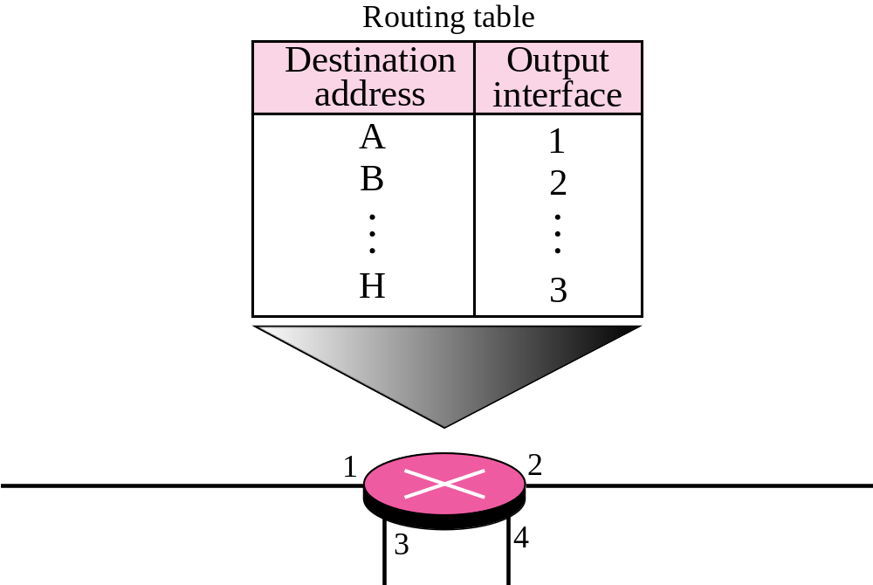
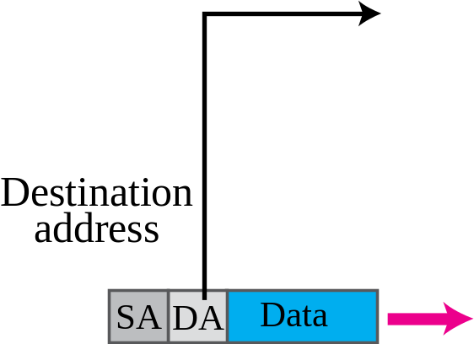
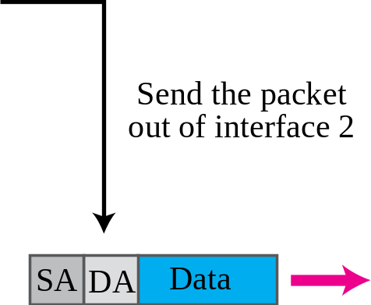
Figure 4.4 Forwarding process in a packet-switched network
TCP/IP Protocol Suite

Slide 12
Note
In a packet-switched network, the forwarding decision is based on the destination address of the packet.
TCP/IP Protocol Suite

Slide 13
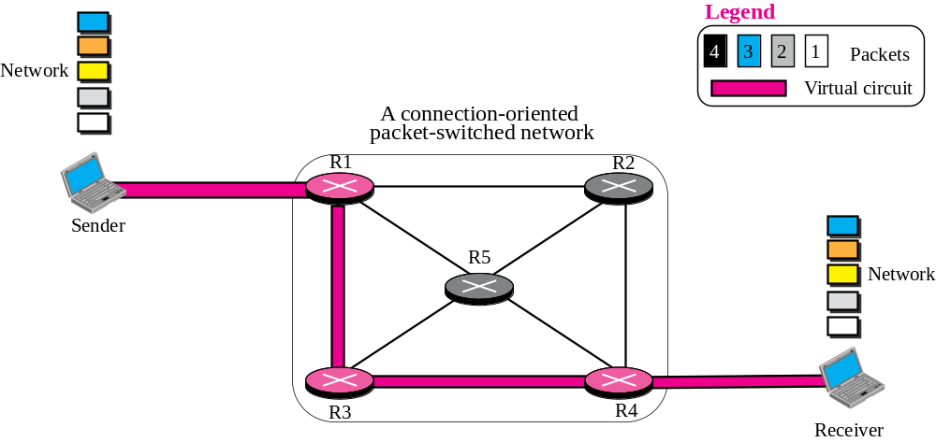
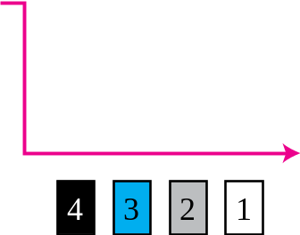




(NOTE) A virtual circuit (VC) switched network
TCP/IP Protocol Suite

Slide 14
4-4 NETWORK LAYER SERVICES
In this section, we briefly discuss services provided by the network layer. Our discussion is mostly based on the connectionless service, the dominant service in today’s Internet.
TCP/IP Protocol Suite

Slide 15
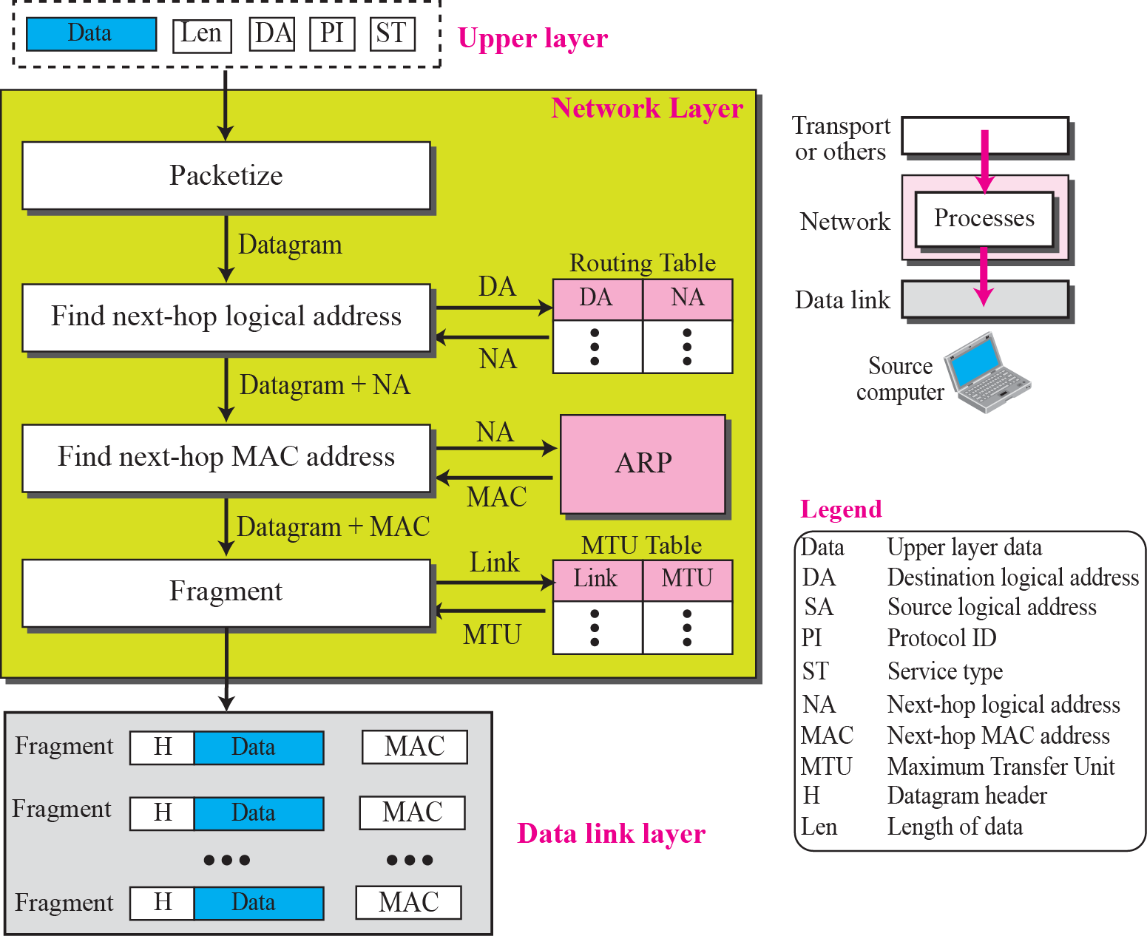
Figure 4.13 Services provided at the source computer
TCP/IP Protocol Suite

Slide 16
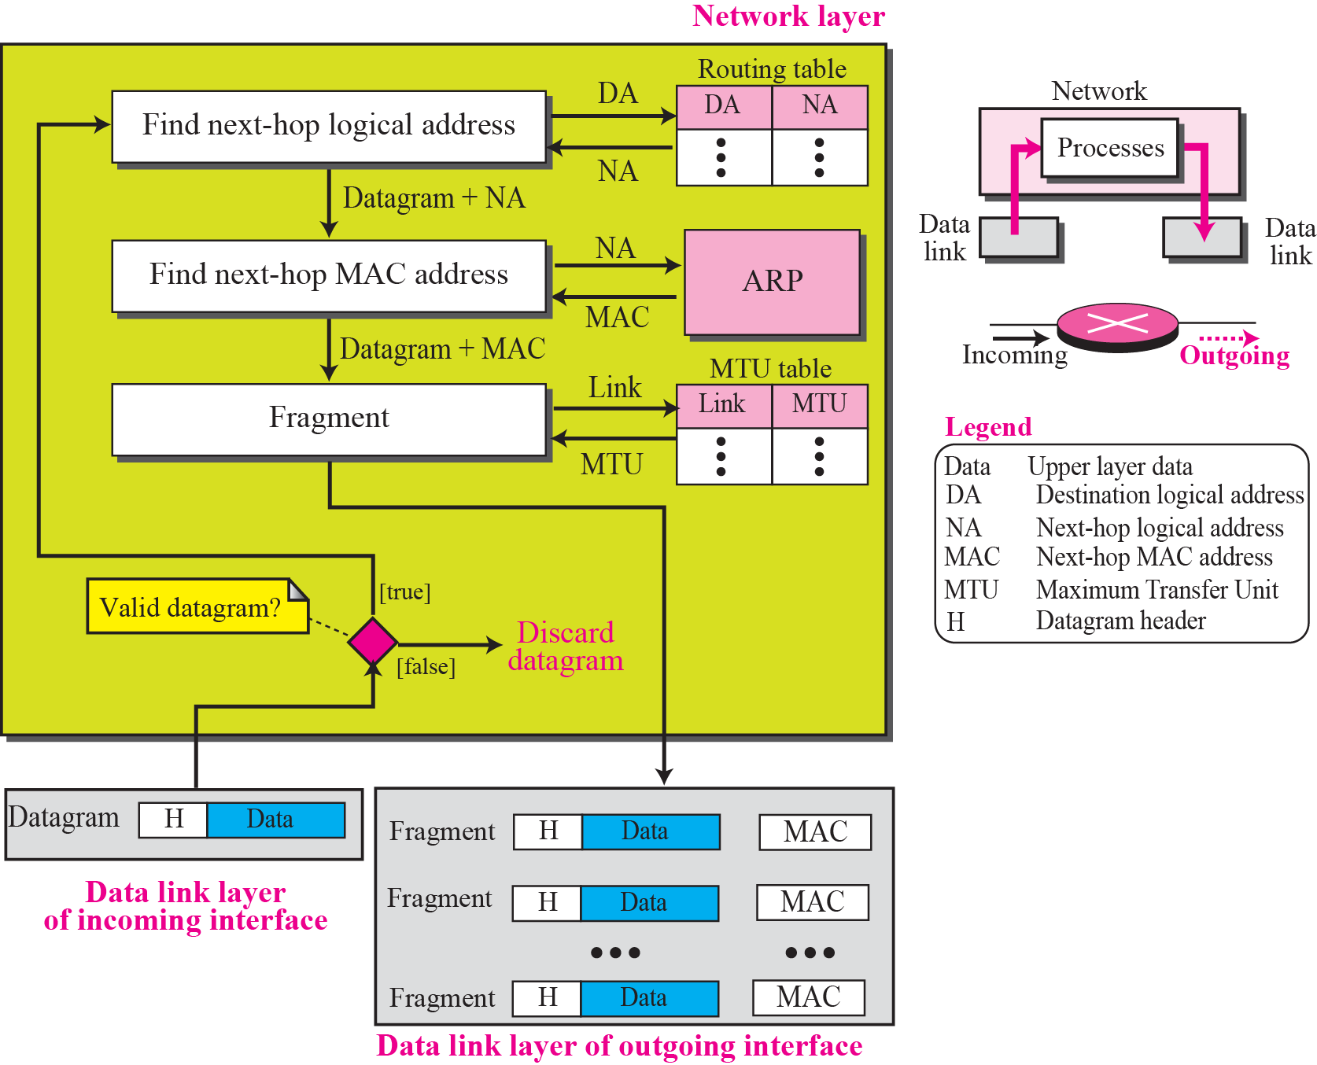
Figure 4.14 Processing at each router
TCP/IP Protocol Suite

Slide 17
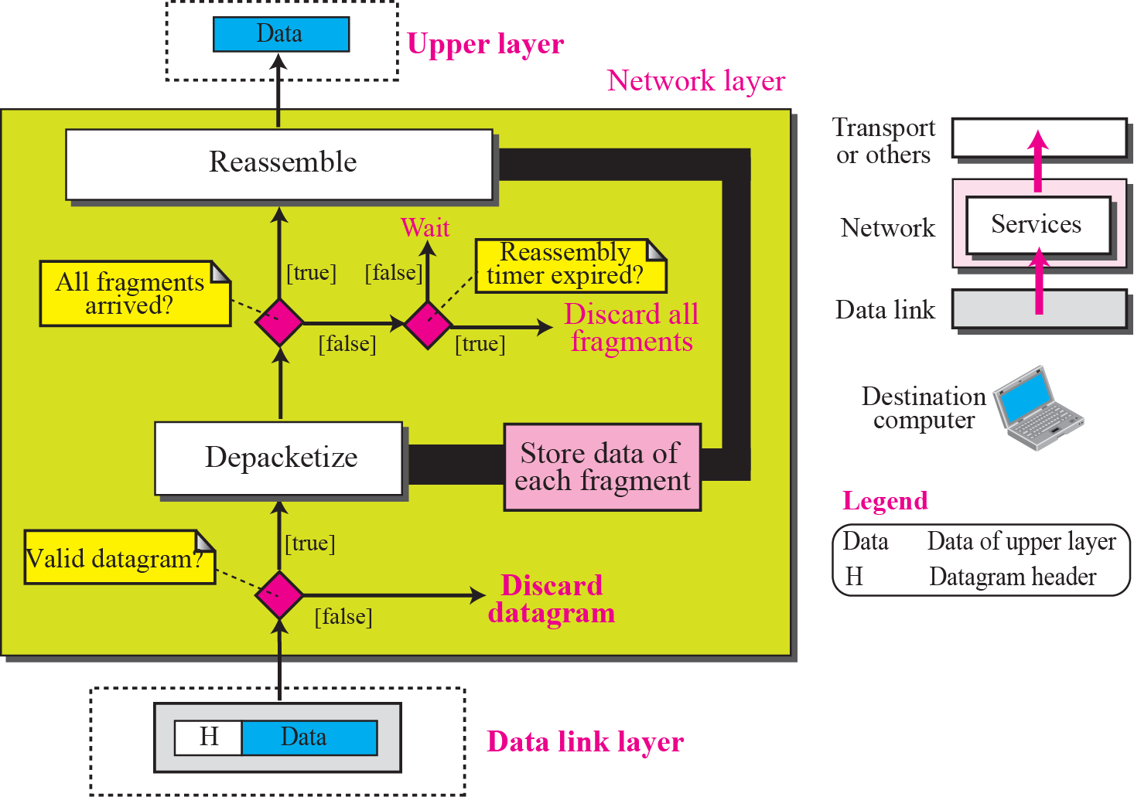
Figure 4.15 Processing at the destination computer
TCP/IP Protocol Suite

