Slide 1

Chapter 5
IPv4 Addresses
TCP/IP Protocol Suite

Slide 2
5-1 INTRODUCTION
The identifier used in the IP layer of the TCP/IP protocol suite to identify each device connected to the Internet is called the Internet address or IP address. An IPv4 address is a 32-bit address that uniquely and universally defines the connection of a host or a router to the Internet; an IP address is the address of the interface.
TCP/IP Protocol Suite

Slide 3

Note
An IPv4 address is 32 bits long.
Note
The IPv4 addresses are unique
and universal.
TCP/IP Protocol Suite

Slide 4
Note
The address space of IPv4 is
2³² or 4,294,967,296.
TCP/IP Protocol Suite

Slide 5
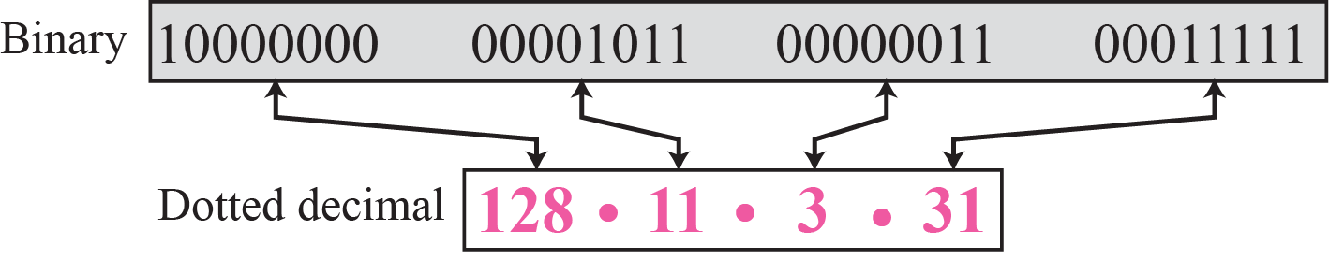
Figure 5.1 Dotted-decimal notation
TCP/IP Protocol Suite

Slide 6
Example 5.1
Change the following IPv4 addresses from binary notation to dotted-decimal notation.
a. 10000001 00001011 00001011 11101111
b. 11000001 10000011 00011011 11111111
c. 11100111 11011011 10001011 01101111
d. 11111001 10011011 11111011 00001111
Solution
We replace each group of 8 bits with its equivalent decimal number (see Appendix B) and add dots for separation:
a. 129.11.11.239
b. 193.131.27.255
c. 231.219.139.111
d. 249.155.251.15
TCP/IP Protocol Suite

Slide 7
Example 5.2
Change the following IPv4 addresses from dotted-decimal notation to binary notation.
a. 111.56.45.78
b. 221.34.7.82
c. 241.8.56.12
d. 75.45.34.78
Solution
We replace each decimal number with its binary equivalent:
a. 01101111 00111000 00101101 01001110
b. 11011101 00100010 00000111 01010010
c. 11110001 00001000 00111000 00001100
d. 01001011 00101101 00100010 01001110
TCP/IP Protocol Suite

Slide 8
Example 5.3
Find the error, if any, in the following IPv4 addresses:
a. 111.56.045.78
b. 221.34.7.8.20
c. 75.45.301.14
d. 11100010.23.14.67
Solution
a. There should be no leading zeroes (045).
b. We may not have more than 4 bytes in an IPv4 address.
c. Each byte should be less than or equal to 255.
d. A mixture of binary notation and dotted-decimal notation.
TCP/IP Protocol Suite

Slide 9
5-2 CLASSFUL ADDRESSING
IP addresses, when started a few decades ago, used the concept of classes. This architecture is called classful addressing. In the mid-1990s, a new architecture, called classless addressing, was introduced that supersedes the original architecture. In this section, we introduce classful addressing because it paves the way for understanding classless addressing and justifies the rationale for moving to the new architecture. Classless addressing is discussed in the next section.
TCP/IP Protocol Suite

Slide 10
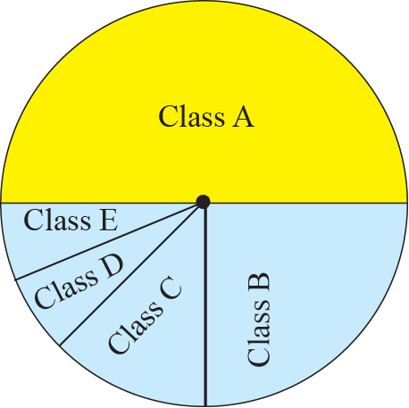
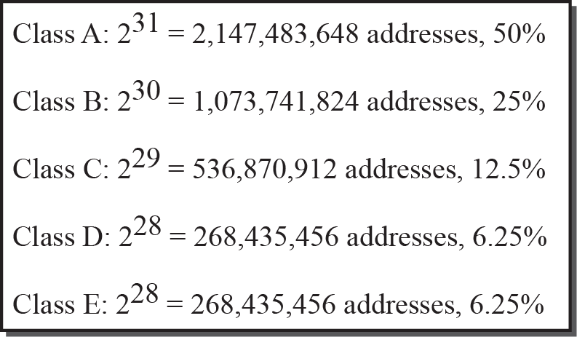
Figure 5.5 Occupation of address space
TCP/IP Protocol Suite

Slide 11
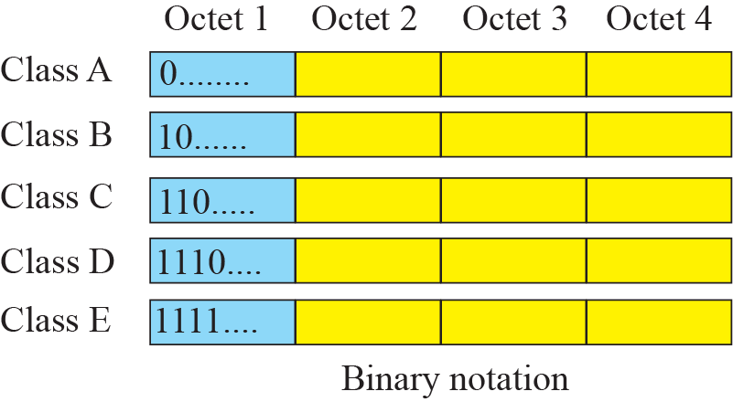
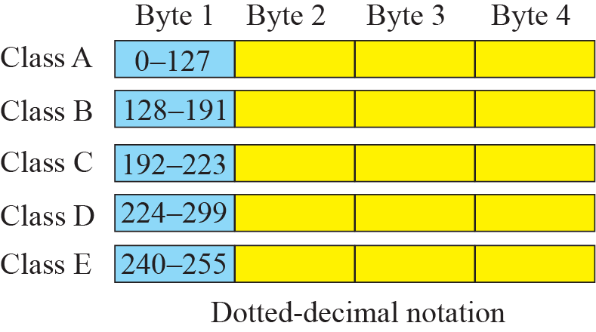
Figure 5.6 Finding the class of address
TCP/IP Protocol Suite

Slide 12
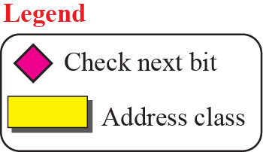
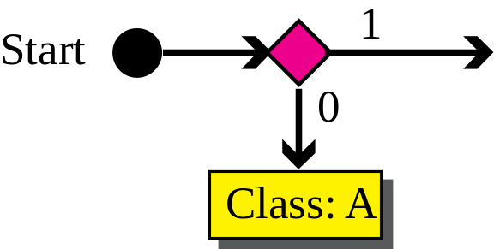
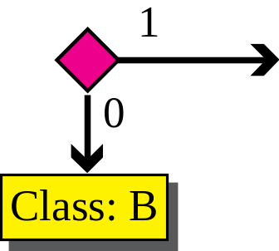
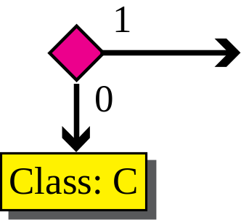
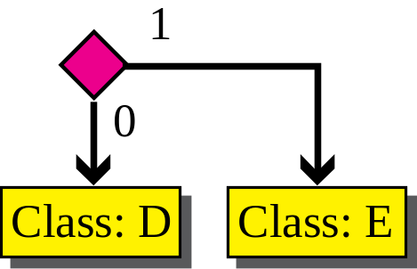
Figure 5.7 Finding the class of an address using continuous checking
TCP/IP Protocol Suite
Notes:
Start0Class: A1Start0Class: AClass: C01

Slide 13
Example 5.10
Find the class of each address:
a. 00000001 00001011 00001011 11101111
b. 11000001 10000011 00011011 11111111
c. 10100111 11011011 10001011 01101111
d. 11110011 10011011 11111011 00001111
Solution
See the procedure in Figure 5.7.
a. The first bit is 0. This is a class A address.
b. The first 2 bits are 1; the third bit is 0. This is a class C address.
c. The first bit is 1; the second bit is 0. This is a class B address.
d. The first 4 bits are 1s. This is a class E address.
TCP/IP Protocol Suite

Slide 14
Example 5.11
Find the class of each address:
a. 227.12.14.87
b. 193.14.56.22
c. 14.23.120.8
d. 252.5.15.111
Solution
a. The first byte is 227 (between 224 and 239); the class is D.
b. The first byte is 193 (between 192 and 223); the class is C.
c. The first byte is 14 (between 0 and 127); the class is A.
d. The first byte is 252 (between 240 and 255); the class is E.
TCP/IP Protocol Suite

Slide 15
Figure 5.8 Netid and hostid
TCP/IP Protocol Suite

Slide 16
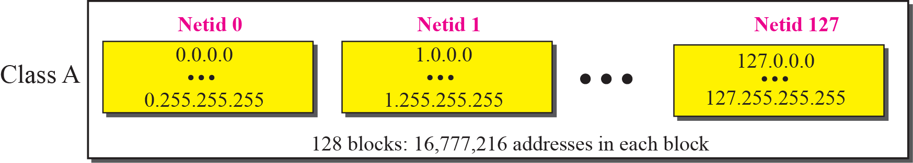
Figure 5.9 Blocks in Class A
TCP/IP Protocol Suite

Slide 17
Note
Millions of class A addresses
are wasted.
TCP/IP Protocol Suite

Slide 18
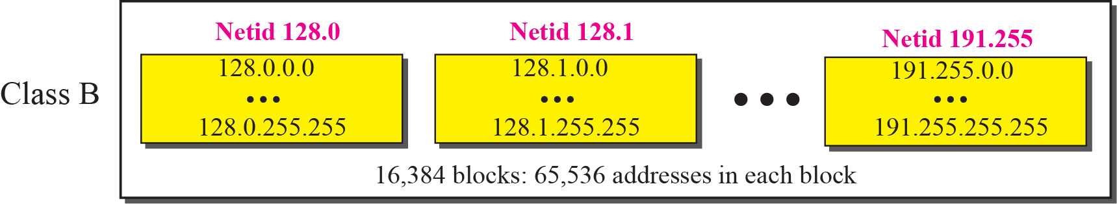
Figure 5.10 Blocks in Class B
TCP/IP Protocol Suite

Slide 19
Note
Many class B addresses are wasted.
TCP/IP Protocol Suite

Slide 20
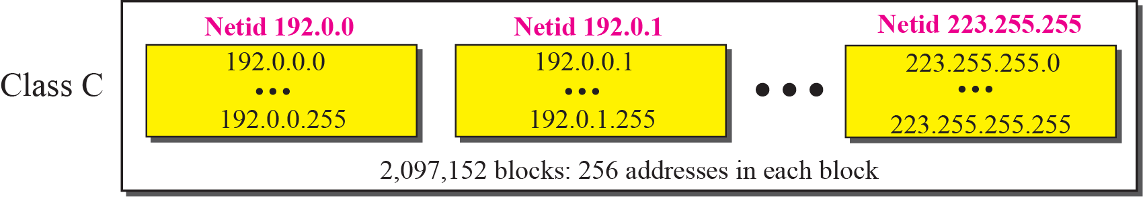
Figure 5.11 Blocks in Class C
TCP/IP Protocol Suite

Slide 21
Note
Not so many organizations are so small to have a class C block.
TCP/IP Protocol Suite

Slide 22
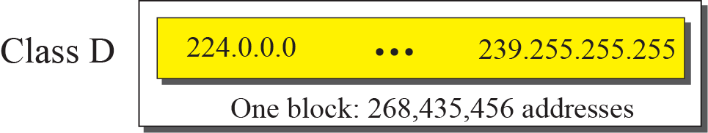
Figure 5.12 The single block in Class D
TCP/IP Protocol Suite

Slide 23
Note
Class D addresses are made of one block, used for multicasting.
TCP/IP Protocol Suite

Slide 24
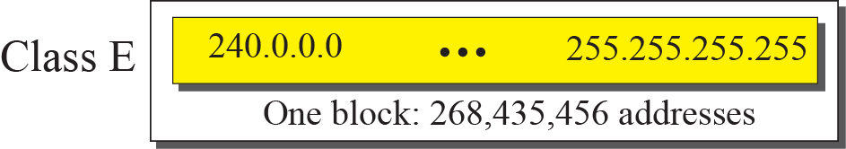
Figure 5.13 The single block in Class E
TCP/IP Protocol Suite

Slide 25
Note
The only block of class E addresses was reserved for future purposes.
TCP/IP Protocol Suite

Slide 26
Note
The range of addresses allocated to an organization in classful addressing
was a block of addresses in
Class A, B, or C.
TCP/IP Protocol Suite

Slide 27
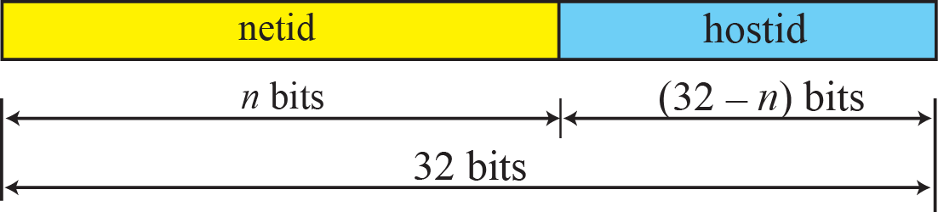
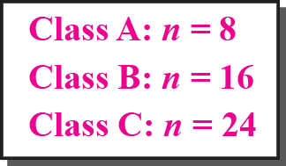
Figure 5.14 Two-level addressing in classful addressing
TCP/IP Protocol Suite

Slide 28
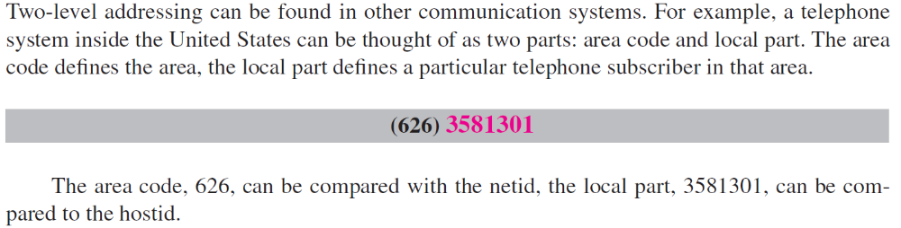
Example 5.12
TCP/IP Protocol Suite

Slide 29
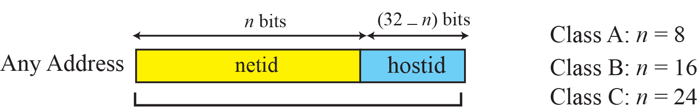
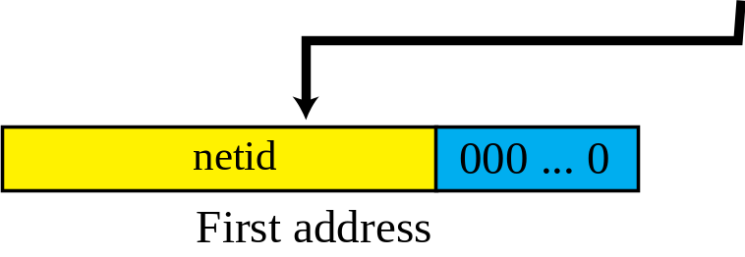
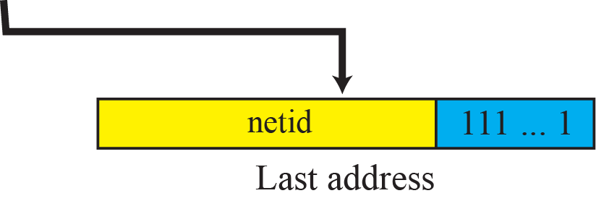
Figure 5.15 Information extraction in classful addressing
TCP/IP Protocol Suite

Slide 30
Note
The network address is the identifier of a network.
TCP/IP Protocol Suite

Slide 31
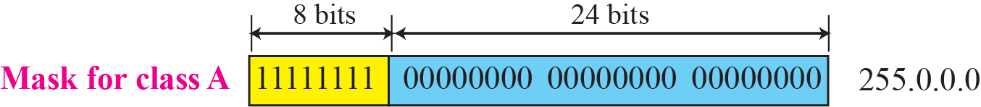
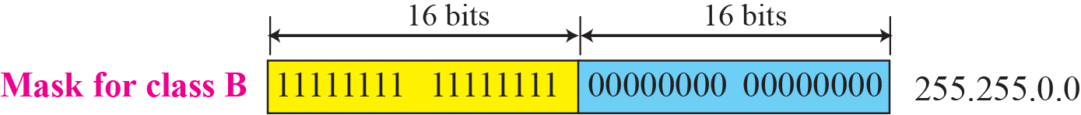
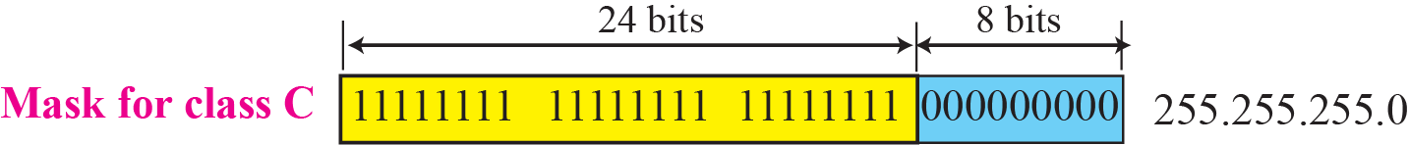
Figure 5.21 Network mask
TCP/IP Protocol Suite

Slide 32
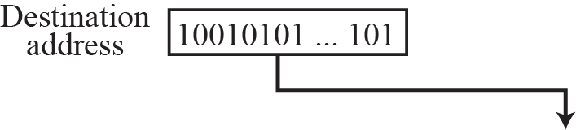
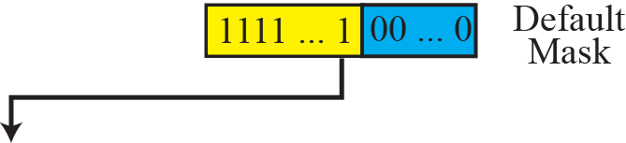
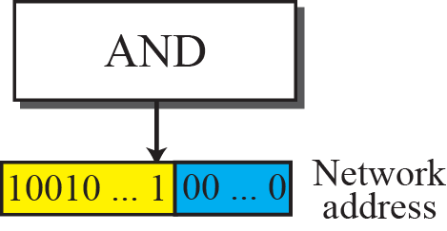
Figure 5.22 Finding a network address using the default mask
TCP/IP Protocol Suite

Slide 33
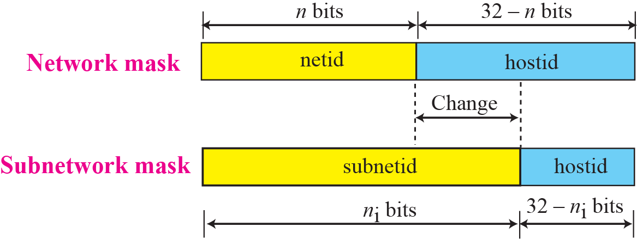
Figure 5.25 Network mask and subnetwork mask
TCP/IP Protocol Suite

Slide 34
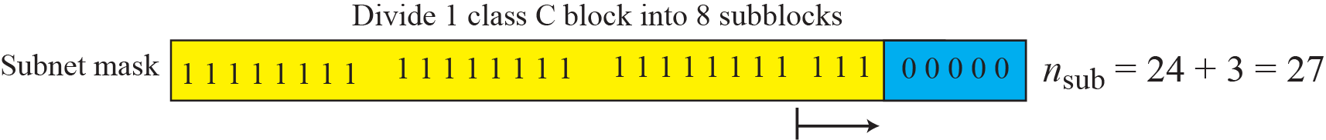
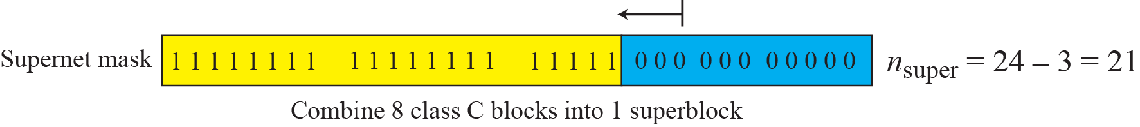
Figure 5.26 Comparison of subnet, default, and supernet mask
TCP/IP Protocol Suite

Slide 35
5-3 CLASSLESS ADDRESSING
Subnetting and supernetting in classful addressing did not really solve the address depletion problem. With the growth of the Internet, it was clear that a larger address space was needed as a long-term solution. Although the long-range solution has already been devised and is called IPv6, a short-term solution was also devised to use the same address space but to change the distribution of addresses to provide a fair share to each organization. The short-term solution still uses IPv4 addresses, but it is called classless addressing.
TCP/IP Protocol Suite

Slide 36
Note
In classless addressing, the prefix defines the network and the suffix
defines the host.
TCP/IP Protocol Suite

Slide 37
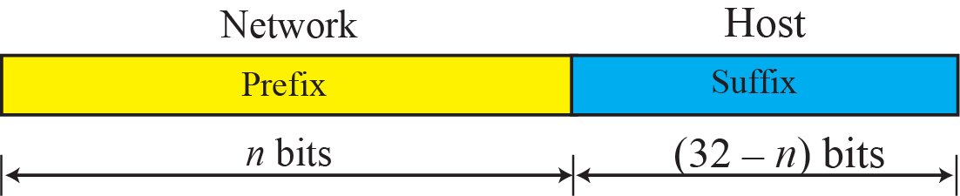
Figure 5.28 Prefix and suffix
TCP/IP Protocol Suite

Slide 38
Note
The prefix length in classless addressing can be 1 to 32.
TCP/IP Protocol Suite

Slide 39
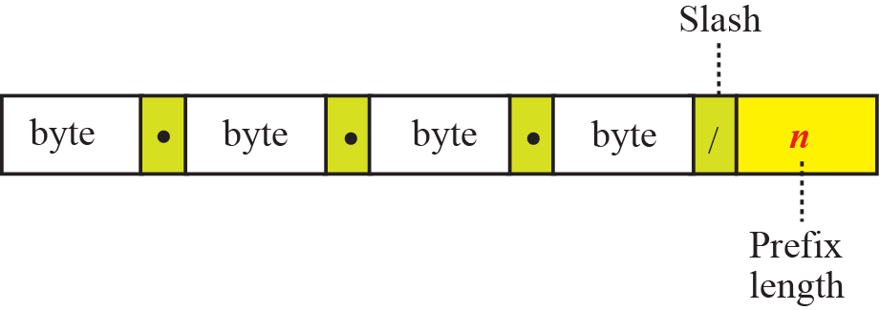
Figure 5.29 Slash notation
TCP/IP Protocol Suite

Slide 40
Note
In classless addressing, we need to know one of the addresses in the block
and the prefix length to define the block.
TCP/IP Protocol Suite

Slide 41
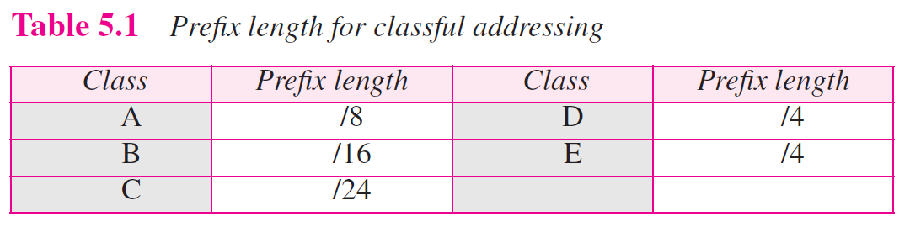
TCP/IP Protocol Suite

Slide 42
5-4 SPECIAL ADDRESSES
In classful addressing some addresses were reserved for special purposes. The classless addressing scheme inherits some of these special addresses from classful addressing.
TCP/IP Protocol Suite

Slide 43
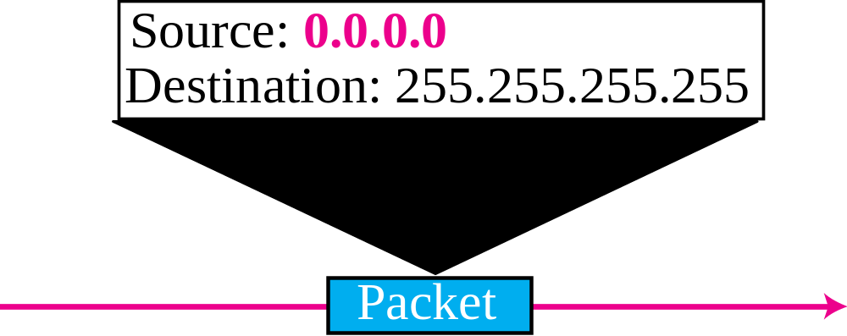
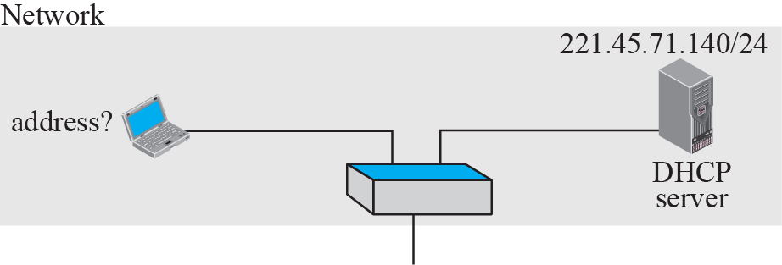
Figure 5.35 Example of using the all-zero address
TCP/IP Protocol Suite

Slide 44
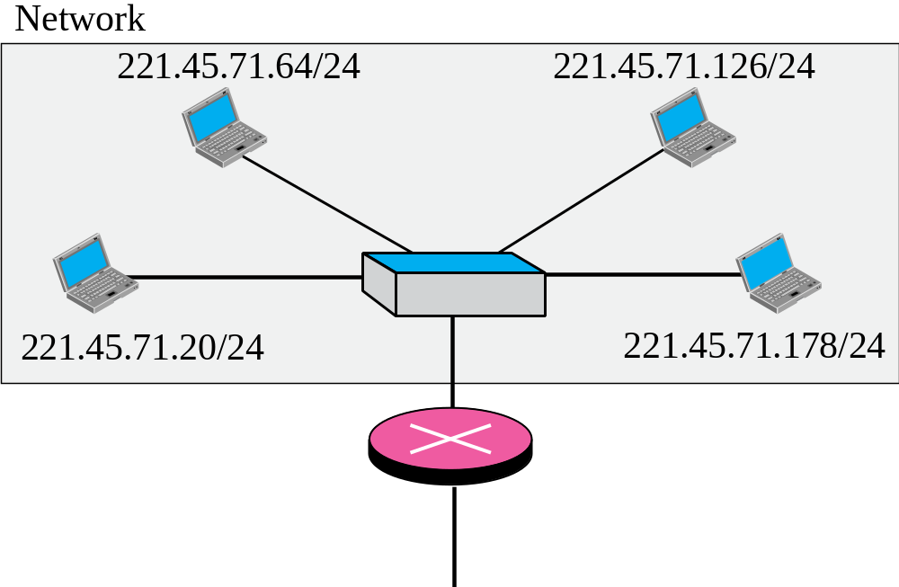
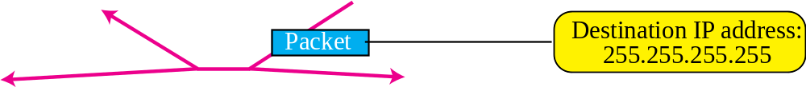
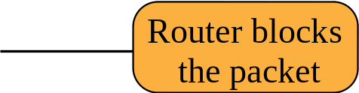
Figure 5.36 Example of limited broadcast address
TCP/IP Protocol Suite

Slide 45
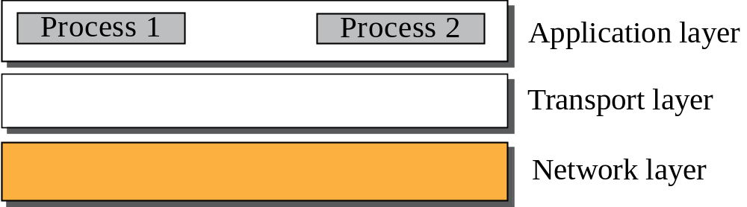
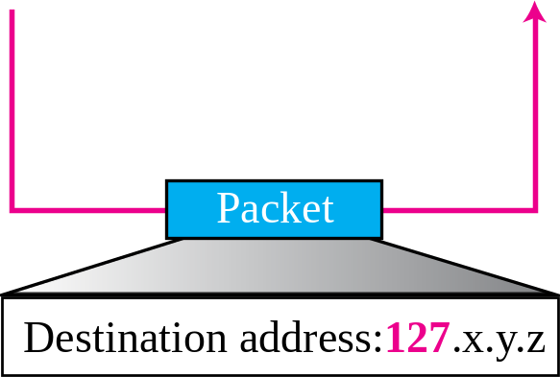
Figure 5.37 Example of loopback address
TCP/IP Protocol Suite

Slide 46
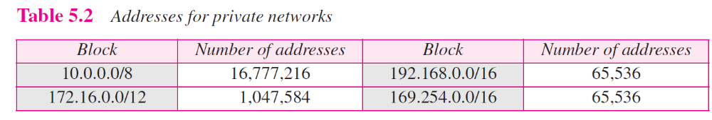
TCP/IP Protocol Suite

Slide 47
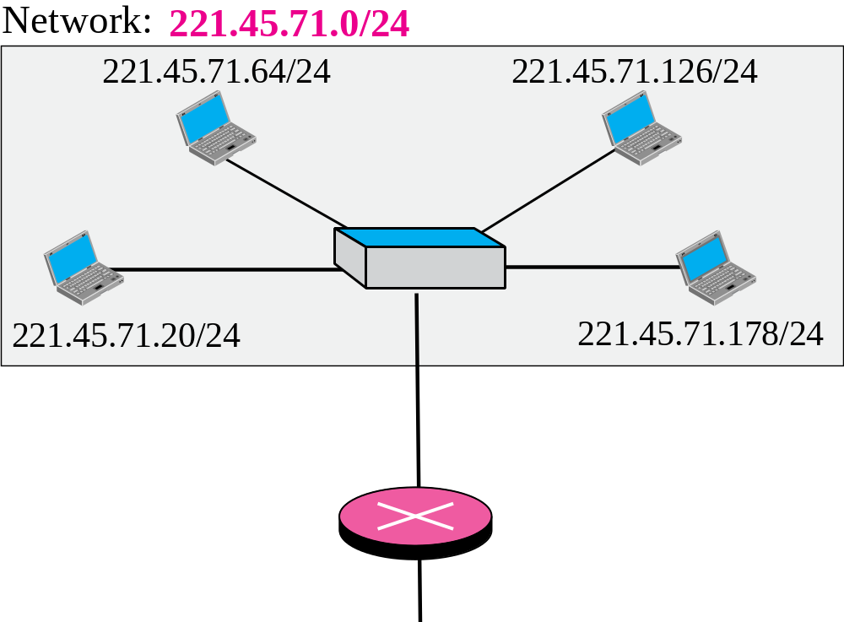
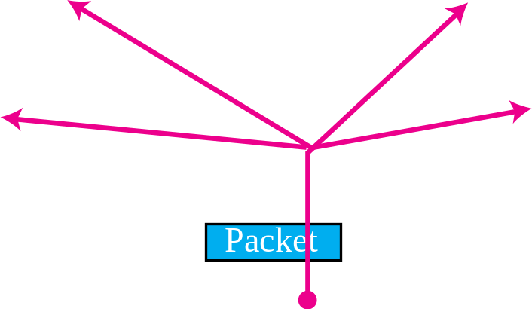
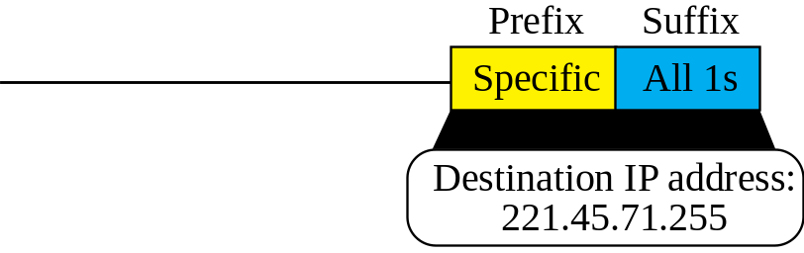
Figure 5.38 Example of a directed broadcast address
TCP/IP Protocol Suite

Slide 48
5-5 NAT
The distribution of addresses through ISPs has created a new problem. If the business grows or the household needs a larger range, the ISP may not be able to grant the demand because the addresses before and after the range may have already been allocated to other networks. In most situations, however, only a portion of computers in a small network need access to the Internet simultaneously. A technology that can help in this cases is network address translation (NAT).
TCP/IP Protocol Suite

Slide 49
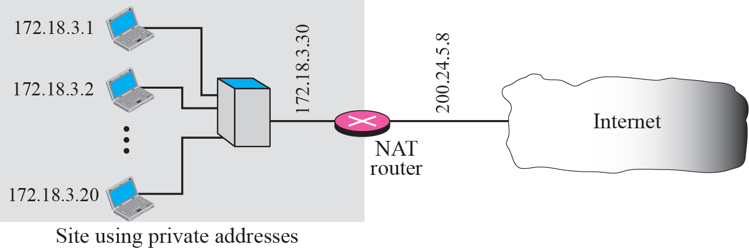
Figure 5.39 NAT
TCP/IP Protocol Suite

Slide 50
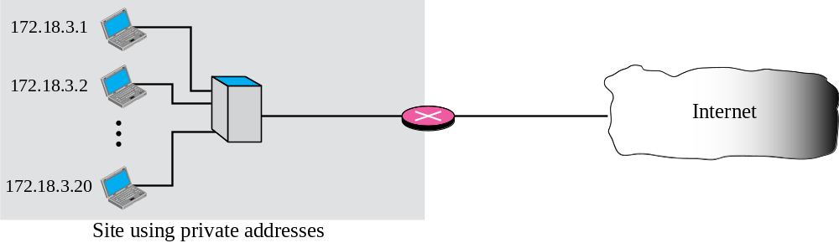
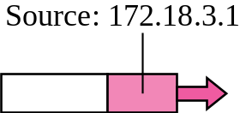
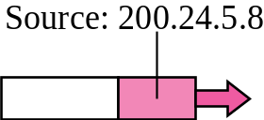
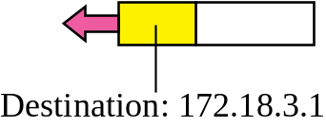
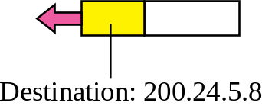
Figure 5.40 Address resolution
TCP/IP Protocol Suite

Slide 51

Figure 5.41 Translation
TCP/IP Protocol Suite

Slide 52

TCP/IP Protocol Suite

