Slide 1

Chapter 6
Delivery and
Forwarding of
IP Packets
TCP/IP Protocol Suite

Slide 2
6-1 DELIVERY
The network layer supervises the handling of the packets by the underlying physical networks. We define this handling as the delivery of a packet. The delivery of a packet to its final destination is accomplished using two different methods of delivery: direct and indirect.
TCP/IP Protocol Suite

Slide 3
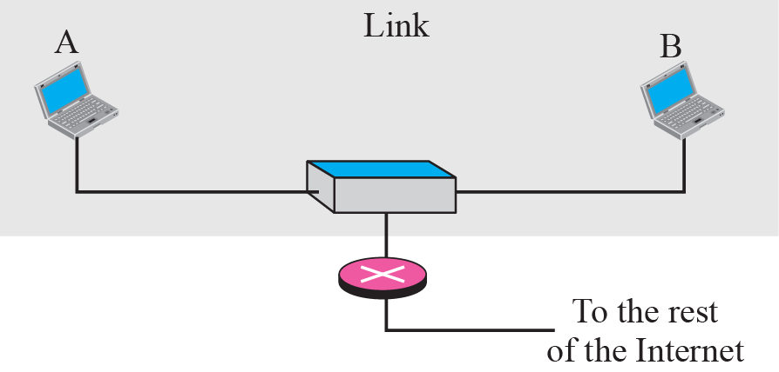
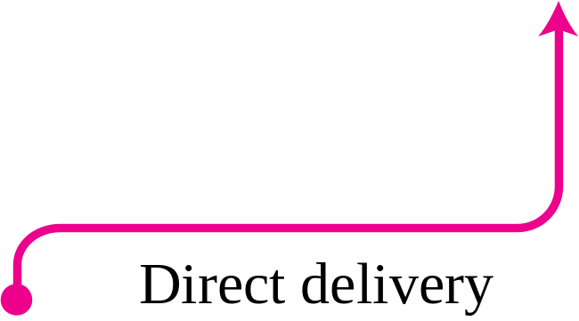
Figure 6.1 Direct delivery
TCP/IP Protocol Suite

Slide 4
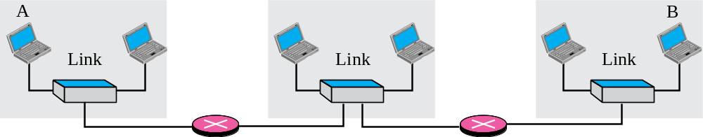
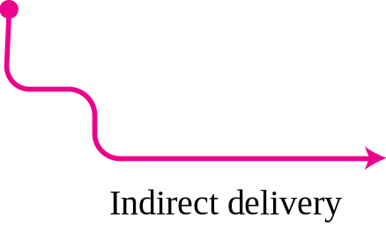
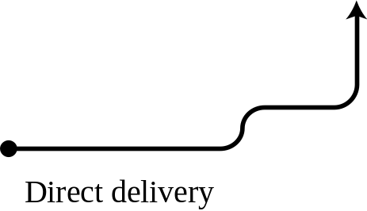

Figure 6.2 Indirect delivery
TCP/IP Protocol Suite

Slide 5
6-2 FORWARDING
Forwarding means to place the packet in its route to its destination. Since the Internet today is made of a combination of links (networks), forwarding means to deliver the packet to the next hop (which can be the final destination or the intermediate connecting device). Although the IP protocol was originally designed as a connectionless protocol, today the tendency is to use IP as a connection-oriented protocol.
TCP/IP Protocol Suite

Slide 6
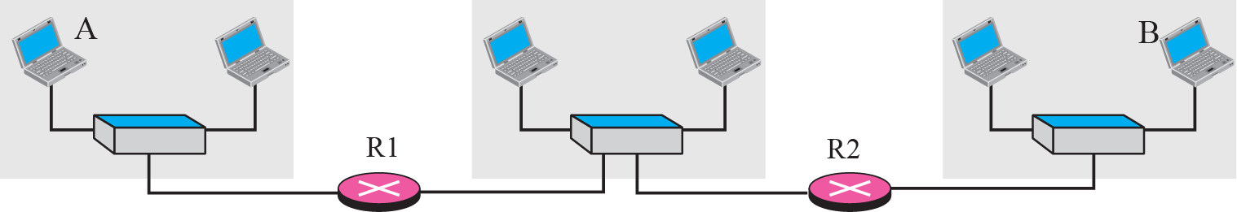
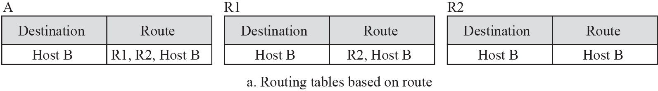
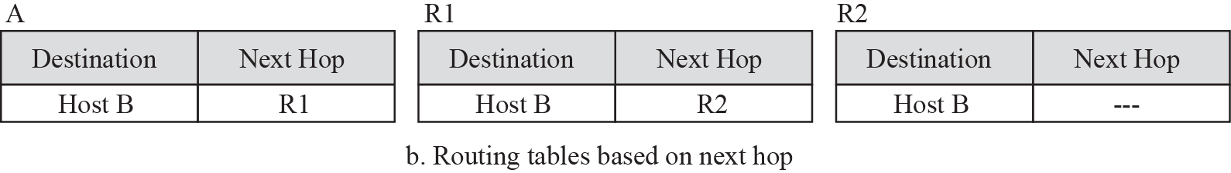
Figure 6.3 Next-hop method
TCP/IP Protocol Suite

Slide 7
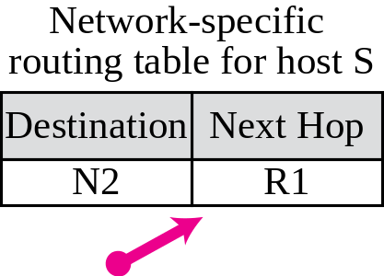
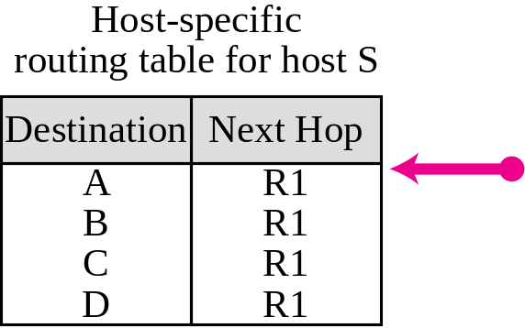
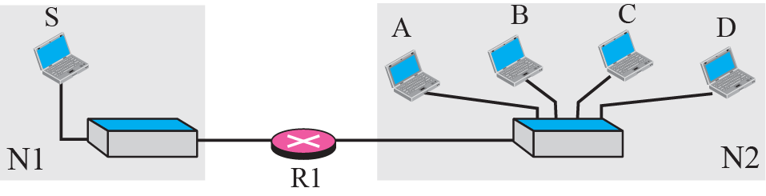
Figure 6.4 Network-specific method
TCP/IP Protocol Suite
Notes:
Host-specific
routing table for host SNext HopR1
R1
R1
R1DestinationA
B
C

Slide 8
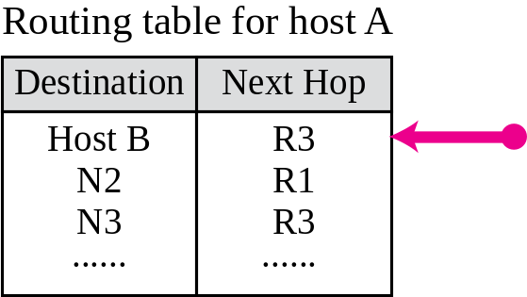
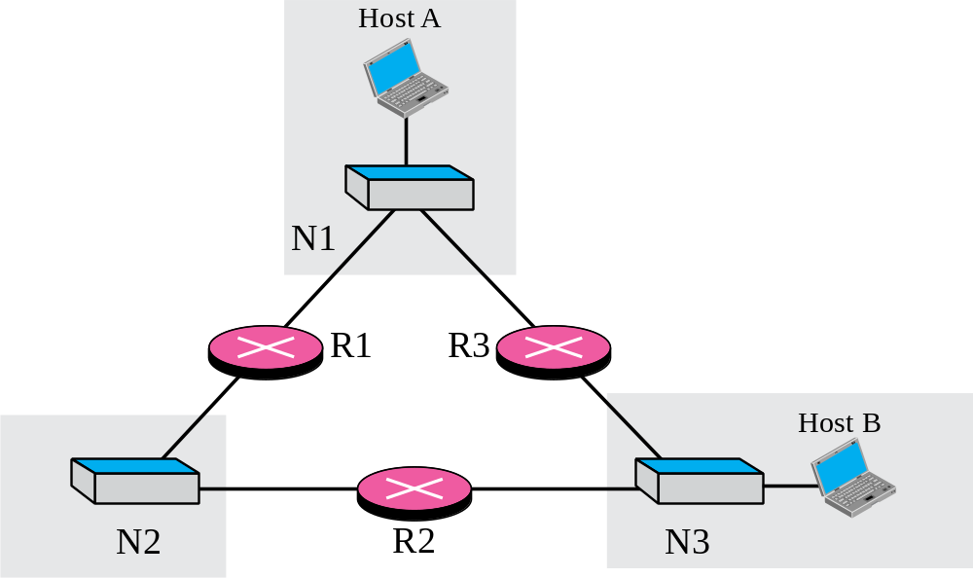
Figure 6.5 Host-specific routing
TCP/IP Protocol Suite

Slide 9
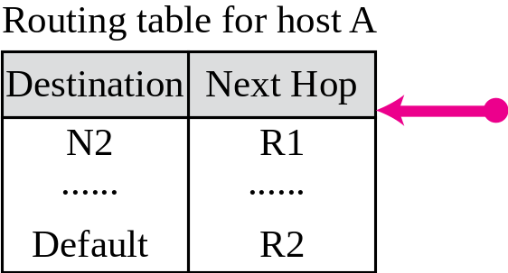
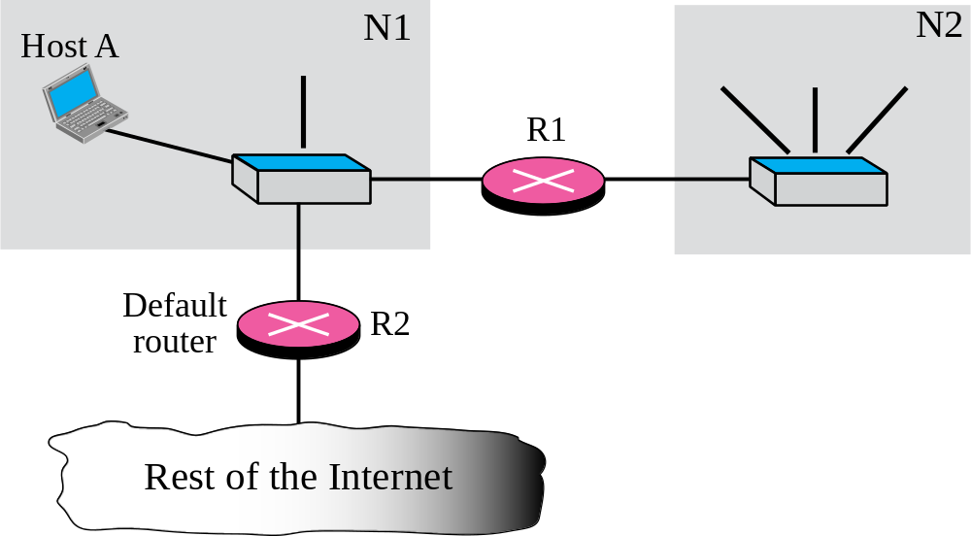
Figure 6.6 Default routing
TCP/IP Protocol Suite

Slide 10
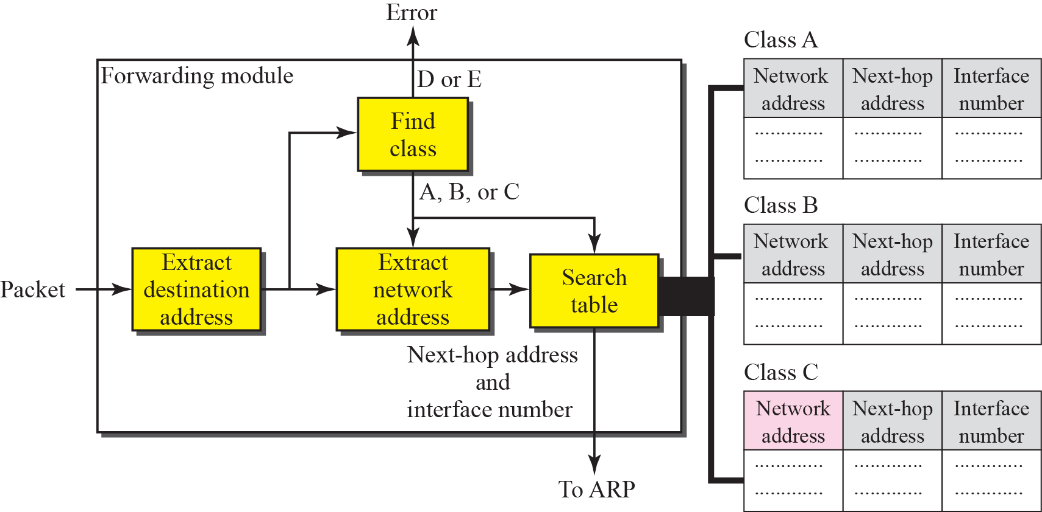
Figure 6.7 Simplified forwarding module in classful address without subnetting
TCP/IP Protocol Suite

Slide 11
Example 6.1
Figure 6.8 shows an imaginary part of the Internet. Show the routing tables for router R1.
Solution
Figure 6.9 shows the three tables used by router R1. Note that some entries in the next-hop address column are empty because in these cases, the destination is in the same network to which the router is connected (direct delivery). In these cases, the next-hop address used by ARP is simply the destination address of the packet as we will see in Chapter 8.
TCP/IP Protocol Suite

Slide 12
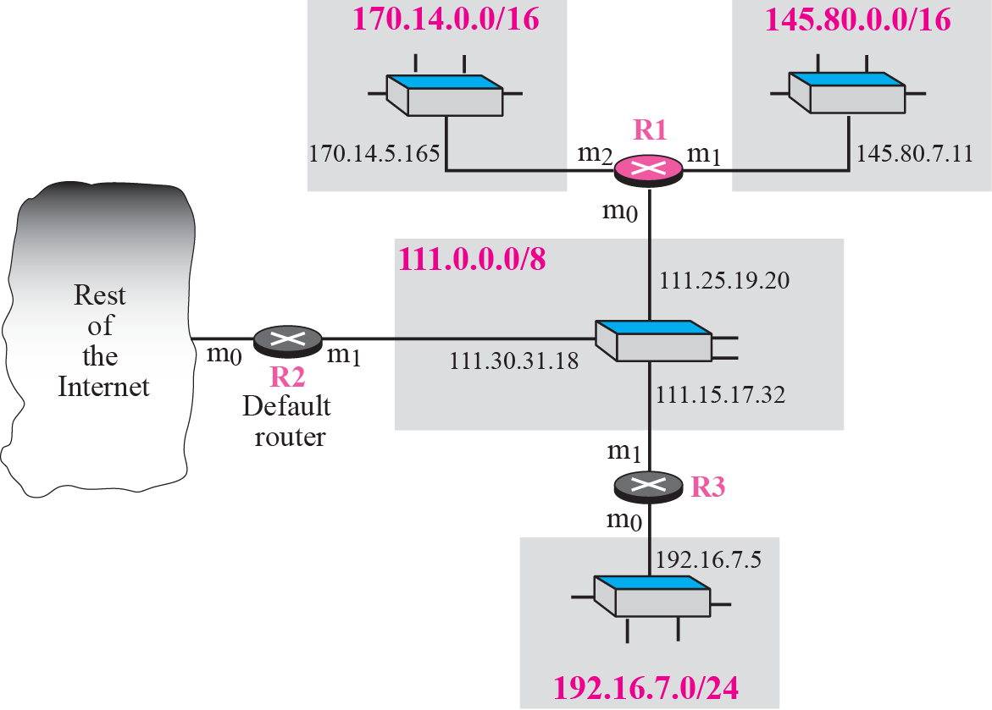
Figure 6.8 Configuration for routing, Example 6.1
TCP/IP Protocol Suite

Slide 13
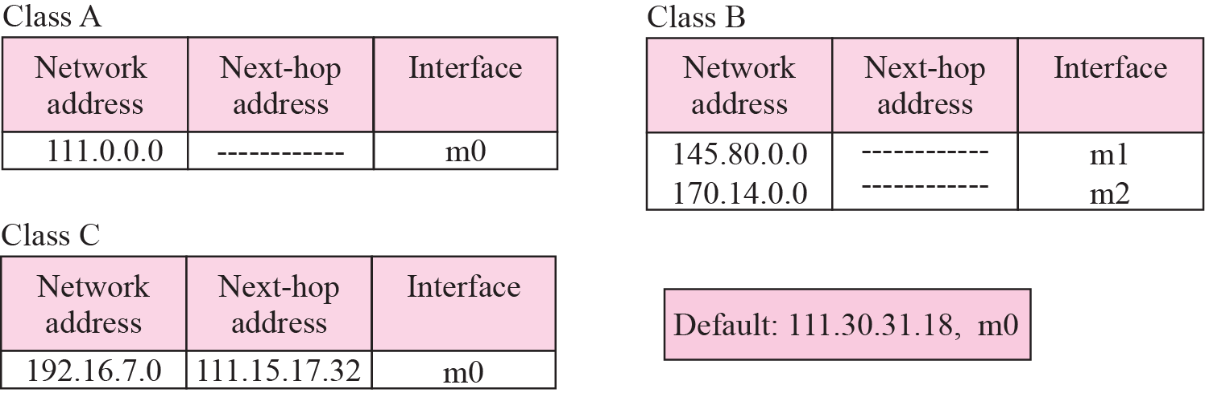
Figure 6.9 Tables for Example 6.1
TCP/IP Protocol Suite

Slide 14
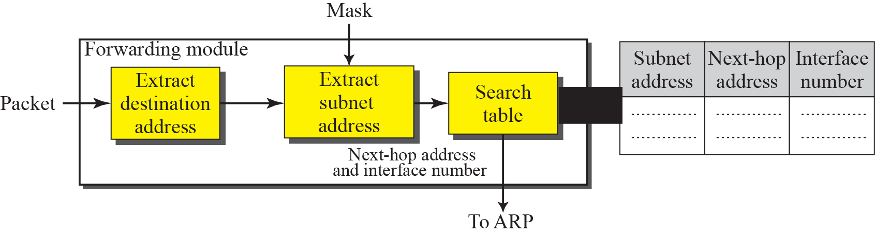
Figure 6.10 Simplified forwarding module in classful address with subnetting
TCP/IP Protocol Suite

Slide 15

Note
In classful addressing we can have a routing table with three columns;
in classless addressing,
we need at least four columns.
TCP/IP Protocol Suite

Slide 16
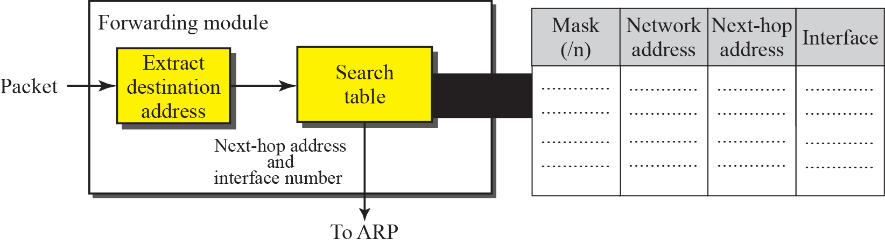
Figure 6.12 Simplified forwarding module in classless address
TCP/IP Protocol Suite

Slide 17
Example 6.7
Make a routing table for router R1 using the configuration in Figure 6.13.
Solution
Table 6.1 shows the corresponding table
TCP/IP Protocol Suite

Slide 18
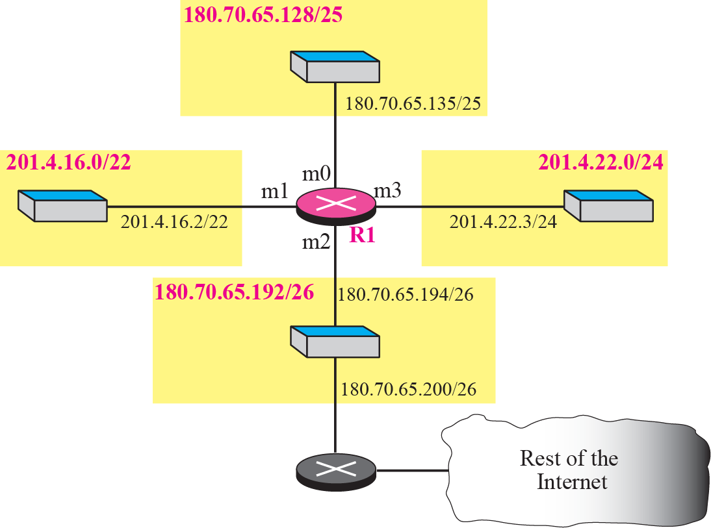
Figure 6.13 Configuration for Example 6.7
TCP/IP Protocol Suite

Slide 19
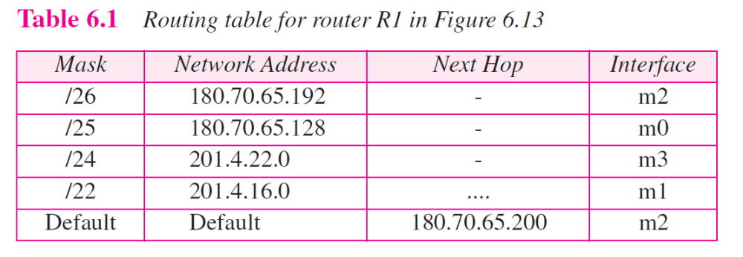
TCP/IP Protocol Suite

Slide 20
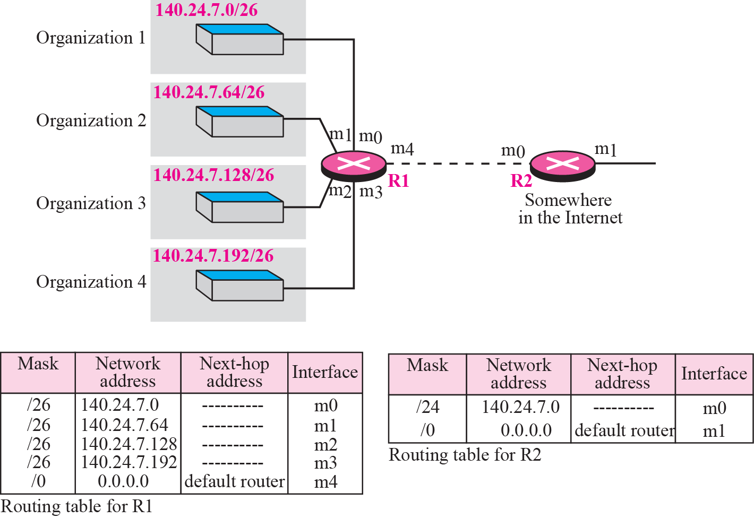
Figure 6.15 Address aggregation
TCP/IP Protocol Suite

Slide 21
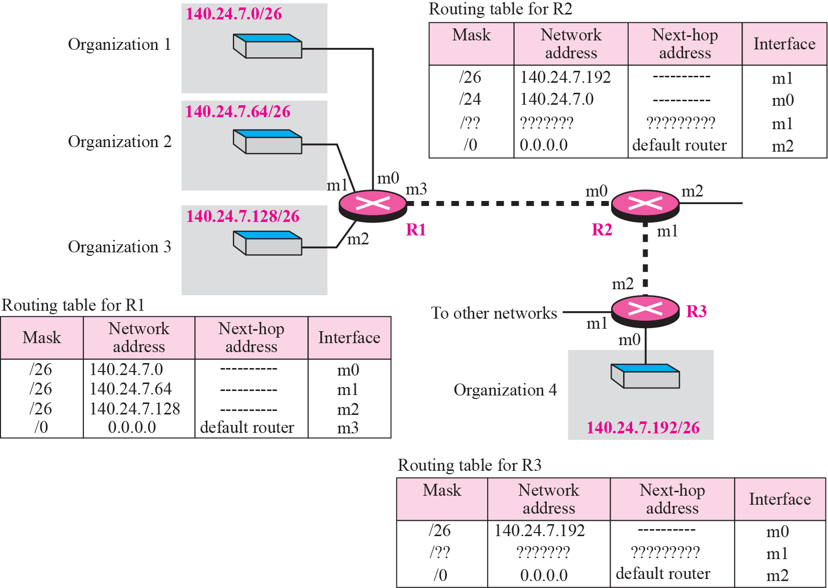
Figure 6.16 Longest mask matching
TCP/IP Protocol Suite

Slide 22
Example 6.12
As an example of hierarchical routing, let us consider Figure 6.17. A regional ISP is granted 16,384 addresses starting from 120.14.64.0. The regional ISP has decided to divide this block into 4 subblocks, each with 4096 addresses. Three of these subblocks are assigned to three local ISPs, the second subblock is reserved for future use. Note that the mask for each block is /20 because the original block with mask /18 is divided into 4 blocks.
TCP/IP Protocol Suite

Slide 23
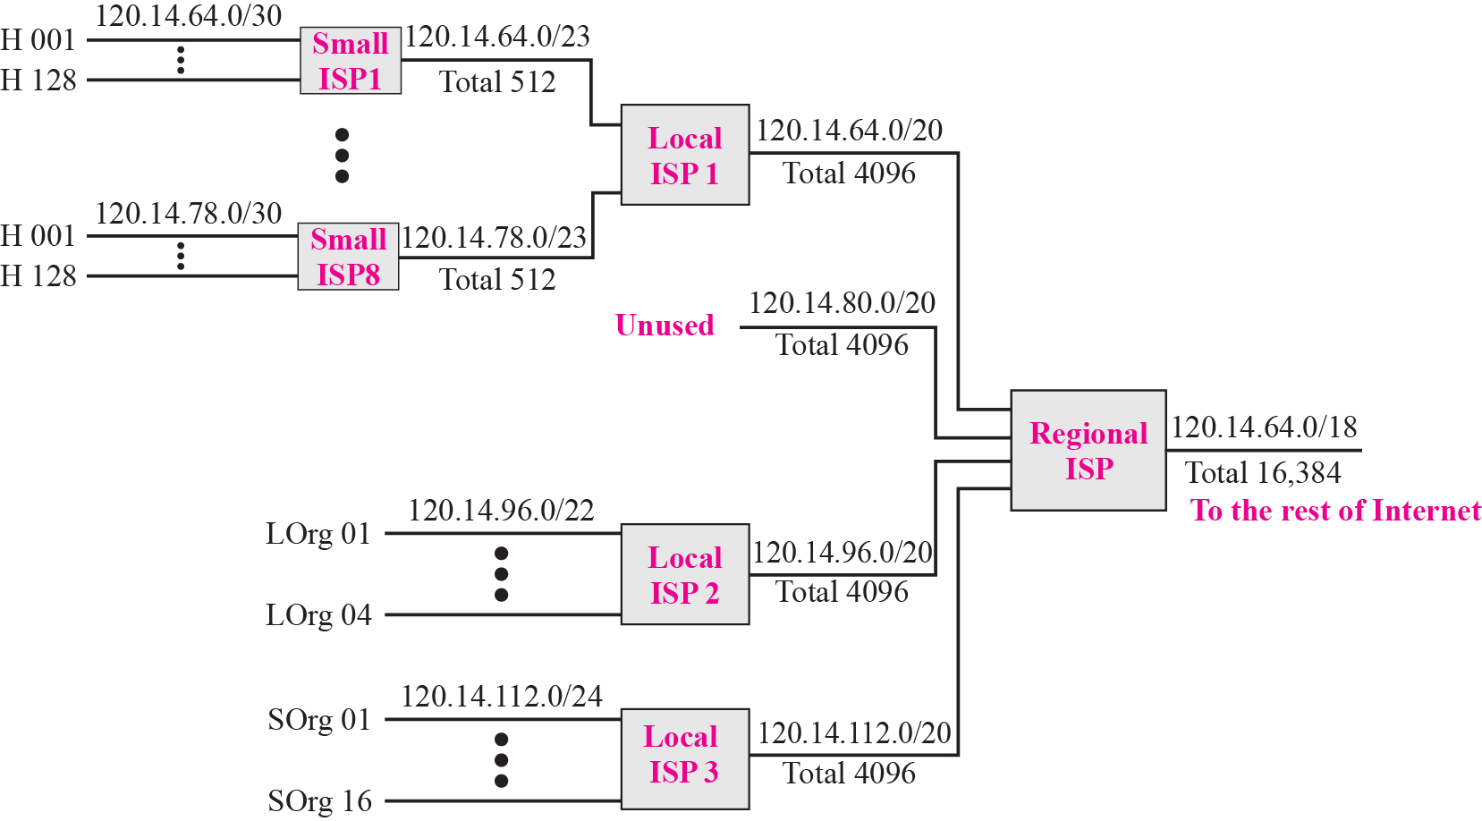
Figure 6.17 Hierarchical routing with ISPs
TCP/IP Protocol Suite

Slide 24
6-3 STRUCTURE OF A ROUTER
In our discussion of forwarding and routing, we represented a router as a black box that accepts incoming packets from one of the input ports (interfaces), uses a routing table to find the output port from which the packet departs, and sends the packet from this output port. In this section we open the black box and look inside. However, our discussion won’t be very detailed; entire books have been written about routers. We just give an overview to the reader.
TCP/IP Protocol Suite

Slide 25
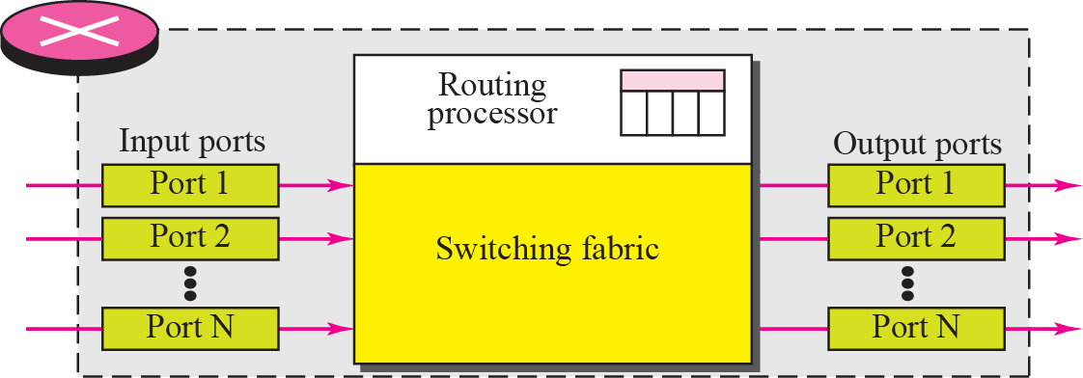
Figure 6.22 Router components
TCP/IP Protocol Suite

Slide 26
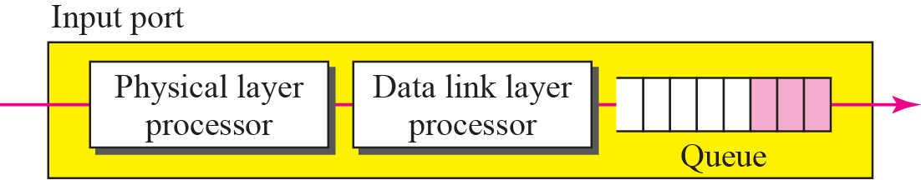
Figure 6.23 Input port
TCP/IP Protocol Suite

Slide 27
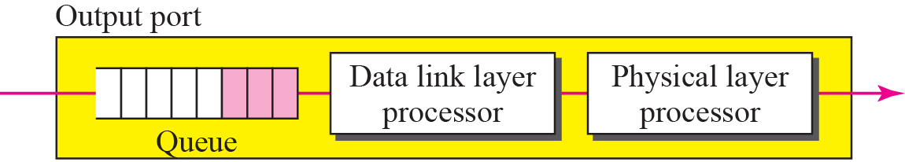
Figure 6.24 Output port
TCP/IP Protocol Suite

Slide 28
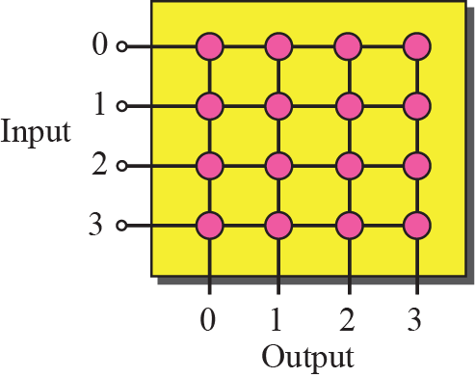
Figure 6.25 Crossbar switch
TCP/IP Protocol Suite

Slide 29
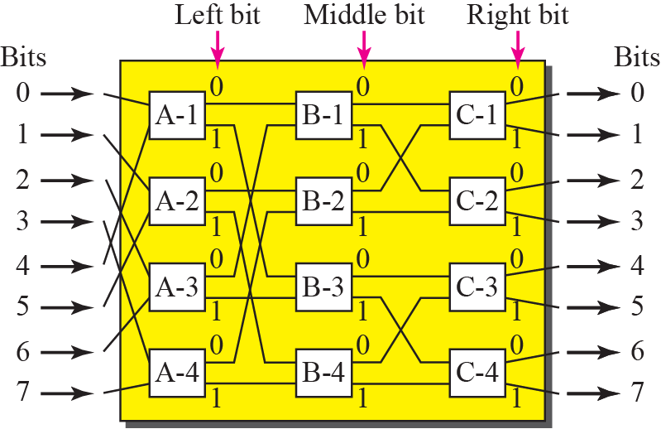
Figure 6.26 A banyan switch
TCP/IP Protocol Suite

Slide 30
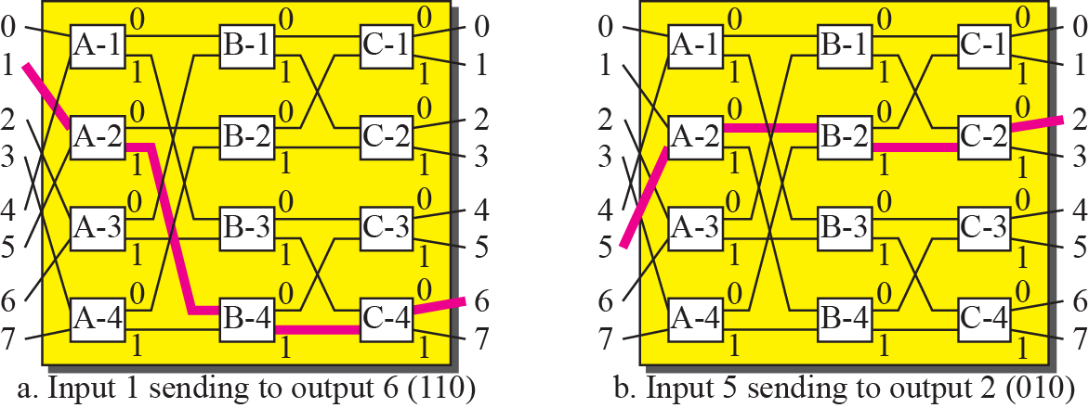
Figure 6.27 Examples of routing in a banyan switch
TCP/IP Protocol Suite

