Slide 1

Chapter 7
Internet Protocol Version4
(IPv4)
TCP/IP Protocol Suite

Slide 2
7-1 INTRODUCTION
The Internet Protocol (IP) is the transmission mechanism used by the TCP/IP protocols at the network layer.
TCP/IP Protocol Suite

Slide 3
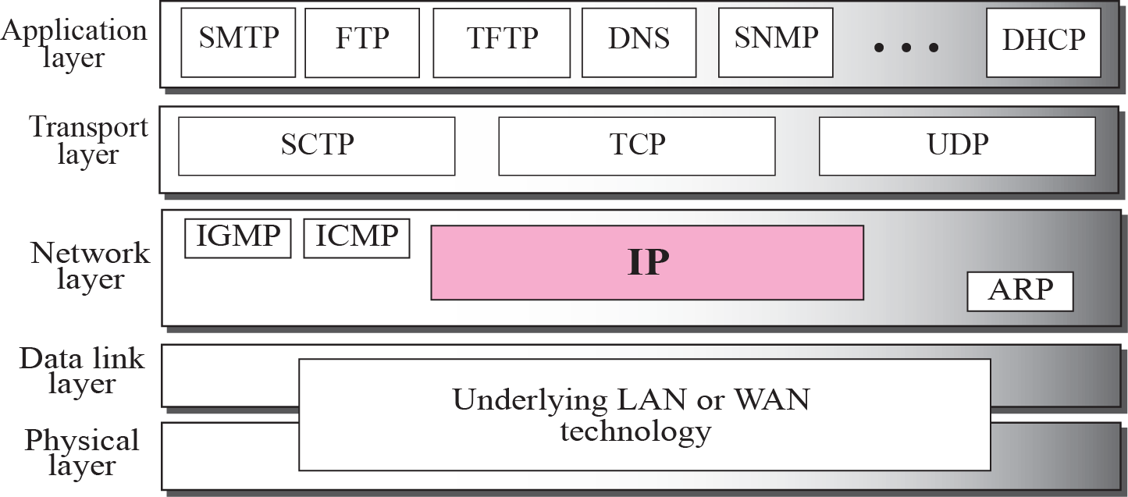
Figure 7.1 Position of IP in TCP/IP protocol suite
TCP/IP Protocol Suite

Slide 4
7-2 DATAGRAMS
Packets in the network (internet) layer are called
datagrams. A datagram is a variable-length packet consisting of two parts: header and data. The header is 20 to 60 bytes in length and contains information essential to routing and delivery. It is customary in TCP/IP to show the header in 4-byte sections. A brief description of each field is in order.
TCP/IP Protocol Suite

Slide 5
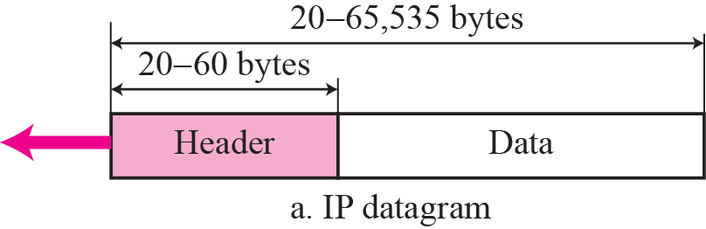
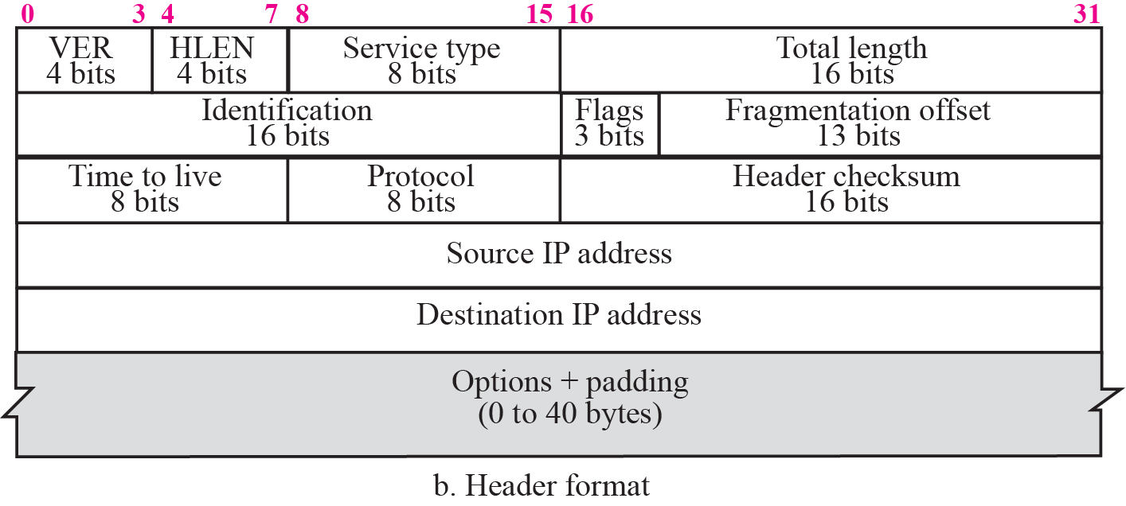
Figure 7.2 IP datagram
TCP/IP Protocol Suite

Slide 6
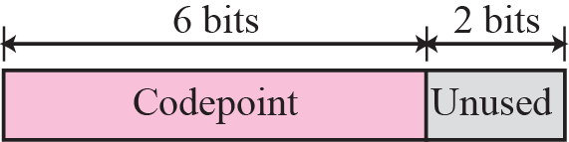
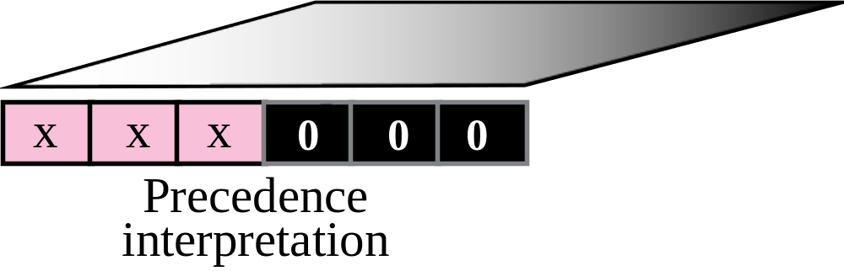
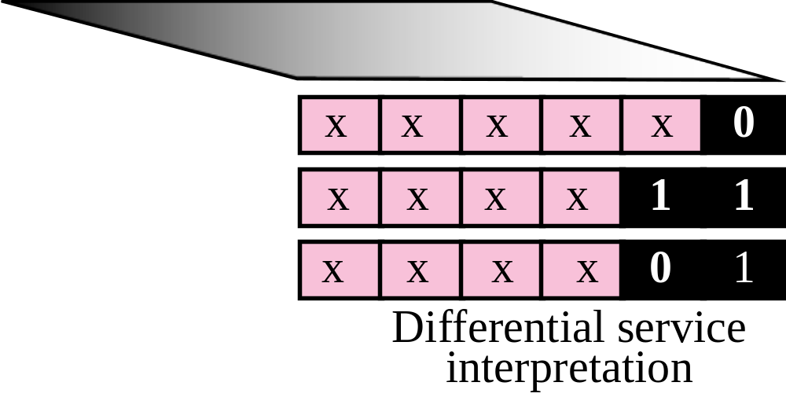
Figure 7.3 Service type
TCP/IP Protocol Suite

Slide 7
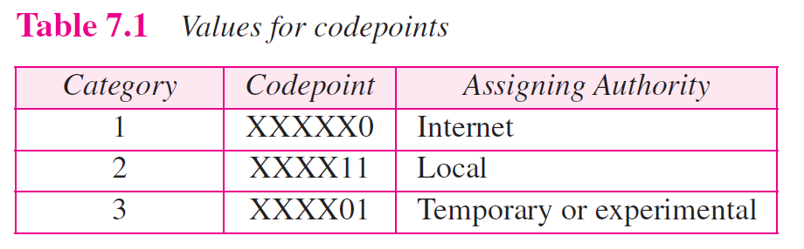
TCP/IP Protocol Suite

Slide 8

Note
The total length field defines the total length of the datagram including the header.
TCP/IP Protocol Suite

Slide 9

Figure 7.4 Encapsulation of a small datagram in an Ethernet frame
TCP/IP Protocol Suite

Slide 10
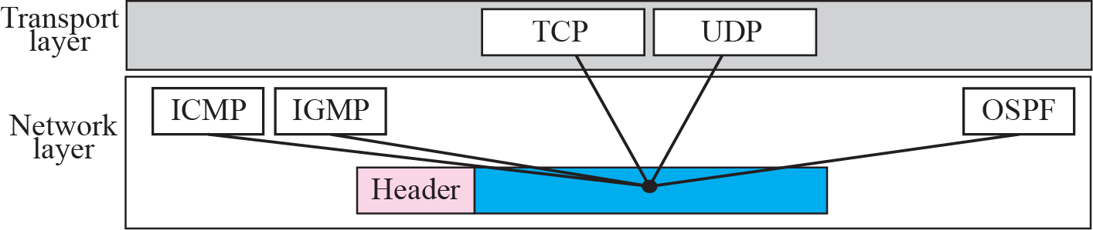
Figure 7.5 Multiplexing
TCP/IP Protocol Suite

Slide 11
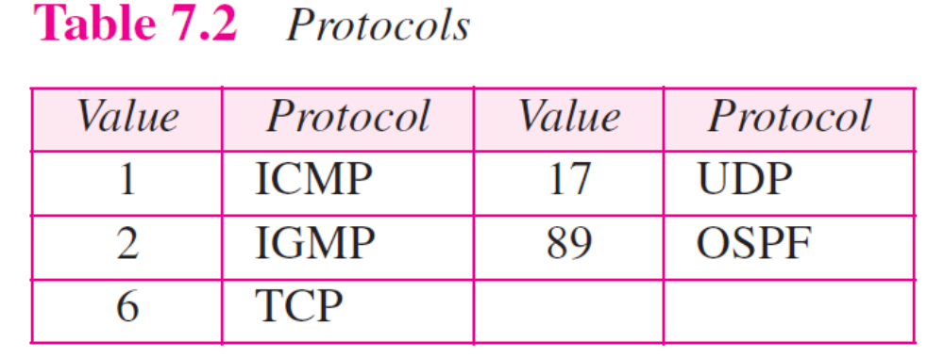
TCP/IP Protocol Suite

Slide 12
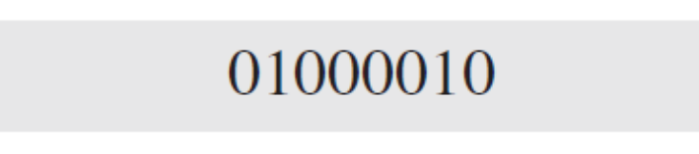
Example 7.1
An IP packet has arrived with the first 8 bits as shown:
The receiver discards the packet. Why?
Solution
There is an error in this packet. The 4 left-most bits (0100) show the version, which is correct. The next 4 bits (0010) show the wrong header length (2 × 4 = 8). The minimum number of bytes in the header must be 20. The packet has been corrupted in transmission.
TCP/IP Protocol Suite

Slide 13
Example 7.2
In an IP packet, the value of HLEN is 1000 in binary. How many bytes of options are being carried by this packet?
Solution
The HLEN value is 8, which means the total number of bytes in the header is 8 × 4 or 32 bytes. The first 20 bytes are the base header, the next 12 bytes are the options.
TCP/IP Protocol Suite

Slide 14
7-3 FRAGMENTATION
A datagram can travel through different networks. Each router decapsulates the IP datagram from the frame it receives, processes it, and then encapsulates it in another frame. The format and size of the received frame depend on the protocol used by the physical network through which the frame has just traveled. The format and size of the sent frame depend on the protocol used by the physical network through which the frame is going to travel.
TCP/IP Protocol Suite

Slide 15

Figure 7.6 MTU
TCP/IP Protocol Suite

Slide 16
Note
Only data in a datagram is fragmented.
TCP/IP Protocol Suite

Slide 17

Figure 7.7 Flags field
TCP/IP Protocol Suite

Slide 18
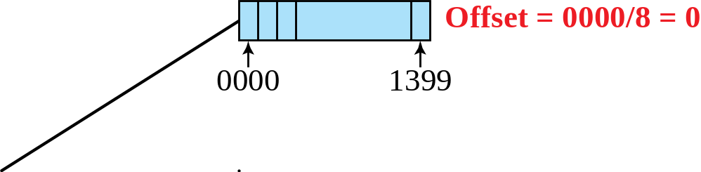
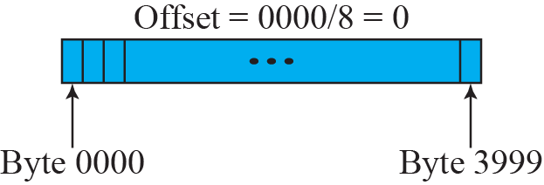
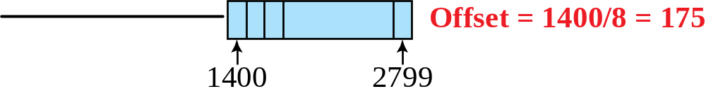
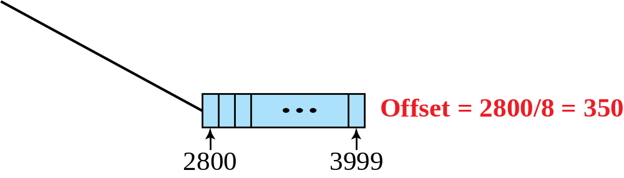
Figure 7.8 Fragmentation example
TCP/IP Protocol Suite

Slide 19
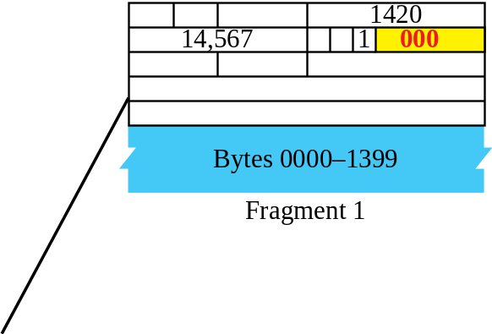
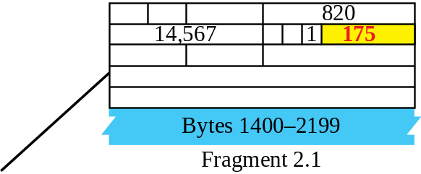
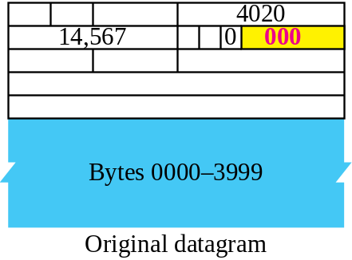
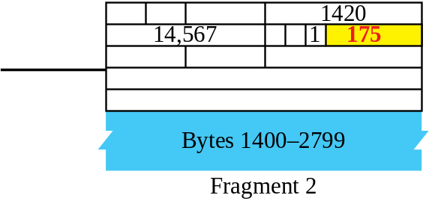
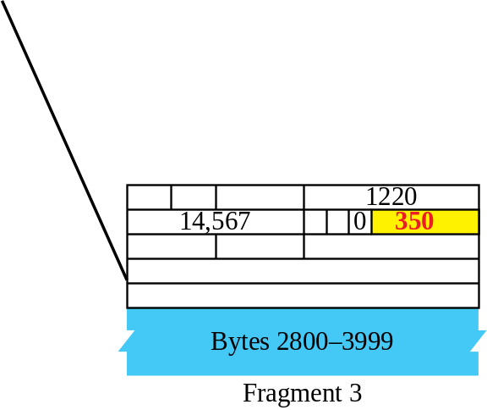
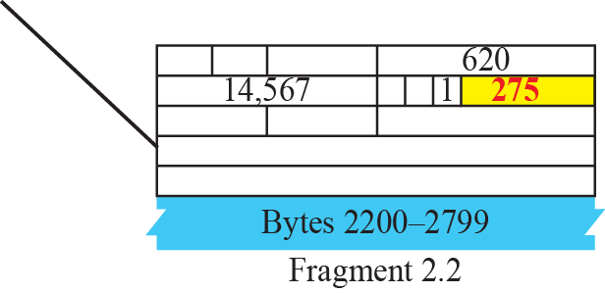
Figure 7.9 Detailed fragmentation example
TCP/IP Protocol Suite

Slide 20
7-4 OPTIONS
The header of the IP datagram is made of two parts: a fixed part and a variable part. The fixed part is 20 bytes long and was discussed in the previous section. The variable part comprises the options, which can be a maximum of 40 bytes.
Options, as the name implies, are not required for a datagram. They can be used for network testing and debugging. Although options are not a required part of the IP header, option processing is required of the IP software.
TCP/IP Protocol Suite

Slide 21
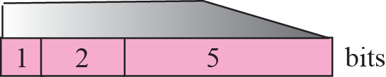
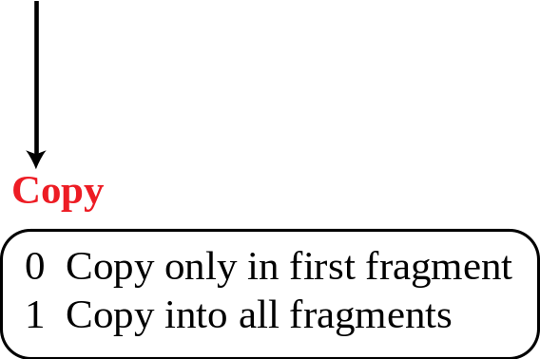
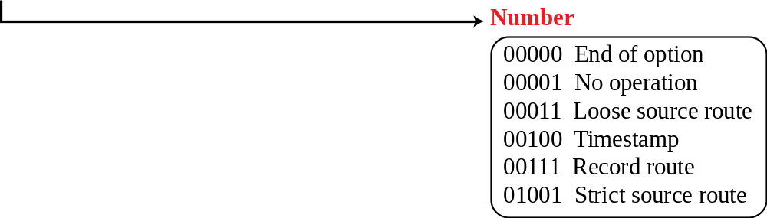
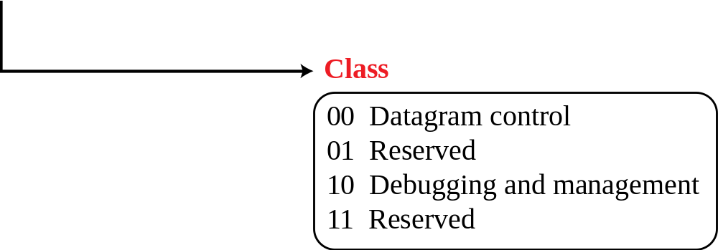
Figure 7.10 Option format
TCP/IP Protocol Suite

Slide 22
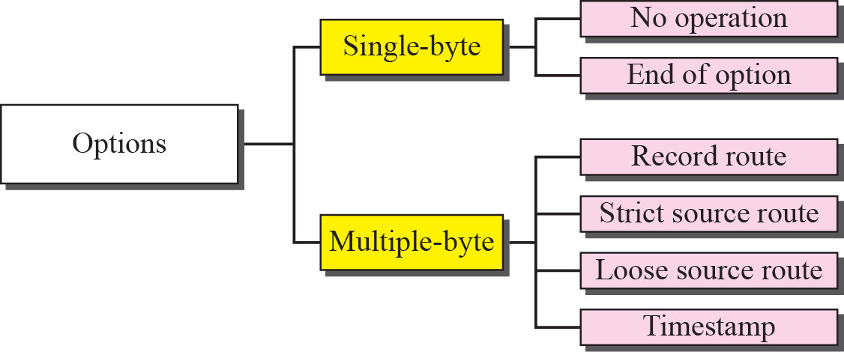
Figure 7.11 Categories of options
TCP/IP Protocol Suite

Slide 23
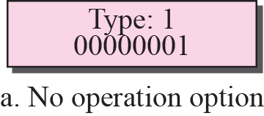
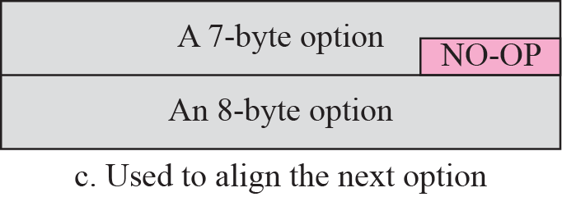
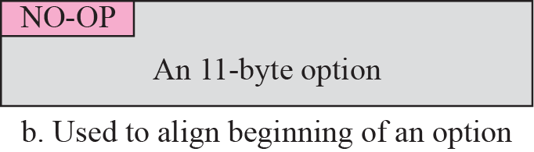
Figure 7.12 No operation option
TCP/IP Protocol Suite

Slide 24
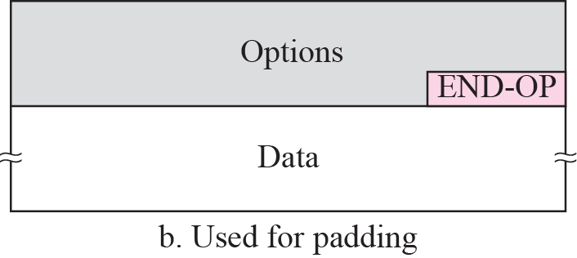
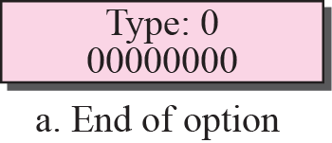
Figure 7.13 Endo-of-option option
TCP/IP Protocol Suite

Slide 25
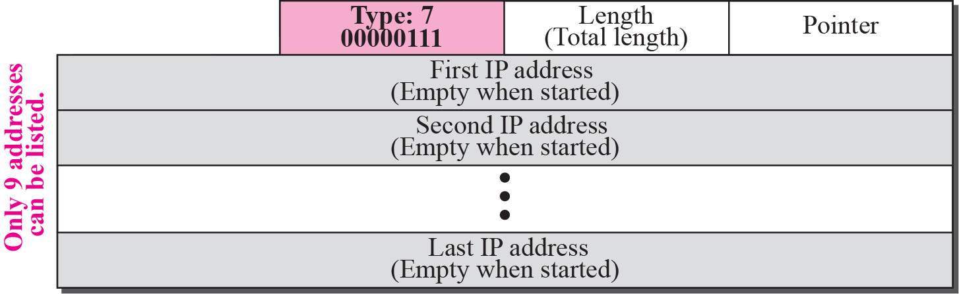
Figure 7.14 Record-route option
TCP/IP Protocol Suite

Slide 26
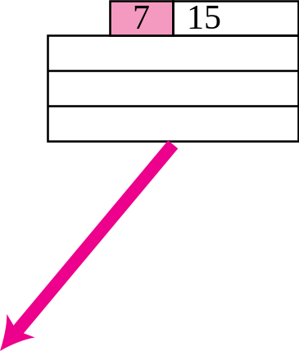
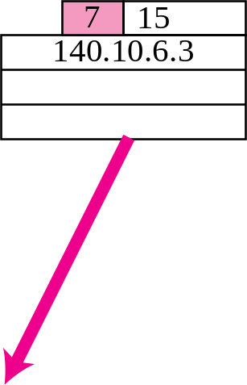
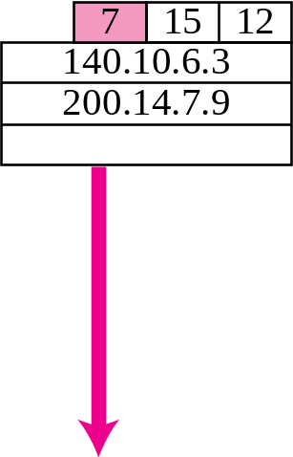
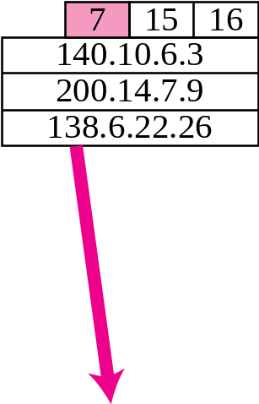
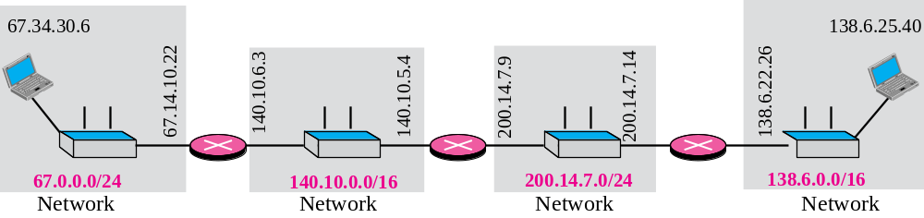
Figure 7.15 Record-route concept
TCP/IP Protocol Suite

Slide 27
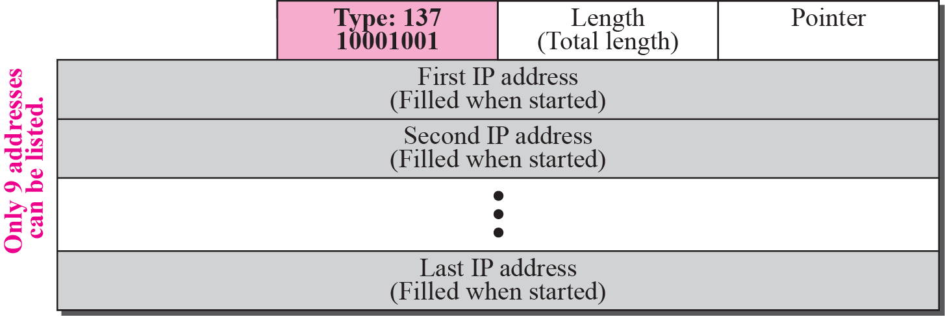
Figure 7.16 Strict-source-route option
TCP/IP Protocol Suite

Slide 28
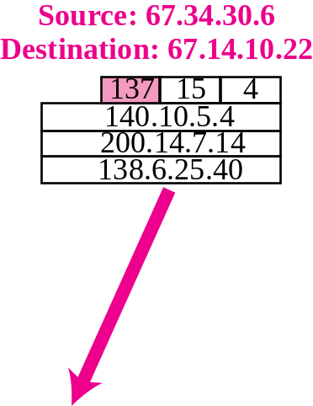
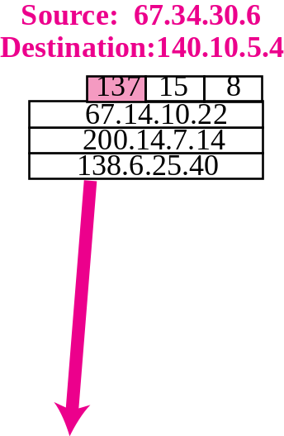
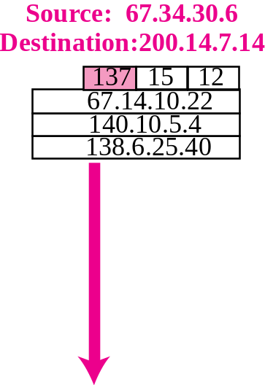
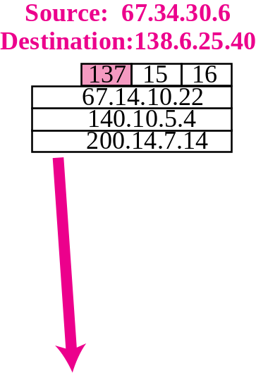
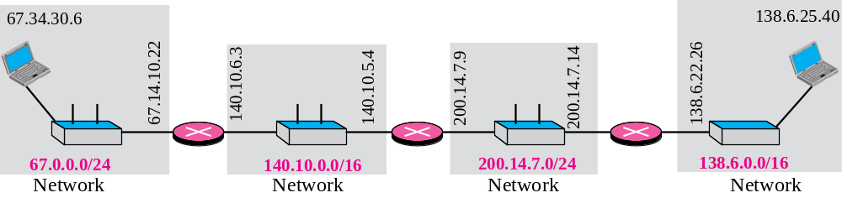
Figure 7.17 Strict-source-route option
TCP/IP Protocol Suite

Slide 29
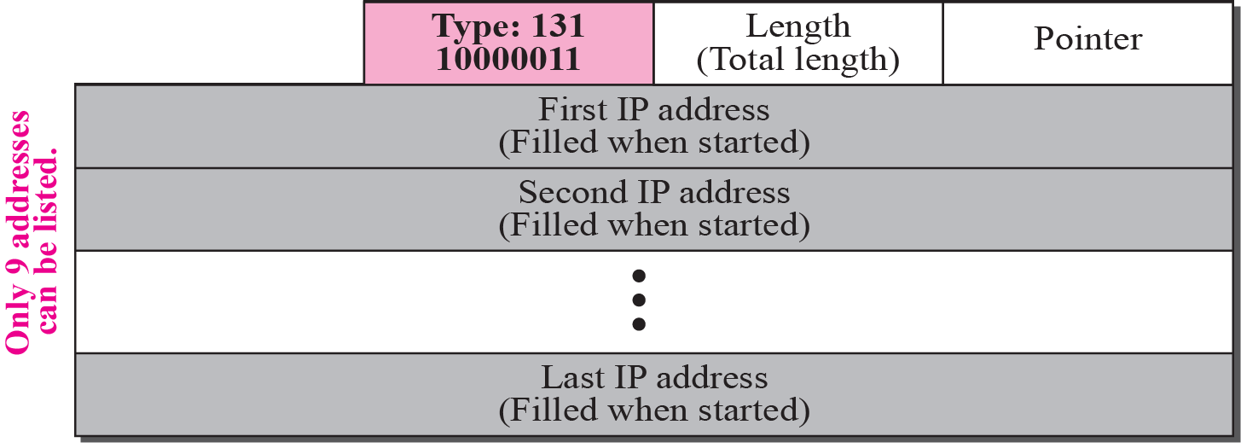
Figure 7.18 Loose-source-route option
TCP/IP Protocol Suite

Slide 30
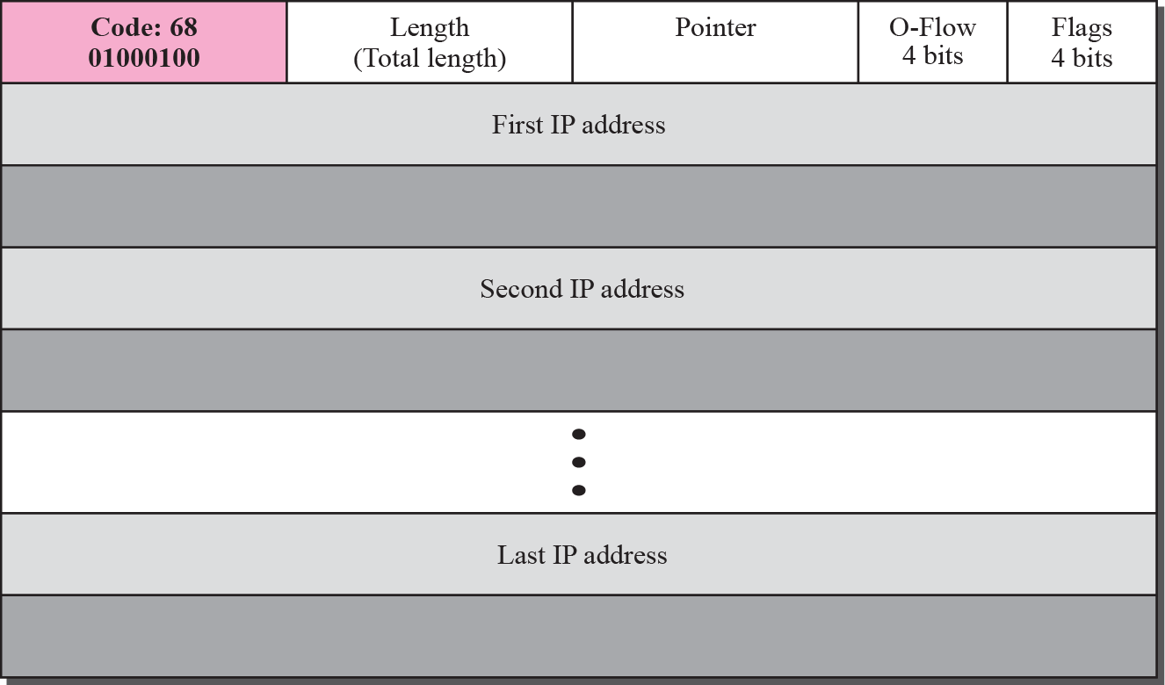
Figure 7.19 Time-stamp option
TCP/IP Protocol Suite

Slide 31
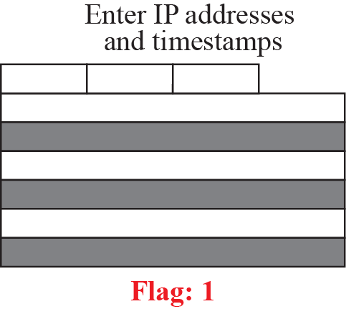
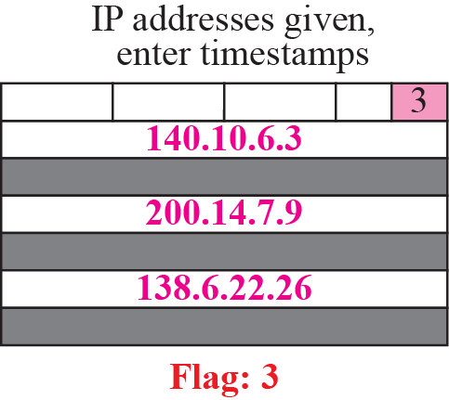
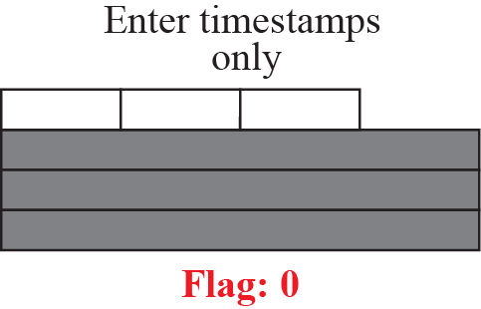
Figure 7.20 Use of flags in timestamp
TCP/IP Protocol Suite

Slide 32
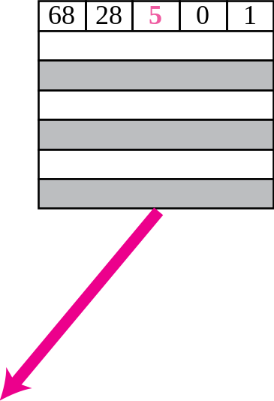
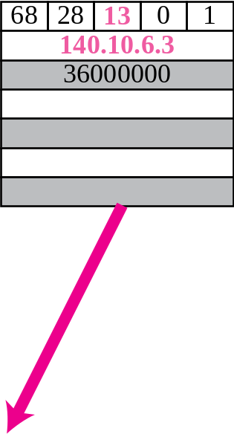
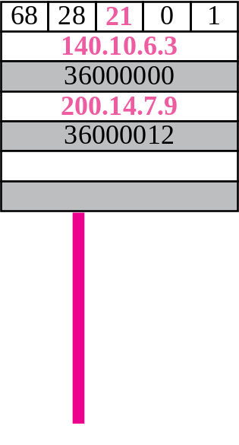


Figure 7.21 Timestamp concept
TCP/IP Protocol Suite

Slide 33

Example 7.13
We can also use the ping utility with the -R option to implement the record route option. The result shows the interfaces and IP addresses.
TCP/IP Protocol Suite

Slide 34

Example 7.14
The traceroute utility can also be used to keep track of the route of a packet. The result shows the three routers visited.
TCP/IP Protocol Suite

Slide 35
7-5 CHECKSUM
The error detection method used by most TCP/IP protocols is called the checksum. The checksum protects against the corruption that may occur during the transmission of a packet. It is redundant information added to the packet. The checksum is calculated at the sender and the value obtained is sent with the packet. The receiver repeats the same calculation on the whole packet including the checksum. If the result is satisfactory (see below), the packet is accepted; otherwise, it is rejected.
TCP/IP Protocol Suite

Slide 36




Figure 7.22 Checksum concept
TCP/IP Protocol Suite

Slide 37



Figure 7.23 Checksum in one’s complement arithmetic
TCP/IP Protocol Suite

Slide 38
Note
Checksum in IP covers only the header, not the data.
TCP/IP Protocol Suite

Slide 39


Figure 7.24 Example of checksum calculation at the sender
TCP/IP Protocol Suite
Notes:
Substitute for 012.6.7.917015010.12.14.50028Substitute for 012.6.7.917015010.12.14.50028Substitute for 0Substitute for 0

Slide 40


Figure 7.25 Example of checksum calculation at the receiver
TCP/IP Protocol Suite

