Slide 1

Chapter 10
Mobile
IP
TCP/IP Protocol Suite

Slide 2
10-1 ADDRESSING
The main problem that must be solved in providing mobile communication using the IP protocol is addressing.
TCP/IP Protocol Suite

Slide 3
Topics Discussed in the Section
Stationary Host
Mobile Host
TCP/IP Protocol Suite

Slide 4

Note
The IP addresses are designed to work with stationary hosts because part
of the address defines the network to which the host is attached.
TCP/IP Protocol Suite

Slide 5
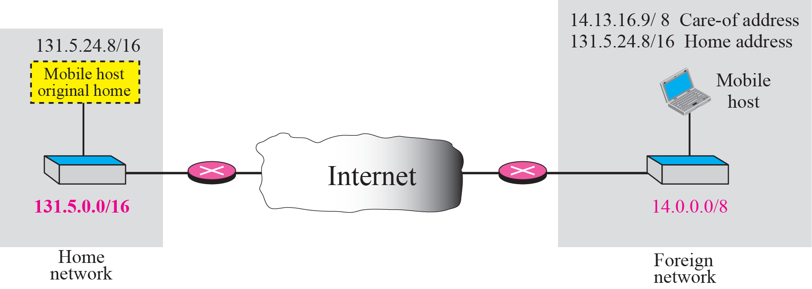
Figure 10.1 Home address and care-of address
TCP/IP Protocol Suite

Slide 6
Note
Mobile IP has two addresses for a mobile host: one home address and
one care-of address.
The home address is permanent;
the care-of address changes as the
mobile host moves from one
network to another.
TCP/IP Protocol Suite

Slide 7
10-2 AGENTS
To make the change of address transparent to the rest of the Internet requires a home agent and a foreign agent.
TCP/IP Protocol Suite

Slide 8
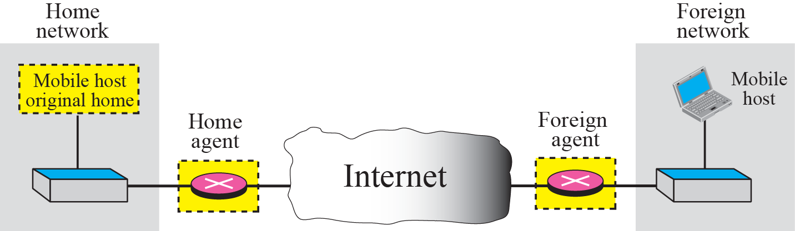
Figure 10.2 Home agent and foreign agent
TCP/IP Protocol Suite

Slide 9
Note
When the mobile host and the foreign agent are the same, the care-of
address is called a colocated
care-of address.
TCP/IP Protocol Suite

Slide 10
10-3 THREE PHASES
To communicate with a remote host, a mobile host goes through three phases: agent discovery, registration, and data transfer.
The first phase, agent discovery, involves the mobile host, the foreign agent, and the home agent. The second phase, registration, also involves the mobile host and the two agents. Finally, in the third phase, the remote host is also involved. We discuss each phase separately.
TCP/IP Protocol Suite

Slide 11
Topics Discussed in the Section
Agent Discovery
Registration
Data Transfer
TCP/IP Protocol Suite

Slide 12
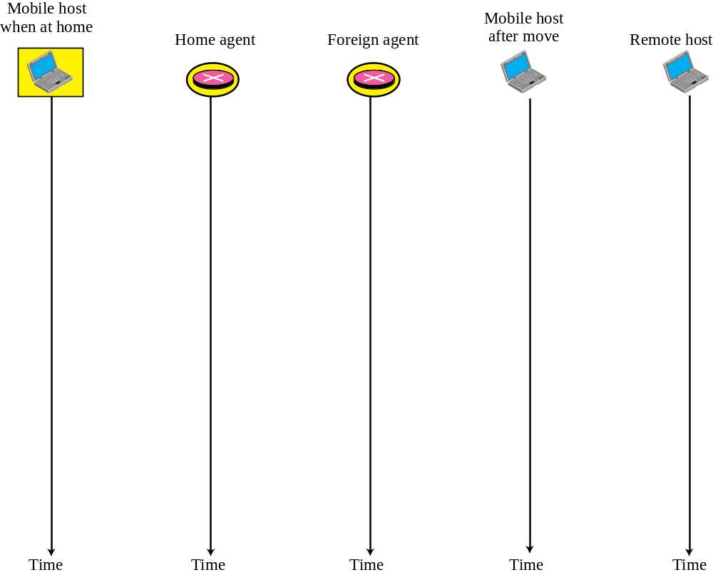

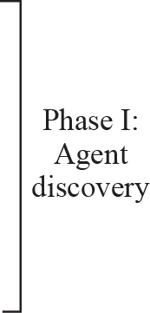
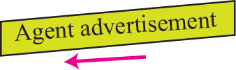


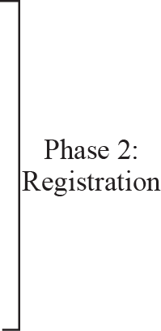





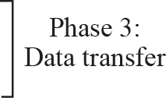
Figure 10.3 Remote host and mobile host configuration
TCP/IP Protocol Suite

Slide 13
Note
Mobile IP does not use a new packet type for agent advertisement; it uses
the router advertisement packet
of ICMP, and appends an agent advertisement message.
TCP/IP Protocol Suite

Slide 14
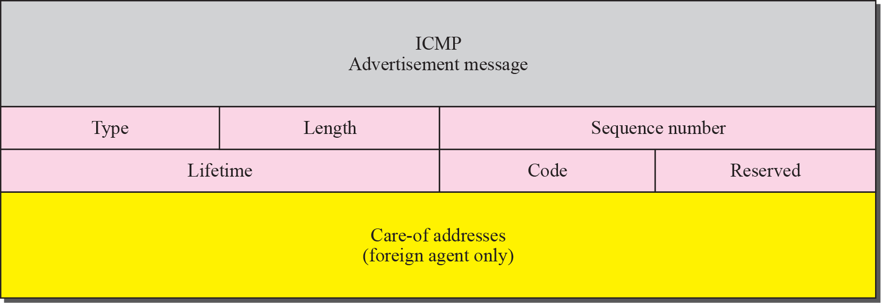
Figure 10.4 Agent advertisement
TCP/IP Protocol Suite

Slide 15
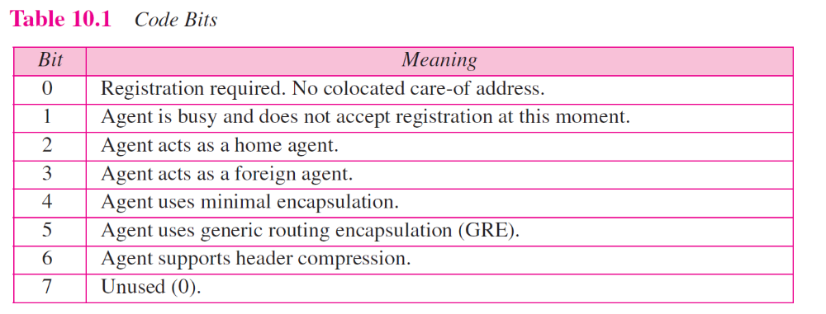
TCP/IP Protocol Suite

Slide 16
Note
Mobile IP does not use a new packet type for agent solicitation;
it uses the router solicitation
packet of ICMP.
TCP/IP Protocol Suite

Slide 17
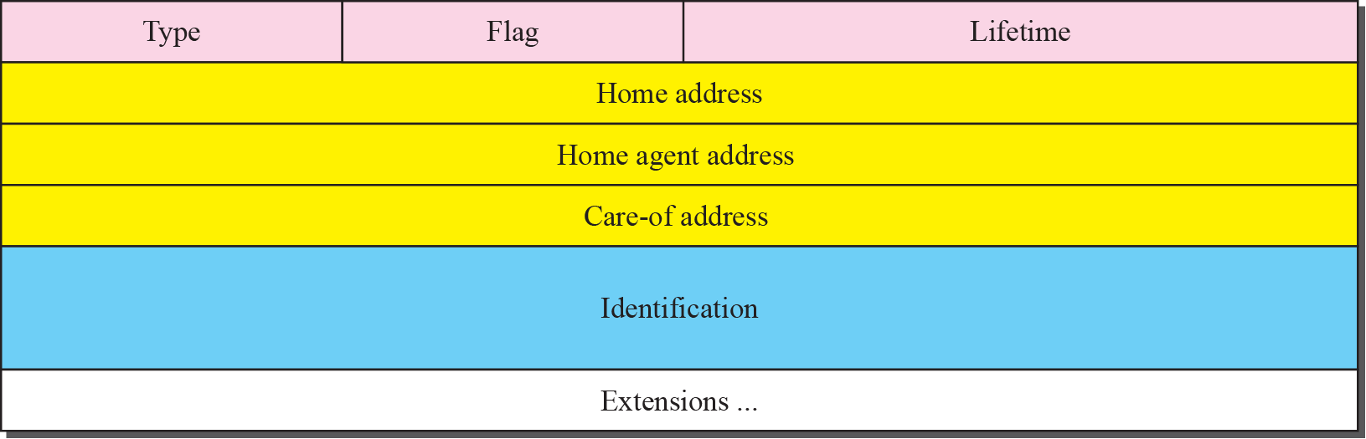
Figure 10.5 Registration request format
TCP/IP Protocol Suite

Slide 18
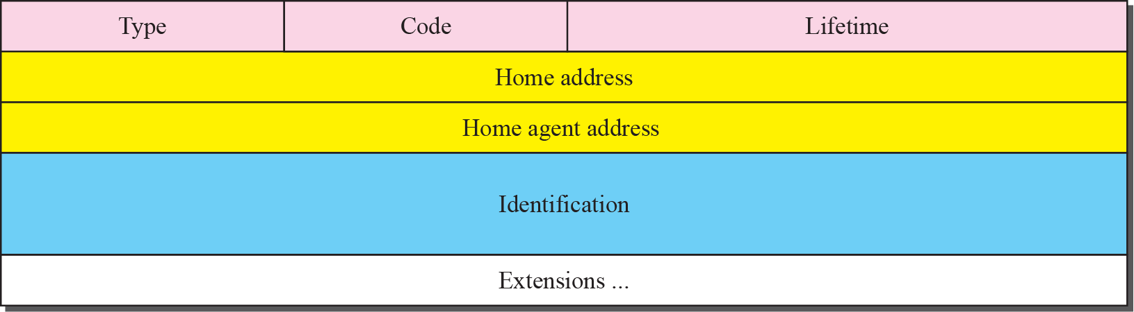
Figure 10.6 Registration reply format
TCP/IP Protocol Suite

Slide 19
Note
A registration request or reply is sent by UDP using the well-known port 434.
TCP/IP Protocol Suite

Slide 20
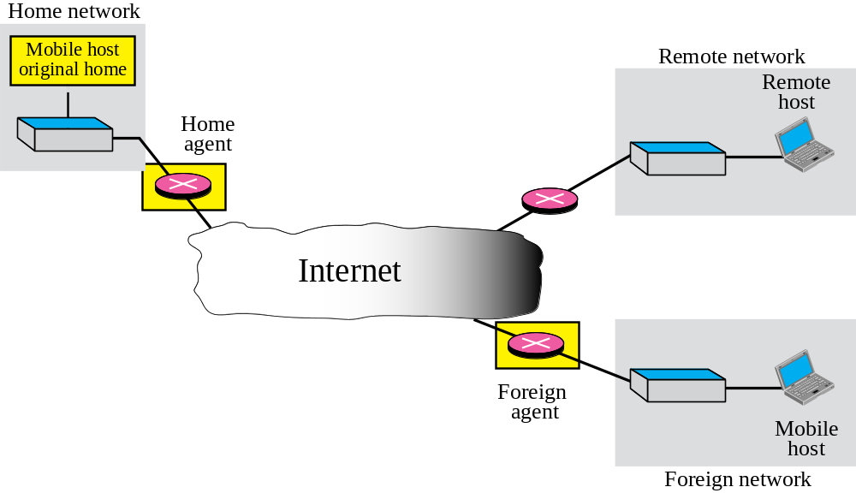
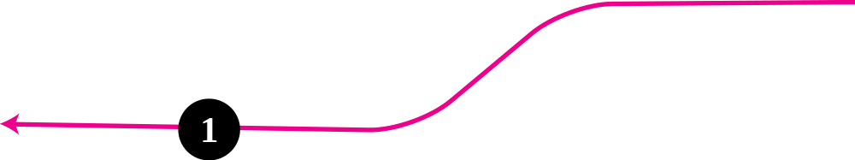
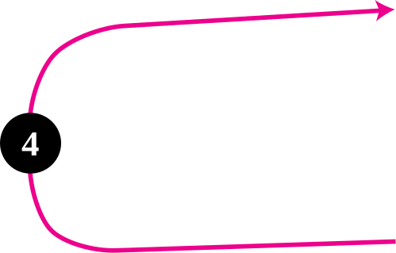
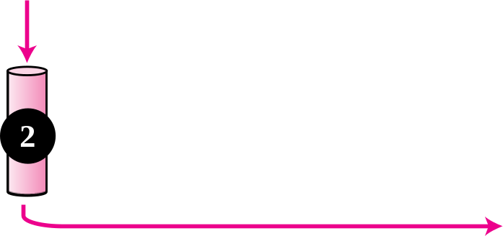

Figure 10.7 Data transfer
TCP/IP Protocol Suite

Slide 21
Note
The movement of the mobile host is transparent to the rest of the Internet.
TCP/IP Protocol Suite

Slide 22
10-4 INEFFICIENCY IN MOBILE IP
Communication involving mobile IP can be inefficient. The inefficiency can be severe or moderate. The severe case is called double crossing or 2X . The moderate case is called triangle routing or dog-leg routing.
TCP/IP Protocol Suite

Slide 23
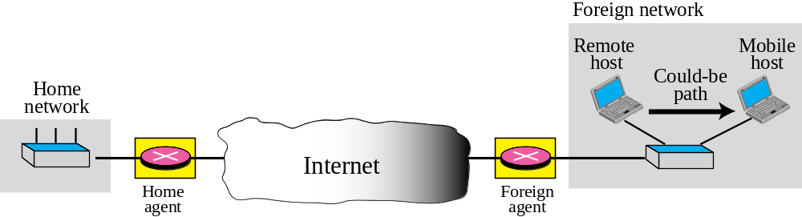
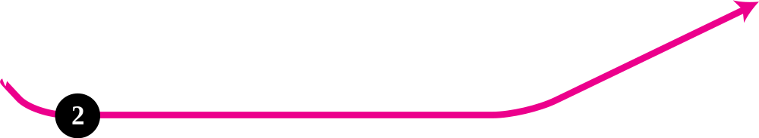
Figure 10.8 Double crossing
TCP/IP Protocol Suite

Slide 24
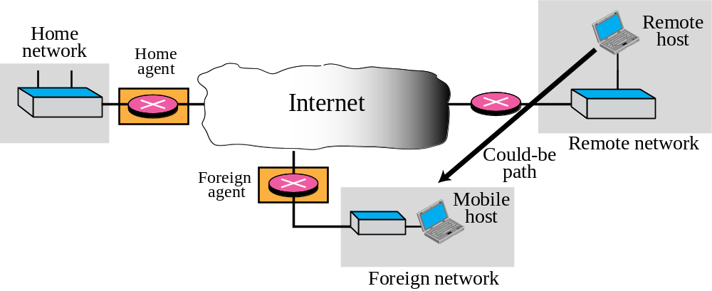



Figure 10.9 Triangle routing
TCP/IP Protocol Suite

