Slide 1

Chapter 11
Unicast Routing
Protocols
TCP/IP Protocol Suite

Slide 2
11-1 INTRODUCTION
An internet is a combination of networks connected by routers. When a datagram goes from a source to a destination, it will probably pass through many routers until it reaches the router attached to the destination network.
TCP/IP Protocol Suite

Slide 3
11-2 INTER- AND INTRA-DOMAIN
ROUTING
Today, an internet can be so large that one routing protocol cannot handle the task of updating the routing tables of all routers. For this reason, an internet is divided into autonomous systems. An
autonomous system (AS) is a group of networks and routers under the authority of a single administration. Routing inside an autonomous system is called intra-domain routing. Routing between autonomous systems is called inter-domain routing
TCP/IP Protocol Suite

Slide 4
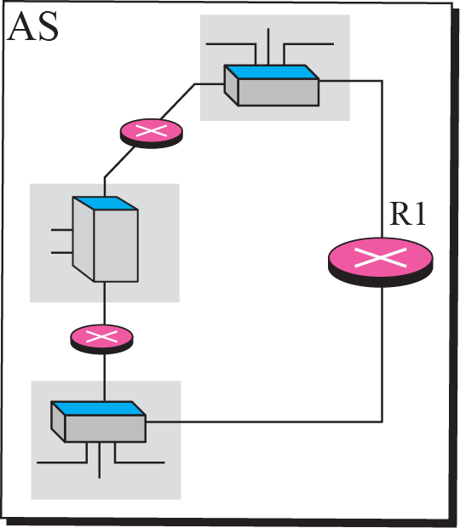
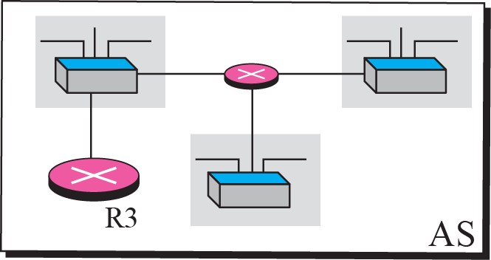

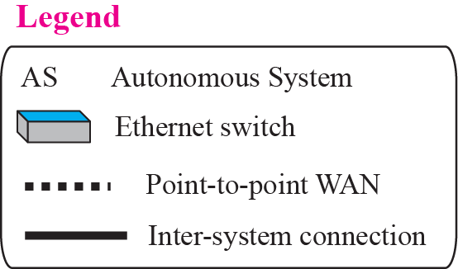
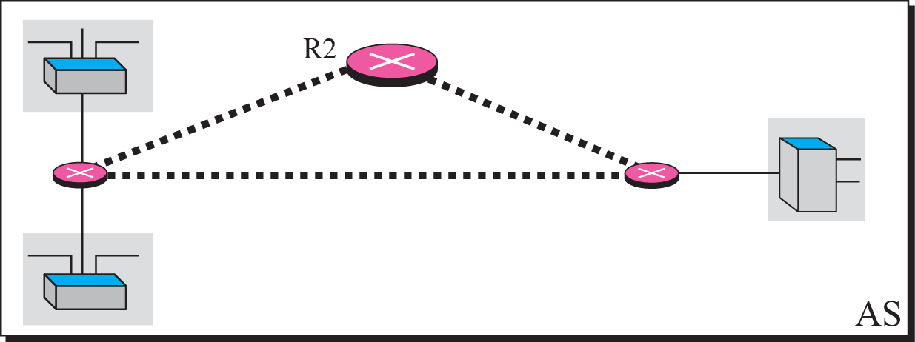
Figure 11.1 Autonomous systems
TCP/IP Protocol Suite

Slide 5
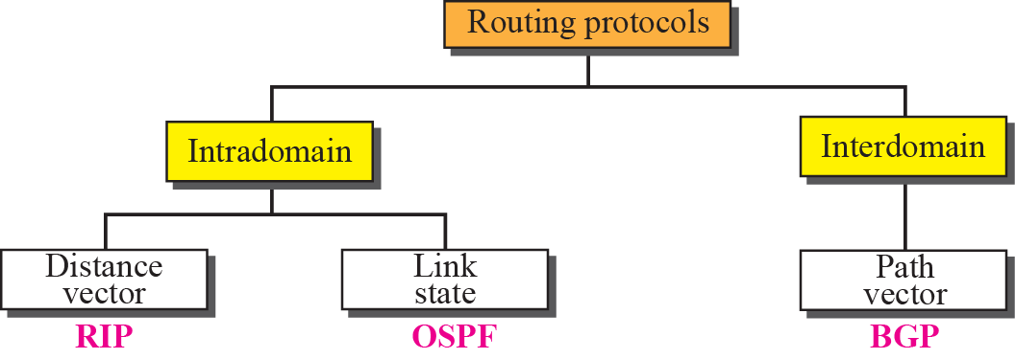
Figure 11.2 Popular routing protocols
TCP/IP Protocol Suite

Slide 6
11-3 DISTANCE VECTOR ROUTING
Today, an internet can be so large that one routing protocol cannot handle the task of updating the routing tables of all routers. For this reason, an internet is divided into autonomous systems. An
autonomous system (AS) is a group of networks and routers under the authority of a single administration. Routing inside an autonomous system is called intra-domain routing. Routing between autonomous systems is called inter-domain routing
TCP/IP Protocol Suite

Slide 7
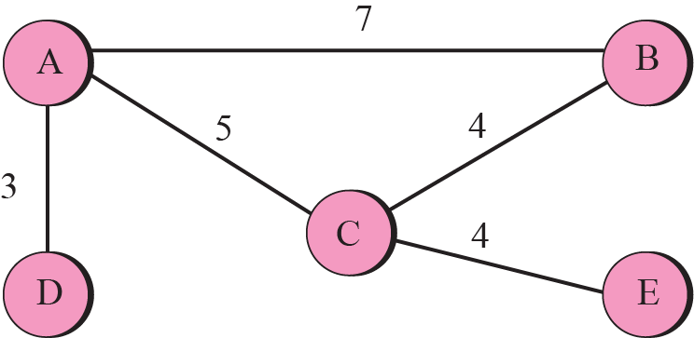
Figure 11.3 A graph for Bellman-Ford algorithm
TCP/IP Protocol Suite

Slide 8
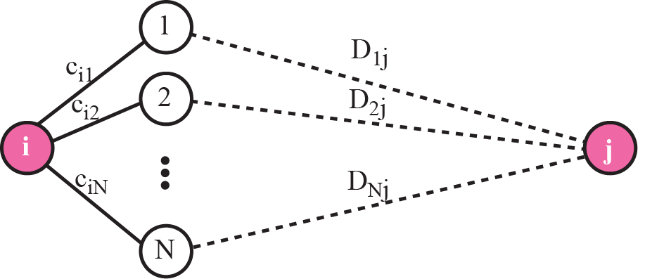
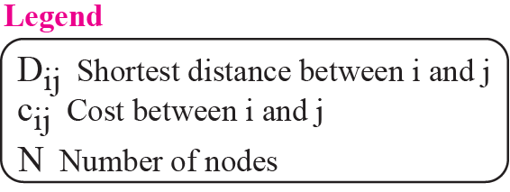
Figure 11.4 The fact behind Bellman-Ford algorithm
TCP/IP Protocol Suite

Slide 9
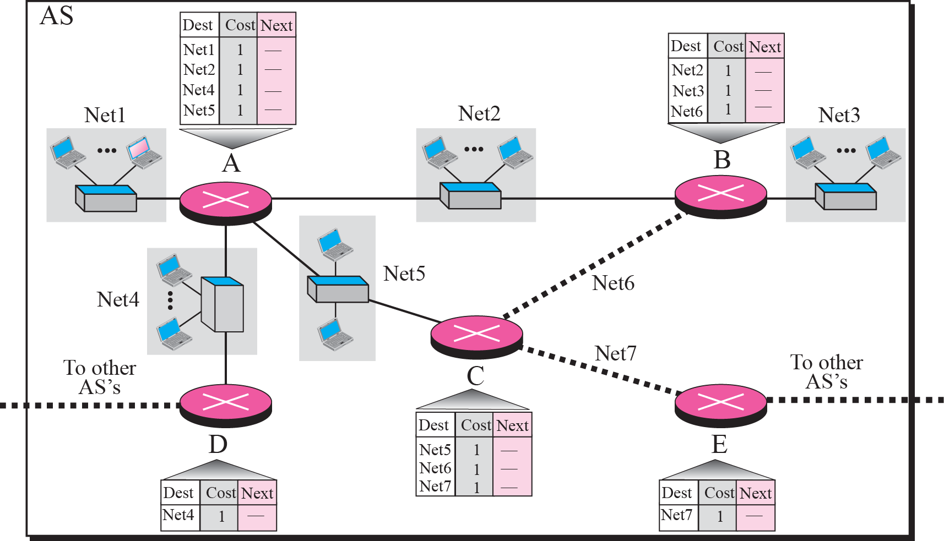
Figure 11.5 Example 11.1
TCP/IP Protocol Suite

Slide 10
Example 11.2
Now assume router A sends four records to its neighbors, routers B, D, and C. Figure 11.6 shows the changes in B’s routing table when it receives these records. We leave the changes in the routing tables of other neighbors as exercise.
TCP/IP Protocol Suite

Slide 11
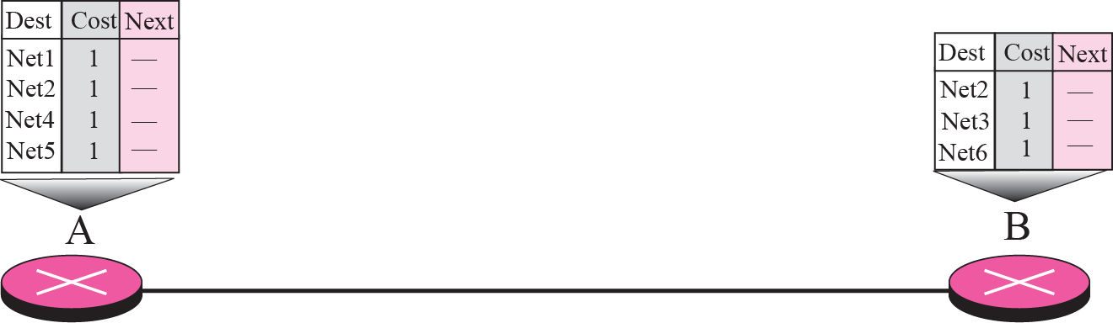




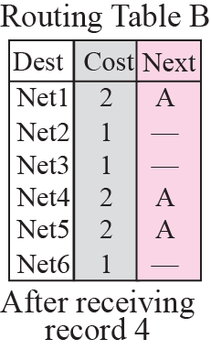
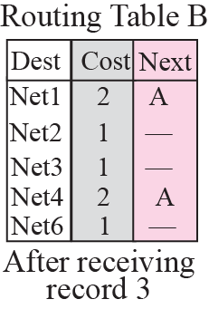
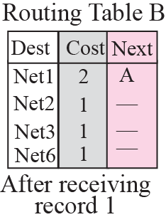
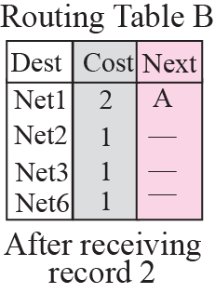
Figure 11.6 Example 11.2
TCP/IP Protocol Suite

Slide 12
Example 11.3
Figure 11.7 shows the final routing tables for routers in Figure 11.5.
TCP/IP Protocol Suite

Slide 13
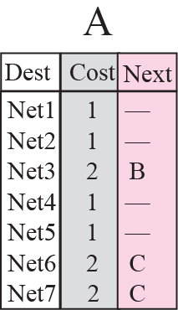
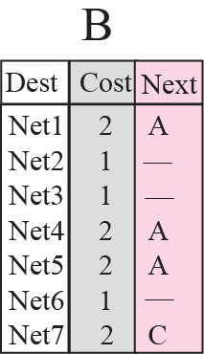
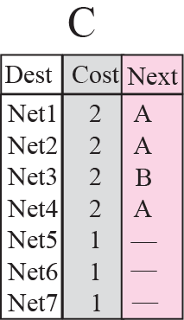
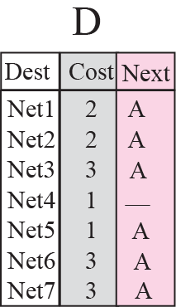
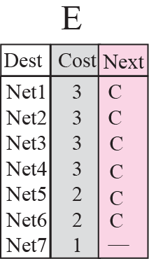
Figure 11.7 Example 11.3
TCP/IP Protocol Suite

Slide 14
11-4 RIP
The Routing Information Protocol (RIP) is an intra-domain (interior) routing protocol used inside an autonomous system. It is a very simple protocol based on distance vector routing. RIP implements distance vector routing directly with some considerations.
TCP/IP Protocol Suite

Slide 15
Topics Discussed in the Section
RIP Message Format
Request and Response
Timers in RIP
RIP Version 2
Encapsulation
TCP/IP Protocol Suite

Slide 16
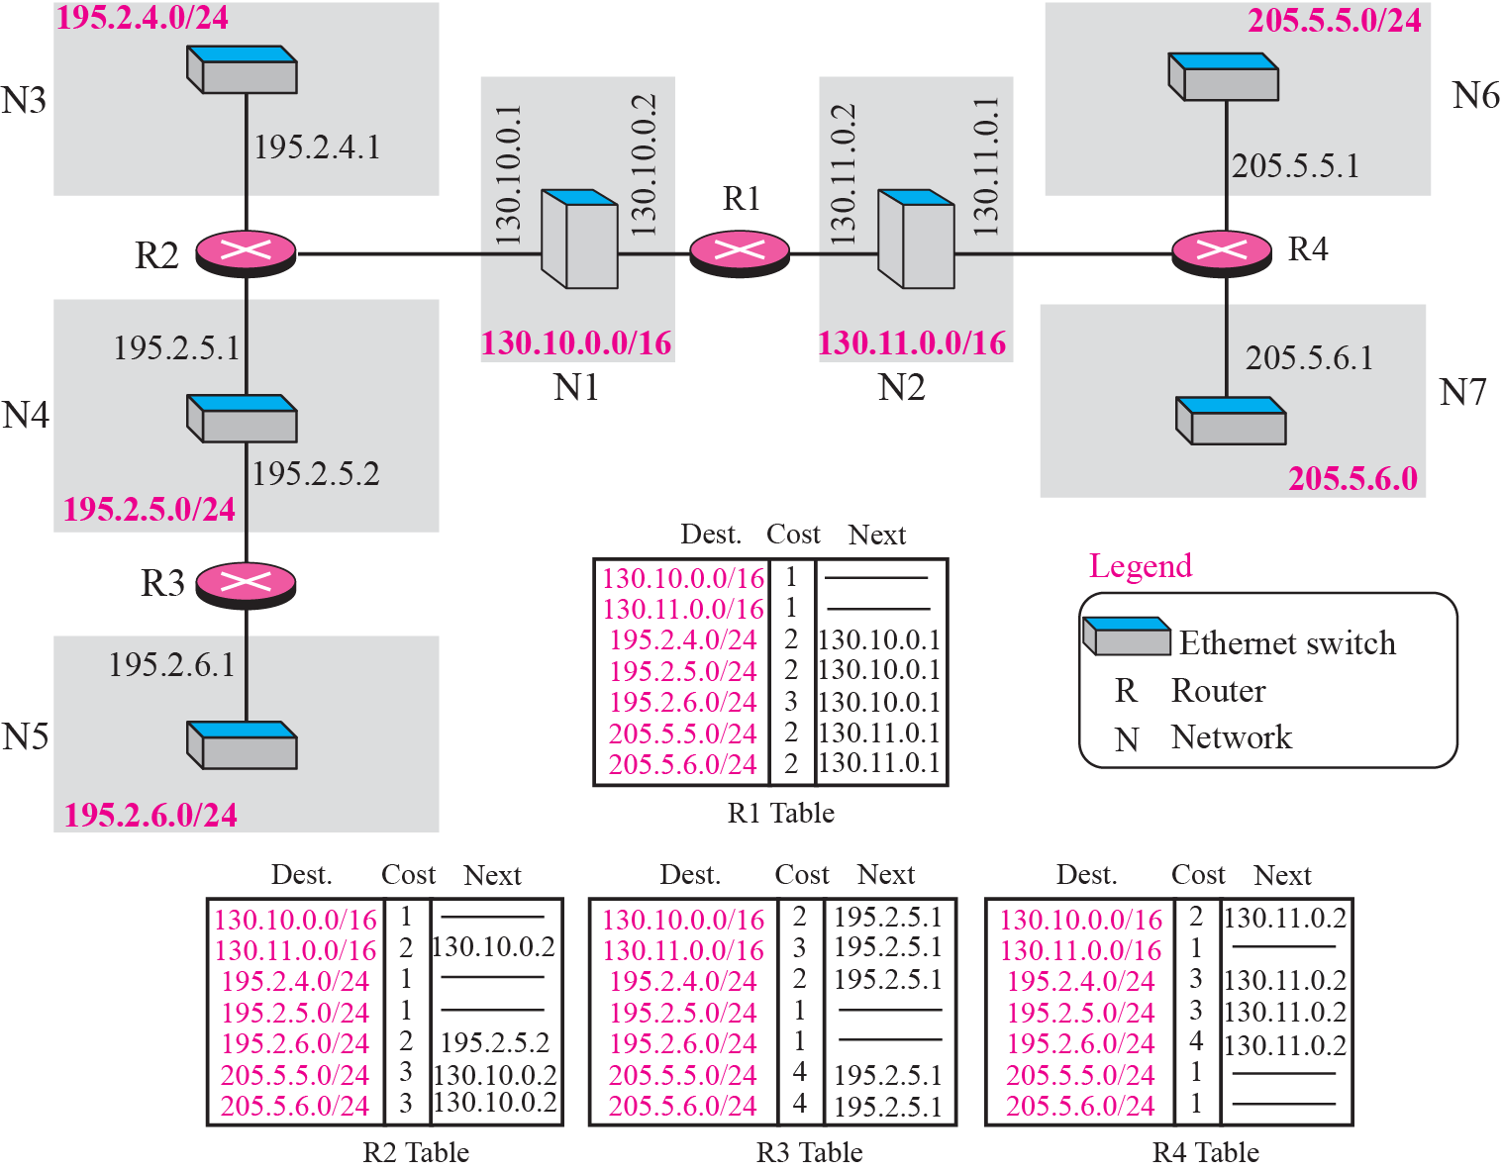
Figure 11.10 Example of a domain using RIP
TCP/IP Protocol Suite

Slide 17
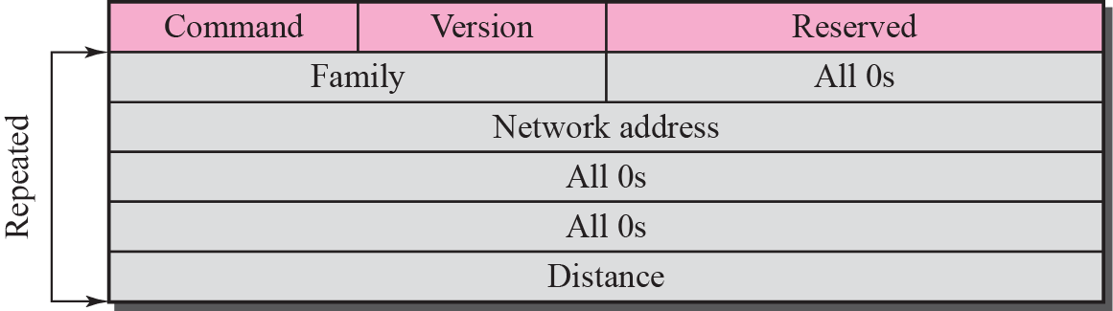
Figure 11.11 RIP message format
TCP/IP Protocol Suite

Slide 18
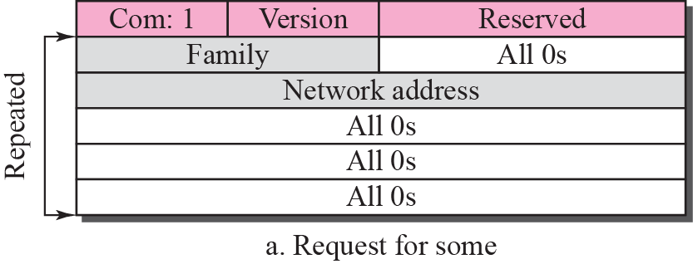
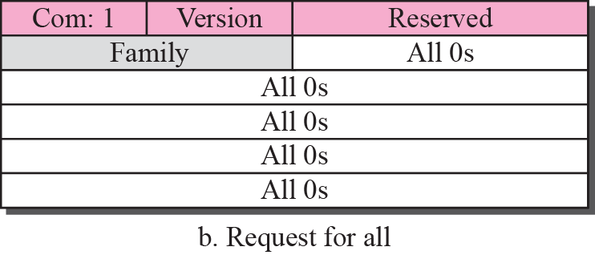
Figure 11.12 Request messages
TCP/IP Protocol Suite

Slide 19

Note
RIP uses the services of UDP on well-known port 520.
TCP/IP Protocol Suite

Slide 20
11-5 LINK STATE ROUTING
Link state routing has a different philosophy from that of distance vector routing. In link state routing, if each node in the domain has the entire topology of the domain—the list of nodes and links, how they are connected including the type, cost (metric), and the condition of the links (up or down)—the node can use the Dijkstra algorithm to build a routing table.
TCP/IP Protocol Suite

Slide 21
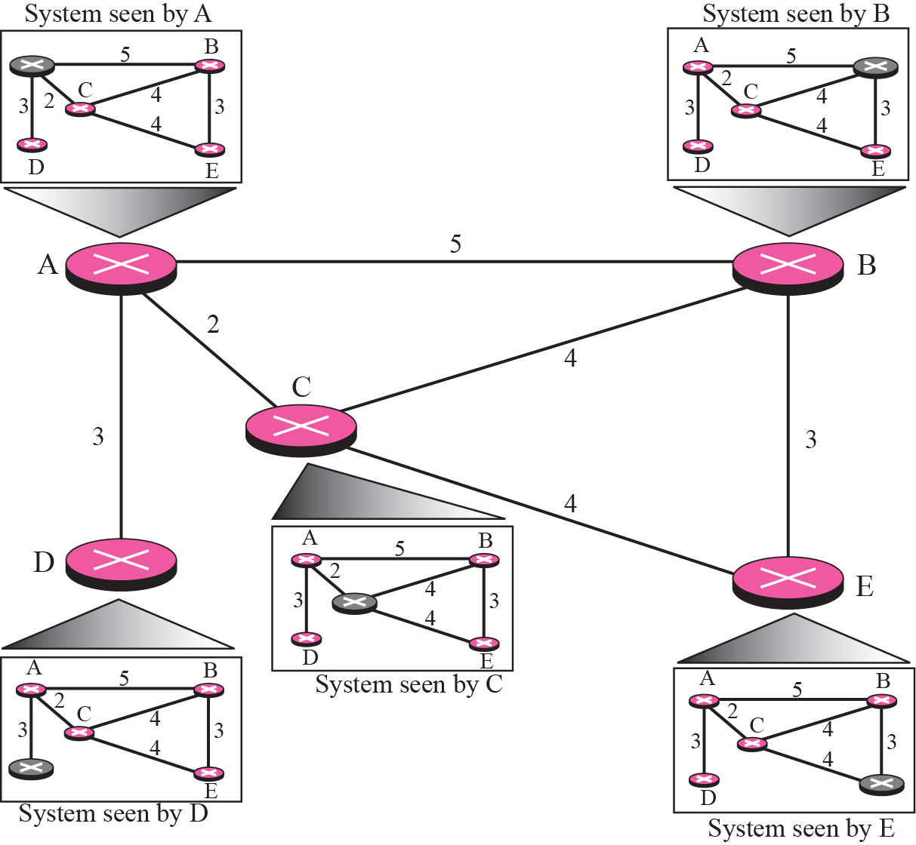
Figure 11.17 Concept of Link state routing
TCP/IP Protocol Suite

Slide 22
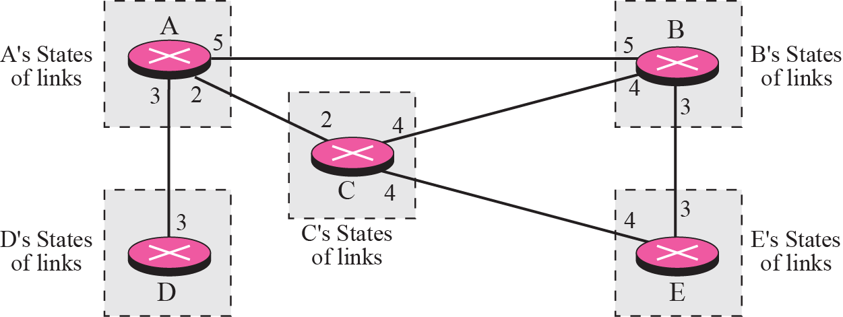
Figure 11.18 Link state knowledge
TCP/IP Protocol Suite

Slide 23
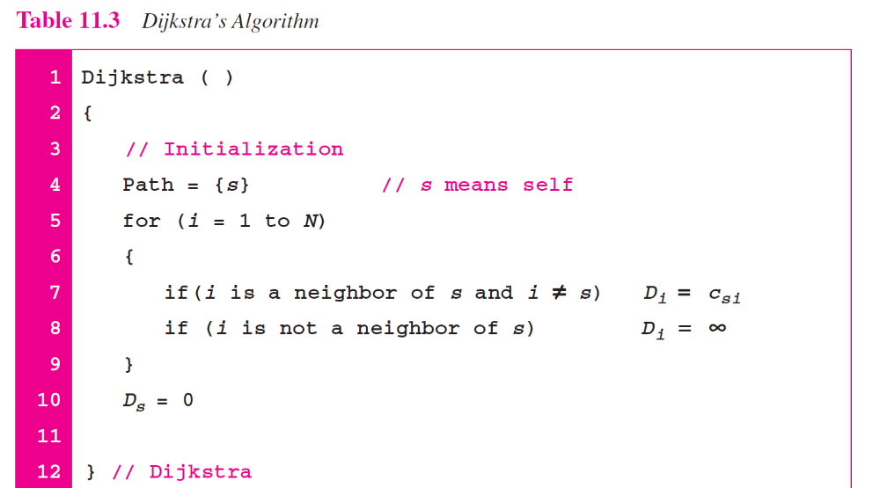
TCP/IP Protocol Suite

Slide 24
11-6 OSPF
The Open Shortest Path First (OSPF) protocol is an intra-domain routing protocol based on link state routing. Its domain is also an autonomous system.
TCP/IP Protocol Suite

Slide 25
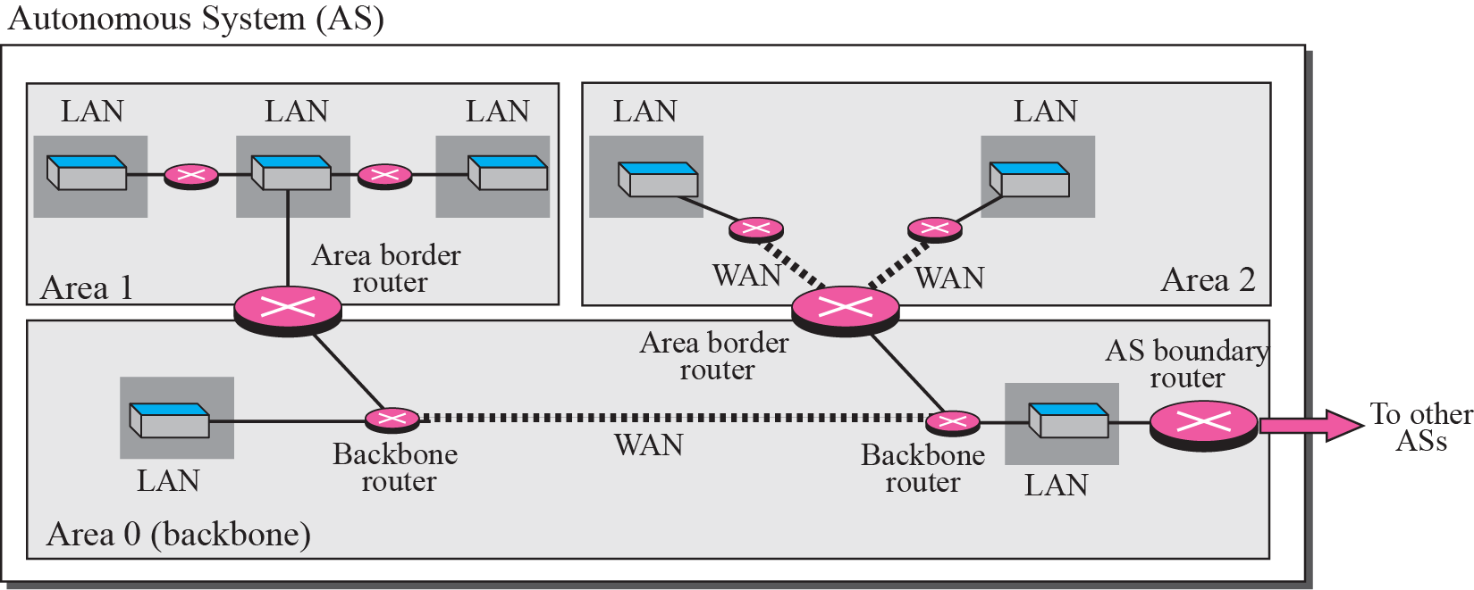
Figure 11.21 Areas in an autonomous system
TCP/IP Protocol Suite

Slide 26
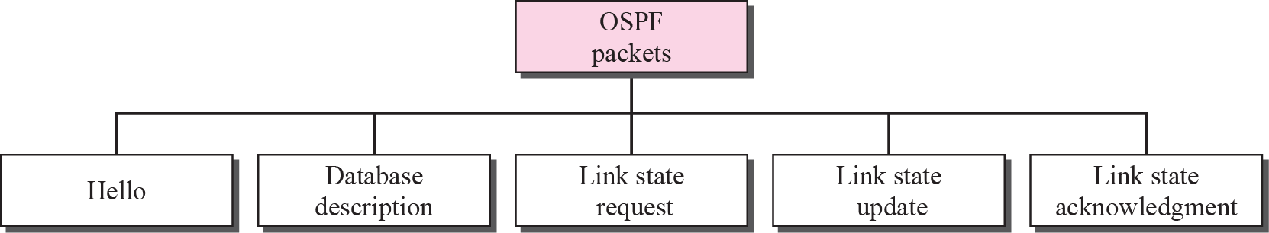
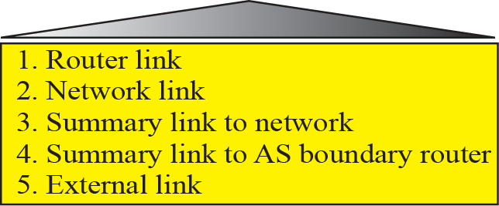
Figure 11.27 Types of OSPF packet
TCP/IP Protocol Suite

Slide 27
Note
OSPF packets are encapsulated in
IP datagrams.
TCP/IP Protocol Suite

Slide 28
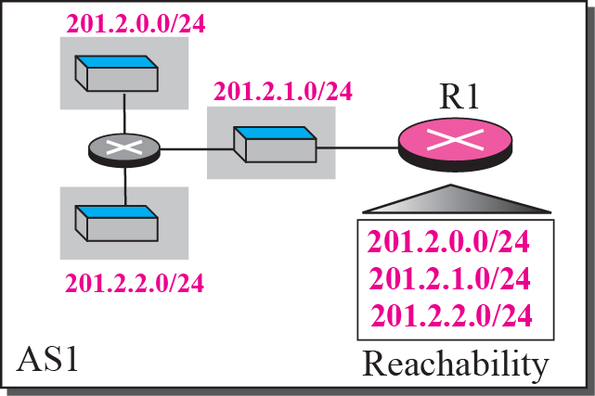
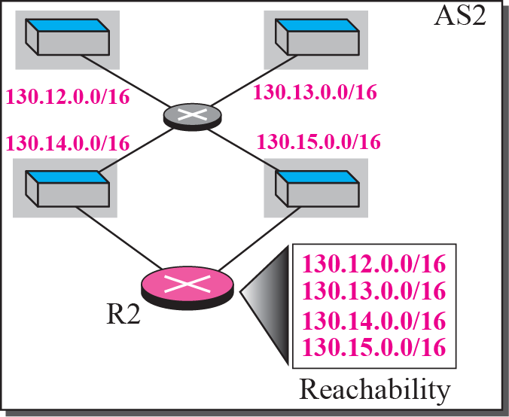


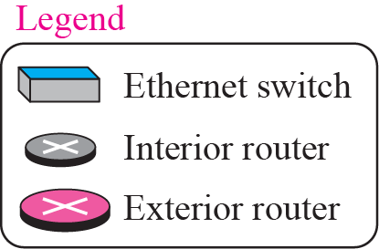
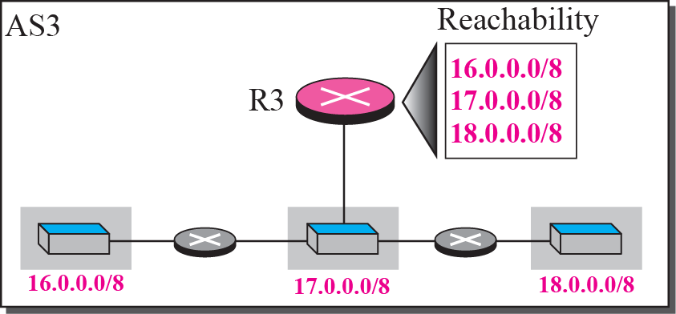
11-7 PATH VECTOR ROUTING
Figure 11.50 AS(Autonomous System), Domain
TCP/IP Protocol Suite

Slide 29
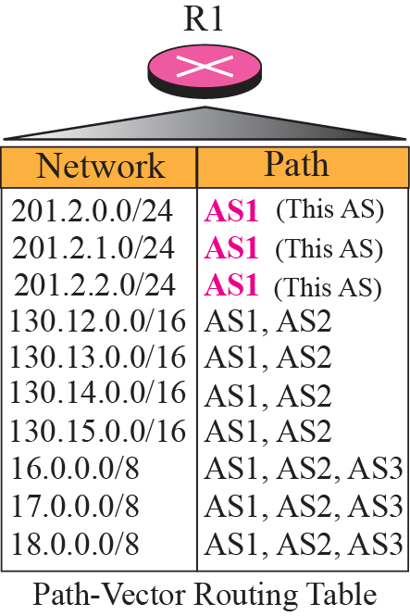
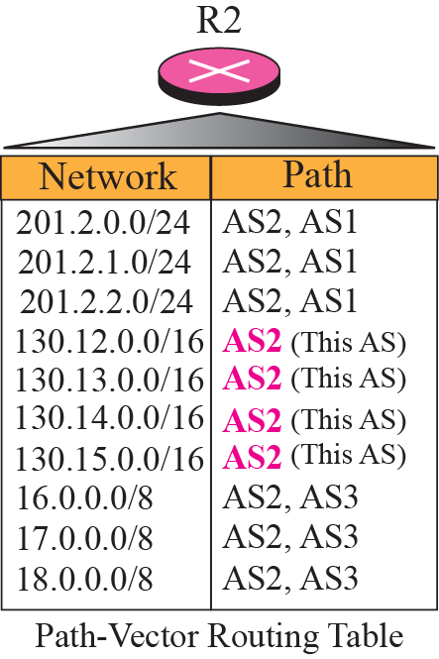
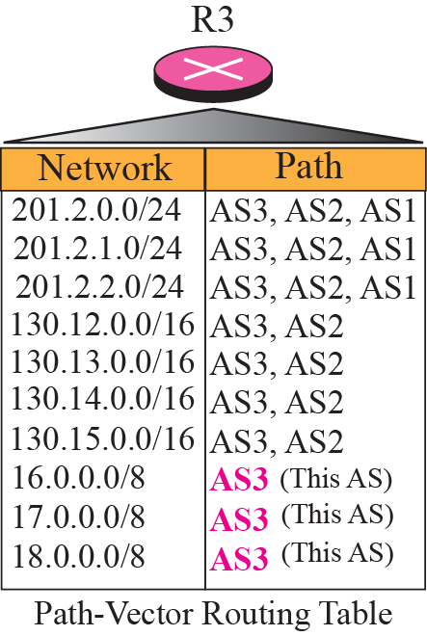
Figure 11.51 Routing tables for three autonomous system (AS)
TCP/IP Protocol Suite

Slide 30
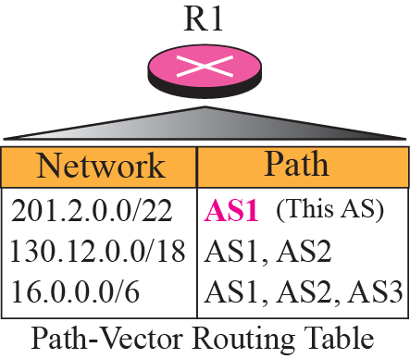
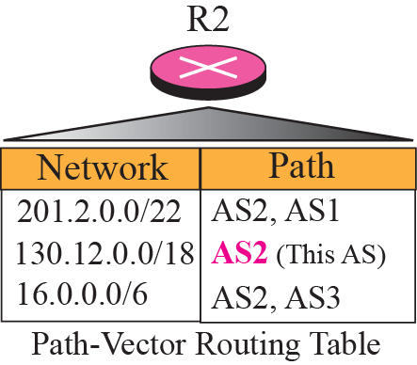
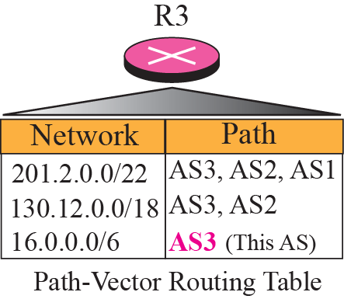
Figure 11.52 Routing tables after aggregation
TCP/IP Protocol Suite

Slide 31
11-8 BGP
Border Gateway Protocol (BGP) is an interdomain routing protocol using path vector routing. It first appeared in 1989 and has gone through four versions.
TCP/IP Protocol Suite

Slide 32
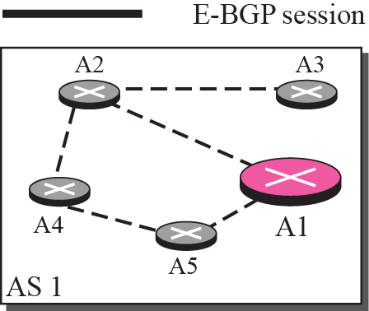
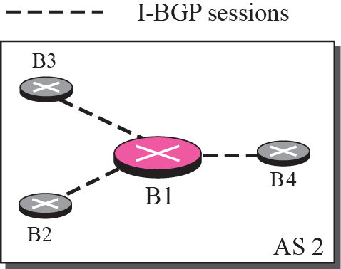
Figure 11.53 Internal and external BGP sessions
TCP/IP Protocol Suite

Slide 33
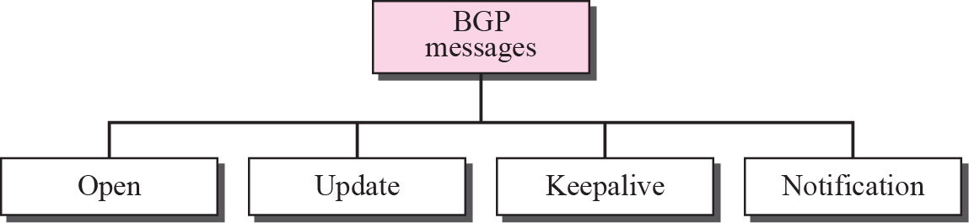
Figure 11.54 Types of BGP messages
TCP/IP Protocol Suite

Slide 34
Note
BGP supports classless addressing
and CIDR.
TCP/IP Protocol Suite

Slide 35
Note
BGP uses the services of TCP
on port 179.
TCP/IP Protocol Suite

