Slide 1

Chapter 12
Multicasting
And
Multicast
Routing
Protocols
TCP/IP Protocol Suite

Slide 2
12-1 INTRODUCTION
We have learned that forwarding a datagram is normally based on the prefix of the destination address in the datagram. Address aggregation mechanism may combine several datagrams to be delivered to an ISP and then separate them to be delivered to their final destination networks, but the principle does not change.
Understanding the above forwarding principle, we can now define unicasting, multicasting, and broadcasting. Let us clarify these terms as they relate to the Internet.
TCP/IP Protocol Suite

Slide 3
Topics Discussed in the Section
Unicasting
Multicasting
Broadcasting
TCP/IP Protocol Suite

Slide 4
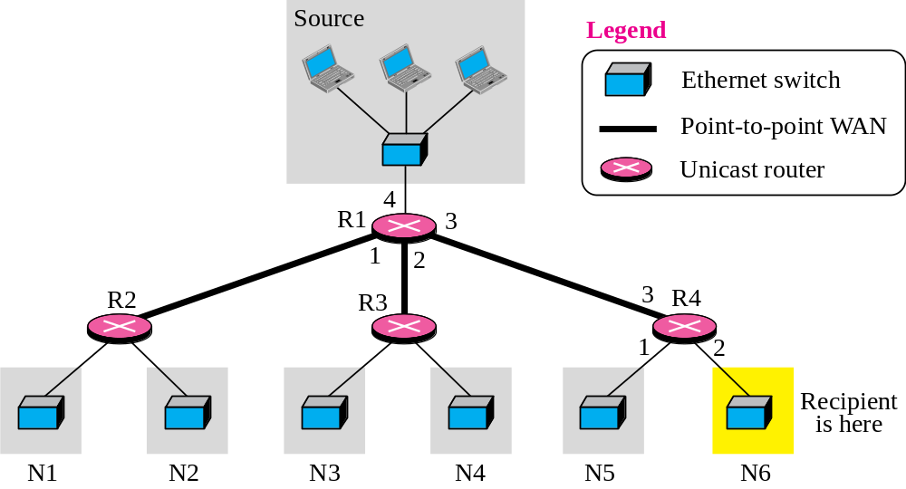
Figure 12.1 Unicasting
TCP/IP Protocol Suite

Slide 5

Note
In unicasting, the router forwards the received datagram through
only one of its interfaces.
TCP/IP Protocol Suite

Slide 6
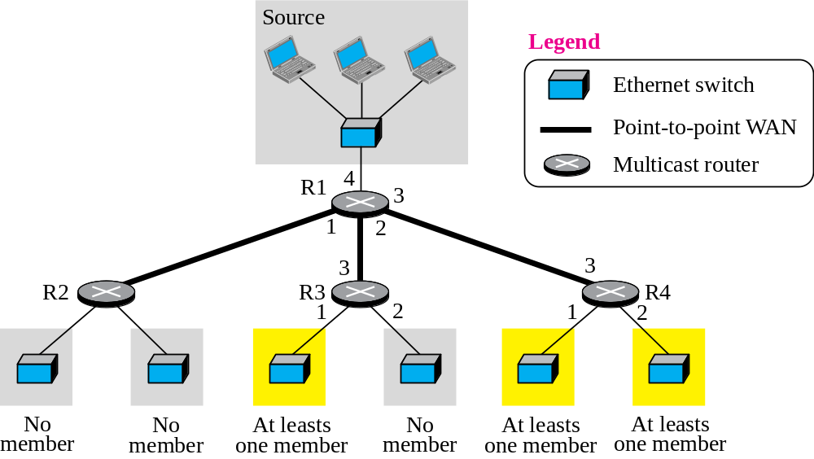
Figure 12.2 Multicasting
TCP/IP Protocol Suite

Slide 7
Note
In multicasting, the router may
forward the received datagram
through several of its interfaces.
TCP/IP Protocol Suite

Slide 8
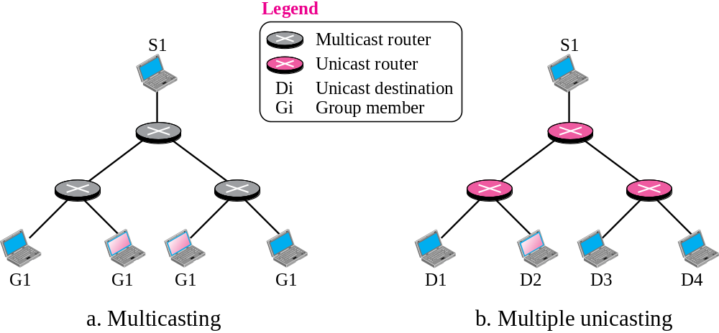


Figure 12.3 Multicasting versus multiple unicasting
TCP/IP Protocol Suite

Slide 9
Note
Emulation of multicasting through multiple unicasting is not
efficient and may create
long delays, particularly
with a large group.
TCP/IP Protocol Suite

Slide 10
12-2 MULTICAST ADDRESSES
A multicast address is a destination address for a group of hosts that have joined a multicast group. A packet that uses a multicast address as a destination can reach all members of the group unless there are some filtering restriction by the receiver.
TCP/IP Protocol Suite

Slide 11
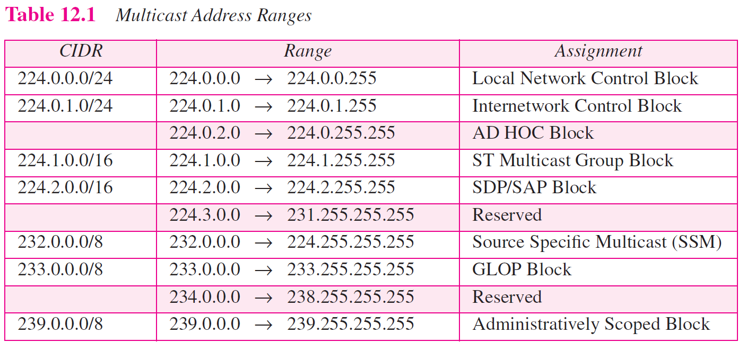
TCP/IP Protocol Suite

Slide 12
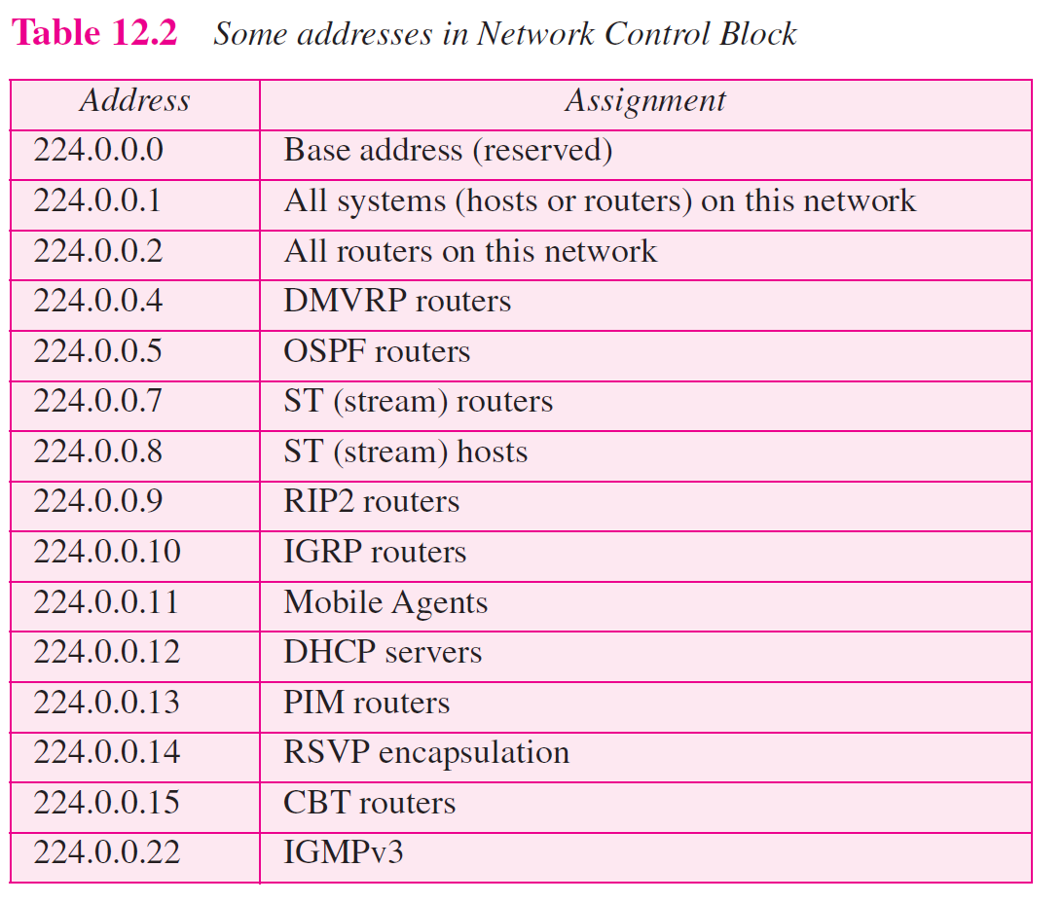
TCP/IP Protocol Suite

Slide 13
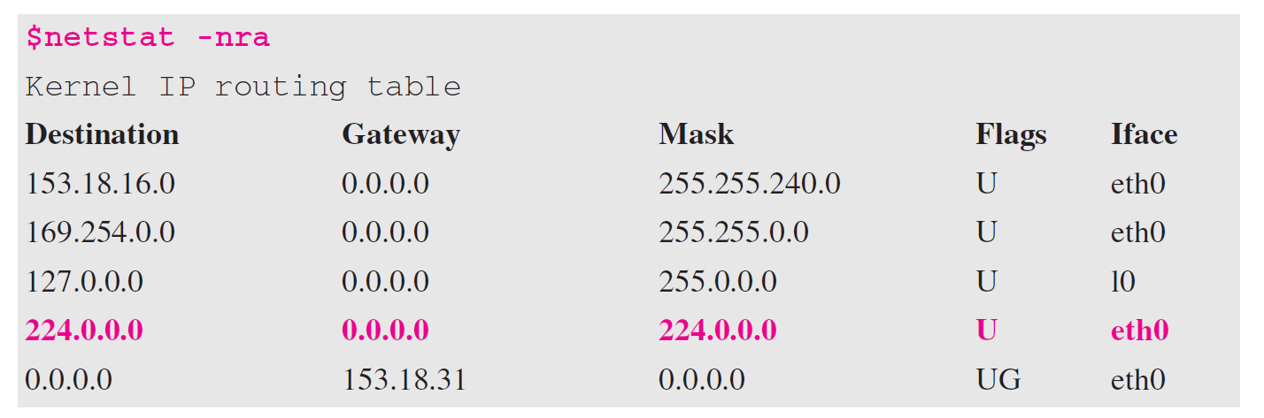
Example 12.1
We use netstat with three options, -n, -r, and -a. The -n option gives the numeric versions of IP addresses, the -r option gives the routing table, and the -a option gives all addresses (unicast and multicast). Note that we show only the fields relative to our discussion. The multicast address is shown in color.
TCP/IP Protocol Suite

Slide 14
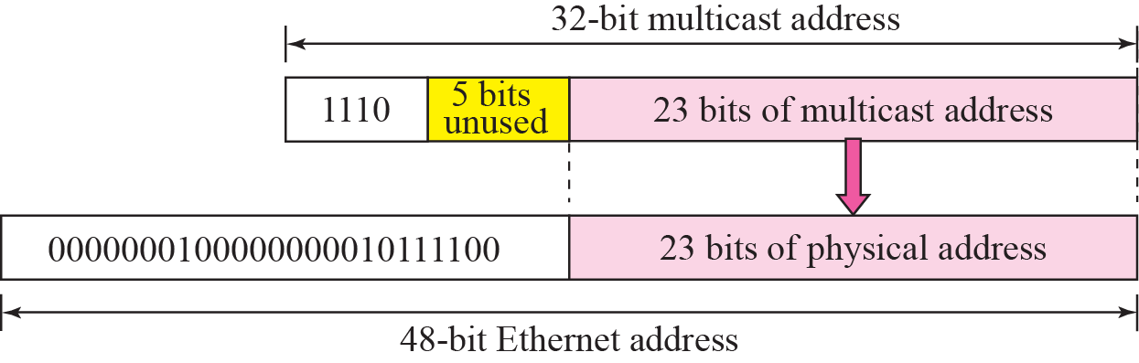
Figure 12.4 Mapping class D to Ethernet physical address
TCP/IP Protocol Suite

Slide 15
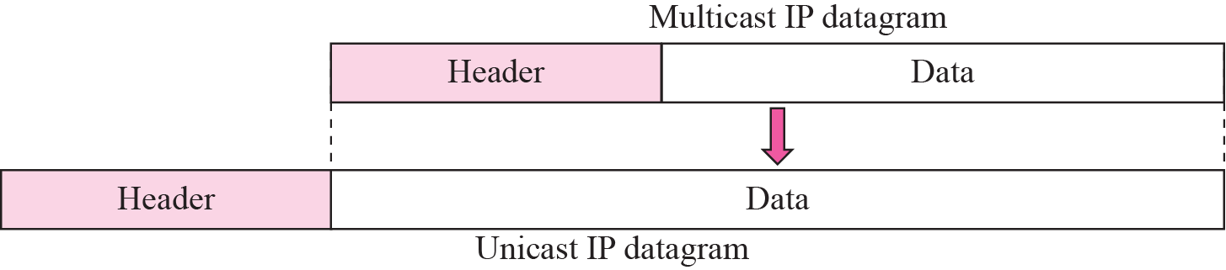
Figure 12.5 Tunneling
TCP/IP Protocol Suite

Slide 16
12-3 IGMP
Multicast communication means that a sender sends a message to a group of recipients that are members of the same group. Each multicast router needs to know the list of groups that have at least one loyal member related to each interface. Collection of this type of information is done at two levels: locally and globally. The first task is done by the IGMP protocol; the second task is done by the multicast routing protocols.
TCP/IP Protocol Suite

Slide 17
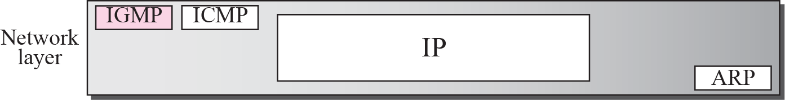
Figure 12.6 Position of IGMP in the network layer
TCP/IP Protocol Suite

Slide 18
Note
IGMP is a group management protocol. It helps a multicast router create and update a list of loyal members related
to each router interface.
TCP/IP Protocol Suite

Slide 19
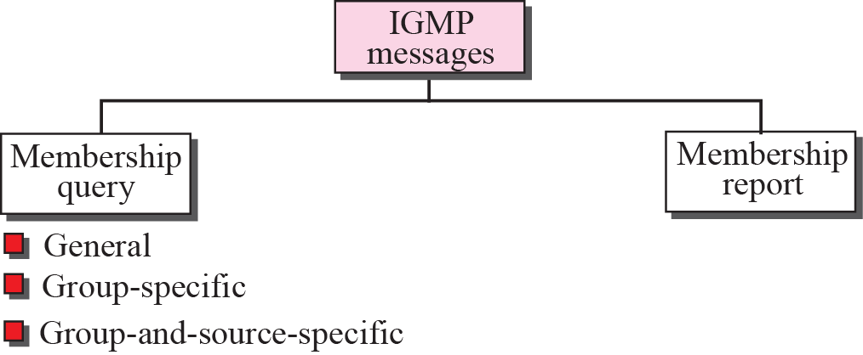
Figure 12.7 IGMP messages
TCP/IP Protocol Suite

Slide 20
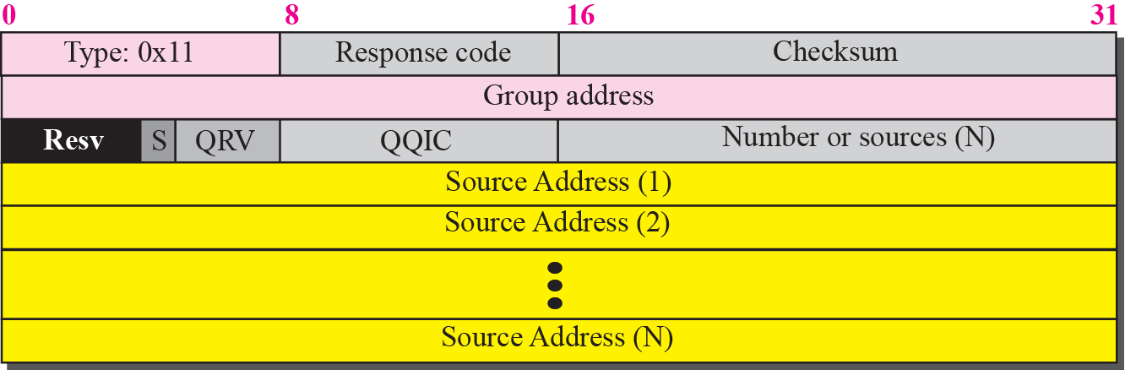
Figure 12.8 Membership query message format
TCP/IP Protocol Suite

Slide 21
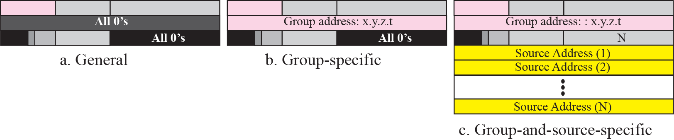
Figure 12.9 Three forms of query messages
TCP/IP Protocol Suite

Slide 22
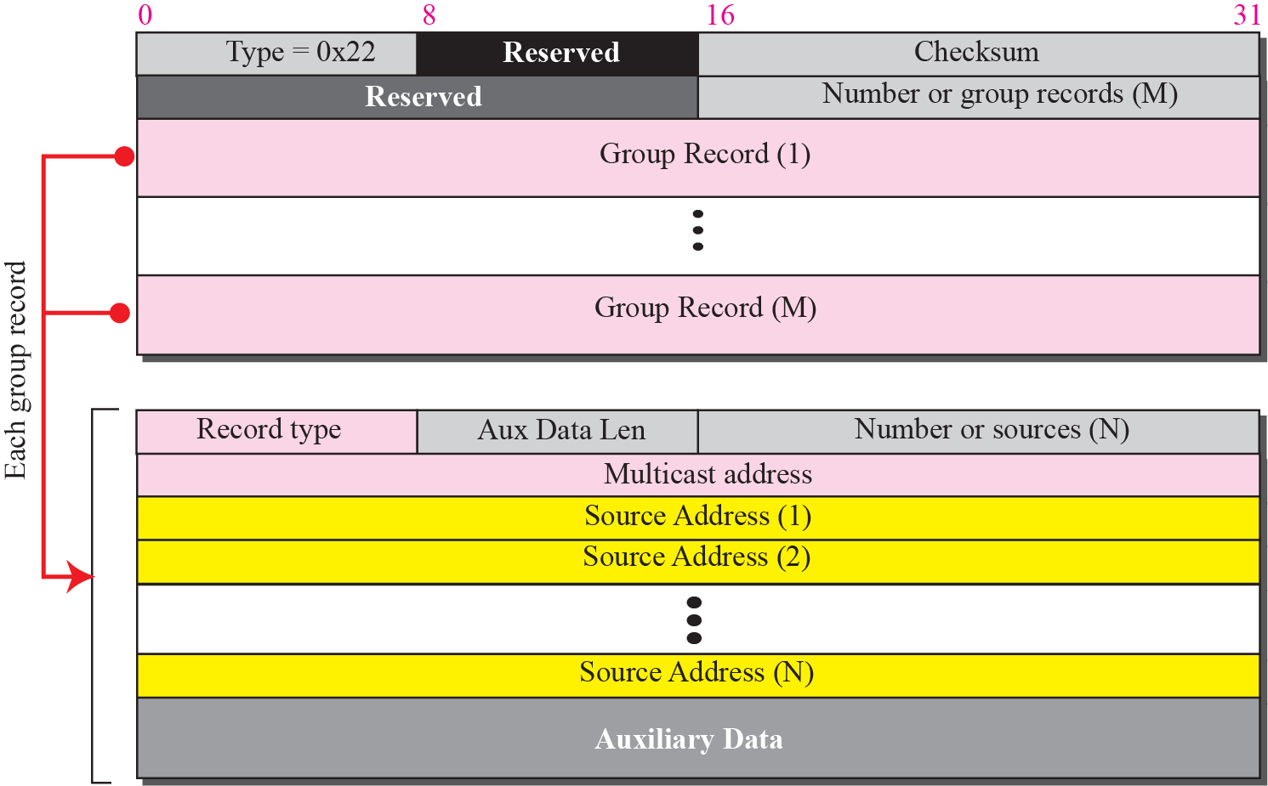
Figure 12.10 Membership report message format
TCP/IP Protocol Suite

Slide 23
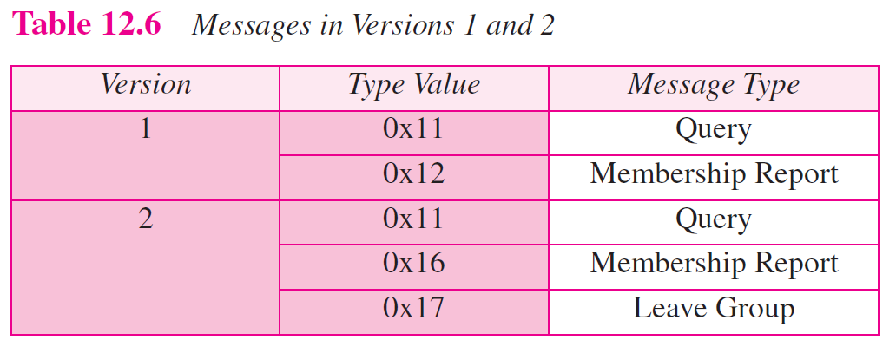
TCP/IP Protocol Suite

Slide 24
12-4 MULTICAST ROUTING
Now we show how information collected by IGMP is disseminated to other routers using multicast routing protocols. However, we first discuss the idea of optimal routing, common in all multicast protocols. We then give an overview of multicast routing protocols.
TCP/IP Protocol Suite

Slide 25
Topics Discussed in the Section
Optimal Routing: Shortest Path Trees
TCP/IP Protocol Suite

Slide 26
Note
In unicast routing, each router in the domain has a table that defines a shortest path to possible destinations.
TCP/IP Protocol Suite

Slide 27
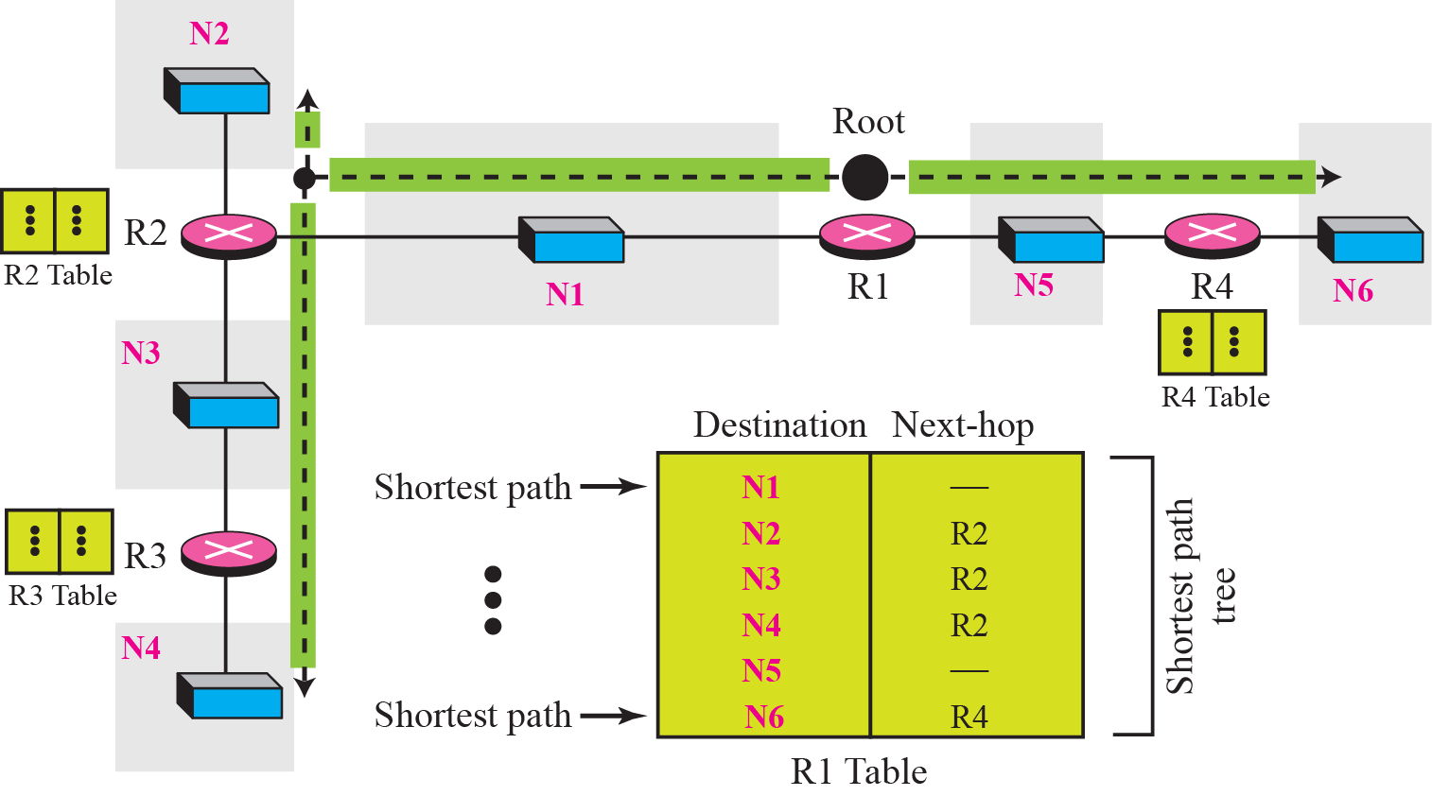
Figure 12.18 Shortest path tree in multicast routing
TCP/IP Protocol Suite

Slide 28
Note
In multicast routing, each involved router needs to construct a shortest
path tree for each group.
TCP/IP Protocol Suite

Slide 29
Note
In the source-based tree approach, each router needs to have one shortest path tree for each group.
TCP/IP Protocol Suite

Slide 30
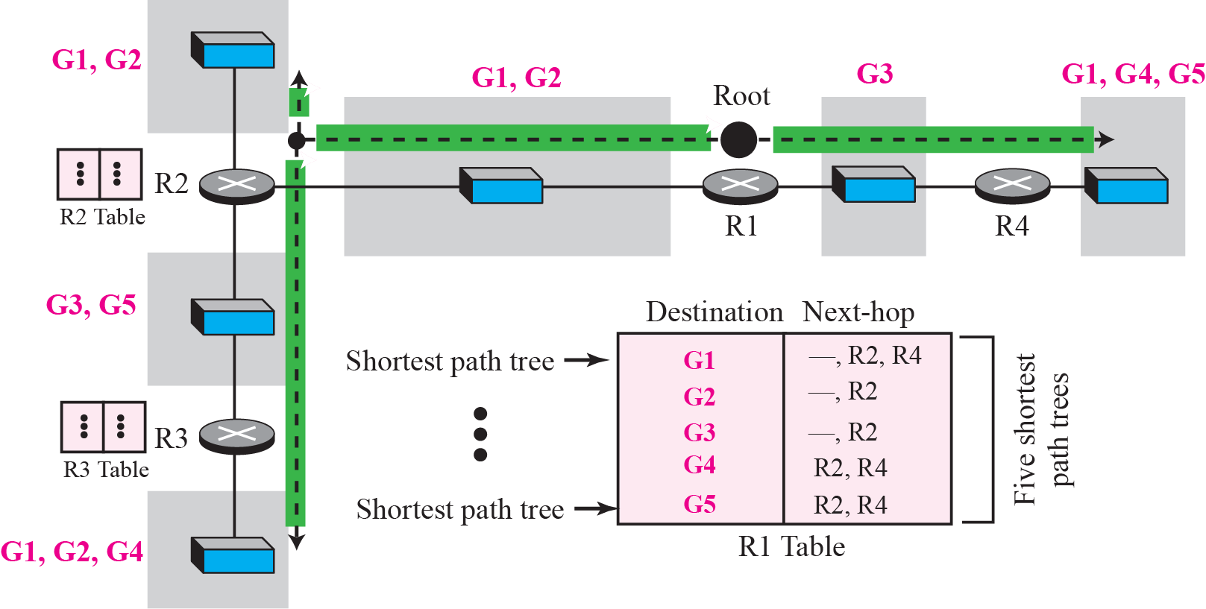
Figure 12.19 Source-based tree approach
TCP/IP Protocol Suite

Slide 31
Note
In the group-shared tree approach, only the core router, which has a shortest path tree for each group, is involved
in multicasting.
TCP/IP Protocol Suite

Slide 32
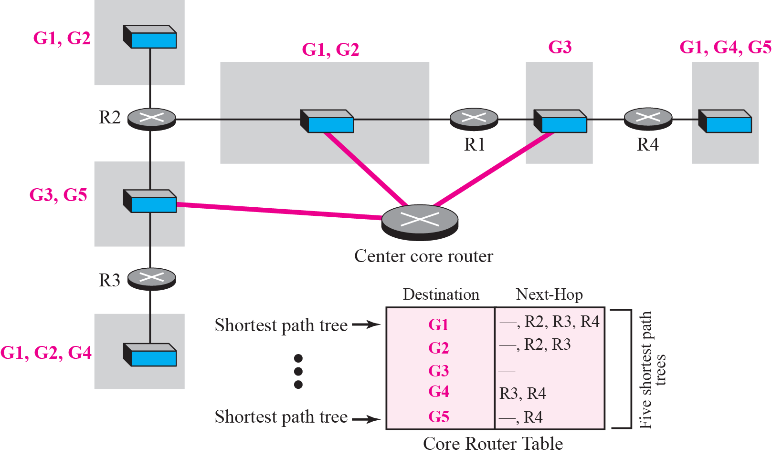
Figure 12.20 Group-shared tree approach
TCP/IP Protocol Suite

Slide 33
12-4 ROUTING PROTOCOLS
During the last few decades, several multicast routing protocols have emerged. Some of these protocols are extensions of unicast routing protocols; some are totally new. We discuss these protocols in the remainder of this chapter. Figure 12.21 shows the taxonomy of these protocols.
TCP/IP Protocol Suite

Slide 34
Topics Discussed in the Section
Multicast Link State Routing: MOSPF
Multicast Distance Vector: DVMRP
Core-Based Tree: CBT
Protocol Independent Multicast: PIM
TCP/IP Protocol Suite

Slide 35
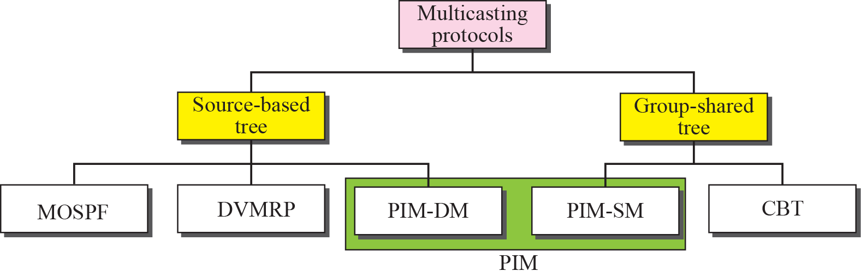
Figure 12.21 Taxonomy of common multicast protocols
TCP/IP Protocol Suite

Slide 36
12-6 MBONE
Multimedia and real-time communication have increased the need for multicasting in the Internet. However, only a small fraction of Internet routers are multicast routers. Although this problem may be solved in the next few years by adding more and more multicast routers, there is another solution for this problem. The solution is tunneling. The multicast routers are seen as a group of routers on top of unicast routers. The multicast routers may not be connected directly, but they are connected logically.
TCP/IP Protocol Suite

Slide 37
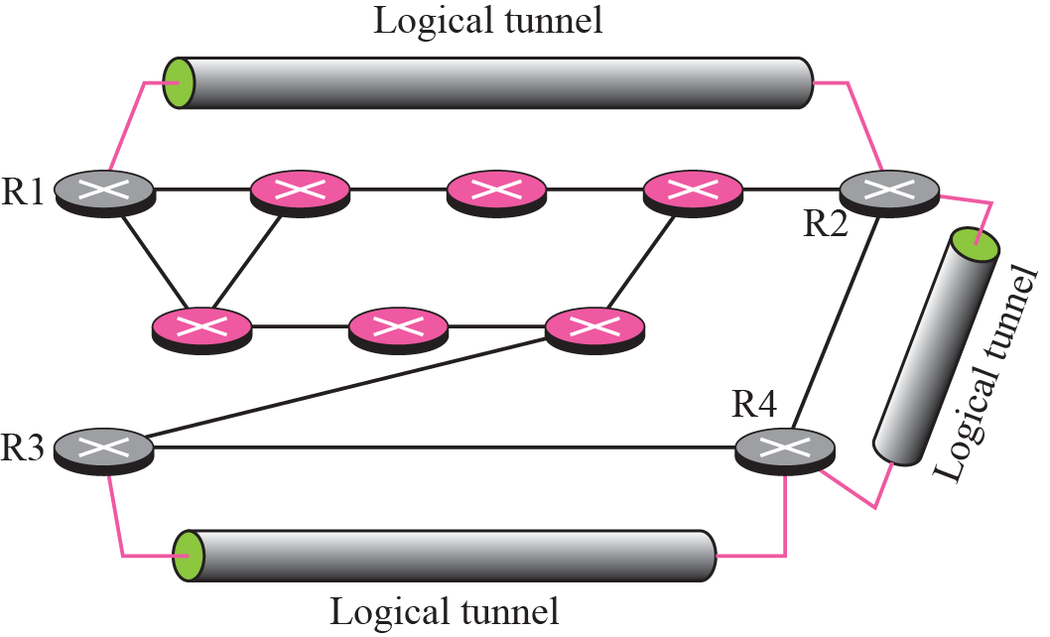
Figure 12.28 Logical tunneling
TCP/IP Protocol Suite

Slide 38
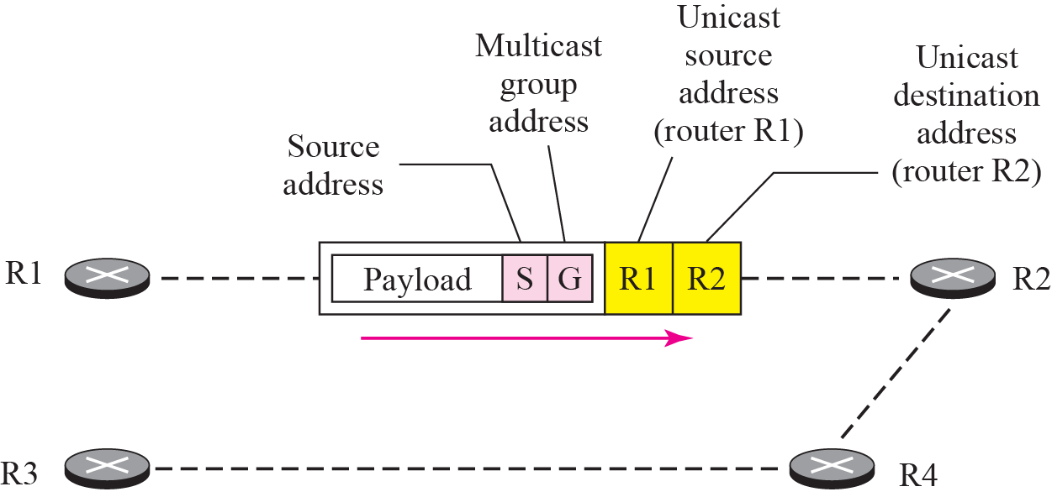
Figure 12.29 MBONE
TCP/IP Protocol Suite

