Slide 1
Chapter 13.
Introduction to Transport Layer
Process-to-Process Communication
UDP
TCP
SCTP
DCCP

Slide 2
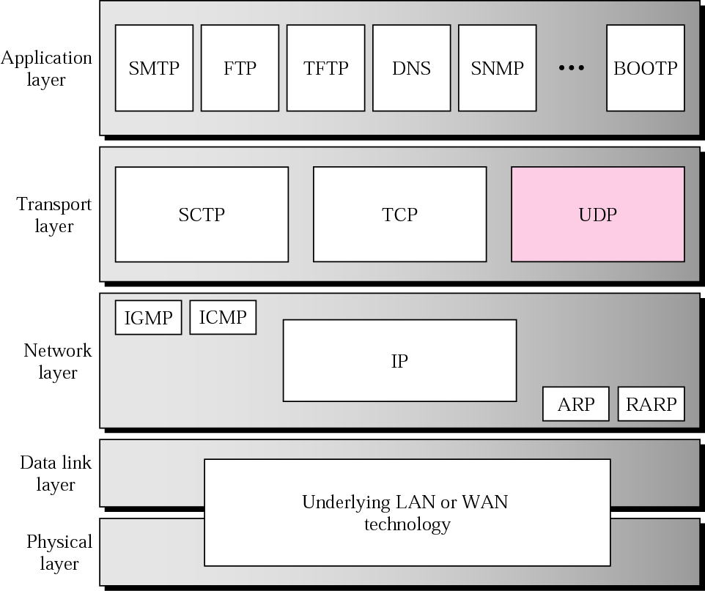
Position of Transport Layer in the TCP/IP protocol suite
Computer Networks
<number>/30

Slide 3
Process-to-Process Communications
Notes
  host-to-host communication
  process-to-process communication
Port Numbers & Socket Addresses
Computer Networks
<number>/30

Slide 4
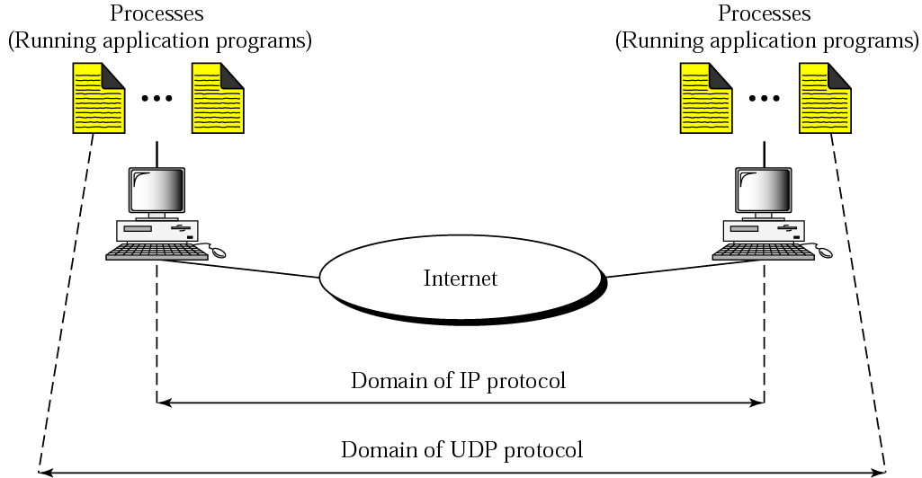
UDP versus IP
Computer Networks
<number>/30

Slide 5
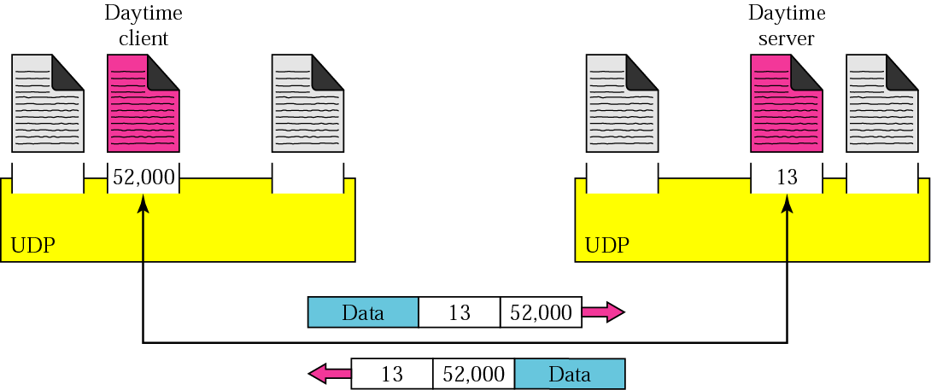
Port numbers
Computer Networks
<number>/30

Slide 6
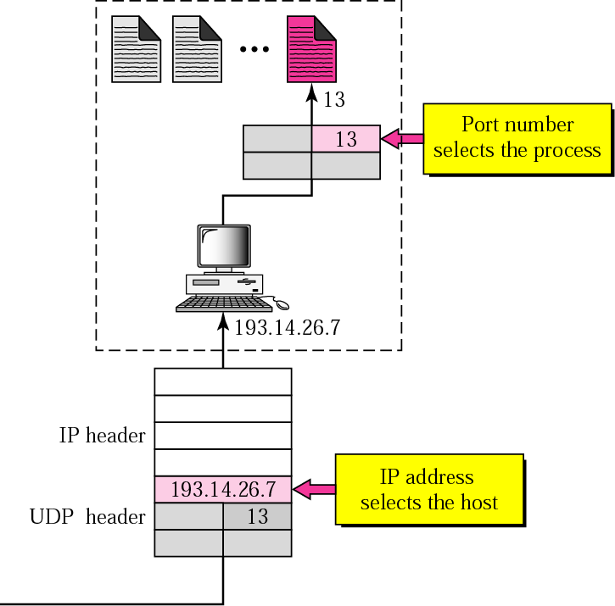
IP addresses versus port numbers
Computer Networks
<number>/30

Slide 7
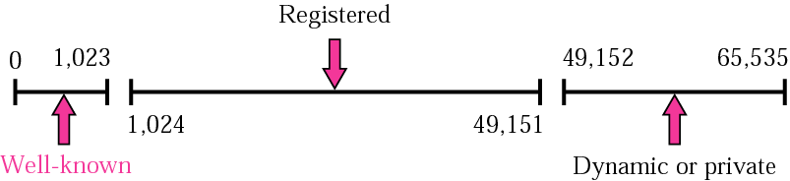
ICANN ranges
Computer Networks
<number>/30

Slide 8

Note:
The well-known port numbers are less than 1024.
Computer Networks
<number>/30

Slide 9
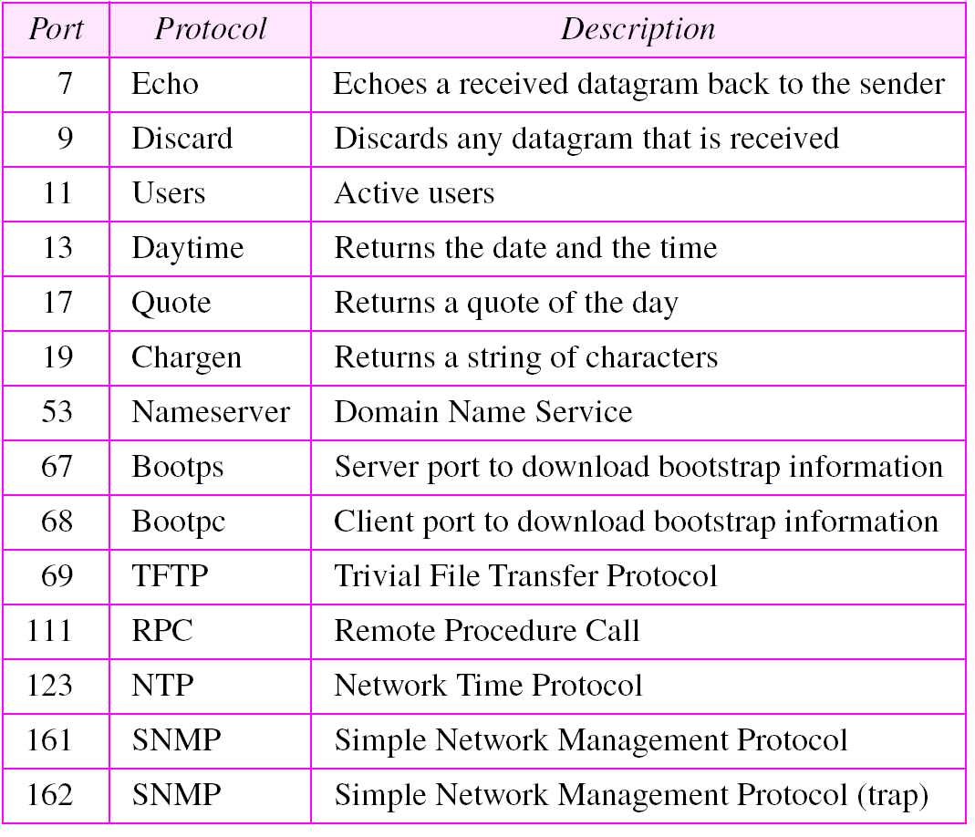
Well-known ports used with UDP
Computer Networks
<number>/30

Slide 10
Example 1
In UNIX, the well-known ports are stored in a file called /etc/services.
Each line in this file gives the name of the server and the well-known port number.
We can use the grep utility to extract the line corresponding to the desired application. The following shows the port for TFTP.
Note TFTP can use port 69 on either UDP or TCP.
$ grep tftp /etc/services
tftp 69/tcp
tftp 69/udp
Computer Networks
<number>/30

Slide 11
Example 1 (Continued)
SNMP uses two port numbers (161 and 162), each for a different purpose, as we will see in Chapter 21.
$ grep snmp /etc/services
snmp 161/tcp #Simple Net Mgmt Proto
snmp 161/udp #Simple Net Mgmt Proto
snmptrap 162/udp #Traps for SNMP
Computer Networks
<number>/30

Slide 12
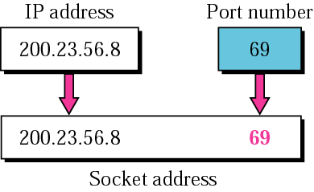
Figure 11.6 Socket address
Computer Networks
<number>/30

