Slide 1

Chapter 14
User Datagram
Program
(UDP)
TCP/IP Protocol Suite

Slide 2
14-1 INTRODUCTION
Figure 14.1 shows the relationship of the User Datagram Protocol (UDP) to the other protocols and layers of the TCP/IP protocol suite: UDP is located between the application layer and the IP layer, and serves as the intermediary between the application programs and the network operations.
TCP/IP Protocol Suite

Slide 3
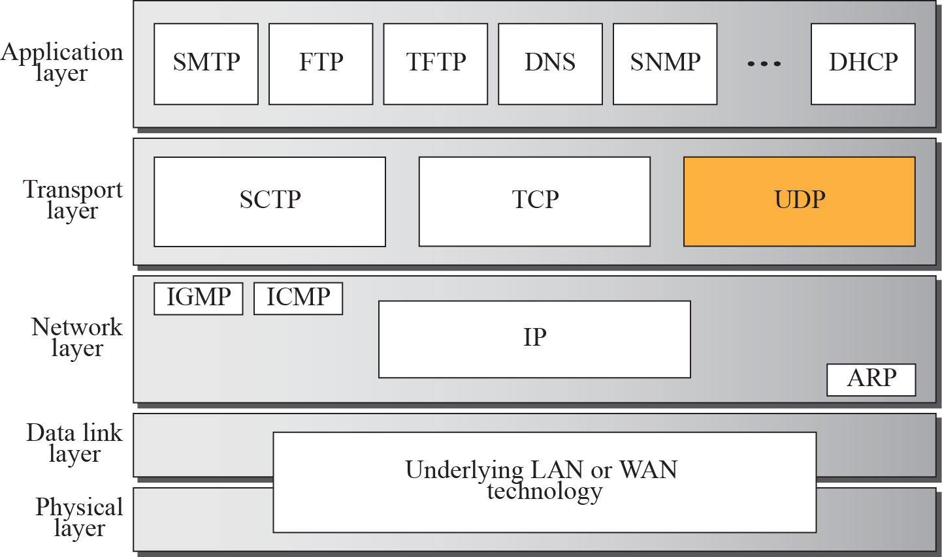
Figure 14.1 Position of UDP in the TCP/IP protocol suite
TCP/IP Protocol Suite

Slide 4
14-2 USER DATAGRAM
UDP packets, called user datagrams, have a fixed-size header of 8 bytes. Figure 14.2 shows the format of a user datagram.
TCP/IP Protocol Suite

Slide 5
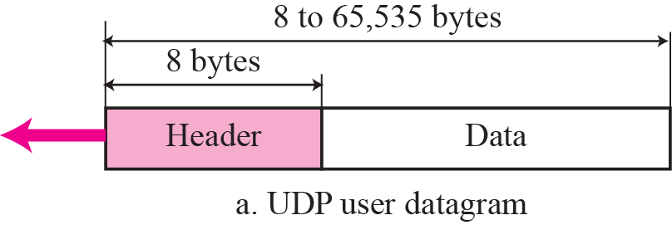
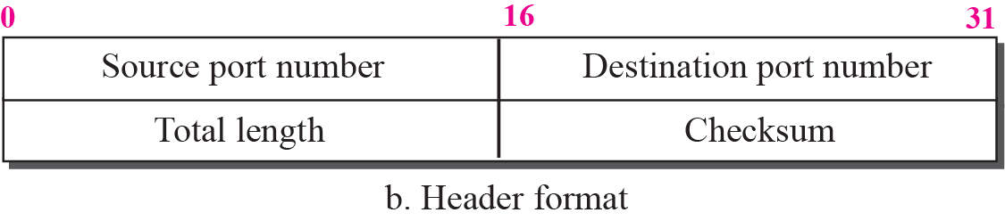
Figure 14.2 User datagram format
TCP/IP Protocol Suite

Slide 6
14-3 UDP Services
We discussed the general services provided by a transport layer protocol in Chapter 13. In this section, we discuss what portions of those general services are provided by UDP.
TCP/IP Protocol Suite

Slide 7
Topics Discussed in the Section
Process-to-Process Communication
Connectionless Service
Flow Control
Error Control
Congestion Control
Encapsulation and Decapsulation
Queuing
Multiplexing and Demultiplexing
Comparison between UDP and Generic Simple
Protocol
TCP/IP Protocol Suite

Slide 8
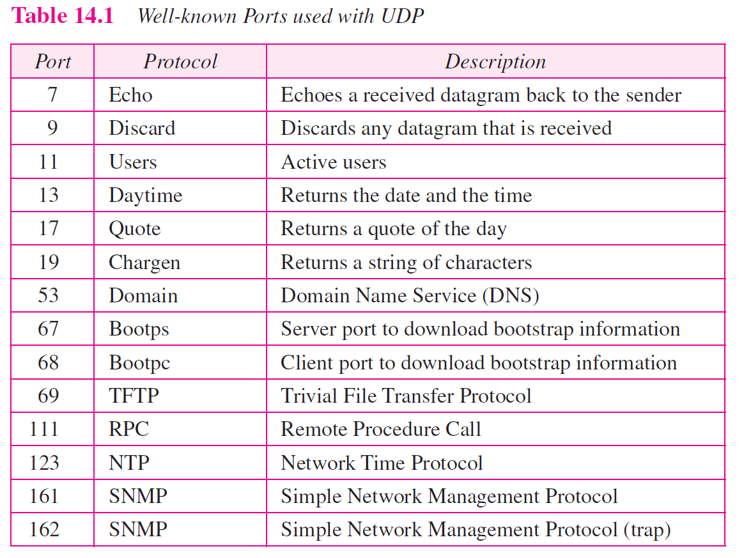
TCP/IP Protocol Suite

Slide 9
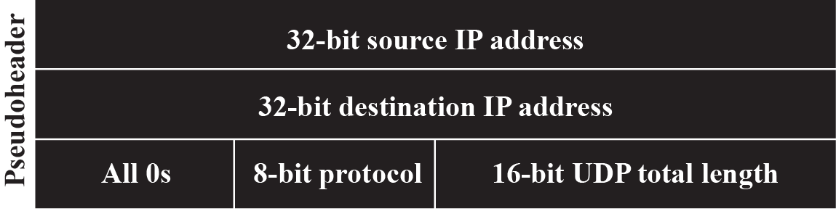
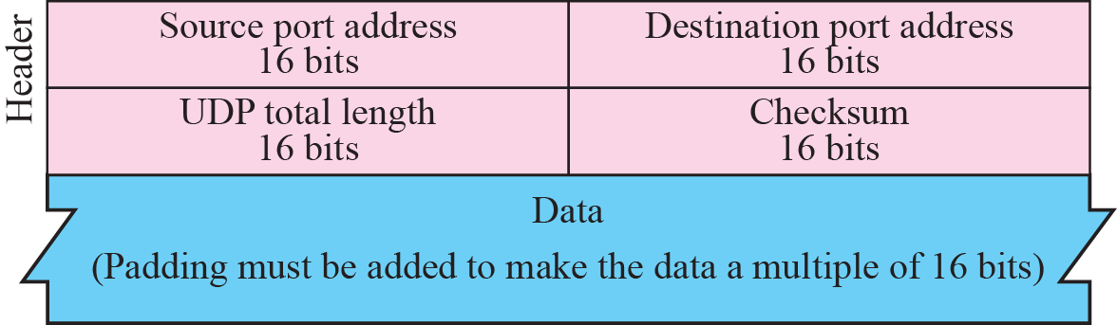
Figure 14.3 Pseudoheader for checksum calculation
TCP/IP Protocol Suite

Slide 10
Example 14.2
Figure 14.4 shows the checksum calculation for a very small user datagram with only 7 bytes of data. Because the number of bytes of data is odd, padding is added for checksum calculation. The pseudoheader as well as the padding will be dropped when the user datagram is delivered to IP (see Appendix F).
TCP/IP Protocol Suite

Slide 11
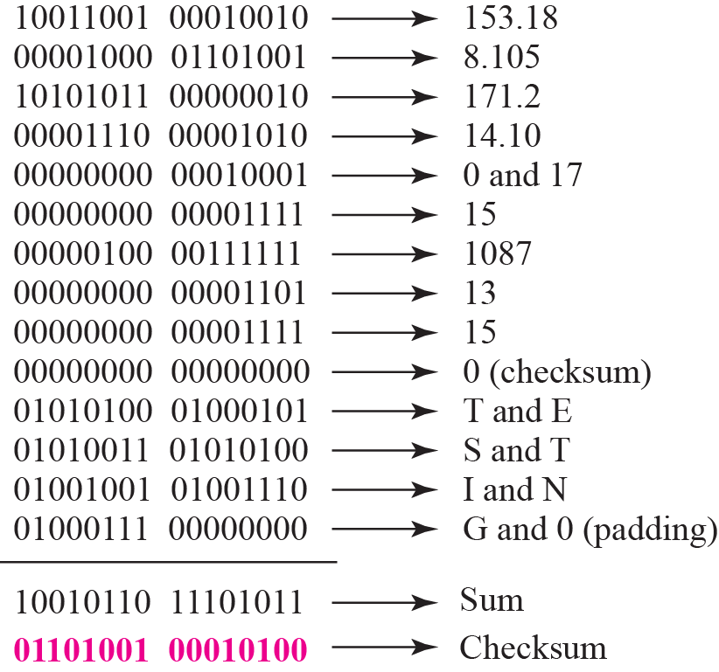
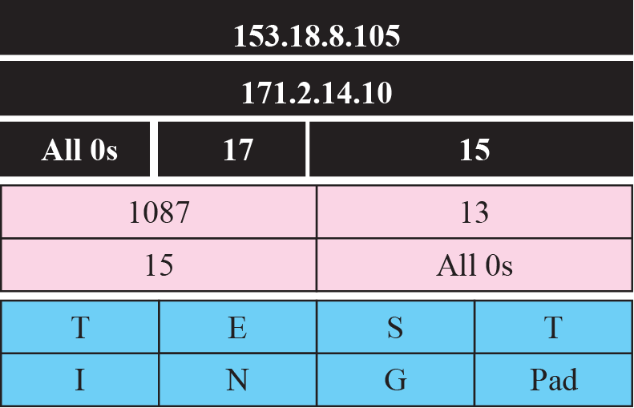
Figure 14.4 Checksum calculation for a simple UDP user datagram
TCP/IP Protocol Suite

Slide 12
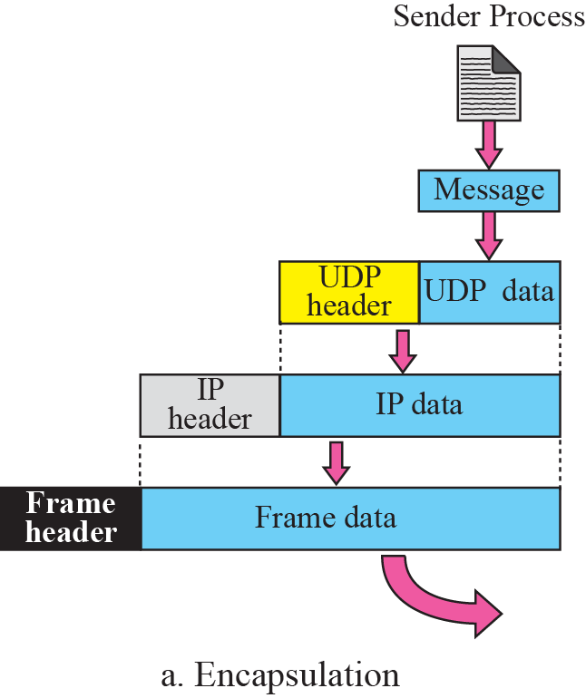
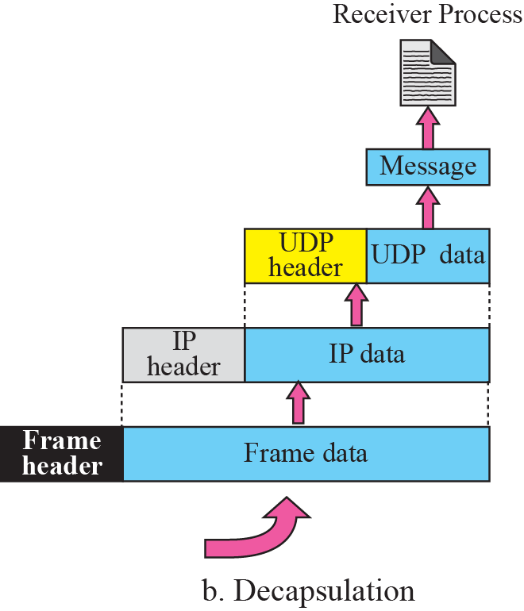

Figure 14.5 Encapsulation and decapsulation
TCP/IP Protocol Suite

Slide 13
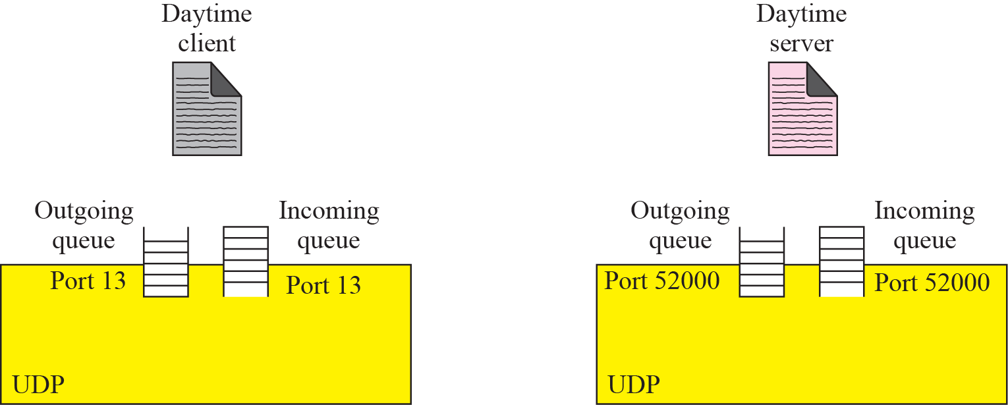






Figure 14.6 Queues in UDP
TCP/IP Protocol Suite

Slide 14
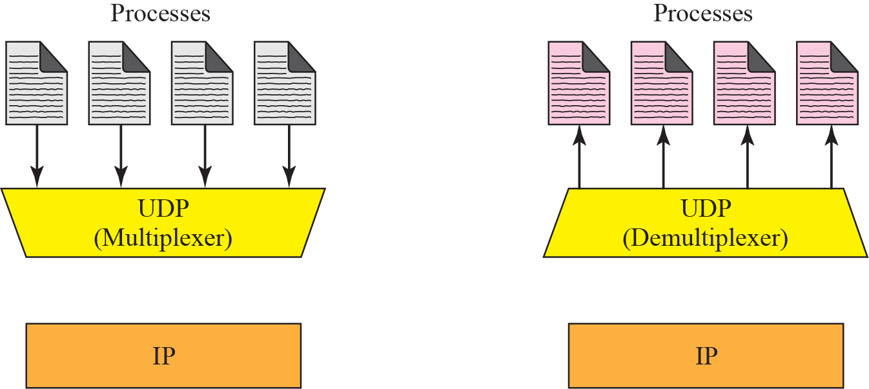





Figure 14.7 Multiplexing and demultiplexing
TCP/IP Protocol Suite

Slide 15

Note
UDP is an example of the connectionless simple protocol we discussed in Chapter 13 with the exception of an optional checksum added to packets for error detection.
TCP/IP Protocol Suite

Slide 16
14-4 UDP APPLICATION
Although UDP meets almost none of the criteria we mentioned in Chapter 13 for a reliable transport-layer protocol, UDP is preferable for some applications. The reason is that some services may have some side effects that are either unacceptable or not preferable. An application designer needs sometimes to compromise to get the optimum.
TCP/IP Protocol Suite

Slide 17
14-5 UDP PACKAGE
To show how UDP handles the sending and receiving of UDP packets, we present a simple version of the UDP package.
We can say that the UDP package involves five components: a control-block table, input queues, a control-block module, an input module, and an output module.
TCP/IP Protocol Suite

Slide 18
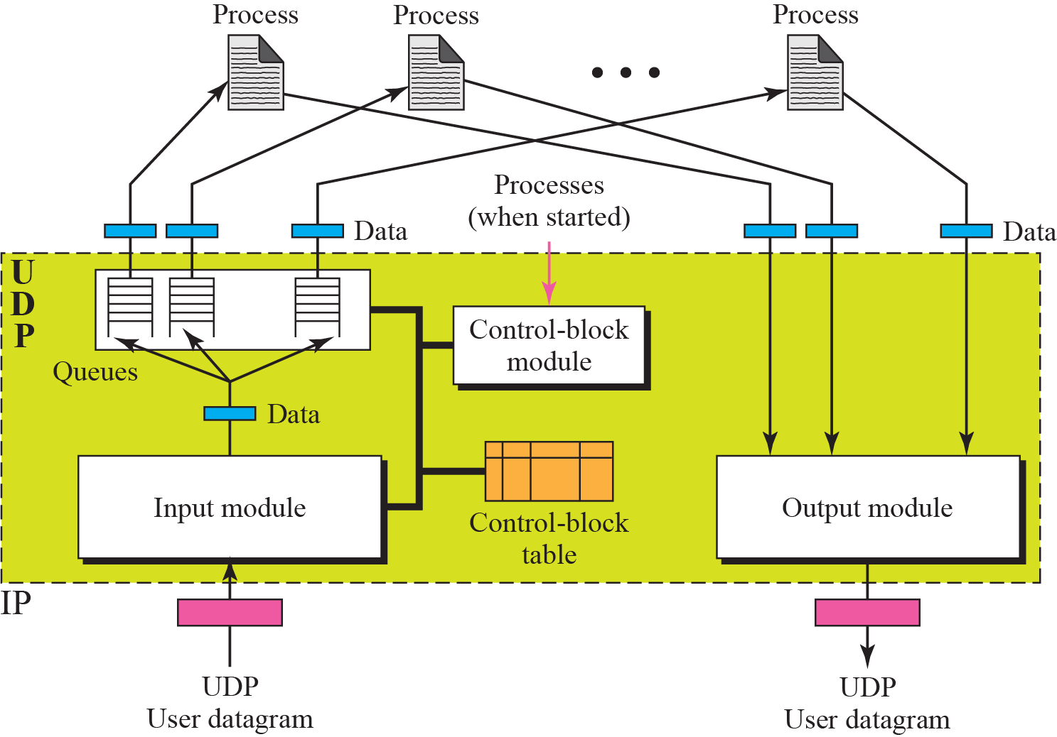
Figure 14.8 UDP design
TCP/IP Protocol Suite

