Slide 1
SCTP:
Protocol Overview & APIs

Slide 2
ToC
SCTP Basics
SCTP Protocol Operations
SCTP Messages
SCTP APIs

Slide 3
SCTP is …
Stream Control Transmission Protocol
3rd Transport Layer Protocol next to TCP/UDP
  Protocol ID = 132 (TCP = 6, UDP = 17)
Possibly a good match with IPv6
  As a suite of the next-generation Internet protocols
An enhanced version of TCP and UDP
Originally targeted to VoIP signaling transport
  For fast and reliable transport between VoIP servers

Slide 4
SCTP History
RFC 2960 (October 2000)
  SIGTRAN (Signaling Transport) WG of IETF
  To support Telephony Signaling (VoIP)
    Between Signaling Gateways over IP networks
SCTP naming history
  From the SIGTRAN WG meeting in Orlando 1998
    TCPng, Simple Control Transmission Protocol, …
IETF Transport Area WG (tsvwg)
  SCTP was originally destined to running over UDP
  It is located as a new Transport Protocol (by IESG)

Slide 5
SCTP Documents
Textbook
  SCTP: Reference Guide, R. Stewart & Q. Xie (2001)
RFC
  RFC 2960 (SCTP), 2000/10
  RFC 3257 (SCTP Applicability Statement), 2002/04
  RFC 3286 (Introduction to SCTP), 2002/05
  RFC 3309 (SCTP Checksum Change), 2002/09
  RFC 3436 (TLS over SCTP), 2002/12
  RFC 3554 (SCTP with IPsec), 2003/07
  RFC 3708 (Using TCP DSACK and SCTP TSN), 2004/02
  RFC 3758 (Partial Reliable SCTP), 2004/05

Slide 6
Reference Sites
SCTP reference implementations
  LK-SCTP (Linux Kernel SCTP) Project
    http://sourceforge.net/projects/lksctp
    http://lksctp.sourceforge.net/
  SCTPLIB (User Space Implementation)
    http://www.sctp.de/sctp.html (Siemens)

Slide 7
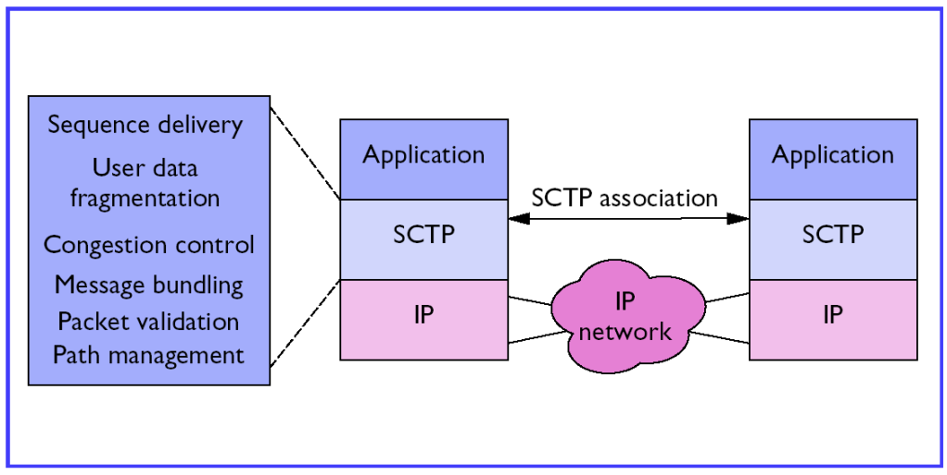
Protocol Model (1/2)
Transport Layer Protocol (near to TCP and UDP)
  Enhanced transport layer services
  Association (session, connection) between two end hosts

Slide 8
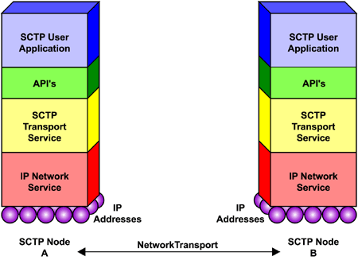
Protocol Model (2/2)
  Application (Upper Layer Protocol, ULP)
  SCTP API
  SCTP with multiple interfaces to an IP network

Slide 9
SCTP Architecture
Connection-oriented unicast protocol (TCP)
  Over IPv4 or IPv6
Reliable (full-duplex) Transport (TCP)
  Transmission Sequence Number (TSN)
  With the partial-reliability extension (PR-SCTP)
Support of Ordered and Unordered delivery
  Delivery from SCTP to ULP
TCP-friendly congestion control
Selective acknowledgments (TCP SACK)

Slide 10
SCTP Features
Message-oriented (not byte-oriented)
  Data Chunks (with TSN and Stream ID)
Multi-homing support
  SCTP binding to multiple IP addresses
Multi-streaming support
  Stream ID, Stream Sequence Number (SSN)
Enhanced DOS protection
  Four-way handshake initiation (TCP SYNC)
  Verification tag & Cookie mechanism

Slide 11
TCP vs. SCTP
TCP
  Single streaming (Byte-oriented)
    Head-of-line blocking (longer delay)
  TCP Single homing
    Bind a single IP address (+ a port)
  3-way initiation (vulnerable to DOS such as SYN attacks)
SCTP
  Multi-streaming (Message-oriented)
    Avoid unnecessary delay (for real-time applications)
  SCTP multi-homing
    Bind multiple IP addresses (+ a port)
  4-way initiation (prevent the TCP SYN storms)
    States (e.g., TCB) are created only after COOK-ECHO

Slide 12
Applicability
Signaling Transport over IP networks
  Between VoIP Signaling Gateway (SIGTRAN WG)
  Between AAA servers
Multimedia Streaming Applications
  Multi-streaming (a stream per media) in a session
  Not yet examined
Mobility (Handover) Support (Transport Layer Mobility)
  Multi-homing capability
  ADDIP (during the session)

Slide 13
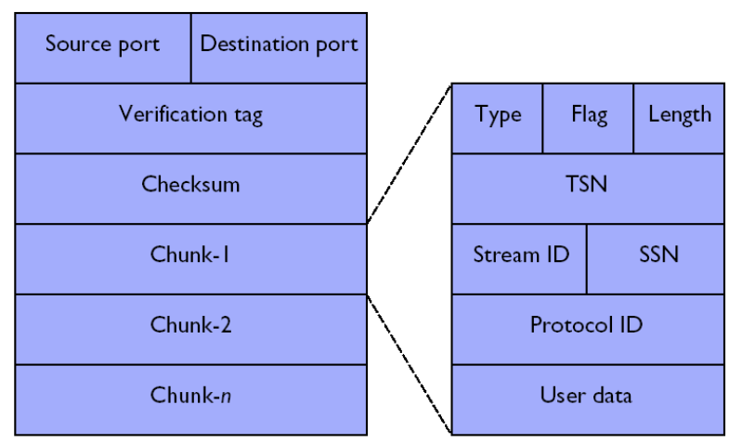
SCTP Multi-Streaming (1/2)
SCTP packet contains multiple (independent) streams

Slide 14
SCTP Multi-Streaming (2/2)
User data is partitioned into multiple streams
  Each stream are sequentially delivered independently
Data transmission versus data delivery
  Transmission: SCTP ⬄ SCTP
    Reliable transmission
    Transmission Sequence Number (TSN)
    Per association (for error/flow/congestion control)
  Delivery: ULP ⬄ SCTP ⬄ SCTP ⬄ ULP
    Ordered/unordered delivery
    Stream ID and Stream Sequence Number (SSN)
    Per stream (for ordering)

Slide 15
SCTP Multi-Homing (1/2)
Association =
  One port number + one or more IP addresses

Slide 16
SCTP Multi-Homing (2/2)
A single SCTP endpoint to support multiple IP addresses
  In initiation, two SCTP endpoints exchange the lists of addresses
    Each endpoint can to receive messages from any addresses
  A single port number is used across the entire address list
Application of SCTP multi-homing (for backup path)
  At present, the multi-homing is used for redundancy only
    A single address is chosen as the "primary" address
    It is used as the destination for normal transmission
    Retransmitted DATA chunks use the alternate addresses
Notes
  ADDIP: adding/deleting addresses in the mid-session
  Use of Multi-homing for handover (mobile SCTP)

Slide 17
SCTP Protocol Operations
Initiation
Data Transfer
Shutdown

Slide 18
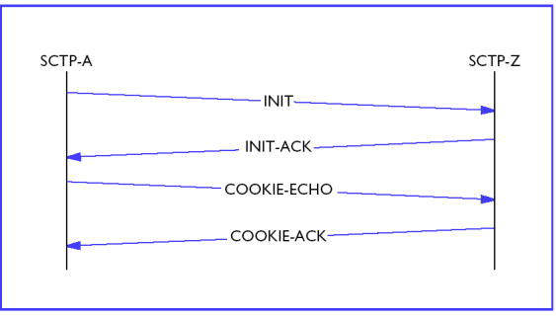
Initiation
An SCTP association:
  [IP addresses at A + Port-A] + [IP addresses at Z + Port-Z]
Four-way handshake between two hosts

Slide 19
Initiation
Cookie mechanism
  SCTP-A sends INIT message to SCTP-Z
  SCTP-Z responds with an INIT-ACK message
    Does not allocate resource
    Creates a Cookie parameter and sends it back to the source of INIT message
  SCTP-A echoes back the cookie in the form of a COOKIE-ECHO message
  Upon receiving the COOKIE-ECHO,
    SCTP-Z fully reconstructs its state and
    sends back a COOKIE-ACK message to acknowledge that the setup is complete

Slide 20
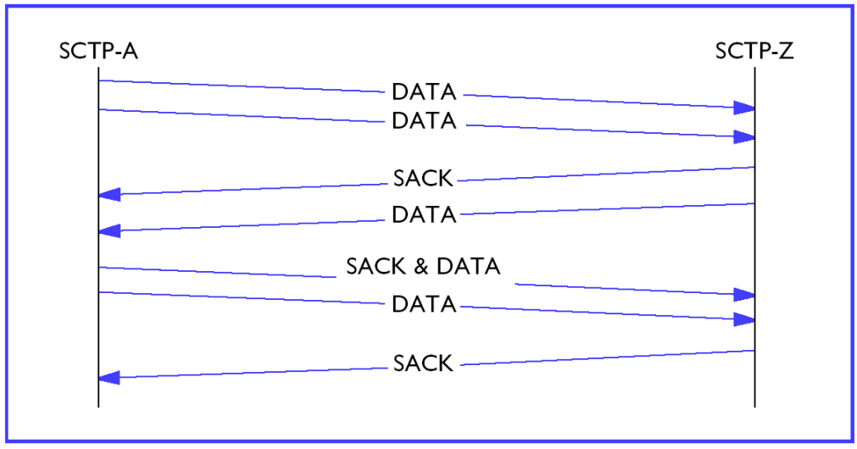
Data Transfer
In the data transfer phase, two SCTP hosts exchange
  Data Chunks & SACK (Selective ACK) Chunks

Slide 21
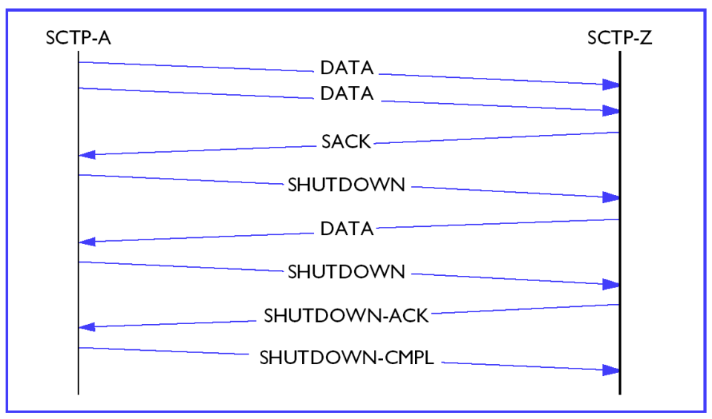
Shutdown
Three-way handshake (graceful)
  SHUTDOWN, SHUTDOWN-ACK, SHUTDOWN-COMPLETE

Slide 22
SCTP Packets
Data and Control Chunks

Slide 23
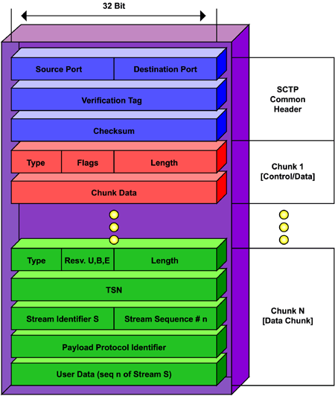
Packet Format
Common Header
  Port numbers (16+16)
  Verification tag (32)
  Checksum (32)
One or more Chunks
  Data and Control chunks
  TLV format

Slide 24
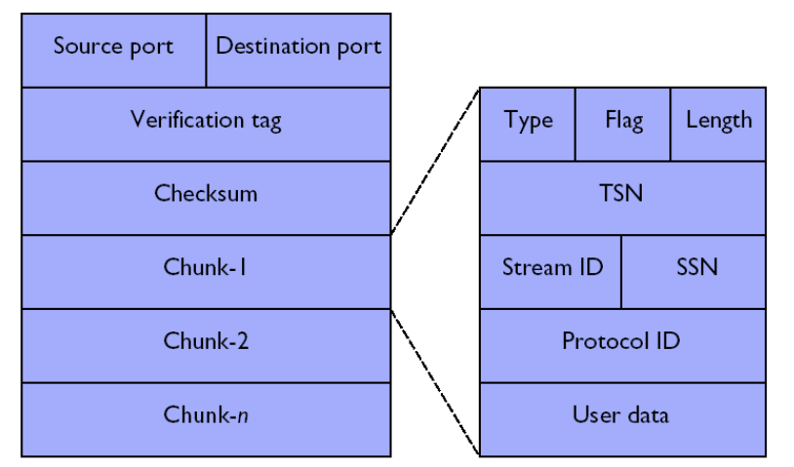
Packet Format
Data Chunks
  Common header (possibly with Control chunks)
  One or more data chunks
    Protocol ID (32): on ULP (e.g. SS7 signaling)

Slide 25
SCTP Chunks
DATA Chunks
Control Chunks
  INIT, INIT-ACK, COOKIE-ECHO, COOKIE-ACK
  SACK
  HEARTBEAT, HEARTBEAT-ACK
  SHUTDOWN, SHUTDOWN-ACK, SHUTDOWN-COMPLETE
  ERROR (not critical), ABORT (critical, abnormal shutdown)
Extensional Chunks
  ADD-IP: ASCONF, ASCONF-ACK
  PR-SCTP: FORWARD-TSN (Forward Cumulative TSN)
  SCTP-AUTH: AUTH (Authentication) Chunk

Slide 26
Socket APIs for SCTP
Refer to <IETF RFC 6458 (December 2011)>
Design Objectives
  Maintain consistency with existing socket APIs
    Consistent with socket API for IPv4, IPv6, TCP, UDP
  Support an one-to-many style interfaces
    Many SCTP associations over One socket
    Similar to UDP socket
  Support an one-to-one style interfaces
    One SCTP association over One socket
    Similar to TCP socket

Slide 27
One-to-Many Style (1)
1-to-MANY relationship between socket and associations
Basic Operations
  Typical Server
    socket(), bind(),listen(), recvmsg(), sendmsg(), close()
  Typical Client
    socket(), sendmsg(), recvmsg(), close()

Slide 28
One-to-Many Style (2)
Socket()
  sd = socket(PF_INET, SOCK_SEQPACKET, IPPROTO_SCTP);
Bind()
  ret = bind(int sd, struct sockaddr *addr, socklen_t addrlen);
Listen()
  int listen(int sd, int backlog);
Connect()
  ret = connect(int sd, const struct sockaddr *nam, socklen_t len);
Sendmsg() & Recvmsg()
  ssize_t sendmsg(int sd, const struct msghdr *message, int flags);
  ssize_t recvmsg(int sd, struct msghdr *message, int flags);
Close()
  ret = close(int sd);

Slide 29
One-to-One Style
Typical Server
  1. socket()
  2. bind()
  3. listen()
  4. accept()
  5. close()
Typical Client
  1. socket()
  2. connect()
  3. close()

Slide 30
New APIs for SCTP
sctp_bindx()
sctp_peeloff(): Branched-off Association
sctp_getpaddrs()
sctp_freepaddrs()
sctp_getladdrs()
sctp_freeladdrs()
sctp_sendmsg()
sctp_recvmsg()
sctp_connectx()
sctp_send()

