Slide 1
Chapter 9. Elementary SCTP Sockets
(Unix Netowork Programming: 3rd Ed. Vol 1., by Richard Stevens)
Introduction
Interface Models
SCTP API Functions
SCTP Notifications

Slide 2
Introduction
SCTP is
  a newer transport protocol,
  standardized in the IETF in 2000
    compared with TCP, which was standardized in 1981
  first designed to meet the needs of the growing IP telephony market;
    transporting telephony signaling across the Internet.
  a reliable, message-oriented protocol, providing multiple streams between endpoints and transport-level support for multihoming.
one-to-one interface for SCTP
  provides very nearly the same application interface as TCP.
  allows for trivial porting of applications
    but does not permit use of some of SCTP's advanced features.
one-to-many interface for SCTP
  provides full support for these features, but may require significant retooling of existing applications.
  recommended for most new applications developed for SCTP
<number>/24

Slide 3
Interface Models
There are two types of SCTP sockets
  a one-to-one socket
  a one-to-many socket
one-to-one socket
  corresponds to exactly one SCTP association
  similar to the relationship between a TCP socket and a TCP connection
one-to-many socket,
  several SCTP associations can be active on a given socket simultaneously
  similar to UDP socket
    bound to a particular port can receive interleaved datagrams from several remote UDP endpoints that are all simultaneously sending data
<number>/24

Slide 4
One-to-One Socket
Developed for easy porting of existing TCP apps to SCTP
There are some differences
  Any socket options must be converted to the SCTP equivalent:
    TCP_NODELAY ⬄ SCTP_NODELAY
  SCTP preserves message boundaries;
    Similar to UDP
    Application-layer message boundaries are not required
  Does not support “half-close” to a connection
    3-way handshake shutdown (termination)
<number>/24

Slide 5
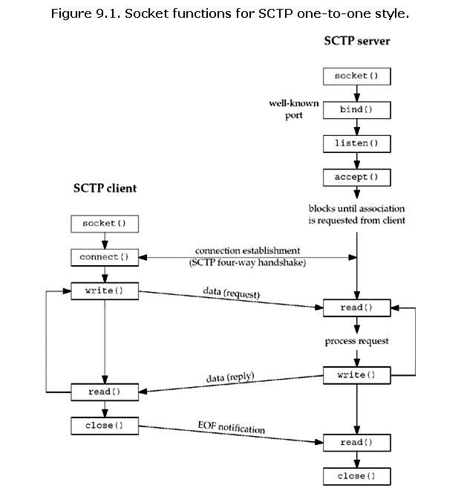
<number>/24

Slide 6
One-to-Many Socket
One-to-Many Socket
  A single socket descriptor will represent multiple associations
    (c.f.) UDP socket can receive messages from multiple clients
  An association ID is used
    to identify a single association on a one-to-many socket.
    sctp_assoc_t; it is normally an integer.
Keep the following issues in mind
  When the client closes the association, the server side will automatically close as well, thus removing any state for the association inside the kernel
  Only the one-to-many style can be used to cause data to be piggybacked on the third or fourth packet of the 4-way setup
  The user must use the sendto, sendmsg, or sctp_sendmsg functions, and may not use the send or write function.
    (c.f.) sctp_peeloff function for a one-to-one-style socket
  Association events (SCTP notifications)
    As ancillary data to the recvmsg and sctp_recvmsg call
<number>/24

Slide 7
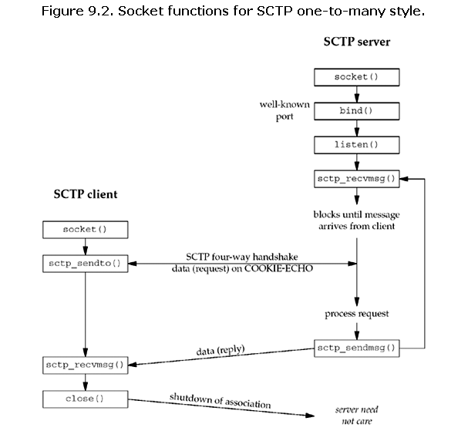
<number>/24

Slide 8
SCTP APIs
Some APIs (SCTP-specific)
  sctp_bindx()
  sctp_connectx()
  sctp_getpaddrs()
  sctp_freepaddrs()
  sctp_getladdrs()
  sctp_freeladdrs()
  sctp_sendmsg()
  sctp_recvmsg()
  sctp_opt_info()
  sctp_peeloff()
  shutdown
Note (all the APIs for TCP/UDP can also be used for SCTP)
  AF_INET or AF_INET6
  SOCK_STREAM or SOCK_SEQPACKET
  IPPROTO_SCTP (132)
<number>/24

Slide 9
sctp_bindx
#include <netinet/sctp.h>
int sctp_bindx(int sockfd, const struct sockaddr *addrs,
int addrcnt, int flags);
Returns: 0 if OK, –1 on error
An SCTP server may wish to bind a subset of IP addresses associated with the host system.
  Traditionally, a TCP or UDP server can bind one or all addresses on a host, but they cannot bind a subset of addresses.
  The sctp_bindx function provides more flexibility by allowing an SCTP socket to bind a particular subset of addresses.
addrcnt
  The number of addresses being passed to sctp_bindx is specified by the addrcnt parameter.
flags
  parameter directs the sctp_bindx call
  to perform one of the two actions
<number>/24

Slide 10

sctp_bindx
Dynamic address feature
  a call to sctp_bindx with the SCTP_BINDX_REM_ADDR or SCTP_BINDX_ADD_ADDR flag will
  cause the endpoint to send an appropriate message to the peer to change the peer's address lists.
  If implementations that do not support
    this functionality will return EOPNOTSUPP.
  This feature can be useful if the system supports dynamic provisioning of interfaces;
    for example, if a new Ethernet interface is brought up, the application can use SCTP_BINDX_ADD_ADDR to start using the additional interface on an existing connection
<number>/24

Slide 11
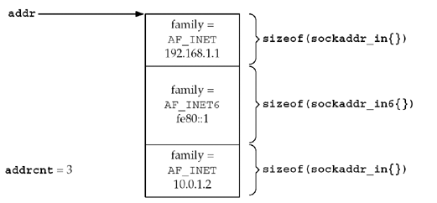
sctp_connectx
#include <netinet/sctp.h>
int sctp_connectx(int sockfd, const struct sockaddr *addrs,
int addrcnt);
Returns: 0 for success, –1 on error
Used to connect to a multihomed peer
<number>/24

Slide 12
sctp_getpaddrs
#include <netinet/sctp.h>
int sctp_getpaddrs(int sockfd, sctp_assoc_t id,
struct sockaddr **addrs);
Returns: the number of peer addresses stored in addrs,
–1 on error
getpeername
  was not designed with the concept of a multihoming-aware transport protocol;
  when using SCTP, it only returns the primary address
When all the addresses are required,
  the sctp_getpaddrs function provides a mechanism for an application to retrieve all the addresses of a peer
The caller should use sctp_freepaddrs to free resources allocated by sctp_getpaddrs when finished with them
<number>/24

Slide 13
sctp_getladdrs
#include <netinet/sctp.h>
int sctp_getladdrs(int sockfd, sctp_assoc_t id,
struct sockaddr **addrs);
Returns: the number of local addresses stored in addrs,
–1 on error
Used to retrieve the local addresses that are part of an association
This function is often necessary when a local endpoint wishes to know exactly which local addresses are in use
id is the association identification for a one-to-many style socket.
  If the socket is using the one-to-one style, the id field is ignored
The addrs parameter is a packed list of local addresses
caller should use sctp_freeladdrs to free resources allocated by sctp_getladdrs when finished with them
<number>/24

Slide 14
sctp_freepaddrs & sctp_freeladdrs
#include <netinet/sctp.h>
void sctp_freepaddrs(struct sockaddr *addrs);
void sctp_freeladdrs(struct sockaddr *addrs);
sctp_freepaddrs function
  frees resources allocated by the sctp_getpaddrs function
sctp_freeladdrs function
  frees resources allocated by the sctp_getladdrs function
<number>/24

Slide 15
sctp_sendmsg
ssize_t sctp_sendmsg(int sockfd, const void *msg,
size_t msgsz, const struct sockaddr *to,
socklen_t tolen, uint32_t ppid, uint32_t flags,
uint16_t stream, uint32_t timetolive,
uint32_t context);
Returns: the number of bytes written, –1 on error
sendmsg
  An application can control various features of SCTP by using the sendmsg function along with ancillary data
sctp_sendmsg
  many SCTP implementations provide an auxiliary library call (possibly implemented as a system call)
  that eases an application's use of SCTP's advanced features
<number>/24

Slide 16

sctp_sendmsg
sctp_sendmsg has a simplified sending method
  sockfd field holds the socket descriptor returned from a socket system call.
  msg field points to a buffer of msgsz
  tolen field holds the length of the address stored in to.
  ppid field holds the pay-load protocol identifier that will be passed with the data chunk.
  flags field will be passed to the SCTP stack to identify any SCTP options
An implementation may
  map sctp_sendmsg to a sendmsg function
<number>/24

Slide 17
sctp_recvmsg
ssize_t sctp_recvmsg(int sockfd, void *msg, size_t msgsz,
struct sockaddr *from, socklen_t *fromlen,
struct sctp_sndrcvinfo *sinfo, int *msg_flags);
Returns: the number of bytes read, –1 on error
msg_flags will normally accompany the recvmsg function call
  e.g., MSG_NOTIFICATION, MSG_EOR, etc.
it also allows the user to retrieve the sctp_sndrcvinfo structure that accompanies the message that was read into the message buffer.
If the notification sctp_data_io_event has been enabled, the sctp_sndrcvinfo structure will be filled in with detailed information
  the sctp_data_io_event must be subscribed to with the SCTP_EVENTS socket option
Any message flags will be contained in the msg_flags argument
<number>/24

Slide 18
sctp_opt_info
int sctp_opt_info(int sockfd, sctp_assoc_t assoc_id, int opt
void *arg, socklen_t *siz);
Returns: 0 for success, –1 on error
sctp_opt_info function is provided for implementations that cannot use the getsockopt functions for SCTP
  for example, SCTP_STATUS
the sctp_opt_info call is a library call that repackages the arguments into the appropriate getsockopt call
<number>/24

Slide 19
sctp_peeloff
int sctp_peeloff(int sockfd, sctp_assoc_t id);
Returns: a new socket descriptor on success, –1 on error
it is possible to extract an association contained by a one-to-many socket into an individual one-to-one-style socket.
The semantics are much like the accept function call with an additional argument.
The caller passes the sockfd of the one-to-many socket and the association identification id that is being extracted.
At the completion of the call, a new socket descriptor is returned.
This new descriptor will be a one-to-one-style socket descriptor with the requested association.
<number>/24

Slide 20
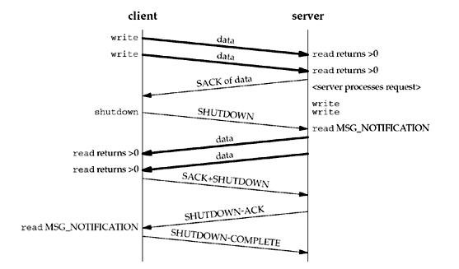
shutdown
SCTP's design does not provide a half-closed state,
  shutdown call is done differently than a TCP endpoint.
<number>/24

Slide 21
Notifications
The SCTP user can track the state of its association(s) via these notifications.
Notifications communicate transport-level events, including network status change, association startups, remote operational errors, ,,
  example of using notifications in Section 23.7.
8 events can be subscribed to using the SCTP_EVENTS socket option.
  7 events generate additional data—termed a notification—that a user will receive via the normal socket descriptor
  When reading from a socket with notification subscriptions, user data and notifications will be interleaved on the socket buffer
  To differentiate between peer data and a notification, the user uses either the recvmsg function or the sctp_recvmsg function.
  When the data returned is an event notification, the msg_flags field will contain the MSG_NOTIFICATION flag.
  This flag tells the application that the message just read is not data from the peer, but a notification from the local SCTP stack
<number>/24

Slide 22
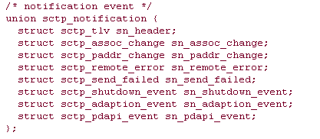
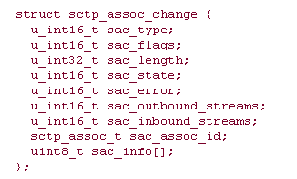
Notifications
<number>/24

Slide 23
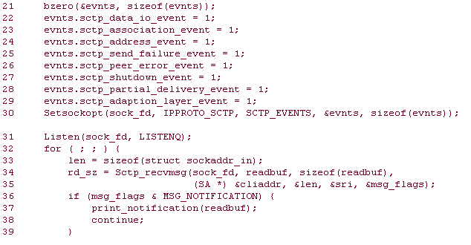
Notifications
How to subscribe the event notifications
  See Section 23.4 (Figure 23.4 & 23.5)
<number>/24

Slide 24
Summary
SCTP provides two different interface styles
  one-to-one style
    compatible with existing TCP applications
    to ease migration to SCTP
  one-to-many style
    allowing access to all of SCTP's features.
The sctp_peeloff function provides a method of extracting an association from one style to the other.
SCTP also provides numerous notifications of transport events to which an application may wish to subscribe.
  These events can aid an application in better managing the associations it maintains.
Since SCTP is multihomed
  sctp_bindx, sctp_connectx, sctp_getladdrs, sctp_getpaddrs
Utility functions such as sctp_sendmsg and sctp_recvmsg
more detailed examples: Chapters 10 and 23
<number>/24

