Slide 1

Chapter 16
Stream
Control
Transmission
Protocol
(SCTP)
TCP/IP Protocol Suite

Slide 2
Chapter
Outline
16.1 Introduction
16.2 SCTP Services
16.3 STCP Features
16.4 Packet Format
16.5 An SCTP Association
16.6 State Transition Diagram
16.7 Flow Control
16.8 Error Control
16.9 Congestion Control
TCP/IP Protocol Suite

Slide 3
16-1 INTRODUCTION
Stream Control Transmission Protocol (SCTP) is a new reliable, message-oriented transport-layer protocol. Figure 16.1 shows the relationship of SCTP to the other protocols in the Internet protocol suite. SCTP lies between the application layer and the network layer and serves as the intermediary between the application programs and the network operations.
TCP/IP Protocol Suite

Slide 4
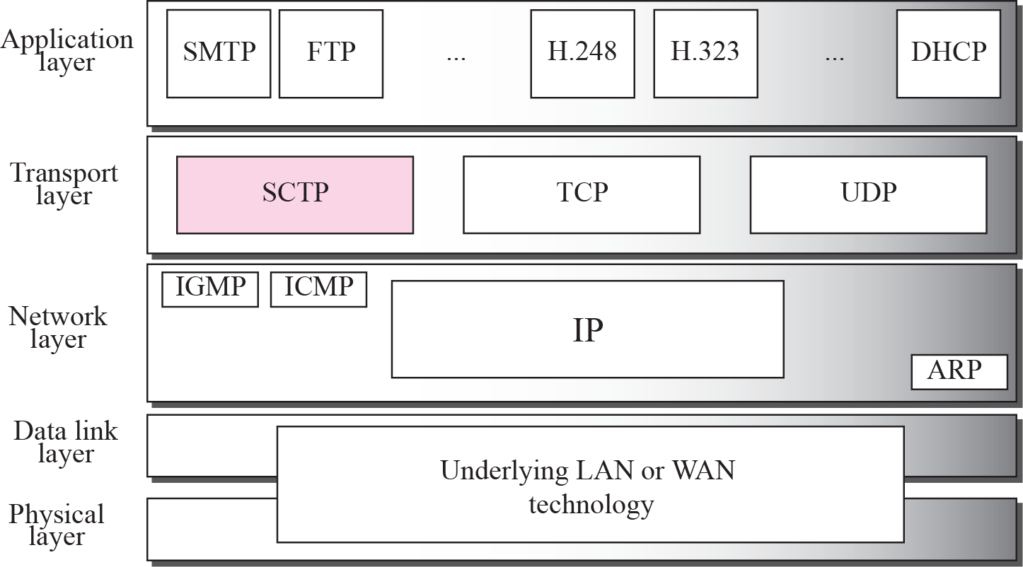
Figure 16.1 TCP/IP Protocol suite
TCP/IP Protocol Suite

Slide 5

Note
SCTP is a message-oriented,
reliable protocol that combines the
best features of UDP and TCP.
TCP/IP Protocol Suite

Slide 6
16-2 SCTP SERVICES
Before discussing the operation of SCTP, let us explain the services offered by SCTP to the application layer processes.
TCP/IP Protocol Suite

Slide 7
Topics Discussed in the Section
Process-to-Process Communication
Multiple Streams
Multihoming
Full-Duplex Communication
Connection-Oriented Service
Reliable Service
TCP/IP Protocol Suite

Slide 8
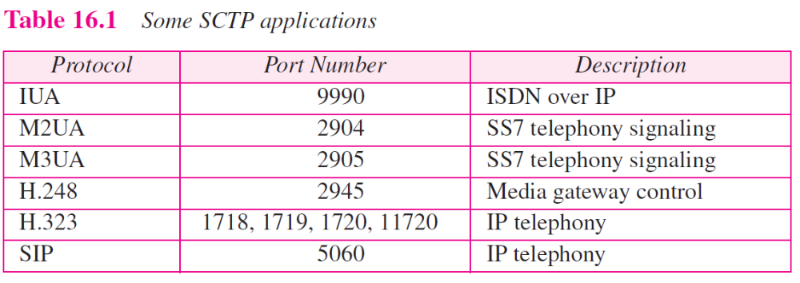
TCP/IP Protocol Suite

Slide 9
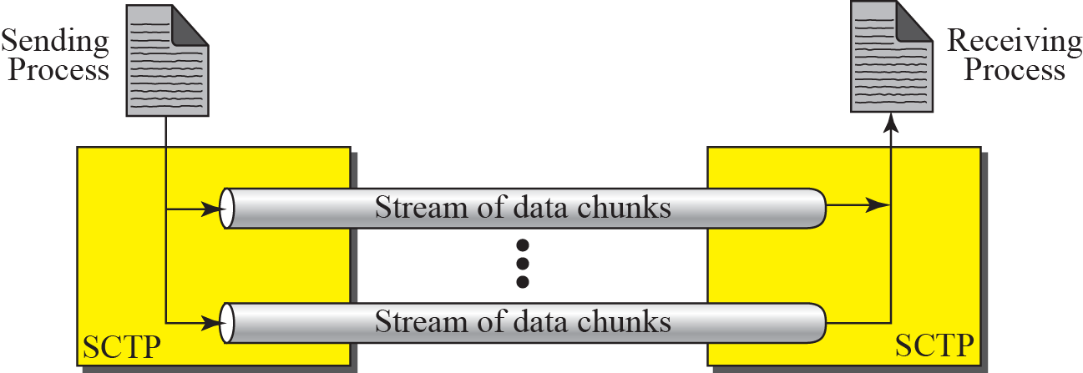
Figure 16.2 Multiple-stream concept
TCP/IP Protocol Suite

Slide 10
Note
An association in SCTP can involve multiple streams.
TCP/IP Protocol Suite

Slide 11
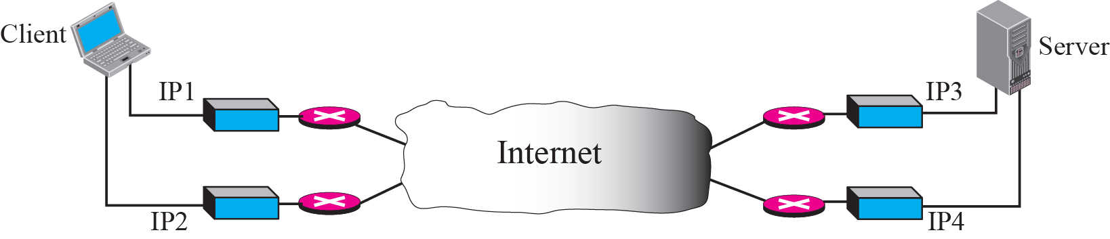
Figure 16.3 Multihoming concept
TCP/IP Protocol Suite

Slide 12
Note
SCTP association allows multiple IP addresses for each end.
TCP/IP Protocol Suite

Slide 13
16-3 SCTP FEATURES
Let us first discuss the general features of SCTP and then compare them with those of TCP.
TCP/IP Protocol Suite

Slide 14
Topics Discussed in the Section
Transmission Sequence Number (TSN)
Stream Identifier (SI)
Stream Sequence Number (SSN)
Packets
Acknowledgment Number
Flow Control
Error Control
Congestion Control
TCP/IP Protocol Suite

Slide 15
Note
In SCTP, a data chunk is numbered using a TSN.
TCP/IP Protocol Suite

Slide 16
Note
To distinguish between different streams, SCTP uses an SI.
TCP/IP Protocol Suite

Slide 17
Note
To distinguish between different data chunks belonging to the same stream,
SCTP uses SSNs.
TCP/IP Protocol Suite

Slide 18
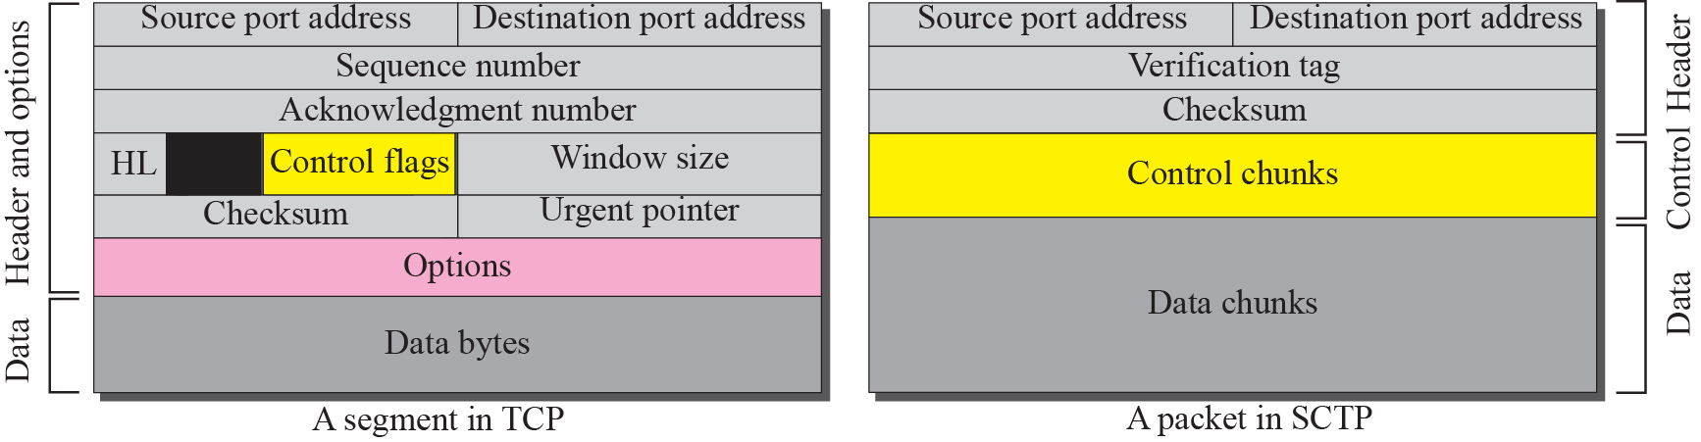
Figure 16.4 Comparison between a TCP segment and an SCTP packet
TCP/IP Protocol Suite

Slide 19
Note
TCP has segments; SCTP has packets.
TCP/IP Protocol Suite

Slide 20
Note
In SCTP, control information and data information are carried in separate chunks.
TCP/IP Protocol Suite

Slide 21
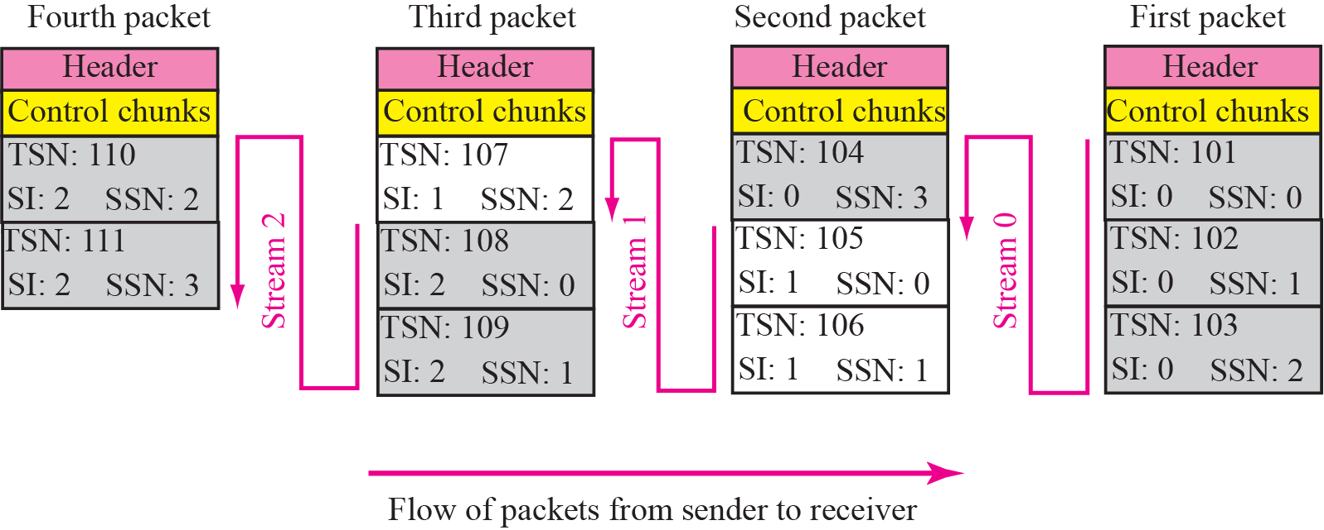
Figure 16.5 Packet, data chunks, and streams
TCP/IP Protocol Suite

Slide 22
Note
Data chunks are identified by three identifiers: TSN, SI, and SSN.
TSN is a cumulative number identifying the association; SI defines the stream;
SSN defines the chunk in a stream.
TCP/IP Protocol Suite

Slide 23
Note
In SCTP, acknowledgment numbers are used to acknowledge only data chunks;
control chunks are acknowledged by other control chunks if necessary.
TCP/IP Protocol Suite

Slide 24
16-4 PACKET FORMAT
In this section, we show the format of a packet and different types of chunks. Most of the information presented in this section will become clear later; this section can be skipped in the first reading or used only as the reference. An SCTP packet has a mandatory general header and a set of blocks called chunks. There are two types of chunks: control chunks and data chunks.
TCP/IP Protocol Suite

Slide 25
Topics Discussed in the Section
General Header
Chunks
TCP/IP Protocol Suite

Slide 26
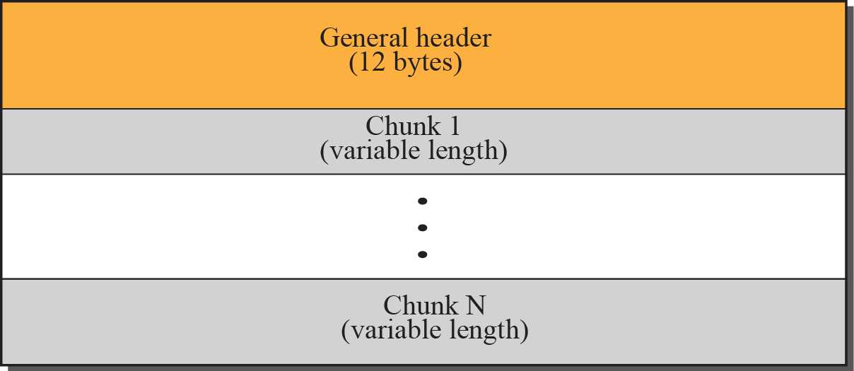
Figure 16.6 SCTP packet format
TCP/IP Protocol Suite

Slide 27
Note
In an SCTP packet, control chunks come before data chunks.
TCP/IP Protocol Suite

Slide 28
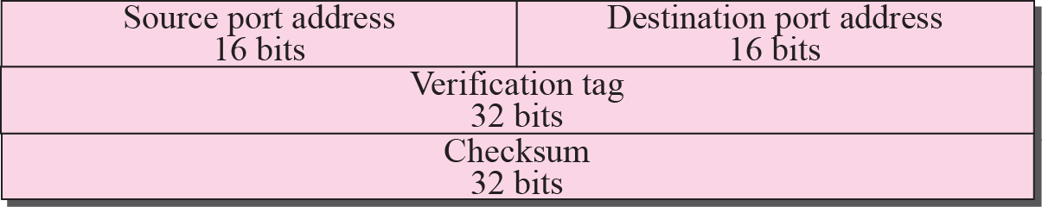
Figure 16.7 Common layout of a chunk
TCP/IP Protocol Suite

Slide 29
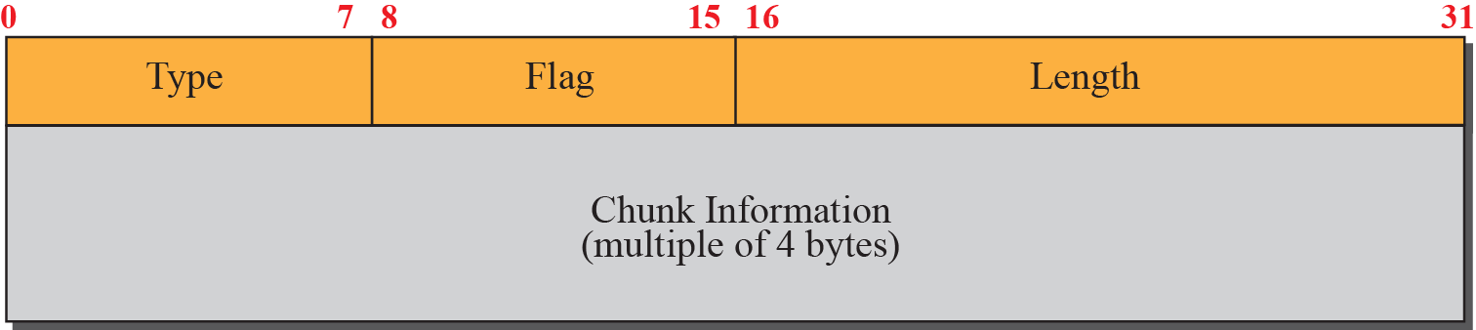
Figure 16.8 Multiple-stream concept
TCP/IP Protocol Suite

Slide 30
Note
Chunks need to terminate on a 32-bit
(4-byte) boundary.
TCP/IP Protocol Suite

Slide 31
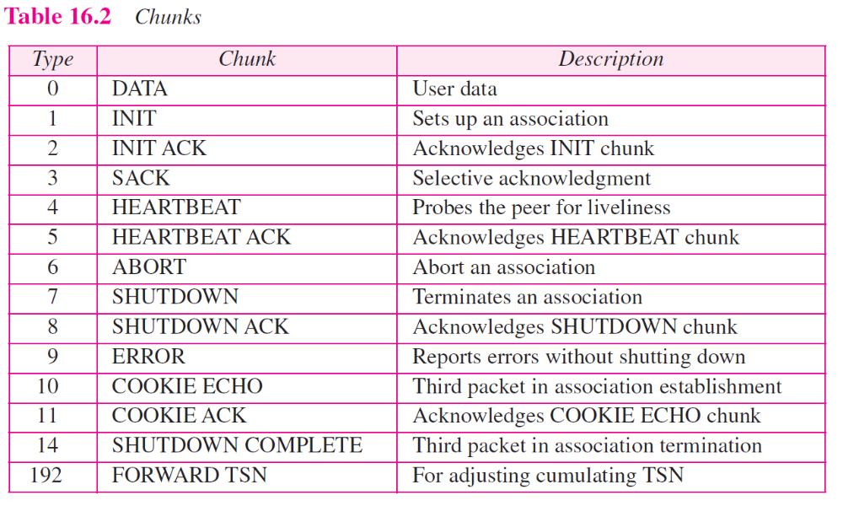
TCP/IP Protocol Suite

Slide 32
Note
The number of padding bytes is not included in the value of the length field.
TCP/IP Protocol Suite

Slide 33
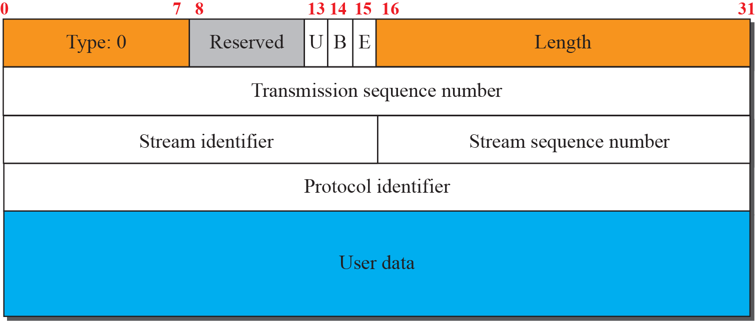
Figure 16.9 Data chunk
TCP/IP Protocol Suite

Slide 34
Note
A DATA chunk cannot carry data belonging to more than one message, but a message can be split into several chunks. The data field of the DATA chunk must carry at least one byte of data, which means the value of length field cannot be less than 17.
TCP/IP Protocol Suite

Slide 35
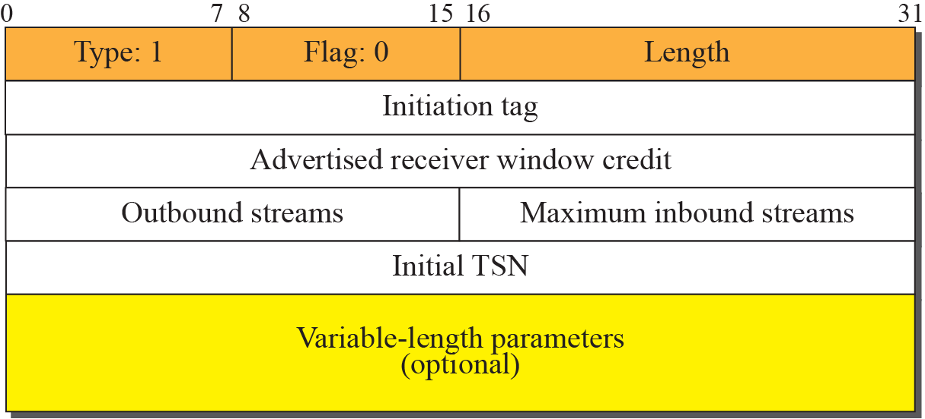
Figure 16.10 INIT chunk
TCP/IP Protocol Suite

Slide 36
Note
No other chunk can be carried in a packet that carries an INIT chunk.
TCP/IP Protocol Suite

Slide 37
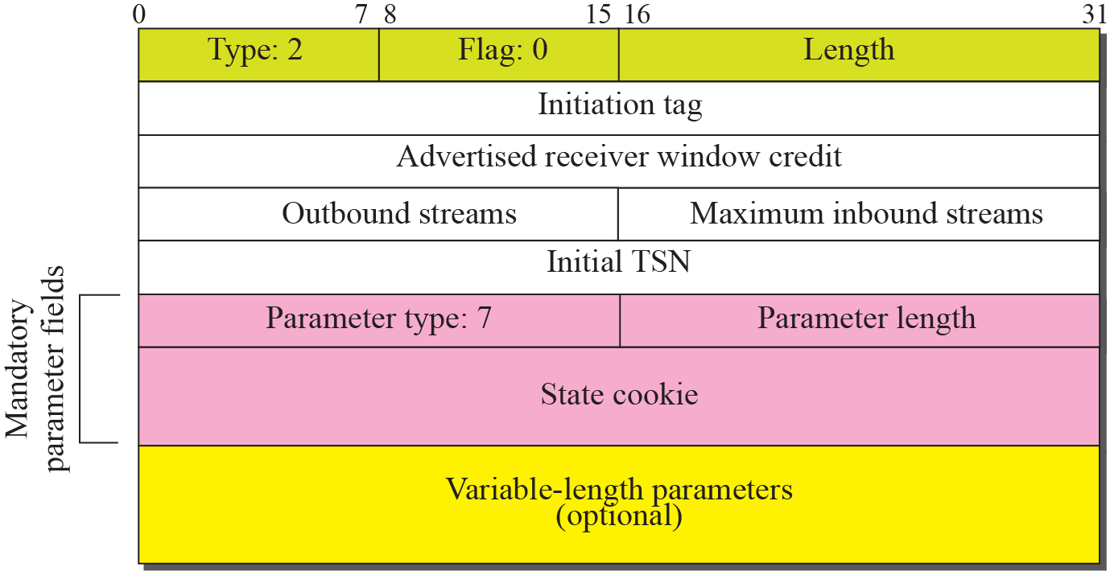
Figure 16.11 INIT ACK chunk
TCP/IP Protocol Suite

Slide 38
Note
No other chunk can be carried in a packet that carries an INIT ACK chunk.
TCP/IP Protocol Suite

Slide 39
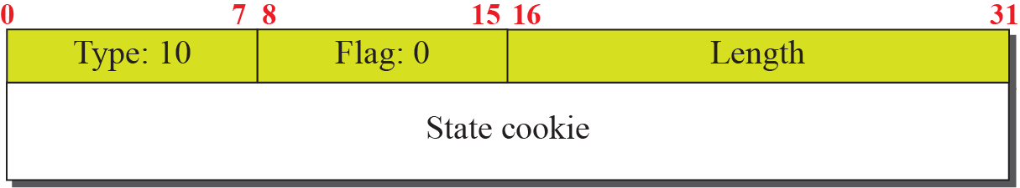
Figure 16.12 COOKIE ECHO chunk
TCP/IP Protocol Suite

Slide 40
Figure 16.13 COOKIE ACK
TCP/IP Protocol Suite

Slide 41
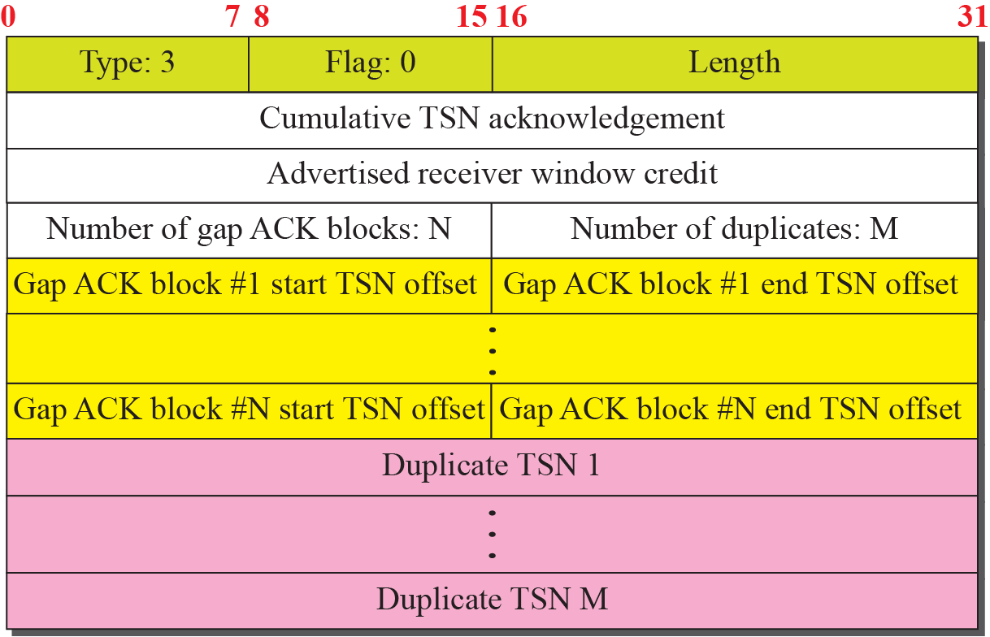
Figure 16.14 SACK chunk
TCP/IP Protocol Suite

Slide 42
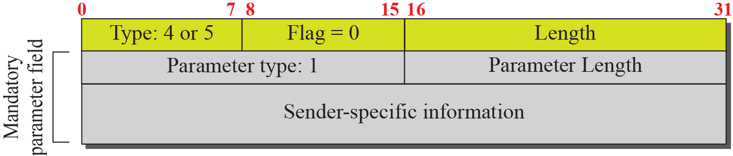
Figure 16.15 HEARTBEAT and HEARTBEAT ACK chunk
TCP/IP Protocol Suite

Slide 43
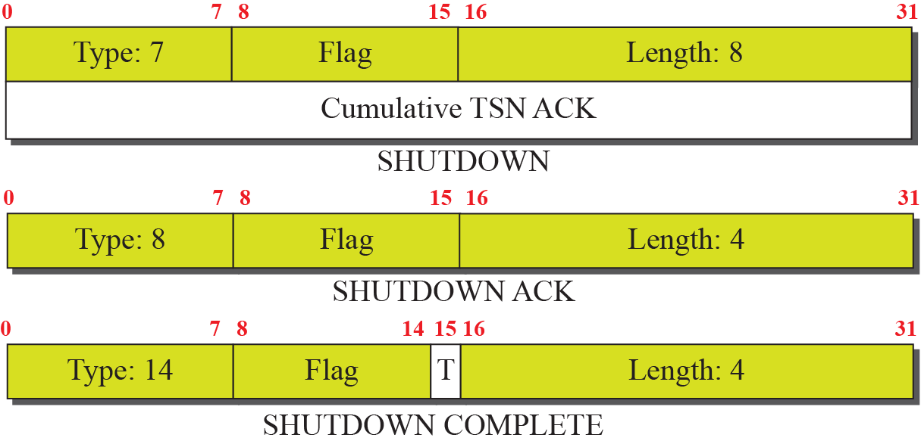
Figure 16.16 SHUTDOWN chunks
TCP/IP Protocol Suite

Slide 44
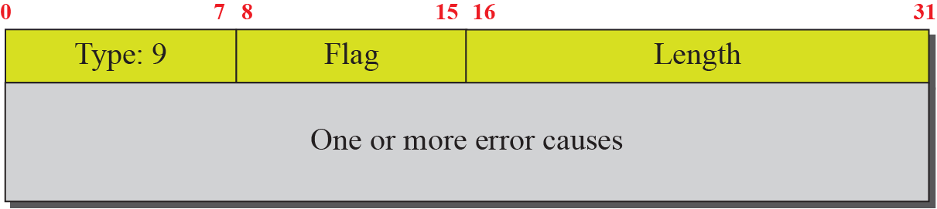
Figure 16.17 ERROR chunk
TCP/IP Protocol Suite

Slide 45
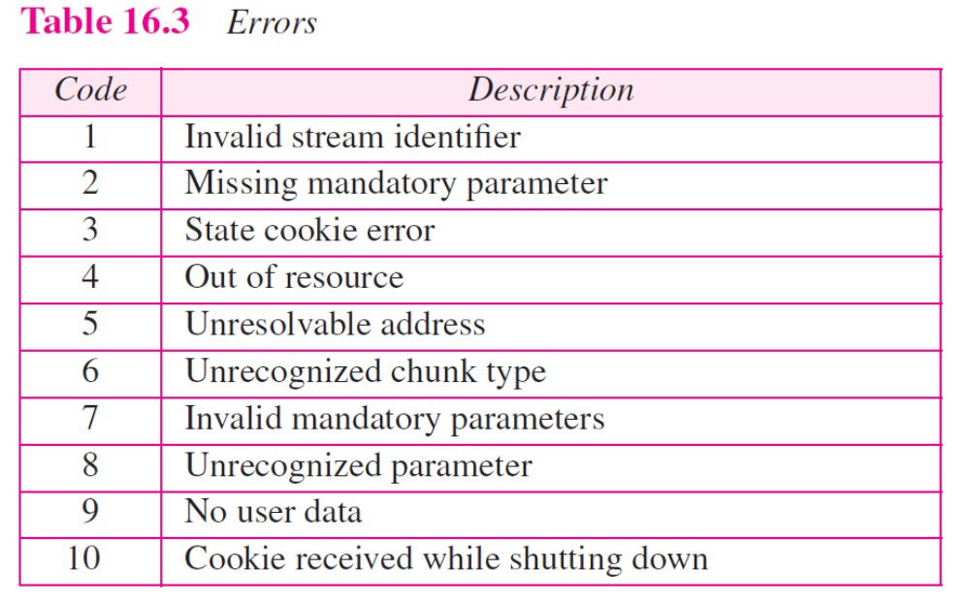
TCP/IP Protocol Suite

Slide 46
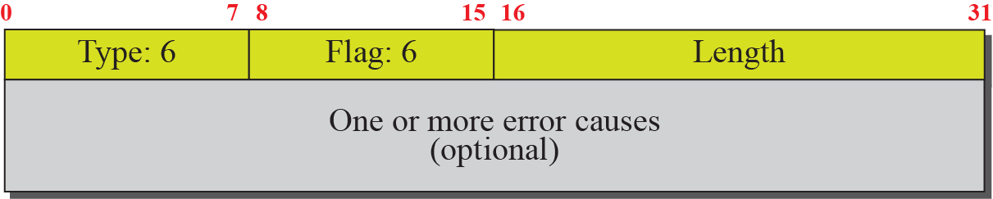
Figure 16.18 ABORT chunk
TCP/IP Protocol Suite

Slide 47
16-5 AN SCTP ASSOCIATION
SCTP, like TCP, is a connection-oriented protocol. However, a connection in SCTP is called an association to emphasize multihoming.
TCP/IP Protocol Suite

Slide 48
Topics Discussed in the Section
Association Establishment
Data Transfer
Association Termination
Association Abortion
TCP/IP Protocol Suite

Slide 49
Note
A connection in SCTP is called an association.
TCP/IP Protocol Suite

Slide 50
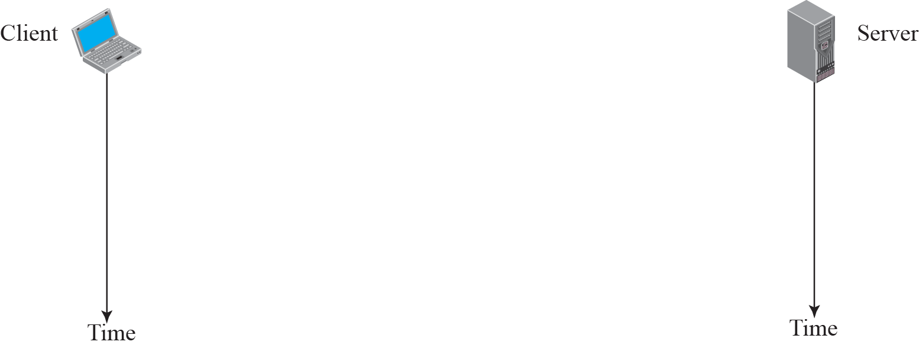
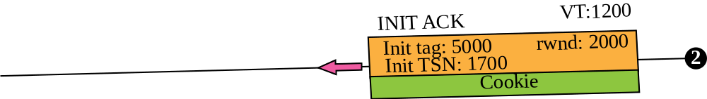
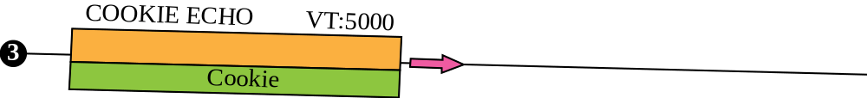
Figure 16.19 Four-way handshaking
TCP/IP Protocol Suite

Slide 51
Note
No other chunk is allowed in a packet carrying an INIT or INIT ACK chunk.
A COOKIE ECHO or a COOKIE ACK chunk can carry data chunks.
TCP/IP Protocol Suite

Slide 52
Note
In SCTP, only data chunks consume TSNs; data chunks are the only chunks that are acknowledged.
TCP/IP Protocol Suite

Slide 53
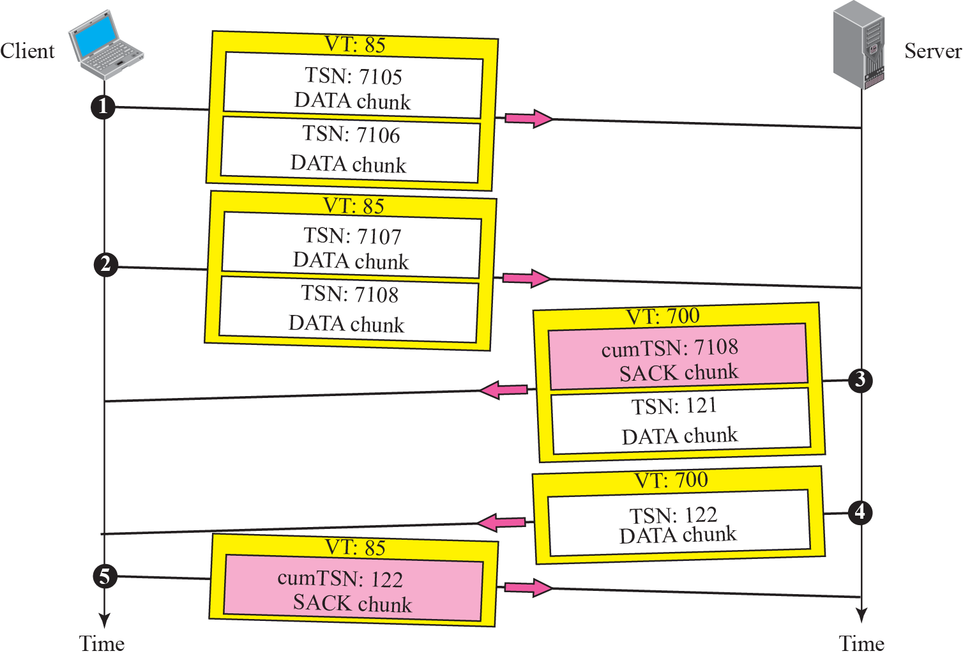
Figure 16.20 Simple data transfer
TCP/IP Protocol Suite

Slide 54
Note
The acknowledgment in SCTP defines the cumulative TSN, the TSN of the last data chunk received in order.
TCP/IP Protocol Suite

Slide 55
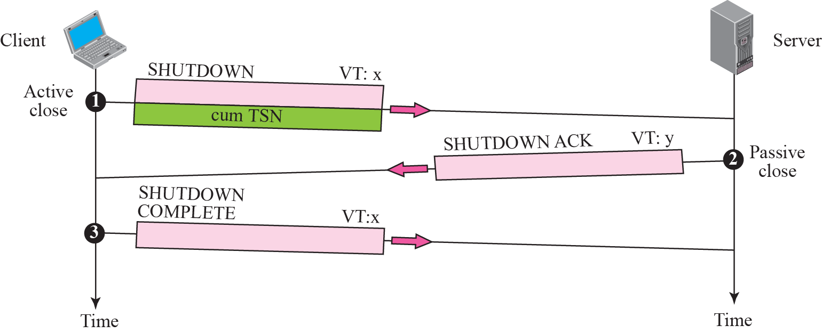
Figure 16.21 Association termination
TCP/IP Protocol Suite

Slide 56
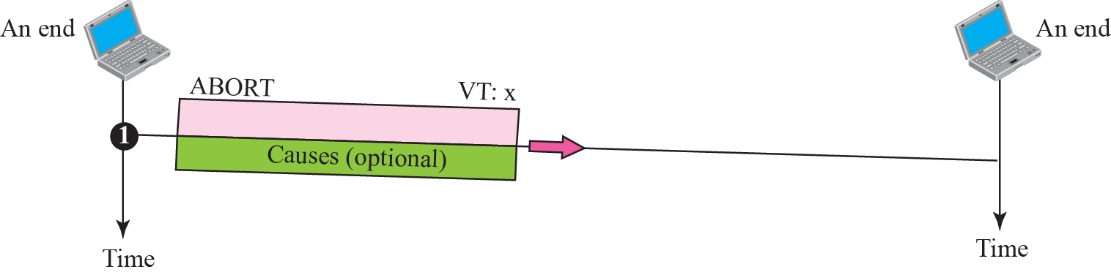
Figure 16.22 Association abortion
TCP/IP Protocol Suite

Slide 57
16-6 STATE TRANSITION DIAGRAM
To keep track of all the different events happening during association establishment, association termination, and data transfer, the SCTP software, like TCP, is implemented as a finite state machine. Figure 16.23 shows the state transition diagram for both client and server.
TCP/IP Protocol Suite

Slide 58
Topics Discussed in the Section
Scenarios
TCP/IP Protocol Suite

Slide 59
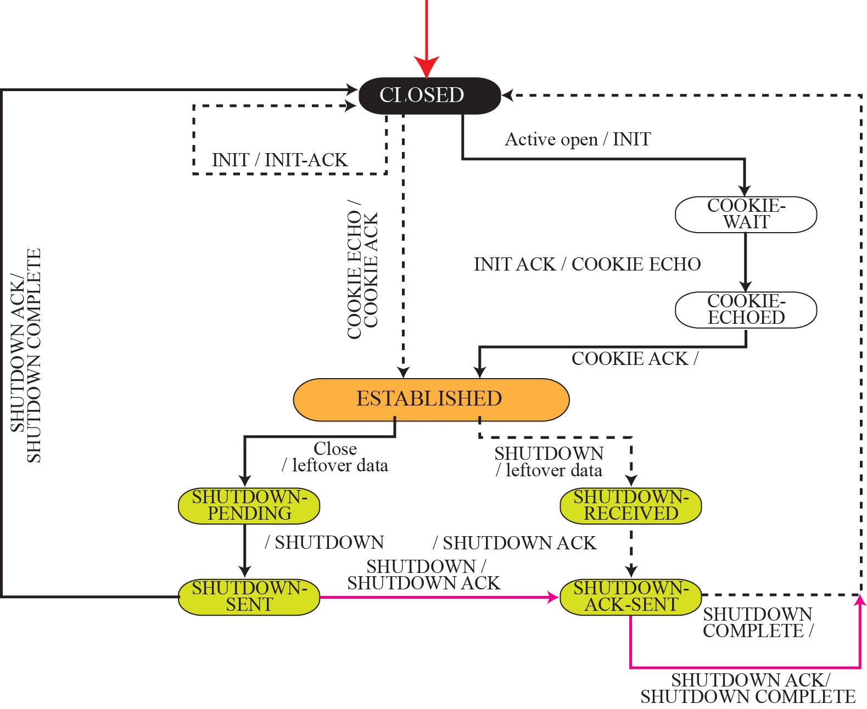
Figure 16.23 State transition diagram
TCP/IP Protocol Suite

Slide 60
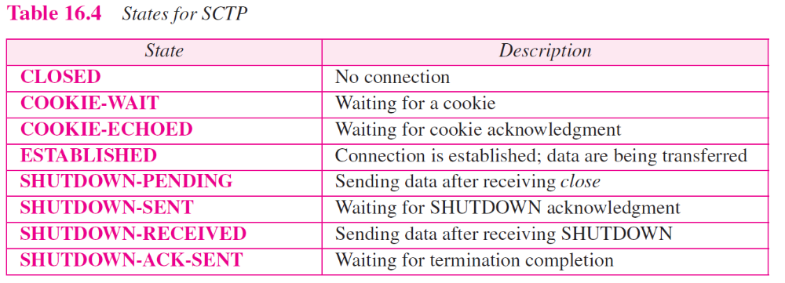
TCP/IP Protocol Suite

Slide 61
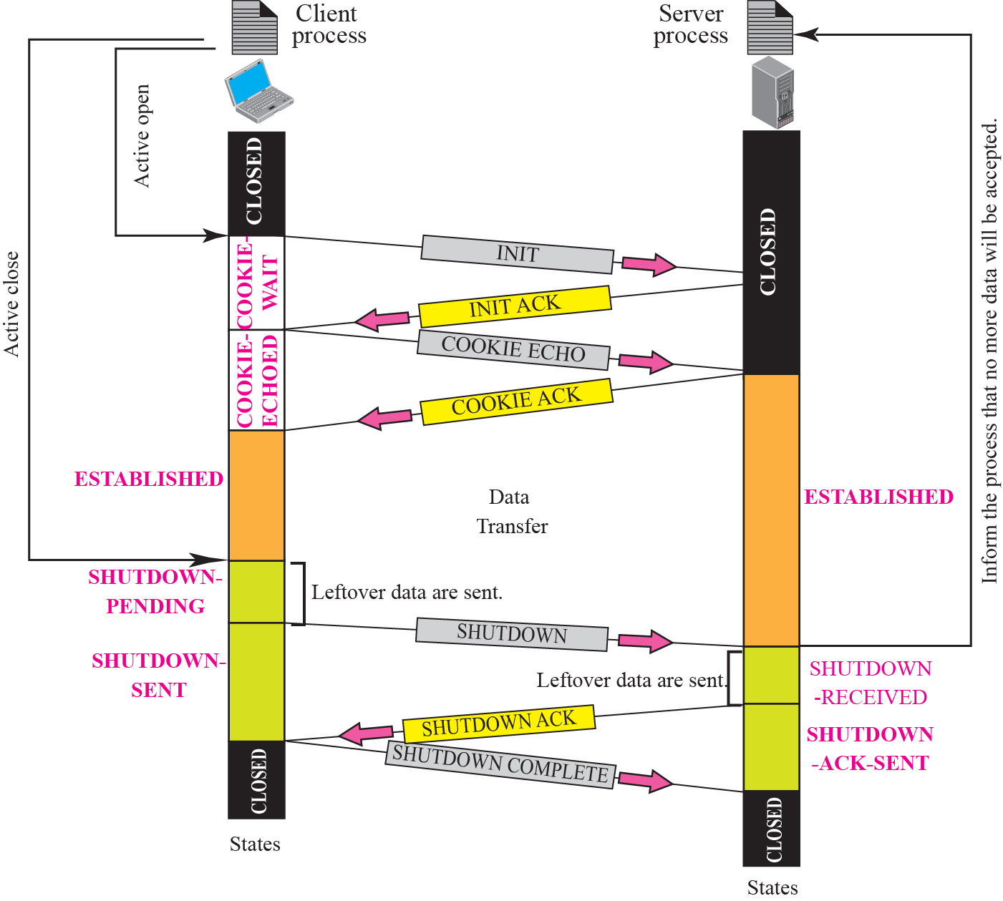
Figure 16.24 A common scenario of state
TCP/IP Protocol Suite

Slide 62
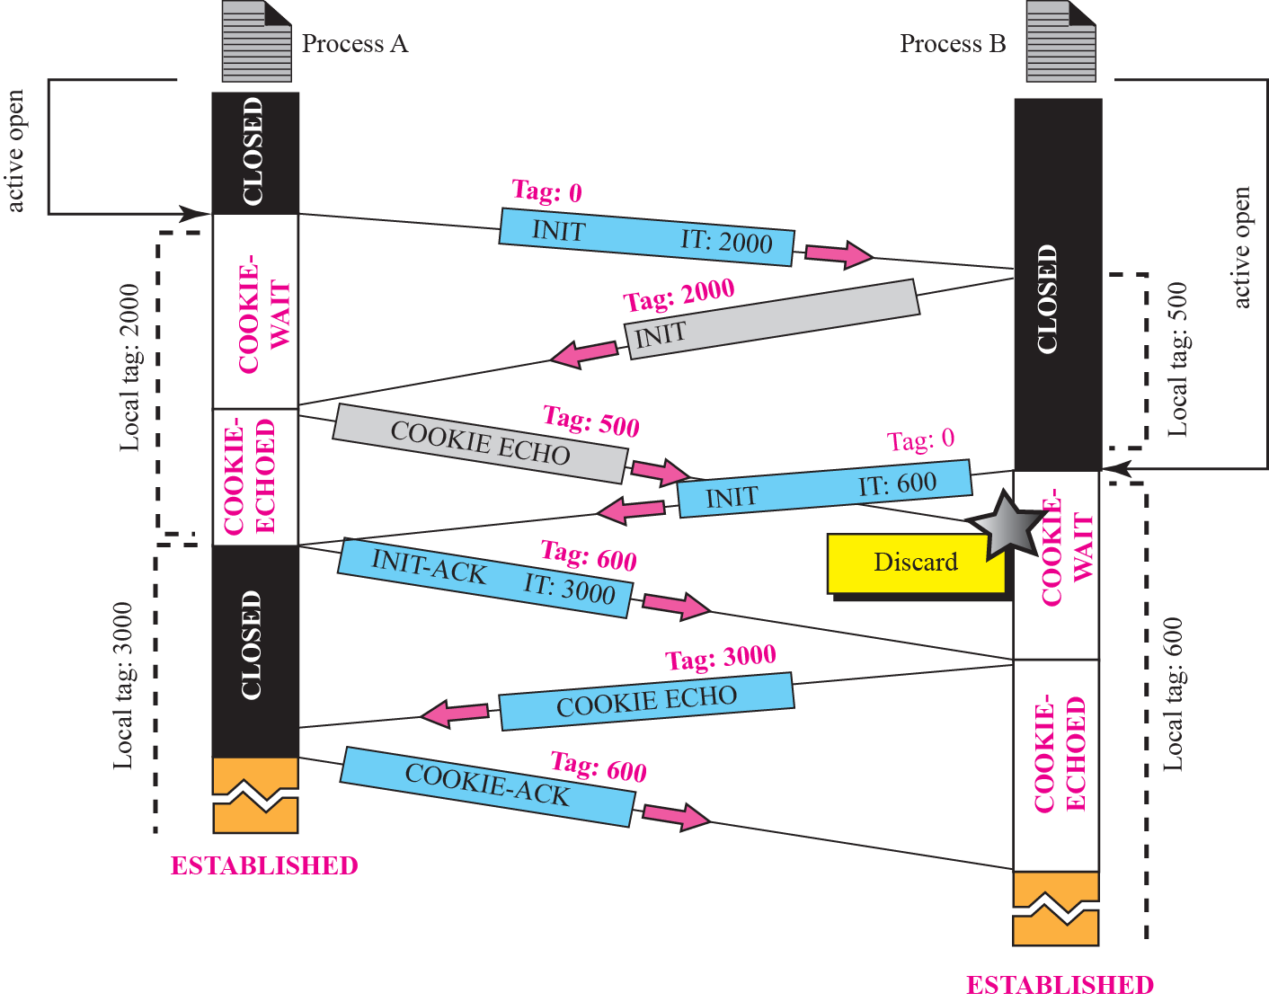
Figure 16.25 Simultaneous open
TCP/IP Protocol Suite

Slide 63
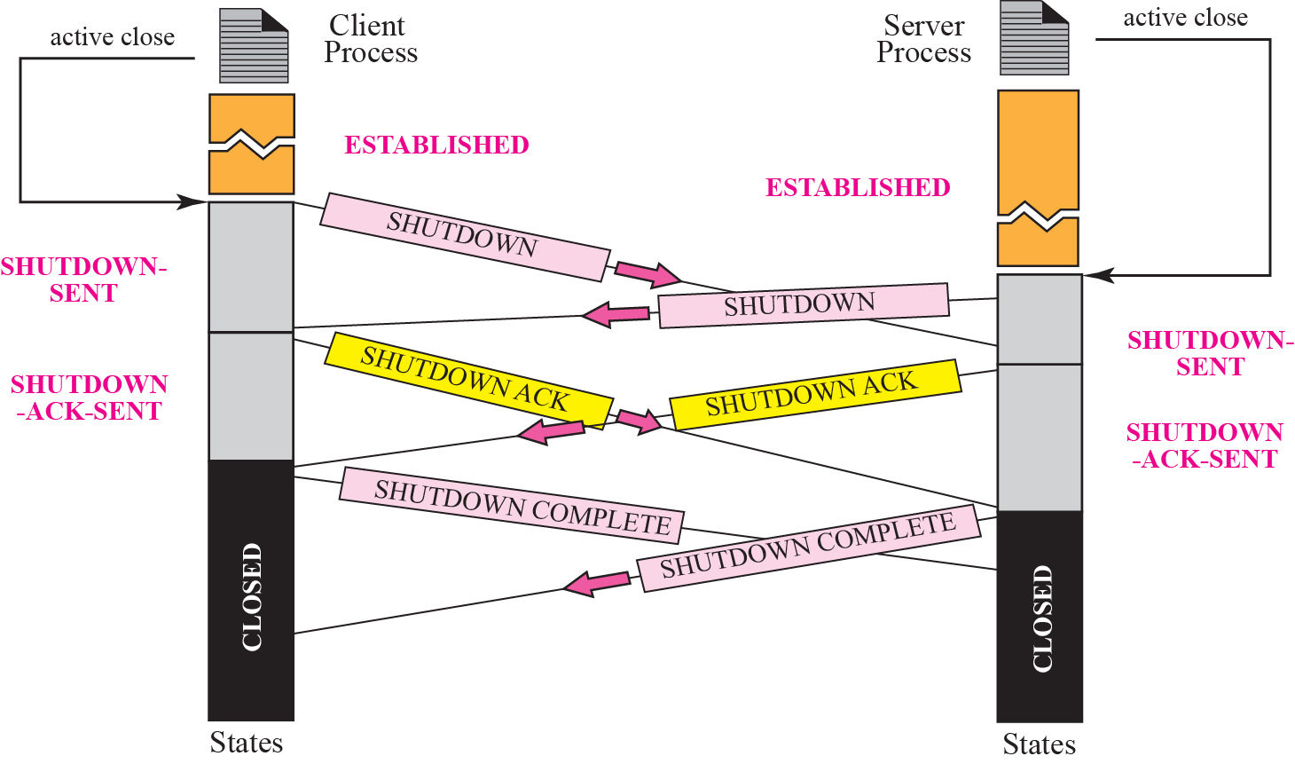
Figure 16.26 Simultaneous close
TCP/IP Protocol Suite

Slide 64
16-7 FLOW CONTROL
Flow control in SCTP is similar to that in TCP. In TCP, we need to deal with only one unit of data, the byte. In SCTP, we need to handle two units of data, the byte and the chunk. The values of rwnd and cwnd are expressed in bytes; the values of TSN and acknowledgments are expressed in chunks.
TCP/IP Protocol Suite

Slide 65
Topics Discussed in the Section
Receiver Site
Sender Site
A Scenario
TCP/IP Protocol Suite

Slide 66
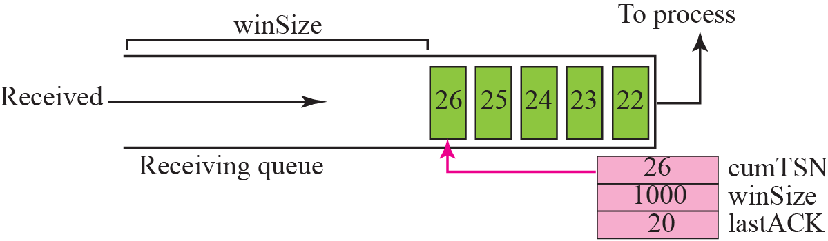
Figure 16.27 Flow control, receiver site
TCP/IP Protocol Suite

Slide 67
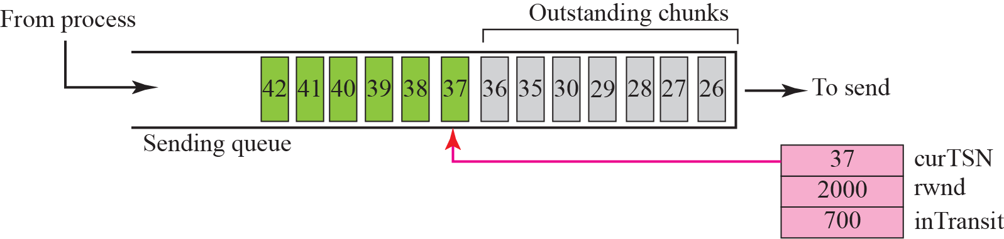
Figure 16.28 Flow control, sender site
TCP/IP Protocol Suite

Slide 68
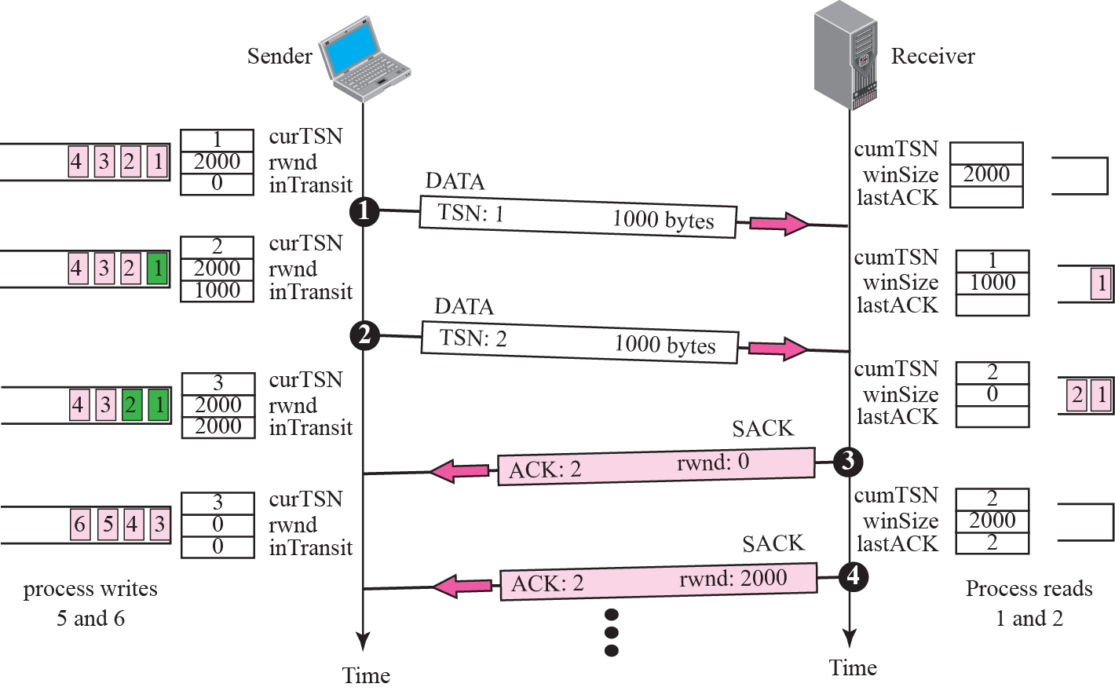
Figure 16.29 Flow control scenario
TCP/IP Protocol Suite

Slide 69
16-8 ERROR CONTROL
SCTP, like TCP, is a reliable transport-layer protocol. It uses a SACK chunk to report the state of the receiver buffer to the sender. Each implementation uses a different set of entities and timers for the receiver and sender sites. We use a very simple design to convey the concept to the reader.
TCP/IP Protocol Suite

Slide 70
Topics Discussed in the Section
Receiver Site
Sender Site
Sending Data Chunks
Generating SANK Chunks
TCP/IP Protocol Suite

Slide 71
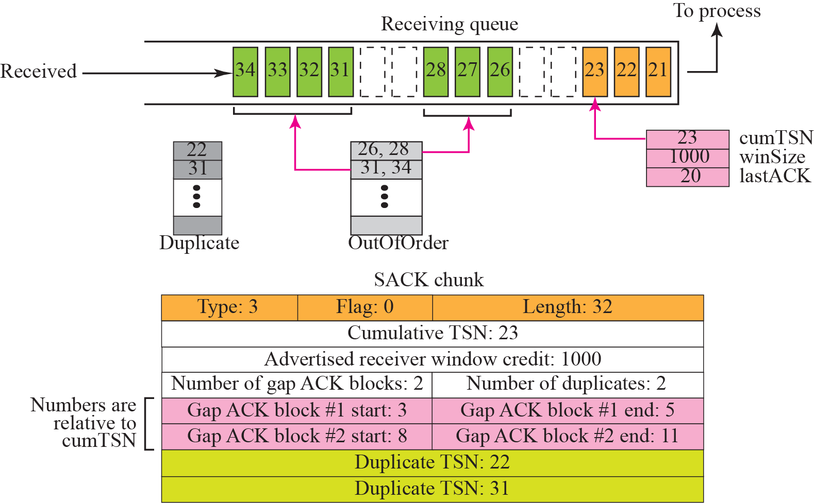
Figure 16.30 Error-control receiver site
TCP/IP Protocol Suite

Slide 72
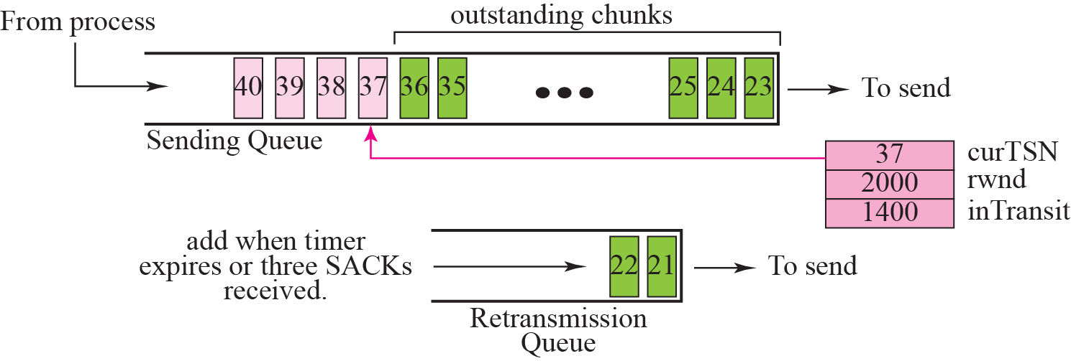
Figure 16.31 Error control, sender site
TCP/IP Protocol Suite

Slide 73
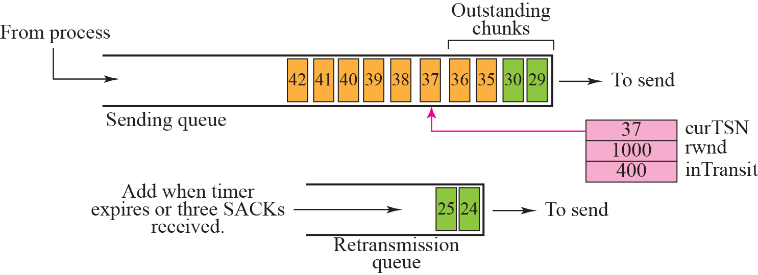
Figure 16.32 New state at the sender site after receiving a SACK chunk
TCP/IP Protocol Suite

Slide 74
16-9 CONGESTION CONTROL
SCTP, like TCP, is a transport layer protocol with packets subject to congestion in the network. The SCTP designers have used the same strategies we described for congestion control in Chapter 15 for TCP. SCTP has slow start, congestion avoidance, and congestion detection phases. Like TCP, SCTP also uses fast retransmission and fast recovery.
TCP/IP Protocol Suite

Slide 75
Topics Discussed in the Section
Congestion Control and Multihoming
Explicit Congestion Notification
TCP/IP Protocol Suite

