Slide 1

Chapter 17
Introduction
to the
Application
Layer
TCP/IP Protocol Suite

Slide 2
17-1 CLIENT-SERVER PARADIGM
The purpose of a network, or an internetwork, is to provide services to users: A user at a local site wants to receive a service from a computer at a remote site. One way to achieve this purpose is to run two programs. A local computer runs a program to request a service from a remote computer; the remote computer runs a program to give service to the requesting program. This means that two computers, connected by an internet, must each run a program, one to provide a service and one to request a service.
TCP/IP Protocol Suite

Slide 3
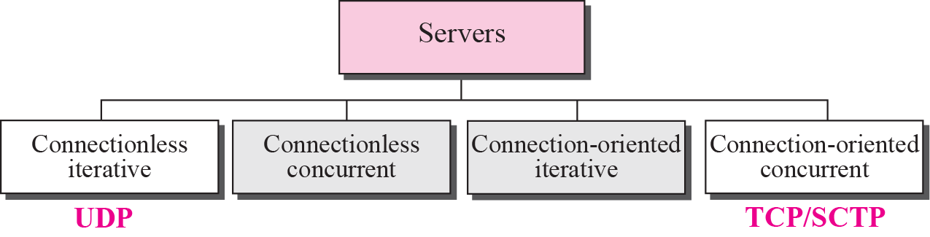
Figure 17.1 Server types
TCP/IP Protocol Suite

Slide 4
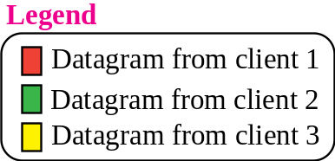
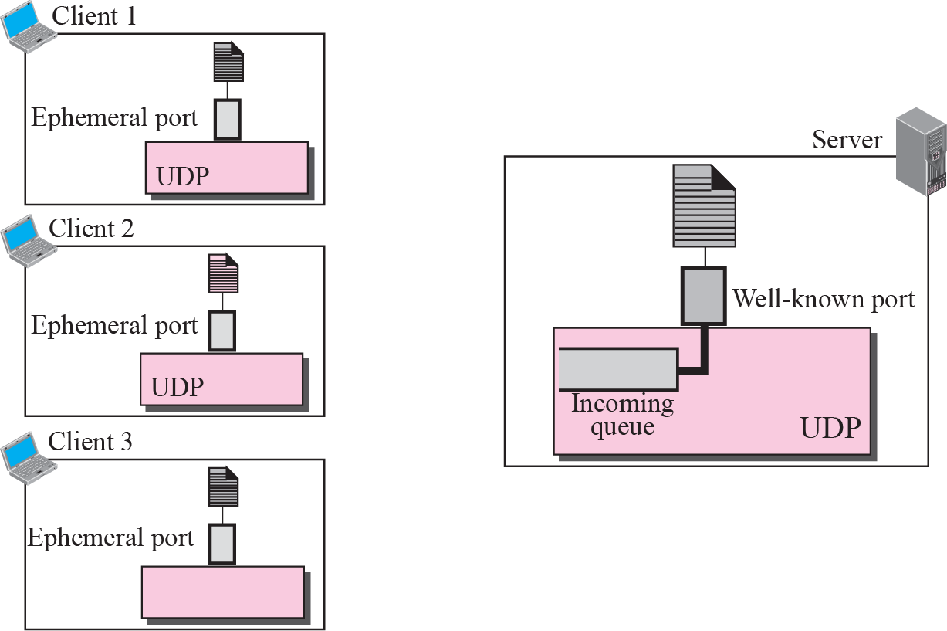

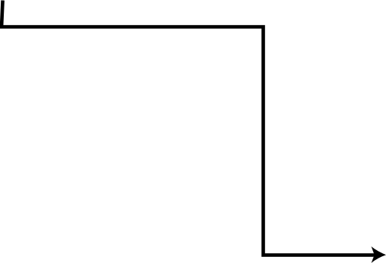

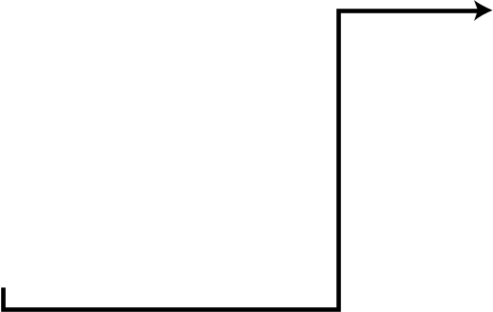
Figure 17.2 Connectionless iterative server
TCP/IP Protocol Suite

Slide 5
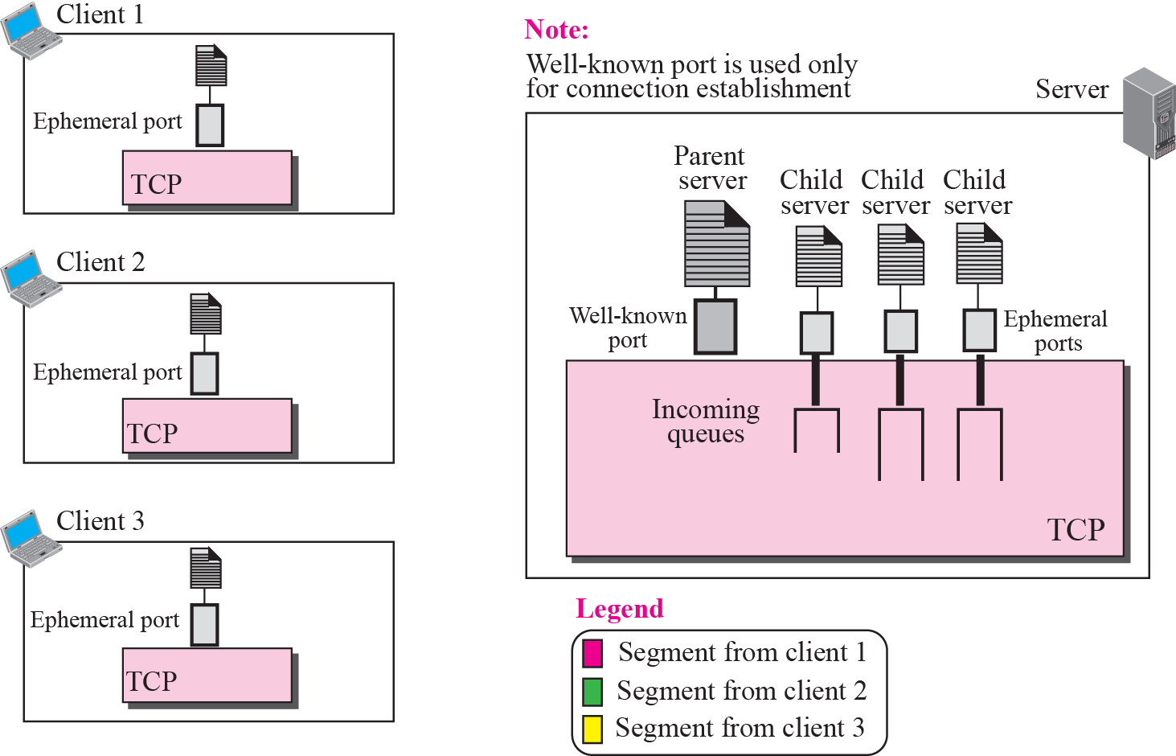
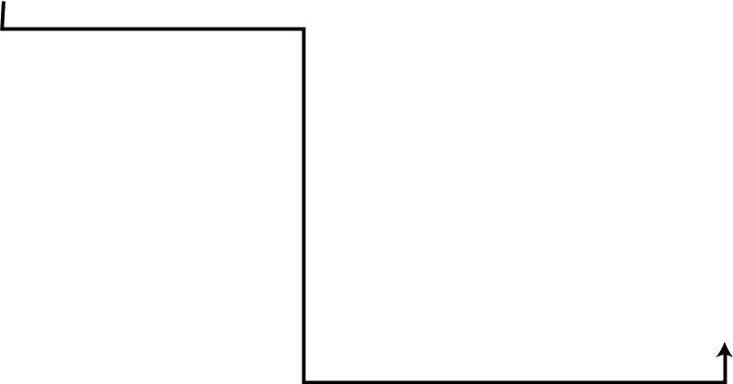

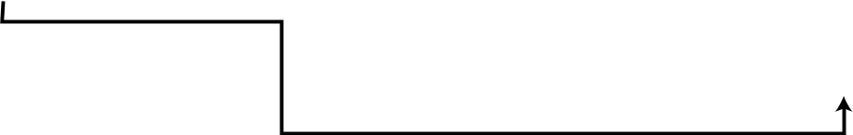

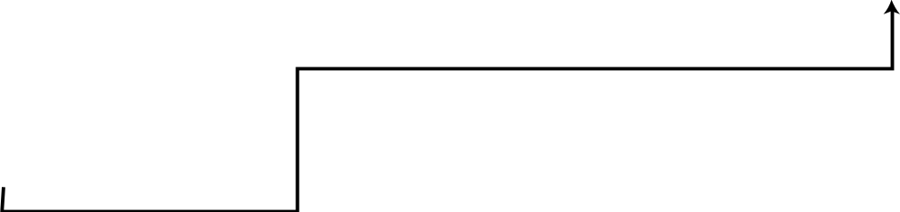
Figure 17.3 Connection-oriented concurrent server
TCP/IP Protocol Suite

Slide 6

Note
An interface is a set of instructions designed for interaction between two entities.
TCP/IP Protocol Suite

Slide 7
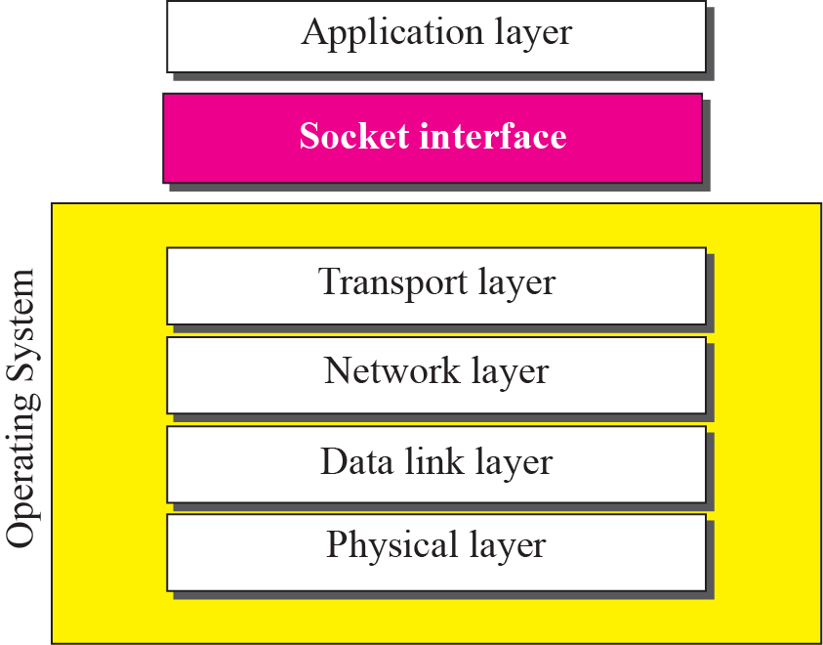
Figure 17.4 Relation between the operating system and the TCP/IP suite
TCP/IP Protocol Suite

Slide 8
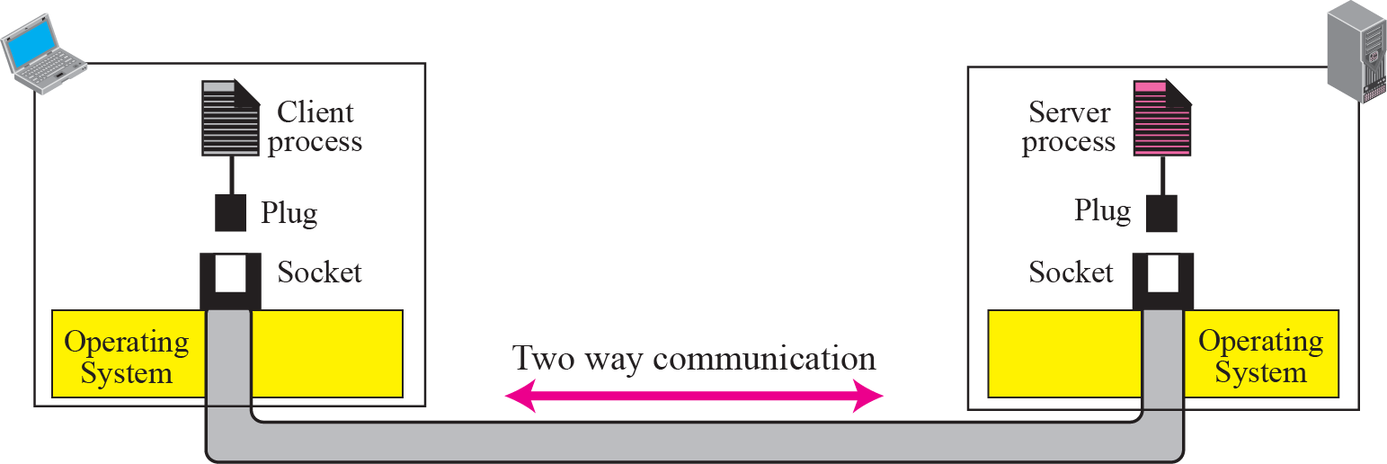
Figure 17.5 Concepts of sockets
TCP/IP Protocol Suite

Slide 9
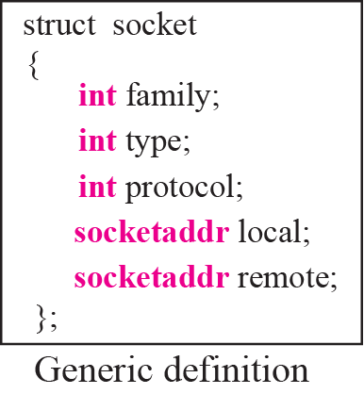
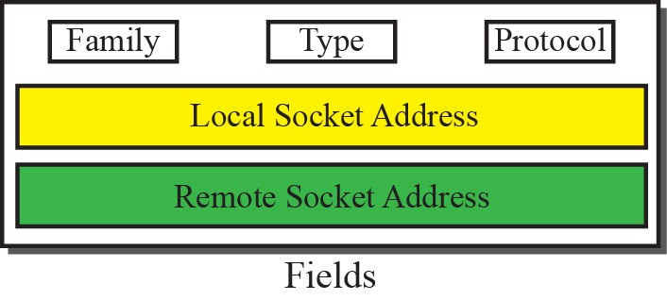
Figure 17.6 Socket data structure
TCP/IP Protocol Suite

Slide 10
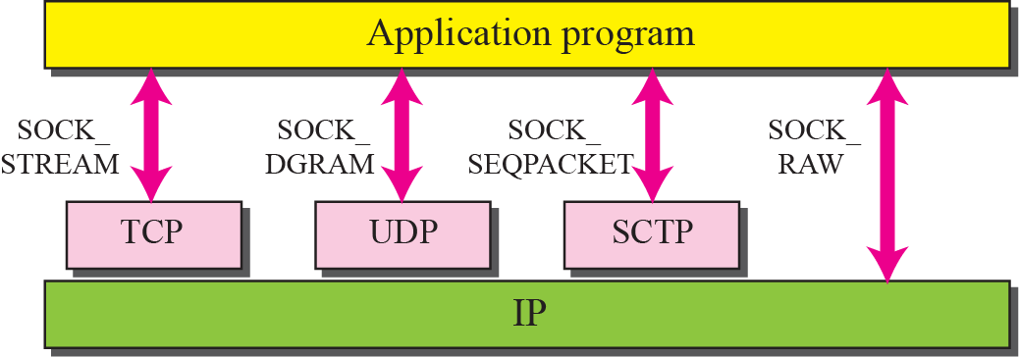
Figure 17.7 Socket types
TCP/IP Protocol Suite

Slide 11
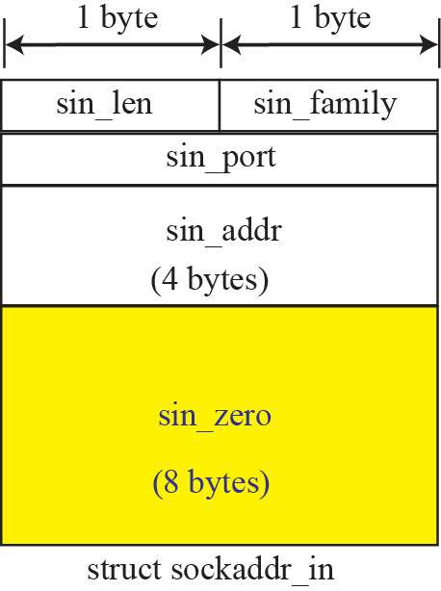
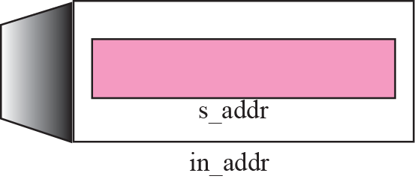
Figure 17.8 IPv4 socket address
TCP/IP Protocol Suite

Slide 12
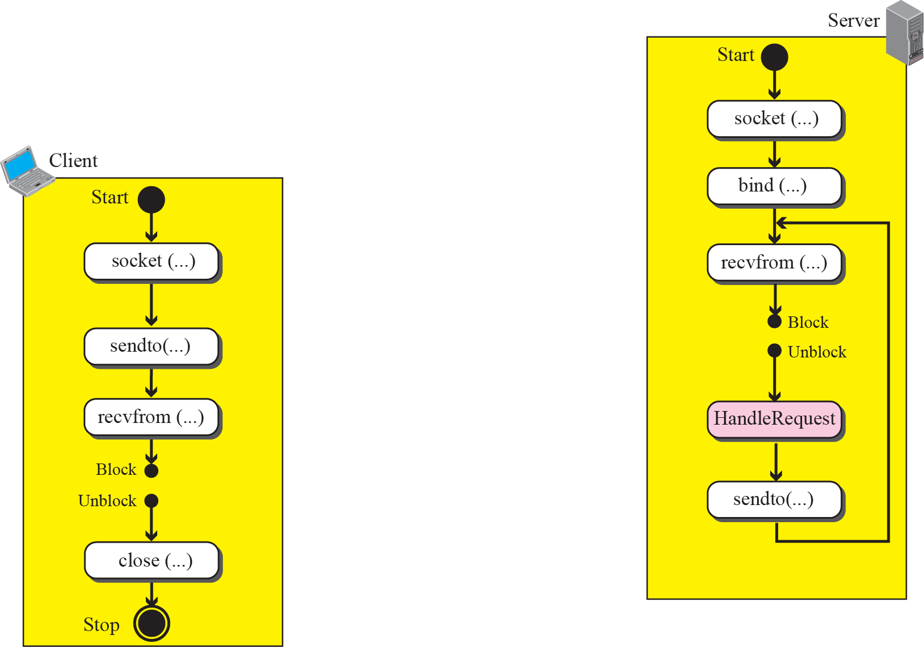
Figure 17.9 Connectionless iterative communication using UDP
TCP/IP Protocol Suite

Slide 13
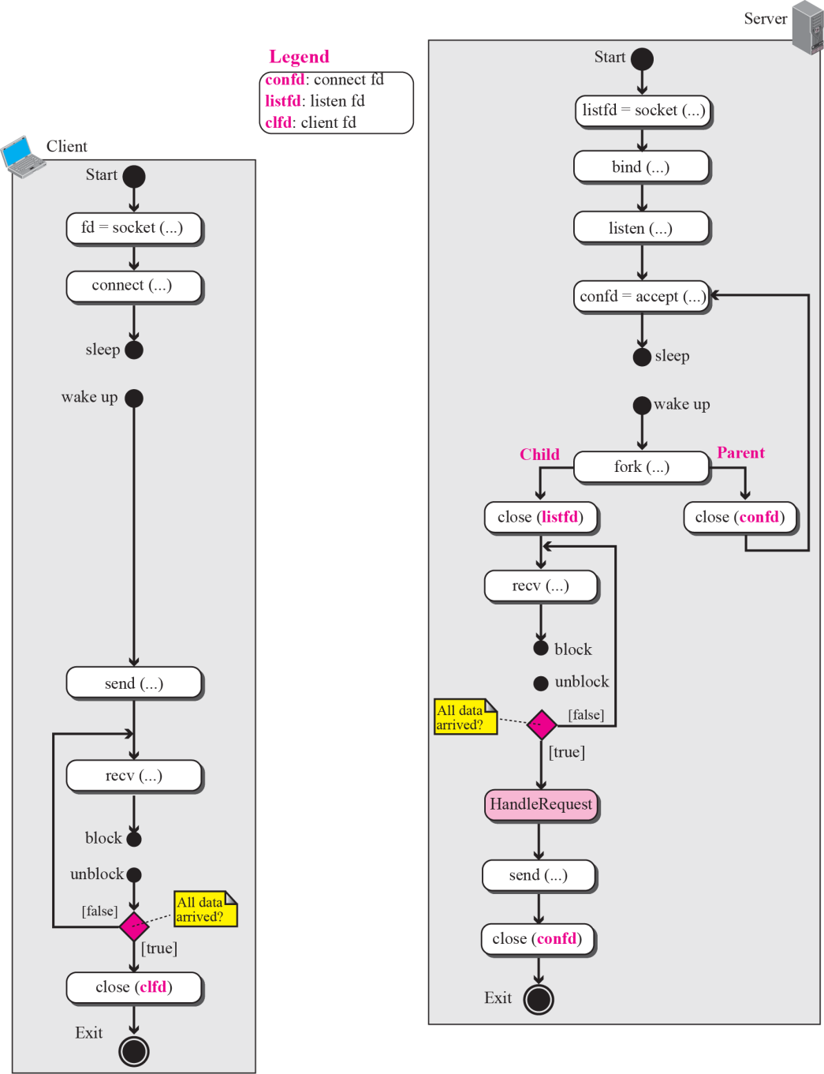



Figure 17.11 Flow diagram for connection-oriented, concurrent communication
TCP/IP Protocol Suite

Slide 14
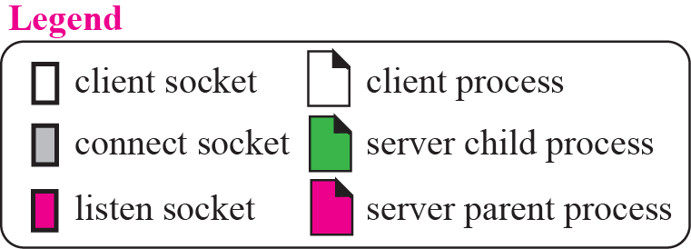
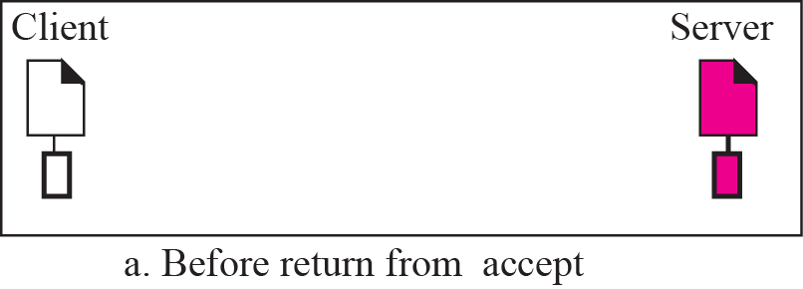
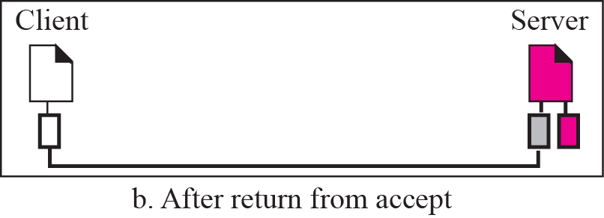
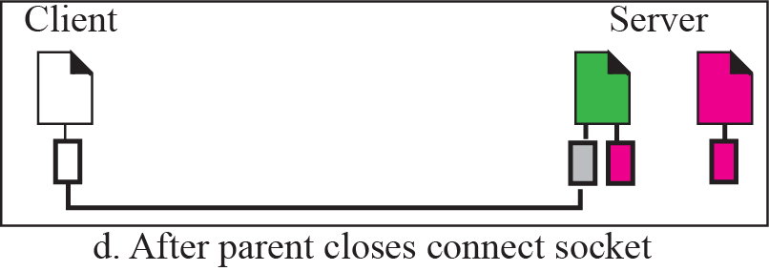
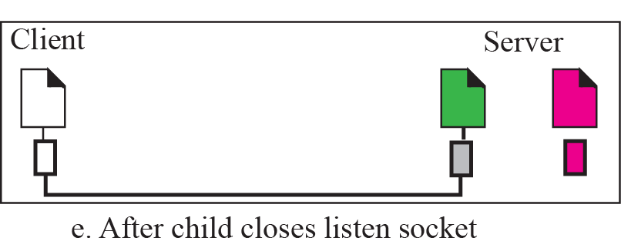
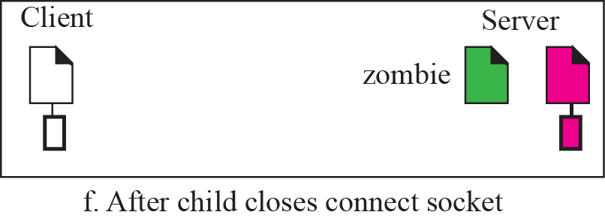
Figure 17.12 Status of parent and child processes with respect to the socket
TCP/IP Protocol Suite

Slide 15
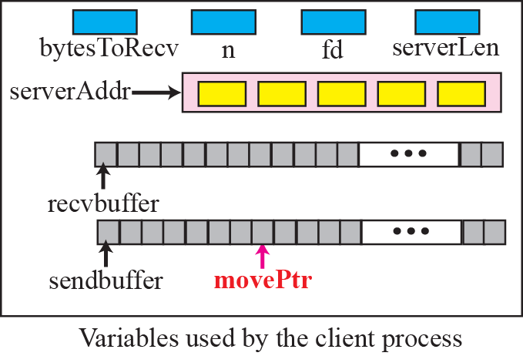
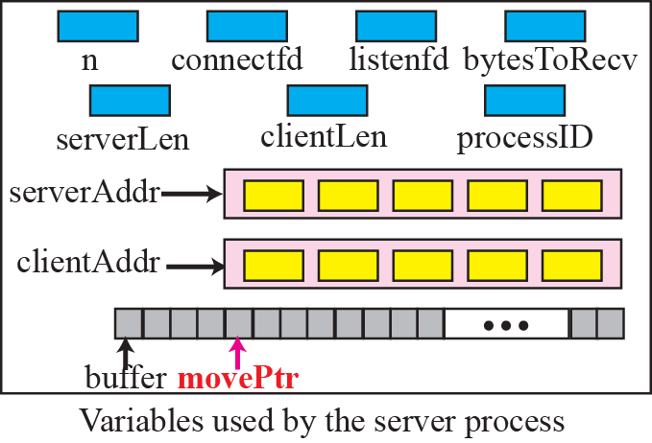
Figure 17.13 Variable used in echo client and echo sever using TCP
TCP/IP Protocol Suite

Slide 16
17-2 PEER-TO-PEER PARADIGM
Although most of the applications available in the Internet today use the client-server paradigm, the idea of using peer-to-peer (P2P) paradigm recently has attracted some attention. In this paradigm, two peer computers can communicate with each other to exchange services. This paradigm is interesting in some areas such file as transfer in which the client-server paradigm may put a lot of the load on the server machine. However, we need to mention that the P2P paradigm does not ignore the client-server paradigm; it is based on this paradigm.
TCP/IP Protocol Suite

