Slide 1

Chapter 18
Host Configuration:
DHCP
TCP/IP Protocol Suite

Slide 2
18-1 INTRODUCTION
Each computer that uses the TCP/IP protocol suite needs to know its IP address. If the computer uses classless addressing or is a member of a subnet, it also needs to know its subnet mask. Most computers today need two other pieces of information: the address of a default router to be able to communicate with other networks and the address of a name server to be able to use names instead of addresses as we will see in the next chapter. In other words, four pieces of information are normally needed.
TCP/IP Protocol Suite

Slide 3
18-2 DHCP OPERATION
The DHCP client and server can either be on the same network or on different networks. Let us discuss each situation separately.
TCP/IP Protocol Suite

Slide 4
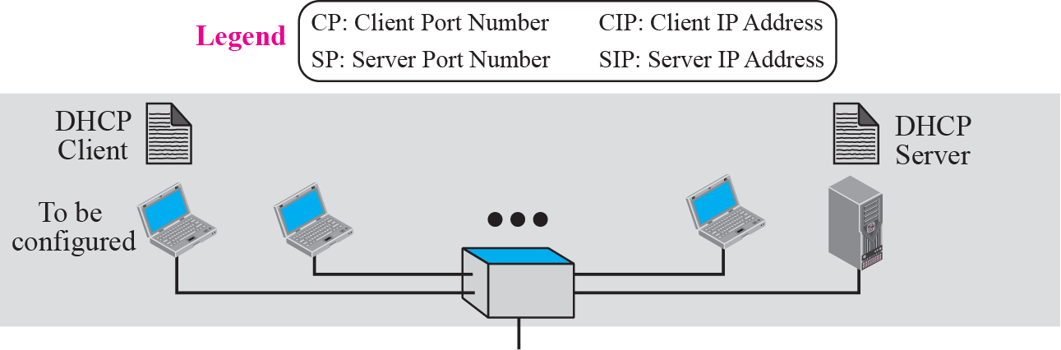
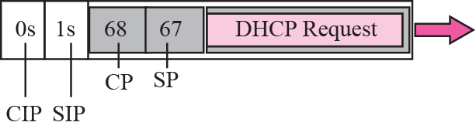
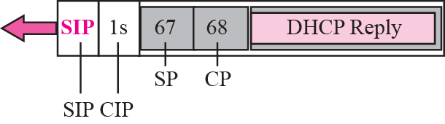
Figure 18.1 Client and server on the same network
TCP/IP Protocol Suite

Slide 5
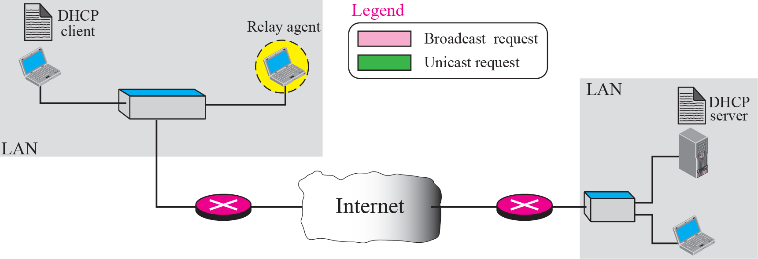

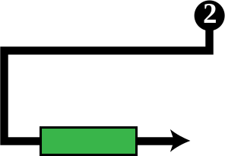
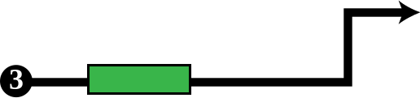
Figure 18.2 Client and server on two different networks
TCP/IP Protocol Suite

Slide 6
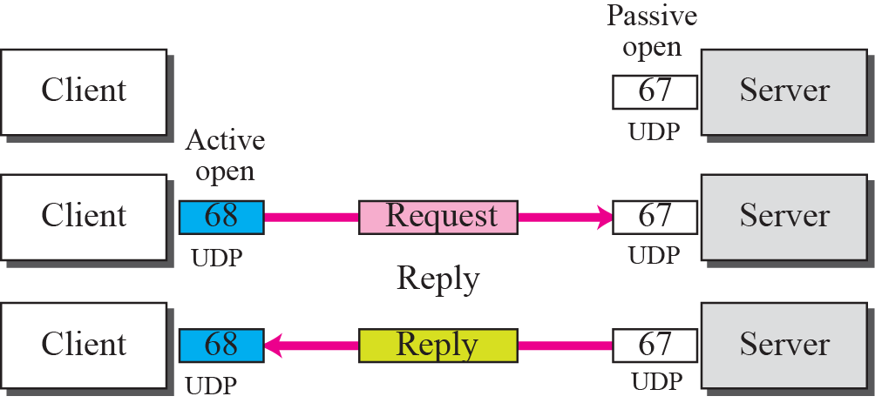
Figure 18.3 Use of UDP ports
TCP/IP Protocol Suite

Slide 7
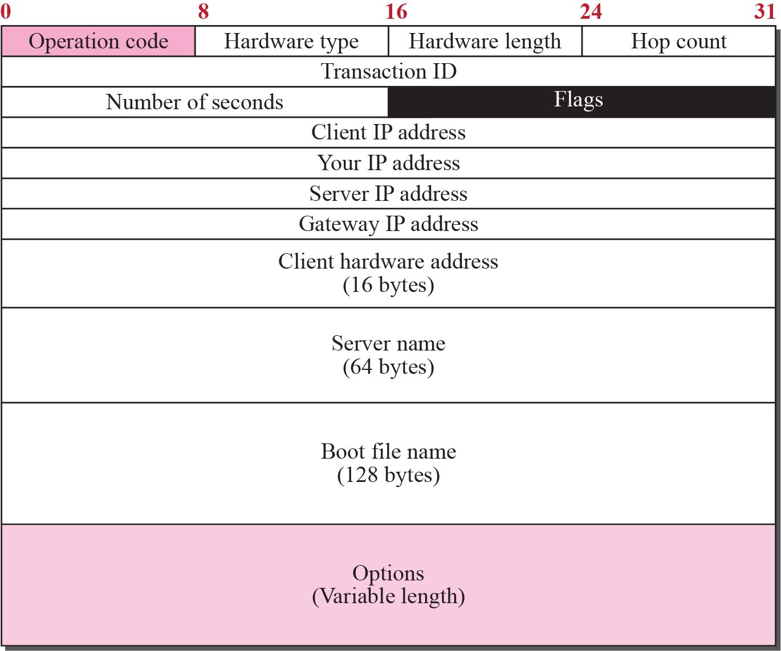
Figure 18.4 DHCP packet format
TCP/IP Protocol Suite

Slide 8
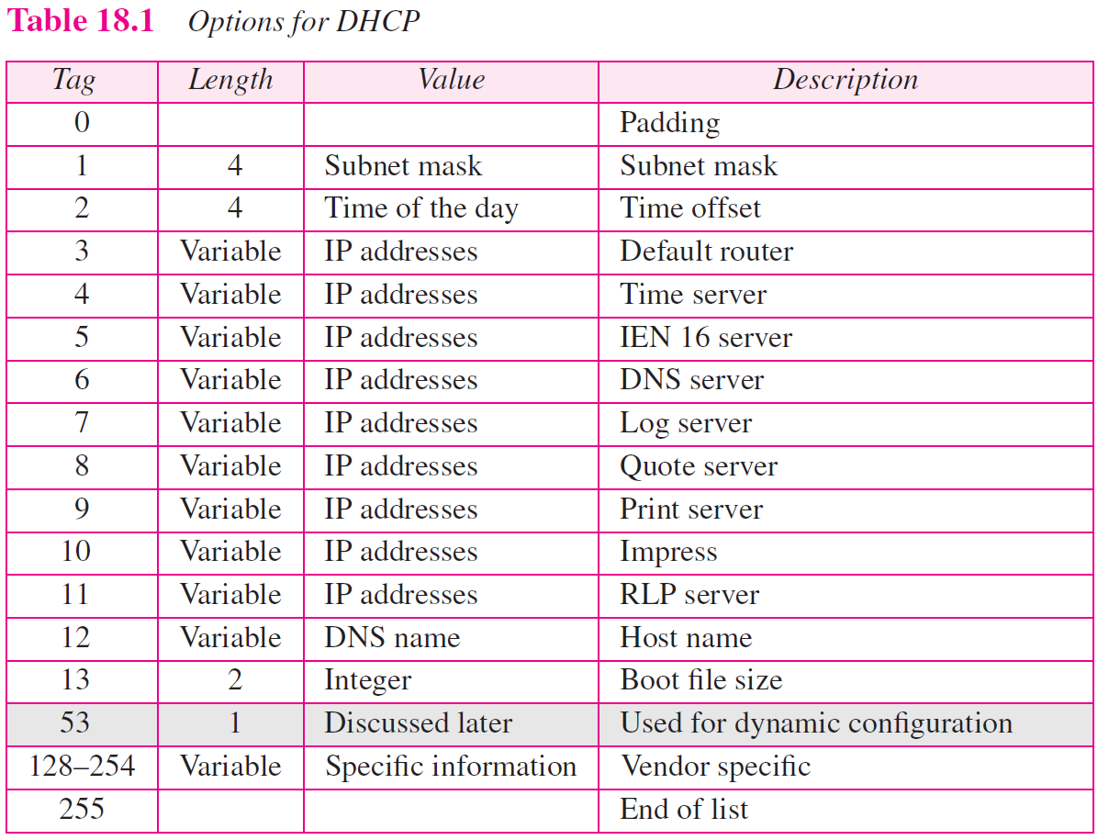
TCP/IP Protocol Suite

Slide 9
18-3 CONFIGURATION
The DHCP has been devised to provide static and dynamic address allocation.
TCP/IP Protocol Suite

Slide 10
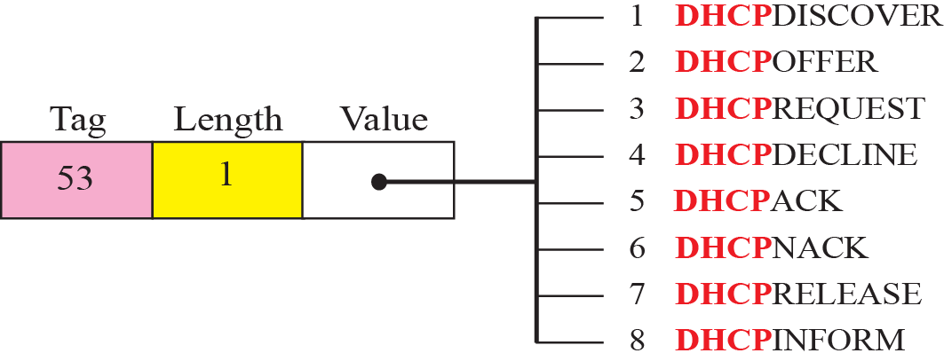
Figure 18.7 Option with tag 53
TCP/IP Protocol Suite

Slide 11
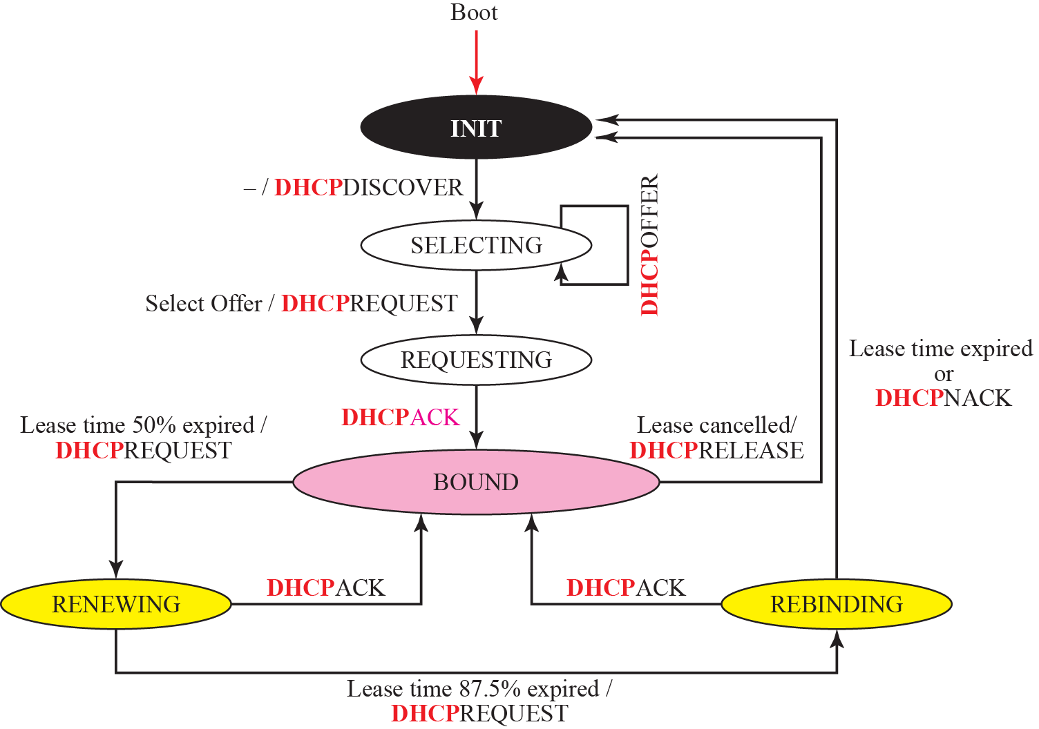
Figure 18.8 DHCP client transition diagram
TCP/IP Protocol Suite

Slide 12
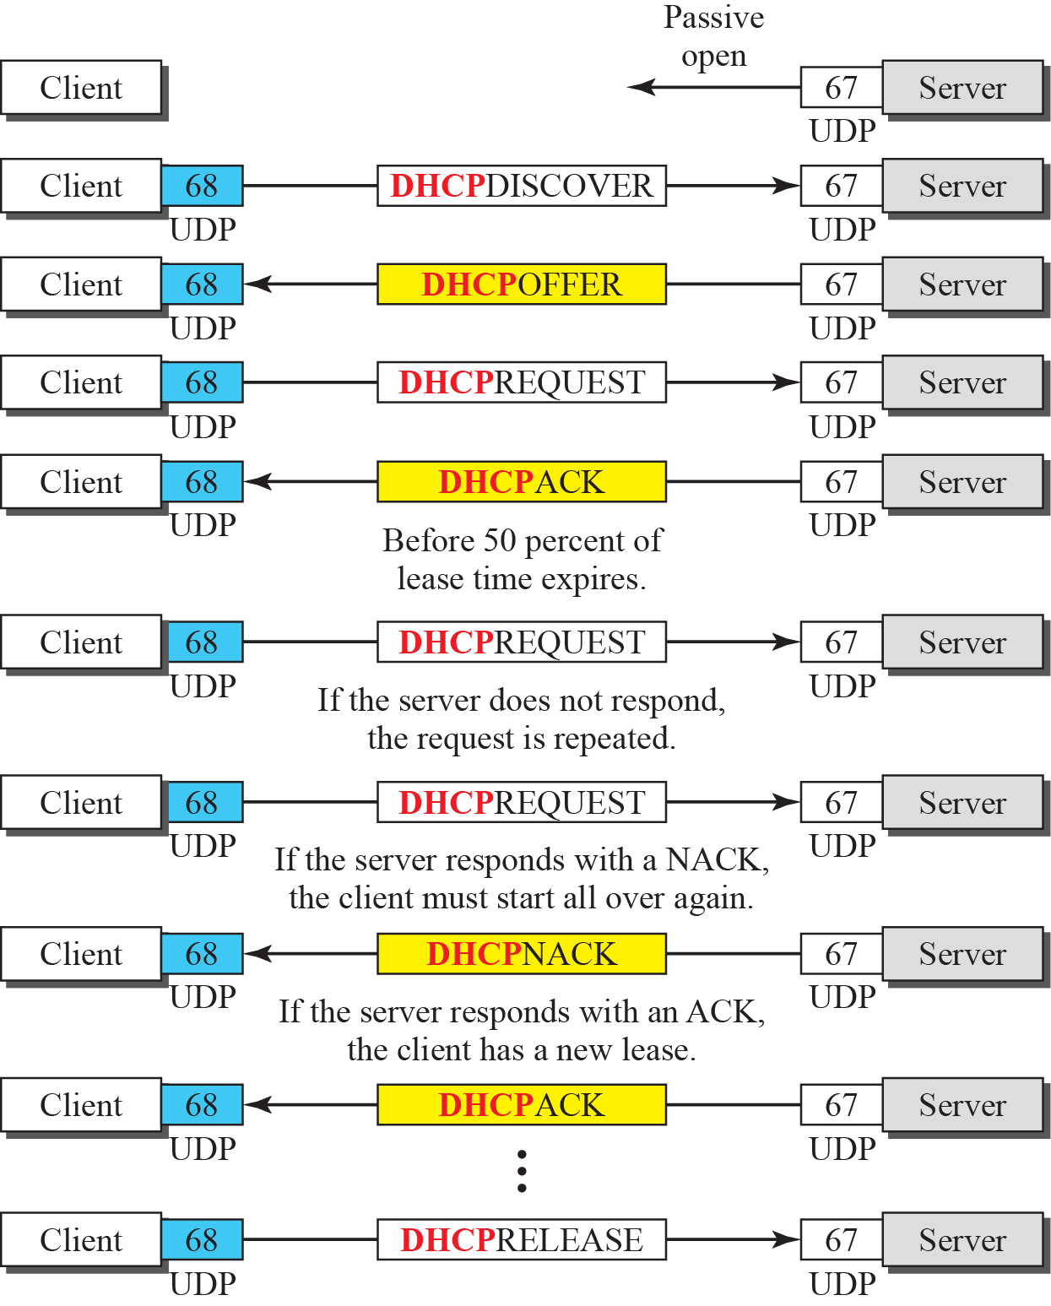
Figure 18.9 Exchanging messages
TCP/IP Protocol Suite

