Slide 1

Chapter 19
Domain Name
System
(DNS)
TCP/IP Protocol Suite

Slide 2
19-1 NEED FOR DNS
To identify an entity, TCP/IP protocols use the IP address, which uniquely identifies the connection of a host to the Internet. However, people prefer to use names instead of numeric addresses. Therefore, we need a system that can map a name to an address or an address to a name.
TCP/IP Protocol Suite

Slide 3

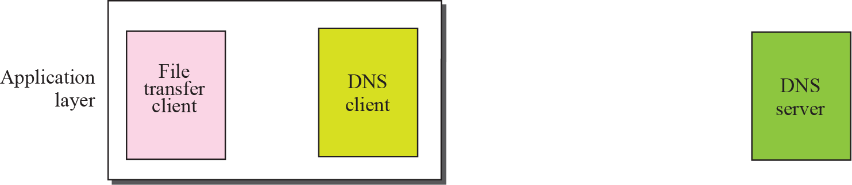
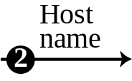
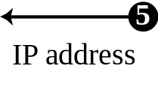
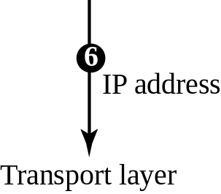


Figure 19.1 Purpose of DNS
TCP/IP Protocol Suite

Slide 4
19-2 NAME SPACE
To be unambiguous, the names assigned to machines must be carefully selected from a name space with complete control over the binding between the names and IP addresses. In other words, the names must be unique because the addresses are unique. A name space that maps each address to a unique name can be organized in two ways: flat or hierarchical.
TCP/IP Protocol Suite

Slide 5
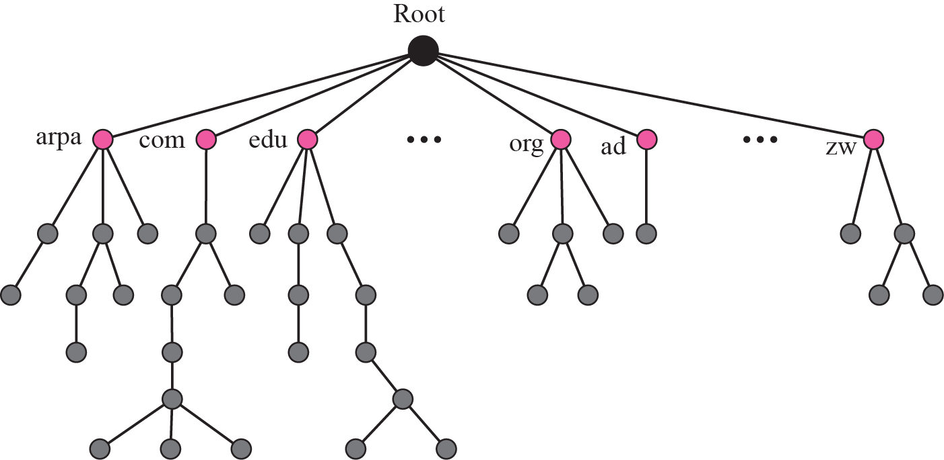
Figure 19.2 Domain name space
TCP/IP Protocol Suite

Slide 6
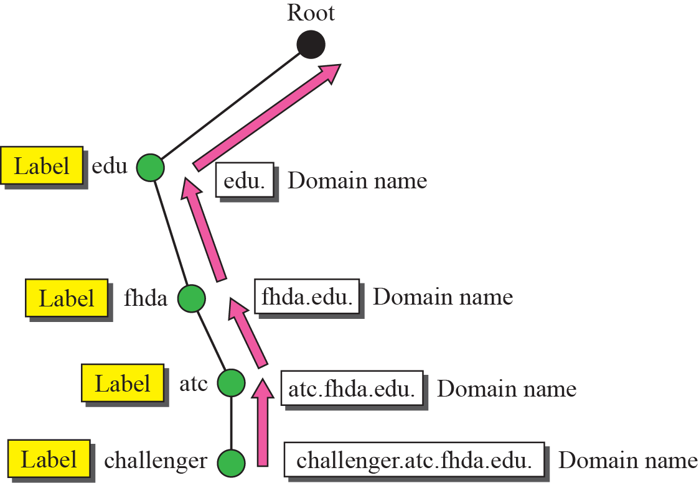
Figure 19.3 Domain names and labels
TCP/IP Protocol Suite

Slide 7

Figure 19.4 FQDN and PQDN
TCP/IP Protocol Suite

Slide 8
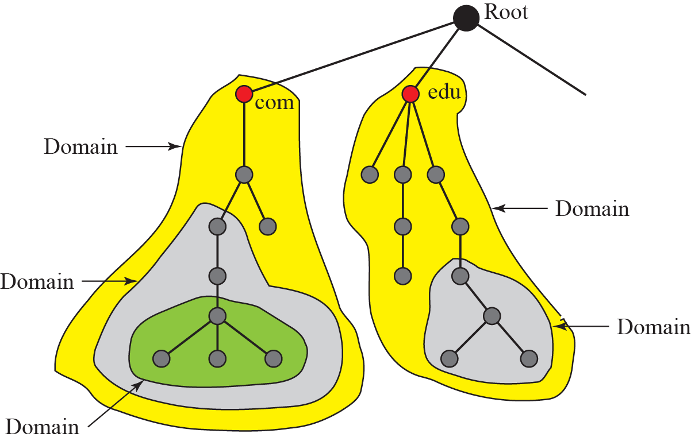
Figure 19.5 Domains
TCP/IP Protocol Suite

Slide 9
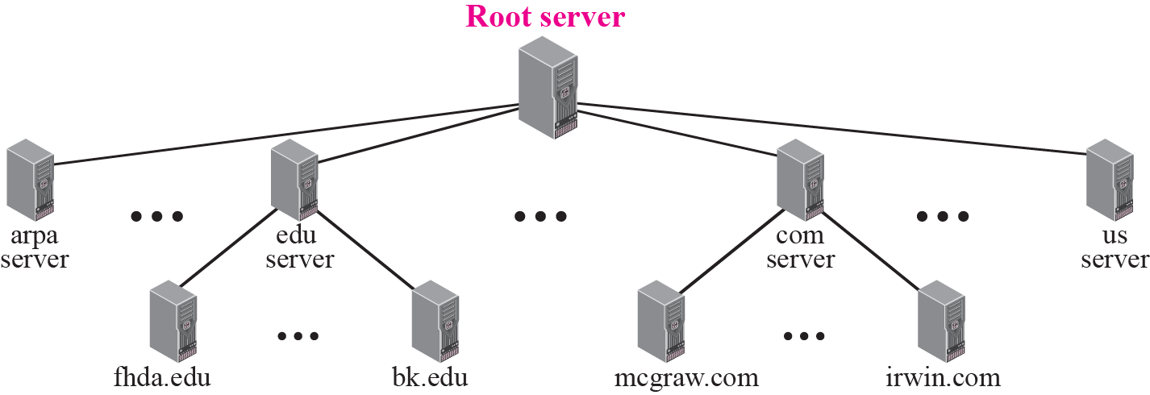
Figure 19.6 Hierarchy of name servers
TCP/IP Protocol Suite

Slide 10
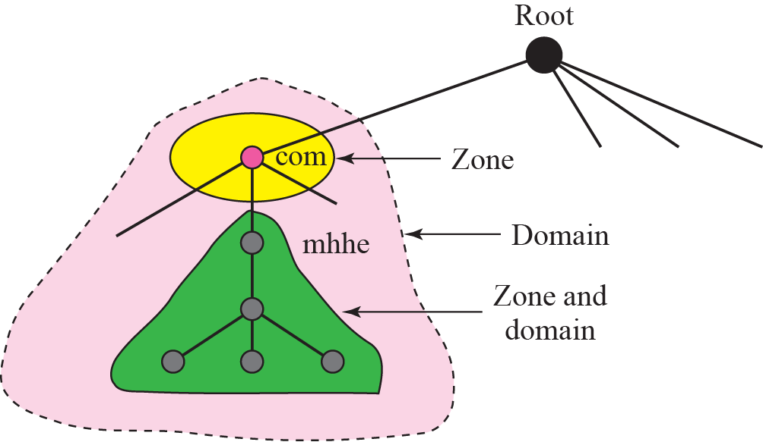
Figure 19.7 Zones and domains
TCP/IP Protocol Suite

Slide 11

Note
A primary server loads all information from the disk file; the secondary server loads all information from the primary server.
When the secondary downloads information from the primary, it is
called zone transfer.
TCP/IP Protocol Suite

Slide 12
19-3 DNS IN THE INTERNET
DNS is a protocol that can be used in different platforms. In the Internet, the domain name space (tree) is divided into three different sections: generic domains, country domains, and the inverse domain (see Figure 19.8).
TCP/IP Protocol Suite

Slide 13
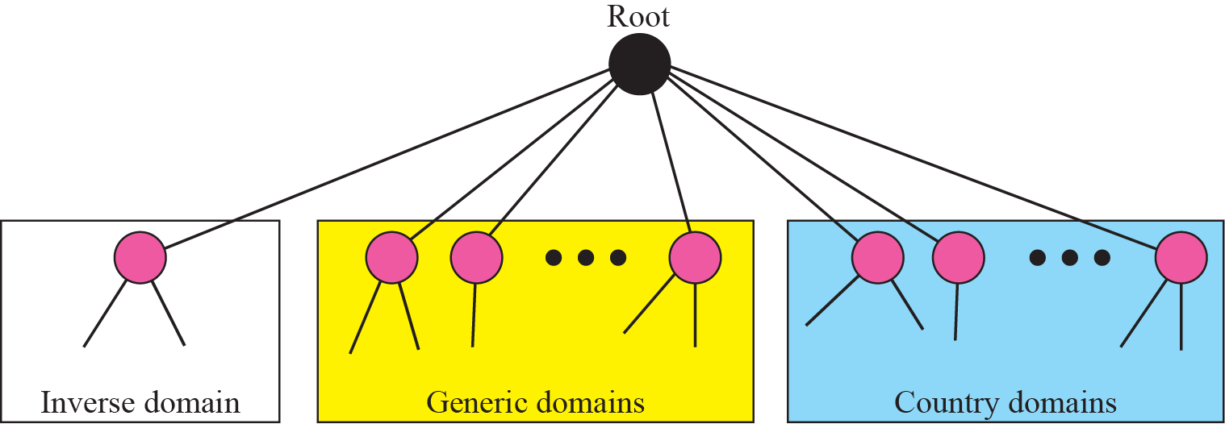
Figure 19.8 DNS used in the Internet
TCP/IP Protocol Suite

Slide 14
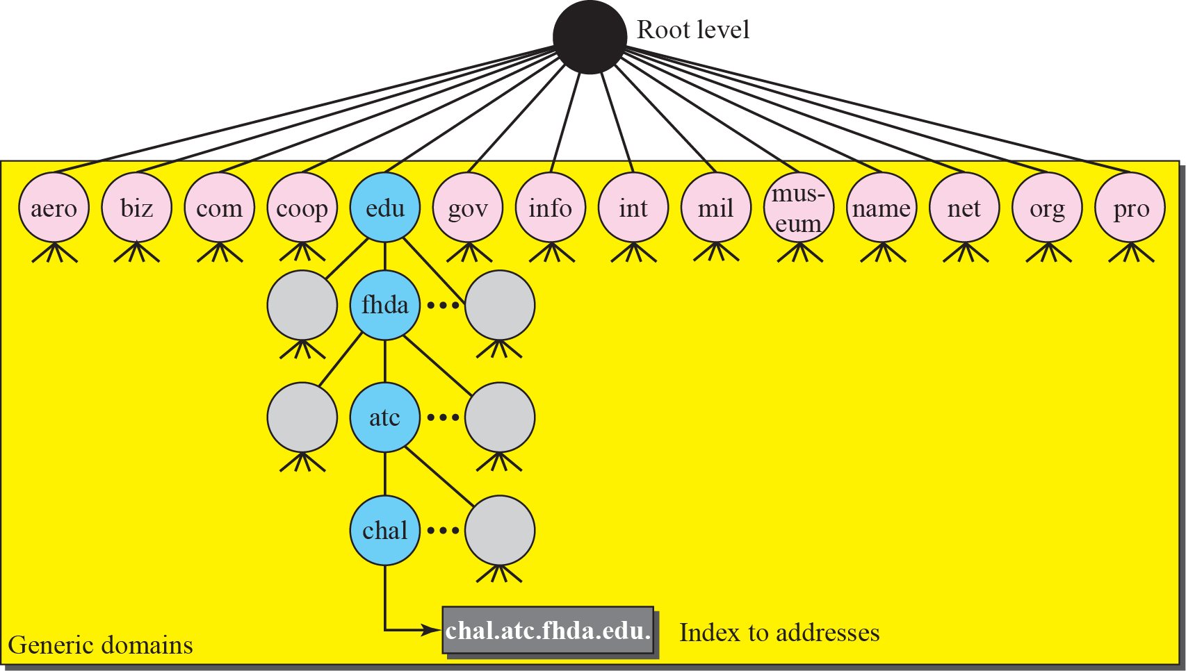
Figure 19.9 Generic domains
TCP/IP Protocol Suite

Slide 15
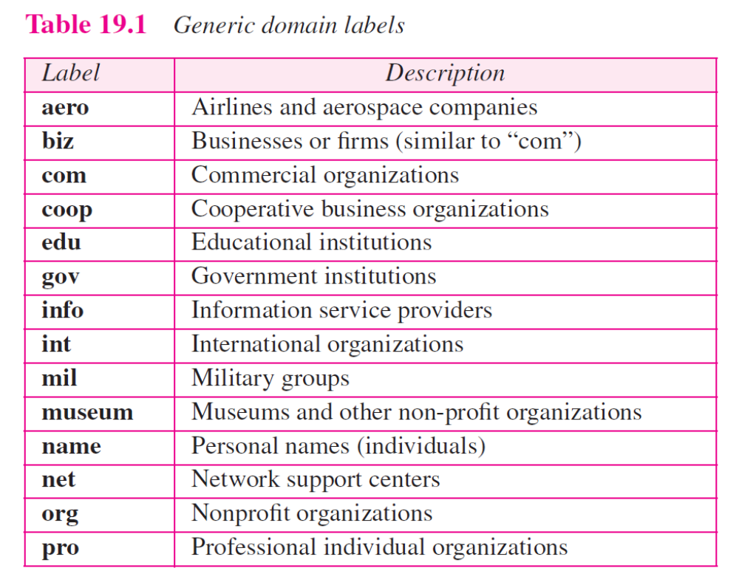
TCP/IP Protocol Suite

Slide 16
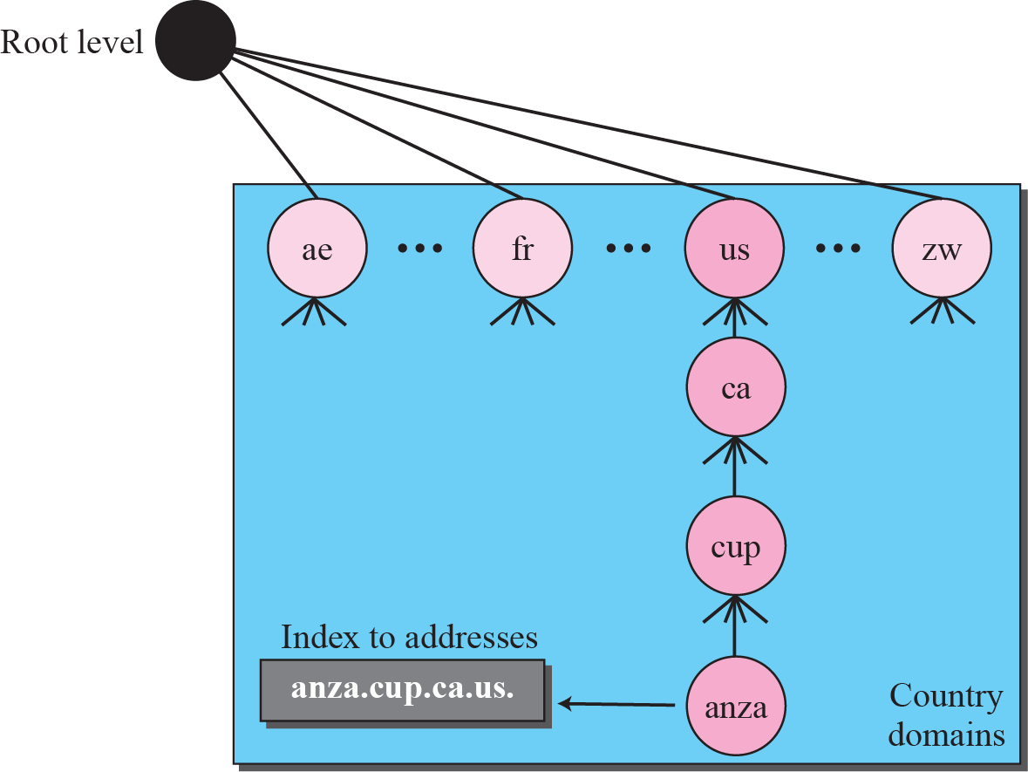
Figure 19.10 Country domains
TCP/IP Protocol Suite

Slide 17
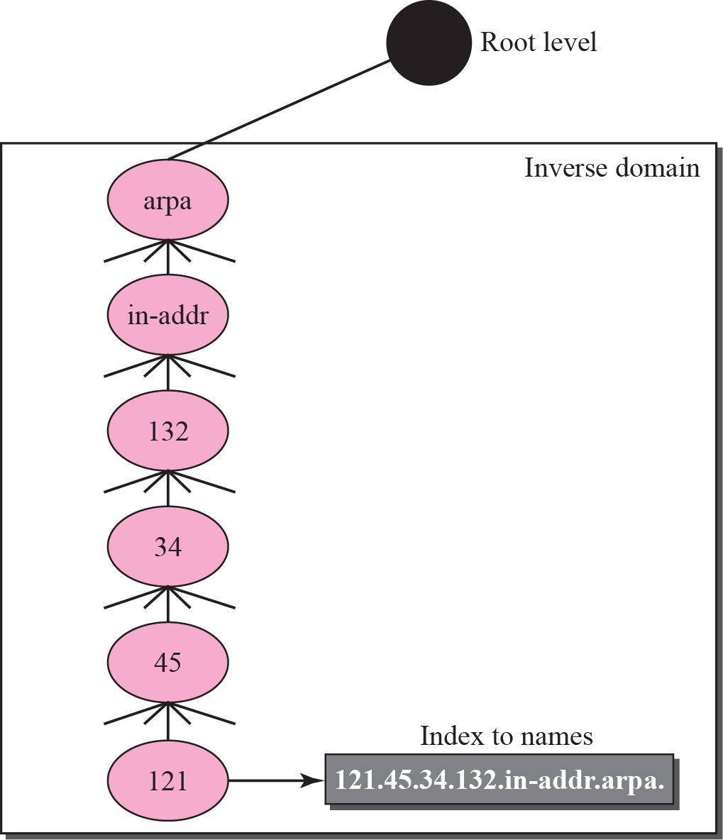
Figure 19.11 Inverse domain
TCP/IP Protocol Suite

Slide 18
19-4 RESOLUTION
Mapping a name to an address or an address to a name is called name-address resolution.
TCP/IP Protocol Suite

Slide 19
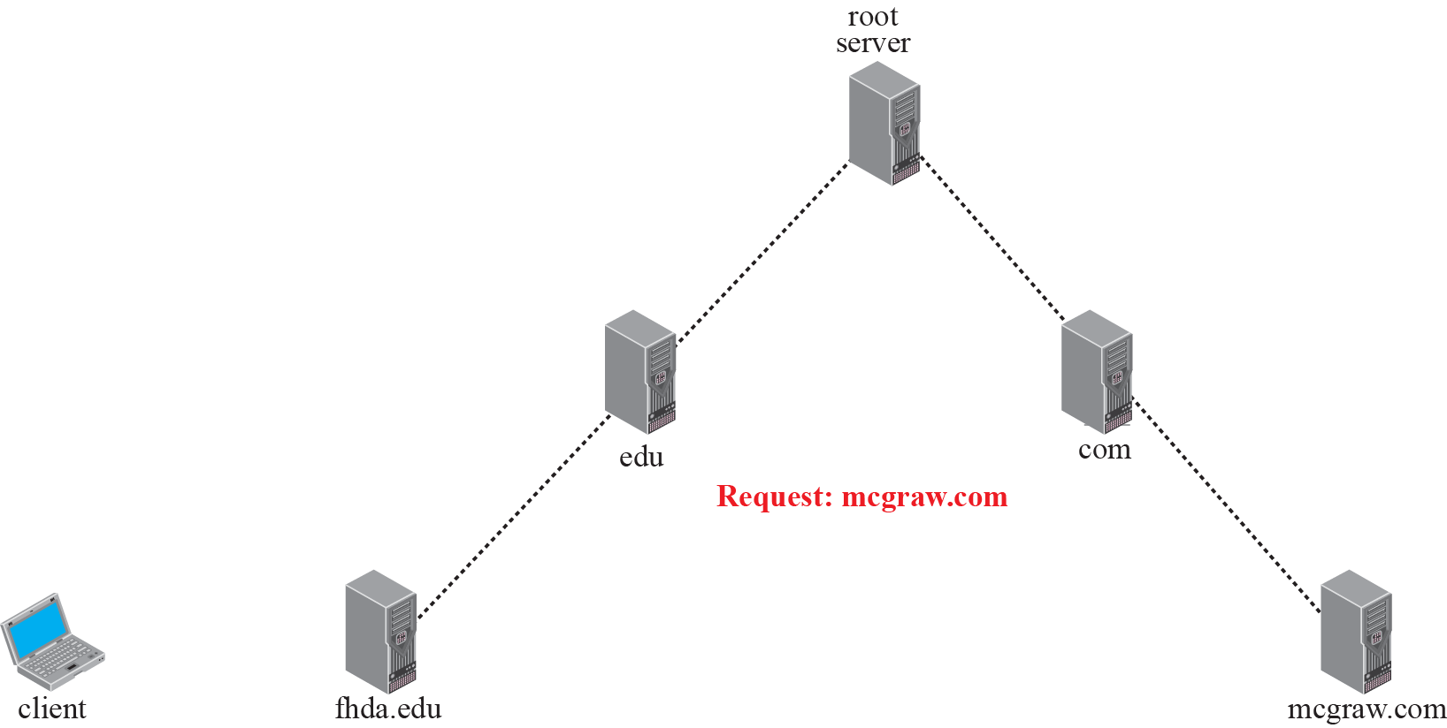










Figure 19.12 Recursive resolution
TCP/IP Protocol Suite

Slide 20
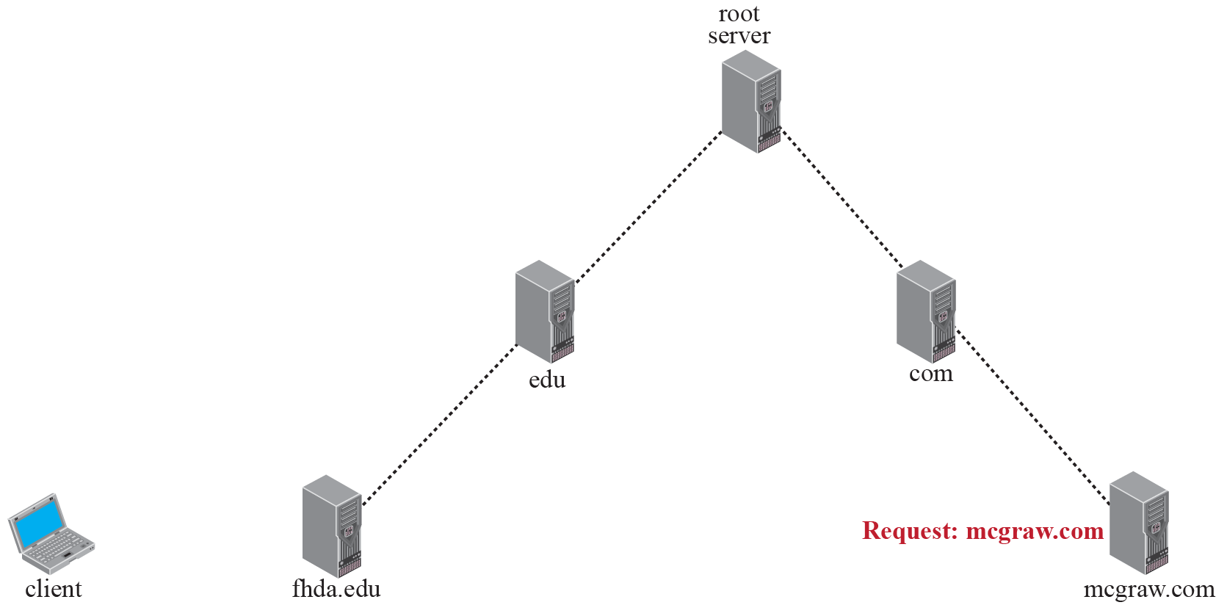










Figure 19.13 Iterative resolution
TCP/IP Protocol Suite

Slide 21
19-5 DNS MESSAGES
DNS has two types of messages: query and response. Both types have the same format. The query message consists of a header and question records; the response message consists of a header, question records, answer records, authoritative records, and additional records (see Figure 19.14).
TCP/IP Protocol Suite

Slide 22

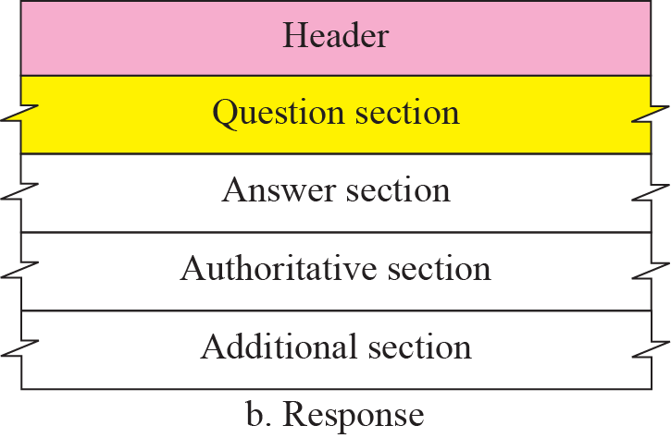
Figure 19.14 Query and response messages
TCP/IP Protocol Suite

Slide 23
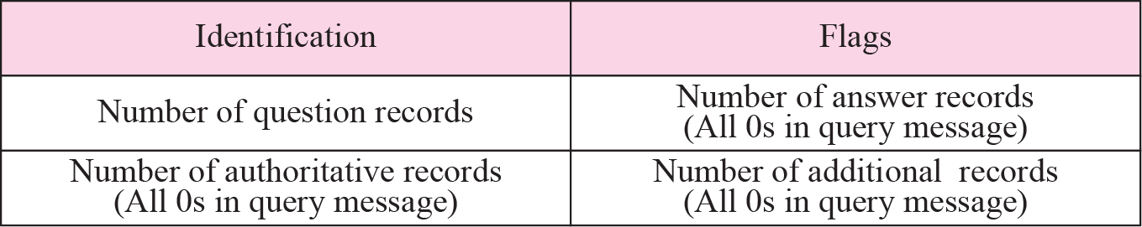
Figure 19.15 Header format
TCP/IP Protocol Suite

Slide 24
19-6 TYPES OF RECORDS
As we saw in the previous section, two types of records are used in DNS. The question records are used in the question section of the query and response messages. The resource records are used in the answer, authoritative, and additional information sections of the response message.
TCP/IP Protocol Suite

Slide 25
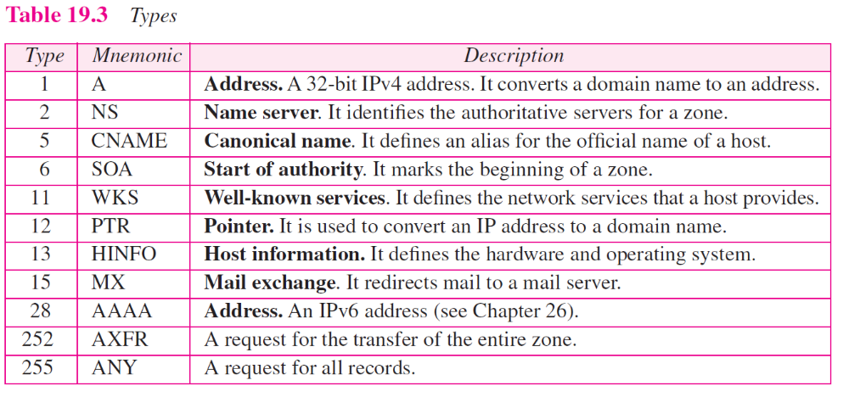
TCP/IP Protocol Suite

Slide 26
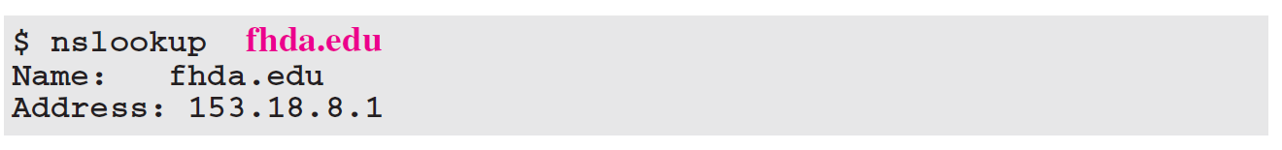
Example 19.3
In UNIX and Windows, the nslookup utility can be used to retrieve address/name mapping. The following shows how we can retrieve an address when the domain name is given.
The nslookup utility can also be used to retrieve the domain name when the address is given as shown below:
TCP/IP Protocol Suite

Slide 27
19-8 ENCAPSULATION
DNS can use either UDP or TCP. In both cases the well-known port used by the server is port 53. UDP is used when the size of the response message is less than 512 bytes because most UDP packages have a 512-byte packet size limit. If the size of the response message is more than 512 bytes, a TCP connection is used. In that case, one of two scenarios can occur:
TCP/IP Protocol Suite

Slide 28
19-9 REGISTRARS
How are new domains added to DNS? This is done through a registrar, a commercial entity accredited by ICANN. A registrar first verifies that the requested domain name is unique and then enters it into the DNS database. A fee is charged.
TCP/IP Protocol Suite

Slide 29
19-10 DDNS
When the DNS was designed, no one predicted that there would be so many address changes. In DNS, when there is a change, such as adding a new host, removing a host, or changing an IP address, the change must be made to the DNS master file. The DNS master file must be updated dynamically. The Dynamic Domain Name System (DDNS) therefore was devised to respond to this need.
TCP/IP Protocol Suite

Slide 30
19-11 SECURITY OF DNS
DNS is one of the most important systems in the Internet infrastructure; it provides crucial services to the Internet users. Applications such as Web access or e-mail are heavily dependent on the proper operation of DNS. DNS can be attacked in several
Ways.
To protect DNS, IETF has devised a technology named DNS Security (DNSSEC) that provides the message origin authentication and message integrity using a security service called digital signature (See Chapter 29).
TCP/IP Protocol Suite

