Slide 1

Chapter 20
Remote Login:
TELNET
and
SSH
TCP/IP Protocol Suite

Slide 2
20-1 TELNET
TELNET is an abbreviation for TErminaL NETwork. It is the standard TCP/IP protocol for virtual terminal service as proposed by ISO. TELNET enables the establishment of a connection to a remote system in such a way that the local terminal appears to be a terminal at the remote system.
TCP/IP Protocol Suite

Slide 3

Note
TELNET is a general-purpose
client-server application program.
TCP/IP Protocol Suite

Slide 4
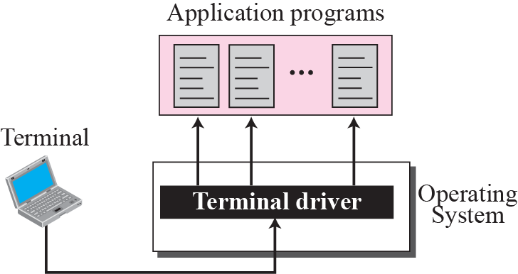
Figure 20.1 Local login
TCP/IP Protocol Suite

Slide 5
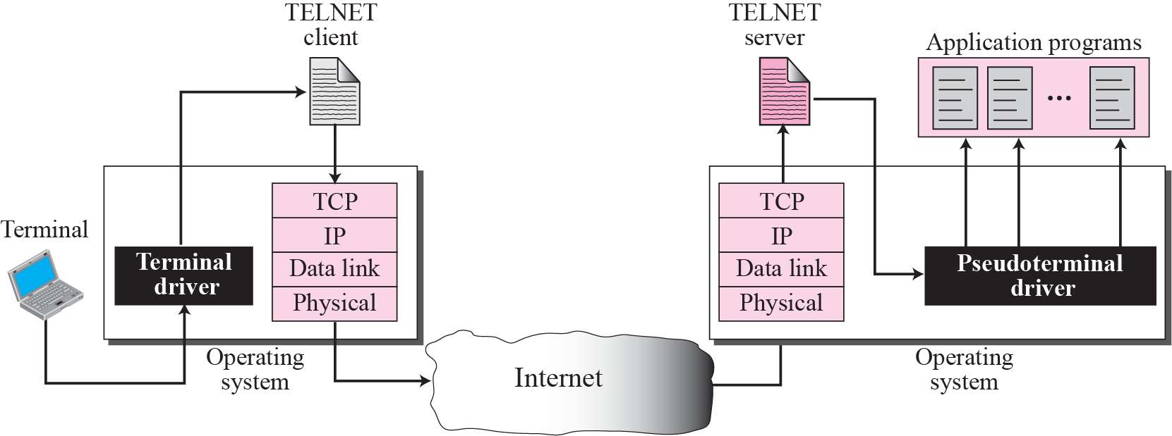
Figure 20.2 Remote login
TCP/IP Protocol Suite

Slide 6
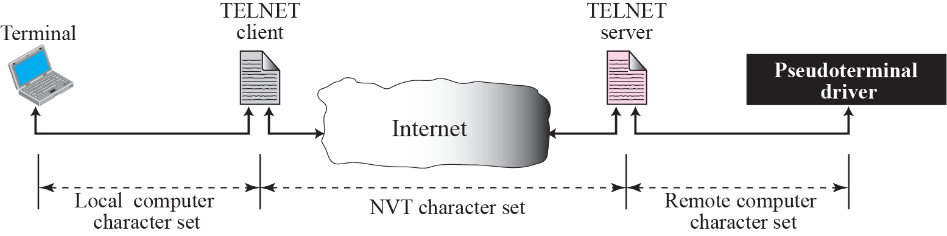
Figure 20.3 Concept of NVT
TCP/IP Protocol Suite

Slide 7

Figure 20.4 Format of data and control characters
TCP/IP Protocol Suite

Slide 8
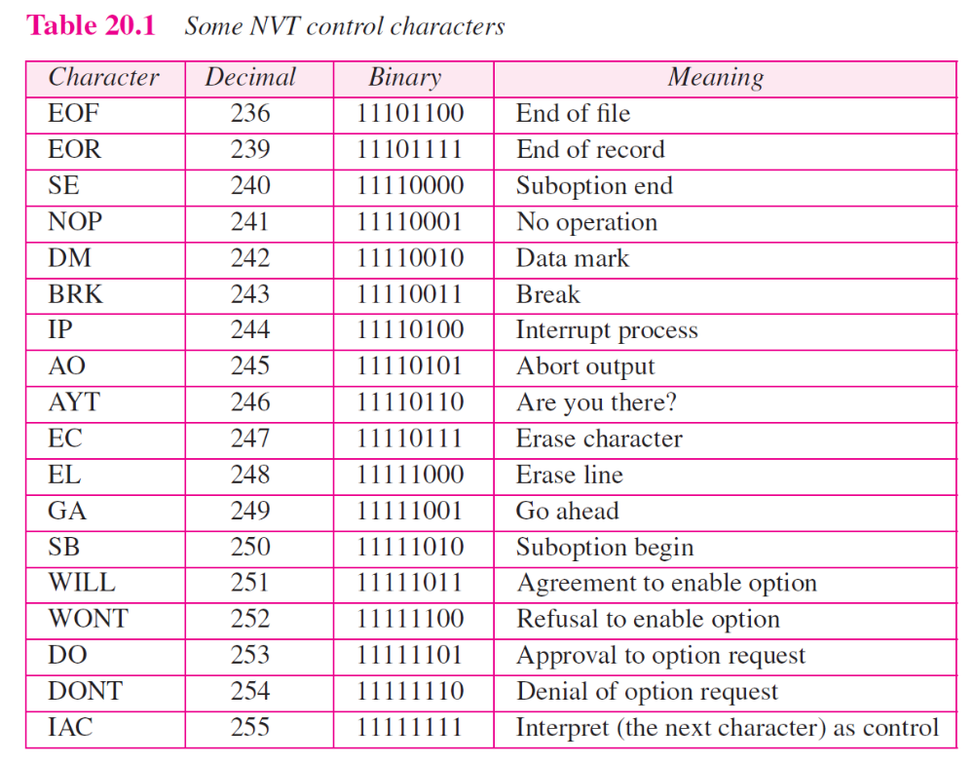
TCP/IP Protocol Suite

Slide 9
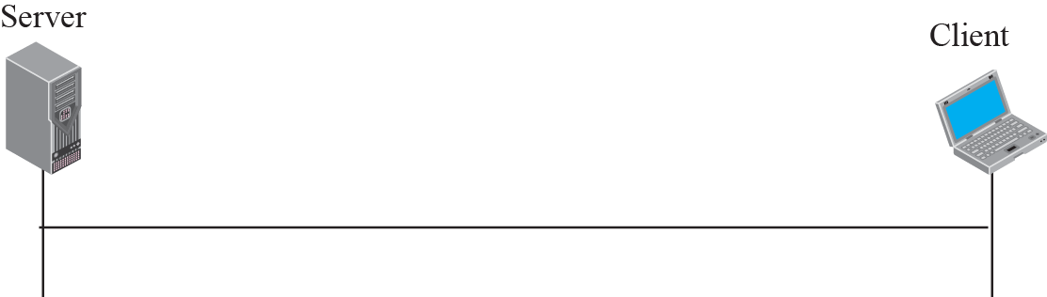
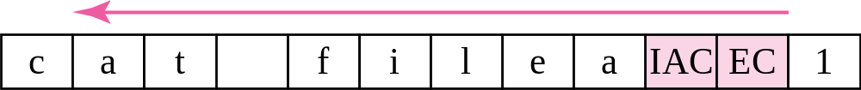
Figure 20.5 An example of embedding
TCP/IP Protocol Suite

Slide 10
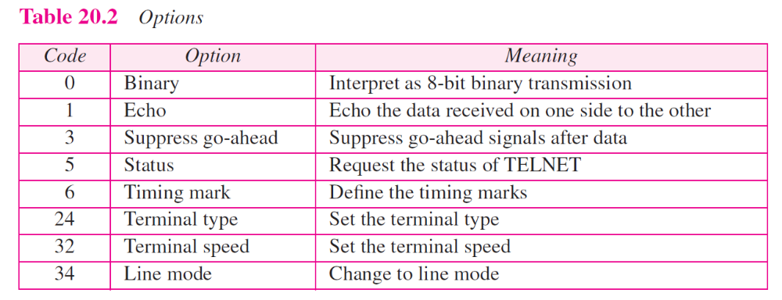
TCP/IP Protocol Suite

Slide 11
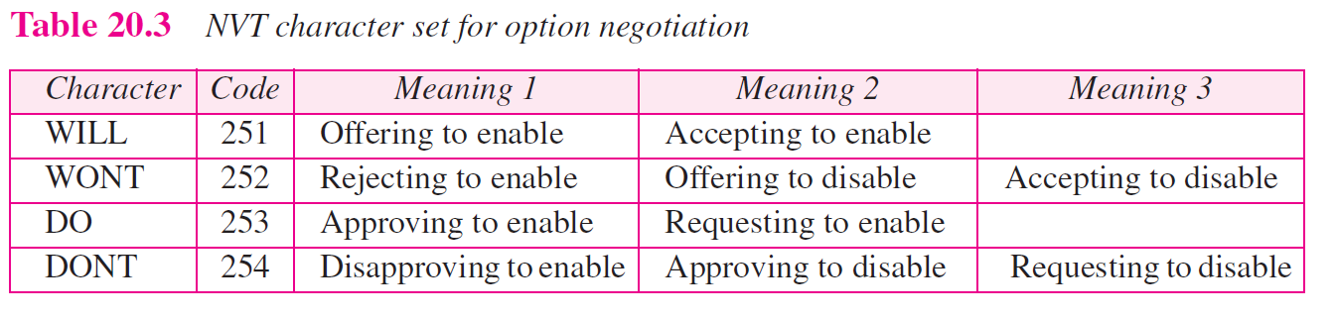
TCP/IP Protocol Suite

Slide 12



Figure 20.6 Offer to enable an option
TCP/IP Protocol Suite

Slide 13



Figure 20.7 Request to enable an option
TCP/IP Protocol Suite

Slide 14


Figure 20.8 Offer to disable an option
TCP/IP Protocol Suite

Slide 15


Figure 20.9 Request to disable an option
TCP/IP Protocol Suite

Slide 16
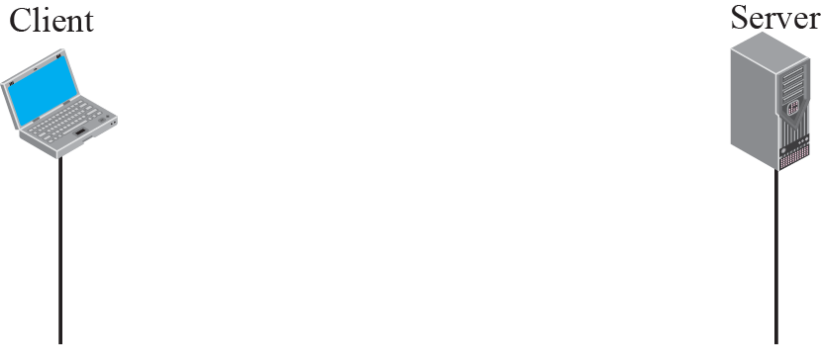

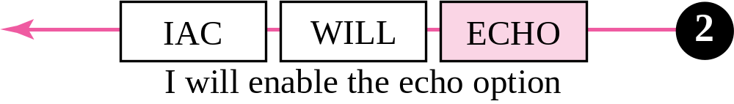
Figure 20.10 Example 20.1: Echo option
TCP/IP Protocol Suite

Slide 17
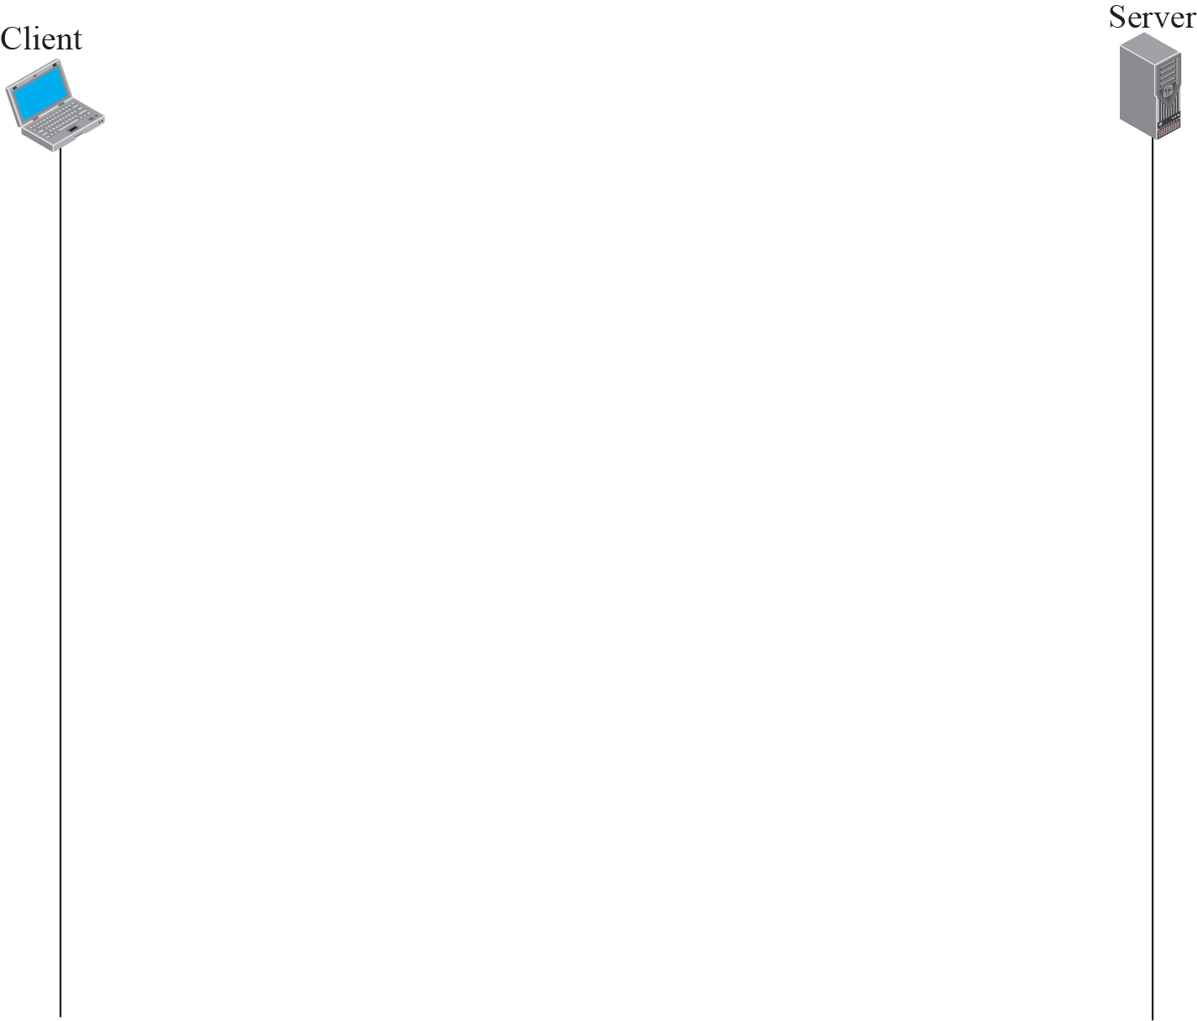
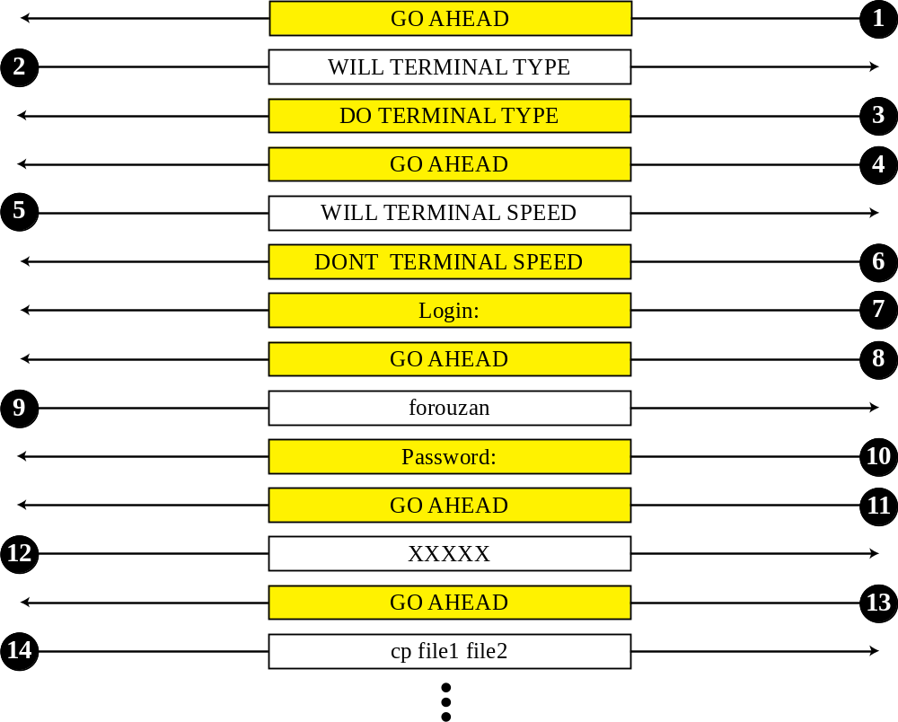
Figure 20.15 Example 20.2
TCP/IP Protocol Suite

Slide 18
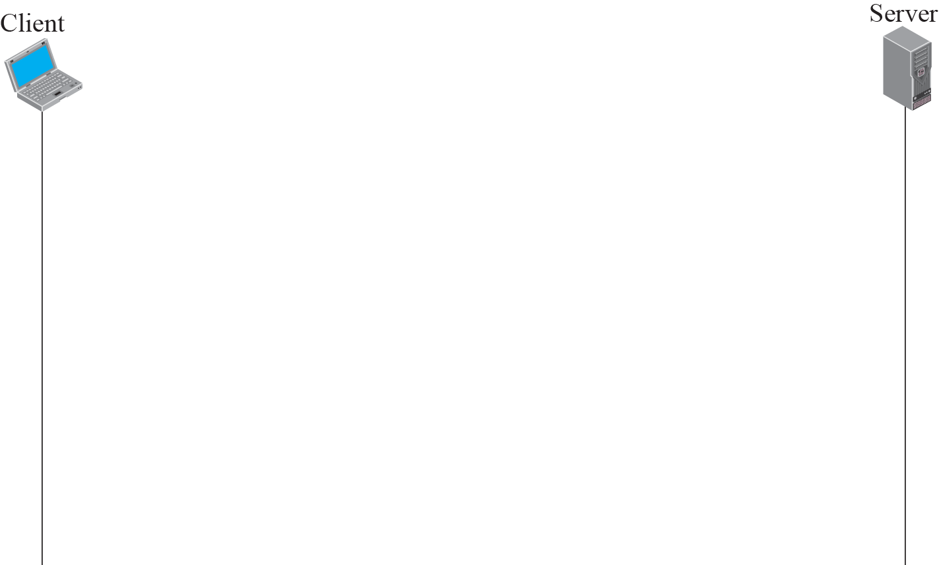
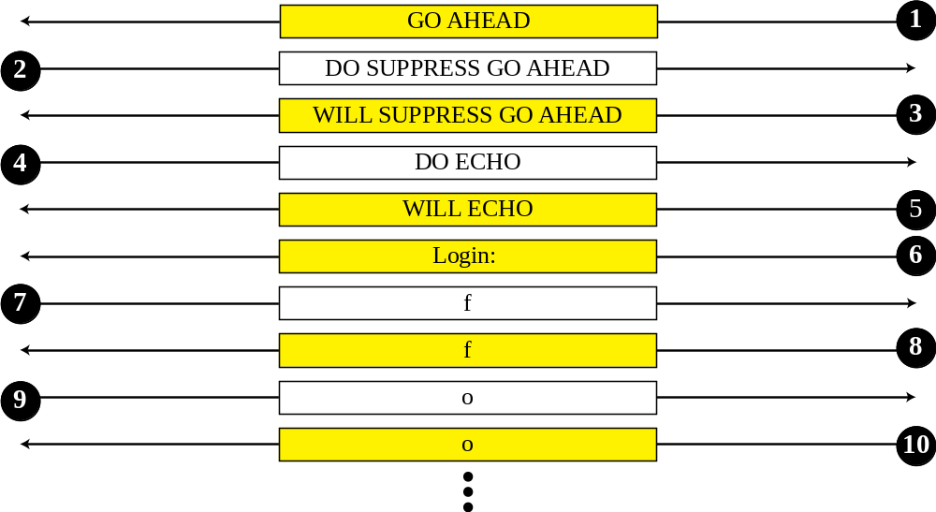
Figure 20.16 Example 20.3
TCP/IP Protocol Suite

Slide 19
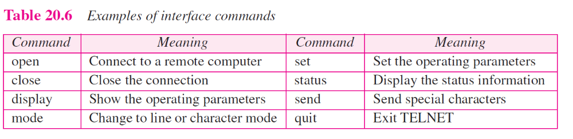
TCP/IP Protocol Suite

Slide 20
20-2 SECURE SHELL (SSH)
Another popular remote login application program is Secure Shell (SSH). SSH, like TELNET, uses TCP as the underlying transport protocol, but SSH is more secure and provides more services than TELNET.
TCP/IP Protocol Suite

