Slide 1

Chapter 21
File Transfer:
FTP
and
TFTP
TCP/IP Protocol Suite

Slide 2
21-1 FTP
File Transfer Protocol (FTP) is the standard mechanism provided by TCP/IP for copying a file from one host to another. Although transferring files from one system to another seems simple and straightforward, some problems must be dealt with first. For example, two systems may use different file name conventions. Two systems may have different ways to represent text and data. Two systems may have different directory structures. All of these problems have been solved by FTP in a very simple and elegant approach.
TCP/IP Protocol Suite

Slide 3

Note
FTP uses the services of TCP.
It needs two TCP connections. The well-known port 21 is used for the control connection and the well-known
port 20 for the data connection.
TCP/IP Protocol Suite

Slide 4
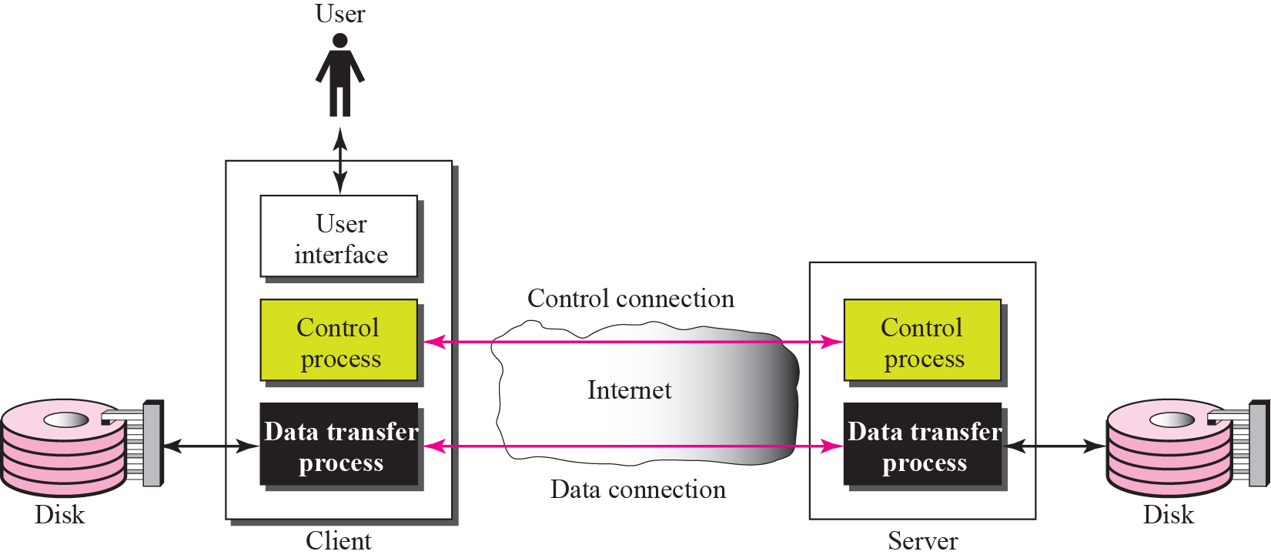
Figure 21.1 FTP
TCP/IP Protocol Suite

Slide 5
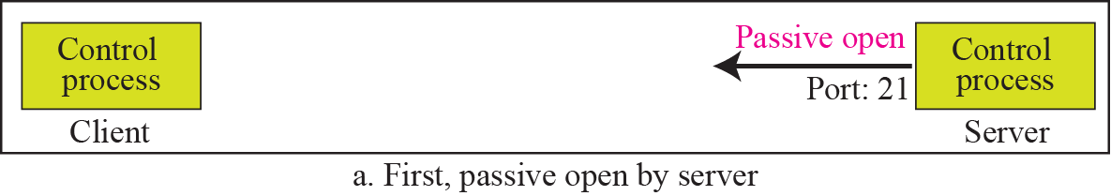
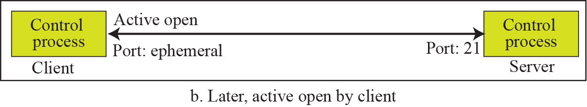
Figure 21.2 Opening the control connection
TCP/IP Protocol Suite

Slide 6
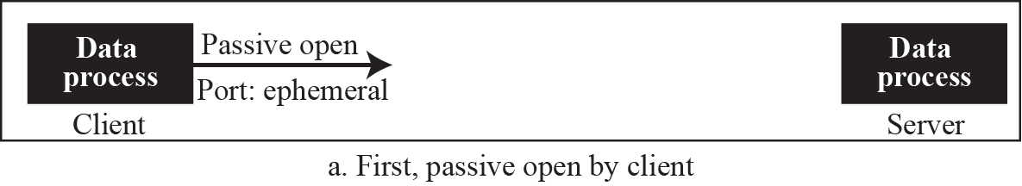
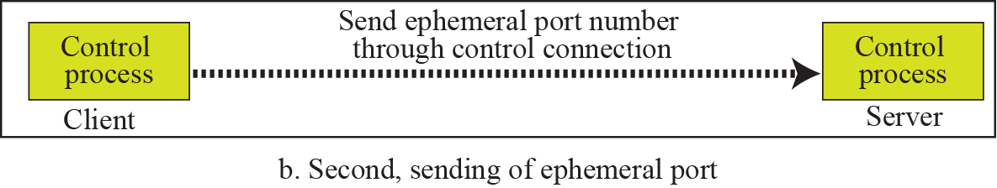
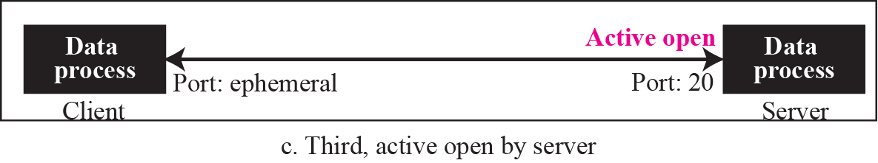
Figure 21.3 Creating the data connection
TCP/IP Protocol Suite

Slide 7

Figure 21.4 Using the control connection
TCP/IP Protocol Suite

Slide 8
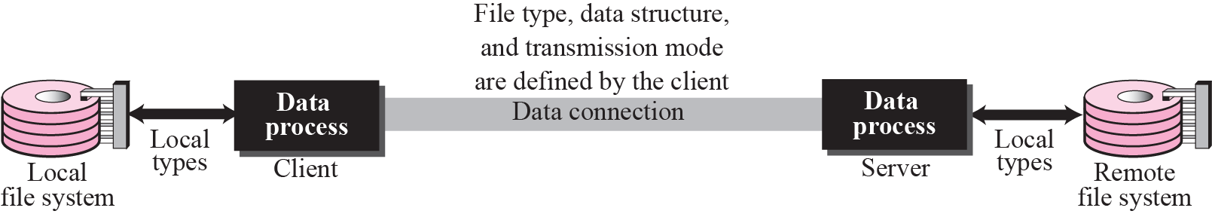
Figure 21.5 Using the data connection
TCP/IP Protocol Suite

Slide 9
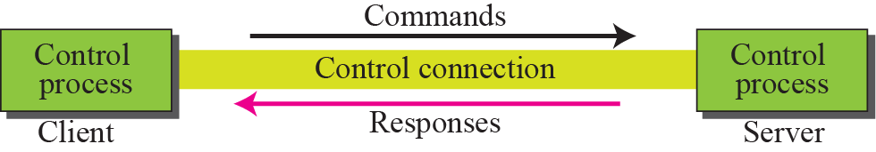
Figure 21.6 Command processing
TCP/IP Protocol Suite

Slide 10
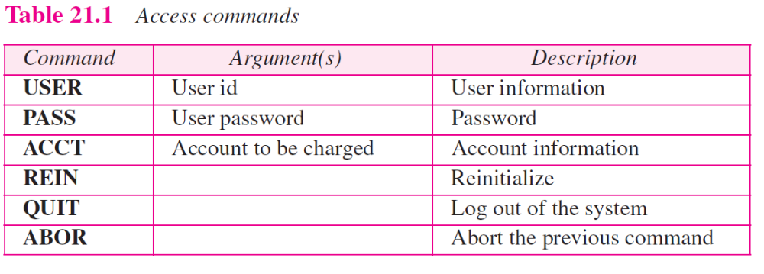
TCP/IP Protocol Suite

Slide 11
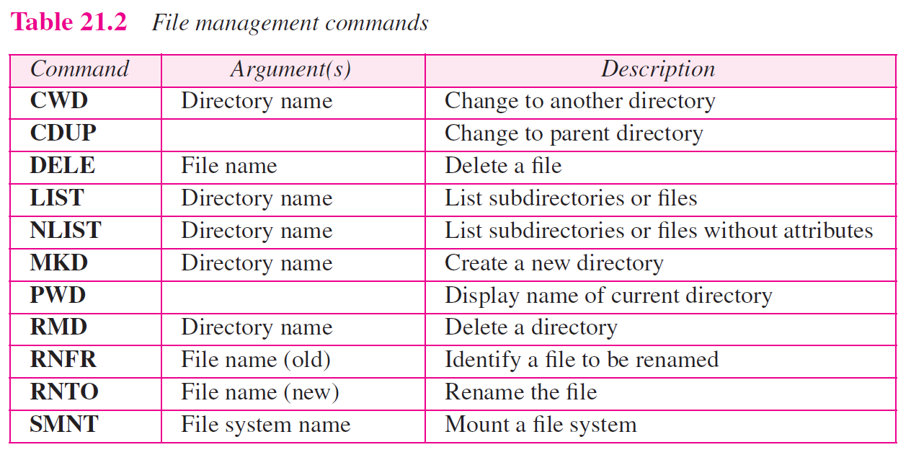
TCP/IP Protocol Suite

Slide 12
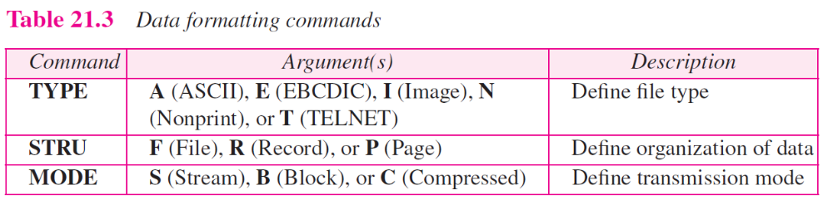
TCP/IP Protocol Suite

Slide 13
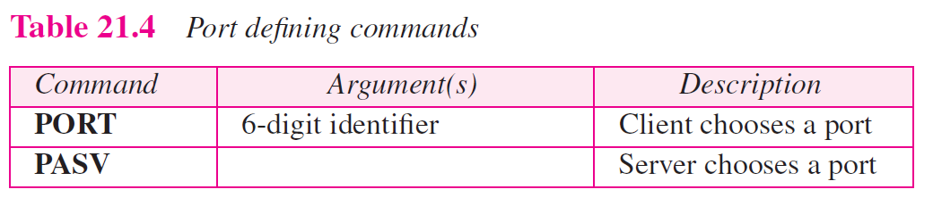
TCP/IP Protocol Suite

Slide 14
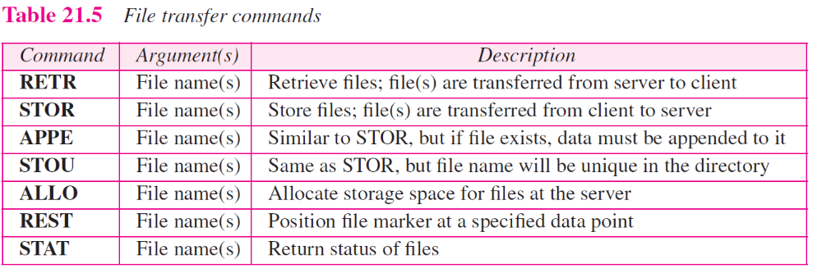
TCP/IP Protocol Suite

Slide 15
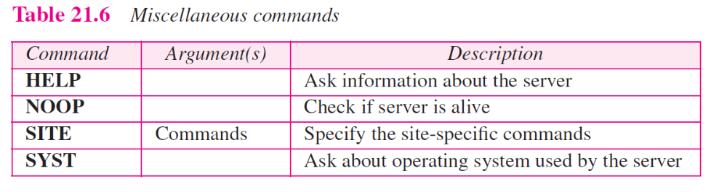
TCP/IP Protocol Suite

Slide 16
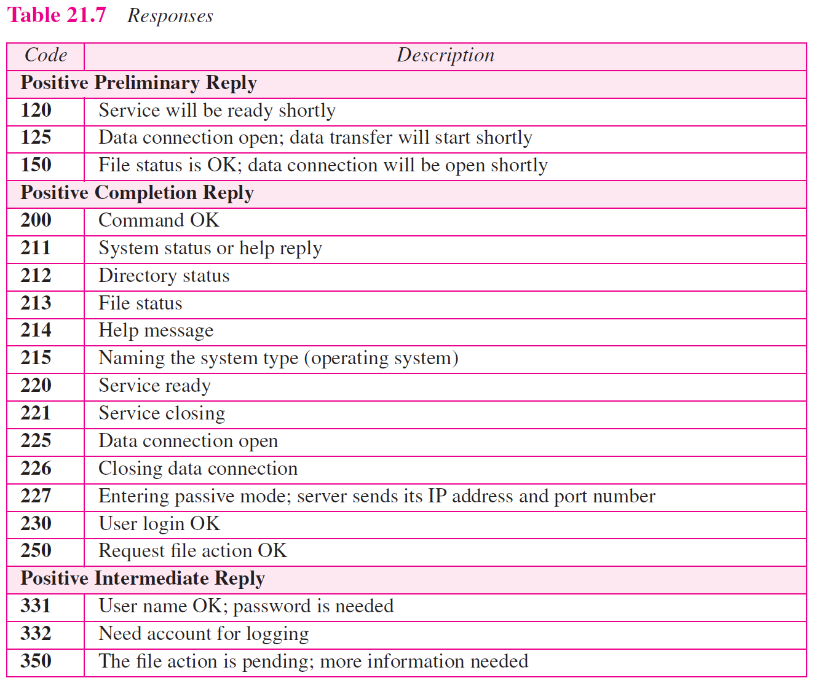
TCP/IP Protocol Suite

Slide 17
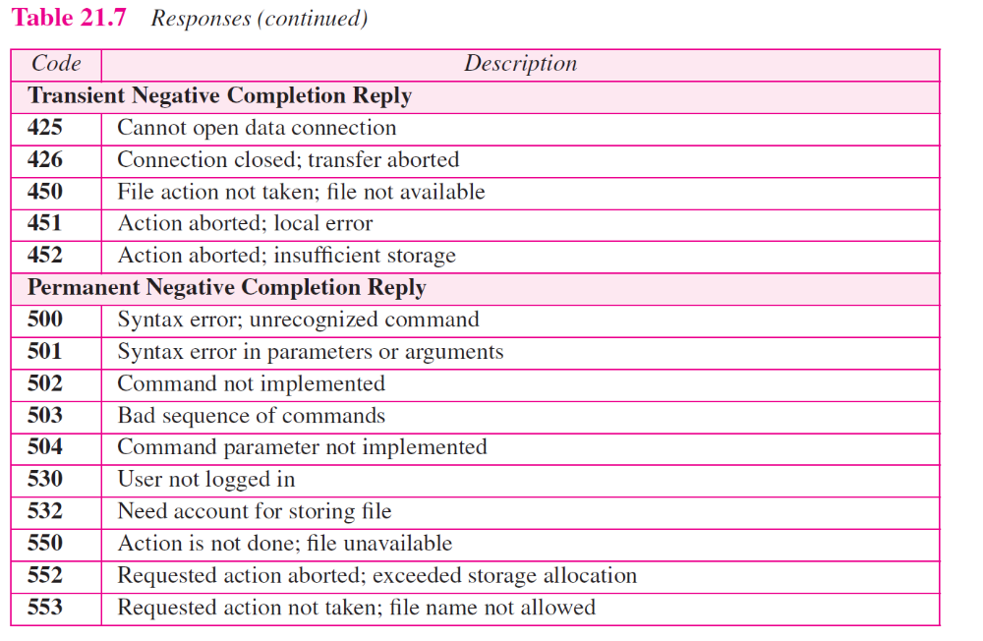
TCP/IP Protocol Suite

Slide 18
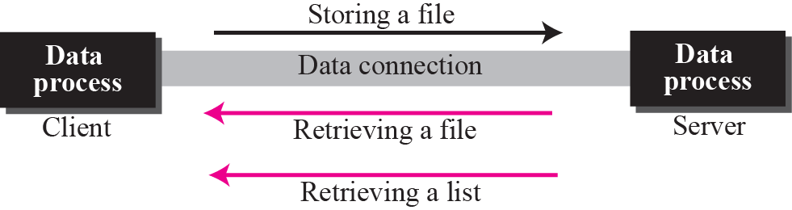
Figure 21.7 File transfer
TCP/IP Protocol Suite

Slide 19
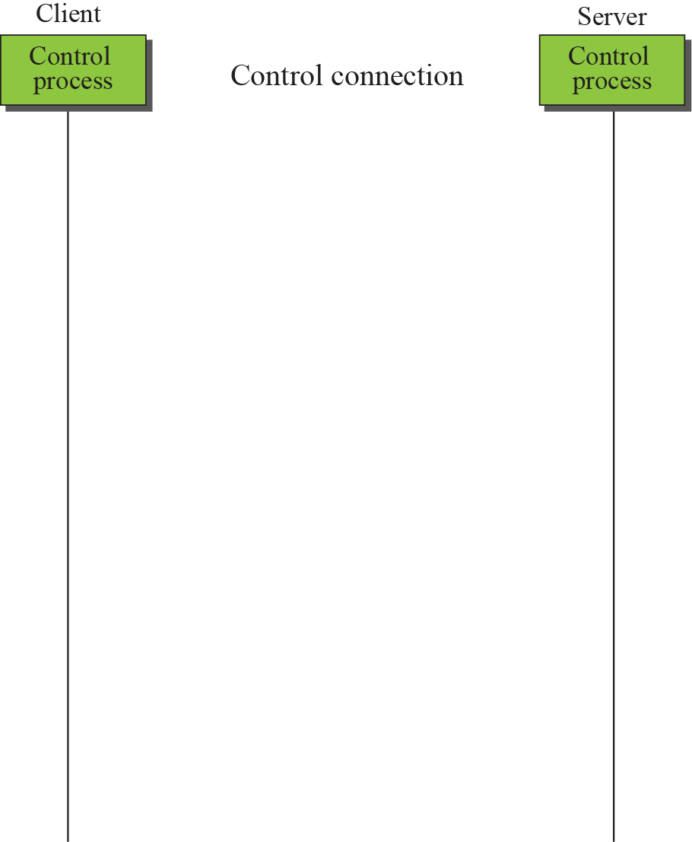
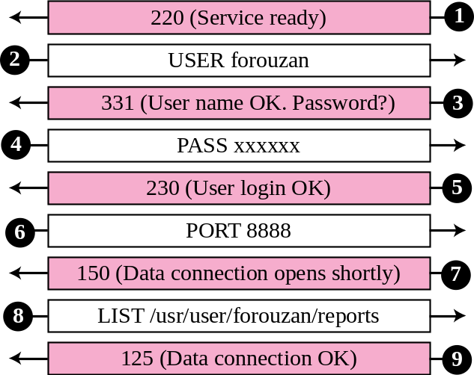
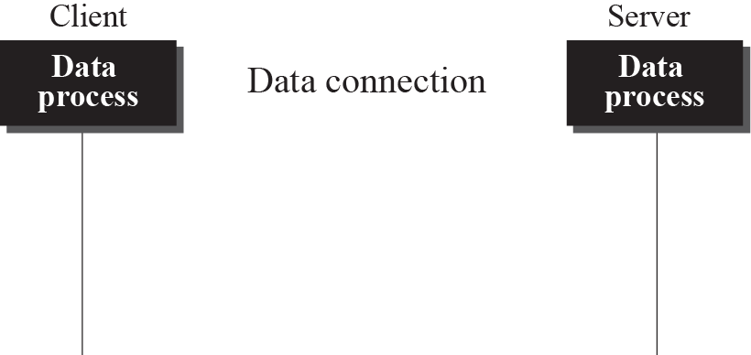
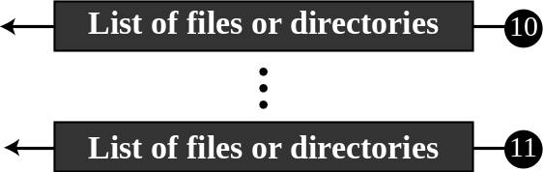

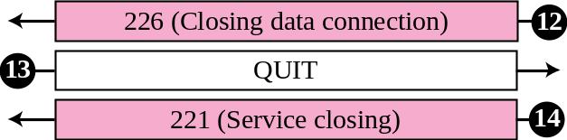
Figure 21.8 Example 21.1
TCP/IP Protocol Suite

Slide 20
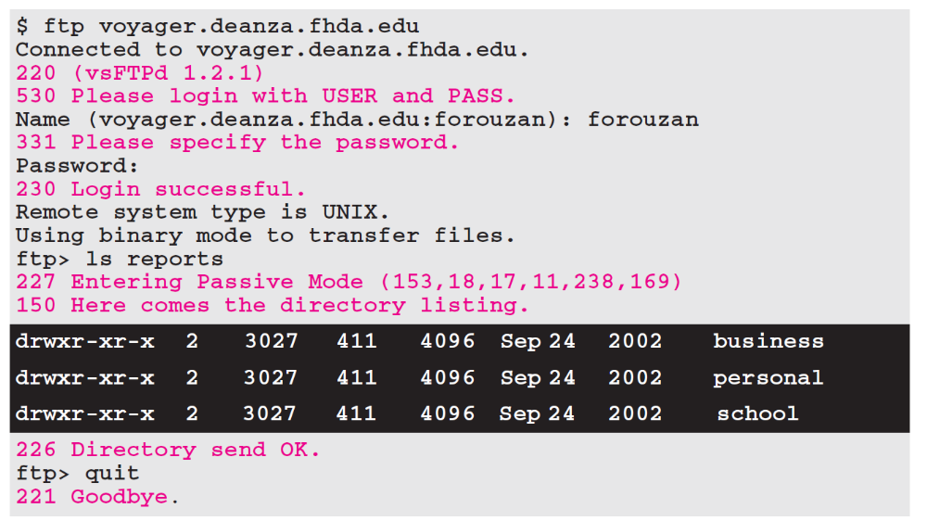
Example 21.2
The following shows an actual FTP session that parallels Example 21.1. The colored lines show the responses from the server control connection; the black lines show the commands sent by the client. The lines in white with black background show data transfer.
TCP/IP Protocol Suite

Slide 21
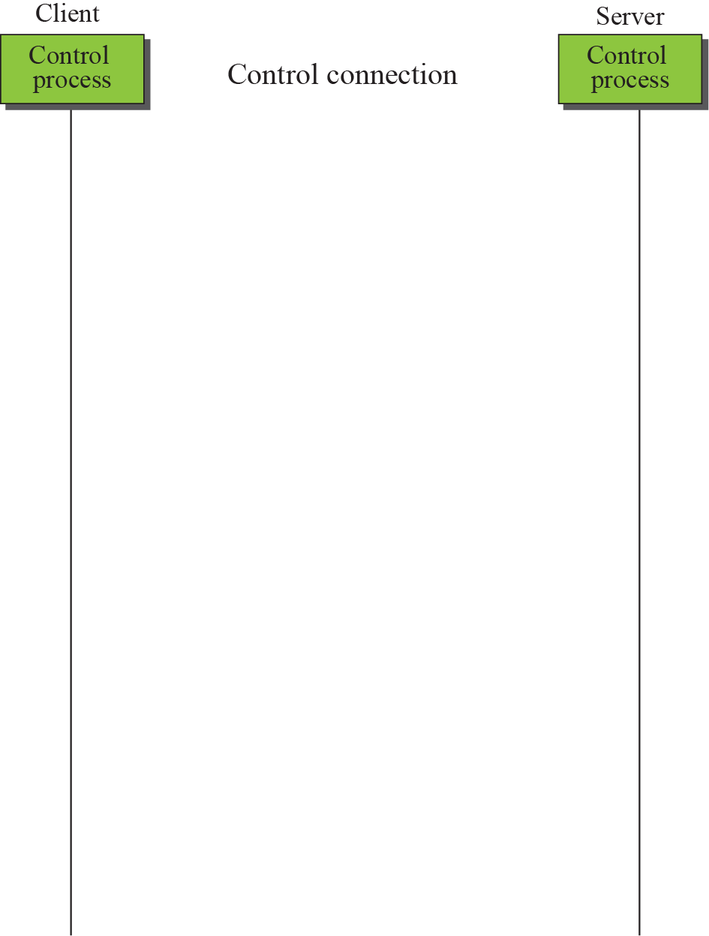
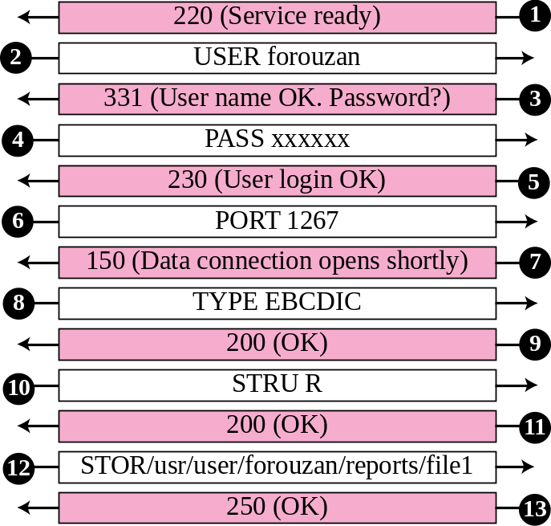
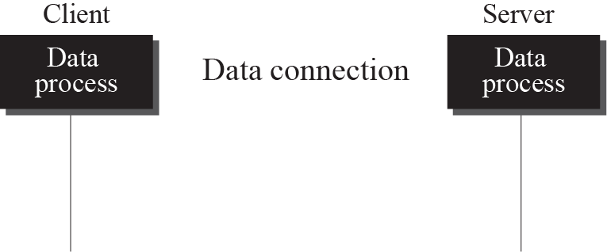

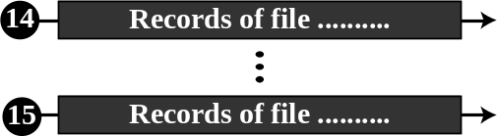
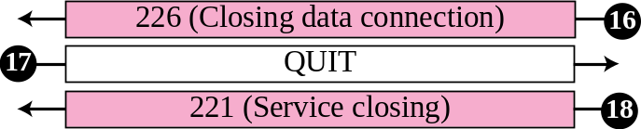
Figure 21.9 Example 21.3
TCP/IP Protocol Suite

Slide 22
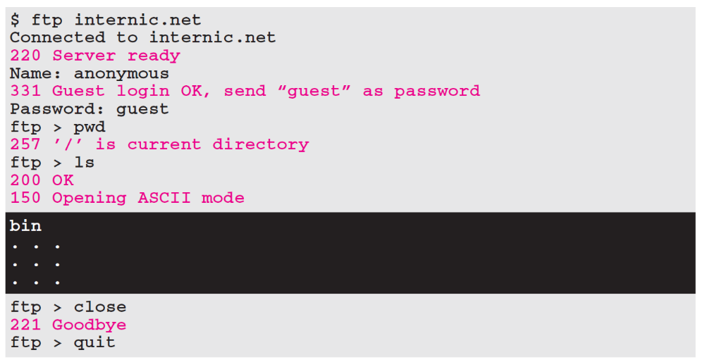
Example 21.4
We show an example of anonymous FTP. We assume that some public data are available at internic.net.
TCP/IP Protocol Suite

Slide 23
21-2 TFTP
There are occasions when we need to simply copy a file without the need for all of the features of the FTP protocol. For example, when a diskless workstation or a router is booted, we need to download the bootstrap and configuration files. Here we do not need all of the sophistication provided in FTP. We just need a protocol that quickly copies the files.
TCP/IP Protocol Suite

Slide 24
Note
TFTP uses the services of UDP on the well-known port 69.
TCP/IP Protocol Suite

Slide 25
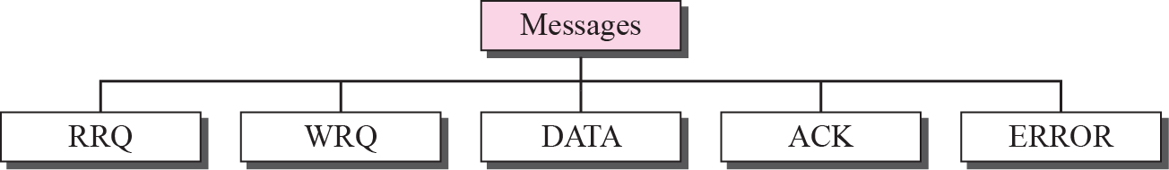
Figure 21.10 Message categories
TCP/IP Protocol Suite

Slide 26
Figure 21.11 RRQ format
TCP/IP Protocol Suite

Slide 27
Figure 21.12 WRQ format
TCP/IP Protocol Suite

Slide 28
Figure 21.13 Data Format
TCP/IP Protocol Suite

Slide 29
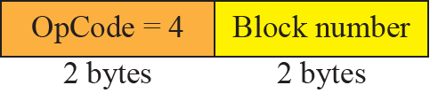
Figure 21.14 ACK format
TCP/IP Protocol Suite

Slide 30
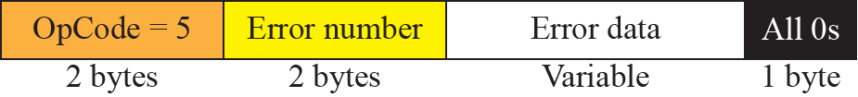
Figure 21.15 ERROR format
TCP/IP Protocol Suite

Slide 31
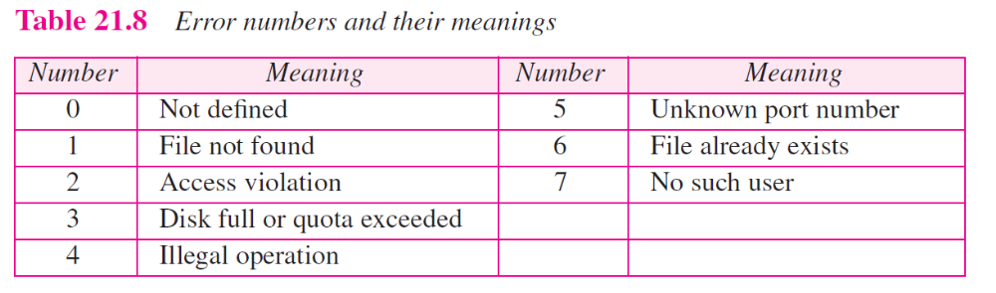
TCP/IP Protocol Suite

Slide 32
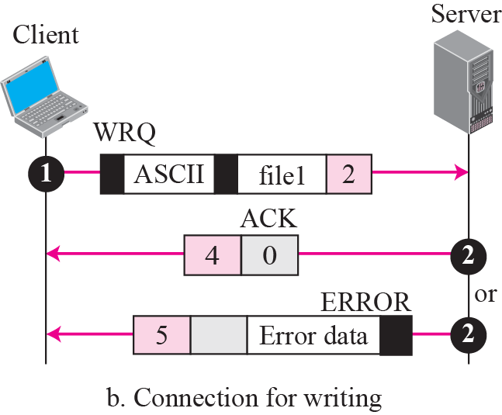
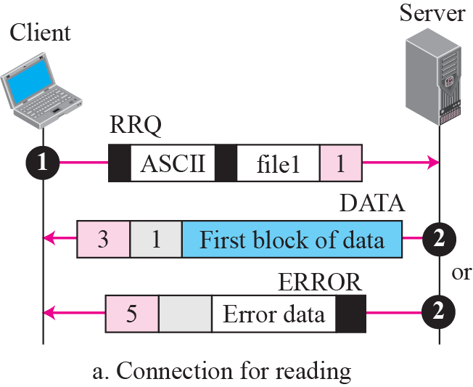
Figure 21.16 Connection establishment
TCP/IP Protocol Suite

Slide 33
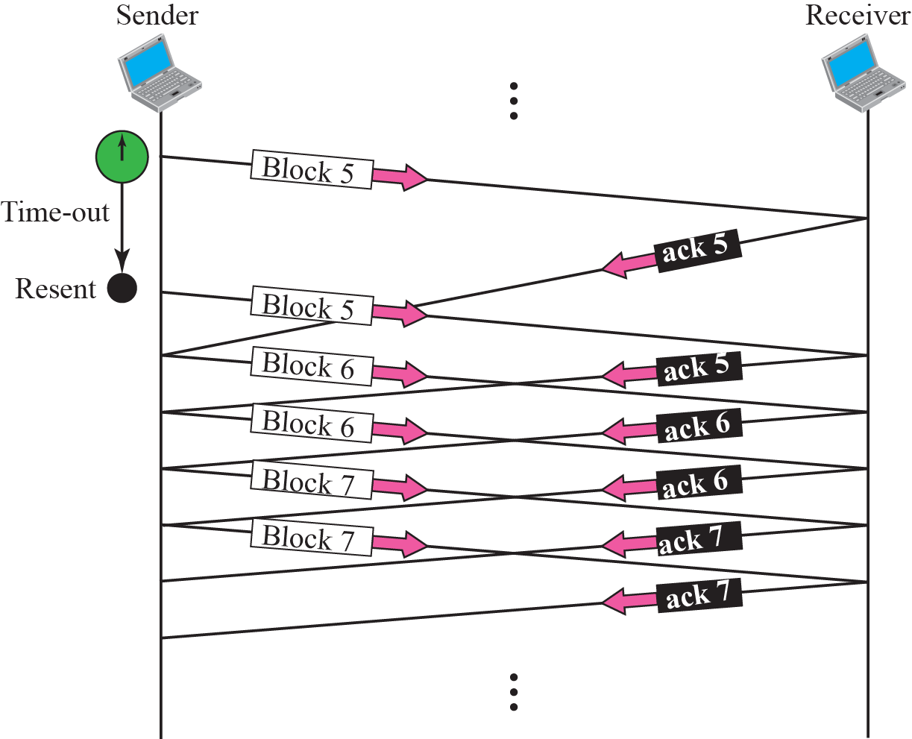
Figure 21.17 Server’s apprentice bug
TCP/IP Protocol Suite

Slide 34
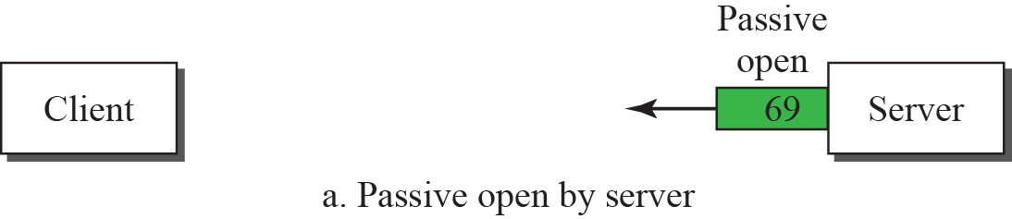
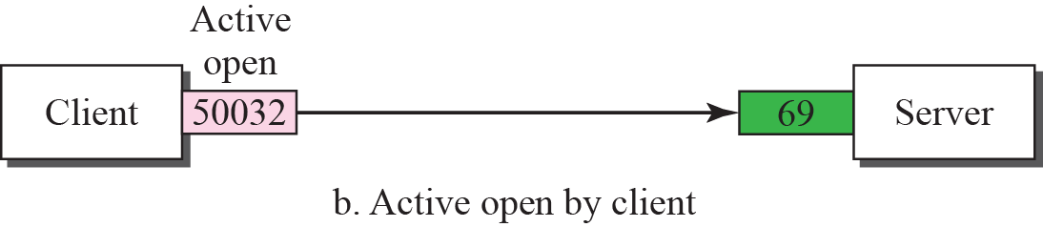
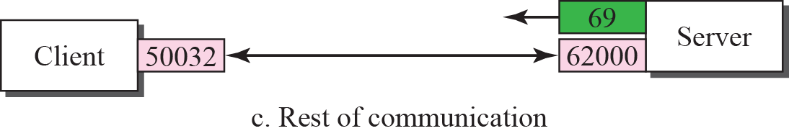
Figure 21.18 UDP port numbers used by TFTP
TCP/IP Protocol Suite

Slide 35
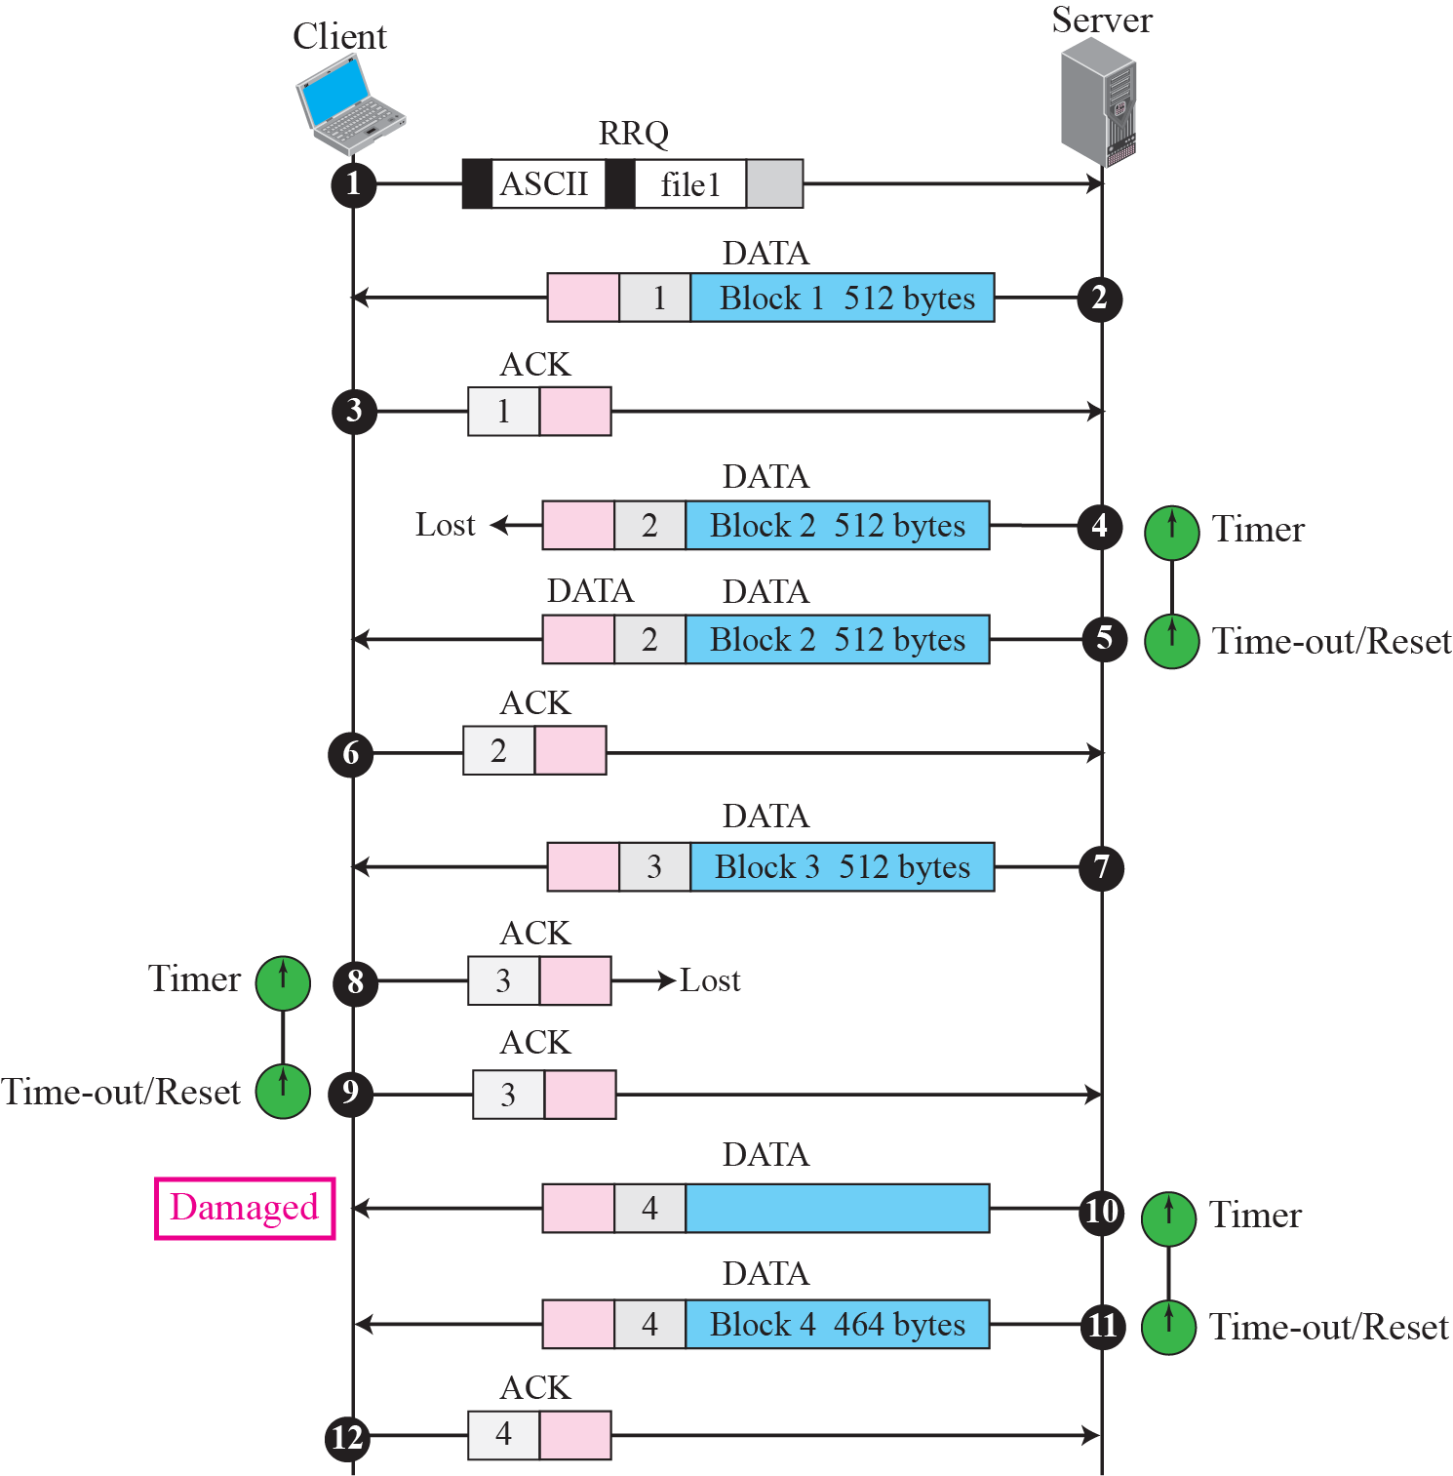
Figure 21.19 TFTP example
TCP/IP Protocol Suite

Slide 36
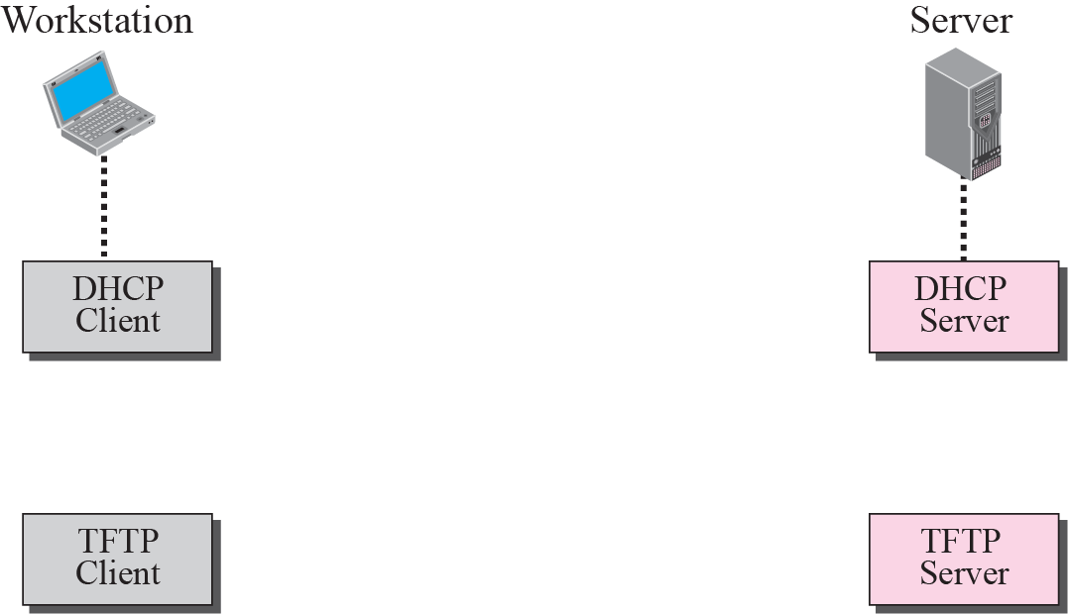

Figure 21.20 Use of TFTP with DHCP
TCP/IP Protocol Suite

