Slide 1

Chapter 22
World Wide Web
and
HTTP
TCP/IP Protocol Suite

Slide 2
22-1 ARCHITECTURE
The WWW today is a distributed client-server service, in which a client using a browser can access a service using a server. However, the service provided is distributed over many locations called sites. Each site holds one or more documents, referred to as Web pages. Each Web page, however, can contain some links to other Web pages in the same or other sites. In other words, a Web page can be simple or composite.
TCP/IP Protocol Suite

Slide 3
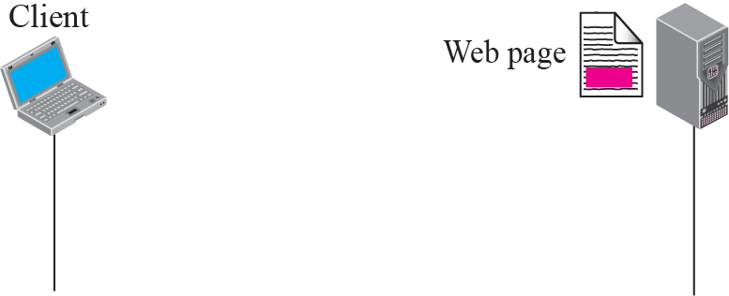
Figure 22.1 Example 22.1
TCP/IP Protocol Suite

Slide 4
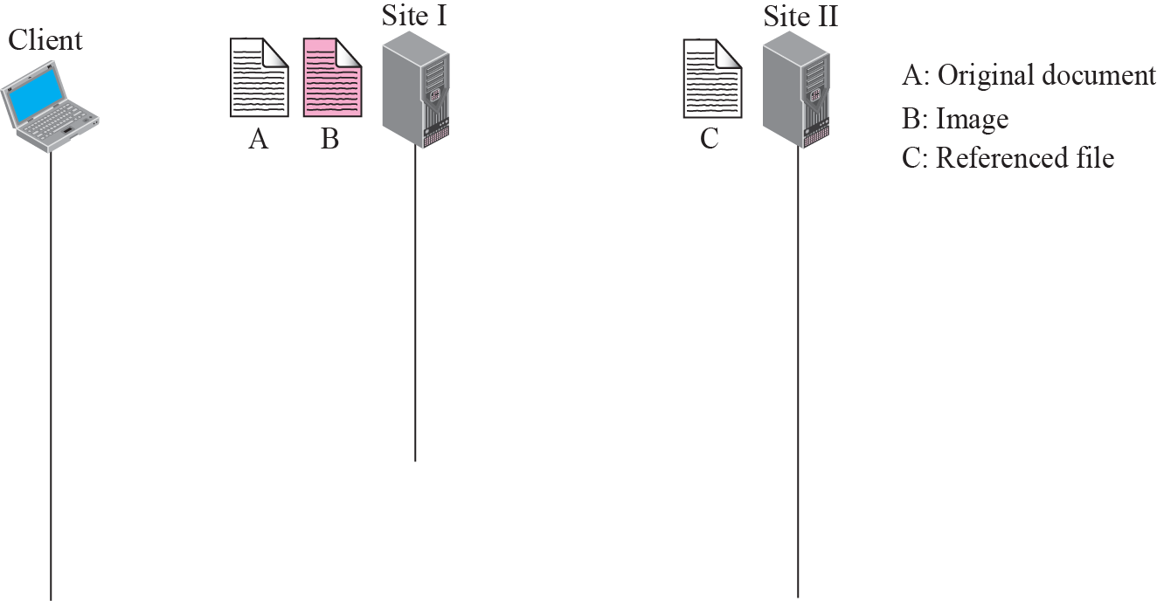




Figure 22.2 Example 22.2
TCP/IP Protocol Suite

Slide 5
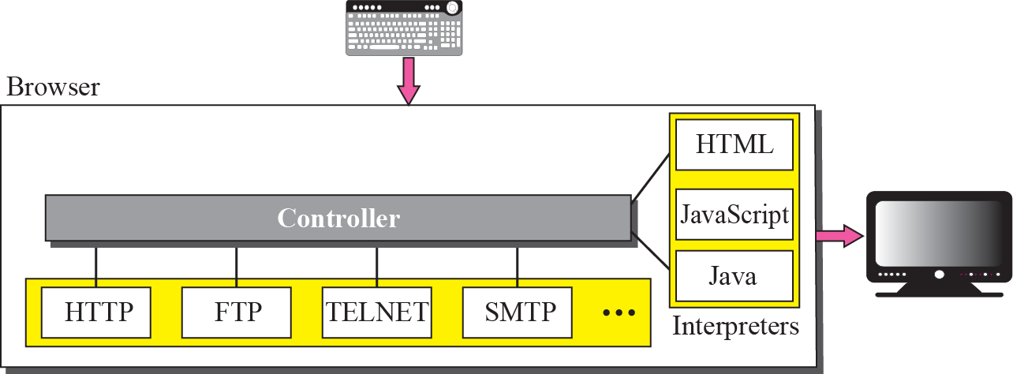
Figure 22.3 Browser
TCP/IP Protocol Suite

Slide 6
Figure 22.4 URL
TCP/IP Protocol Suite

Slide 7
22-2 WEB DOCUMENTS
The documents in the WWW can be grouped into three broad categories: static, dynamic, and active. The category is based on the time the contents of the document are determined.
TCP/IP Protocol Suite

Slide 8
Topics Discussed in the Section
Static Documents
Dynamic Documents
Active Documents
TCP/IP Protocol Suite

Slide 9
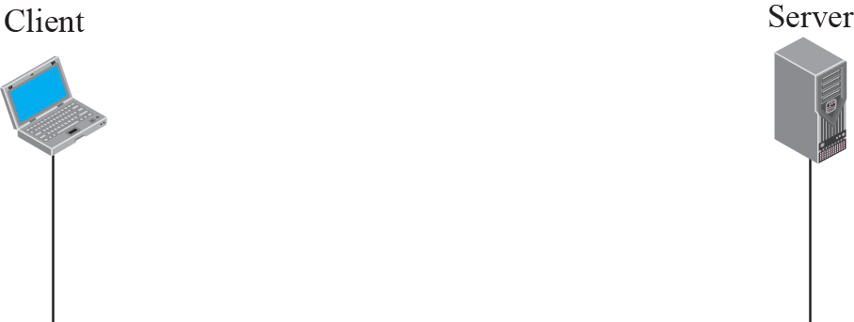
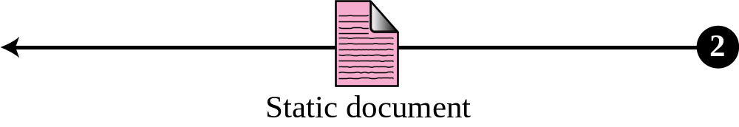
Figure 22.5 Static document
TCP/IP Protocol Suite

Slide 10

Note
HTML, XML, XSL, and XHTML are discussed in Appendix E.
TCP/IP Protocol Suite

Slide 11
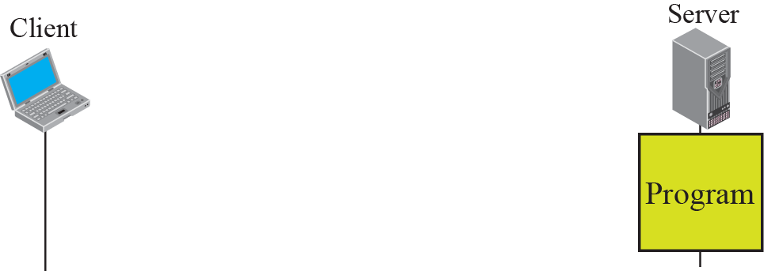
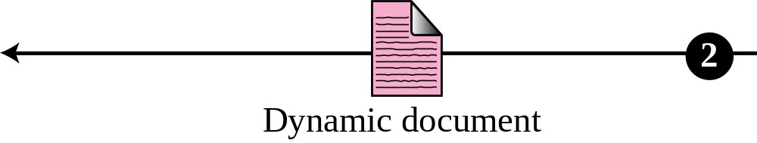
Figure 22.6 Dynamic document using CGI
TCP/IP Protocol Suite

Slide 12
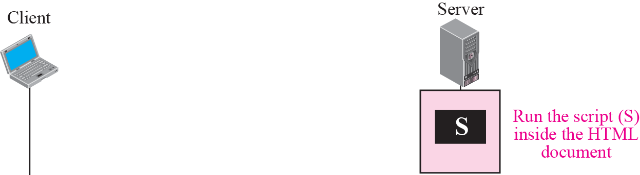
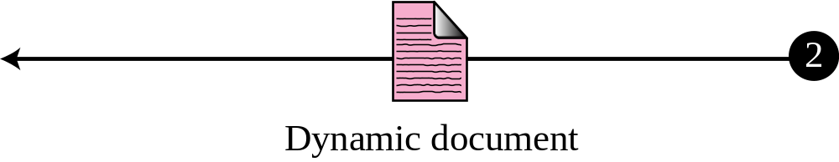
Figure 22.7 Dynamic document using server-site script
TCP/IP Protocol Suite

Slide 13
Note
Dynamic documents are sometimes referred to as server-site dynamic documents.
TCP/IP Protocol Suite

Slide 14
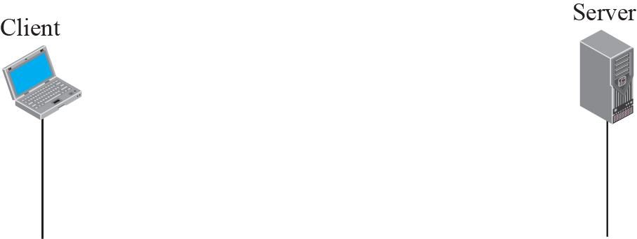
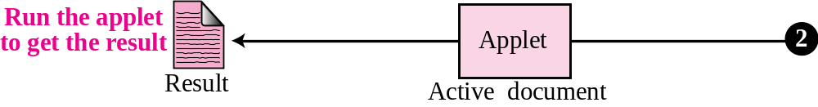
Figure 22.8 Active document using Java applet
TCP/IP Protocol Suite

Slide 15
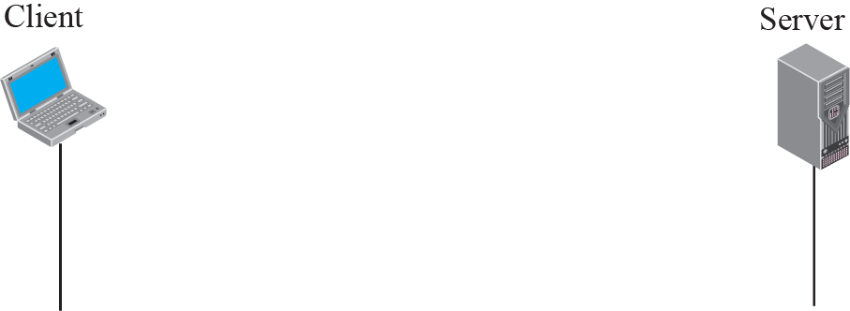
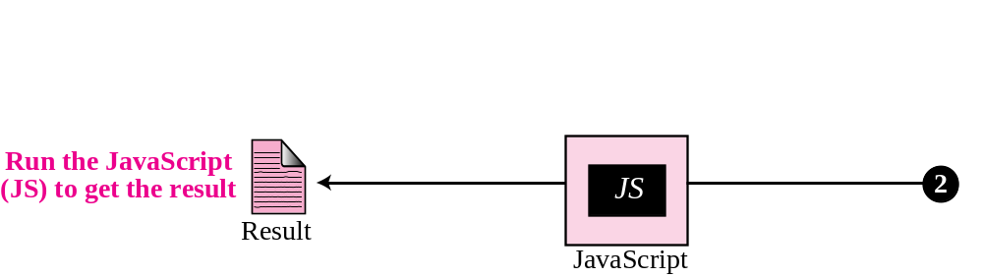
Figure 22.9 Active document using client-site script
TCP/IP Protocol Suite

Slide 16
Note
Active documents are sometimes referred to as client-site dynamic documents.
TCP/IP Protocol Suite

Slide 17
22-3 HTTP
The Hypertext Transfer Protocol (HTTP) is a protocol used mainly to access data on the World Wide Web. HTTP functions like a combination of FTP (Chapter 21) and SMTP (Chapter 23). It is similar to FTP because it transfers files and uses the services of TCP. However, it is much simpler than FTP because it uses only one TCP connection. There is no separate control connection; only data are transferred between the client and the server.
TCP/IP Protocol Suite

Slide 18
Note
HTTP uses the services of TCP on well-known port 80.
TCP/IP Protocol Suite

Slide 19
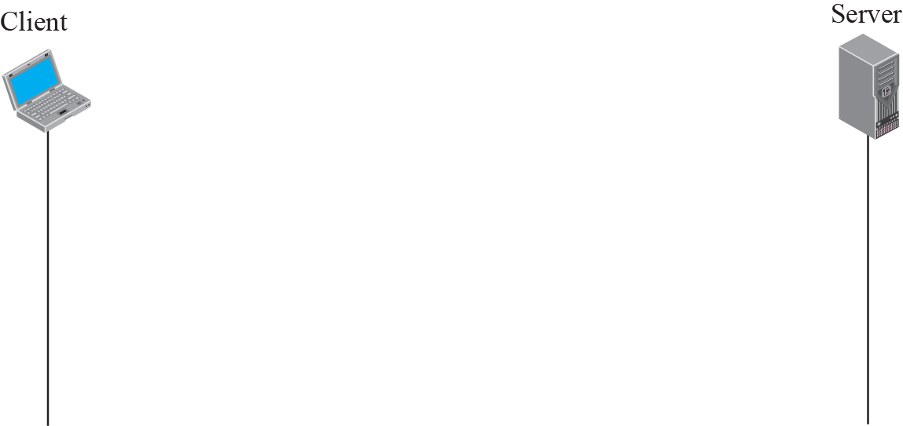
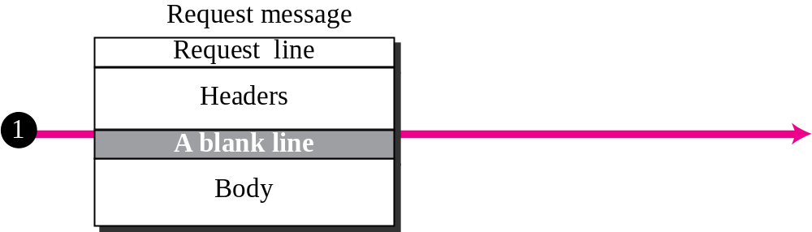
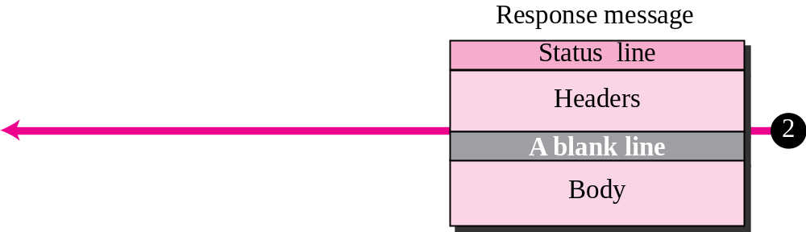
Figure 22.10 HTTP transaction
TCP/IP Protocol Suite

Slide 20
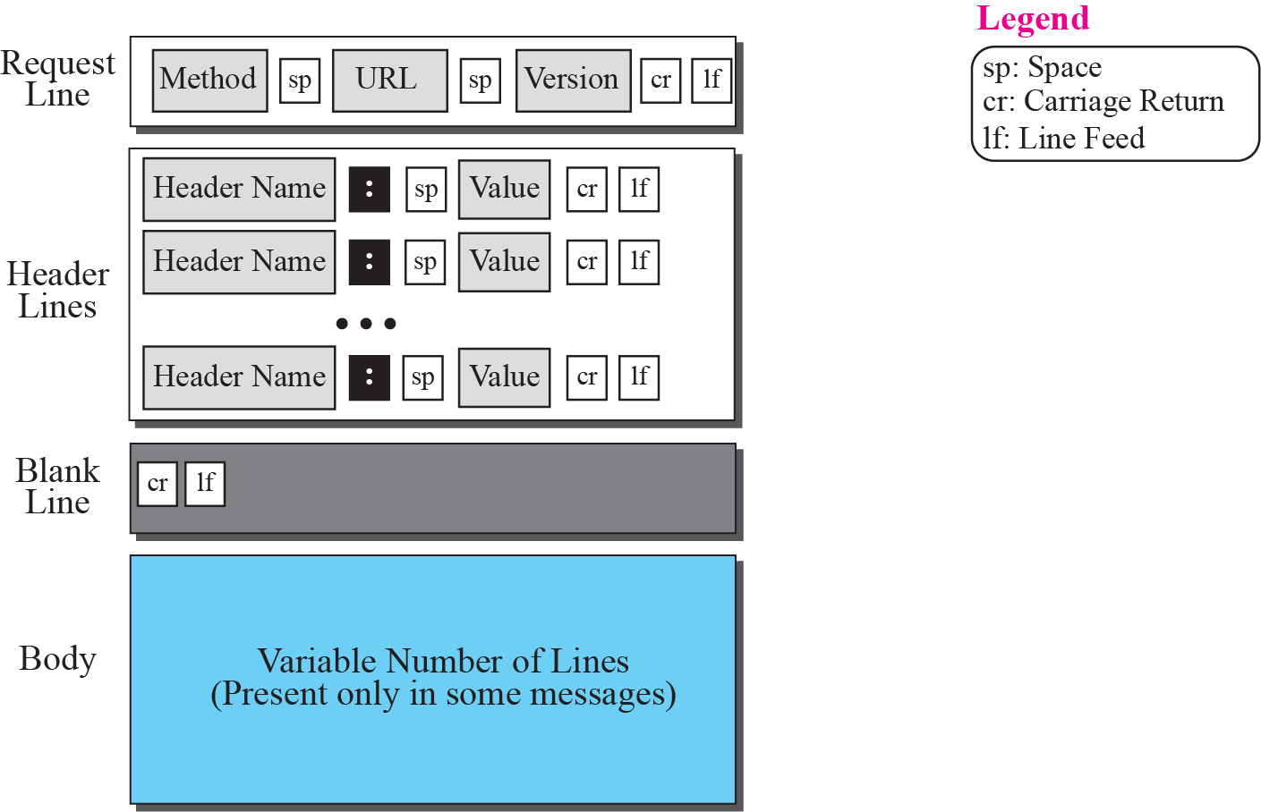
Figure 22.11 Format of the request message
TCP/IP Protocol Suite

Slide 21
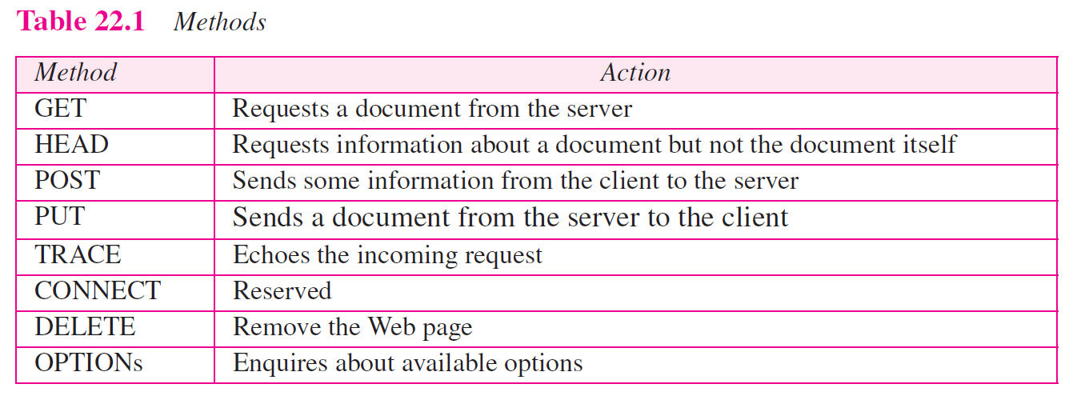
TCP/IP Protocol Suite

Slide 22
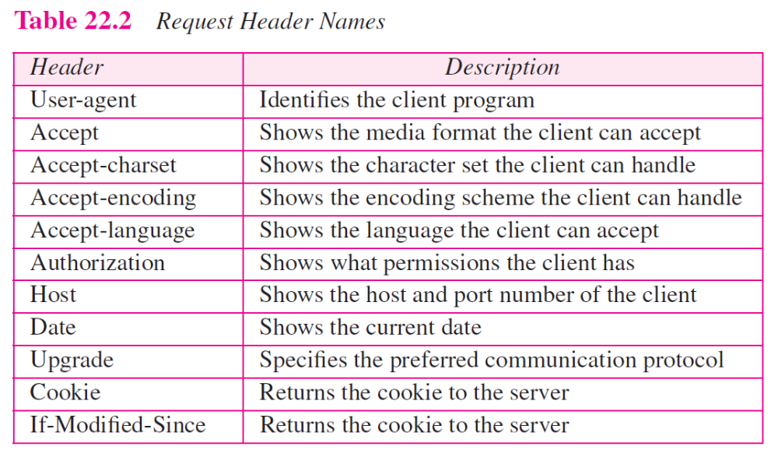
TCP/IP Protocol Suite

Slide 23
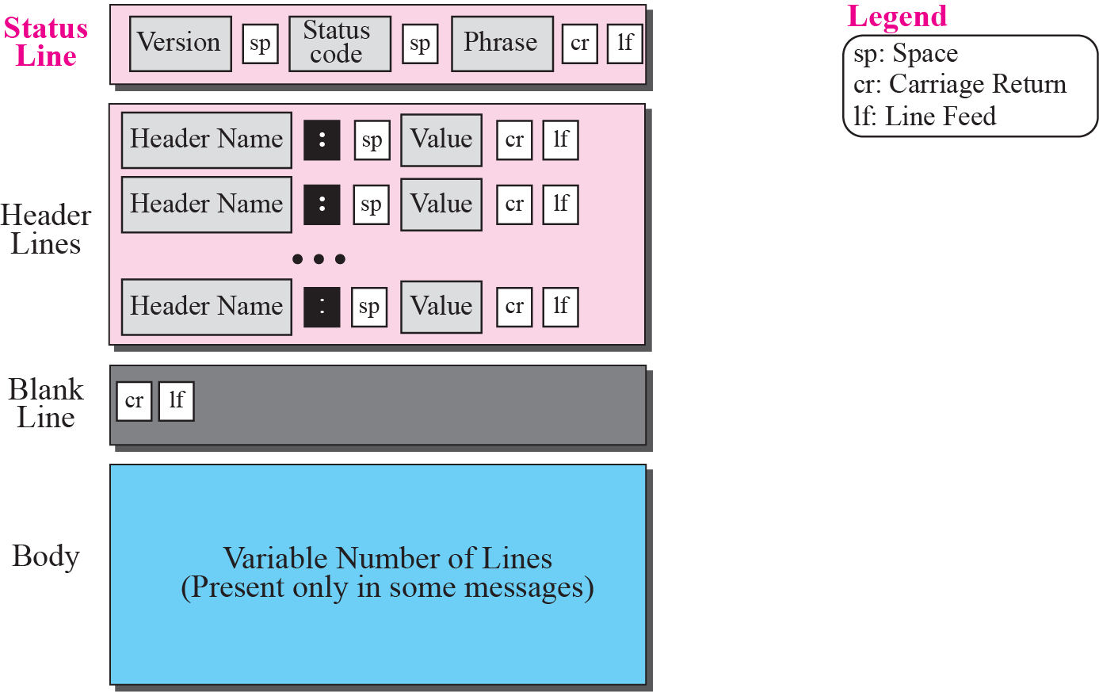
Figure 22.12 Format of the response message
TCP/IP Protocol Suite

Slide 24
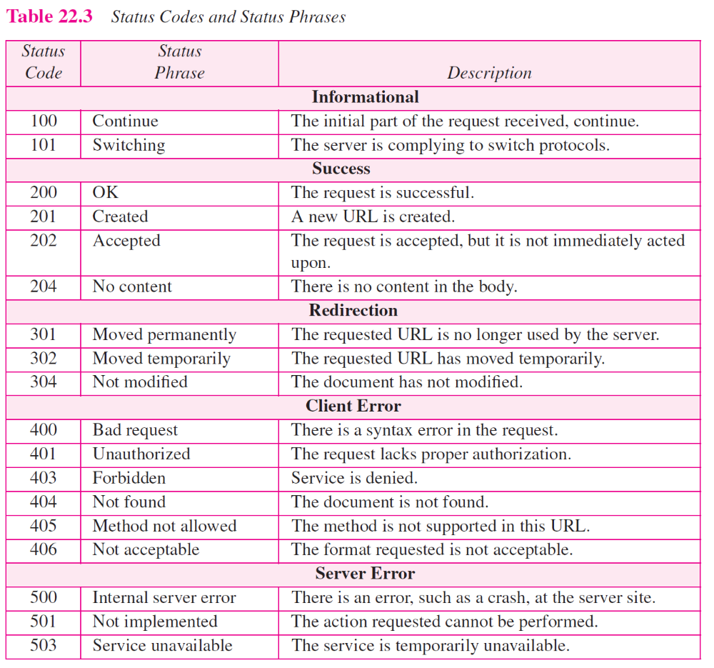
TCP/IP Protocol Suite

Slide 25
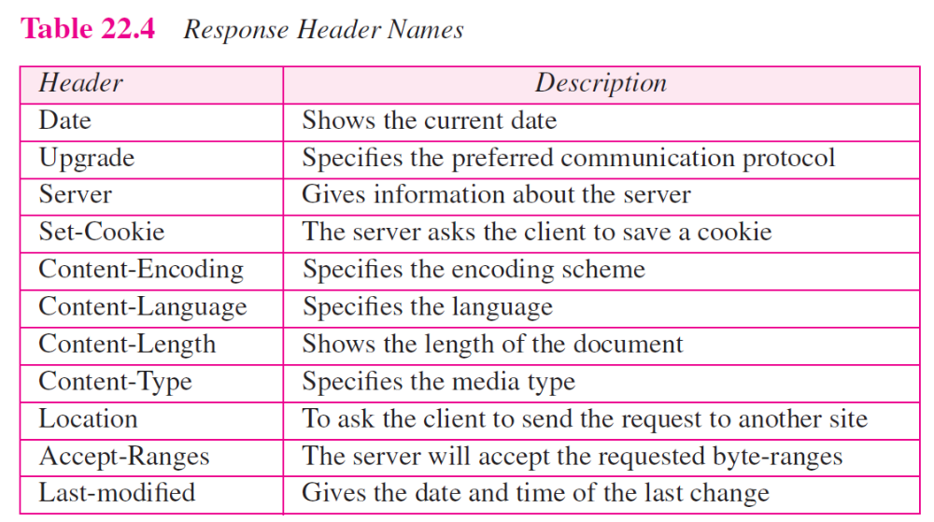
TCP/IP Protocol Suite

Slide 26
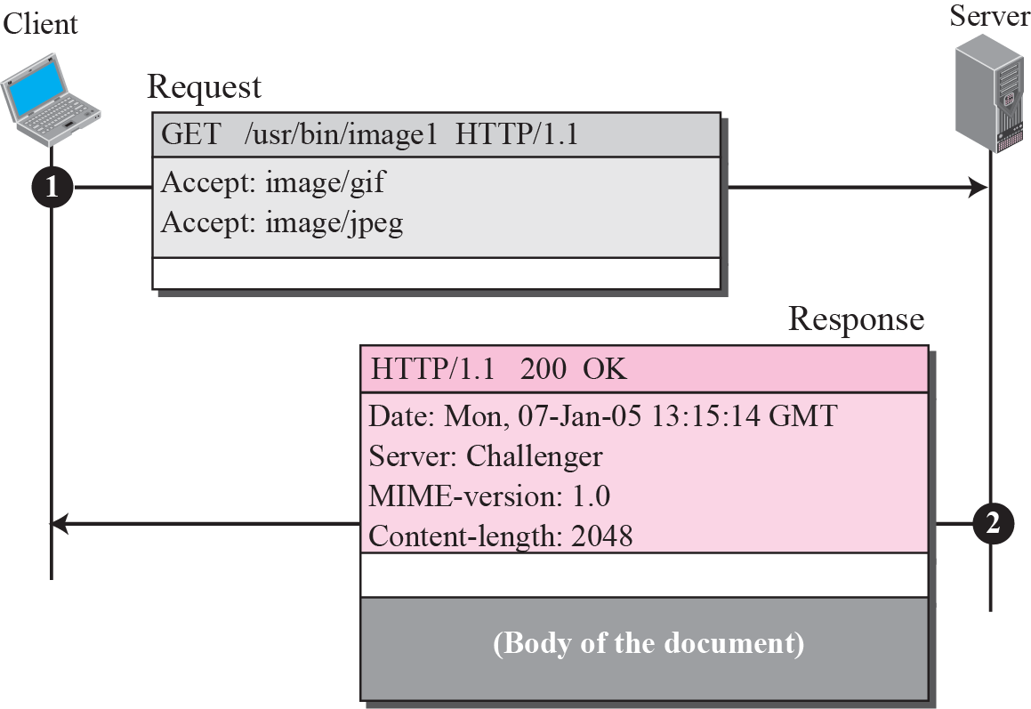
Figure 22.13 Example 22.4
TCP/IP Protocol Suite

Slide 27
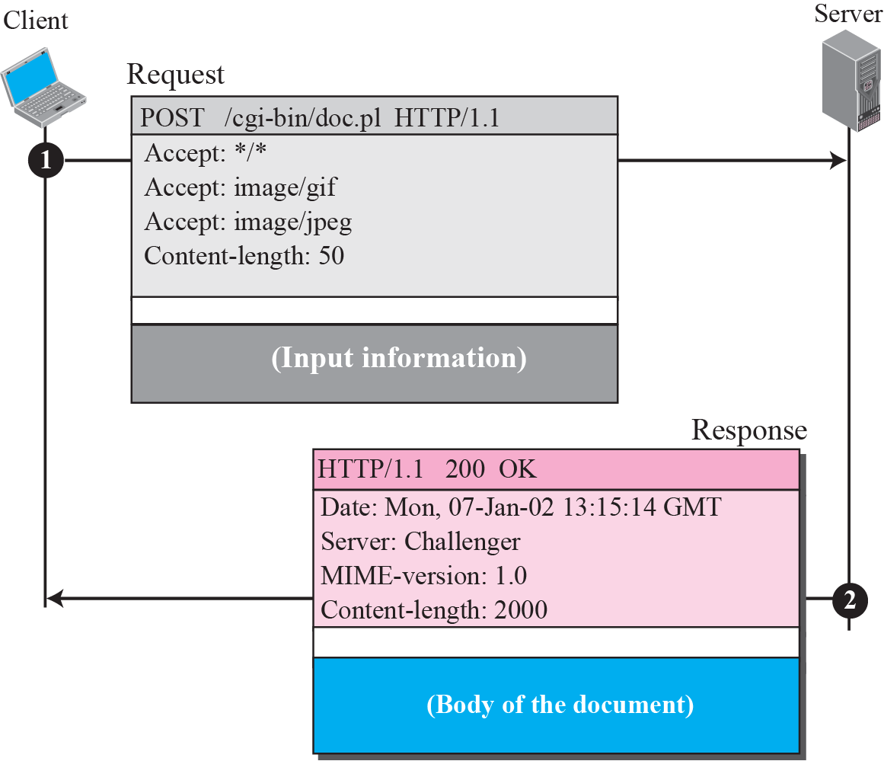
Figure 22.14 Example 22.5
TCP/IP Protocol Suite

Slide 28
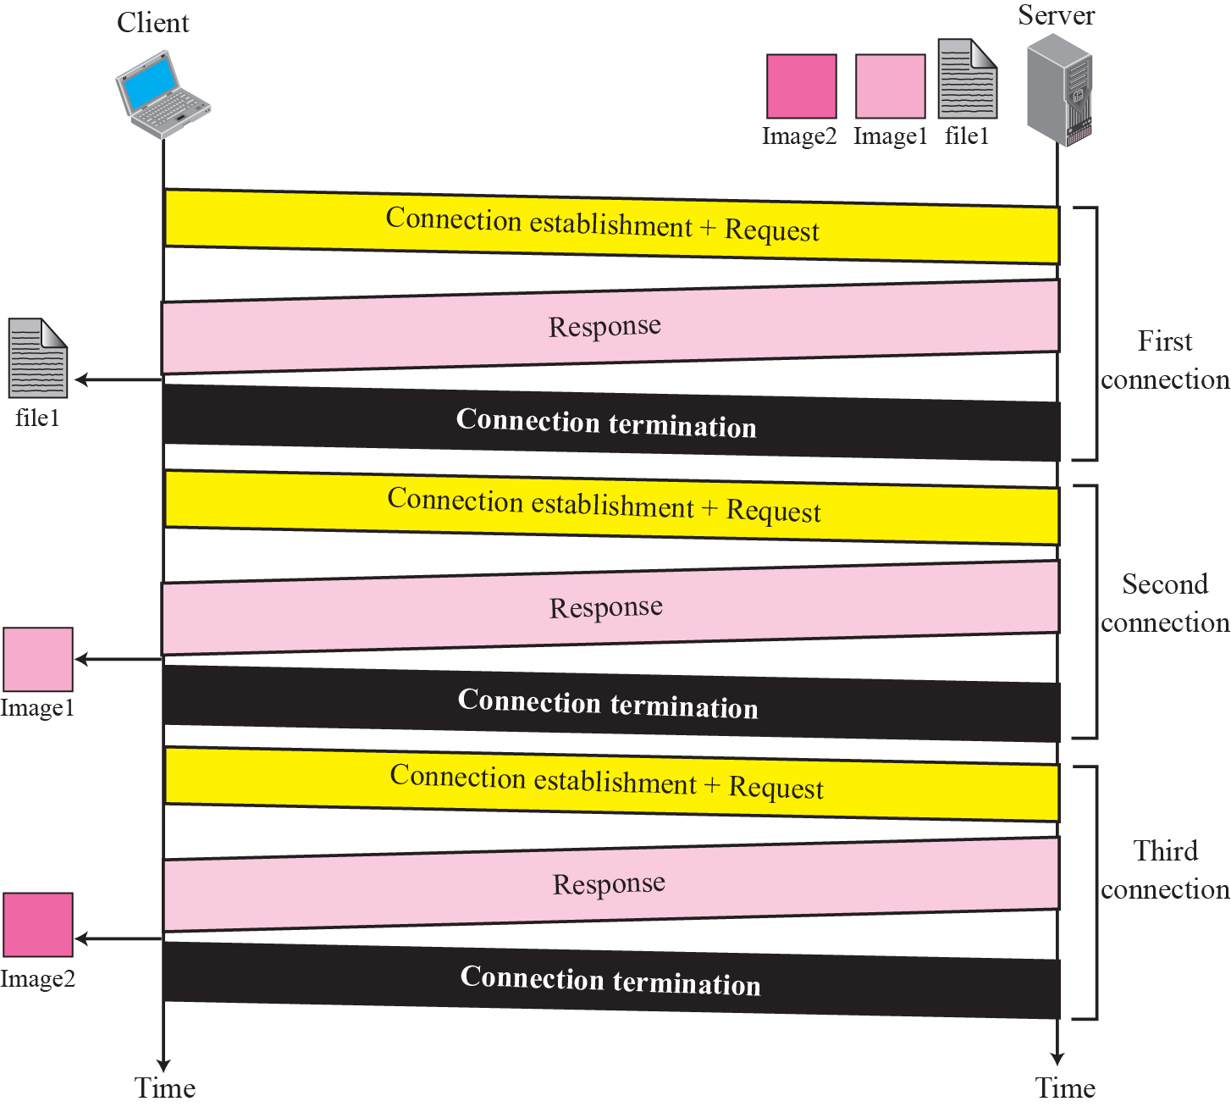
Figure 22.15 Example 22.8
TCP/IP Protocol Suite

Slide 29
Note
HTTP version 1.1 specifies a persistent connection by default.
TCP/IP Protocol Suite

Slide 30
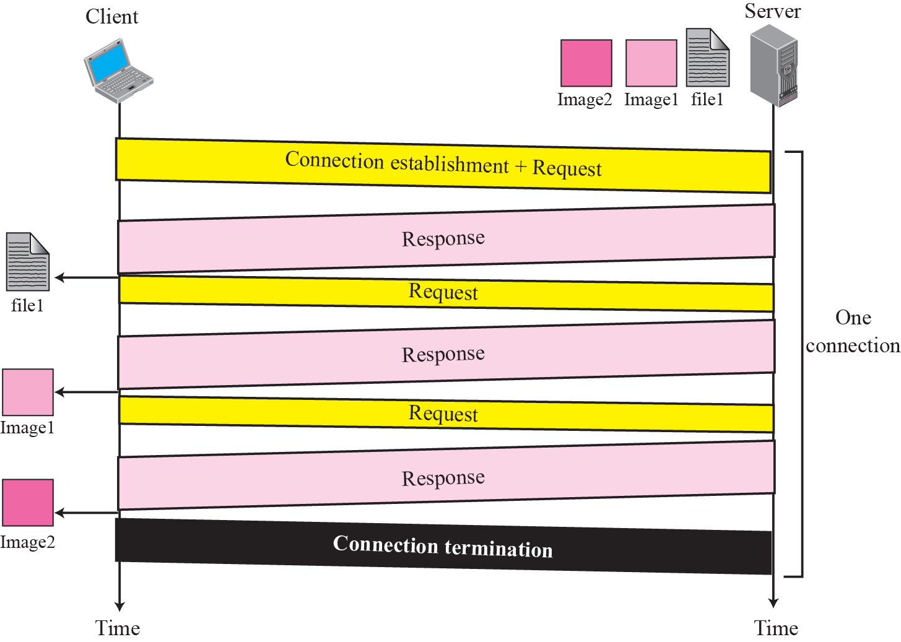
Figure 22.16 Example 22.9
TCP/IP Protocol Suite

