Slide 1

Chapter 23
Electronic Mail:
SMTP, POP
IMAP, and MIME
TCP/IP Protocol Suite

Slide 2
23-1 ARCHITECTURE
To explain the architecture of e-mail, we give four scenarios. We begin with the simplest situation and add complexity as we proceed. The fourth scenario is the most common in the exchange of e-mail.
TCP/IP Protocol Suite

Slide 3
Topics Discussed in the Section
First Scenario
Second Scenario
Third Scenario
Fourth Scenario
TCP/IP Protocol Suite

Slide 4
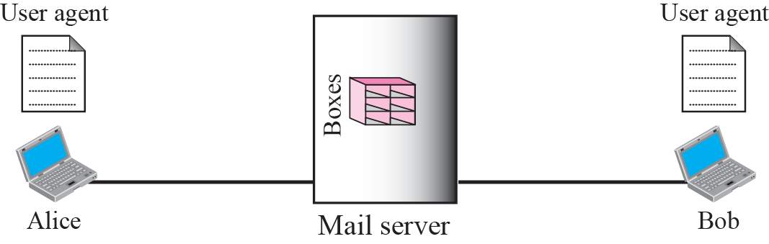

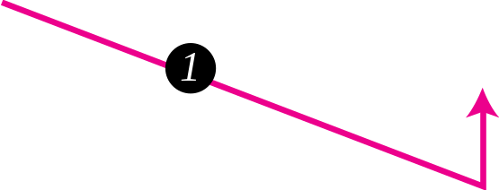
Figure 23.1 First scenario
TCP/IP Protocol Suite

Slide 5

Note
When the sender and the receiver of an e-mail are on the same mail server,
we need only two user agents.
TCP/IP Protocol Suite

Slide 6
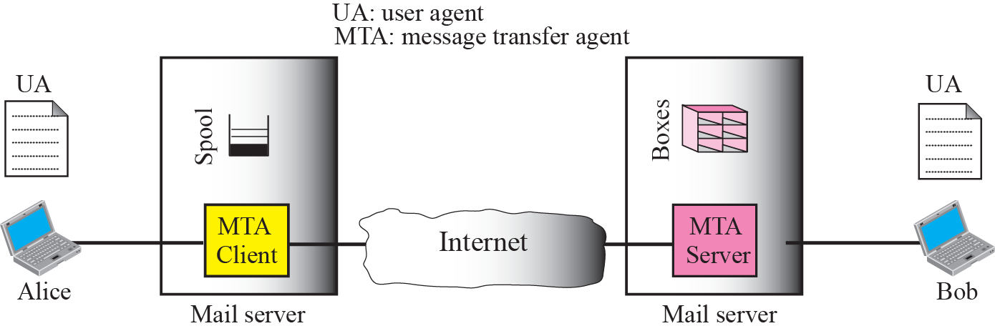

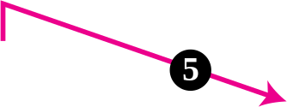



Figure 23.2 Second scenario
TCP/IP Protocol Suite

Slide 7
Note
When the sender and the receiver of an e-mail are on different mail servers,
we need two UAs and a pair of MTAs (client and server).
TCP/IP Protocol Suite

Slide 8
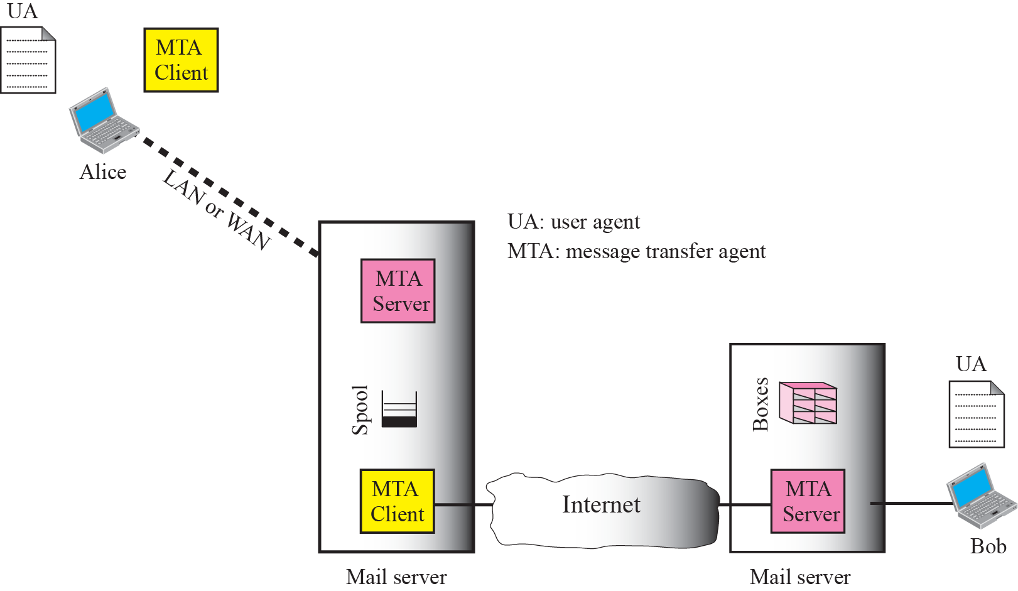

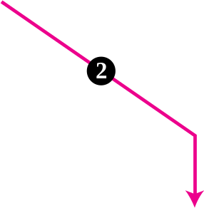





Figure 23.3 Third scenario
TCP/IP Protocol Suite

Slide 9
Note
When the sender is connected to the mail server via a LAN or a WAN, we
need two UAs and two pairs of MTAs
(client and server).
TCP/IP Protocol Suite

Slide 10
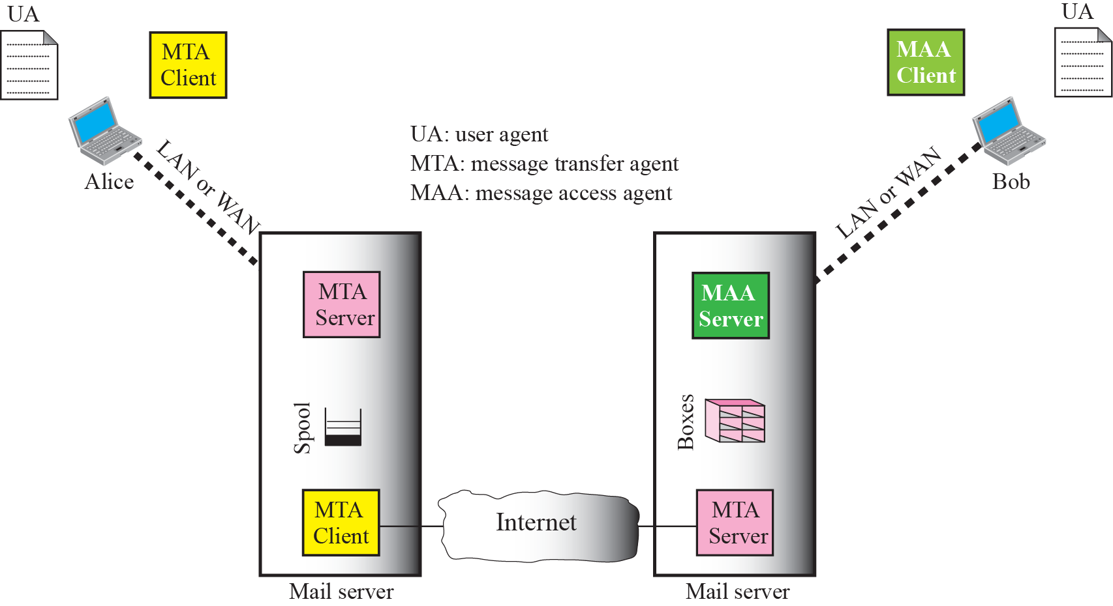

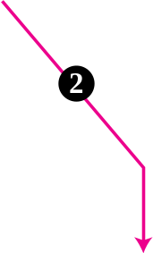

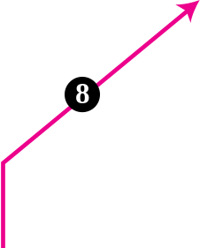





Figure 23.4 Fourth scenario
TCP/IP Protocol Suite

Slide 11
Note
When both sender and receiver are connected to the mail server via a LAN or a WAN, we need two UAs, two pairs of MTAs (client and server), and a pair of MAAs (client and server). This is the most common situation today.
TCP/IP Protocol Suite

Slide 12
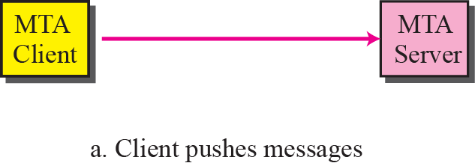
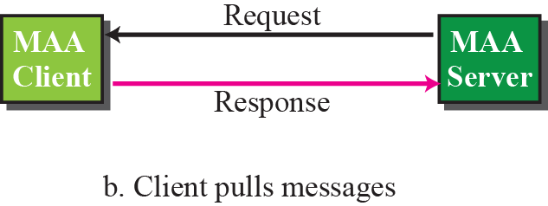
Figure 23.5 Push versus pull
TCP/IP Protocol Suite

Slide 13
23-2 USER AGENT
The first component of an electronic mail system is the user agent (UA). It provides service to the user to make the process of sending and receiving a message easier.
TCP/IP Protocol Suite

Slide 14
Note
Some examples of command-driven user agents are mail, pine, and elm.
TCP/IP Protocol Suite

Slide 15
Note
Some examples of GUI-based user agents are Eudora, Outlook,
And Netscape.
TCP/IP Protocol Suite

Slide 16
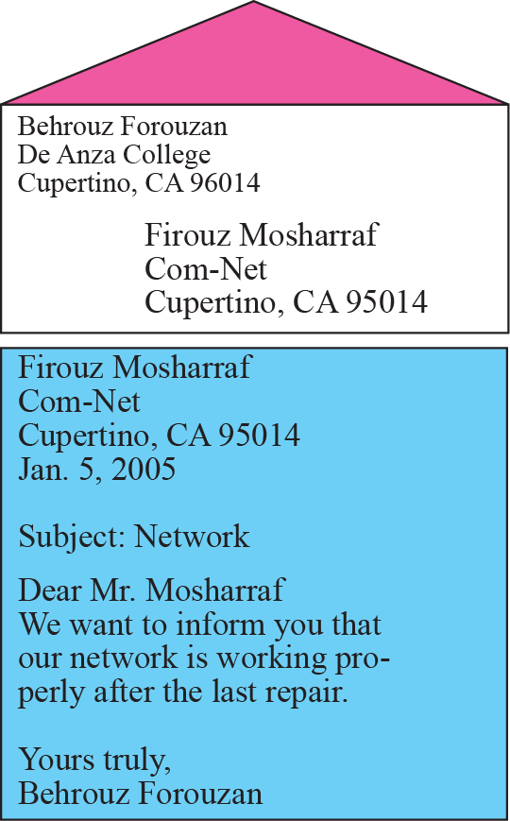
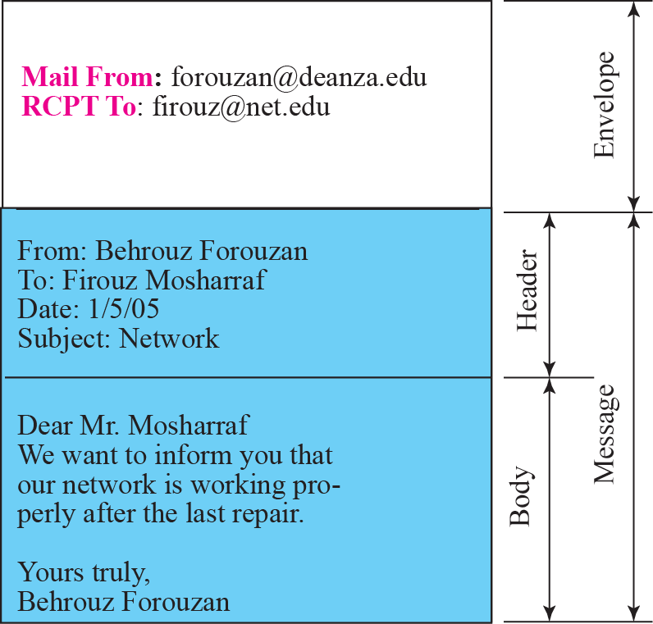
Figure 23.6 Format of an email
TCP/IP Protocol Suite

Slide 17
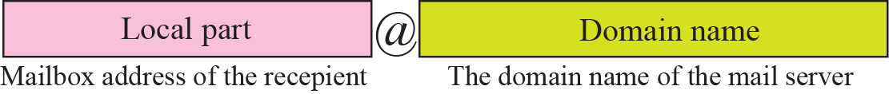
Figure 23.7 E-mail address
TCP/IP Protocol Suite

Slide 18
23-3 MESSAGE TRANSFER AGENT
The actual mail transfer is done through message transfer agents (MTAs). To send mail, a system must have the client MTA, and to receive mail, a system must have a server MTA. The formal protocol that defines the MTA client and server in the Internet is called Simple Mail Transfer Protocol (SMTP). As we said before, two pairs of MTA client-server programs are used in the most common situation (fourth scenario). Figure 23.8 shows the range of the SMTP protocol in this scenario.
TCP/IP Protocol Suite

Slide 19
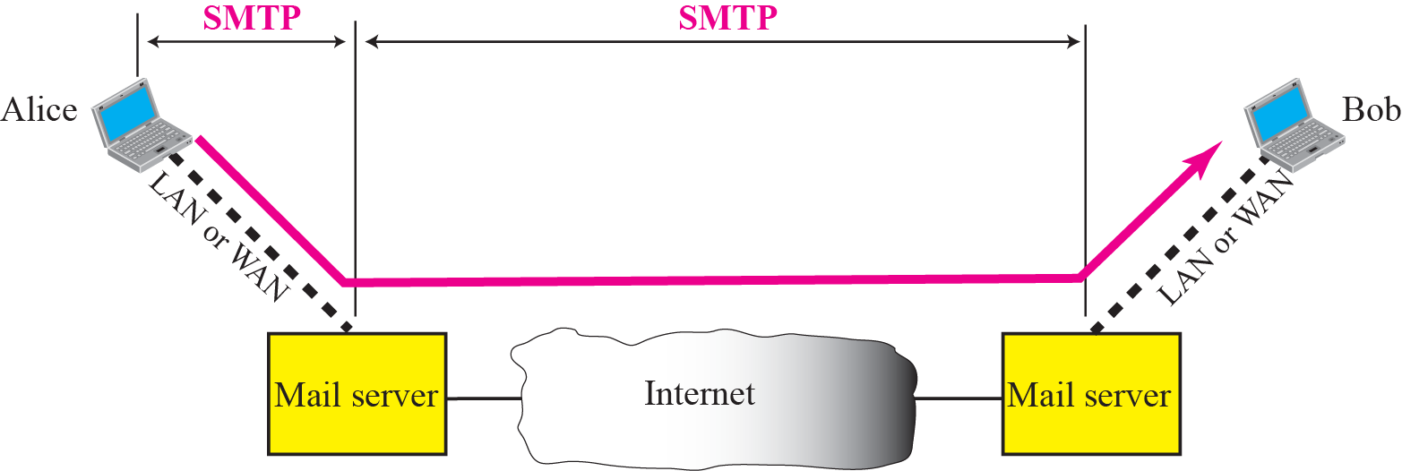
Figure 23.8 SMTP range
TCP/IP Protocol Suite

Slide 20
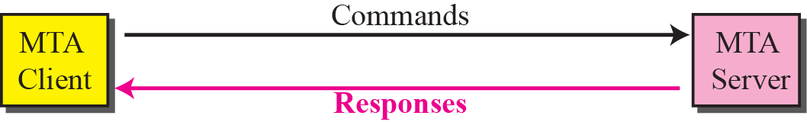
Figure 23.9 Commands and responses
TCP/IP Protocol Suite

Slide 21
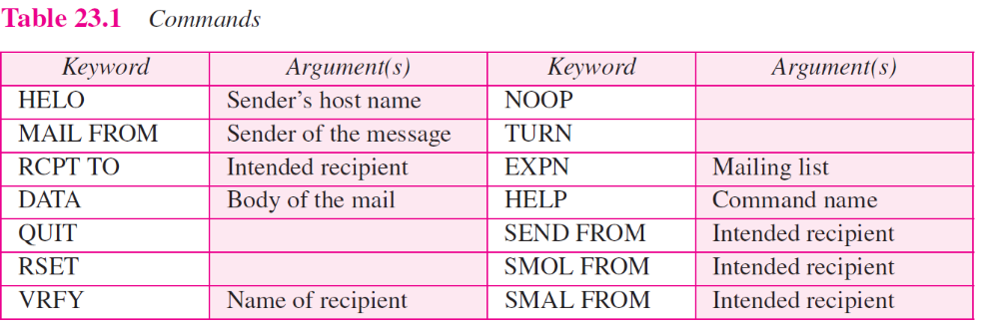
TCP/IP Protocol Suite

Slide 22
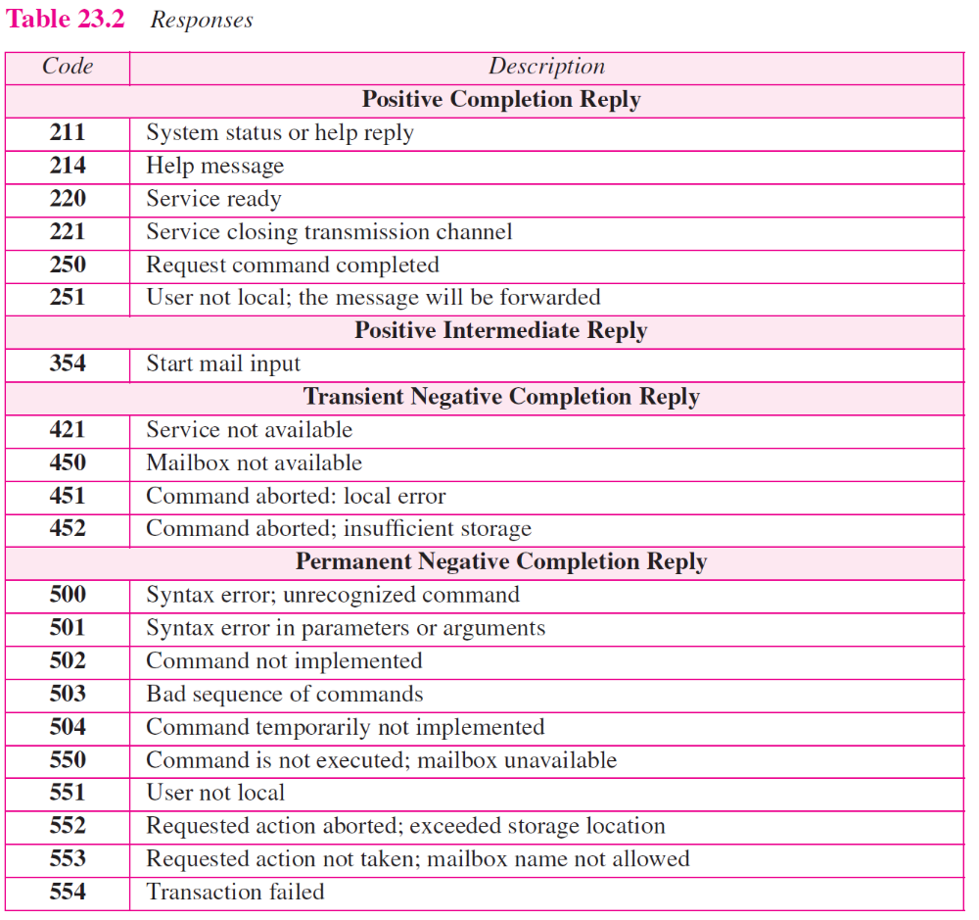
TCP/IP Protocol Suite

Slide 23
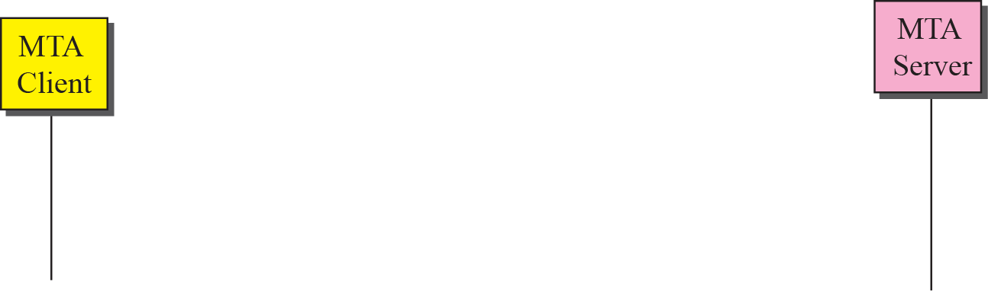
Figure 23.10 Connection establishment
TCP/IP Protocol Suite

Slide 24
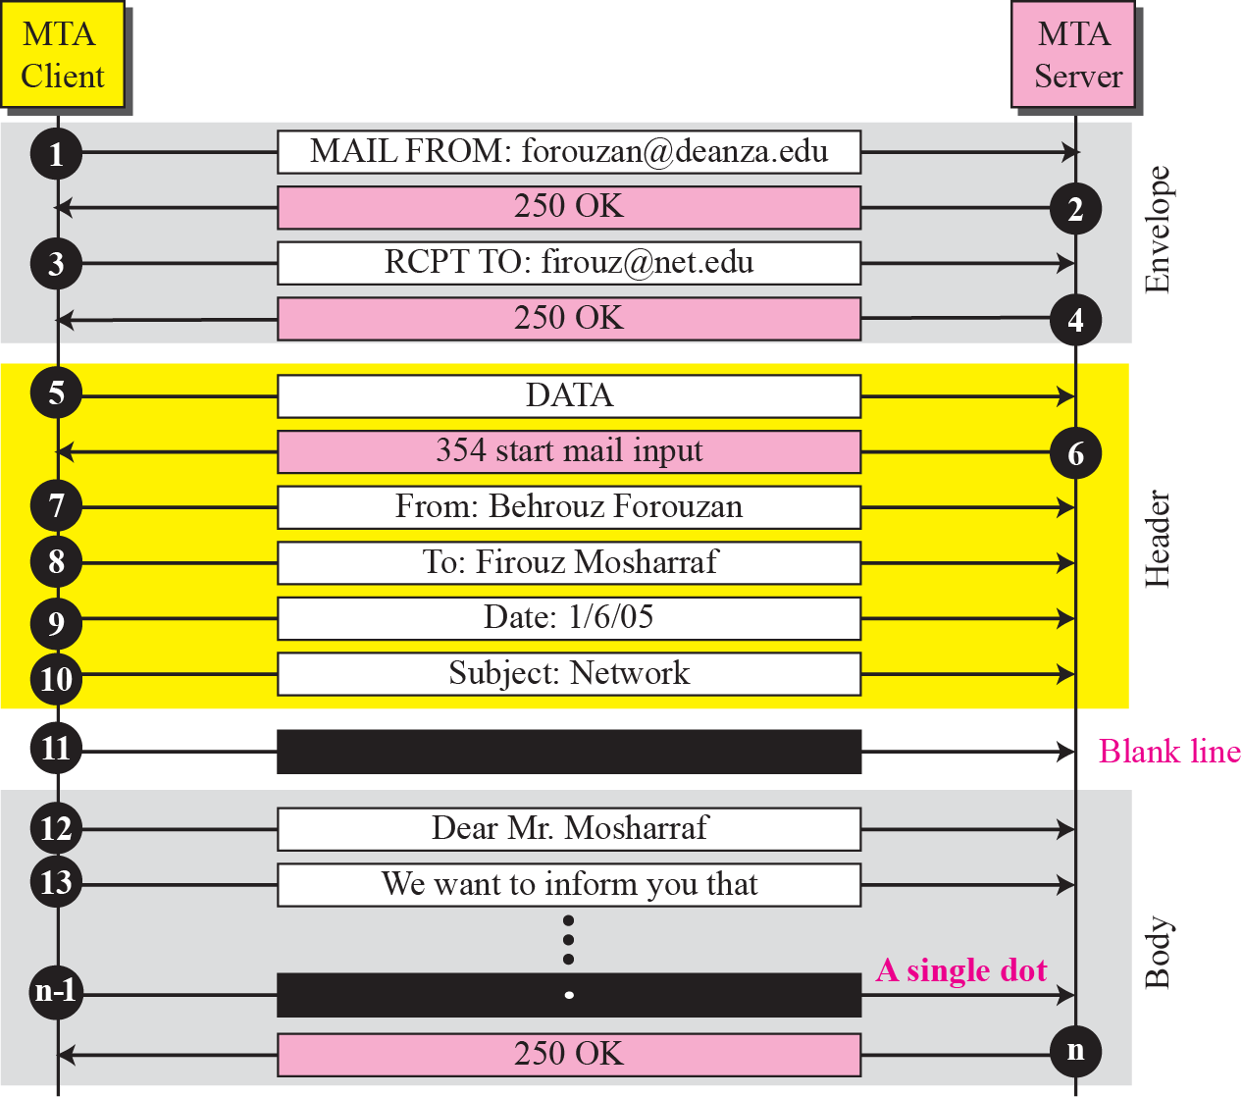
Figure 23.11 Message transfer
TCP/IP Protocol Suite

Slide 25
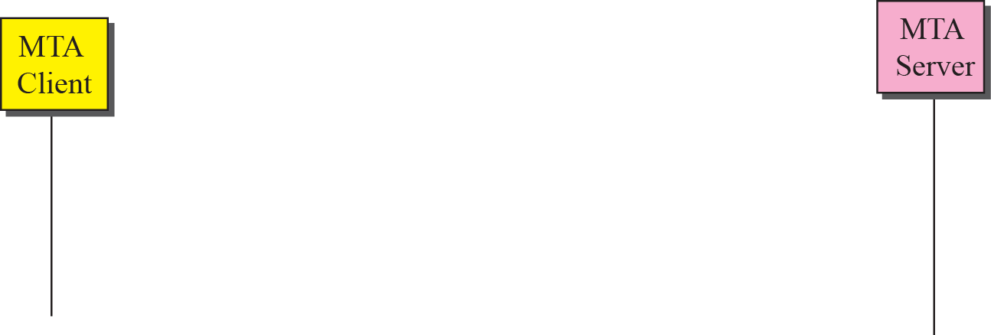
Figure 23.12 Connection termination
TCP/IP Protocol Suite

Slide 26
23-4 MESSAGE ACCESS AGENT
The first and the second stages of mail delivery use SMTP. However, SMTP is not involved in the third stage because SMTP is a push protocol; it pushes the message from the client to the server. In other words, the direction of the bulk data (messages) is from the client to the server. On the other hand, the third stage needs a pull protocol; the client must pull messages from the server. The direction of the bulk data are from the server to the client. The third stage uses a message access agent.
TCP/IP Protocol Suite

Slide 27
Topics Discussed in the Section
POP3
IMAP4
TCP/IP Protocol Suite

Slide 28
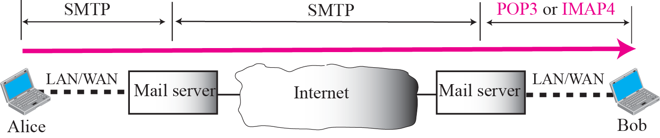
Figure 23.13 Pop3 and IMAP4
TCP/IP Protocol Suite

Slide 29
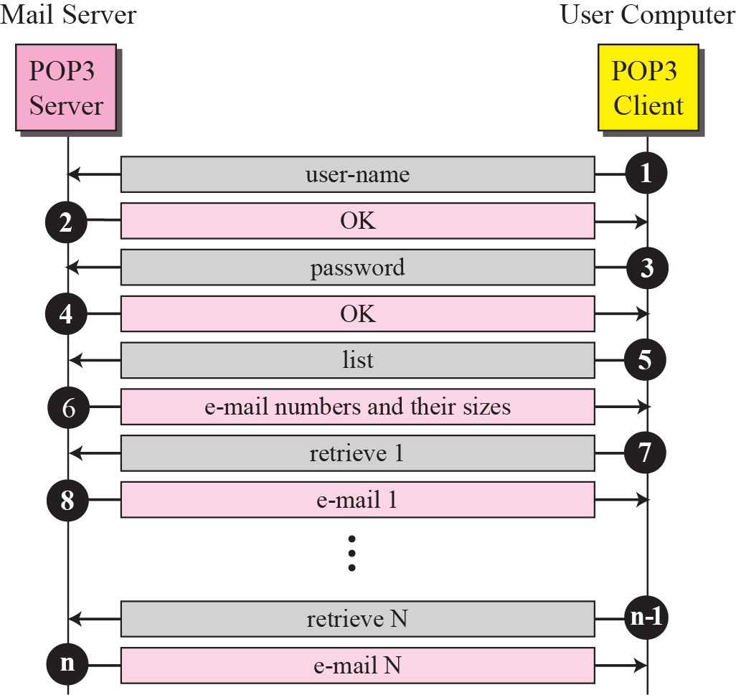
Figure 23.14 Pop3
TCP/IP Protocol Suite

Slide 30
23-5 MIME
Electronic mail has a simple structure. Its simplicity, however, comes with a price. It can send messages only in NVT 7-bit ASCII format. In other words, it has some limitations. Multipurpose Internet Mail Extensions (MIME) is a supplementary protocol that allows non-ASCII data to be sent through e-mail. MIME transforms non-ASCII data at the sender site to NVT ASCII data and delivers it to the client MTA to be sent through the Internet. The message at the receiving site is transformed back to the original data.
TCP/IP Protocol Suite

Slide 31
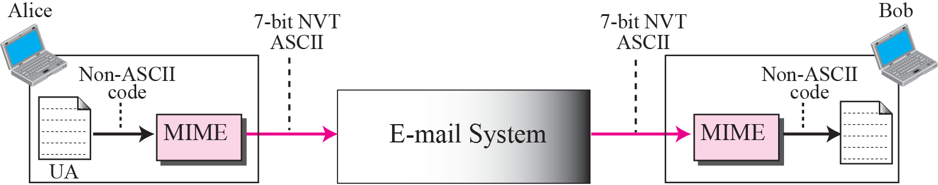
Figure 23.15 MIME
TCP/IP Protocol Suite

Slide 32
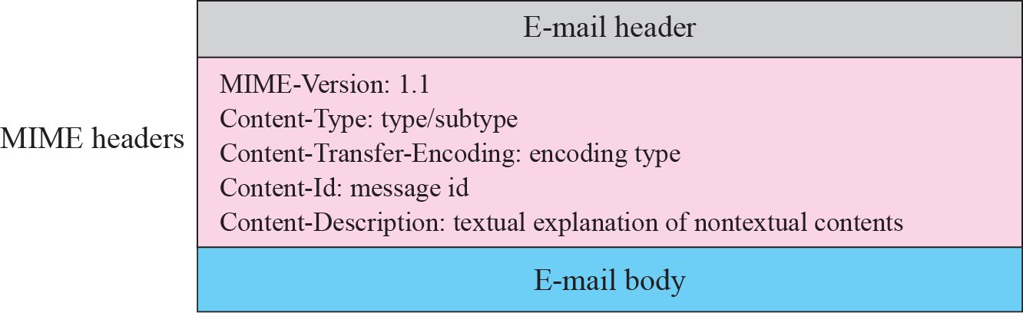
Figure 23.16 MIME header
TCP/IP Protocol Suite

Slide 33
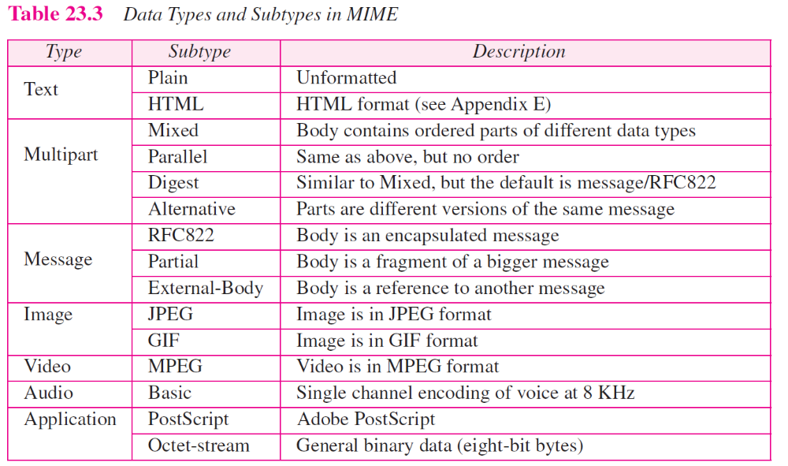
TCP/IP Protocol Suite

Slide 34
23-6 WEB-BASED MAIL
E-mail is such a common application that some websites today provide this service to anyone who accesses the site. Three common sites are Hotmail, Yahoo, and Google. The idea is very simple. Let us go through two cases:
TCP/IP Protocol Suite

Slide 35
Topics Discussed in the Section
Case I
Case II
TCP/IP Protocol Suite

Slide 36
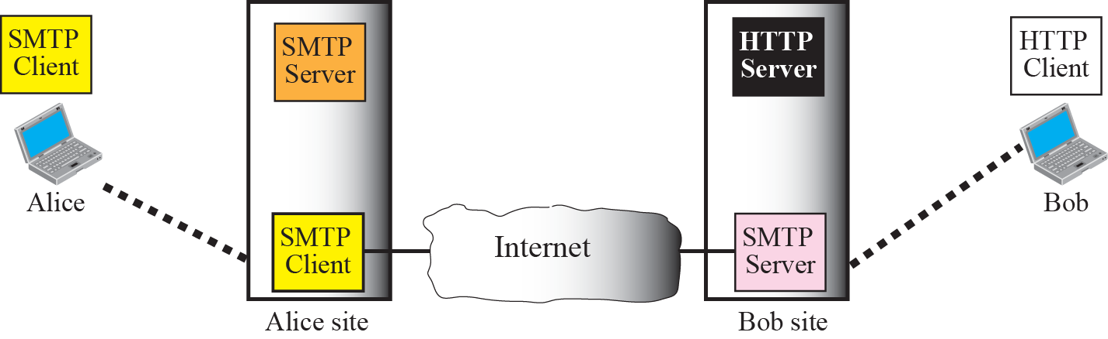

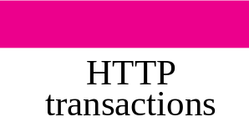



Figure 23.19 Web-based e-mail, case 1
TCP/IP Protocol Suite

Slide 37

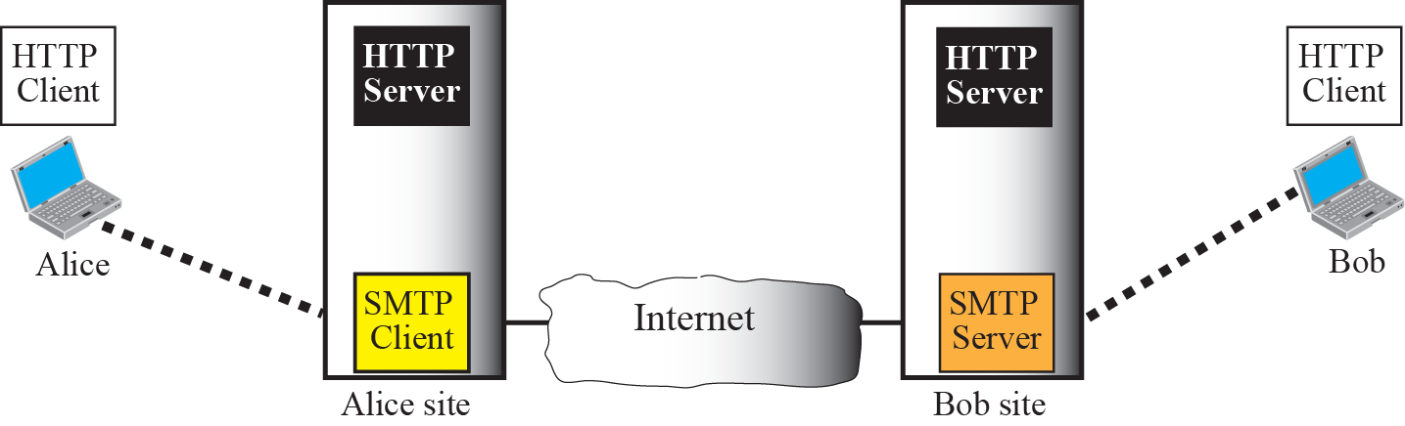



Figure 23.20 Web-based e-mail, case 2
TCP/IP Protocol Suite

Slide 38
23-6 E-MAIL SECURITY
The protocol discussed in this chapter does not provide any security provisions per se. However, e-mail exchanges can be secured using two application-layer securities designed in particular for e-mail systems. Two of these protocols, Pretty Good Privacy (PGP) and Secure MIME (SMIME) are discussed in Chapter 30 after we have discussed the basic network security.
TCP/IP Protocol Suite

