Slide 1

Chapter 24
Network Management:
SNMP
TCP/IP Protocol Suite

Slide 2
24-1 CONCEPT
SNMP uses the concept of manager and agent. That is, a manager, usually a host, controls and monitors a set of agents, usually routers or servers (see Figure 24.1).
TCP/IP Protocol Suite

Slide 3
Topics Discussed in the Section
Managers and Agents
TCP/IP Protocol Suite

Slide 4
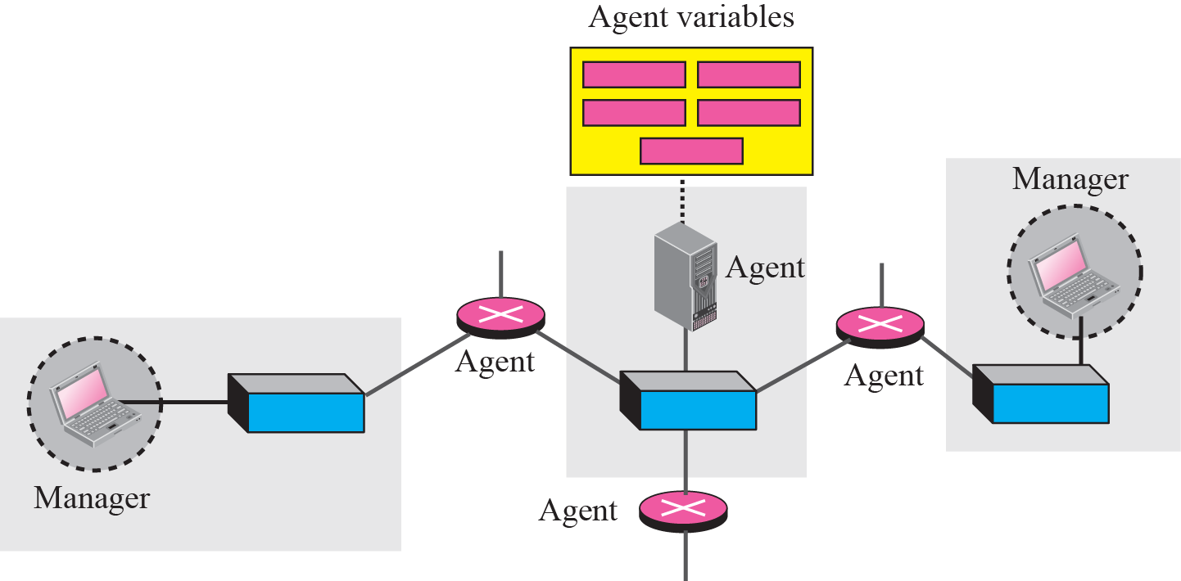
Figure 24.1 SNMP concept
TCP/IP Protocol Suite

Slide 5
24-2 MANAGEMENT COMPONENTS
To do management tasks, SNMP uses two other protocols: Structure of Management Information (SMI) and Management Information Base (MIB). In other words, management on the Internet is done through the cooperation of three protocols: SNMP, SMI, and MIB, as shown in Figure 24.2.
TCP/IP Protocol Suite

Slide 6
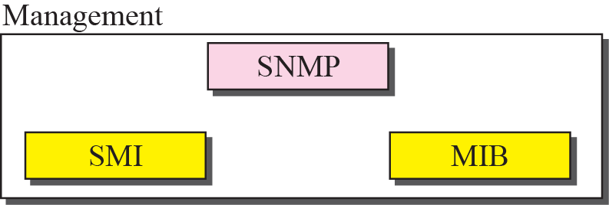
Figure 24.2 Companion of network management on the Internet
TCP/IP Protocol Suite

Slide 7

Note
SNMP defines the format of packets exchanged between a manager and an agent. It reads and changes the status of objects (values of variables) in SNMP packets.
TCP/IP Protocol Suite

Slide 8
Note
SMI defines the general rules for naming objects, defining object types (including
range and length), and showing how to encode objects and values.
TCP/IP Protocol Suite

Slide 9
Note
MIB creates a collection of named objects, their types, and their
relationships to each other in an entity to be managed.
TCP/IP Protocol Suite

Slide 10
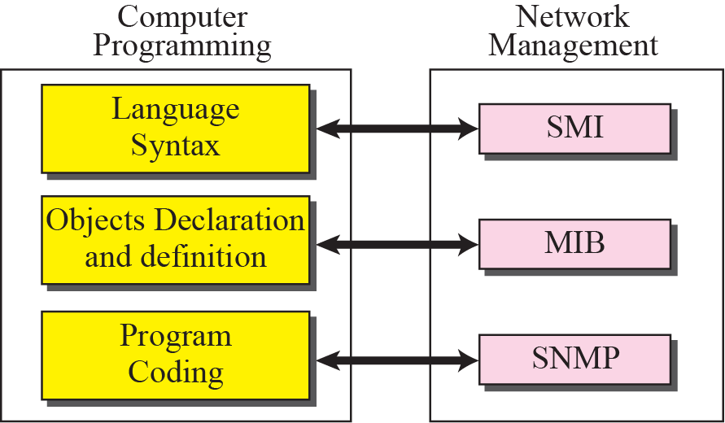
Figure 24.3 Comparing computer programming and network management
TCP/IP Protocol Suite

Slide 11
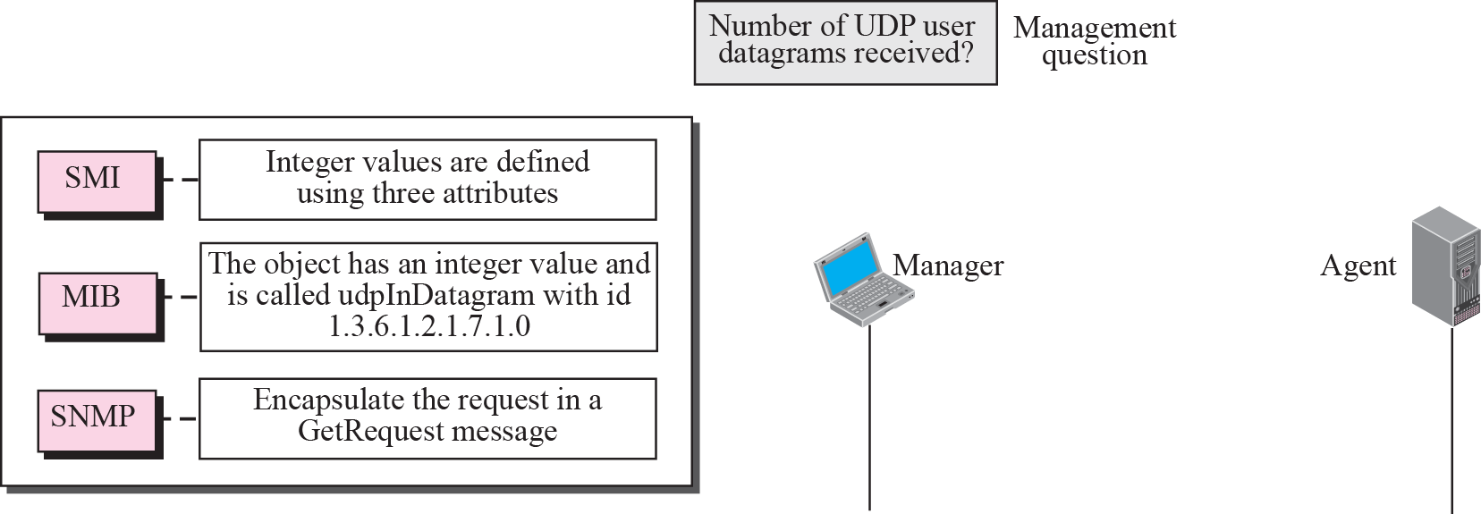






Figure 24.4 Management overview
TCP/IP Protocol Suite

Slide 12
24-3 SMI
The Structure of Management Information is a component for network management. Its functions are:
1. To name objects.
2. To define the type of data that can be stored in an object.
3. To show how to encode data for transmission
over the network.
SMI is a guideline for SNMP. It emphasizes three attributes to handle an object: name, data type, and encoding method.
TCP/IP Protocol Suite

Slide 13
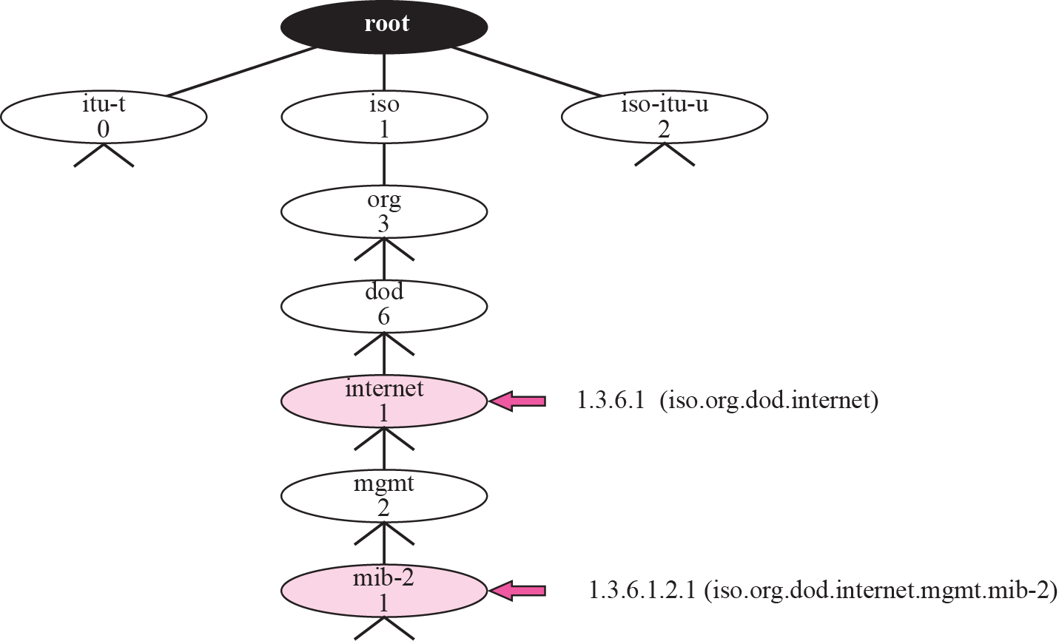
Figure 24.5 Object identifier
TCP/IP Protocol Suite

Slide 14
Note
All objects managed by SNMP are given an object identifier.
The object identifier always starts with 1.3.6.1.2.1.
TCP/IP Protocol Suite

Slide 15
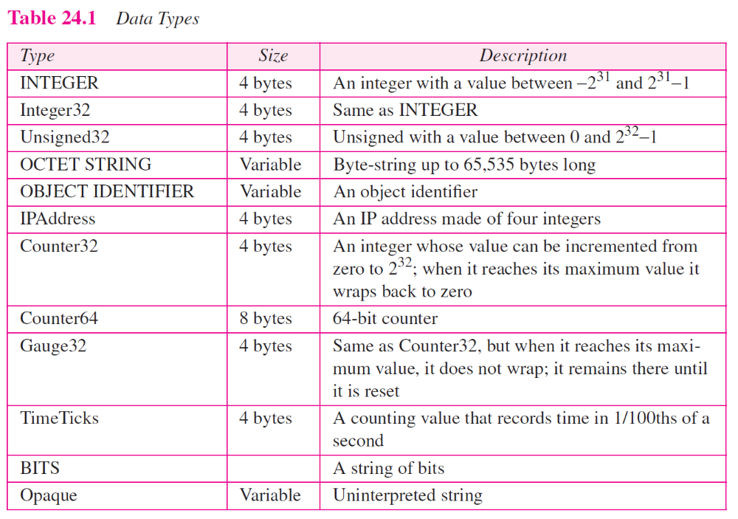
TCP/IP Protocol Suite

Slide 16
24-4 MIB
The Management Information Base, version 2 (MIB2) is the second component used in network management. Each agent has its own MIB2, which is a collection of all the objects that the manager can manage. The objects in MIB2 are categorized under 10 different groups: system, interface, address translation, ip, icmp, tcp, udp, egp, transmission, and snmp. These groups are under the mib-2 object in the object identifier tree (see Figure 24.12). Each group has defined variables and/or tables.
TCP/IP Protocol Suite

Slide 17
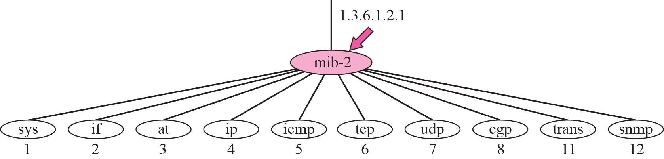
Figure 24.12 mib-2
TCP/IP Protocol Suite

Slide 18
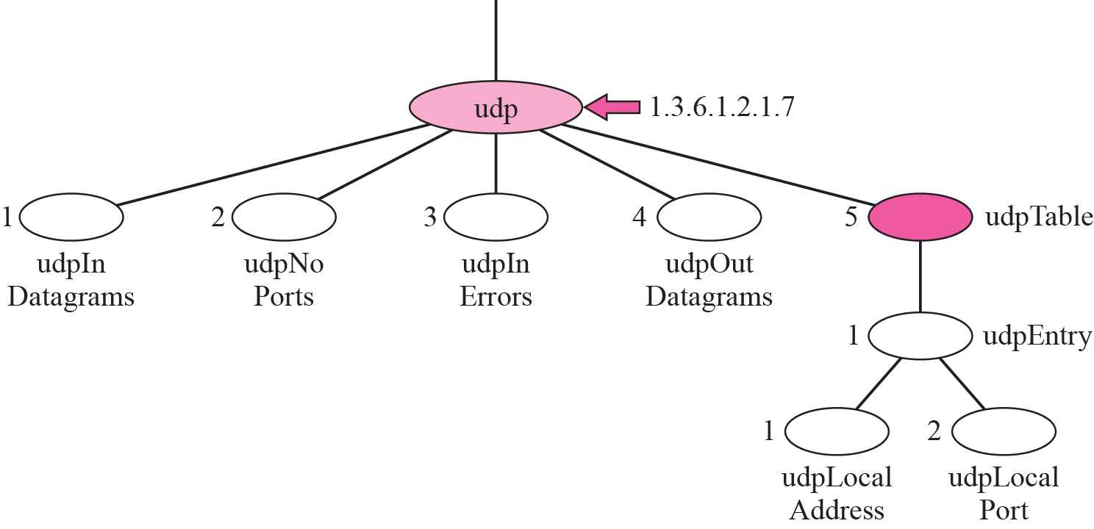
Figure 24.13 udp group
TCP/IP Protocol Suite

Slide 19
24-5 SNMP
SNMP uses both SMI and MIB in Internet network management. It is an application program that allows:
1. A manager to retrieve the value of an object defined in an agent.
2. A manager to store a value in an object defined in an agent.
3. An agent to send an alarm message about an abnormal situation to the manager.
TCP/IP Protocol Suite

Slide 20
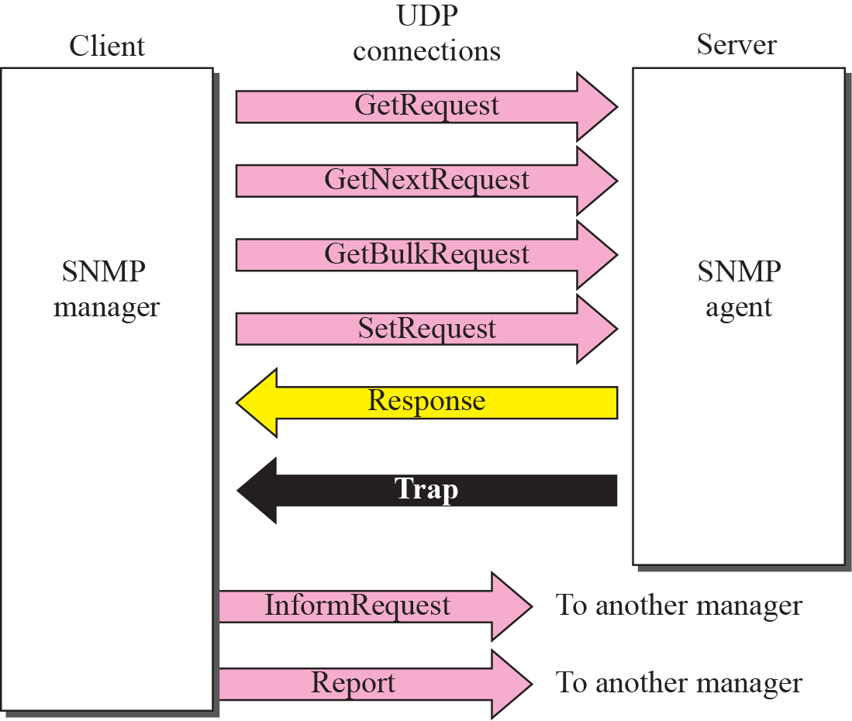
Figure 24.17 SNMP PDUs
TCP/IP Protocol Suite

Slide 21
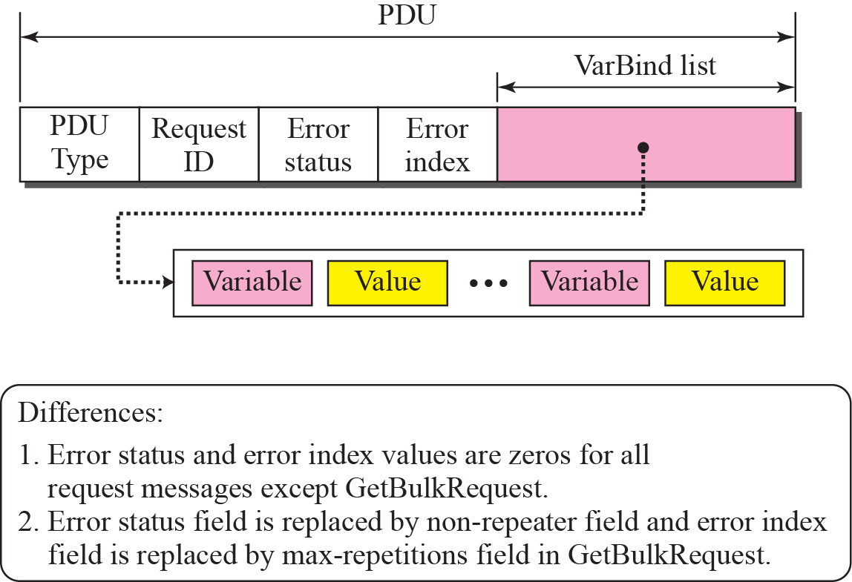
Figure 24.18 SNMP PDU format
TCP/IP Protocol Suite

Slide 22
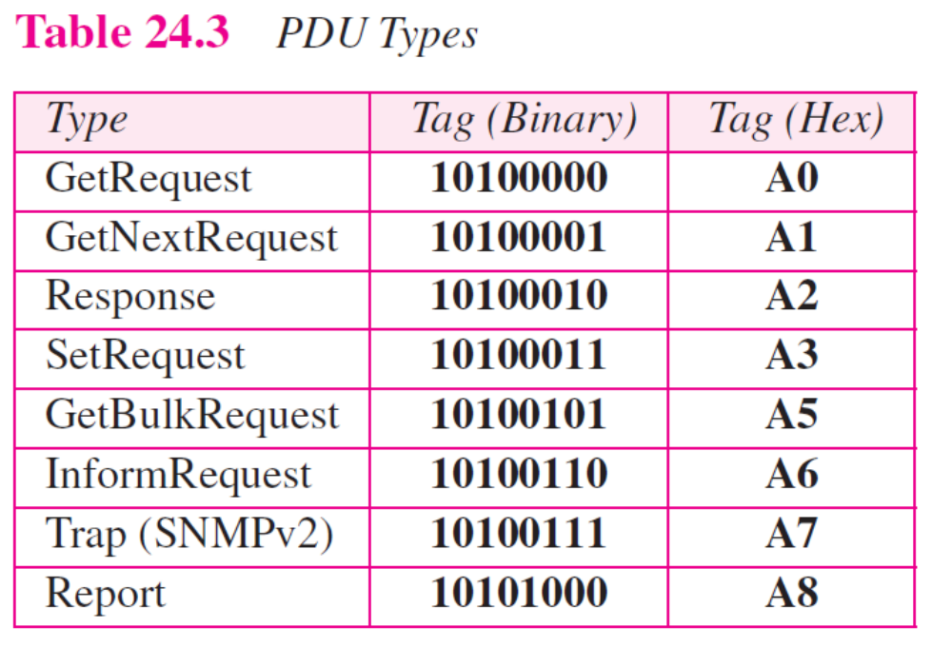
TCP/IP Protocol Suite

Slide 23
24-6 UDP PORTS
SNMP uses the services of UDP on two well-known ports, 161 and 162. The well-known port 161 is used by the server (agent), and the well-known port 162 is used by the client (manager).
TCP/IP Protocol Suite

Slide 24
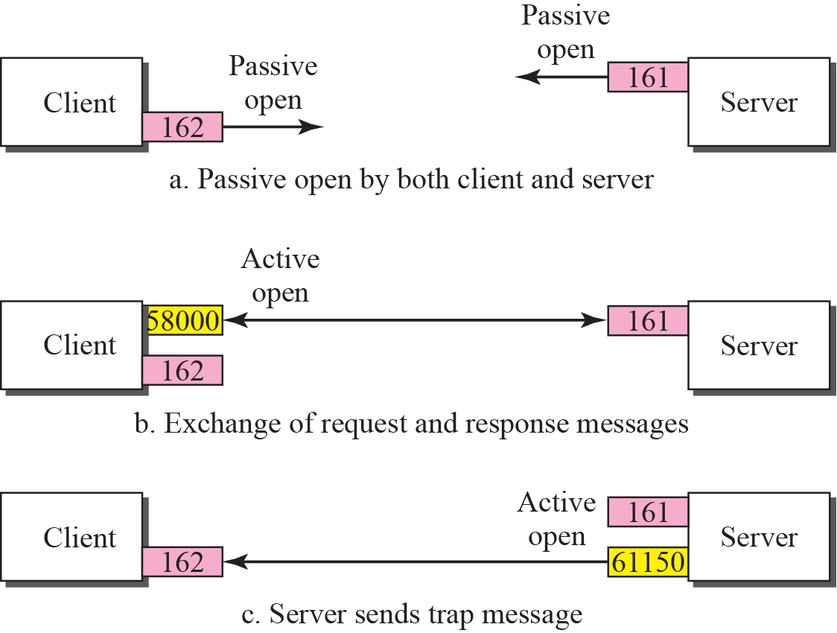
Figure 24.2 Port numbers for SNMP
TCP/IP Protocol Suite

Slide 25
24-7 SECURITY
SNMPv3 has added two new features to the previous version: security and remote administration. SNMPv3 allows a manager to choose one or more levels of security when accessing an agent. Different aspects of security can be configured by the manager to allow message authentication, confidentiality, and integrity.
SNMPv3 also allows remote configuration of security aspects without requiring the administrator to actually be at the place where the device is located.
TCP/IP Protocol Suite

