Slide 1

Chapter 25
Multimedia
TCP/IP Protocol Suite

Slide 2
25-1 INTRODUCTION
We can divide audio and video services into three broad categories: streaming stored audio/video, streaming live audio/video, and interactive audio/video, as shown in Figure 25.1. Streaming means a user can listen (or watch) the file after the downloading has started.
TCP/IP Protocol Suite

Slide 3
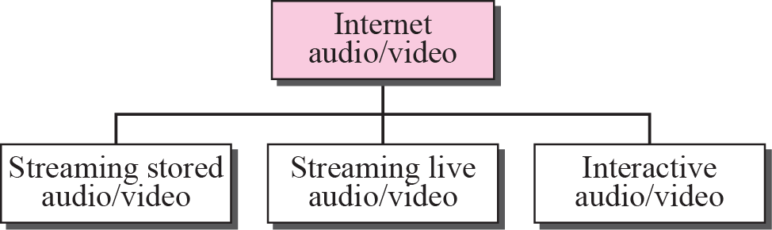
Figure 25.1 Internet audio/video
TCP/IP Protocol Suite

Slide 4

Note
Streaming stored audio/video refers to on-demand requests for compressed
audio/video files.
TCP/IP Protocol Suite

Slide 5
Note
Streaming live audio/video refers to
the broadcasting of radio and TV
programs through the Internet.
TCP/IP Protocol Suite

Slide 6
Note
Interactive audio/video refers to the use of the Internet for interactive
audio/video applications.
TCP/IP Protocol Suite

Slide 7
25-2 DIGITIZING AUDIO AND VIDEO
Before audio or video signals can be sent on the Internet, they need to be digitized. We discuss audio and video separately.
TCP/IP Protocol Suite

Slide 8
Topics Discussed in the Section
Digitizing Audio
Digitizing Video
TCP/IP Protocol Suite

Slide 9
Note
Compression is needed to send video over the Internet.
TCP/IP Protocol Suite

Slide 10
25-3 AUDIO AND VIDEO COMPRESSION
To send audio or video over the Internet requires compression. In this section, we first discuss audio compression and then video compression.
TCP/IP Protocol Suite

Slide 11
Topics Discussed in the Section
Audio Compression
Video Compression: JPEG (image), MPEG(video)
TCP/IP Protocol Suite

Slide 12
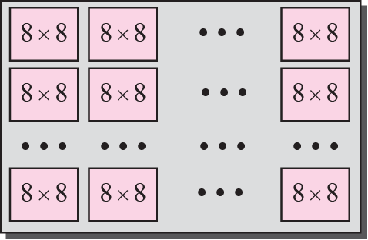
Figure 25.2 JPEG gray scale
TCP/IP Protocol Suite

Slide 13
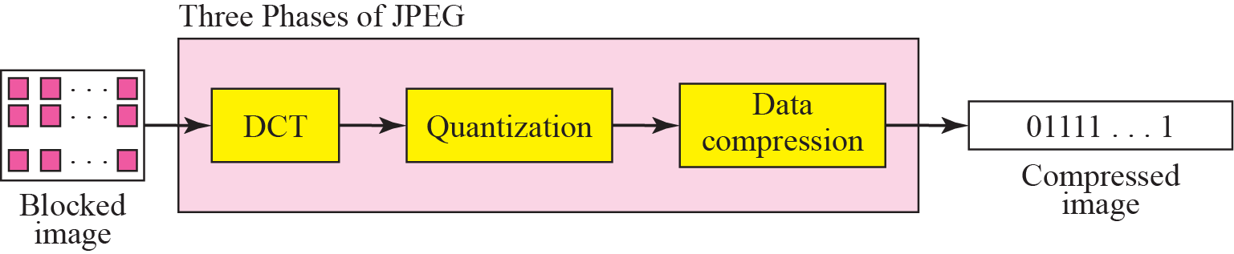
Figure 25.3 JPEG process
TCP/IP Protocol Suite

Slide 14
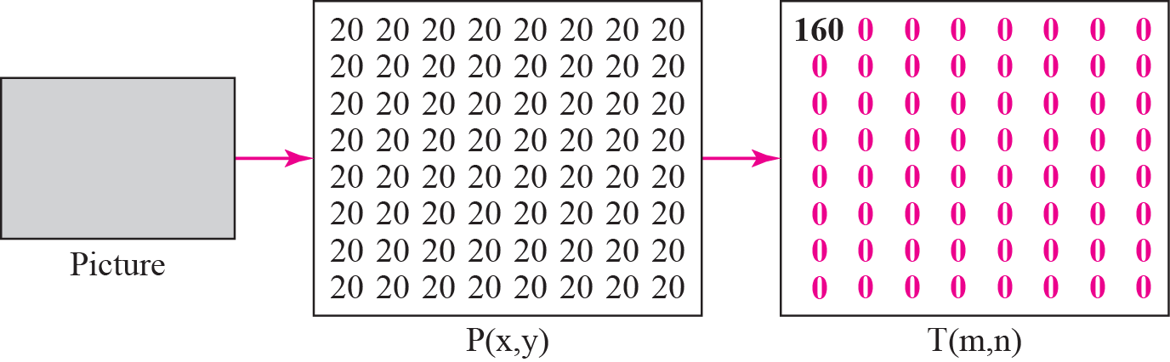
Figure 25.4 Case 1: uniform gray scale
TCP/IP Protocol Suite

Slide 15
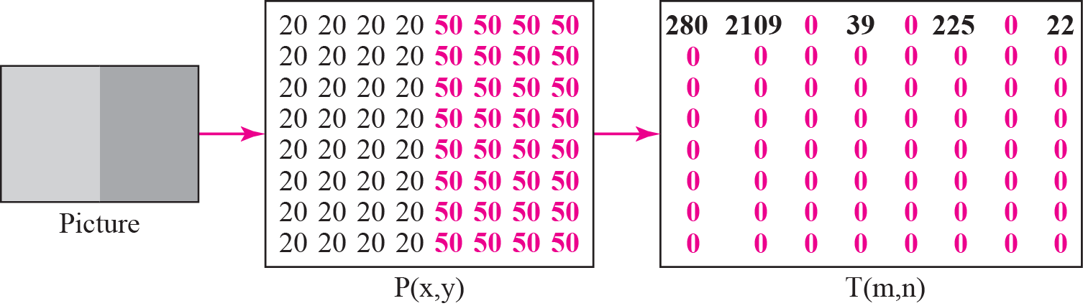
Figure 25.5 Case2: two sections
TCP/IP Protocol Suite

Slide 16
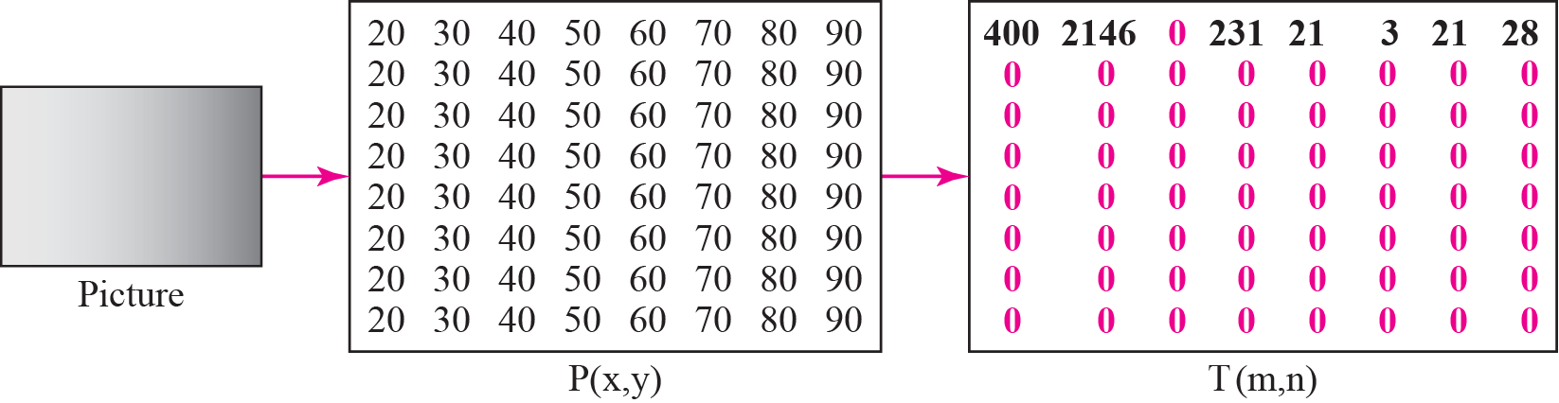
Figure 25.6 Case 3 : gradient gray scale
TCP/IP Protocol Suite

Slide 17
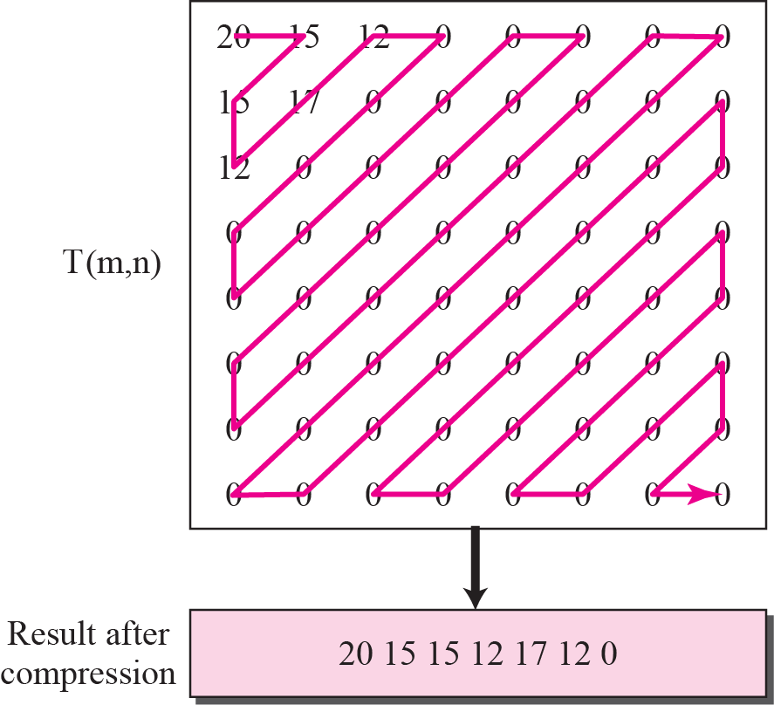
Figure 25.7 Reading the table
TCP/IP Protocol Suite

Slide 18

Figure 25.8 MPEG frames
TCP/IP Protocol Suite

Slide 19
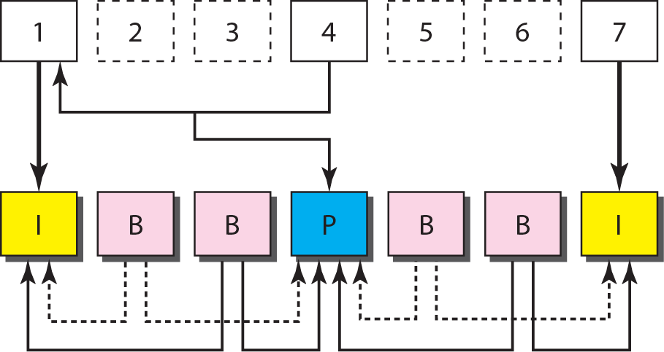
Figure 25.9 MPEG frame construction
TCP/IP Protocol Suite

Slide 20
25-4 STREAMING STORED
AUDIO/VIDEO
Now that we have discussed digitizing and compressing audio/video, we turn our attention to specific applications. The first is streaming stored audio and video. Downloading these types of files from a Web server can be different from downloading other types of files. To understand the concept, let us discuss three approaches, each with a different complexity.
TCP/IP Protocol Suite

Slide 21
Topics Discussed in the Section
First Approach: Using a Web Server
Second Approach: Using a Web Server with Metafile
Third Approach: Using a Media Server
Fourth Approach: Using a Media Server and RTSP
TCP/IP Protocol Suite

Slide 22
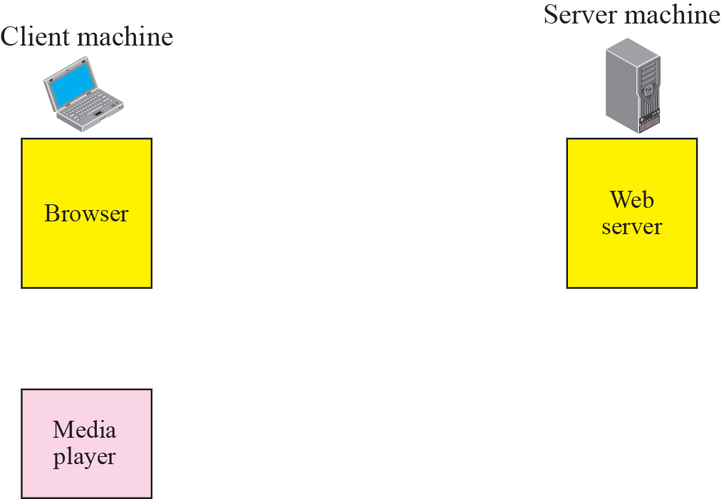


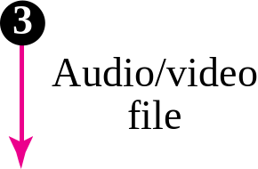
Figure 25.10 Using a Web server
TCP/IP Protocol Suite

Slide 23
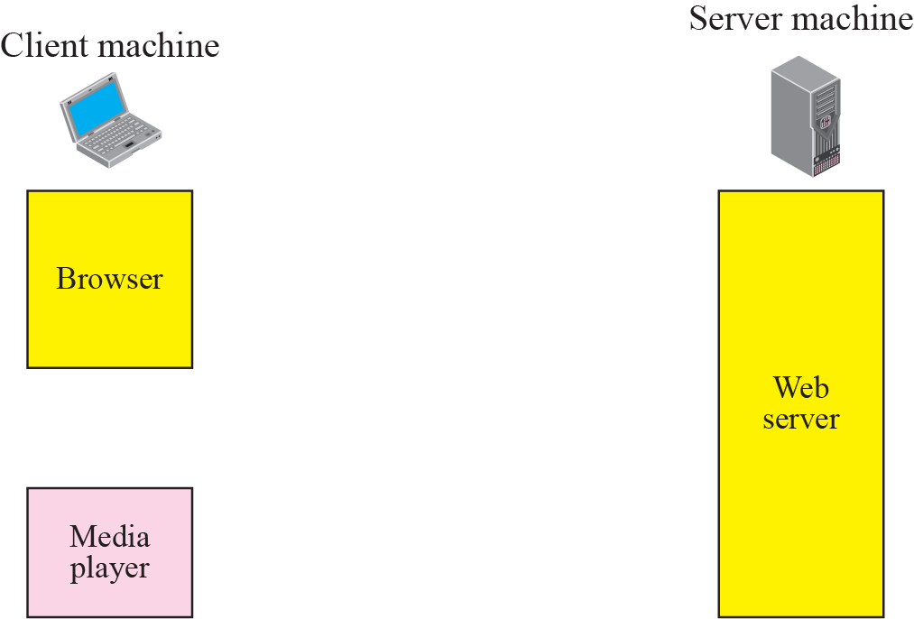




Figure 25.11 Using a Web server with a metafile
TCP/IP Protocol Suite

Slide 24
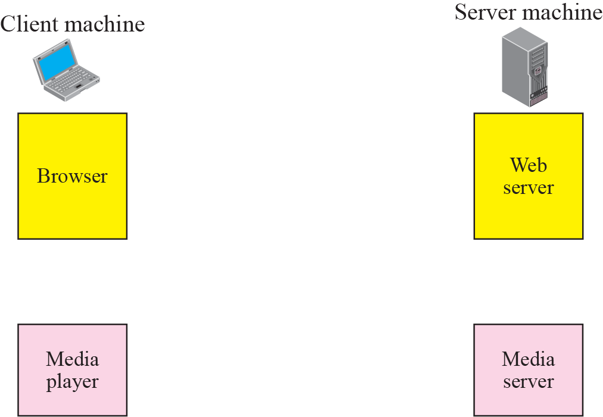
Figure 25.12 Using a media server
TCP/IP Protocol Suite

Slide 25
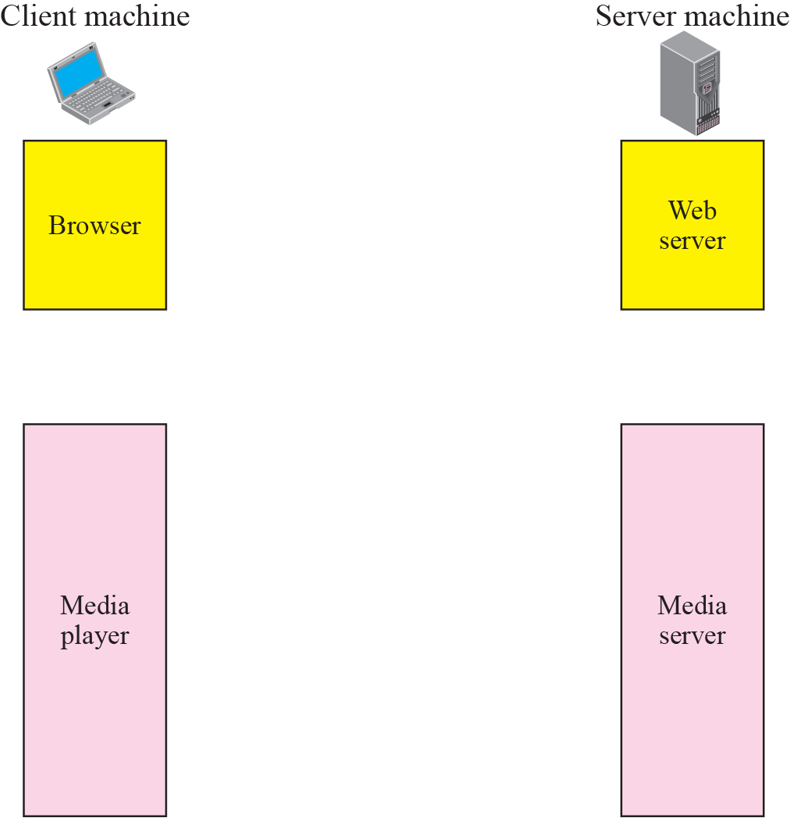


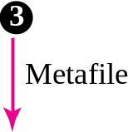







Figure 25.13 Using a media server and RTSP
TCP/IP Protocol Suite

Slide 26
25-5 STREAMING LIVE AUDIO/VIDEO
Streaming live audio/video is similar to the broadcasting of audio and video by radio and TV stations. Instead of broadcasting to the air, the stations broadcast through the Internet. There are several similarities between streaming stored audio/video and streaming live audio/video. They are both sensitive to delay; neither can accept retransmission. However, there is a difference. In the first application, the communication is unicast and on-demand. In the second, the communication is multicast and live.
TCP/IP Protocol Suite

Slide 27
25-6 REAL-TIME INTERACTIVE
AUDIO/VIDEO
In real-time interactive audio/video, people communicate with one another in real time. The Internet phone or voice over IP is an example of this type of application. Video conferencing is another example that allows people to communicate visually and orally.
TCP/IP Protocol Suite

Slide 28
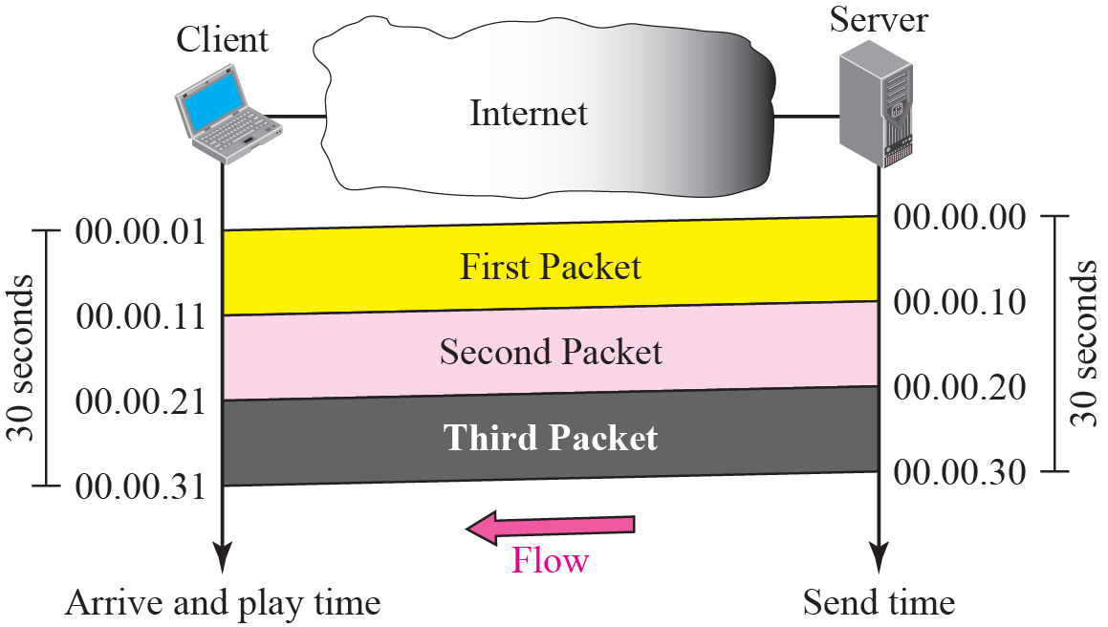
Figure 25.14 Time relationship
TCP/IP Protocol Suite

Slide 29
Note
Jitter is introduced in real-time data by the delay between packets.
TCP/IP Protocol Suite

Slide 30
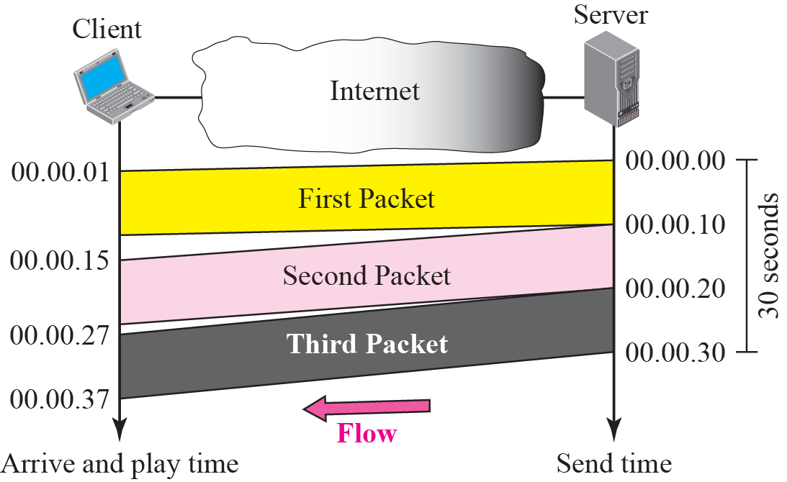
Figure 25.15 Jitter
TCP/IP Protocol Suite

Slide 31
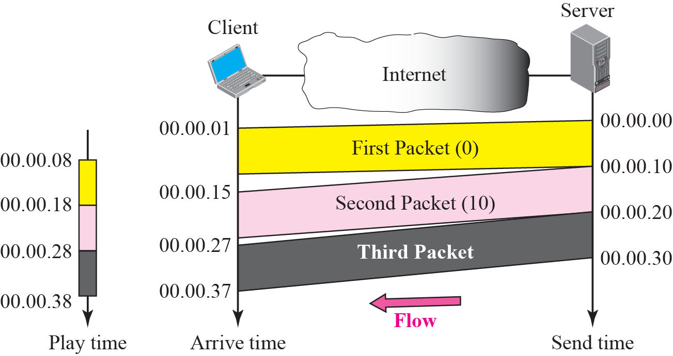
Figure 25.16 Timestamp
TCP/IP Protocol Suite

Slide 32
Note
To prevent jitter, we can timestamp the packets and separate the arrival time from the playback time.
TCP/IP Protocol Suite

Slide 33
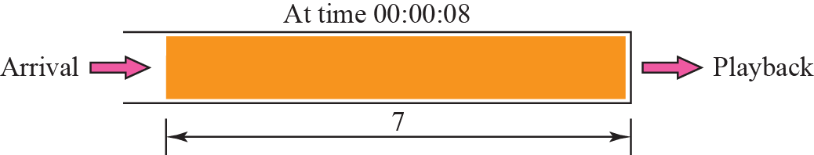
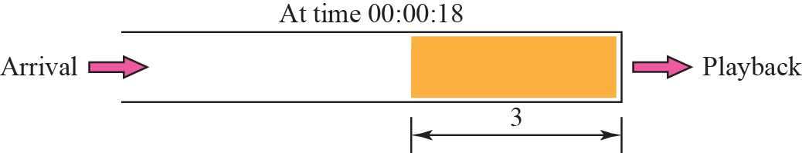
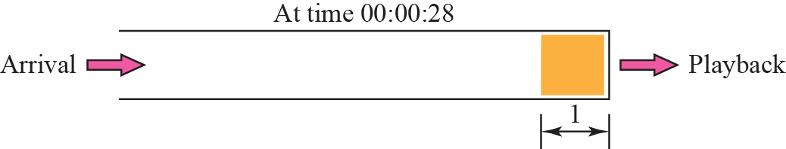
Figure 25.17 Playback buffer
TCP/IP Protocol Suite

Slide 34
Note
A playback buffer is required for
real-time traffic.
TCP/IP Protocol Suite

Slide 35
Note
A sequence number on each packet is required for real-time traffic.
TCP/IP Protocol Suite

Slide 36
Note
Real-time traffic needs the support of multicasting.
TCP/IP Protocol Suite

Slide 37
Note
Translation means changing the encoding of a payload to a lower
quality to match the bandwidth
of the receiving network.
TCP/IP Protocol Suite

Slide 38
Note
Mixing means combining several streams of traffic into one stream.
TCP/IP Protocol Suite

Slide 39
Note
TCP, with all its sophistication, is not suitable for interactive multimedia
traffic because we cannot allow retransmission of packets.
TCP/IP Protocol Suite

Slide 40
Note
UDP is more suitable than TCP for interactive traffic. However, we need
the services of RTP, another
transport layer protocol, to make
up for the deficiencies of UDP.
TCP/IP Protocol Suite

Slide 41
25-7 RTP
Real-time Transport Protocol (RTP) is the protocol designed to handle real-time traffic on the Internet. RTP does not have a delivery mechanism (multicasting, port numbers, and so on); it must be used with UDP. RTP stands between UDP and the application program. The main contributions of RTP are timestamping, sequencing, and mixing facilities.
TCP/IP Protocol Suite

Slide 42
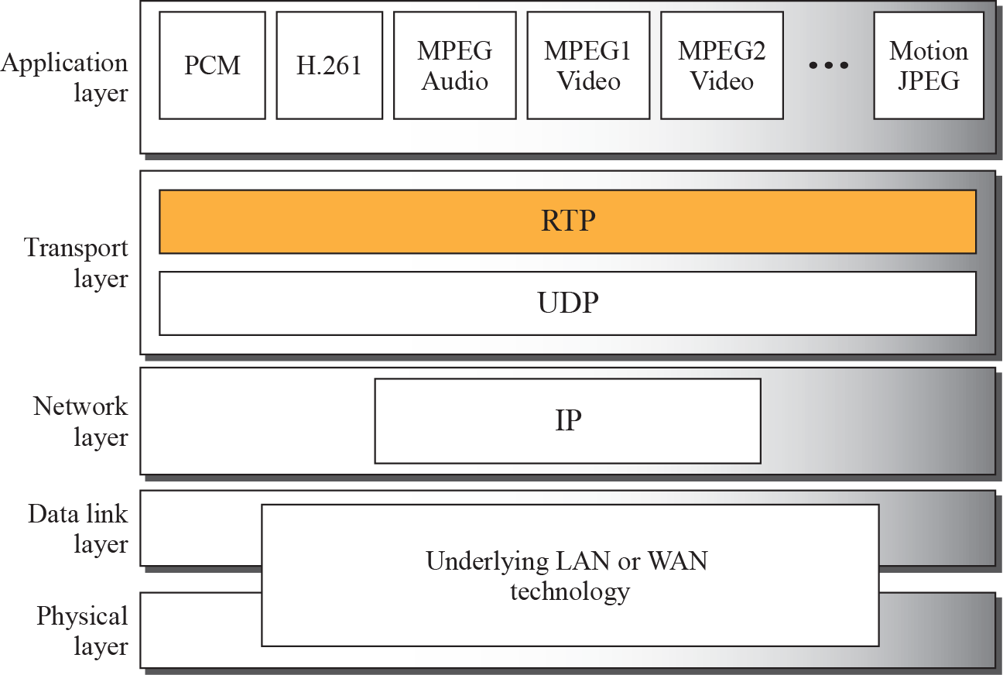
Figure 25.18 RTP packet header format
TCP/IP Protocol Suite

Slide 43
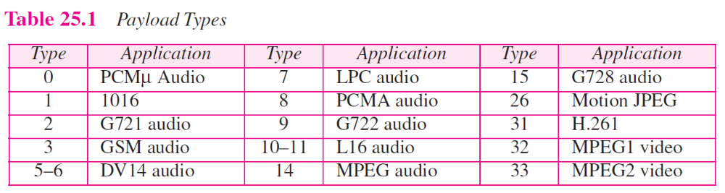
TCP/IP Protocol Suite

Slide 44
Note
RTP uses a temporary even-numbered UDP port.
TCP/IP Protocol Suite

Slide 45
25-8 RTCP
RTP allows only one type of message, one that carries data from the source to the destination. In many cases, there is a need for other messages in a session. These messages control the flow and quality of data and allow the recipient to send feedback to the source or sources. Real-Time Transport Control Protocol (RTCP) is a protocol designed for this purpose.
TCP/IP Protocol Suite

Slide 46
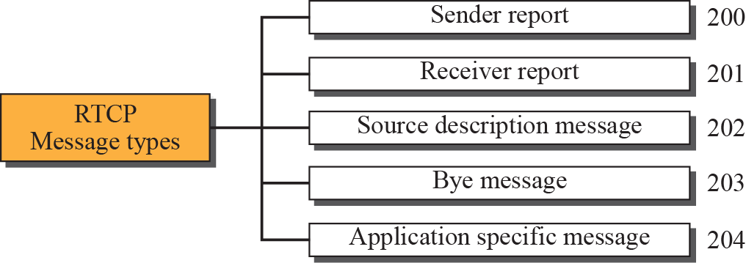
Figure 25.20 RTCP message types
TCP/IP Protocol Suite

Slide 47
Note
RTCP uses an odd-numbered UDP port number that follows the port number
selected for RTP.
TCP/IP Protocol Suite

Slide 48
25-9 VOICE OVER IP
Let us concentrate on one real-time interactive audio/video application: voice over IP, or Internet telephony. The idea is to use the Internet as a telephone network with some additional capabilities. Instead of communicating over a circuit-switched network, this application allows communication between two parties over the packet-switched Internet. Two protocols have been designed to handle this type of communication: SIP and H.323. We briefly discuss both.
TCP/IP Protocol Suite

Slide 49
Topics Discussed in the Section
SIP
H.323
TCP/IP Protocol Suite

Slide 50
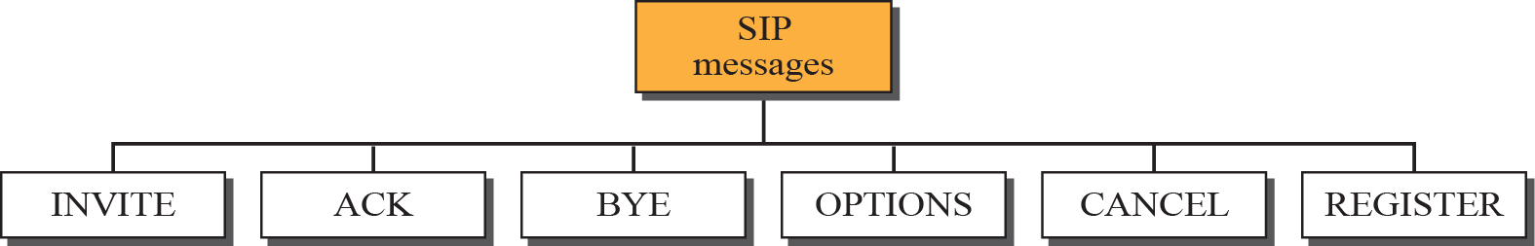
Figure 25.21 SIP messages
TCP/IP Protocol Suite

Slide 51
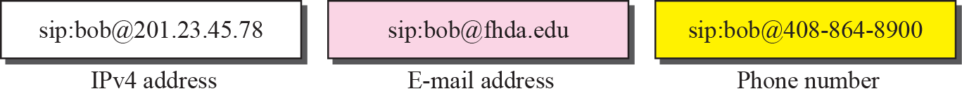
Figure 25.22 SIP formats
TCP/IP Protocol Suite

Slide 52
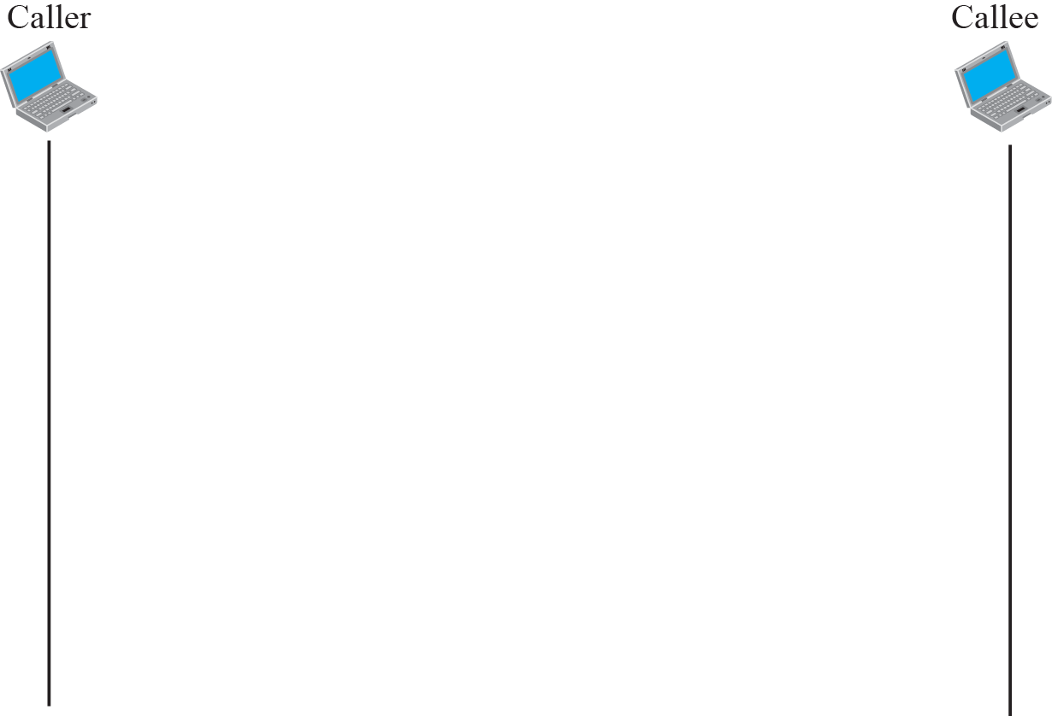
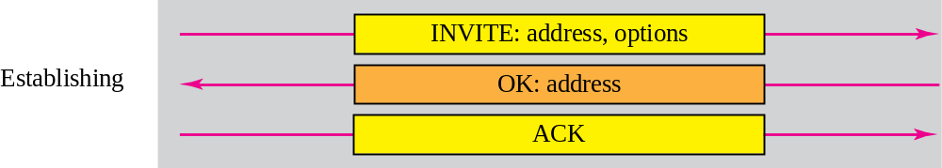
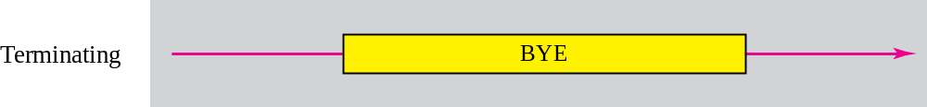
Figure 25.23 SIP simple session
TCP/IP Protocol Suite

Slide 53
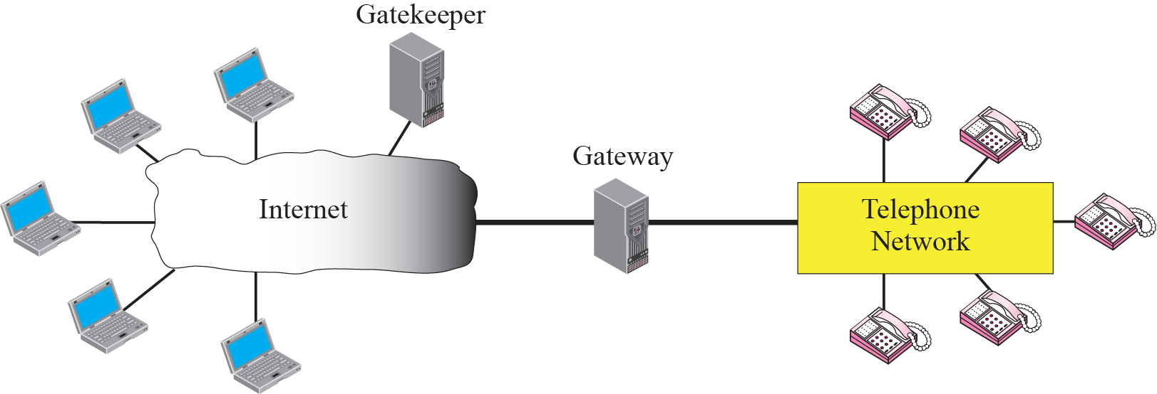
Figure 25.25 H.323 architecture
TCP/IP Protocol Suite

Slide 54
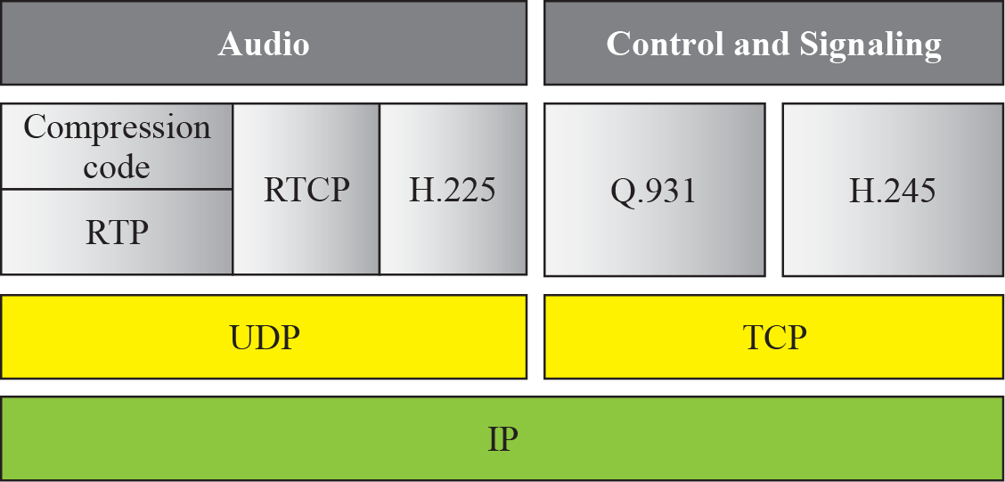
Figure 25.26 H.323 protocols
TCP/IP Protocol Suite

Slide 55
25-10 QUALITY OF SERVICE
Quality of service (QoS) is an internetworking issue that has been discussed more than defined. We can informally define quality of service as something a flow of data seeks to attain. Although QoS can be applied to both textual data and multimedia, it is more an issue when we are dealing with multimedia.
TCP/IP Protocol Suite

Slide 56
25-11 INTEGRATED SERVICES
IP was originally designed for best-effort delivery. This means that every user receives the same level of services. This type of delivery does not guarantee the minimum of a service, such as bandwidth, to applications such as real-time audio and video. Integrated Services, sometimes called IntServ, is a flow-based QoS model, which means that a user needs to create a flow, a kind of virtual circuit, from the source to the destination and inform all routers of the resource requirement.
TCP/IP Protocol Suite

Slide 57
Note
Integrated Services is a flow-based QoS model designed for IP.
TCP/IP Protocol Suite

Slide 58
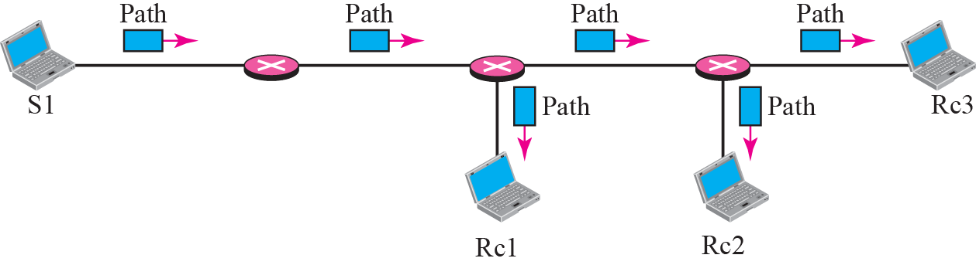
Figure 25.35 Path messages
TCP/IP Protocol Suite

Slide 59
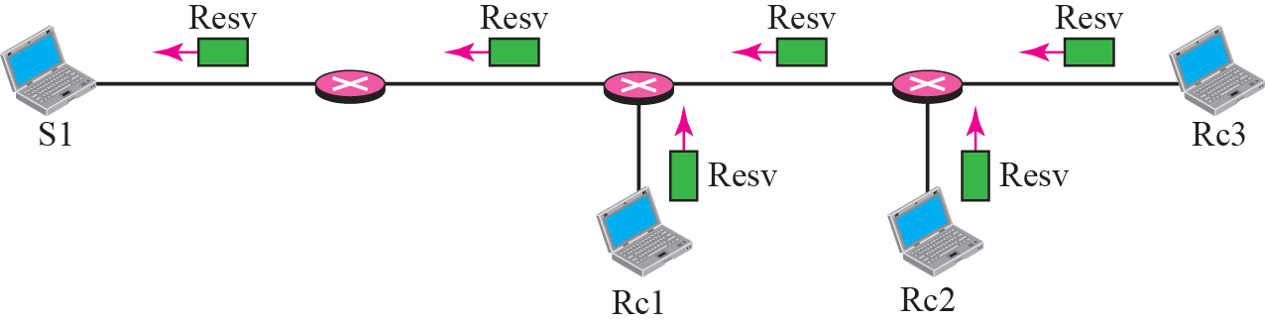
Figure 25.36 Resv messages
TCP/IP Protocol Suite

Slide 60
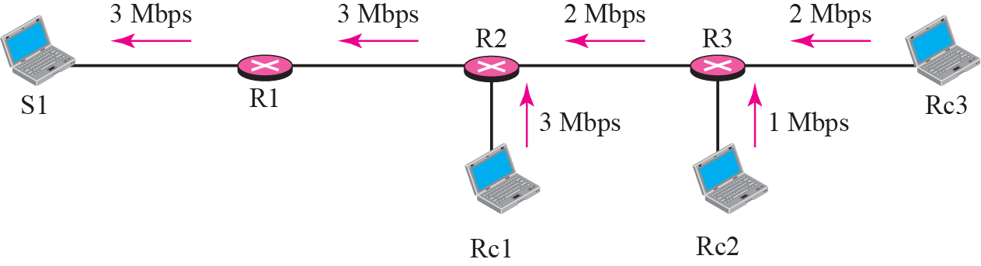
Figure 25.37 Reservation merging
TCP/IP Protocol Suite

Slide 61
25-12 DIFFERENTIATED SERVICES
Differentiated Services (DS or Diffserv) was introduced by the IETF (Internet Engineering Task Force) to handle the shortcomings of Integrated Services.
TCP/IP Protocol Suite

Slide 62
Note
Differentiated Services is a class-based QoS model designed for IP.
TCP/IP Protocol Suite

Slide 63

Figure 25.39 DS field
TCP/IP Protocol Suite

Slide 64
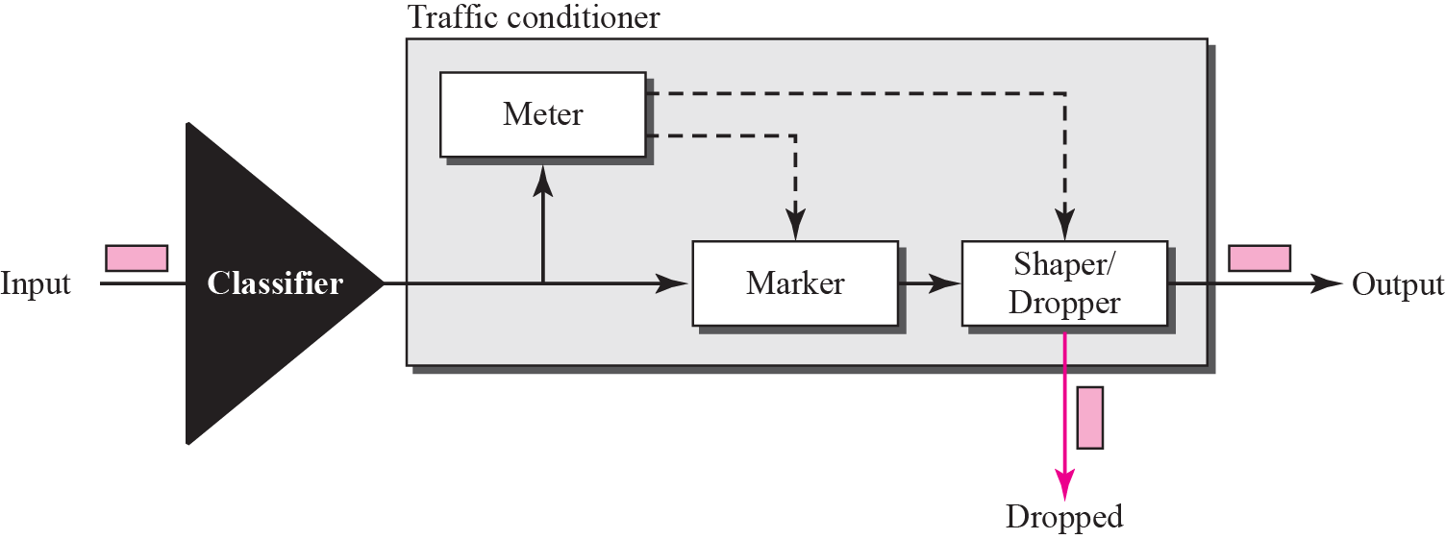
Figure 25.40 Traffic conditioner
TCP/IP Protocol Suite

