Slide 1

Chapter 26
IPv6
Addressing
TCP/IP Protocol Suite

Slide 2
Topics Discussed in the Section
Notations
Address Space
Three Address Types
Broadcasting and Multicasting
TCP/IP Protocol Suite

Slide 3
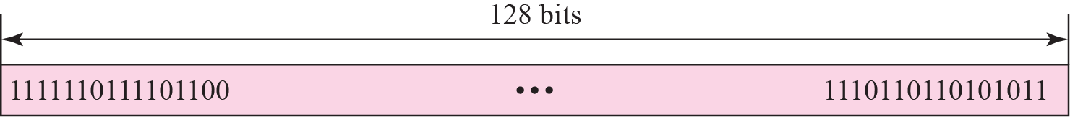
Figure 26.1 IPv6 addresses
TCP/IP Protocol Suite

Slide 4
Figure 26.2 Colon hexadecimal notation
TCP/IP Protocol Suite

Slide 5
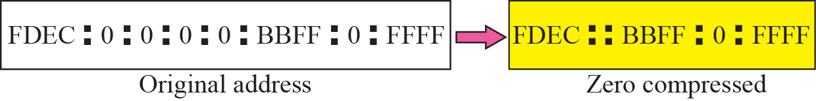
Figure 26.3 Zero compression
TCP/IP Protocol Suite

Slide 6

Figure 26.4 CIDR address
TCP/IP Protocol Suite

Slide 7
Example 26.1
Show the unabbreviated colon hex notation for the following IPv6 addresses:
a. An address with 64 0s followed by 64 1s.
b. An address with 128 0s.
c. An address with 128 1s.
d. An address with 128 alternative 1s and 0s.
Solution
a. 0000:0000:0000:0000:FFFF:FFFF:FFFF:FFFF
b. 0000:0000:0000:0000:0000:0000:0000:0000
c. FFFF:FFFF:FFFF:FFFF:FFFF:FFFF:FFFF:FFFF
d. AAAA:AAAA:AAAA:AAAA:AAAA:AAAA:AAAA:AAAA
TCP/IP Protocol Suite

Slide 8
Example 26.2
The following shows the zero contraction version of addresses in Example 26.1 (part c and d cannot be abbreviated)
a. :: FFFF:FFFF:FFFF:FFFF
b. ::
c. FFFF:FFFF:FFFF:FFFF:FFFF:FFFF:FFFF:FFFF
d. AAAA:AAAA:AAAA:AAAA:AAAA:AAAA:AAAA:AAAA
TCP/IP Protocol Suite

Slide 9
Example 26.3
Show abbreviations for the following addresses:
a. 0000:0000:FFFF:0000:0000:0000:0000:0000
b. 1234:2346:0000:0000:0000:0000:0000:1111
c. 0000:0001:0000:0000:0000:0000:1200:1000
d. 0000:0000:0000:0000:0000:FFFF:24.123.12.6
Solution
a. 0:0:FFFF::
b. 1234:2346::1111
c. 0:1::1200:1000
d. ::FFFF:24.123.12.6
TCP/IP Protocol Suite

Slide 10
Example 26.4
Decompress the following addresses and show the complete unabbreviated IPv6 address:
a. 1111::2222
b. ::
c. 0:1::
d. AAAA:A:AA::1234
Solution
a. 1111:0000:0000:0000:0000:0000:0000:2222
b. 0000:0000:0000:0000:0000:0000:0000:0000
c. 0000:0001:0000:0000:0000:0000:0000:0000
d. AAAA:000A:00AA:0000:0000:0000:0000:1234
TCP/IP Protocol Suite

Slide 11
26-2 ADDRESS SPACE ALLOCATION
Like the address space of IPv4, the address space of IPv6 is divided into several blocks of varying size and each block is allocated for special purpose. Most of the blocks are still unassigned and have been left aside for future use. To better understand the allocation and the location of each block in address space, we first divide the whole address space into eight equal ranges. This division does not show the block allocation, but we believe it shows where each actual block is located (Figure 26.5).
TCP/IP Protocol Suite

Slide 12
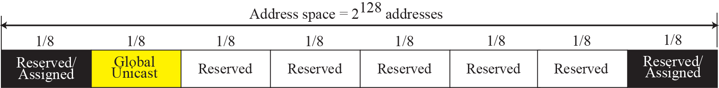
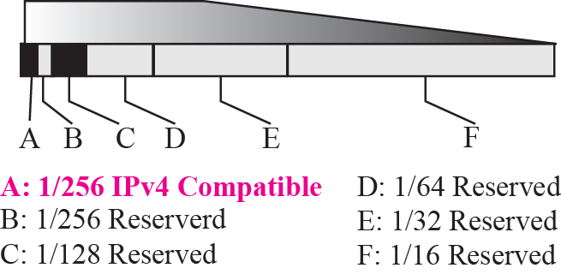
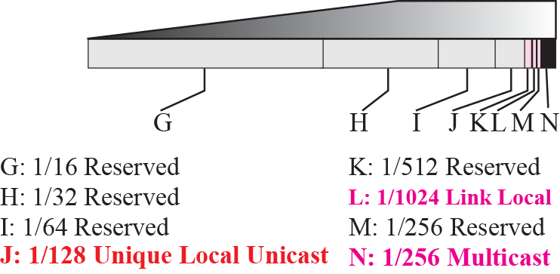
Figure 26.5 Address space allocation
TCP/IP Protocol Suite

Slide 13
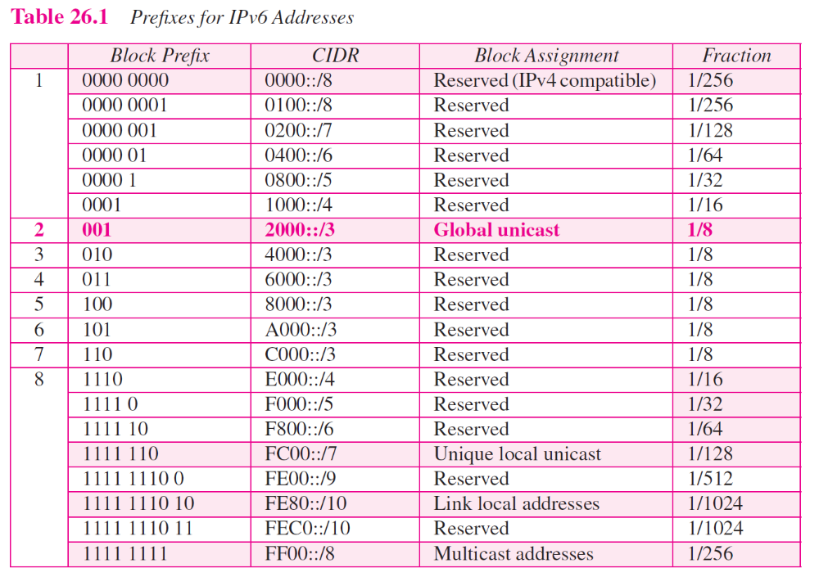
TCP/IP Protocol Suite

Slide 14
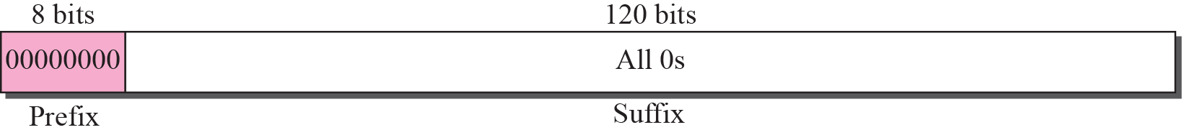
Figure 26.7 Unspecified address
TCP/IP Protocol Suite

Slide 15

Note
The unspecified address in IPv6 is ::/128. It should never be used as a destination address.
TCP/IP Protocol Suite

Slide 16
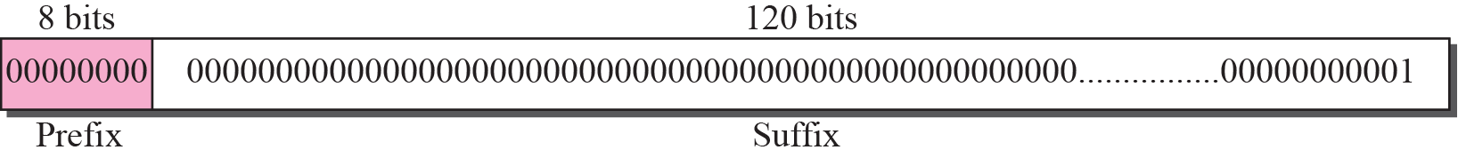
Figure 26.8 Loopback address
TCP/IP Protocol Suite

Slide 17
Note
The loopback address in IPv6 is ::1/128.
It should never be used as a
destination address.
TCP/IP Protocol Suite

Slide 18
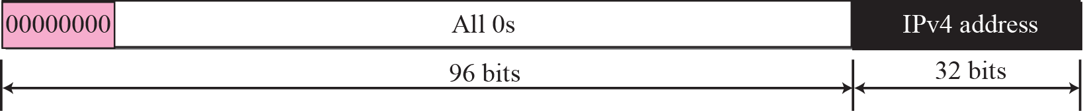
Figure 26.9 Compatible address
TCP/IP Protocol Suite

Slide 19
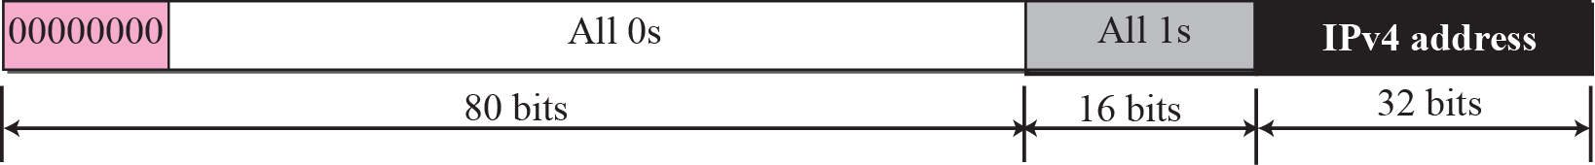
Figure 26.10 Mapped address
TCP/IP Protocol Suite

Slide 20
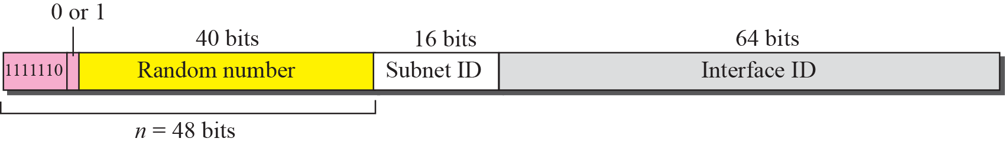
Figure 26.11 Unique local unicast address (site-local)
TCP/IP Protocol Suite

Slide 21
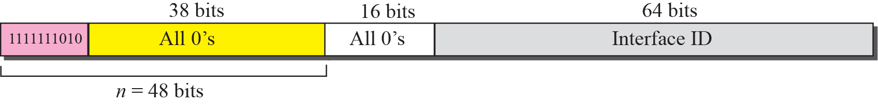
Figure 26.12 Link local address
TCP/IP Protocol Suite

Slide 22
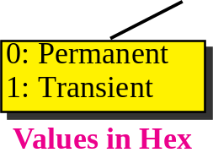
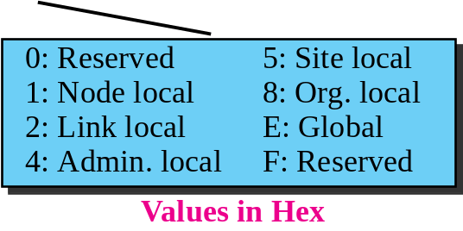
Figure 26.13 Multicast address
TCP/IP Protocol Suite

Slide 23
26-3 GLOBAL UNICAST ADDRESSES
This block in the address space that is used for unicast (one-to-one) communication between two hosts in the Internet is called global unicast address block. CIDR notation for the block is 2000::/3, which means that the three leftmost bits are the same for all addresses in this block (001). The size of this block is 2125 bits, which is more than enough for the Internet expansion in the many years to come.
TCP/IP Protocol Suite

Slide 24
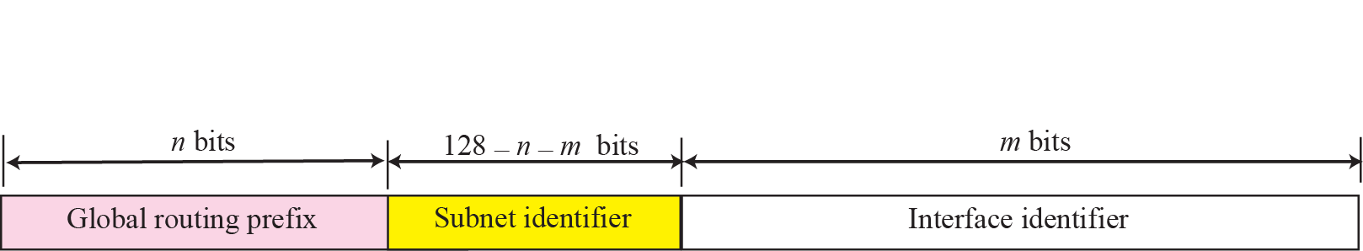
Figure 26.14 Global unicast address
TCP/IP Protocol Suite

Slide 25
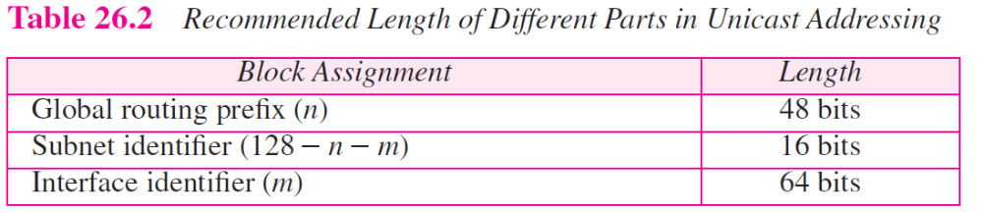
TCP/IP Protocol Suite

Slide 26
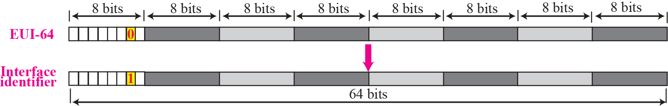
Figure 26.15 Mapping for EUI-64
TCP/IP Protocol Suite

Slide 27
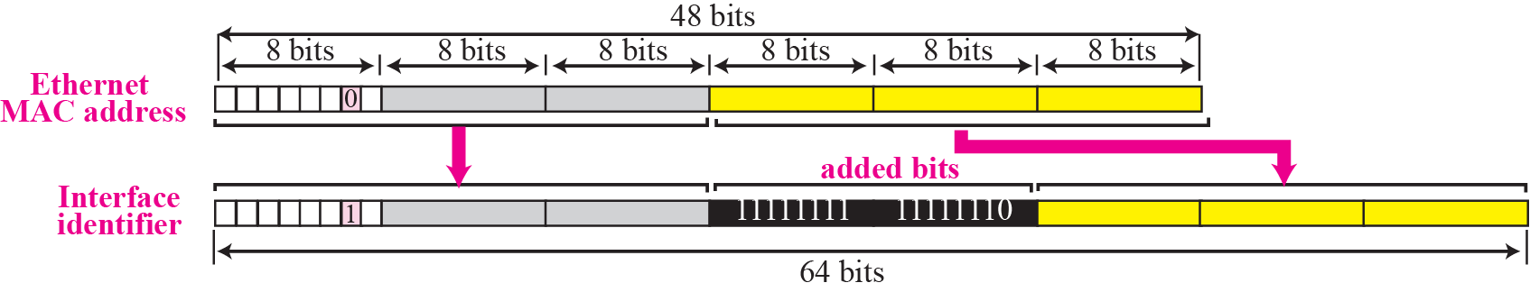
Figure 26.16 Mapping for Ethernet MAC
TCP/IP Protocol Suite

Slide 28
Example 26.11
Find the interface identifier if the physical address in the EUI is (F5-A9-23-EF-07-14-7A-D2)₁₆ using the format we defined for Ethernet addresses.
Solution
We only need to change the seventh bit of the first octet from 0 to 1 and change the format to colon hex notation. The result is F7A9:23EF:0714:7AD2.
TCP/IP Protocol Suite

Slide 29
Example 26.12
Find the interface identifier if the Ethernet physical address is (F5-A9-23-14-7A-D2)₁₆ using the format we defined for Ethernet addresses.
Solution
We only need to change the seventh bit of the first octet from 0 to 1, insert two octet FFFE16 and change the format to colon hex notation. The result is F7A9:23FF:FE14:7AD2 in colon hex.
TCP/IP Protocol Suite

Slide 30
26-4 AUTOCONFIGURATION
One of the interesting features of IPv6 addressing is the autoconfiguration of hosts. As we discussed in IPv4, the host and routers are originally configured manually by the network manager. However, the Dynamic Host Configuration Protocol, DHCP, can be used to allocate an IPv4 address to a host that joins the network. In IPv6, DHCP protocol can still be used to allocate an IPv6 address to a host, but a host can also configure itself.
TCP/IP Protocol Suite

Slide 31
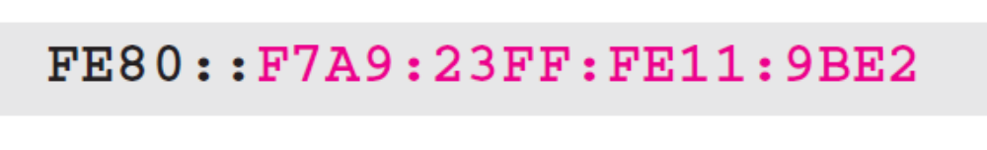
Example 26.15
Assume a host with Ethernet address (F5-A9-23-11-9B-E2)₁₆ has joined the network. What would be its global unicast address if the global unicast prefix of the organization is 3A21:1216:2165 and the subnet identifier is A245.
Solution
The host first creates its interface identifier as
F7A9:23FF:FE11:9BE2
using the Ethernet address read from its card. The host then creates its link-local address as
TCP/IP Protocol Suite

Slide 32
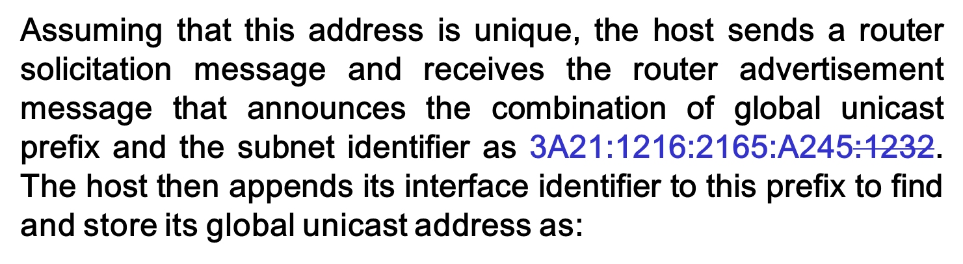
Example 26.15 Continued
TCP/IP Protocol Suite

