Slide 1

Chapter 27
IPv6
Protocol
TCP/IP Protocol Suite

Slide 2
27-1 INTRODUCTION
In this introductory section, we discuss two topics: rationale for a new protocol and the reasons for delayed adoption.
TCP/IP Protocol Suite

Slide 3
27-2 PACKET FORMAT
The IPv6 packet is shown in Figure 27.1. Each packet is composed of a mandatory base header followed by the payload. The payload consists of two parts: optional extension headers and data from an upper layer. The base header occupies 40 bytes, whereas the extension headers and data from the upper layer contain up to 65,535 bytes of information.
TCP/IP Protocol Suite

Slide 4
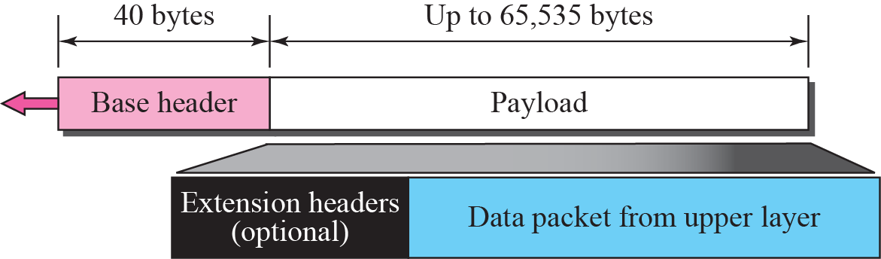
Figure 27.1 IPv6 datagram
TCP/IP Protocol Suite

Slide 5
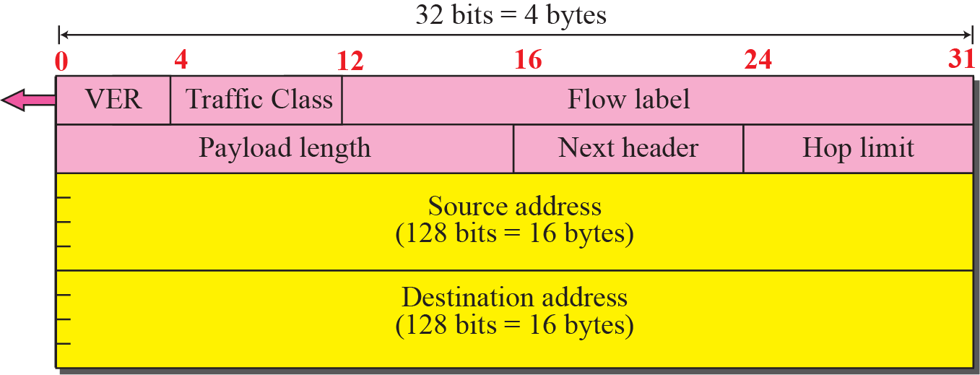
Figure 27.2 Format of the base header
TCP/IP Protocol Suite

Slide 6
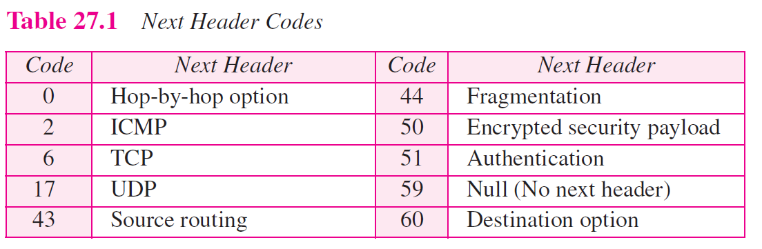
58: ICMPv6
TCP/IP Protocol Suite

Slide 7
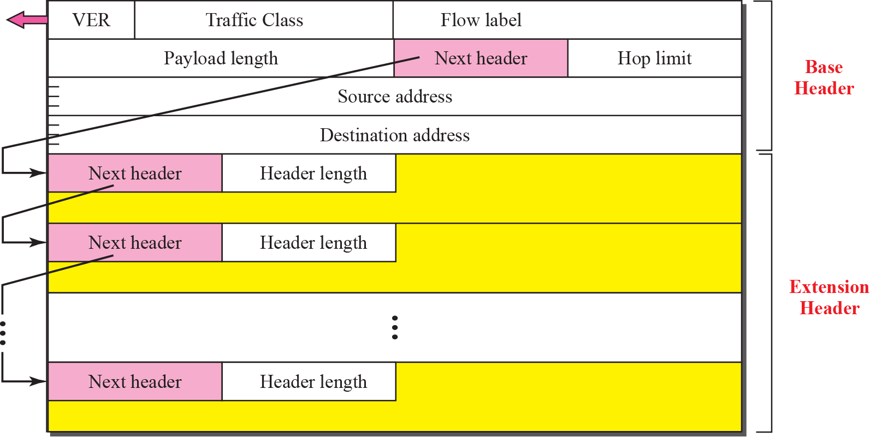
Figure 27.3 Extension header format
TCP/IP Protocol Suite

Slide 8
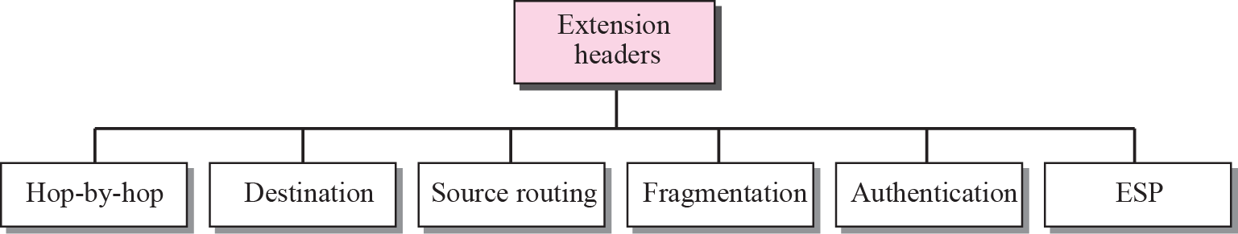
Figure 27.4 Extension header types
TCP/IP Protocol Suite

Slide 9
Figure 27.5 Hop-by-hop option header format
TCP/IP Protocol Suite

Slide 10
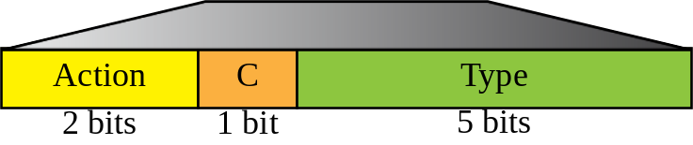

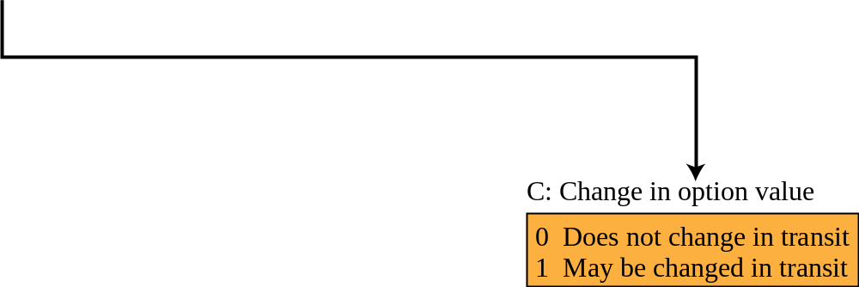
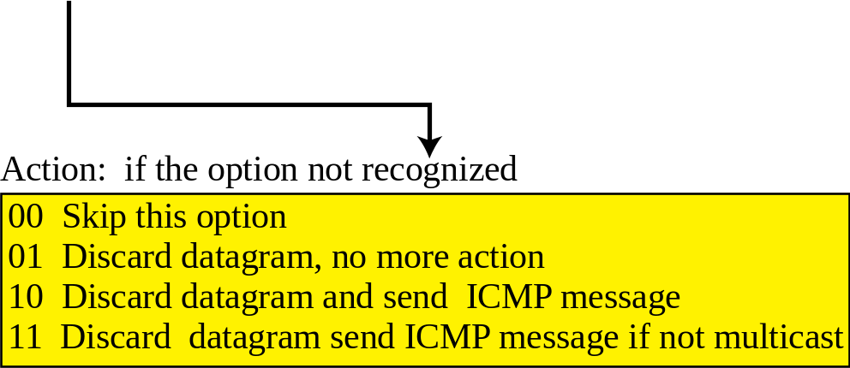
Figure 27.6 The format of the option in a hop-by-hop option header
TCP/IP Protocol Suite

Slide 11
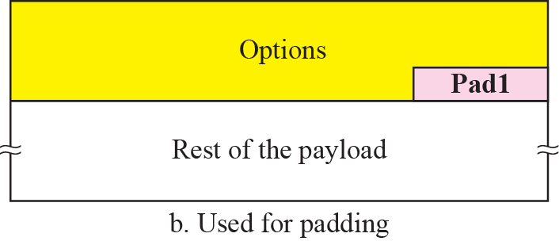
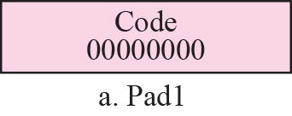
Figure 27.7 Pad1
TCP/IP Protocol Suite

Slide 12
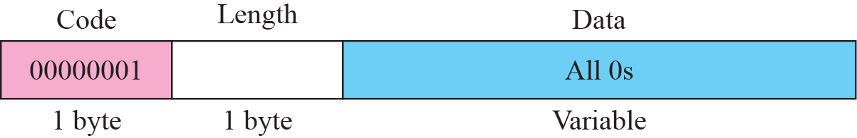
Figure 27.8 PadN
TCP/IP Protocol Suite

Slide 13
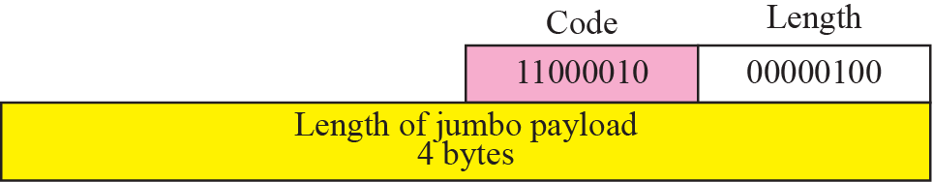
Figure 27.9 Jumbo payload
TCP/IP Protocol Suite

Slide 14
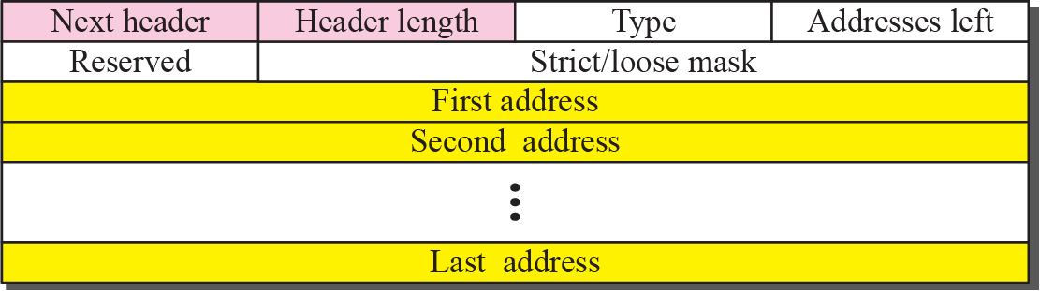
Figure 27.10 Source routing
TCP/IP Protocol Suite

Slide 15
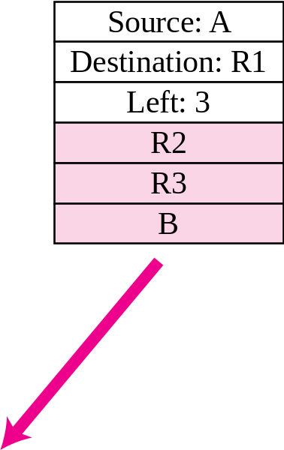
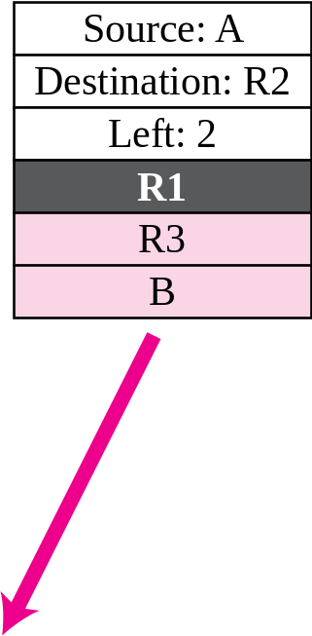
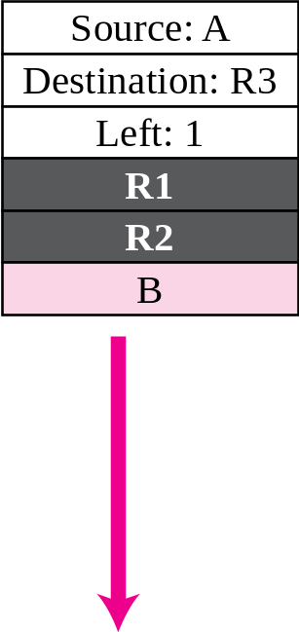
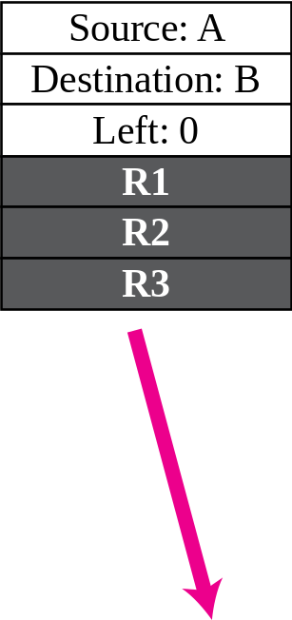
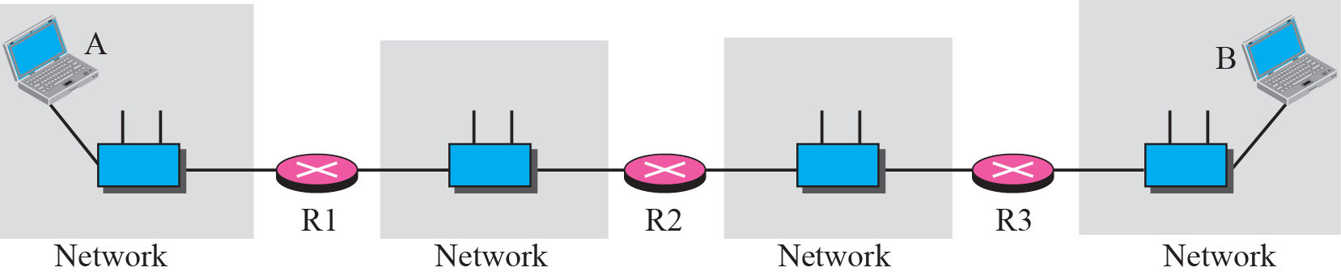
Figure 27.11 Source routing example
TCP/IP Protocol Suite

Slide 16
Figure 27.12 Fragmentation
TCP/IP Protocol Suite

Slide 17

Figure 27.13 Authentication
TCP/IP Protocol Suite

Slide 18
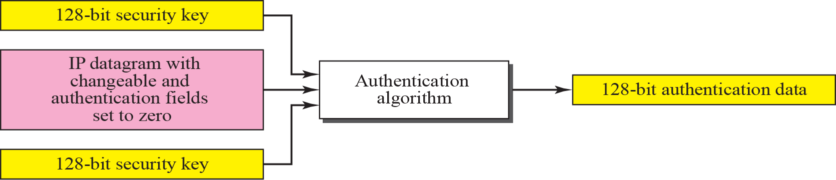
Figure 27.14 Calculation of authentication data
TCP/IP Protocol Suite

Slide 19
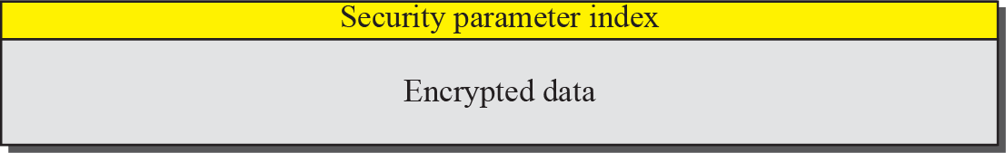
Figure 27.15 Encrypted security payload
TCP/IP Protocol Suite

Slide 20
27-3 TRANSITION FROM IPv4 TO IPv6
Because of the huge number of systems on the Internet, the transition from IPv4 to IPv6 cannot happen suddenly. It will take a considerable amount of time before every system in the Internet can move from IPv4 to IPv6. The transition must be smooth to prevent any problems between IPv4 and IPv6 systems. Three strategies have been devised by the IETF to help the transition (see Figure 27.16).
TCP/IP Protocol Suite

Slide 21
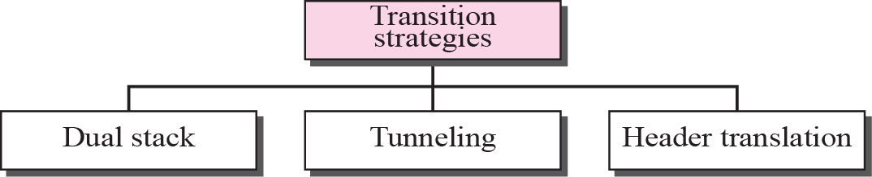
Figure 27.16 Three transition strategies
TCP/IP Protocol Suite

Slide 22
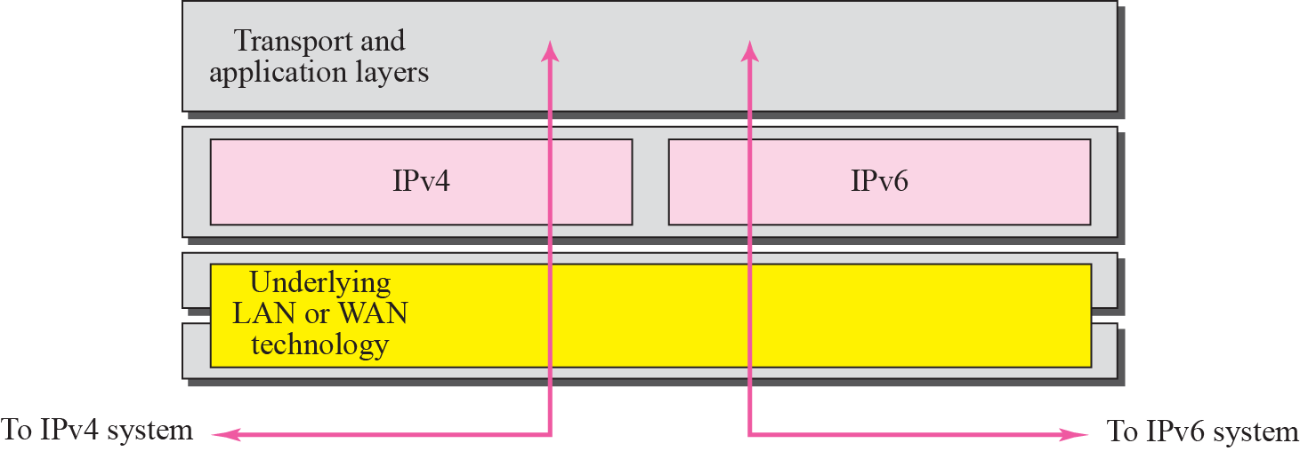
Figure 27.17 Dual stack
TCP/IP Protocol Suite

Slide 23
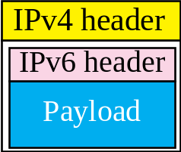
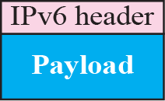
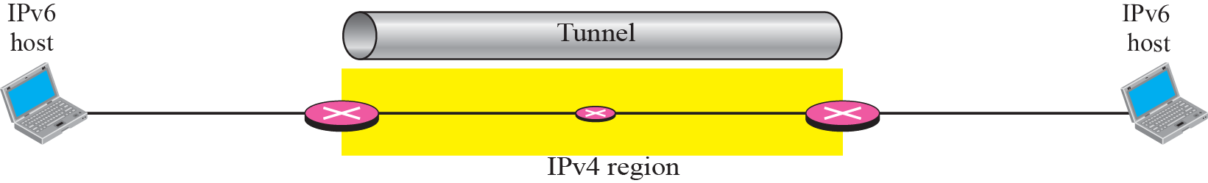
Figure 27.18 Tunneling strategy
TCP/IP Protocol Suite

Slide 24
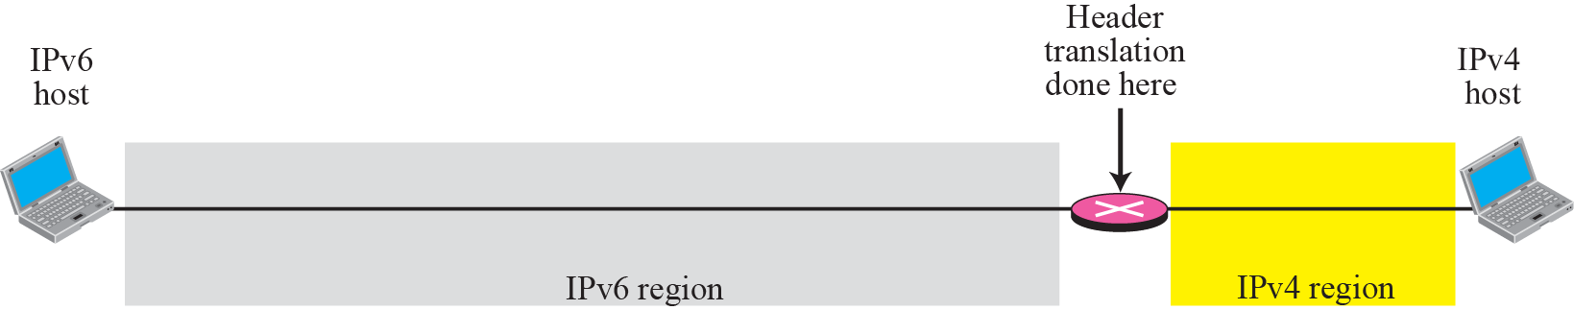
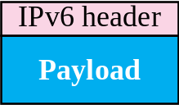
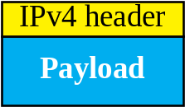
Figure 27.19 Header translation strategy
TCP/IP Protocol Suite

