Slide 1

Chapter 28
ICMPv6
TCP/IP Protocol Suite

Slide 2
28-1 INTRODUCTION
Another protocol that has been modified in version 6 of the TCP/IP protocol suite is ICMP. This new version, Internet Control Message Protocol version 6 ( ICMPv6 ), follows the same strategy and purposes of version 4. ICMPv6, however, is more complicated than ICMPv4: some protocols that were independent in version 4 are now part of ICMPv6 and some new messages have been added to make it more useful.
TCP/IP Protocol Suite

Slide 3
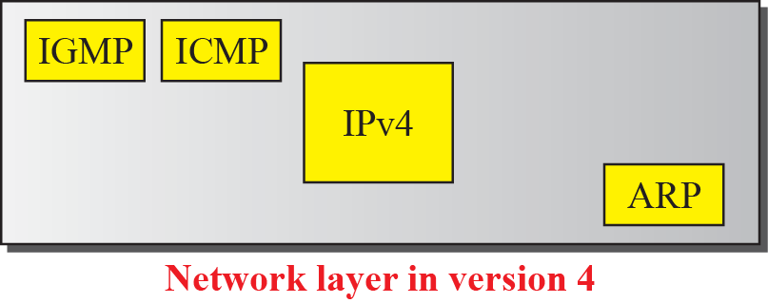
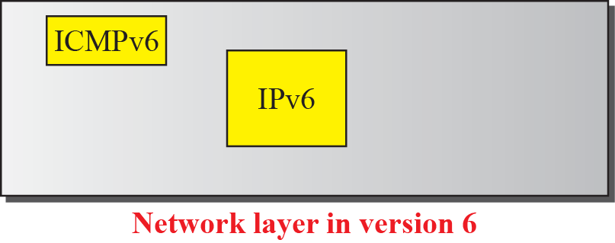
Figure 28.1 Comparison of network layers in version 4 and version 6
TCP/IP Protocol Suite

Slide 4
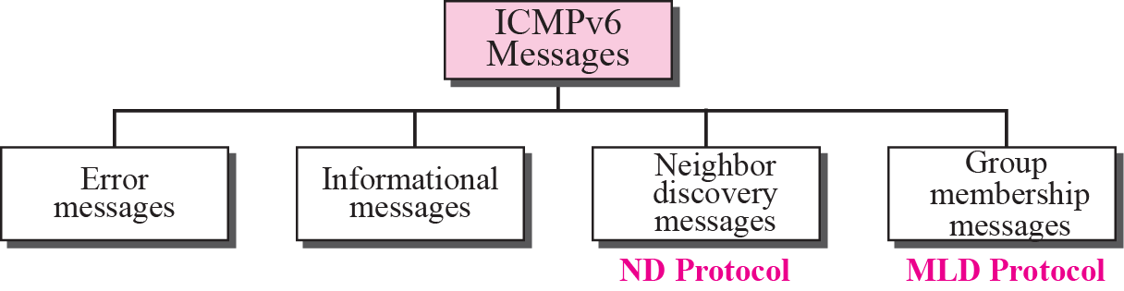
Figure 28.2 Taxonomy of ICMPv6 messages
TCP/IP Protocol Suite

Slide 5
28-2 ERROR MESSAGES
As we saw in our discussion of version 4, one of the main responsibilities of ICMP is to report errors. Four types of errors are handled: destination unreachable, packet too big, time exceeded, and parameter problems (see Figure 28.3).
TCP/IP Protocol Suite

Slide 6
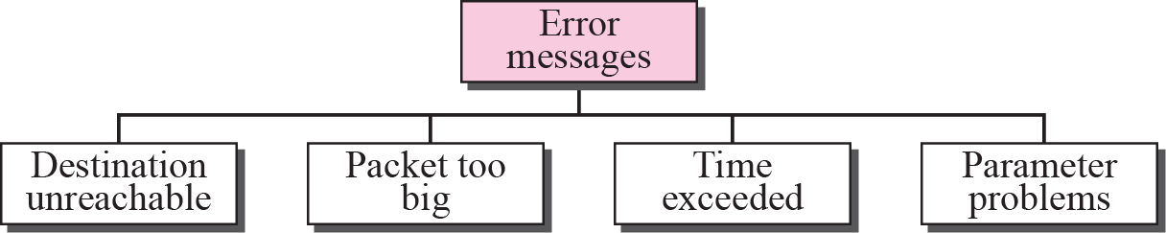
Figure 28.3 Error-reporting messages
TCP/IP Protocol Suite

Slide 7
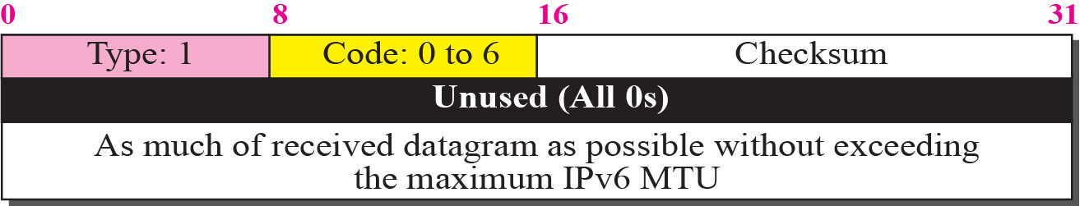
Figure 28.4 Destination unreachable message
TCP/IP Protocol Suite

Slide 8
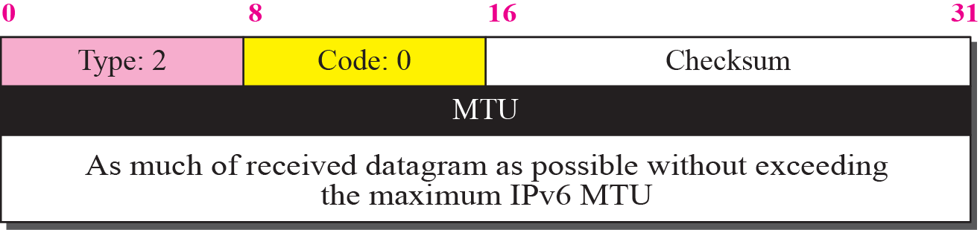
Figure 28.5 Packet-too-big message
TCP/IP Protocol Suite

Slide 9
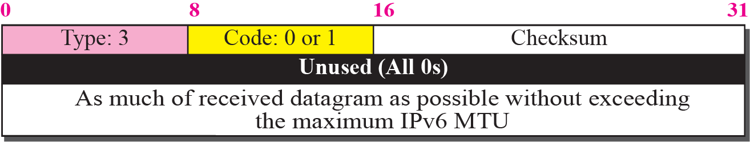
Figure 28.6 Time-exceeded message
TCP/IP Protocol Suite

Slide 10
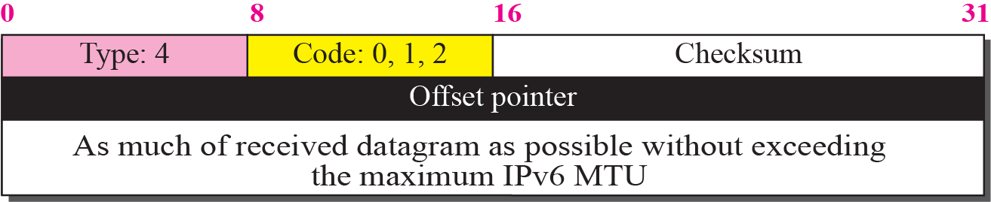
Figure 28.7 Parameter-problem message
TCP/IP Protocol Suite

Slide 11
28-3 INFORMATIONAL MESSAGES
Two of the ICMPv6 messages can be categorized as informational messages: echo request and echo reply messages. As discussed in Chapter 9, the echo request and echo response messages are designed to check if two devices in the Internet can communicate with each other. A host or router can send an echo request message to another host; the receiving computer or router can reply using the echo response message.
TCP/IP Protocol Suite

Slide 12
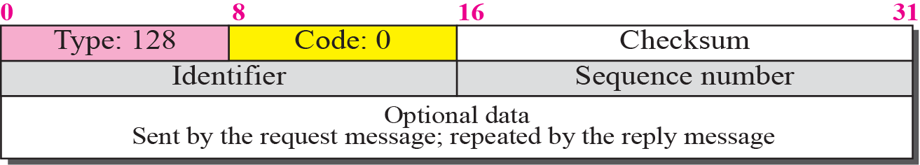
Figure 28.8 Echo-request message
TCP/IP Protocol Suite

Slide 13
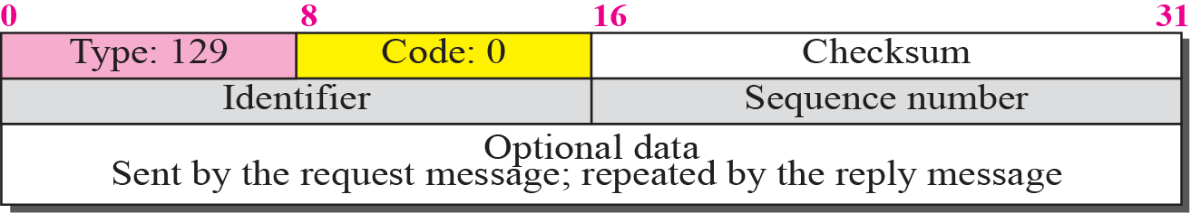
Figure 28.9 Echo-reply message
TCP/IP Protocol Suite

Slide 14
28-4 NEIGHBOR-DISCOVERY
MESSAGES
Several messages in the ICMPv6 have been redefined in ICMPv6 to handle the issue of neighbor discovery. Some new messages have also been added to provide extension. The most important issue is the definition of two new protocols that clearly define the functionality of these group messages: the Neighbor-Discovery (ND) protocol and the Inverse-Neighbor-Discovery (IND) protocol. These two protocols are used by nodes (hosts or routers) on the same link (network).
TCP/IP Protocol Suite

Slide 15
Topics Discussed in the Section
Router-Solicitation Message
Router-Advertisement Message
Neighbor-Solicitation Message
Neighbor-Advertisement Message
Redirection Message
Inverse-Neighbor-Solicitation Message
Inverse-Neighbor-Advertisement Message
TCP/IP Protocol Suite

Slide 16
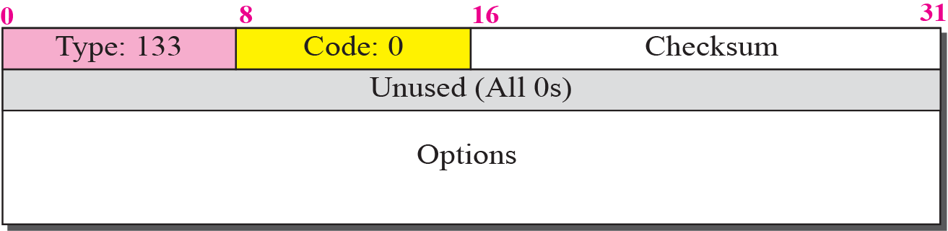
Figure 28.10 Router-solicitation message
TCP/IP Protocol Suite

Slide 17
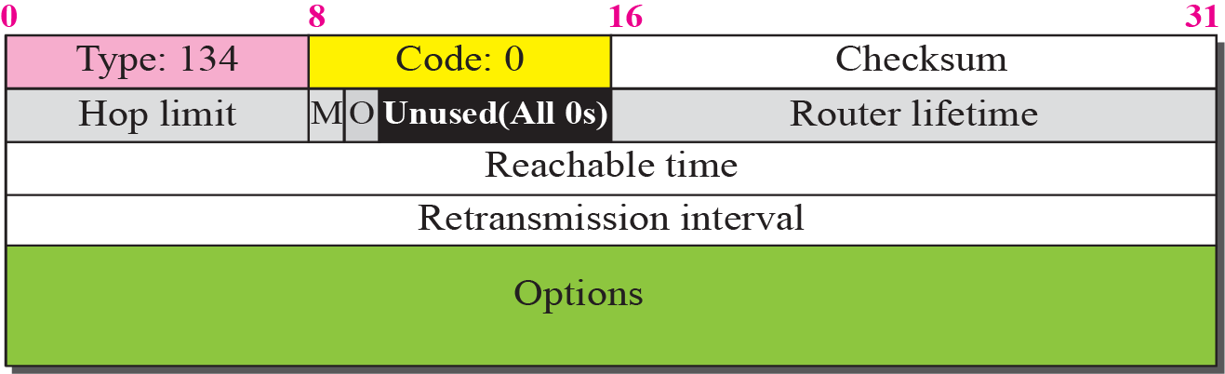
Figure 28.11 Router-advertisement message
TCP/IP Protocol Suite

Slide 18
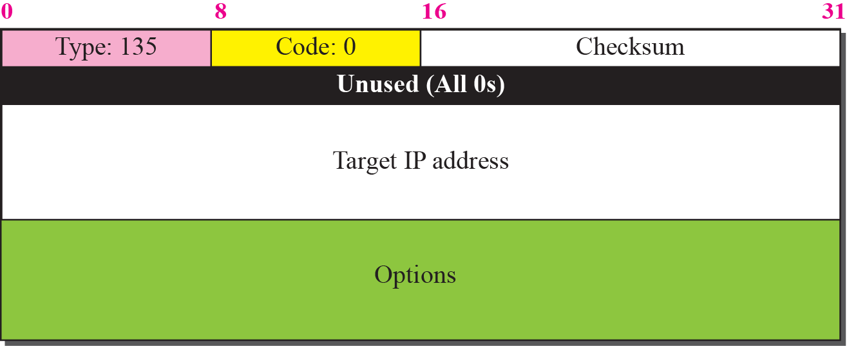
Figure 28.12 Neighbor-solicitation message
TCP/IP Protocol Suite

Slide 19
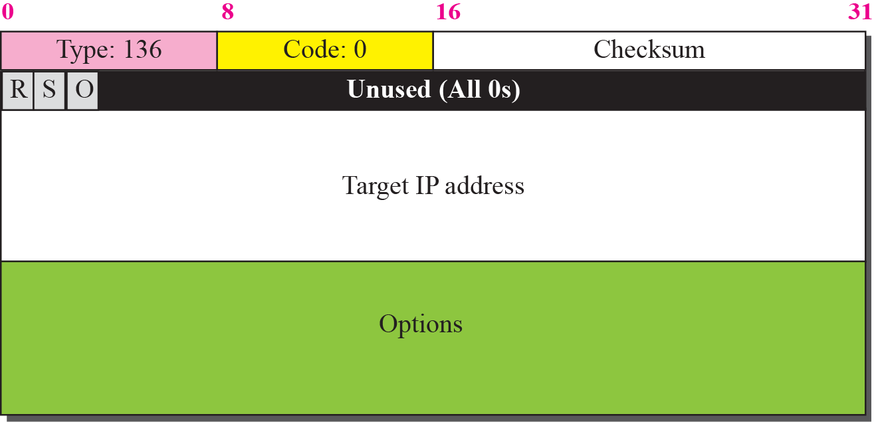
Figure 28.13 Neighbor advertisement message
TCP/IP Protocol Suite

Slide 20
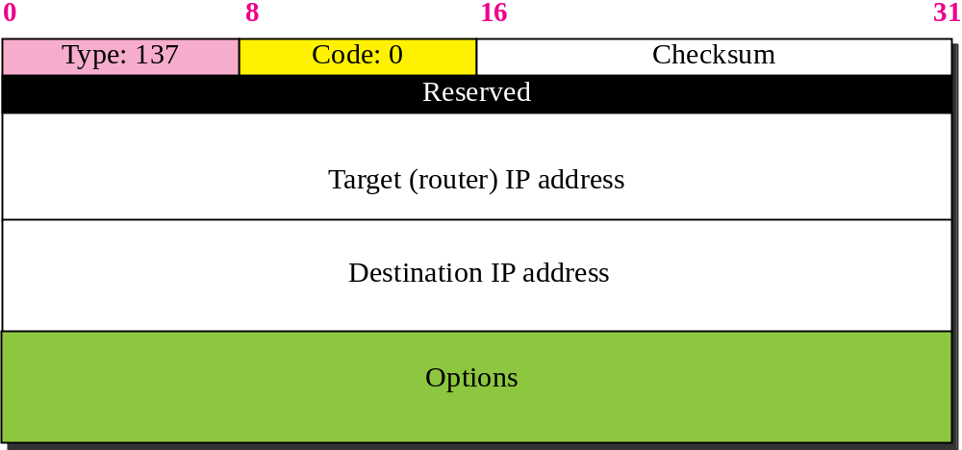
Figure 28.14 Redirection message
TCP/IP Protocol Suite

Slide 21
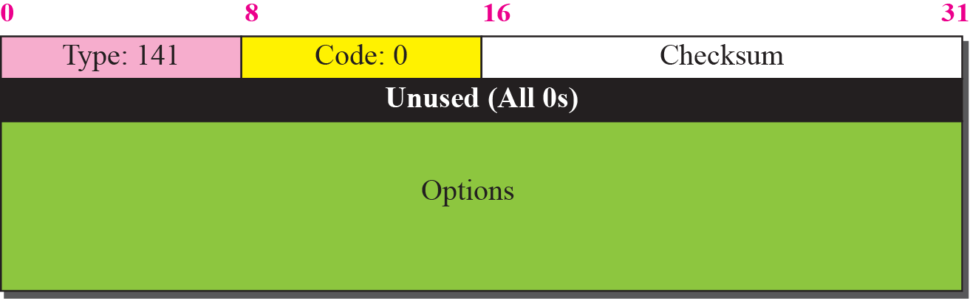
Figure 28.15 Inverse-neighbor-solicitation message
TCP/IP Protocol Suite

Slide 22
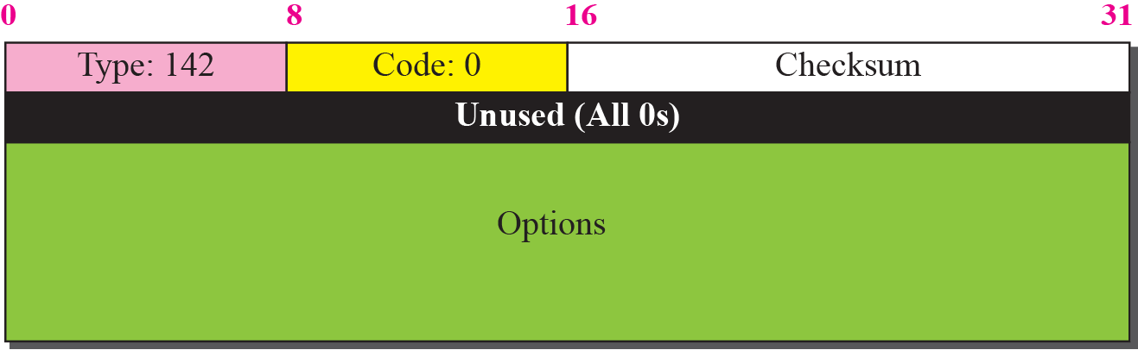
Figure 28.16 Inverse-neighbor-advertisement message
TCP/IP Protocol Suite

Slide 23
28-5 GROUP MEMBERSHIP MESSAGES
The management of multicast delivery handling in IPv4 is given to the IGMPv3 protocol. In IPv6, this responsibility is given to the Multicast Listener Delivery protocol. MLDv1 is the counterpart to IGMPv2; MLDv2 is the counterpart to IGMPv3. The material discussed in this section is taken from RFC 3810. The idea is the same as in IGMPv3, but the sizes and formats of the messages have been changed to fit the larger multicast address size in IPv6.
TCP/IP Protocol Suite

Slide 24
Topics Discussed in the Section
Membership-Query Message
Membership-Report Message
Functionality
TCP/IP Protocol Suite

Slide 25
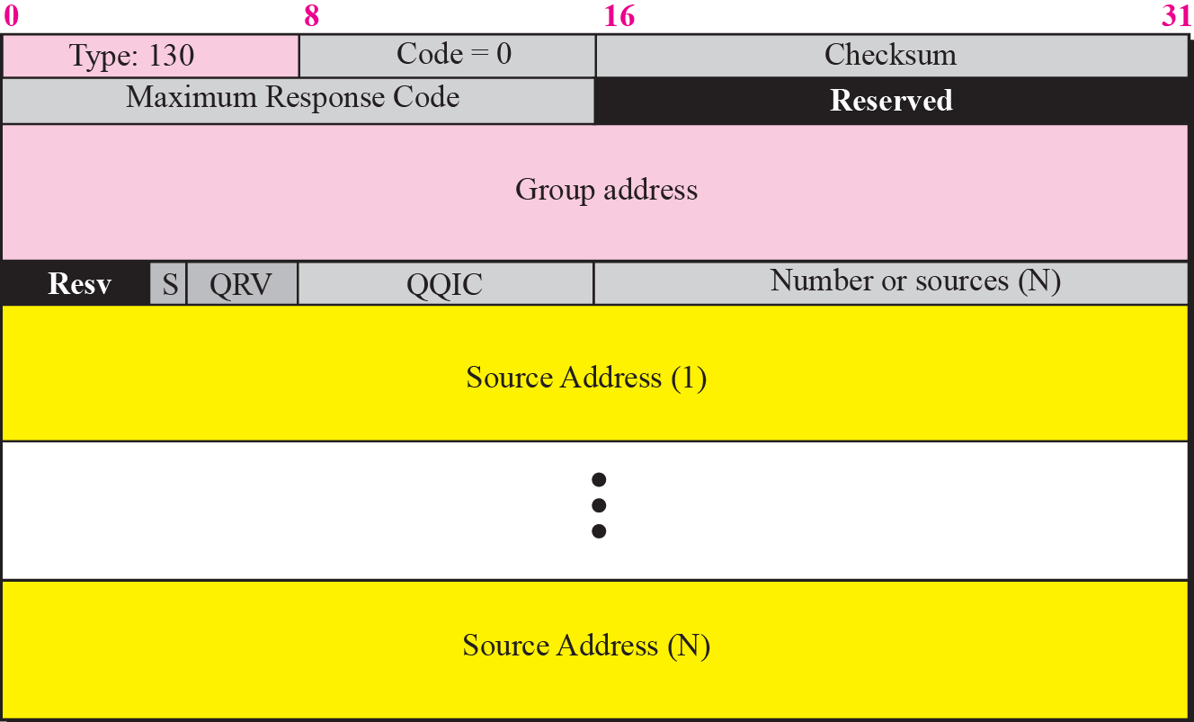
Figure 28.17 Membership query message format
TCP/IP Protocol Suite

Slide 26
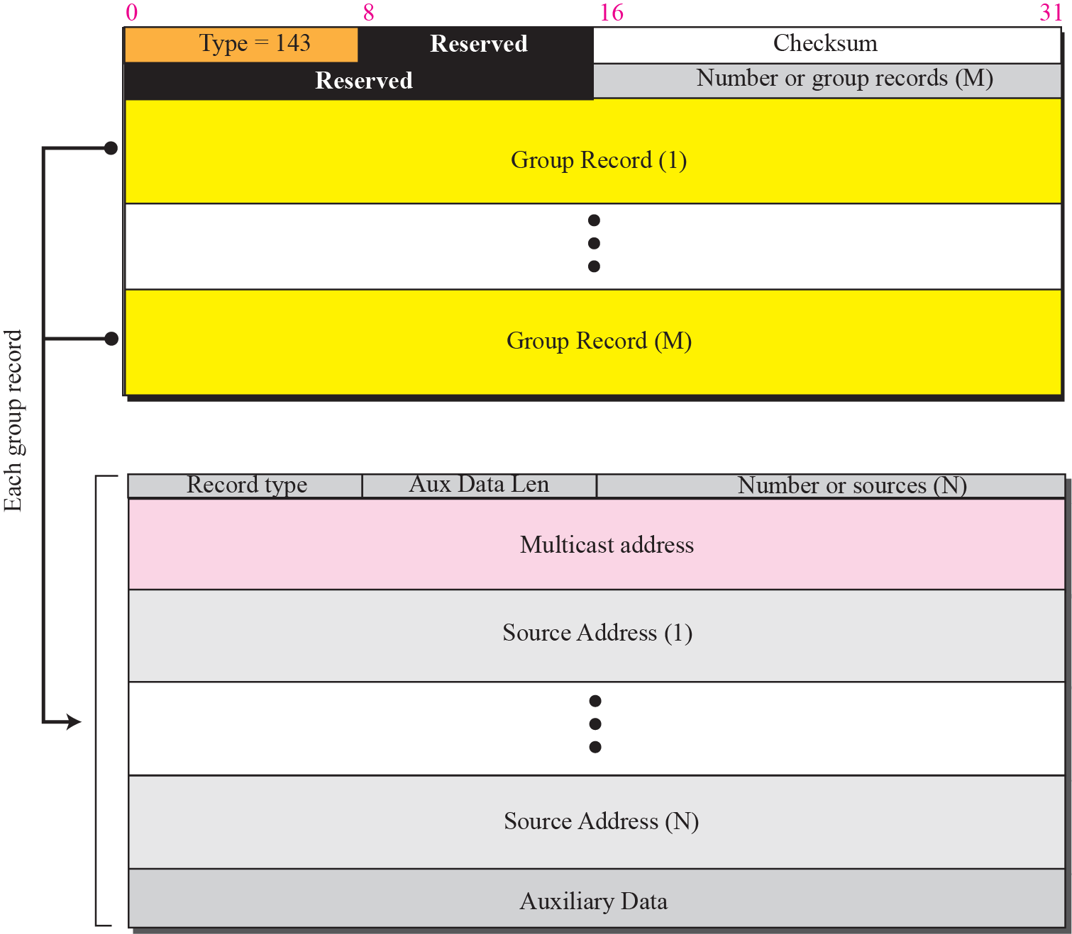
Figure 28.18 Membership-report message format
TCP/IP Protocol Suite

Slide 27
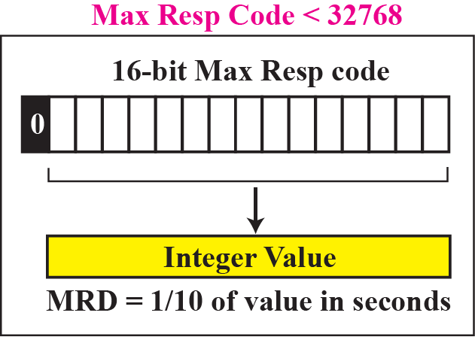
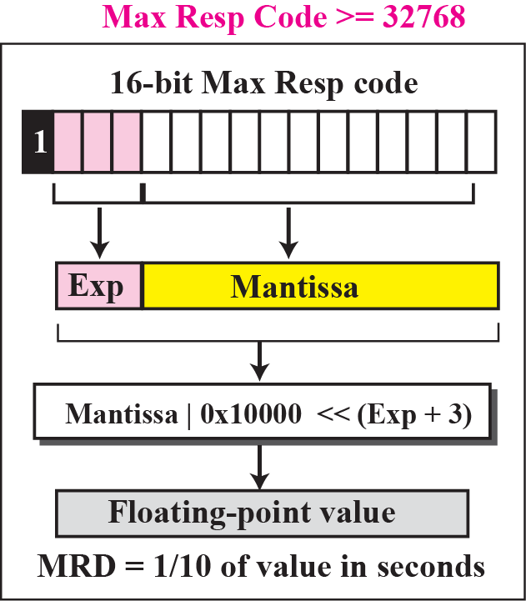
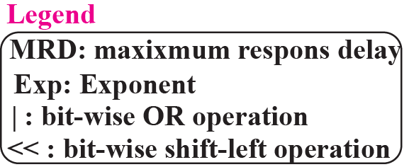
Figure 28.19 Calculation of maximum response time
TCP/IP Protocol Suite

Slide 28
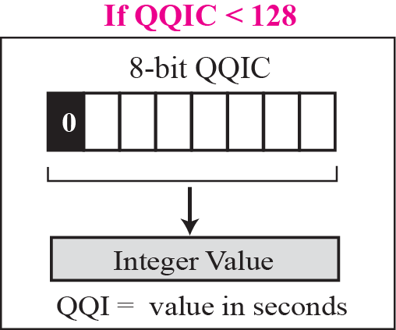
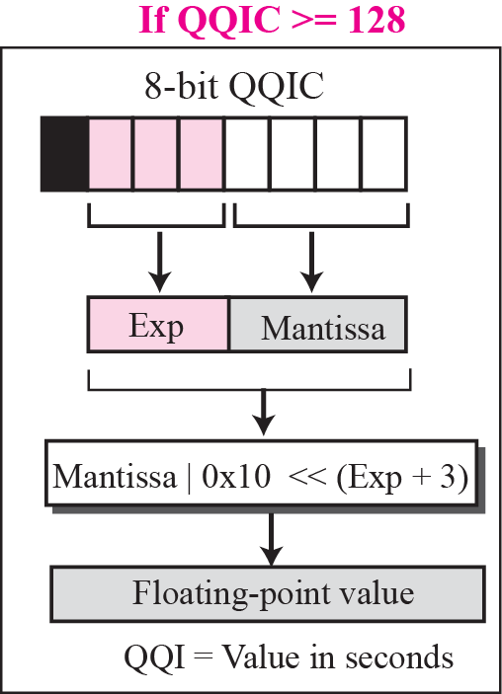
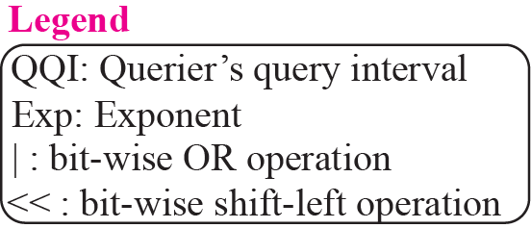
Figure 28.20 Calculation of query interval
TCP/IP Protocol Suite

