Slide 1

Chapter 29
Cryptography
and
Network
Security
TCP/IP Protocol Suite

Slide 2
29-1 INTRODUCTION
We are living in the information age. We need to keep information about every aspect of our lives. In other words, information is an asset that has a value like any other asset. As an asset, information needs to be secured from attacks. To be secured, information needs to be hidden from unauthorized access (confidentiality), protected from unauthorized change (integrity), and available to an authorized entity when it is needed (availability).
TCP/IP Protocol Suite

Slide 3
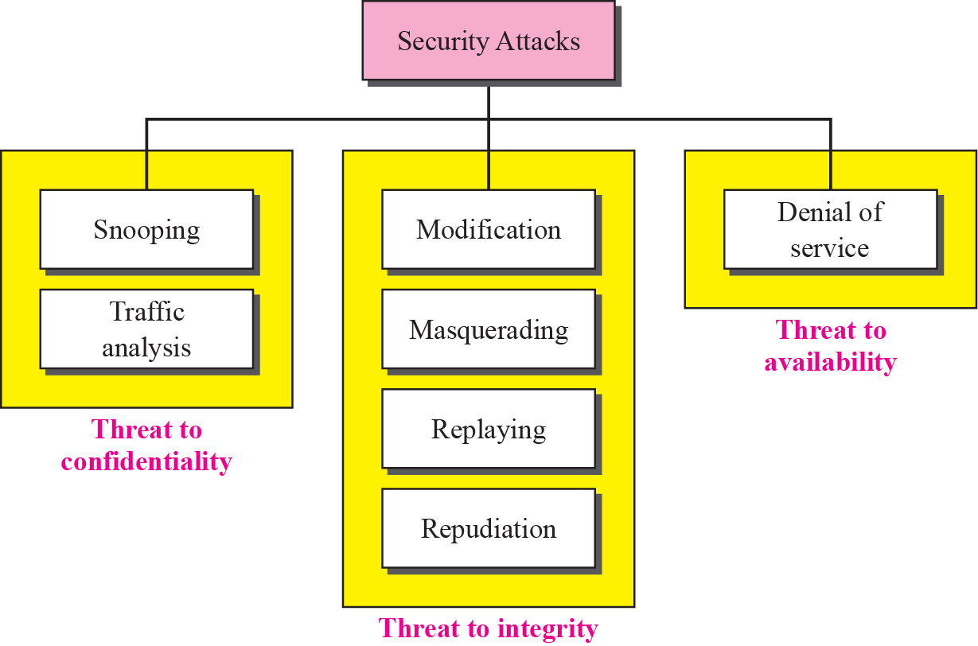
Figure 29.1 Taxonomy of attacks with relation to security goals
TCP/IP Protocol Suite

Slide 4
29-2 TRADITIONAL CIPHERS
We now look at the first goal of security, confidentiality. Confidentiality can be achieved using ciphers. Traditional ciphers are called symmetric-key ciphers (or secret-key ciphers) because the same key is used for encryption and decryption and the key can be used for bidirectional communication. Figure 29.2 shows the general idea behind a symmetric-key cipher.
TCP/IP Protocol Suite

Slide 5
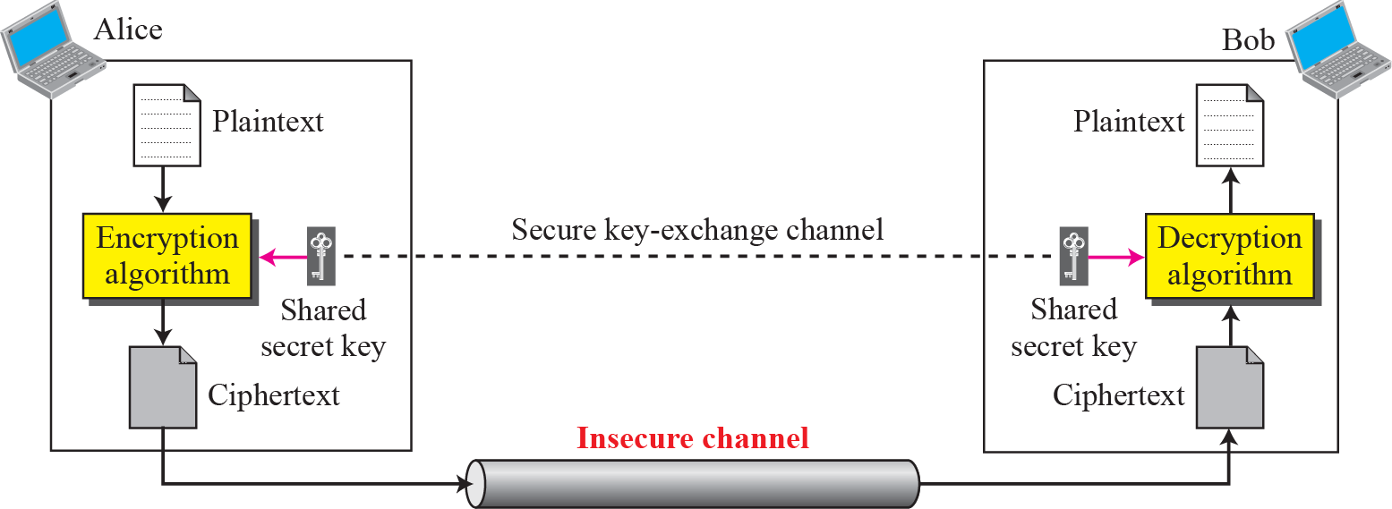
Figure 29.2 General idea of traditional cipher
TCP/IP Protocol Suite

Slide 6
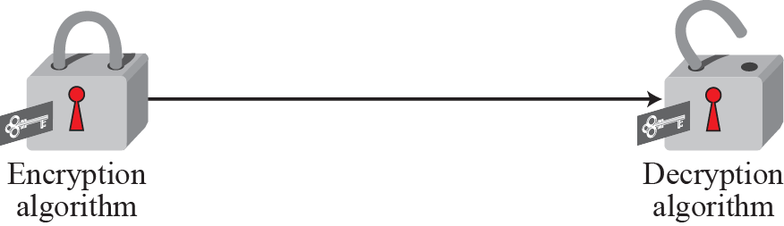
Figure 29.3 Symmetric-key: locking and unlocking with the same key
TCP/IP Protocol Suite

Slide 7

Note
A substitution cipher replaces one symbol with another.
TCP/IP Protocol Suite

Slide 8
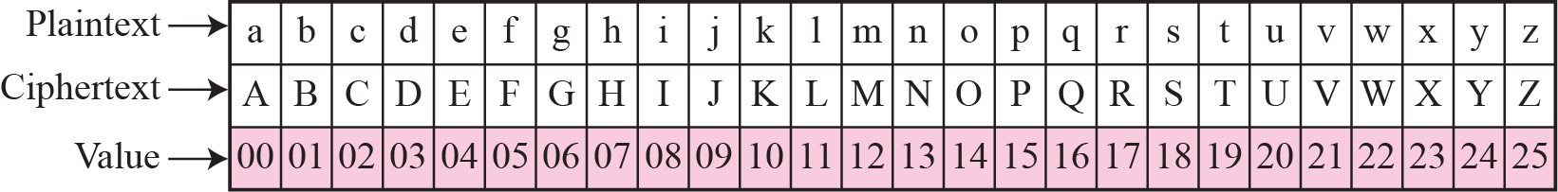
Figure 29.4 Representation of characters in modulo 26
TCP/IP Protocol Suite

Slide 9
Note
In additive cipher, the plaintext, ciphertext, and key are integers in modulo 26.
TCP/IP Protocol Suite

Slide 10
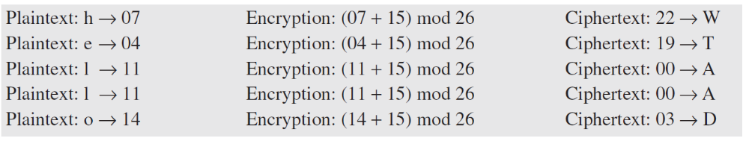
Example 29.1
Use the additive cipher with key = 15 to encrypt the message “hello”.
Solution
We apply the encryption algorithm to the plaintext, character by character. The result is “WTAAD”. Note that the cipher is monoalphabetic because two instances of the same plaintext character (ls) are encrypted as the same character (A).
TCP/IP Protocol Suite

Slide 11
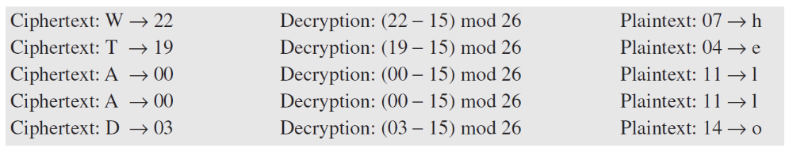
Example 29.2
Use the additive cipher with key = 15 to decrypt the message “WTAAD”.
Solution
We apply the decryption algorithm to the plaintext character by character. The result is “hello”. Note that the operation is in modulo 26, which means that we need to add 26 to a negative result (for example −15 becomes 11).
TCP/IP Protocol Suite

Slide 12
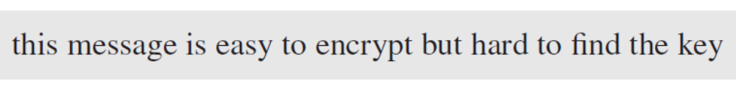
Example 29.3
We can use the key in Figure 29.5 to encrypt the message
The ciphertext is
TCP/IP Protocol Suite

Slide 13
Note
A transposition cipher reorders symbols.
TCP/IP Protocol Suite

Slide 14
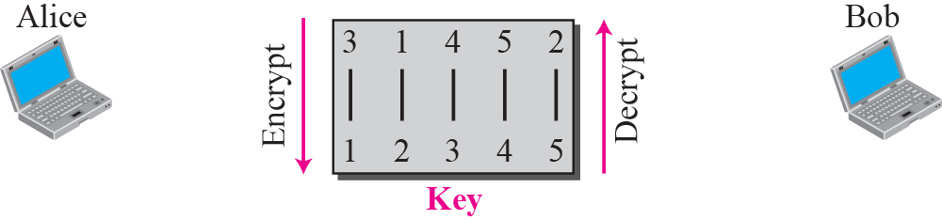
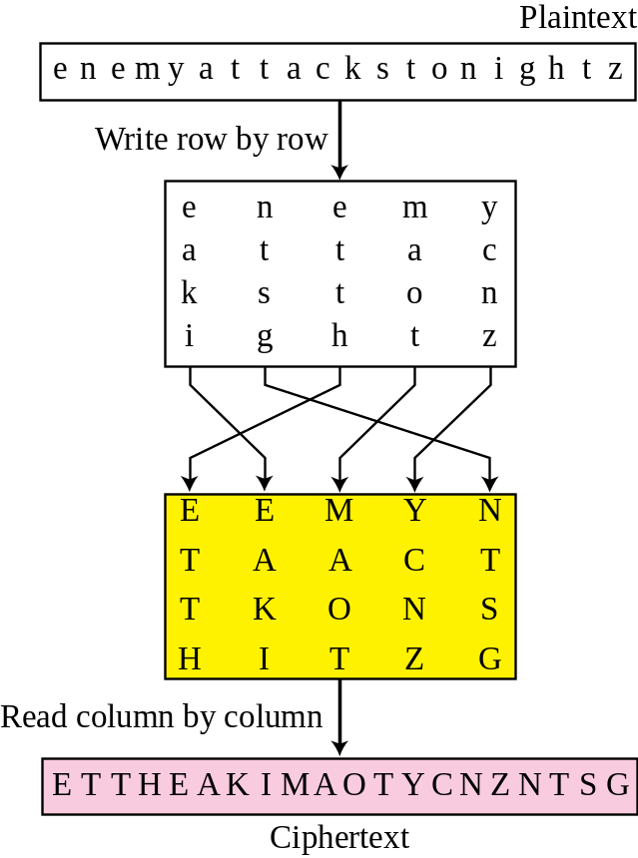
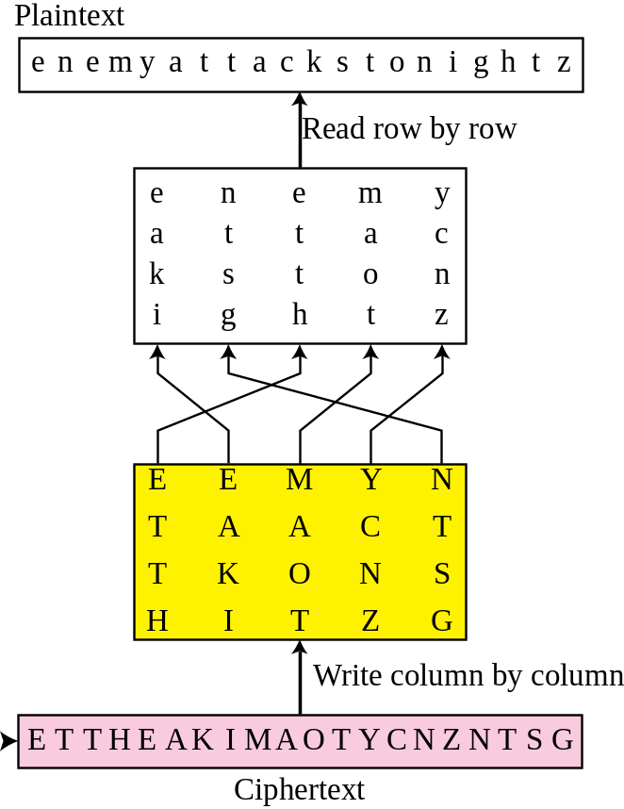

Figure 29.6 Transposition cipher
TCP/IP Protocol Suite

Slide 15
29-3 MODERN CIPHERS
The traditional symmetric-key ciphers that we have studied so far are character-oriented ciphers. With the advent of the computer, we need bit-oriented ciphers. This is because the information to be encrypted is not just text; it can also consist of numbers, graphics, audio, and video data. It is convenient to convert these types of data into a stream of bits, to encrypt the stream, and then to send the encrypted stream. A modern block cipher can be either a block cipher or a stream cipher.
TCP/IP Protocol Suite

Slide 16
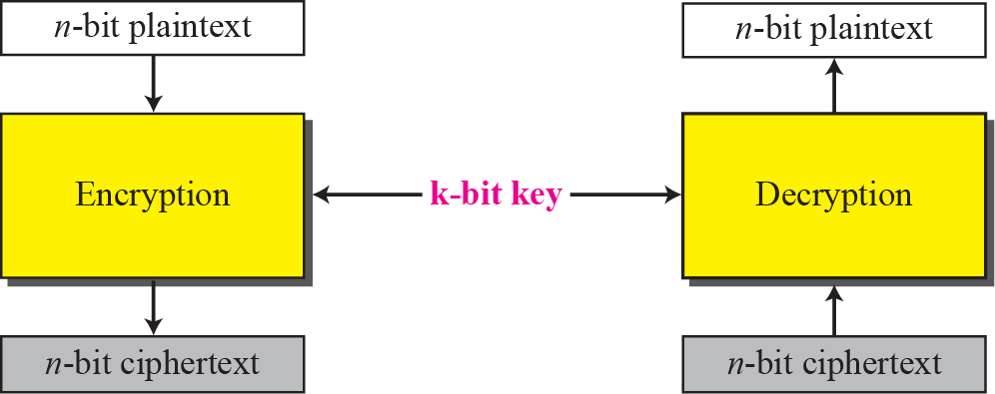
Figure 29.7 A modern block cipher
TCP/IP Protocol Suite

Slide 17
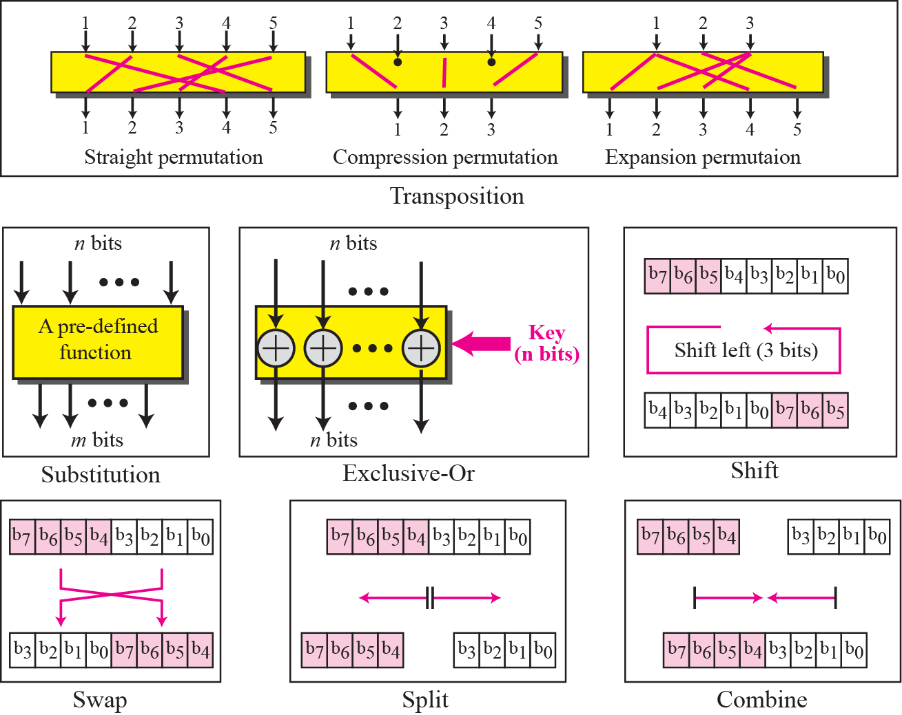
Figure 29.8 Components of a modern block cipher
TCP/IP Protocol Suite

Slide 18
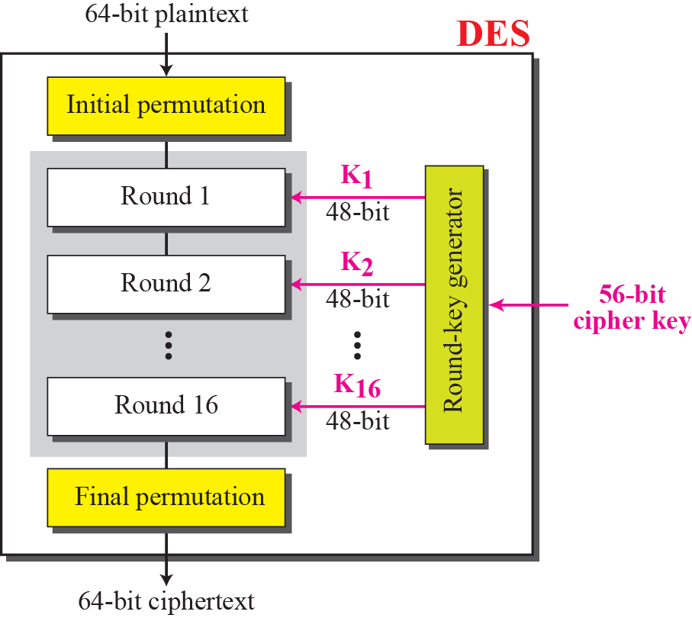
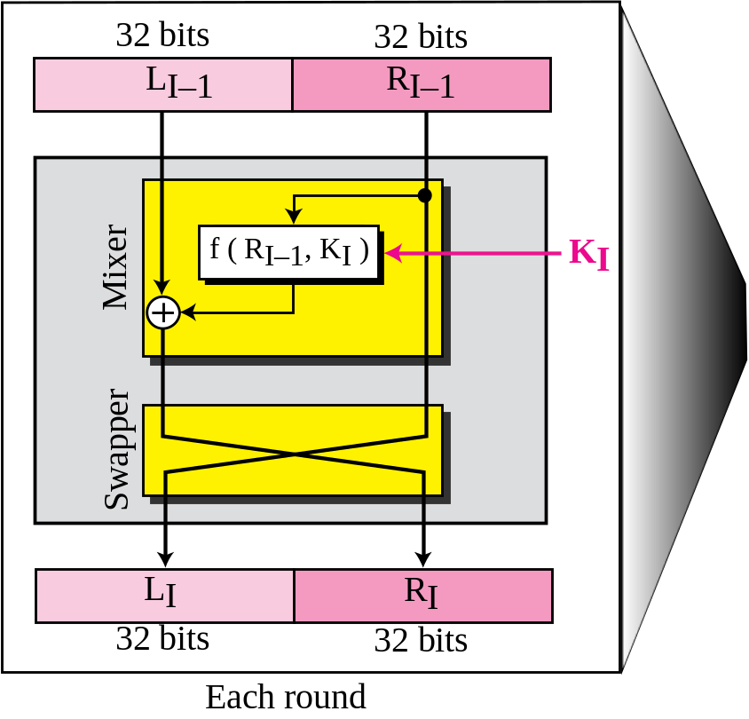
Figure 29.9 General structure of DES
TCP/IP Protocol Suite

Slide 19
Example 29.4
We choose a random plaintext block, a random key, and a computer program to determine what the ciphertext block would be (all in hexadecimal):
TCP/IP Protocol Suite

Slide 20
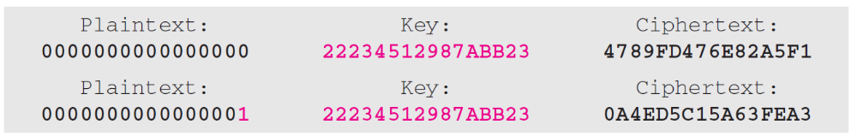
Example 29.5
To check the effectiveness of DES, when a single bit is changed in the input, let us use two different plaintexts with only one single bit difference. The two ciphertexts are completely different without even changing the key:
Although the two plaintext blocks differ only in the rightmost bit, the ciphertext blocks differ in 29 bits.
TCP/IP Protocol Suite

Slide 21
29-4 ASYMMETRIC-KEY CIPHERS
In previous sections we discussed symmetric-key ciphers. In this chapter, we start the discussion of asymmetric-key ciphers. Symmetric-key and asymmetric-key ciphers will exist in parallel and continue to serve the community. We actually believe that they are complements of each other; the advantages of one can compensate for the disadvantages of the other.
TCP/IP Protocol Suite

Slide 22
Note
Symmetric-key cryptography is based on sharing secrecy;
asymmetric-key cryptography is based on personal secrecy.
TCP/IP Protocol Suite

Slide 23
Note
In symmetric-key cryptography, symbols are permuted or substituted;
in asymmetric-key cryptography, numbers are manipulated.
TCP/IP Protocol Suite

Slide 24
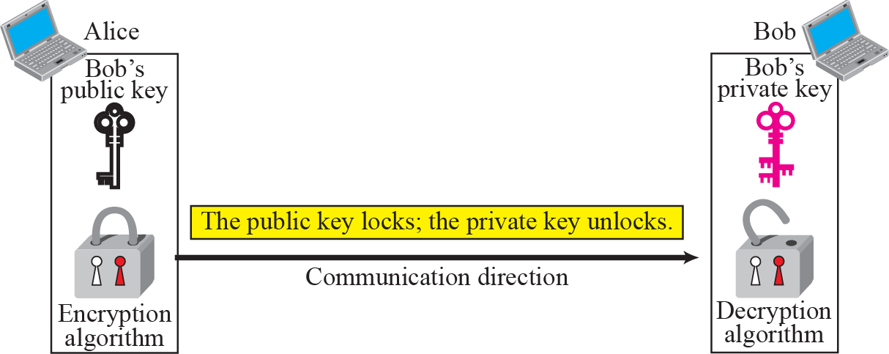
Figure 29.13 Locking and unlocking in asymmetric-key cryptosystem
TCP/IP Protocol Suite

Slide 25
Note
Asymmetric-key ciphers are sometimes called public-key ciphers.
TCP/IP Protocol Suite

Slide 26
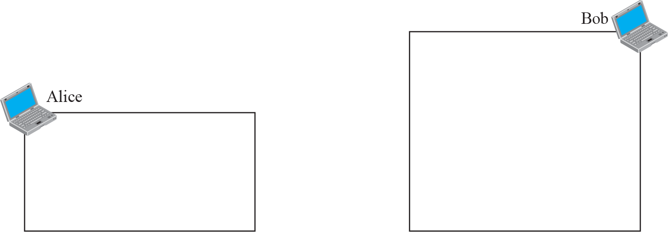
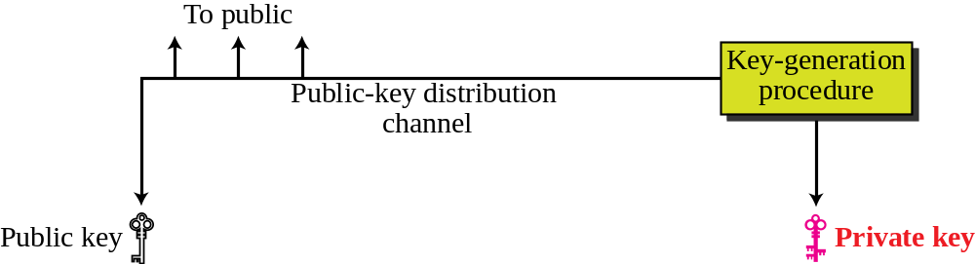
Figure 29.14 General idea of asymmetric-key cryptosystem
TCP/IP Protocol Suite

Slide 27
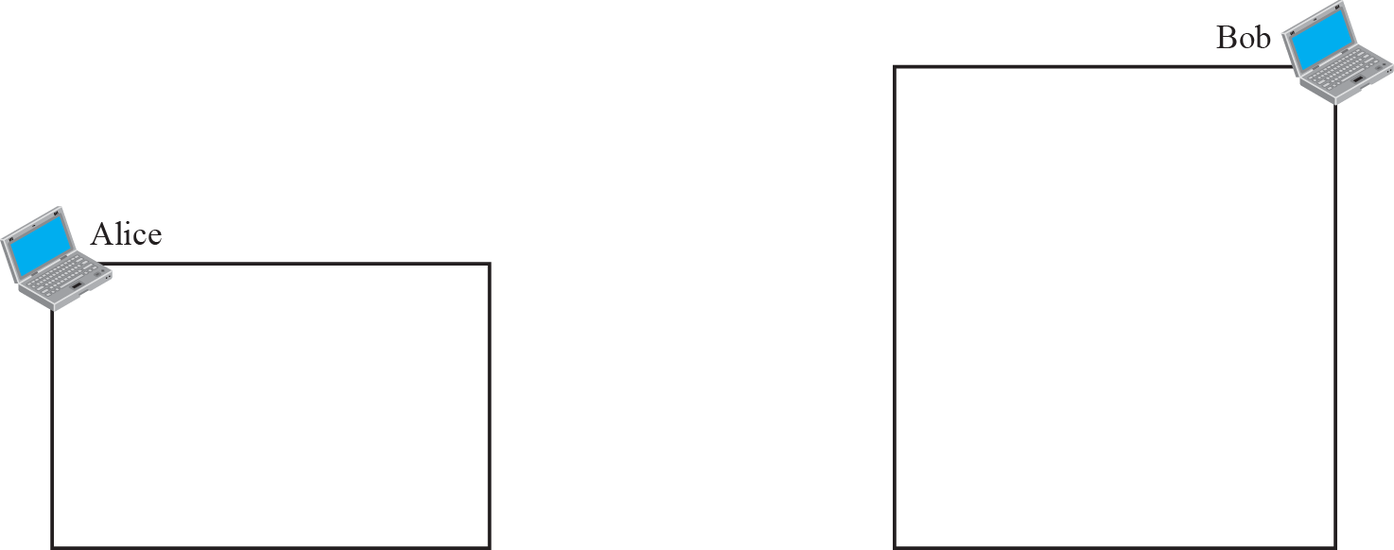
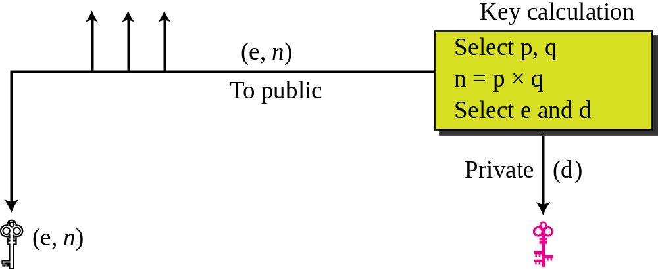
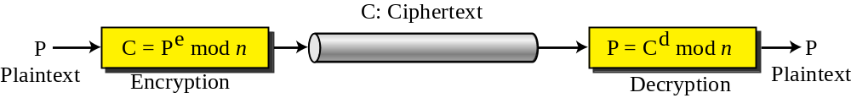
Figure 29.15 Encryption, decryption, and key Generation in RSA
TCP/IP Protocol Suite

Slide 28
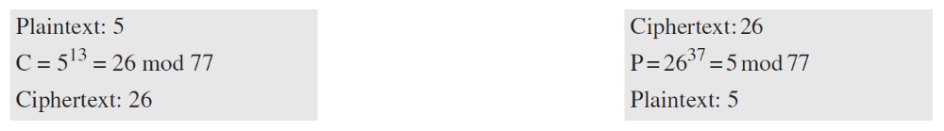
Example 29.6
For the sake of demonstration, let Bob choose 7 and 11 as p and q and calculate n = 7 × 11 = 77. The value of φ(n) =
(7 − 1)(11 − 1), or 60. If he chooses e to be 13, then d is 37. Note that e × d mod 60 = 1. Now imagine that Alice wants to send the plaintext 5 to Bob. She uses the public exponent 13 to encrypt 5. This system is not safe because p and q are small.
TCP/IP Protocol Suite

Slide 29
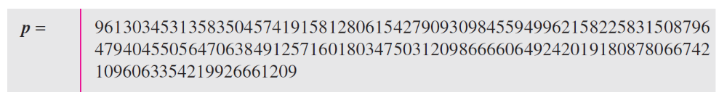
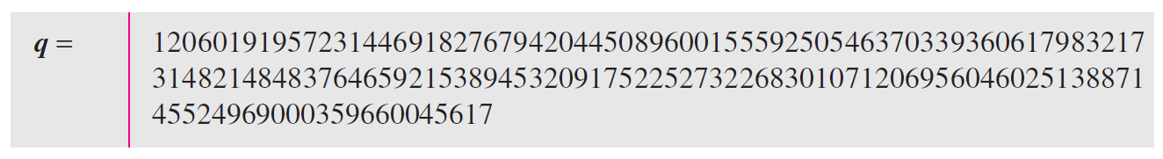
Example 29.7
Here is a more realistic example calculated with a computer. We choose a 512-bit p and q, calculate n and φ(n), We then choose e and calculate d. Finally, we show the results of encryption and decryption. The integer p is a 159-digit number.
The integer q is a 160-digit number.
TCP/IP Protocol Suite

Slide 30
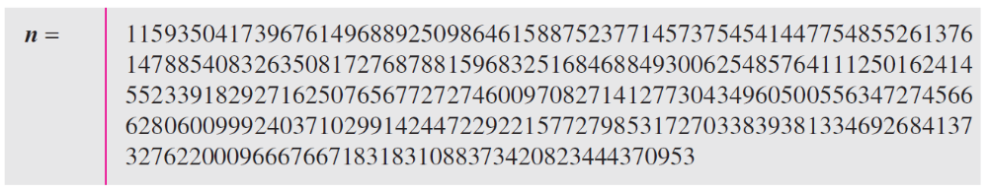
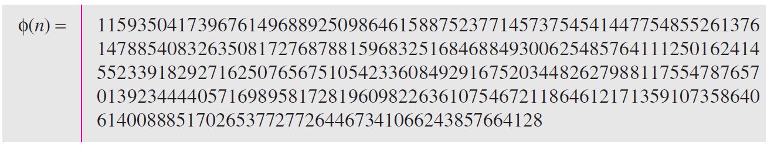
Example 29.7 Continued
The modulus n = p × q. It has 309 digits.
φ(n) = (p − 1)(q − 1) has 309 digits.
TCP/IP Protocol Suite

Slide 31
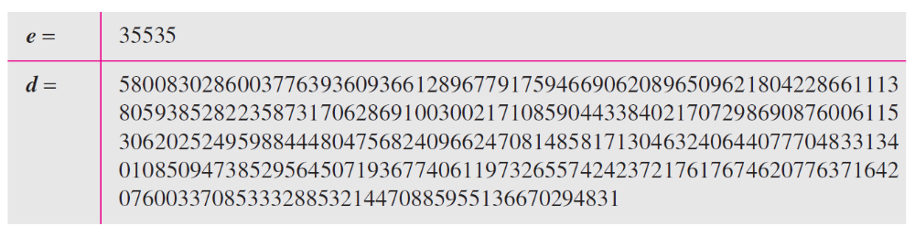
Example 29.7 Continued
Bob chooses e = 35535 (the ideal is 65537). He then finds d.
Alice wants to send the message “THIS IS A TEST”, which can be changed to a numeric value using the 00−26 encoding scheme (26 is the space character).
TCP/IP Protocol Suite

Slide 32
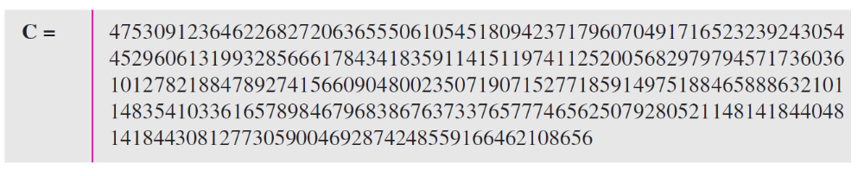
Example 29.7 Continued
The ciphertext calculated by Alice is C = P^{e}, which is
Bob can recover the plaintext from the ciphertext using P = C^{d}, which is
The recovered plaintext is “THIS IS A TEST” after decoding.
TCP/IP Protocol Suite

Slide 33
29-5 MESSAGE INTEGRITY
The cryptography systems that we have studied so far provide secrecy, or confidentiality, but not integrity. However, there are occasions where we may not even need secrecy but instead must have integrity. For example, Alice may write a will to distribute her estate upon her death. The will does not need to be encrypted. After her death, anyone can examine the will. The integrity of the will, however, needs to be preserved. Alice does not want the contents of the will to be changed.
TCP/IP Protocol Suite

Slide 34
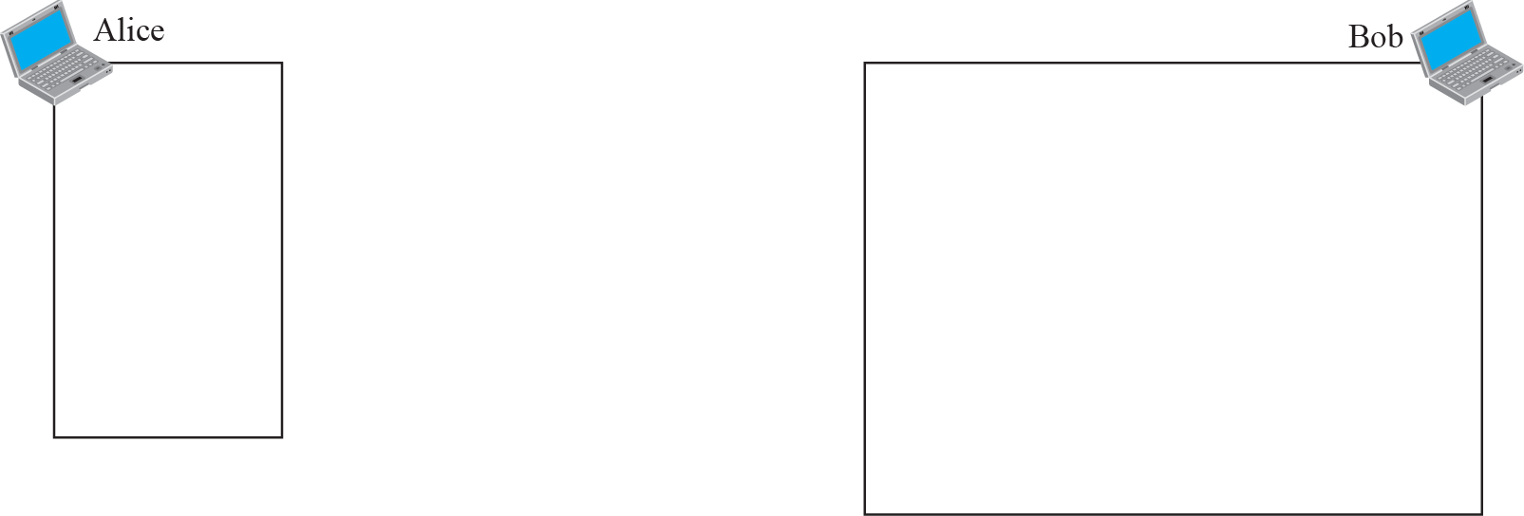
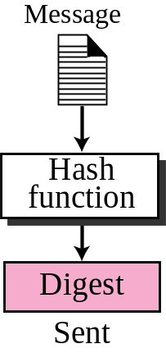
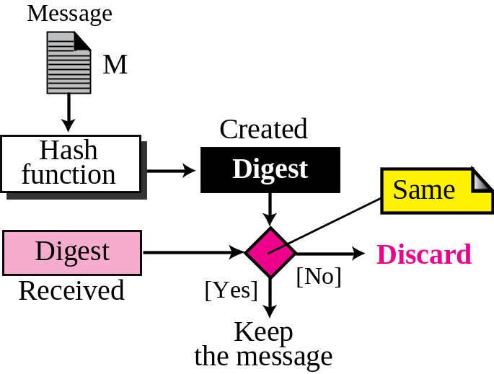
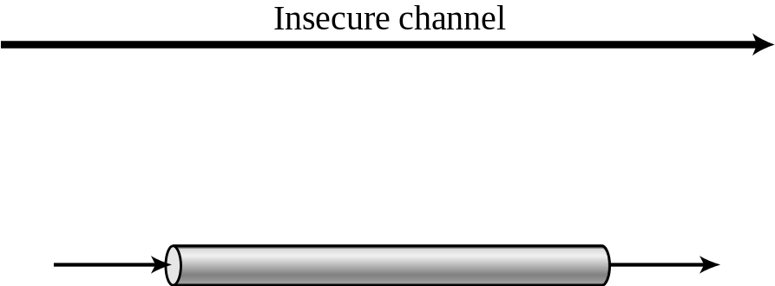
Figure 29.16 Message and digest
TCP/IP Protocol Suite

Slide 35
Note
The message digest needs to be safe from change.
TCP/IP Protocol Suite

Slide 36
29-6 MESSAGE AUTHENTICATION
A digest can be used to check the integrity of a message: that the message has not been changed. To ensure the integrity of the message and the data origin authentication— that Alice is the originator of the message, not somebody else—we need to include a secret held by Alice (that Eve does not possess) in the process; we need to create a message authentication code (MAC). Figure 29.17 shows the idea.
TCP/IP Protocol Suite

Slide 37
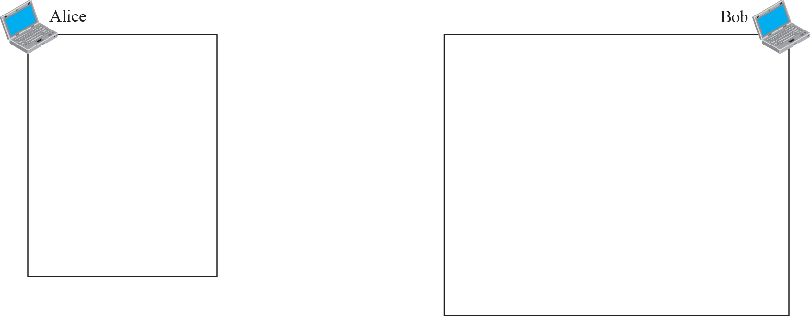
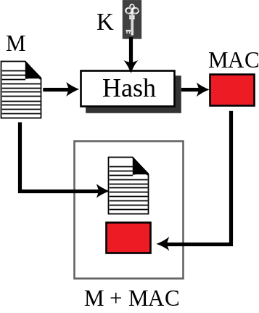
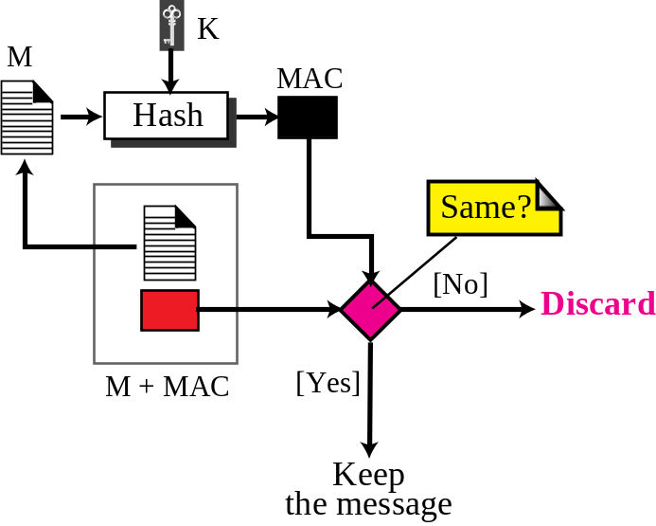
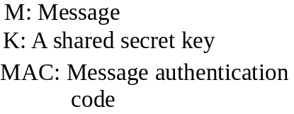
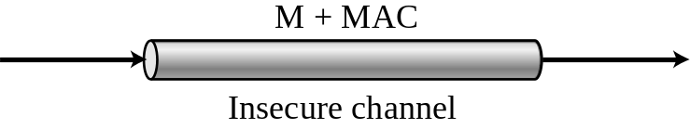
Figure 29.17 Message authentication code
TCP/IP Protocol Suite

Slide 38
Note
A MAC provides message integrity
and message authentication using a combination of a hash function and a secret key.
TCP/IP Protocol Suite

Slide 39
29-7 DIGITAL SIGNATURE
Another way to provide message integrity and message authentication (and some more security services as we see shortly) is a digital signature. A MAC uses a secret key to protect the digest; a digital signature uses a pair of private-public keys.
TCP/IP Protocol Suite

Slide 40
Note
A digital signature uses a pair of private-public keys.
TCP/IP Protocol Suite

Slide 41
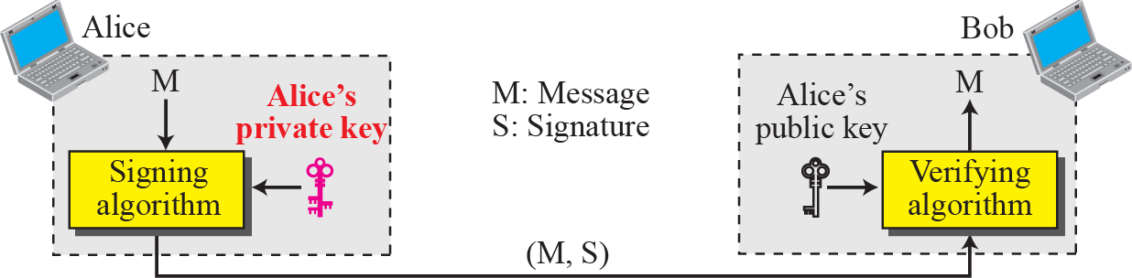
Figure 29.18 Digital signature process
TCP/IP Protocol Suite

Slide 42
Note
A digital signature needs a public-key system.
The signer signs with her private key; the verifier verifies with the signer’s public key.
TCP/IP Protocol Suite

Slide 43
Note
A cryptosystem uses the private and public keys of the receiver:
a digital signature uses the private and public keys of the sender.
TCP/IP Protocol Suite

Slide 44
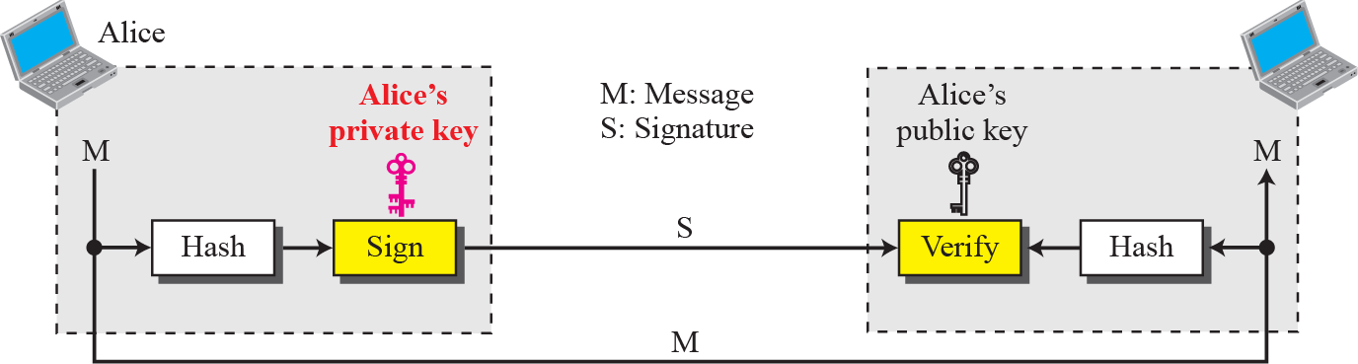
Figure 29.19 Signing the digest
TCP/IP Protocol Suite

Slide 45
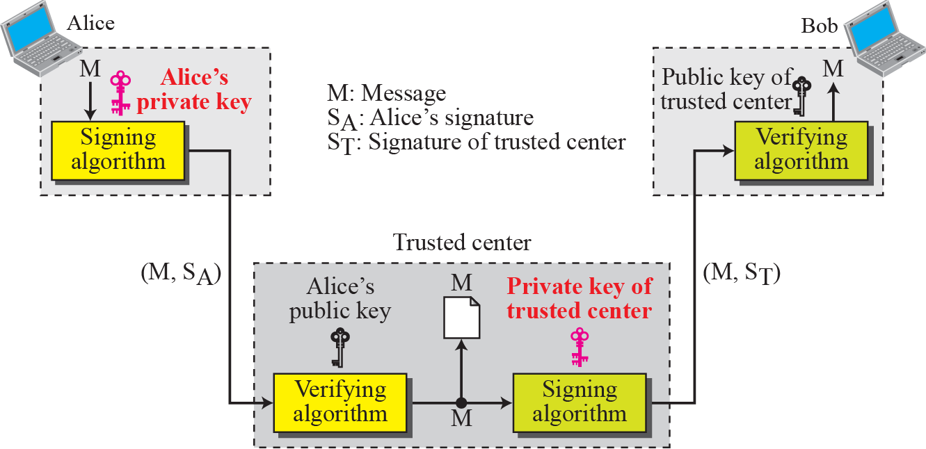
Figure 29.20 Using a trusted center for non-repudiation
TCP/IP Protocol Suite

Slide 46
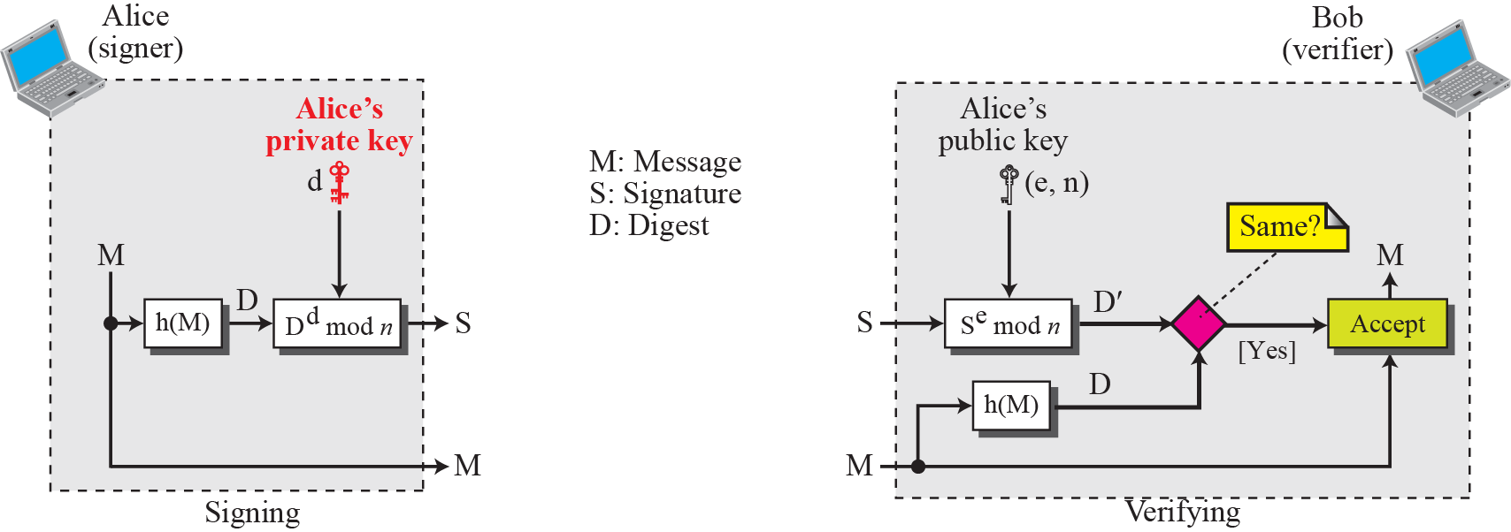
Figure 29.21 The RSA signature on the message digest
TCP/IP Protocol Suite

Slide 47
29-9 KEY MANAGEMENT
We discussed symmetric-key and asymmetric-key cryptography in the previous sections. However, we have not yet discussed how secret keys in symmetric-key cryptography, and public keys in asymmetric-key cryptography, are distributed and maintained. This section touches on these two issues.
TCP/IP Protocol Suite

Slide 48
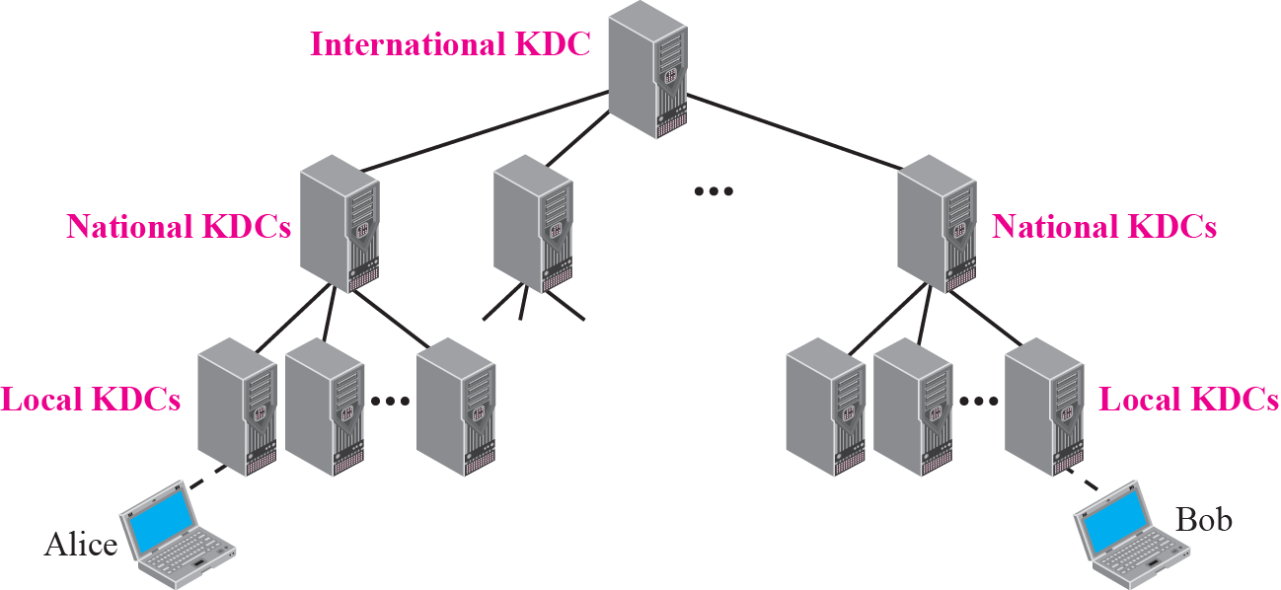
Figure 29.25 Multiple KDC’s
TCP/IP Protocol Suite

Slide 49
Note
A session symmetric key between two parties is used only once.
TCP/IP Protocol Suite

Slide 50
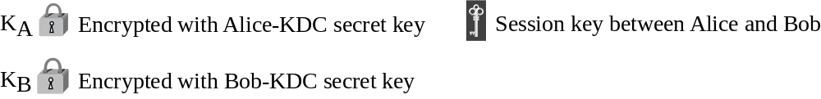
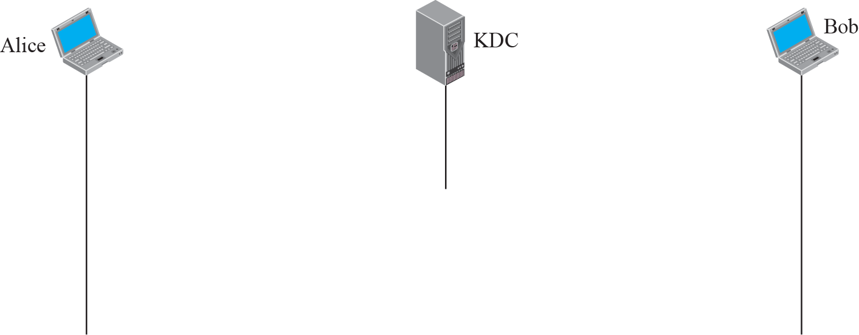

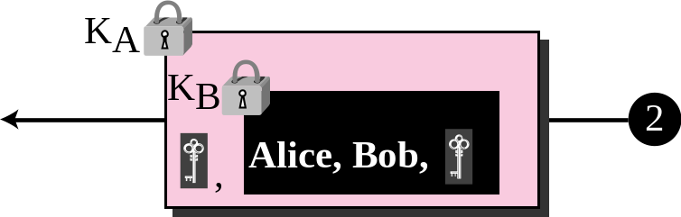
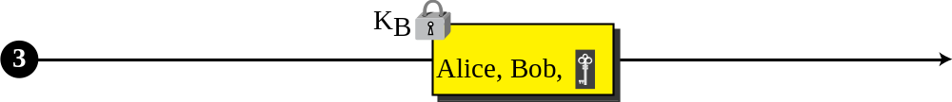
Figure 29.26 Creating a session key using KDC
TCP/IP Protocol Suite

Slide 51
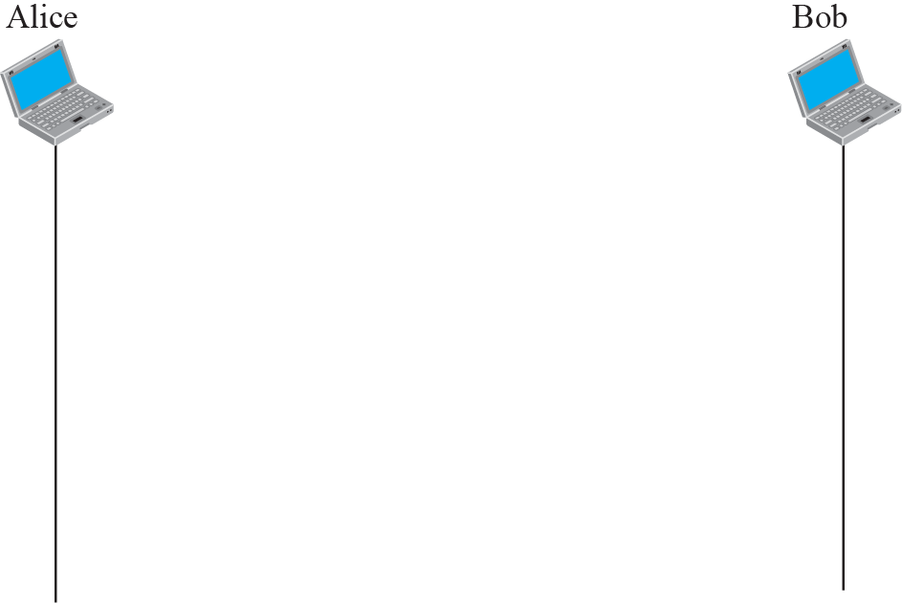






Figure 29.27 Diffie-Hellman method
TCP/IP Protocol Suite

Slide 52
Note
The symmetric (shared) key in the
Diffie-Hellman method is K = g^{xy} mod p.
TCP/IP Protocol Suite

Slide 53
Example 29.8
Let us give a trivial example to make the procedure clear. Our example uses small numbers, but note that in a real situation, the numbers are very large. Assume that g = 7 and p = 23. The steps are as follows:
1. Alice chooses x = 3 and calculates R¹ = 7³ mod 23 = 21.
2. Alice sends the number 21 to Bob.
3. Bob chooses y = 6 and calculates R₂ = 7⁶ mod 23 = 4.
4. Bob sends the number 4 to Alice.
5. Alice calculates the symmetric key K = 4³ mod 23 = 18. Bob calculates the symmetric key K = 21⁶ mod 23 = 18.
The value of K is the same for both Alice and Bob;
g^{xy} mod p = 7¹⁸ mod 35 = 18.
TCP/IP Protocol Suite

