Slide 1

Chapter 30
Internet
Security
TCP/IP Protocol Suite

Slide 2
30-1 NETWORK LAYER SECURITY
We start this chapter with the discussion of security at the network layer. Although in the next two sections we discuss security at the transport and application layers, we also need security at the network layer. IP Security (IPSec) is a collection of protocols designed by the Internet Engineering Task Force (IETF) to provide security for a packet at the network level. IPSec helps create authenticated and confidential packets for the IP layer.
TCP/IP Protocol Suite

Slide 3
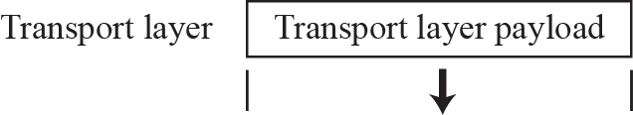
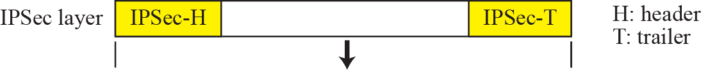
Figure 30.1 IPSec in transport mode
TCP/IP Protocol Suite

Slide 4

Note
IPSec in transport mode does not protect the IP header;
it only protects the information coming from the transport layer.
TCP/IP Protocol Suite

Slide 5
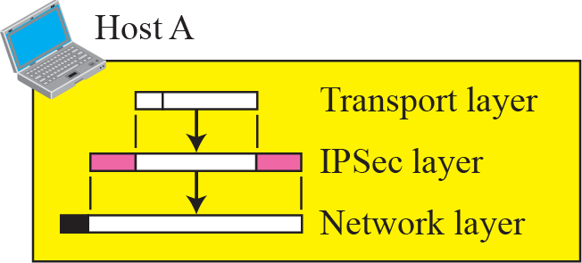
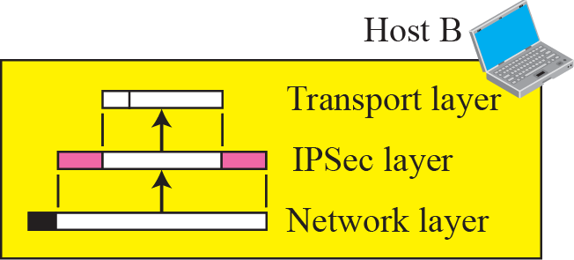
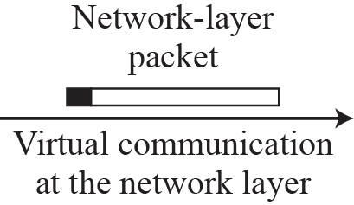
Figure 30.2 Transport mode in Action
TCP/IP Protocol Suite

Slide 6
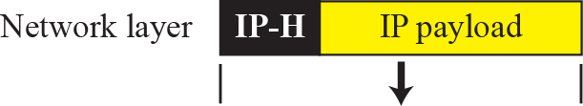
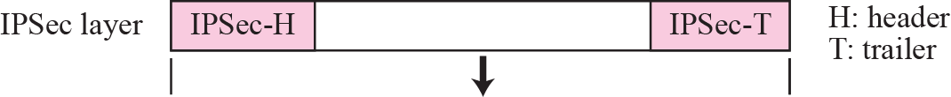
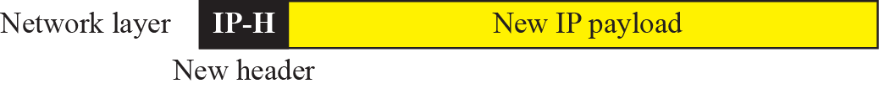
Figure 30.3 IPSec in tunnel mode
TCP/IP Protocol Suite

Slide 7
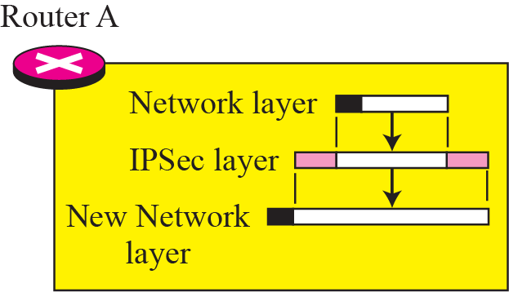
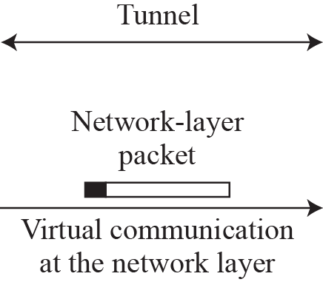
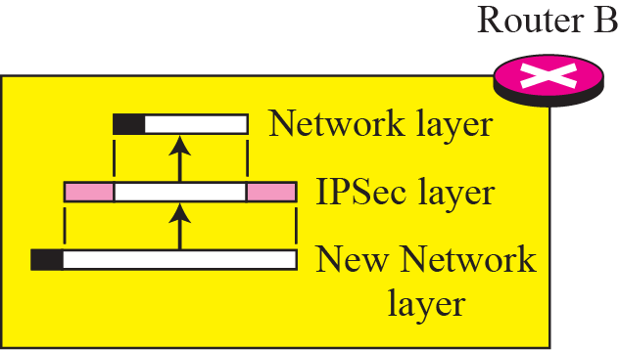
Figure 30.4 Tunnel-mode in action
Tunnel
TCP/IP Protocol Suite

Slide 8
Note
IPSec in tunnel mode protects the original IP header.
TCP/IP Protocol Suite

Slide 9
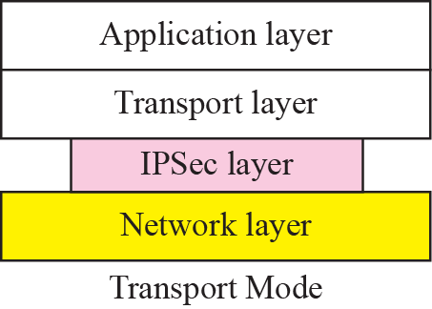
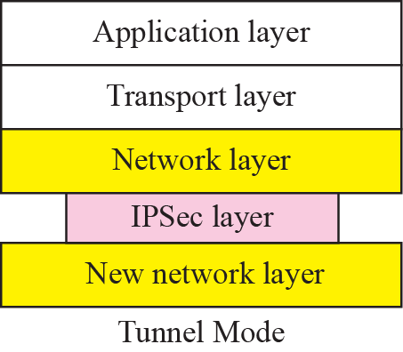
Figure 30.5 Transport mode versus tunnel mode
TCP/IP Protocol Suite

Slide 10
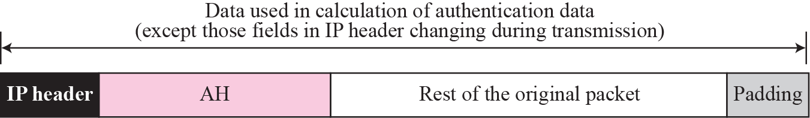
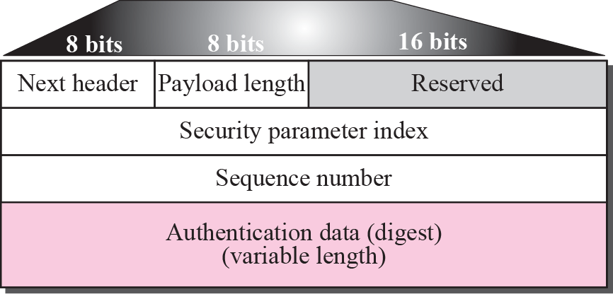
Figure 30.6 Authentication Header (AH) protocol
TCP/IP Protocol Suite

Slide 11
Note
The AH protocol provides source authentication and data integrity,
but not privacy.
TCP/IP Protocol Suite

Slide 12
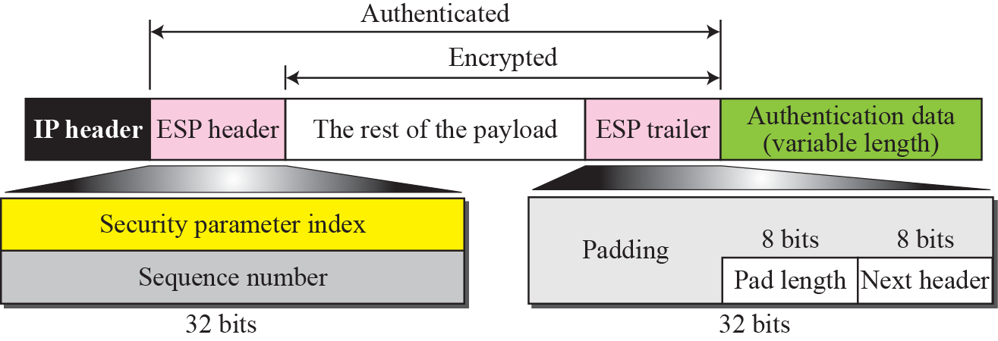
Figure 30.7 Encapsulating Security Payload (ESP)
TCP/IP Protocol Suite

Slide 13
Note
ESP provides source authentication, data integrity, and privacy.
TCP/IP Protocol Suite

Slide 14
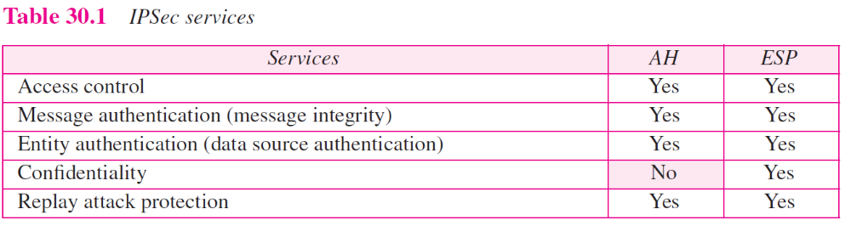
TCP/IP Protocol Suite

Slide 15
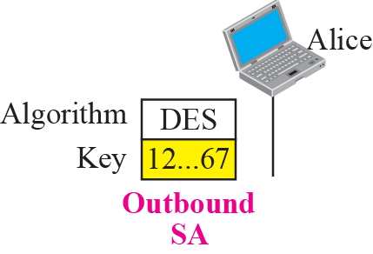
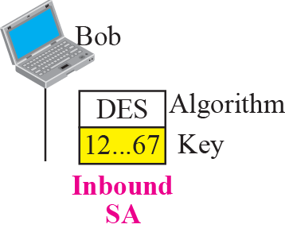
Figure 30.8 Simple SA
TCP/IP Protocol Suite

Slide 16
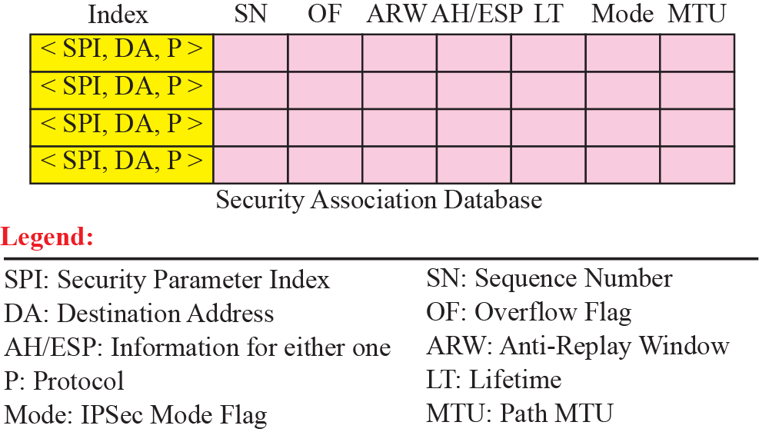
Figure 30.9 SAD
TCP/IP Protocol Suite

Slide 17
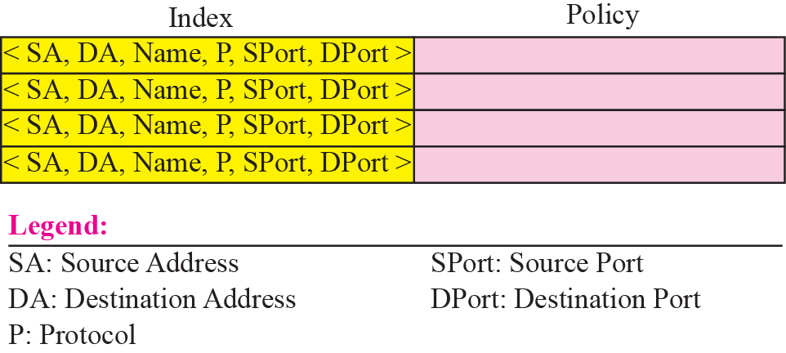
Figure 30.10 SPD
TCP/IP Protocol Suite

Slide 18
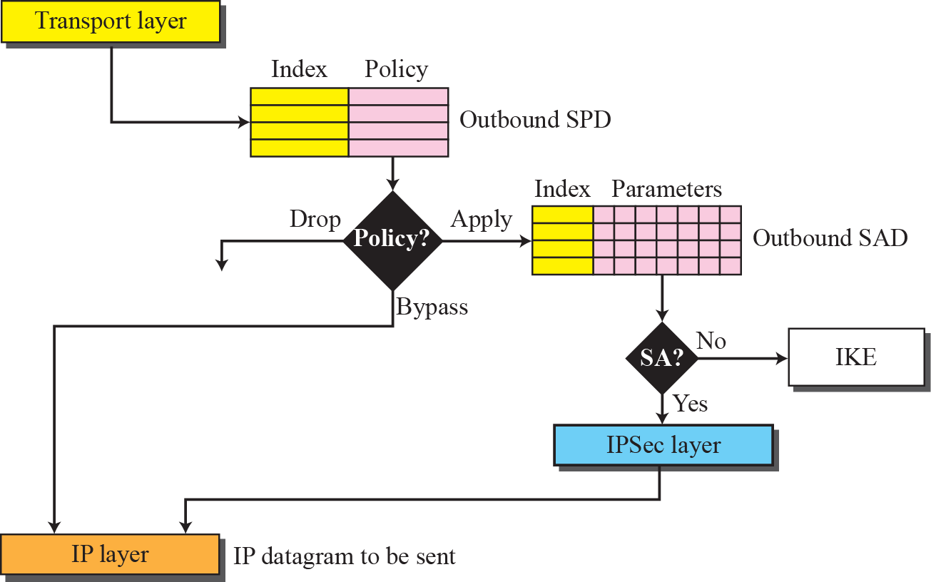
Figure 30.11 Outbound processing
TCP/IP Protocol Suite

Slide 19
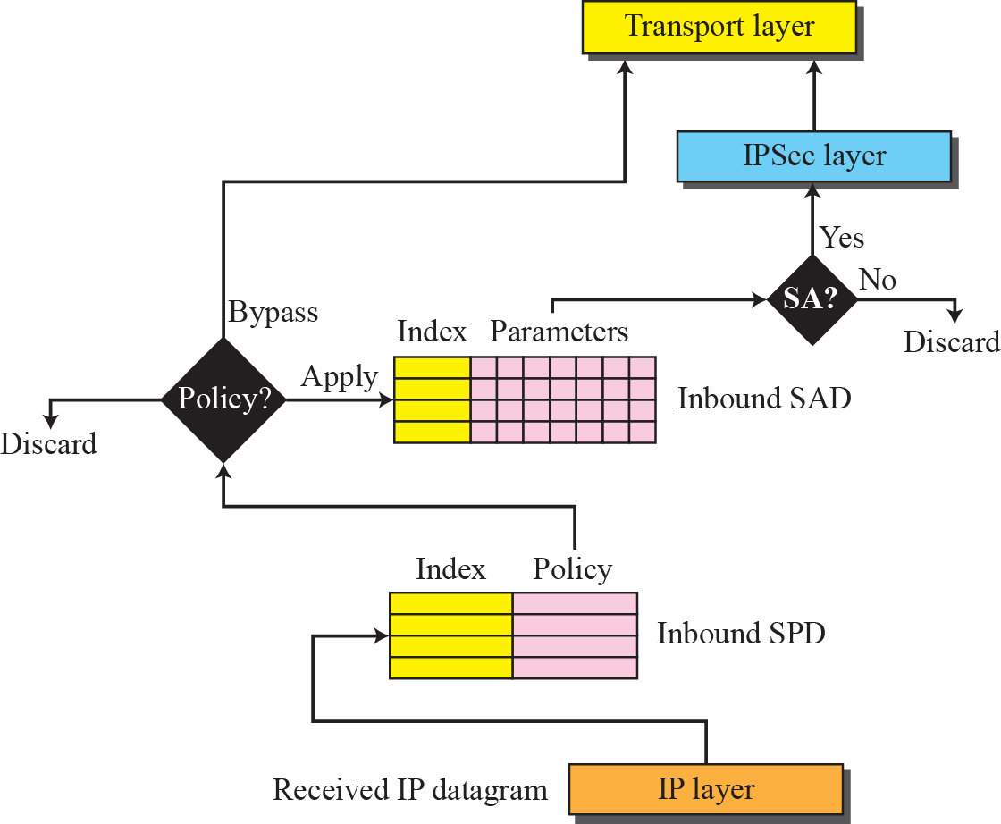
Figure 30.12 Inbound processing
TCP/IP Protocol Suite

Slide 20
Note
IKE creates SAs for IPSec.
TCP/IP Protocol Suite

Slide 21
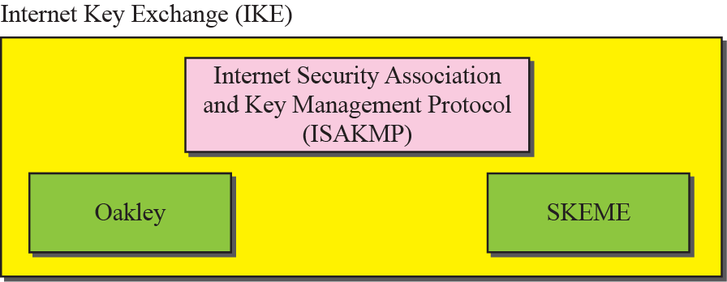
Figure 30.13 IKE components
TCP/IP Protocol Suite

Slide 22
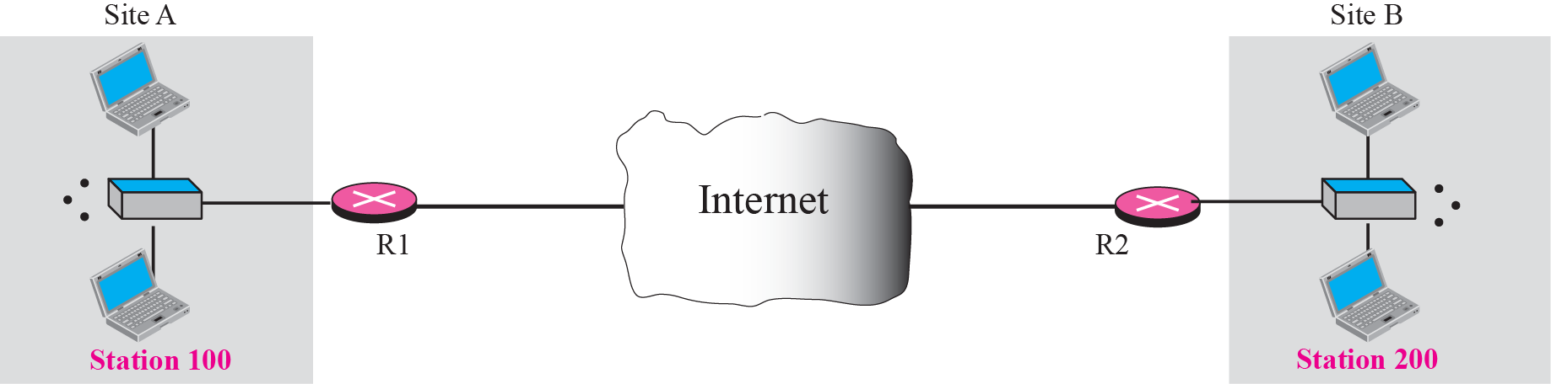
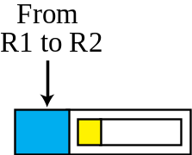
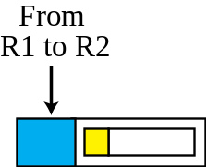
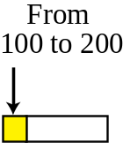
Figure 30.14 Virtual private network
TCP/IP Protocol Suite

Slide 23
30-2 TRANSPORT LAYER SECURITY
Two protocols are dominant today for providing security at the transport layer: the Secure Sockets Layer (SSL) protocol and the Transport Layer Security (TLS) protocol. The latter is actually an IETF version of the former. We discuss SSL in this section; TLS is very similar. Figure 30.15 shows the position of SSL and TLS in the Internet model.
TCP/IP Protocol Suite

Slide 24
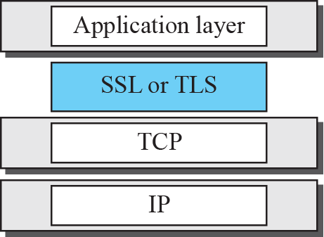
Figure 30.15 Location of SSL and TSL in the Internet mode
TCP/IP Protocol Suite

Slide 25
30-3 APPLICATION LAYER SECURITY
This section discusses two protocols providing security services for e-mails: Pretty Good Privacy (PGP) and Secure/Multipurpose Internet Mail Extension (S/MIME).
TCP/IP Protocol Suite

Slide 26
Topics Discussed in the Section
E-mail Security
Pretty Good Privacy (PGP)
Key Rings
PGP Certificates
S/MIME
Applications of S/MIME
TCP/IP Protocol Suite

Slide 27
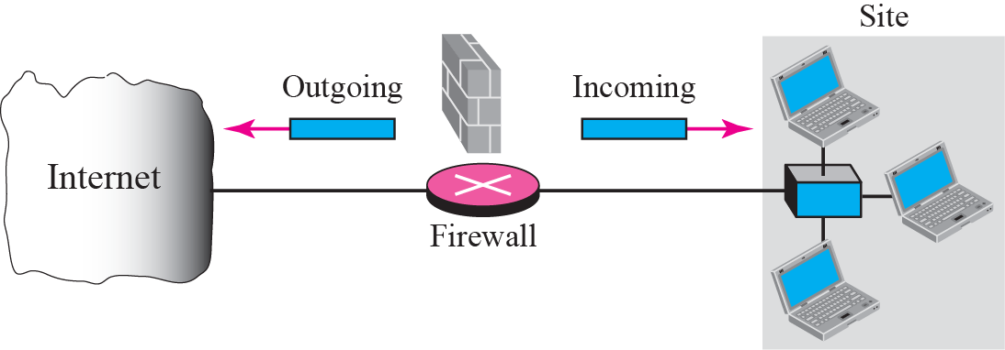
Figure 30.32 Firewall
TCP/IP Protocol Suite

Slide 28
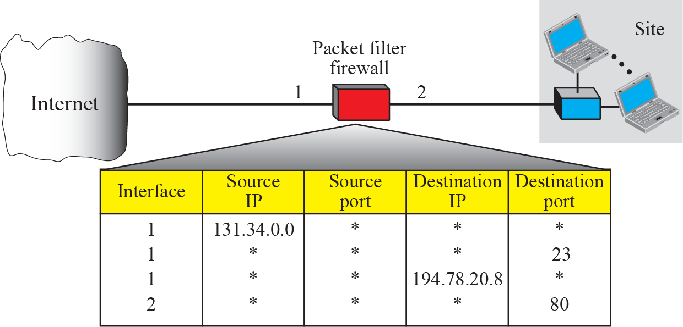
Figure 30.33 Packet-filter firewall
TCP/IP Protocol Suite

