Slide 1
IP Mobility Overview

Slide 2
Classification of Mobility (by Movement Type)
L1 Mobility
L2 Mobility
L3 Mobility
Vertical Handover & Roaming

Slide 3
L1: Movement within a Base Station
Physical Layer MM (by 주파수 강도 제어)
Same MAC address
Same IP address
BS
MN

Slide 4
L2: Movement across different BS
MAC Layer MM
Internet
Router
BS1
BS2
Different MAC address
Same IP address
MN

Slide 5
L3: Movement across different IP subnets
Network Layer MM (IP Mobility)
Internet
R_1
R_2
BS1
BS2
Different MAC address
Different IP address
MN

Slide 6
Vertical Handover
Movement across different radio access technology
MN has multiple network interfaces (e.g., WiBro & 3G)
WiBro …
3G Cellular
MN

Slide 7
Roaming between Operators
Roaming between different operators
AAA interworking: AAA proxy (visited) ⬄ AAA home
LGT
SKT
MN

Slide 8
Mobility Management
Two Technical Issues
Location Management (위치관리)
Maintains the current location of mobile users
Location: BS or IP address ?
For up-coming sessions
(e.g.) Binding Update
Handover Control (핸드오버 제어)
Provides ‘Session Continuity’ against movement of MN
For on-going sessions
(e.g.) Handover Tunnel

Slide 9
Handover
Vertical & Horizontal Handover
Vertical Handover
Handover across heterogeneous access networks
(e.g.) 3G-WiBro
MN has multiple network interfaces
Horizontal Handover
Handover between homogeneous access networks
3G-3G: different IP subnet (IP address changes)
MN has a single network interface

Slide 10
Handover
L2 & L3 Handover
L2 Handover (link-layer HO)
PoA (Point of Attachment) of MN changes
Typical L2 handover delay (link switching delay) = 200 ms
L3 Handover (IP Handover)
IP address of MN changes
(e.g.) IP subnet change
DHCP or IPv6 address configuration
Typical L3 handover delay = several seconds

Slide 11
Mobile IP (MIP)
IETF

Slide 12
Classification of Mobile IP
Mobile IPv4 (MIPv4)
MIPv4
Low-Latency Handover for MIPv4 (FMIPv4)
Regional Registration for MIPv4 (HMIPv4)
Mobile IPv6 (MIPv6)
MIPv6
Fast Handover for MIPv6 (FMIPv6)
Hierarchical MIPv6 (HMIPv6)

Slide 13
MIPv4: Overview
MIPv4 Nodes
MN (Mobile Node): Host
CN (Correspondent Node): Host
HA (Home Agent): Router
FA (Foreign Agent): Router
MIPv4 IP address
HoA (Home Address): MN
CoA (Care-of-Address): FA

Slide 14
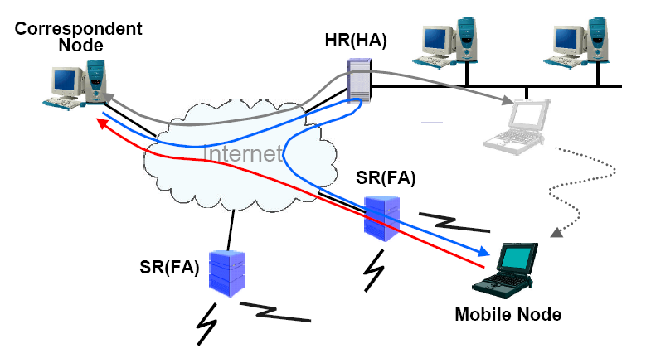
MIPv4: Data Flows

Slide 15
MIPv4: Control Operations
Movement Detection
MN ⬄ FA (CoA)
ICMP Agent Solicitation & Advertisement
Registration to HA (via FA)
MN ⬄ FA ⬄ HA
Over UDP (destination port 434)
Data Tunneling
CN => HA (HoA) => FA (CoA) => MN
IP-in-IP Tunneling, ..

Slide 16
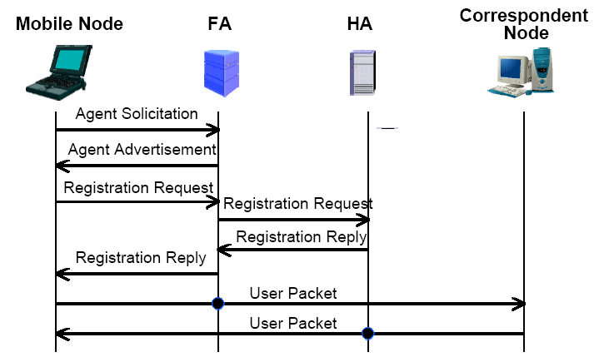
MIPv4: Control & Data Flows

Slide 17
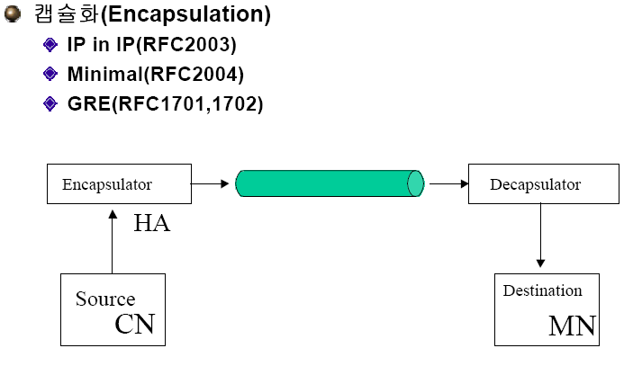
MIPv4: Tunneling Schemes

Slide 18
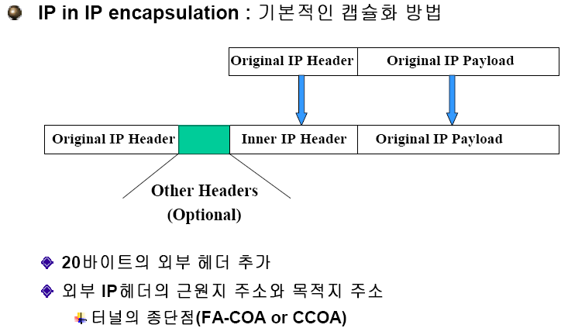
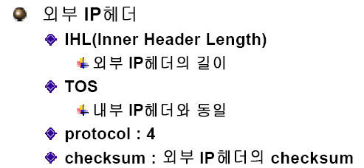
MIPv4: IP-in-IP Tunneling

Slide 19
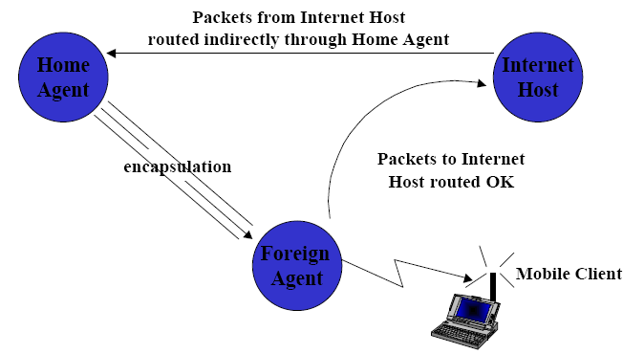
MIPv4: Triangular Routing Problem

Slide 20
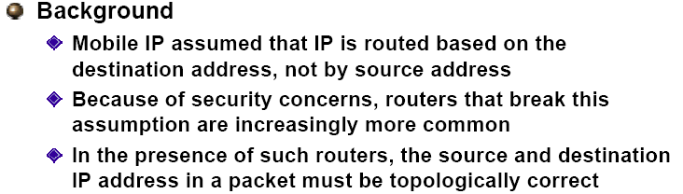
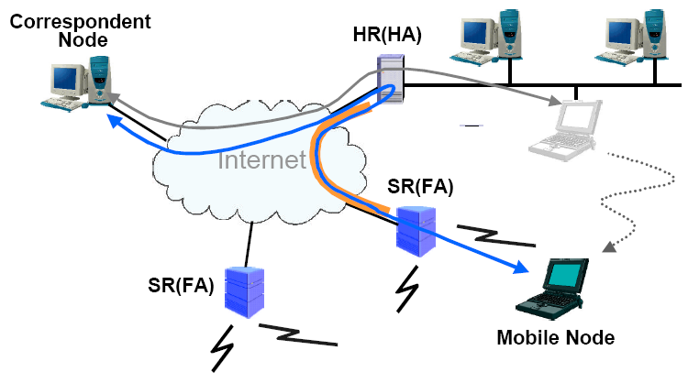
MIPv4: Reverse Tunneling

Slide 21
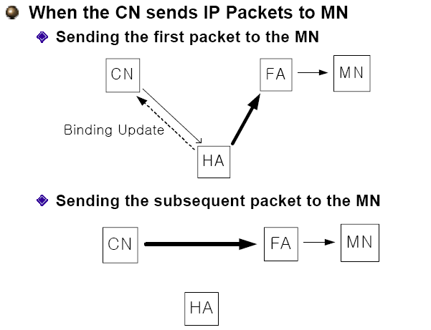
MIPv4: Binding Update
Route Optimization !

Slide 22
Mobile IPv6 (MIPv6)
MIPv6 = MIPv4 + IPv6
IPv6 특성에 맞게 MIPv4를 변경
Major Differences from MIPv4
FA의 기능이 MN 내부로 포함됨 (FA가 없음)
MIPv6 Nodes: MN, CN, HA
CoA: MN의 IP 주소 (MIPv4 CCoA와 유사)
By DHCPv6 or IPv6 Stateless Auto-Configuration
Binding Update (BU): MN ⬄ HA or CN
Mobility Header (a new IPv6 extension header)
Intrinsic Route Optimization
MIPv6 is in the base IPv6 protocol

Slide 23
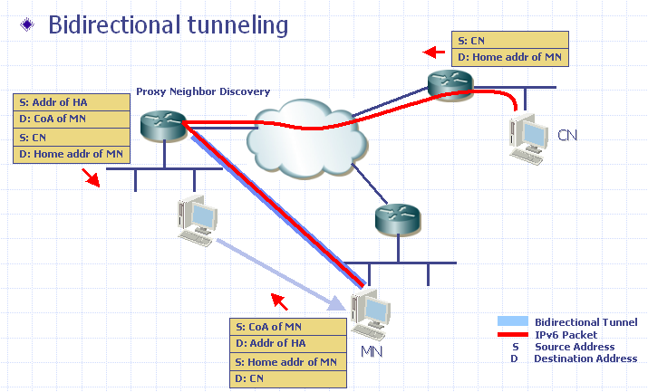
MIPv6: Basic Operations

Slide 24
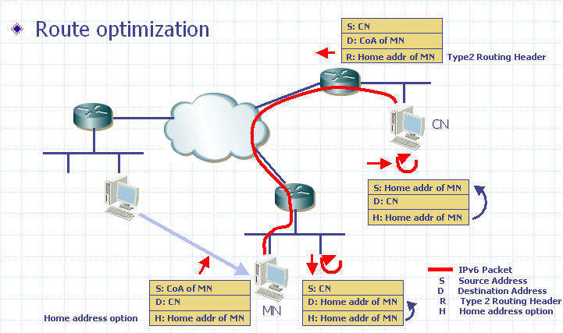
MIPv6: Basic Operations

Slide 25
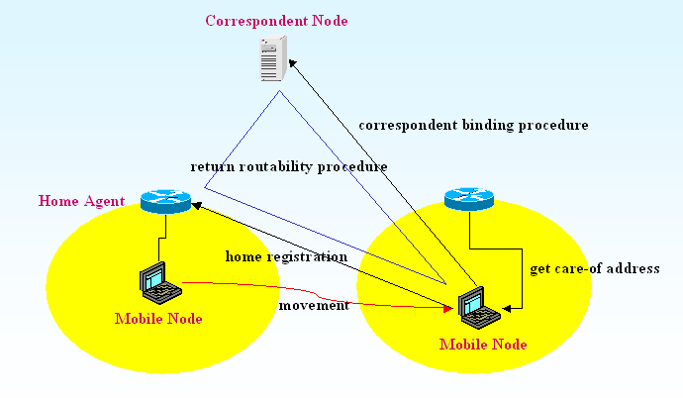
MIPv6: Binding Update

Slide 26
MIPv6: Changes to IPv6
New IPv6 Protocol (Header)
Mobility Header
A new IPv6 extension header
New Option in Destination Option Header
Home Address Option
New Type in Routing Header
Type 2 Routing Header
New ICMP Messages
ICMP HA Address Discovery Request/Reply
ICMP Mobile Prefix Solicitation/ Advertisement

Slide 27
MIPv6: Mobility Header
A new IPv6 extension header
Home Test Init Message
Care-of Test Init Message
Home Test Message
Care-of Test Message
Binding Update Message
Binding Acknowledgement Message
Binding Error Message
Binding Refresh Request Message

Slide 28
MIPv6 Extensions
Mobile IPv6 (MIPv6)
Fast Handover for MIPv6 (FMIPv6)
Hierarchical MIPv6 (HMIPv6)

Slide 29
FMIPv6: Reference Architecture
CN
PAR
NAR
Trigger
MN

Slide 30
FMIPv6: Operations
Handover Initiation
L2 Triggers, RtSolPr, PrRtAdv
Between MN and AR
Tunnel Establishment
To reduce the packet losses during handover
HI (Handover Initiate) and HACK
Between PAR and NAR
Packet Forwarding
PAR => NAR (data buffering at NAR):FBU, FBack
NAR => MN: FNA (Fast NA)

Slide 31
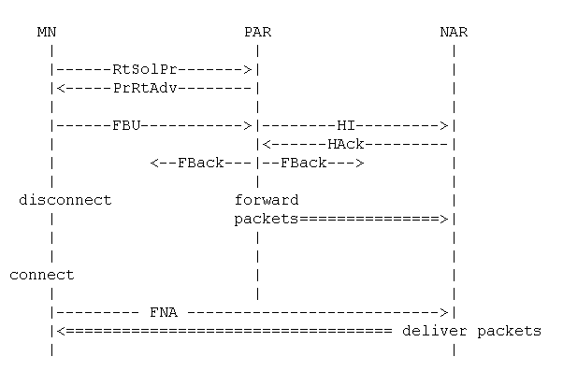
FMIPv6: Operational Flows

Slide 32
HMIPv6: Overview
HMIPv6 Nodes
Hosts: MN, CN, HA
Routers: AR, Mobile Anchor Point (MAP)
IP Address (CoA)
RCoA (Regional CoA): in the MAP region
LCoA (On-Link CoA): in the AR region

Slide 33
HMIPv6: Architecture
HA
CN
MAP
RCoA
AR1
AR2
LCoA_2
LCoA_1
Movement
MN

Slide 34
HMIPv6: Operations
MN
When entering an AR region in the MAP domain,
it gets LCoA (AR region) and RCoA (MAP region)
RCoA does not change in the MAP domain
Local Binding Update (LBU) to MAP
Bind LCoA & RCoA to MAP
MAP (Acting as a local HA)
Only the RCoA need to be registered with CN/HA
Relay all packets between MN and HA/CN

Slide 35
HMIPv6: MAP Tunnel (MAP ⬄ MN)
HA
CN
MAP
AR1
AR2
MN
Outer header
Inner header
LCoA
MAP
RCoA
CN
Home Addr

Slide 36
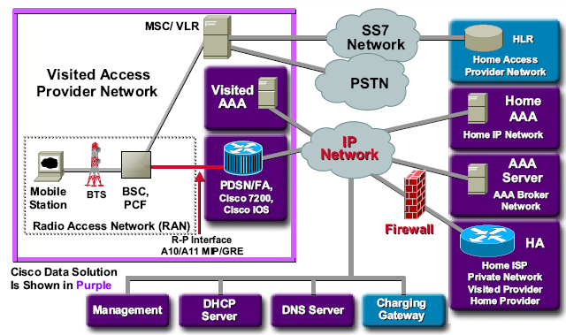
MIP in 3GPP2

Slide 37
MM: Recent Issues
Proxy MIPv6 (PMIPv6)
Distributed Mobility Management (DMM)

Slide 38
Proxy Mobile IPv6 (PMIPv6)
PMIPv6
Network-based Localized Mobility Management protocol
IETF NETLMM WG
Motivations
Host-based Mobile IPv4/v6 has not been yet deployed
Why ?
Too heavy specification of MIPv4/v6 on a small terminal
Battery problem
Waste of air resource

Slide 39
PMIPv6
Host-based vs. Network-based MM
HA
HA
Route Update
Route Update
AR
AR
Movement
Movement
Host-based Mobility
Network-based Mobility

Slide 40
PMIPv6: Overview
IP Tunnel
IP-in-IP tunnel LMA and MAG.
LMA: Localized Mobility Agent MAG: Mobile Access Gateway
LMA
Home Network MN’s Home Network
MN’s Home Network Prefix (MN-HNP)
CAFE:1:/64
MAG1
Host A
LMA Address
LMM (Localized Mobility Management) Domain
MAG2
MN’s Home Network Prefix (MN-HNP)
CAFE:2:/64
Proxy Binding Update (PBU)
Control message sent out by MAG to LMA to register its correct location
Host B
MN Home Address (MN-HoA)
Proxy Care of Address (Proxy-CoA)
The address of MAG.

Slide 41
PMIPv6 Operations
In case that profile store does not have MN Home Prefix
MAG emulates the MN’s home link
Tunnel Setup
This can be omitted when stateless configuration is used.

Slide 42
PMIPv6: Benefits
No host stack change for IP mobility
Avoiding tunneling overhead over the air
Re-use of Mobile IPv6
PMIPv6 is based on Mobile IPv6 [RFC3775].

Slide 43
Distributed Mobility Management (DMM)
Problem Statements & Requirements
DMM Approaches

Slide 44
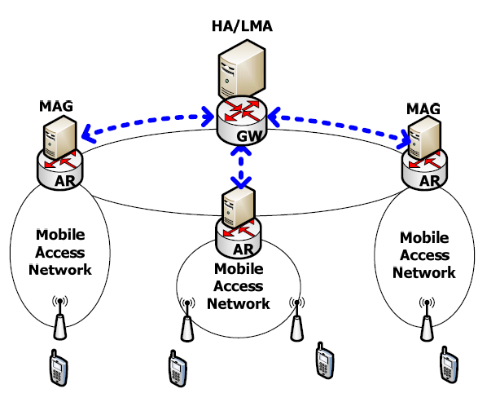
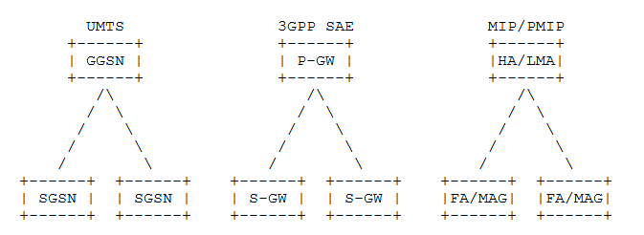
Centralized MM
Current cellular networks
Hierarchical architecture
Centralized mobility anchor
HA, LMA

Slide 45
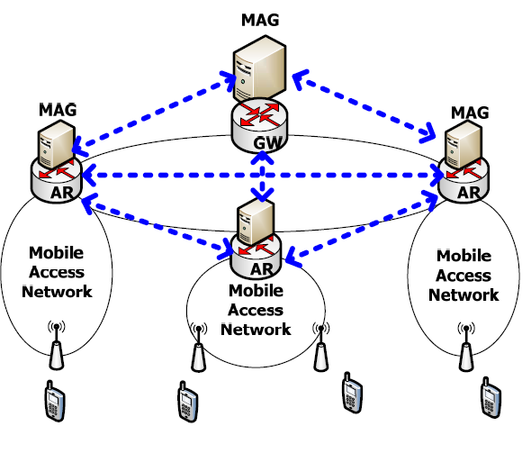
Distributed MM
Future mobile networks
Flat architecture
Mobility management
Distributed Control
Distributed anchors: HA/LMA => AR/MAG
Advantages
Optimal routes
Low control overhead
Handling a single point of failure and attack

Slide 46
DMM Requirements (1)
DMM should be designed to consider
Distribution of the mobility anchors (e.g. HA)
In order to achieve a more flat design
This would improve scalability and robustness of the mobility infrastructure
Placing the MM closer to the edge of network (e.g. AR)
In order to achieve routing optimality and lower delays
Offloading near the edge of the network
Benefit of the core network load

Slide 47
DMM Requirements (2)
DMM should be designed to consider
Separating control and data planes by splitting location and routing anchors
This could minimize the signaling overhead between the mobility anchors
We may keep the control plane centralized, with the data plane distributed
Reusing existing protocols while minimizing changes,
in order to allow faster adoption of the technology

Slide 48
DMM Approaches
Partially Distributed MM
Fully Distributed MM

Slide 49
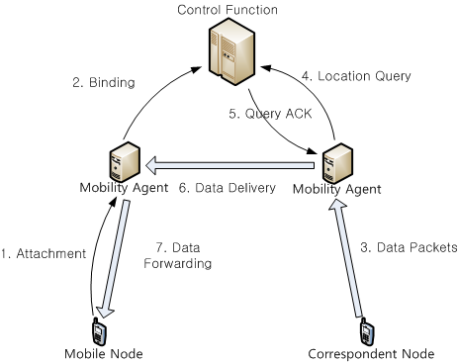
Partially Distributed MM
Only data plane is distributed
With centralized control plane

Slide 50
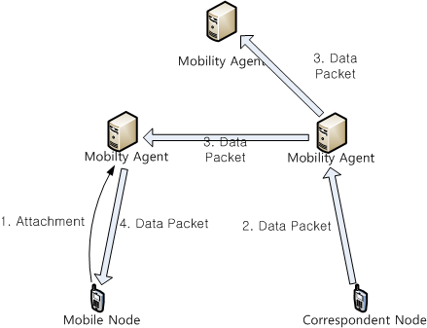
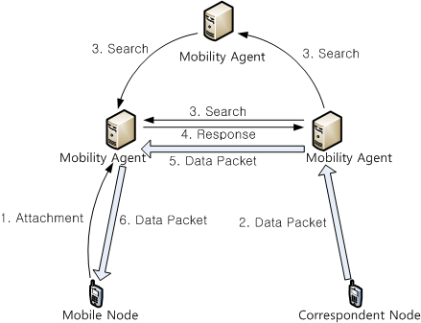
Fully Distributed MM
Both data and control planes are distributed
Data-driven versus Search-driven

