Slide 1

Role Models and Lifecycles in IoT and their Impact on the W3C WoT Thing Description
Michele Blank

Slide 2
What is the WoT and TD? Introduction to the W3C Web of Things and the Thing Description
What is the WoT TD?
W3C Working Group „Web of Things“
Goal: Overcome IoT silos
Building blocks:
Thing Description
Scripting API
Protocol Bindings
Thing Description:
Metadata (Name of Thing, Context)
Interactions offered
TD
Metadata
Properties
Actions
Events
[1] https://www.w3.org/WoT/WG/

Slide 3

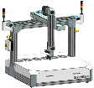
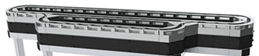
What‘s missing in the current draft of the TD? What happens when the TD changes?
TD
Examples of Things having a TD:
Mobile robot platform in Industry4.0 scenario
Gantry in production line
Conveyor in package processing
Smart HVAC System
→ All together have changes with regard to their
metadata and interactions during their lifetime.
But the TD is of static nature so far, changes in the TD and how to handle them isn’t covered in draft recommendation
TD
TD

Slide 4
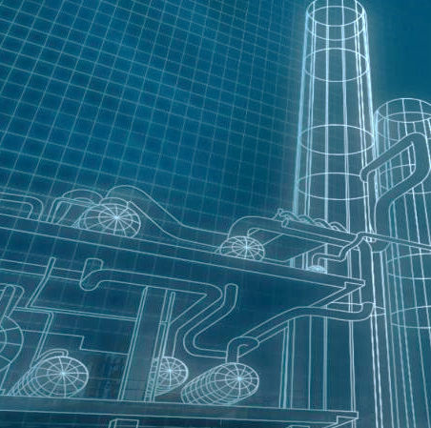

Lifecycle of a Thing Phases in life of a Thing and who interacts with it?
Lifecycle
Phases
Phase: Planning
Requirements definition
Functional description
Draft Design
Interacting Roles
Customer
Business Administration
Architects
Impact on the Thing Description
Thing Description is created
Basic information is added, e.g. manufacturer name

Slide 5
Lifecycle of a Thing Phases in life of a Thing and who interacts with it?
Lifecycle
Phases
Phase: Design
Final Architecture and Concepts
Implementation and Building
Prototyping and Testing
Interacting Roles
Software Engineer
Hardware Engineer
Test Manager
Impact on the Thing Description
Interactions are added or completed
Missing metadata and security information added
RTM version of TD

Slide 6
Lifecycle of a Thing Phases in life of a Thing and who interacts with it?
Lifecycle
Phases
Phase: Manufacturing
Production
Calibration and Tuning
Quality Control and Patches
Interacting Roles
Product Quality Supervisor
Calibration Equipment
Impact on the Thing Description
TD is now individual instance of RTM TD
Added support information

Slide 7
Lifecycle of a Thing Phases in life of a Thing and who interacts with it?
Lifecycle
Phases
Phase: Installation
Commissioning
Security Provisioning
Configuration
Interacting Roles
System Integrator
Installer
Impact on the Thing Description
Metadata about installation might be added
Interaction’s HREFs might change
Interactions may change depending on configuration

Slide 8
Lifecycle of a Thing Phases in life of a Thing and who interacts with it?
Lifecycle
Phases
Phase: Operation
Thing is in Use
Thing interacts wit other Things
Interacting Roles
User
Maintenance Engineer
Impact on the Thing Description
Thing Description is stable

Slide 9
Lifecycle of a Thing Phases in life of a Thing and who interacts with it?
Lifecycle
Phases
Phase: Update
Thing receives an Update
Update : A Change in the Things software or hardware that keeps backwards compatibility
Interacting Roles
User
Maintenance Engineer
System Integrator
Impact on the Thing Description
Thing Description might change metadata
New Interactions might be added

Slide 10
Lifecycle of a Thing Phases in life of a Thing and who interacts with it?
Lifecycle
Phases
Phase: Upgrade
Thing receives an Upgrade
Upgrade : A Change in the Things software or hardware that breaks backwards compatibility
Interacting Roles
User
Maintenance Engineer
System Integrator
Impact on the Thing Description
Thing Description might change metadata
New Interactions added
Interactions change
Interactions are removed

Slide 11
Lifecycle of a Thing Phases in life of a Thing and who interacts with it?
Lifecycle
Phases
Phase: End of Life
Thing is being taken out of service
Permanent end of operation
Interacting Roles
User
Maintenance Engineer
System Integrator
Impact on the Thing Description
Thing Description might change metadata
Interactions change
Interactions are removed
Thing Description might be kept alive

Slide 12
How to track changes in the Thing Description? Who should be able to track the changes?
Changes in Thing Description relevant to
Interacting Things and User-Clients be aware of changes
Manufacturer / System Integrator / Maintenance Engineer to identify current state of Thing unambiguously
Idea: Add version object to Thing Description, offering information about version of TD and who changed it
{
…
“name” : “MyVersionThing”,
“version” : { },
…
}

Slide 13
Summary of Lifecycle phases Which roles are important an how to group them?
How to summarize interacting roles?
Grouping by issuer of TD change
Resulting roles:
“User” and “Builder”
User role: All changes on the Thing resulting in a change of the TD issued by the user or for the user
Builder role: All changes of the Thing before it is in operation at the end user, but including updates/patches

Slide 14
The versioned Thing Description How to express the version information in the Thing Description?
Several requirements for version information:
Unambiguous identification
Type of change (Patch / Update / Upgrade)
Human readability
Our proposed solution: Combination of hash versioning for unambiguous identification of version and semantic versioning for human readability and type of change

Slide 15
The versioned Thing Description Our proposal for a versioned Thing Description
{
…
“name”: “MyVersionThing”,
“version” : {
“instance” : “1.0.1”,
“userlc” : “2fd4e1...eb12”,
“builderlc” : “de9f2c...b4b3”
}
…
}
Semantic version: Corresponding digit is increased on each Patch / Update / Upgrade
Hash version: Hash whole TD (with sem. Version, but empty hash entries)

Slide 16

Outlook What is still missing?
Security issues: Unambiguous identification of Things’ versions allows easy attacks on known vulnerable systems
Drive idea in WoT Working Group to get Feedback and integrate versioning into TD

Slide 17

Thank you for your attention!
Name: Michele Blank Role: PhD Candidate Org-ID: CT RDA NEC WOS-DE
Address: Otto-Hahn-Ring 6 81739 München
Germany
Tel.: +49 89 636634755
E-mail: michele.blank@siemens.com

