Slide 1
CHINOOK MUSIC STORE
DATA ANALYSIS
Submitted by: Akhil Chauhan

Slide 2

Agenda
Problem Statement
About Chinook
Schema and Data description
Data Cleaning & Preparation
Demography Analysis
Key Metrics and Insights
Churn and Risk Analysis
Recommendations

Slide 3

Problem Statement
You are hired as a data analyst at Chinook, and your objective is to analyze music record sales data to gain insights and make recommendations for the company's strategy in the physical music market.
About Chinook:
Global music store with customers across 24 countries.
Sells music albums with wide variety of genres and artists.

Slide 4
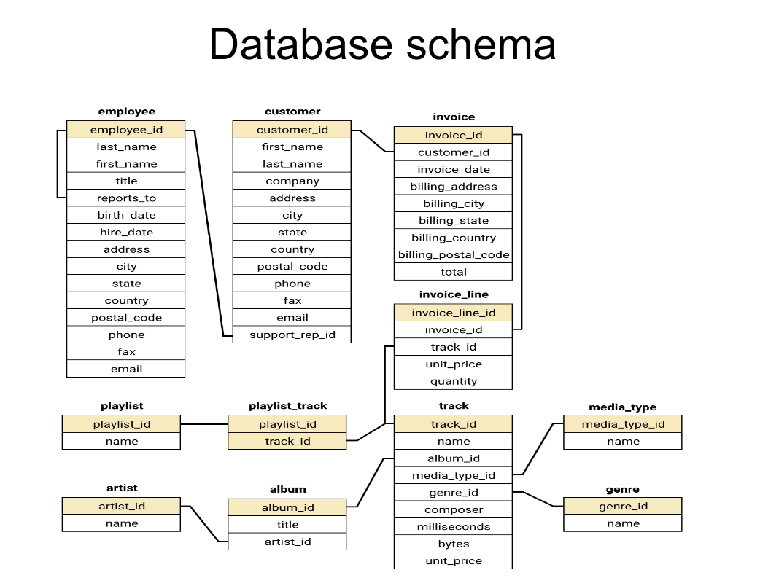

Slide 5
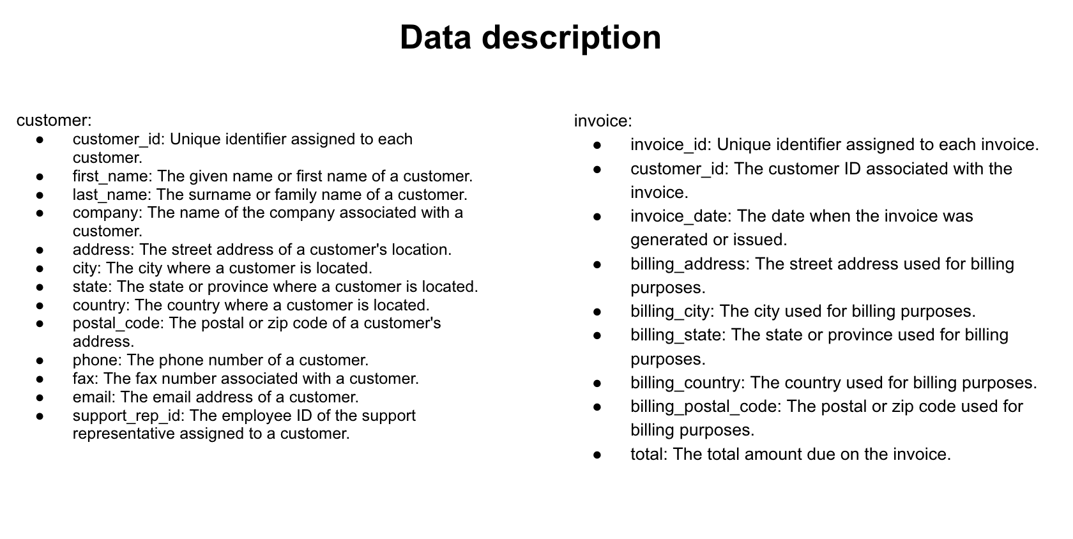

Slide 6
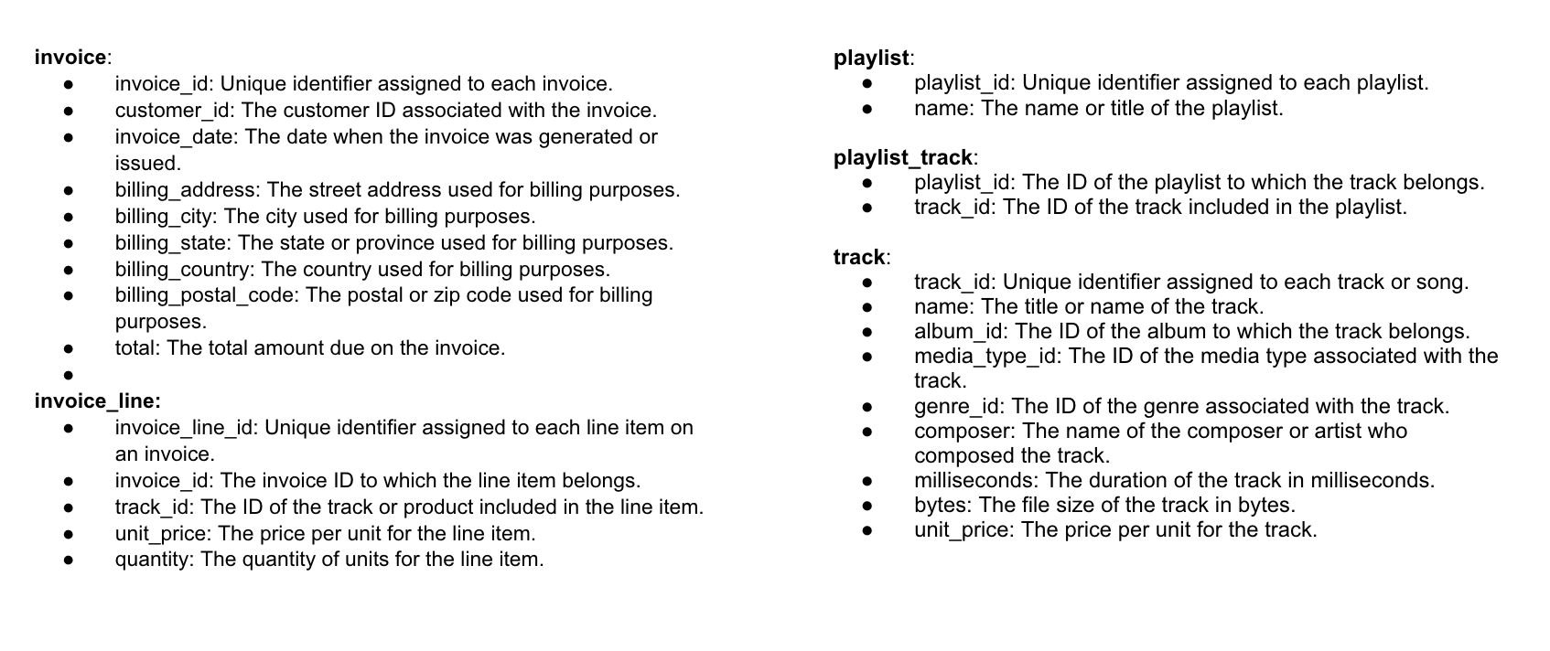

Slide 7
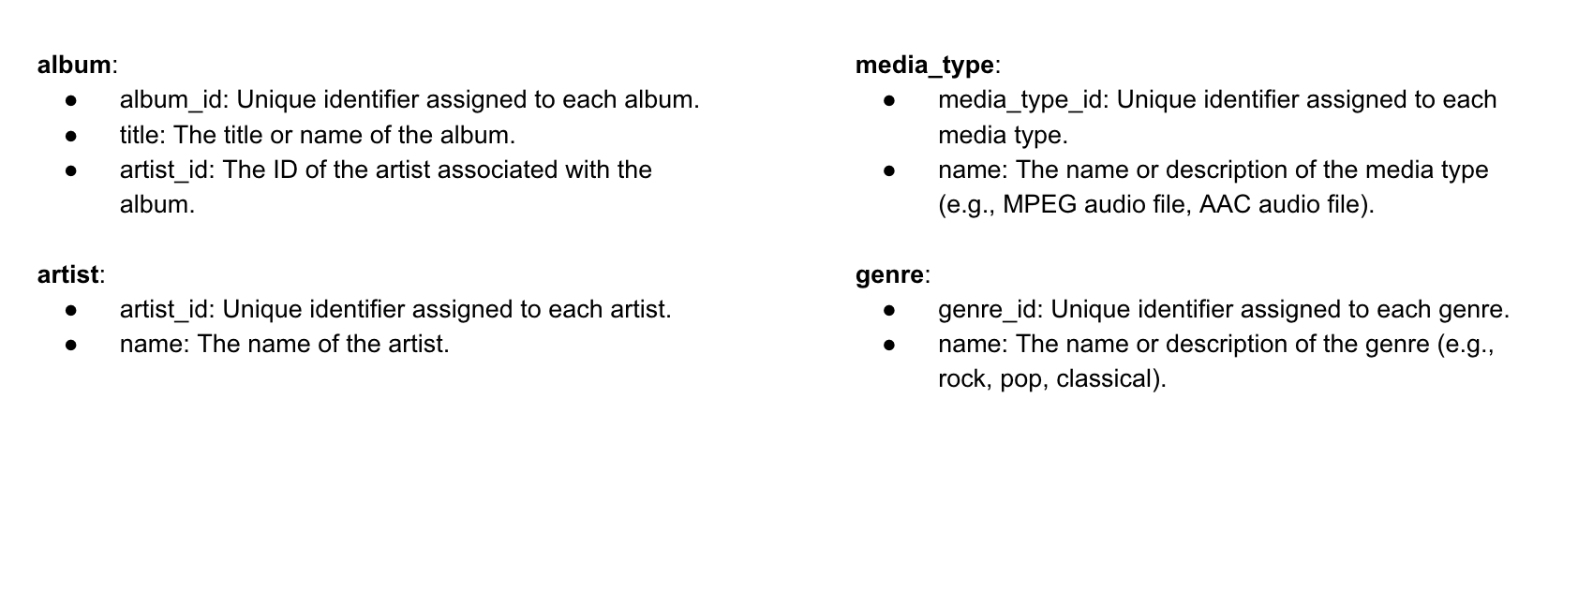

Slide 8
Data Cleaning
Checking Duplicates: Using the primary key , duplicates were checked in each table. No duplicates were found
Handled Missing Values: Tables named track, employee and customer contained some missing values. But, they did not belong to essential transactional attributes.
Checked Data Standardization: Checked the Date formats and other data types across all attributes

Slide 9
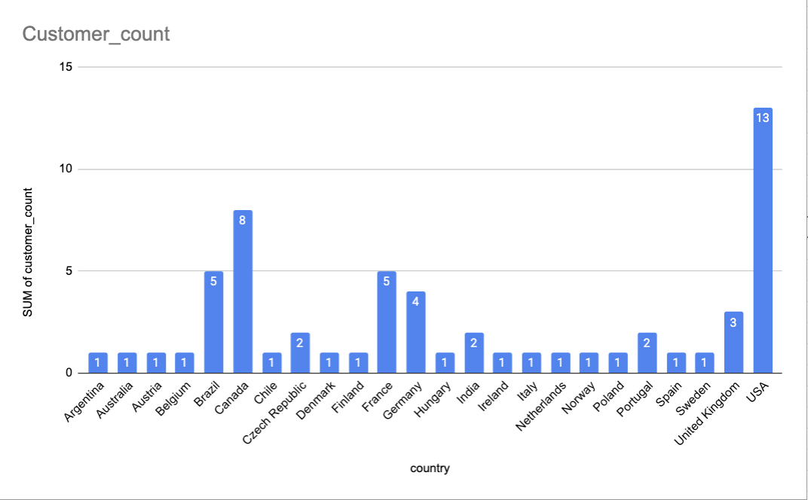
Customer Demographic Breakdown
USA is the largest customer base
Highest number of customers (13), making it Chinook’s primary market.
Canada and Brazil form strong secondary markets
Canada (8 customers) and Brazil (5 customers)
European presence is broad but fragmented
Long tail of single-customer countries
Business Interpretation
Chinook’s customer base is globally distributed, but engagement is concentrated in a few key countries.
Growth strategy should prioritize depth in strong markets (USA, Canada, Brazil) while selectively expanding in high-potential regions.
Figure: Country-wise Customers Count

Slide 10
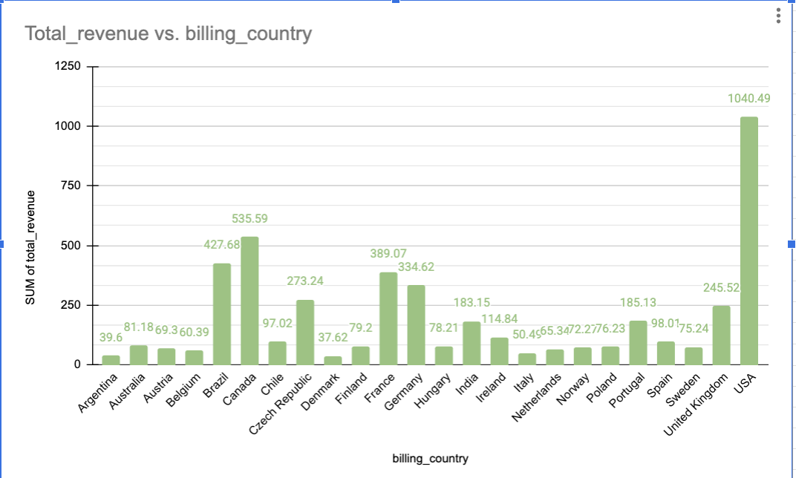
Revenue Generation by Countries
USA is the dominant revenue driver
Generates the highest revenue (~$1,040), significantly outperforming all other countries.
Canada, Brazil, France, and Germany form the second tier
substantial revenue ($300–$550 range), indicating strong market maturity beyond the USA.
High revenue concentration in a few countries
Long tail of low-revenue countries
Many countries contribute below $100
Business Interpretation
Chinook’s revenue is highly concentrated geographically, with the USA acting as the core market.
Secondary markets show healthy revenue potential and could be scaled with targeted investment.
Low-revenue countries may not justify heavy marketing spend at this stage.
Figure: Country-wise Revenue Generated

Slide 11
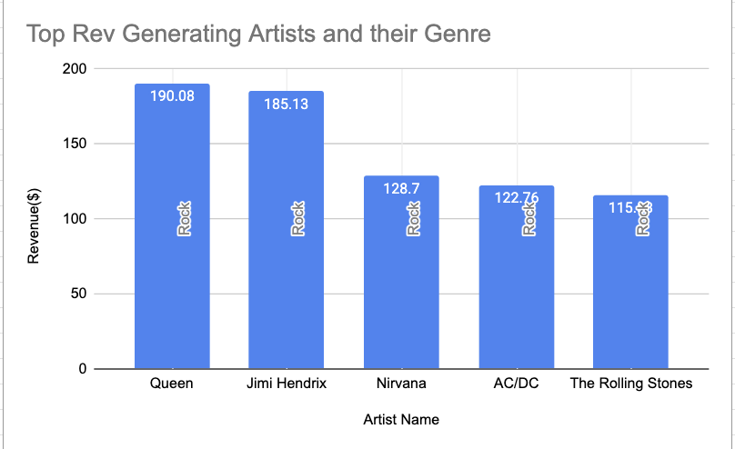
Globally Top Revenue Generating Artist-Genre
Key Insights
Rock artists dominate global revenue generation among top performers.
Queen and Jimi Hendrix are the highest revenue-generating artists overall.
The top 5 revenue-generating artists all belong to the Rock genre, indicating strong genre leadership.
Revenue is concentrated among a small group of iconic Rock artists.
Business Implications
Rock is not only the top genre by sales but also driven by consistently high-performing artists.
Artist-led demand plays a significant role in overall revenue generation.
Figure: Top Revenue Generating Artists and their Genre

Slide 12
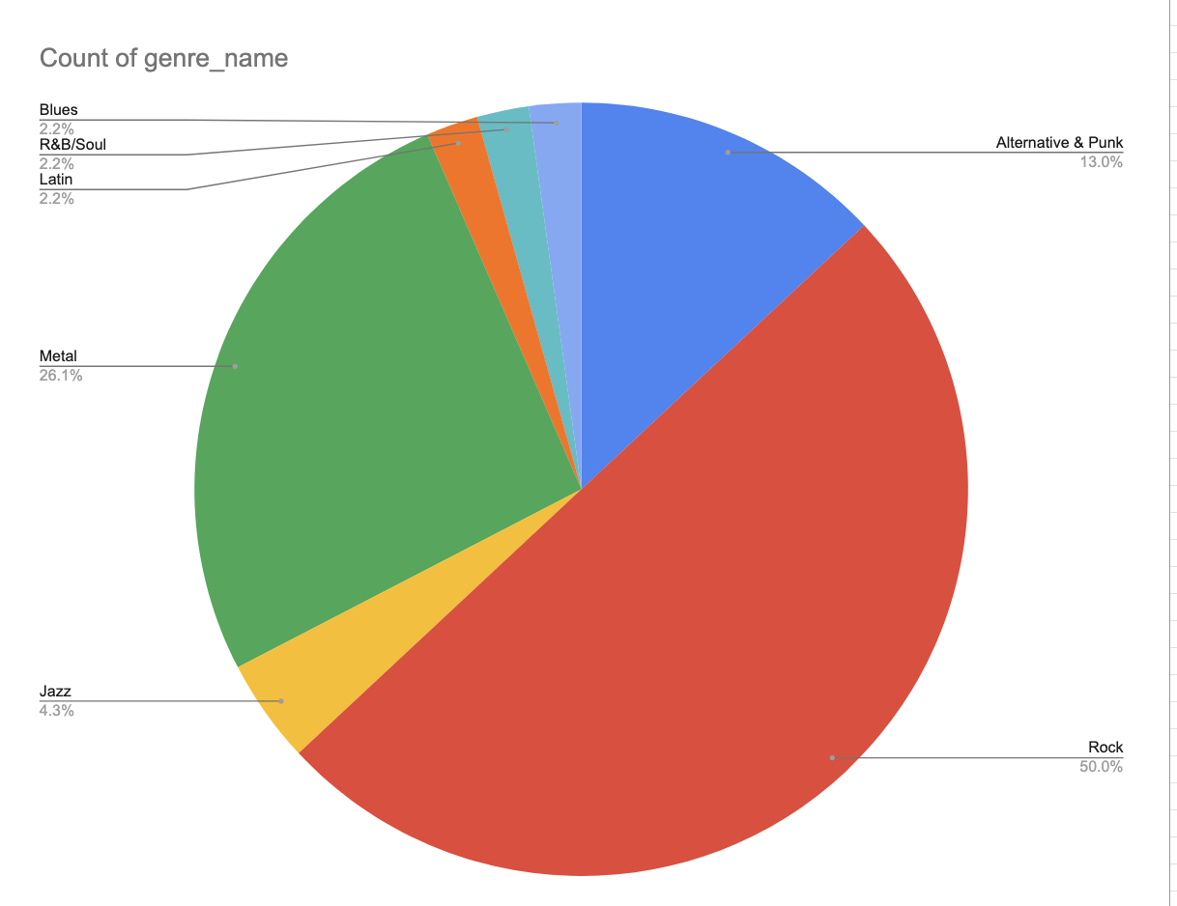
Top Selling Genres in each country
23 out of 24 countries have Rock as their number one genre
This makes Rock the most universally dominant genre across international market.
Secondary Genre Preferences Vary Significantly
While Rock is consistently dominant, second-ranked genres differ across countries, indicating localized taste patterns:
Metal frequently appears as the second-ranked genre, particularly across European countries (e.g., Germany, France, Finland, Hungary).
Alternative & Punk emerges as a strong secondary genre in countries such as Argentina, Australia, Brazil, India, and Italy.
Figure: Percentage of number of countries where a genre appears in the top 2

Slide 13
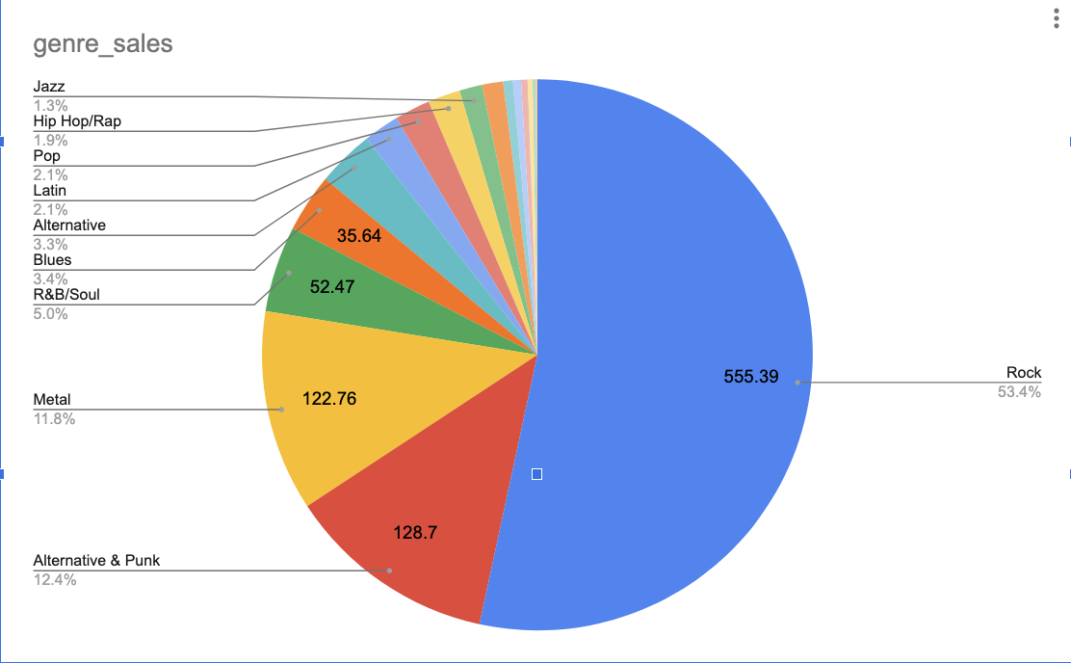
Top Revenue Generating Genres in USA market
Rock dominates the US market, contributing ~53% of total genre revenue.
Alternative & Punk (~12%) and Metal (~11.8%) are the next strongest performers.
Top 3 genres together drive ~77% of total US revenue, indicating high concentration.
All remaining genres individually contribute <5%, forming a long-tail demand.
Business Implications
US revenue is highly concentrated in a few genres, led by Rock.
Mid-tier genres provide incremental value; niche genres serve specialized audiences.
Actionable Takeaways
Prioritize Rock for major promotions and marketing spend.
Use niche genres for targeted, low-cost campaigns rather than mass promotion.
Figure: Contribution by each Genre in Revenue Generation

Slide 14
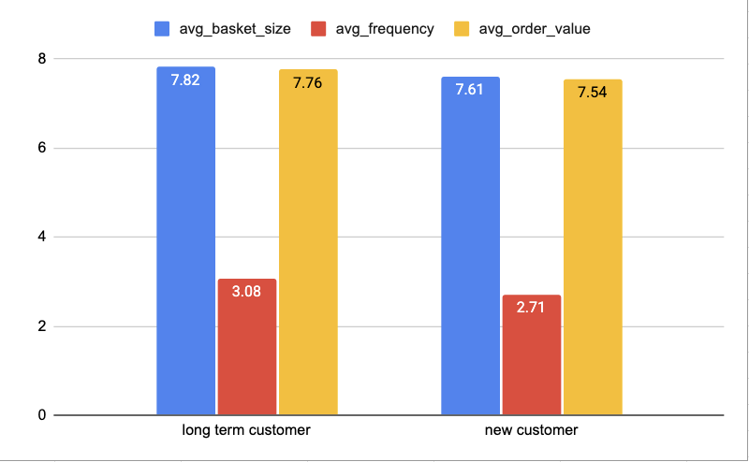
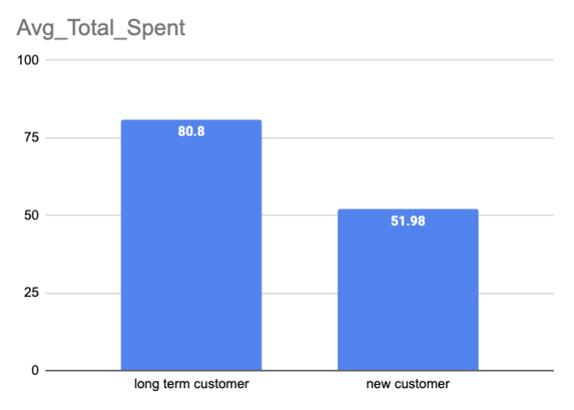
Customer Purchasing Behavior
Comparison b/w Long Term v/s New Customer
Average Basket Size:
Long-term customers have a slightly larger basket size, indicating deeper engagement per transaction.
Purchase Frequency:
Long-term customers purchase more frequently than new customers, reflecting stronger loyalty.
Average Order Value:
Order value is similar across both groups, suggesting spend per transaction is consistent.
Average Total Spend:
Long-term customers generate significantly higher total spend due to repeat purchases over time.
Figures: Different KPIs compared between Long term Customers and New Customers

Slide 15
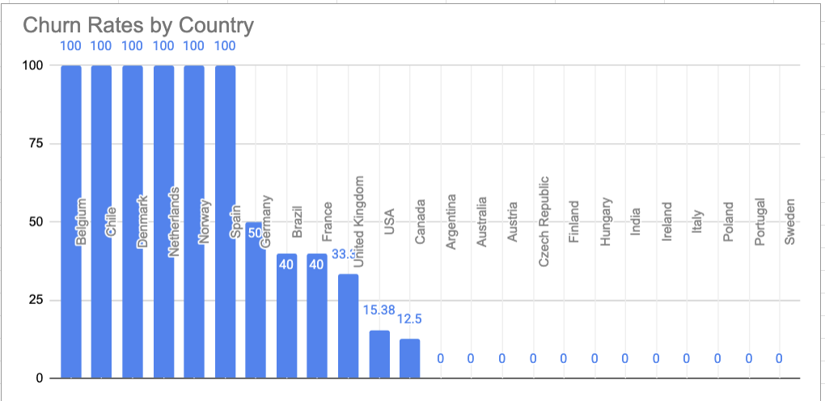
Churn Analysis
Global Churn Rate stands at ~27%
But there’s huge variation in Churn rates among countries
Several countries show 100% churn, mostly because of less amount of total customers
Mid-tier churn markets:
Germany, Brazil, France, and the UK show moderate churn (30–50%), indicating retention challenges despite larger bases.
Strong retention markets:
USA and Canada have low churn (≈15% and 12.5%), reflecting more stable and engaged customer bases.
Zero churn regions:
Countries with 0% churn likely reflect limited historical data or very recent customer activity.
Recommendation: Launch retention campaigns in high-churn regions.
Figure: Countrywise Churn Rates

Slide 16
Risk Profiling of Customers
Critical Risk
  No purchase in the last 180+ days
  Lowest purchase frequency tier (frequency_percentile<33% )
  Represents customers with both inactivity and weak engagement
High Risk (Churn Risk)
  No purchase in the last 180+ days
  Purchase frequency is not in the lowest tier
  Indicates historically active customers who have disengaged recently
Medium Risk (Low Frequency Risk)
  Recent purchase activity
  Lowest purchase frequency tier
  Customers are active but lack consistent repeat behavior
Low Spender (Value Risk)
  Active customers
  Lowest spending tier (spend_tile = 1)
  Engagement exists, but revenue contribution is low
Low Risk
  Recent purchases
  Moderate to high frequency and spending
  Most stable and valuable customer segment

Slide 17
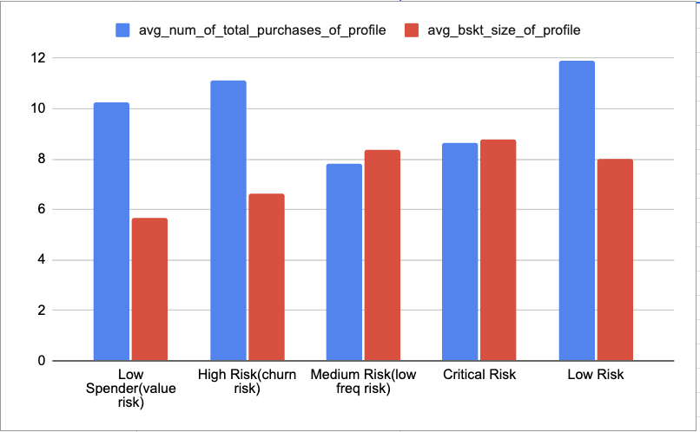
Customer Risk Profile Summary
Low Risk: Most valuable segment with high spend, frequent purchases, and recent activity.
Critical Risk: Longest inactivity period; previously valuable customers now fully disengaged and at highest churn risk.
High Risk (Churn Risk): Strong historical engagement but recent inactivity; ideal targets for win-back campaigns.
Medium Risk (Low Frequency): Active customers with low repeat purchases; revenue growth limited by weak frequency.
Low Spender (Value Risk): Active customers with small basket sizes and low spend; CLV risk due to low transaction value.
Figure: KPIs( Avg total purchases, Avg Basket Size) across Risk Profiles

Slide 18
Recommendations:
Strengthen core markets (USA & Canada) with loyalty programs and personalized engagement to protect high-value customers.
Prioritize Rock-driven promotions, with secondary focus on Alternative & Punk and Metal, as these genres drive most revenue.
Re-engage high-value but inactive customers through targeted win-back campaigns to maximize retention ROI.
Focus on increasing purchase frequency, since revenue growth is driven more by repeat purchases than basket size.
Stabilize medium-risk customers early using personalized nudges to prevent churn.
Upsell low-spender but active customers via bundles and cross-selling strategies to improve CLV.
Adopt geography-aware investment, concentrating spend in high-impact regions and using low-cost strategies in smaller markets.

Slide 19
Conclusion
The analysis reveals clear patterns in customer purchasing behavior, regional trends, and genre preferences, enabling more targeted business decisions.
Customer behavior and revenue are not uniform across regions, requiring market-specific strategies.
Rock genre and a few top artists drive a majority of revenue.
Customer engagement (recency & frequency) is the strongest driver of value and retention.
Clear customer segments and risk profiles enable focused retention, upsell, and churn-prevention actions.
A noticeable share of valuable customers has churned, indicating gaps in retention and re-engagement strategies
Data-driven analysis provides actionable direction for growth, loyalty, and marketing optimization.

Slide 20
THANK YOU

